Slide 1
Internet Technology (week 4)
CSS Review
CSS Pseudo-elements/classes
Basic Page Layout

Slide 2
CSS Example
CSS stands for Cascading Style Sheets
Styles define how to display HTML elements
Selector
Declaration Block
body {
font-family: Tahoma, Arial, sans-serif;
color: black;
background-color: white;
margin: 8px;
}
Value
Property Name

Slide 3
How is CSS Used?
Inline style
e.g. <p style="color: red">
does not separate presentation from content
Internal style sheet
page specific styles
External style sheet (the preference)
style sheet for several pages
<link rel="stylesheet" href="css/styles.css">
Notes:
The selector is normally the HTML element you want to style.
Each declaration consists of a property and a value.
The property is the style attribute you want to change. Each property has a value.

Slide 4
CSS Styling
Backgrounds
colour & images
Text
colour, alignment, decoration, indentation …
Fonts
style & size
Tables
colour, border, width, height, padding …
Notes:
a:link - a normal, unvisited link
a:visited - a link the user has visited
a:hover - a link when the user mouses over it
a:active - a link the moment it is clicked

Slide 5
CSS Colour Specifiers
Predefined names:
white black red …
Hexadecimal intensities of red, green, blue:
0-255 decimal intensities:
Percentage intensities:
#FF0000
R
G
B
rgb(255,255,0)
R
G
B
rgb(80%,80%,100%)
R
G
B
Use HEX and a chart to find the colour you want
http://w3schools.com/cssref/css_colorsfull.asp

Slide 6
Measurements
You’ll mostly use % and px
Unit | Description
% | a percentage
px | pixel, a single dot of the screen
cm | centimetre
mm | millimetre
em | one em is equivalent to the current font size
ex | x-height of current font
pt | point, equivalent to 1/72 inch
pc | pica, equivalent to 12 points or 1/6 of an inch
in | inch

Slide 7
Internet Technology (week 4)
CSS Review
CSS Pseudo-elements
Basic Page Layout

Slide 8
Recall: Selectors
Element selectors
name of an HTML element, e.g. p
Grouping selectors together
the same style applies to all elements, e.g.
h1, h2, h3, h4, h5, h6
class selectors: “.” followed by the value of the class, e.g. .unit or p.unit
id selectors: “#” followed by the id name, e.g. #itech
Find out more from CSS Selector Reference …
Notes:
a:link - a normal, unvisited link
a:visited - a link the user has visited
a:hover - a link when the user mouses over it
a:active - a link the moment it is clicked

Slide 9
CSS Pseudo-elements
to add special effects to a sub-part of an existing element
syntax
selector:pseudo-element {property:value;}
example
p: first-line
{ color:#ff0000; font-variant:small-caps;}
h1:before
{content:url(smiley.gif);}
p: first-letter
{...}
h1:after
{content:url(smiley.gif);}
Visit w3schools.com for further details and … CSS Pseudo-elements

Slide 10
CSS Pseudo-classes
to add special effects to elements themselves or a special state of the element
:hover
the user has the mouse over the element
:active
the element is being activated (e.g. clicked)
:visited
a link has been visited
:focus
the element has the keyboard as its focus
Notes:
a:link - a normal, unvisited link
a:visited - a link the user has visited
a:hover - a link when the user mouses over it
a:active - a link the moment it is clicked

Slide 11
Internet Technology (week 4)
CSS Review
CSS Pseudo-elements
Basic Page Layout

Slide 12
CSS display Property
CSS has two main ways of displaying elements
display: block
display: inline
Example: Centring an image
img.displayed
{display: block;
margin-left: auto;
margin-right: auto;}
<img class="displayed" src="..." alt="..." />
We can also use shorthand:
img.displayed
{display: block;
margin: 0 auto;
}
Notes:
… which are related to the HTML concepts of block and inline elements

Slide 13
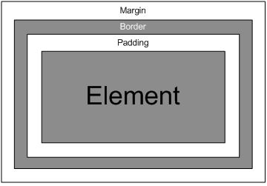
Element: Margin, Border and Padding
The background of an element (image or colour) fills the padding box and the content box only

Slide 14
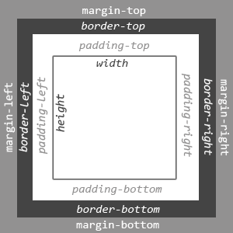
Element: Margin, Border and Padding
Further details on CSS Box Model from w3schools

Slide 15
Margins
Margin values can be specified either on all sides or on individual sides
single value for each margin: top, left, bottom and right, e.g. margin:10px;
two values: 1st=top & bottom; 2nd=left & right, e.g. margin:10px 5px;
four values: top, right, bottom and left, e.g. margin:10px 5px 15px 20px;
Further examples from w3schools …

Slide 16
Width and Height
The width and height properties can be specified using percentage or length values (e.g. pixels or %)
Specifying widths of elements in % means they will will shrink or grow so they are always in scale with the screen size.
p {width: 40%;}

Slide 17
position Property
You’ll rarely need to change the position property
static – default value, i.e. elements are laid out in the normal flow
relative – an element is moved relative to its place in the normal flow according to its top and left values
absolute – an element is taken completely out of the flow and then positioned with respect to the top and left of the first element that contains it. Used for sticky footers, try to avoid in any other case.
fixed – an element remains exactly where it is when the page is scrolled
Further examples from w3schools …

Slide 18
Positioning Scheme
Normal flow
block elements begin new block and inline elements laid out in line within their containing block element
for elements with a static or relative position property
Floated
element is shifted to the left or right within its current line until reaches the edge of its containing block
Absolute position (try to avoid)
elements having a position property value of absolute or fixed are absolutely positioned
More on “float” property from w3schools …
Notes:
All elements on a page are positioned according to one of three positioning schemes

Slide 19

Default static position of 2 DIVS
#box1
#wrapper{
width: 80%
}
#box1 {
width: 20%;
}
#box2 {
width: 20%;
}
#box2
Notes:
All elements on a page are positioned according to one of three positioning schemes

Slide 20
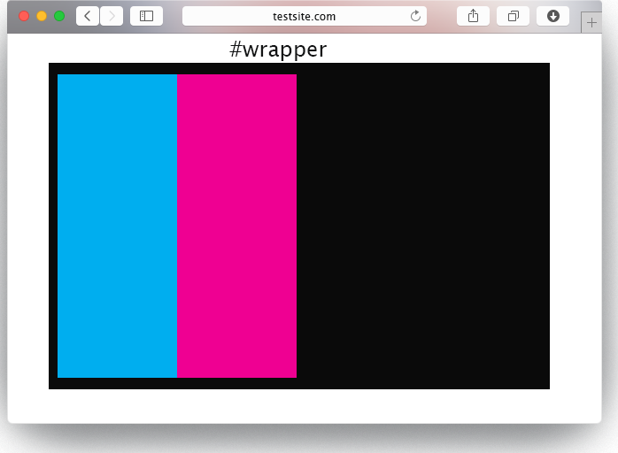
Adding a float to the left
#wrapper{
width: 80%
}
#box1 {
width: 20%;
float: left;
}
#box2 {
width: 20%;
float: left;
}
#box1
#box2
#box1
#box2
Notes:
All elements on a page are positioned according to one of three positioning schemes

Slide 21
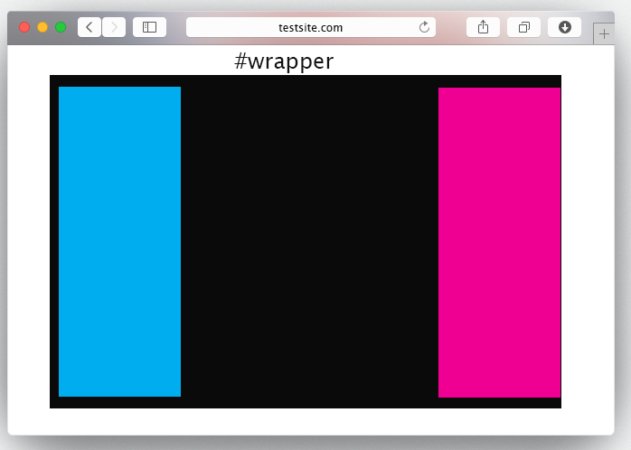
Adding a float to the left and right
#wrapper{
width: 80%
}
#box1 {
width: 20%;
float: left;
}
#box2 {
width: 20%;
float: right;
}
#box1
#box2
#box1
#box2
Notes:
All elements on a page are positioned according to one of three positioning schemes

Slide 22
Task
Download the weekly task from myCourse
Ensure you update your learning log when your done
#box1
#box1
#box2
#box2
Notes:
All elements on a page are positioned according to one of three positioning schemes

Slide 23
References
CSS3 Introduction http://www.w3schools.com/css/css3_intro.asp
Three Ways to Insert (use) CSS http://www.w3schools.com/css/css_howto.asp
CSS color values http://www.w3schools.com/cssref/css_colorsfull.asp
CSS Validation Service http://www.css-validator.org/
CSS Selector Reference http://www.w3schools.com/cssref/css_selectors.asp
CSS Pseudo-elements http://www.w3schools.com/css/css_pseudo_elements.asp
CSS Box Model http://w3schools.com/css/css_boxmodel.asp
CSS margin Property http://www.w3schools.com/cssref/pr_margin.asp
CSS Positioning http://w3schools.com/css/css_positioning.asp
CSS ::first-line Selector http://www.w3schools.com/cssref/sel_firstline.asp
CSS ::first-letter Selector http://www.w3schools.com/cssref/sel_firstletter.asp

