Slide 1
Internet Technology (week 6)
HTML Lists for Navigation
Introduction to CSS3
HTML 5 Semantic Layout

Slide 2
Descendant Selector
The descendant selector matches all elements that are descendants of given element
We can use it to avoid the over use of id’s and class attributes
#contact_section p{
font-color: grey;
font-size: 10px
}
<div id=“contact_section”>
<p> This will be grey </p>
<p> I’ll also be grey </p>
</div> <!-- /#contact_section -->

Slide 3
Lists For Navigation Bar’s
<ul id=“navigation”>
<li><a href=“…”> Home</a> </li>
<li><a href=“…”> Contact</a></li>
<li><a href=“…”> About </a></li>
</ul>
Vertical
Horizontal
#navigation li {
list-style: none;
}
#navigation li {
list-style: none;
display: inline;
}
http://w3schools.com/css/css_navbar.asp

Slide 4
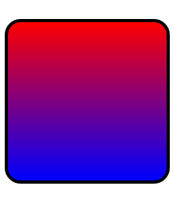
CSS3 Gradient And Radius
CSS3 is the latest version of CSS
There are many new exciting features
Today we’re looking at gradient and radius
Look how easy it is to create an interesting effect on the below <div>
.box1{
width: 100px;
height: 100px;
border: 2px solid black;
border-radius: 10px;
background: linear-gradient(red, blue); }
.box1

Slide 5
HTML5 Semantic Elements
HTML5 gives us the option to use HTML elements that are more expressive
We can replace <div>’s with more meaningful tags
E.G. Instead of using <div id=“header”> we can use the <header> tag

Slide 6
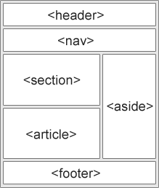
HTML5 Semantic Elements Examples
<header>: defines a header for a document or a section
<nav> - defines a container for navigation links
<section> - defines a section in a document
<article> - defines an independent self-contained article
<aside> - defines content aside from the content (like a sidebar)
<footer>: defines a footer for a document or a section

Slide 7
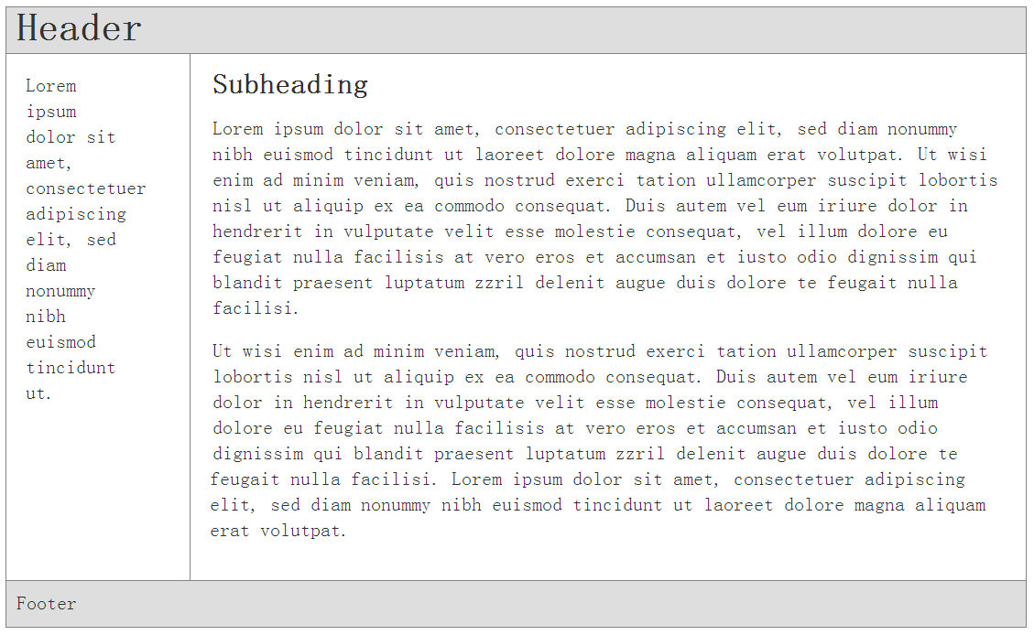
Example of a HTML 5 Layout
HTML CODE <body> <div id=“wrapper”>
<header> <h1>Header</h1> </header>
<aside> <nav> <p> This is your left navigation … </p> </nav>
</aside>
<section> <h2>Subheading</h2> <p> This is the content part … </p>
</section>
<footer> <p> Footer </p> </footer>
</div> </body>

Slide 8
References
Three Ways to Insert (use) CSS http://www.w3schools.com/css/css_howto.asp
CSS Validation Service http://www.css-validator.org/
CSS Selector Reference http://www.w3schools.com/cssref/css_selectors.asp
CSS Pseudo-elements http://www.w3schools.com/css/css_pseudo_elements.asp
CSS Box Model http://w3schools.com/css/css_boxmodel.asp
CSS margin Property http://www.w3schools.com/cssref/pr_margin.asp
CSS float Property http://www.w3schools.com/cssref/pr_class_float.asp
CSS Positioning http://w3schools.com/css/css_positioning.asp
HTML5 Semantic Elements http://www.w3schools.com/html/html5_semantic_elements.asp

