Slide 1

Radio Wave and Antenna Basics
Prepared by Joe Blankenship
Cyber Geography Research Institute International

Slide 2
Agenda
https://github.com/joeblankenship1
Radio Wave Propagation
Antenna Basics
Common Antennas
Safety & Resources

Slide 3
Radio Wave Propagation
Speeds
  186,000 miles/second or 3 x 10⁸ meters/second in a vacuum
  Actual speeds are slightly slower due to impedance
Wavelength is λ = V/F
  λ = Wavelength in meters
  V = Velocity (Speed of Radio Waves in meters per second)
  F = Frequency in Hertz (HZ)
Notes:
The most efficient antennas are built to the known wavelength of the frequency being used/interrogated.
Example: 1 MHz = 984 ft.

Slide 4
Radio Wave Propagation
Band | Frequency
Very Low Freq. (VLF) | Below .03 (30 kHz)
Low Frequencies (LF) | .03 to .3 (30 to 300kHz)
Medium Freq. (MF) | .3 to 3.0 (300 kHz to 3 MHz)
High Freq. (HF) | 3.0 to 30 MHz
Very High Freq. (VHF) | 30 to 300 MHz
Ultrahigh Freq. (UHF) | 300 to 3,000 MHz
Super High Freq. (SHF) | 3,000 to 30,000 MHz (3 to 30 GHz)
Extremely High Freq. (EHF) | 30,000 to 300,000 MHz (30 to 300 GHz)

Slide 5
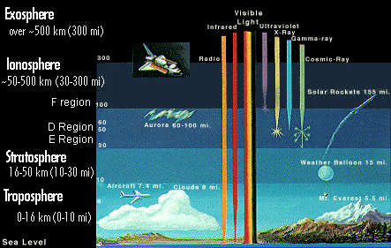
Radio Wave Propagation
Ground Waves travel along the surface of the earth
Sky Waves travel from the transmitter to one of the ionospheric layers and is returned to the earth
  Requires very little power to travel long distances, say around 8000 miles
Atmosphere is subject to seasonal changes that affect signals
  The troposphere, stratosphere, ionosphere
Notes:
There are Four Layers in the Ionosphere.
During the Day, all Four Layers are present.
At Night, the F1 and F2 layers thin out and tend to merge into one layer. The D and E layers disappear.

Slide 6
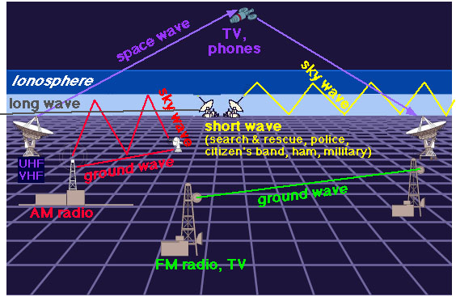
Radio Wave Propagation
Notes:
variables in a sky wave signal—the frequency, the ionospheric layers, the time of day, the season, and the sunspot cycle
variables in a ground wave signal depend on the terrain over which it travels

Slide 7
Radio Wave Propagation
Reflection (at same angle it strikes)
  Metal surfaces, water
Refraction (bending of signal through object)
Diffraction (bending of signal around object)
  Creates shadow zones
Man-made and natural objects
  Foliage, power lines, buildings, bridges
Critical Frequency
  Frequencies higher than the critical frequency will pass through the layer sans refraction
  As a radio wave passes through a layer, it is partially absorbed

Slide 8
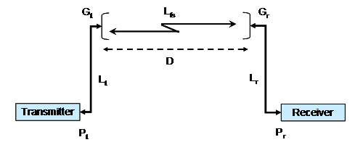
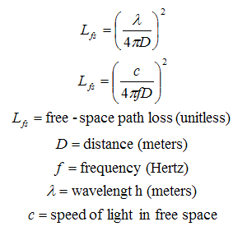
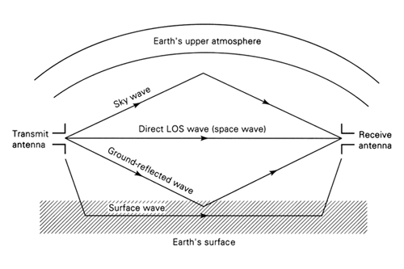
Radio Wave Propagation
Minimum Power for transmission
  Depends on minimum power required by reciever(s)
http://transition.fcc.gov/pshs/techtopics/techtopics17.html

Slide 9
Radio Wave Propagation
Band | Ground Wave | Sky Wave | Power Required (kW)
LF | 0 - 1,000 Miles (0 - 1,609 km) | 500 - 8,000 Miles (835 - 12,872 km) | Above 50 kW
MF | 0 – 100 Miles (0 – 161 km) | 100 – 1,500 Miles (161 – 2,415 km) | .5 – 50 kW
HF | 0 – 50 Miles (0 – 83 km) | 100 – 8,000 Miles (161 – 12,872 km) | .5 – 5 kW
VHF | 0 – 30 Miles (0 – 48 km) | 50 – 150 Miles (83.5 – 241 km) | .5 or less kW
UHF | 0 – 50 Miles (0 – 83 km) | N/A | .5 or less kW

Slide 10
Radio Wave Propagation
Sunspots
  In cycles, vary yearly, distances of 500,000+ miles
  High activity, high frequency; Low, low
  Generally, higher freq. during the day, low at night
Other signals
  Overlapping frequencies
  With low power, a way to mask other signals
  With high power, a way to jam or repeat

Slide 11
Radio Wave Propagation
Break and/or Questions?

Slide 12
Antenna Basics
In its simplest form...
  It is a conductor that is designed to provide “the most attractive path” to ground for a signal
  The antenna...
    Uses a transmission line...
      To transmit/receive/both your data via a carrier from a load
        Grounded within a designed system

Slide 13
Antenna Basics
Antenna Usage
  Transmission
  Reception
  Proper design will permit sustained characteristics for transmission and reception
  However...
    Certain antennas have materials/components that will not allow for transmission as most are built for just reception
    Exam specification carefully!

Slide 14
Antenna Basics
Antenna Wavelength
  Shape and size of an antenna is dependent on the wavelength and format of the signal
  Peak to peak, trough to trough
  Antenna length in feet
    Constant ÷ Frequency in MHz = Antenna Length in Feet and Inches (or meters)
      234 (71.32) for a ¼ wavelength antenna
      468 (142.65) for a ½ wavelength antenna (Best for expedient use, but 5 full wavelengths provides the optimum antenna length for any given frequency)
      936 (285.29) for a full wavelength antenna
      Antenna should be cut a little longer than calculated to ensure good SWR!
Notes:
¼ Wavelength antenna at 12.000 MHz
234 ÷ 12 = 19.5
Answer = The antenna length for a ¼ wave antenna at 12 MHz is 19 Feet 6 Inches long.

Slide 15
Antenna Basics
In general
  Lower frequency, longer antenna; higher, shorter
  Antennas are only good for a certain set of frequencies (frequency response)
    Choose the best compromise between range and efficiency
    Very task dependent
  Examine Smith Chart if available
  Standing Wave Ratio!!!

Slide 16
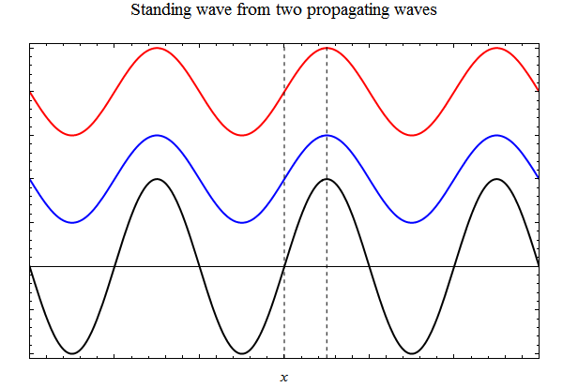
Antenna Basics
Standing Wave Ratio!!!
  Extremely Important
  When properly cut, sine wave begins at one end of the antenna and ends at the other end of the antenna
  When NOT, the sine wave doesn’t match the antenna length, causing standing waves or reflected waves
    High SWR leads to no transmission and/or feedback
    SWR between line and load should
    be less than 1.5 to 1;
    up to 3 to 1 will work... kinda

Slide 17
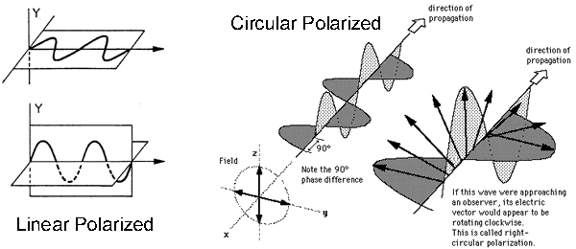
Antenna Basics
Antenna polarization
  Vertical
  Horizontal
  Circular
    Both vertical and horizontal
  Everywhere in between
    Depends on the orientation of the emission vector for the wave in relationship to the earth
    A wave transmitted by a vertical antenna
      Will have a vertically polarized signal
        Which will need to be received by
          A vertically polarized antenna
  Difference in polarization causes loss of signal!

Slide 18
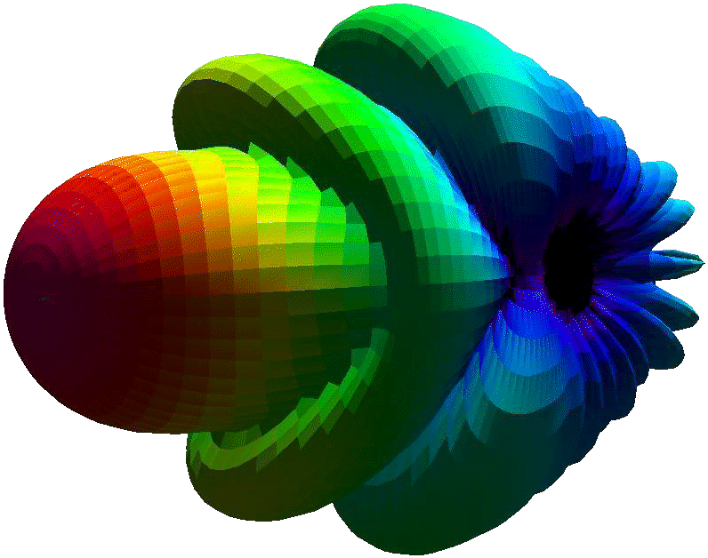
Antenna Basics
Antenna Directivity
  How well an antenna transmits/receives in different direction(s)
  Radiation patterns (Smith Charts AGAIN!)
    Omni-directional
    Directional
      Beam of the antenna
        Narrow
        Wide
      Take-off Angle
      Side Lobes

Slide 19
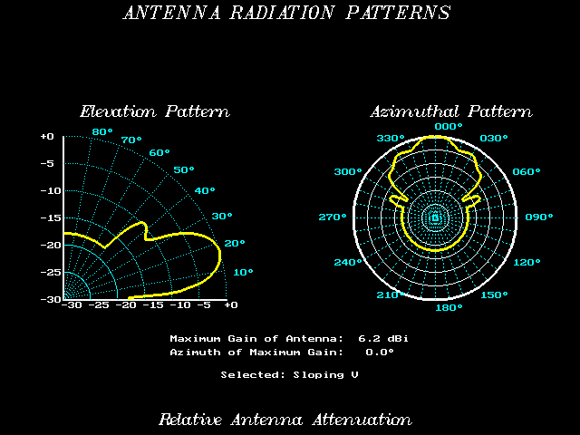
Antenna Basics

Slide 20

Antenna Basics
Antenna Gain
  Directly related to directivity
  Inverse Square Law
    Signal strength for a given surface area is inversely proportional to the distance it traveled from the source
Antenna Loss
  Impedance everywhere
  Both internal to the system
  And external to the antenna

Slide 21
Antenna Basics
Antenna Signal Strength
  More power, more distance
  HOWEVER...
    A properly designed antenna will transmit to the proper distance with less power consumption
  Different consideration based on design
    Omnidirectional vs. Directional
    Environmental Factors
    Operational Considerations
    And last but not least...

Slide 22
Antenna Basics
Antenna Signal Strength
  Legal Considerations!
    The largest of party poopers
    Ensure compliance with local, state, and federal laws
      This also especially applies to international laws when abroad
Antenna Noise
  Internal Causes
    Faulty connections, failing components, damages
  External Causes
    Power lines, other transmissions, motors
  Mitigation through AGC, filters, design, location selection, etc.

Slide 23
Antenna Basics
After looking at the aspects of the antenna itself, we move to what feeds the antenna
Transmission Lines
  Aka feeder lines
  Resonant or tuned (same length as antenna)
  Non-resonant or un-tuned (SWR < 1.5)
    Impedance of antenna and line have to match
  Length (in Meters) = (300/CF) * VF
    VF = Velocity Factor (depends on type of cable)
    CF = Center Frequency

Slide 24
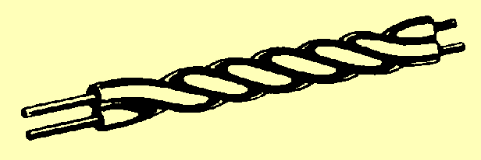
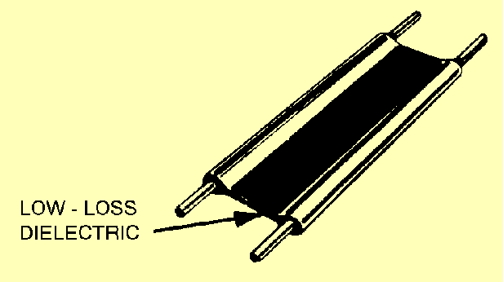
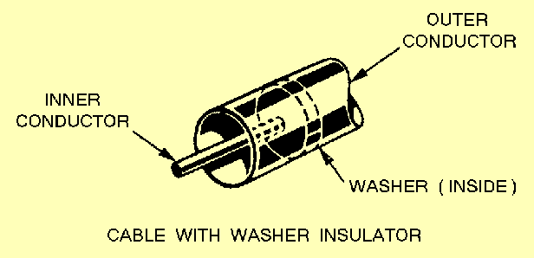
Antenna Basics
Transmission Lines
  Types
    Single Wire (earth return path)
      Used as non-resonant feeder line
    Twisted Pair (high loss; no use above 15 MHz)
      Shielded or unshielded; not the best (worse when wet)
    Ladder Line or Ribbon Line
      Unshielded and constantly spaced
    Coaxial (minimum loss; loss increase with frequency increase)
  Power Loss
    Radiation (line radiates like antenna)
    Heating (current flow causes heat; eddy currents)
    Reflection (traveling waves from transmitter)

Slide 25
Antenna Basics
Antenna Insulation
  The transmitting/receiving element of the antenna must be isolated from ground
  Remember, you're trying to direct the signal through the antenna
    Through the transmission line
      Through the Radio
        And THEN to ground
  Should be designed for ahead of time
  However, any nonconductor should work in a pinch

Slide 26
Antenna Basics
Antenna Counterpoise
  Prevent ground reflected waves from absorption
    Artificial reflective surface such as...
      A suspended wire above the ground
      Series of suspended wires
      Moistened earth or a puddle
    3-5 feet separation between the antenna and counterpoise
Antenna Resistors
  To make a bi-directional antenna unidirectional
    Maximizes directional output

Slide 27
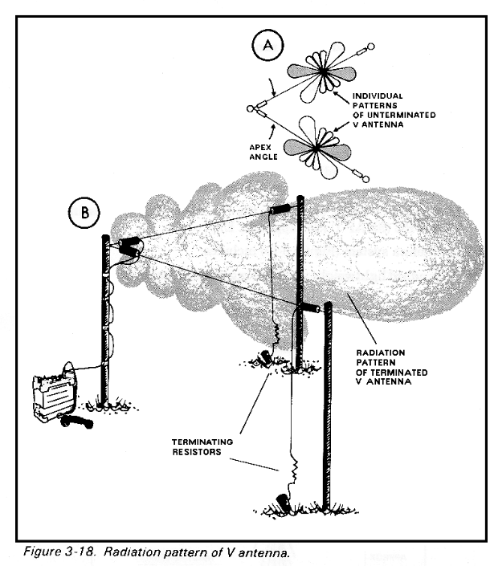
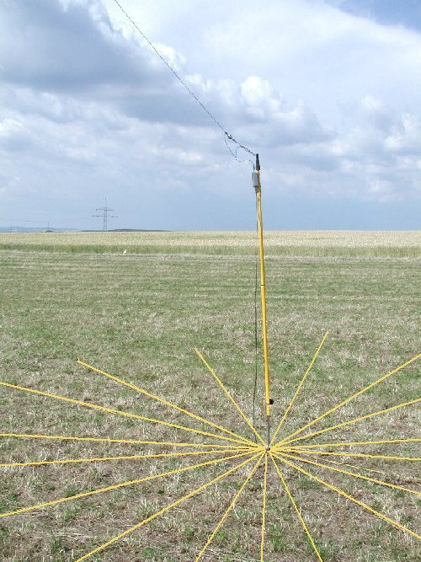
Antenna Basics
Bleeder resistor for static with counterpoise
Antenna resistors for directionality

Slide 28
Antenna Basics
Break and/or Questions?

Slide 29
Common Antennas
Horizontal Antennas
  Suggested max resistance is 100 ohms
  Quarter wavelength above the ground
  Practical Half-wave Antennas
    The ground has the greatest effect on the Medium and High Frequency antennas that are mounted fairly close to it in terms of wavelength.
    Transmit - some of the energy travels directly to the distant station, and part of the energy strikes the ground directly in front of the antenna and a 180º phase shift (Phase Reversal) takes place
    This may cancel out the direct wave if they arrive at the same time and are out of phase—creating a Null effect.
    If they arrive in phase, the ground reflected wave adds to the direct wave, making it stronger.

Slide 30
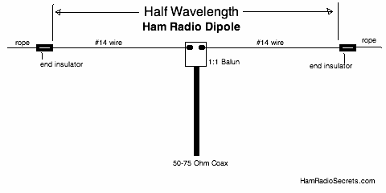
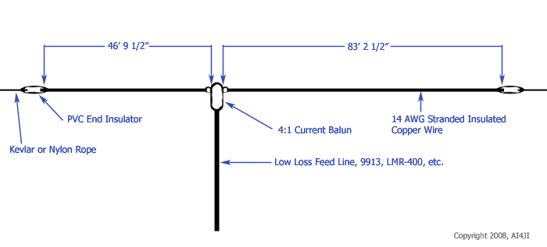
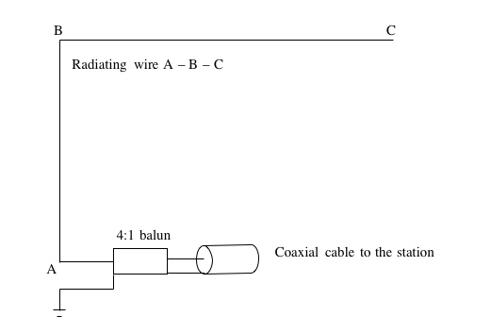
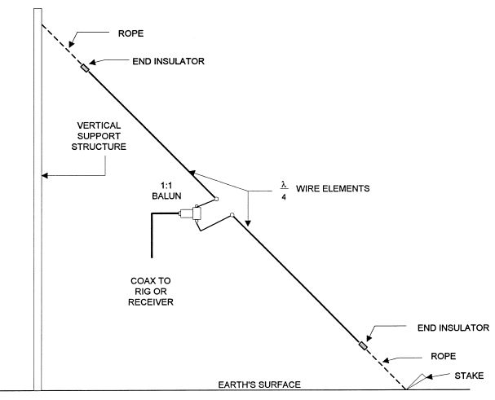
Common Antennas
Horizontal Antennas
  Dipole Antenna
    2-30 MHz
    Coax feeder line
    Feeder line at right angle to antenna
      Reduce radiation
      Reduce coupling feedback
    Counterpoise can be used if there are perceived issues
  Others
    14% off centered
    Inverted L
    Sloping wire (73 ohm impedance)
      Best compromise for ground and sky wave utility!

Slide 31
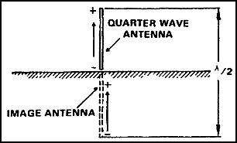
Common Antennas
Grounded Antennas
  Quarter wave antennas
    Used with highly conductive ground
    A ground rod uses the earth as the other ¼ wavelength element (an image antenna)

Slide 32
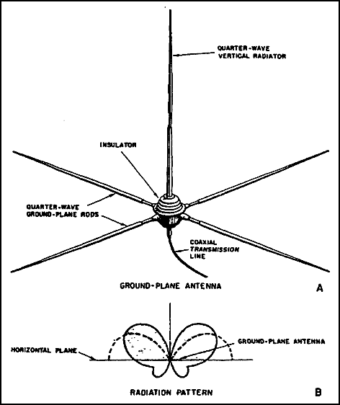
Common Antennas
Ground Plane Antennas
  1 section vertical ¼ wavelength
  N number of spokes ¼ wavelength
    Form an artificial ground
    VHF or higher frequencies
  Example
    Disc-cone Antenna

Slide 33
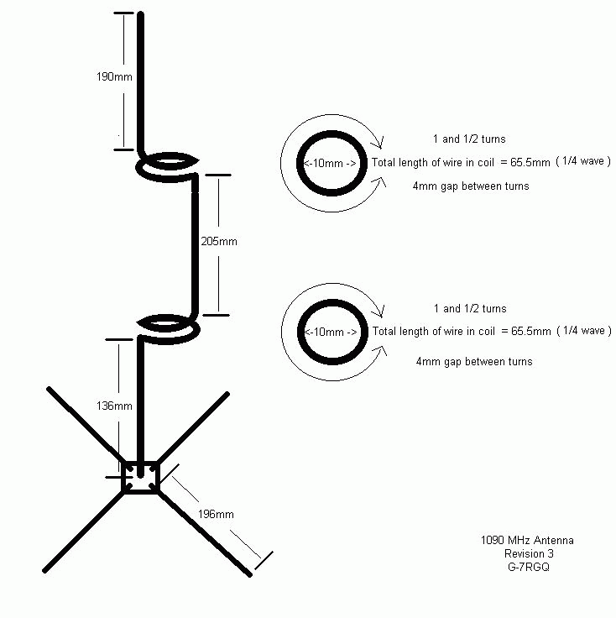
Common Antennas
ADS-B Antenna
  http://revision3.com/hak5/how-to-build-an-ads-b-antenna/

Slide 34
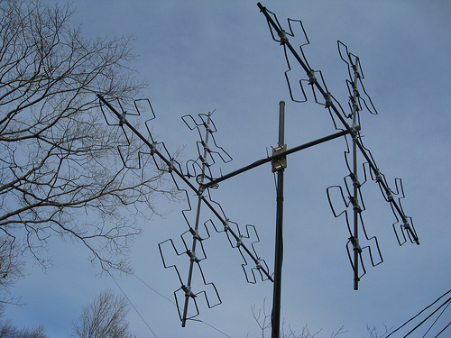
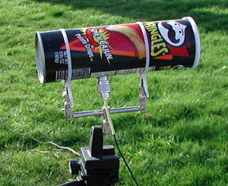
Common Antenna
Other
  Fractal Antenna
    Multilevel or space filling antennas
    Popular for RFID
    Uses a repeating iterations of a set shape to maximize the receptive capability of the antenna over a greater range
  “Cantenna”
    Directional wave guide antenna
    Name says it all...
    Common for WiFi applications

Slide 35
Common Antennas
Usage
  Calculations for the type of antenna, angle, distance, lines, etc. are based on your best knowledge of the signal strength, format, and location.
  Your wavelength and design must match as close as possible to the known signal parameters
  Don't get in trouble!
  Do no harm!

Slide 36
Safety Concerns
When dealing with electricity, deal with it appropriately (protective gear and posture as required)
When erecting antennas, ensure proper gear is used when:
  Climbing or descending from heights
  Building masts or other structures to house antenna
  Assessing environment specific concerns
  Bad weather conditions
Wear “protective glasses” just in case
When in doubt, ground it!

Slide 37
Resources
ARRL
  http://www.arrl.org/
DXZone
  http://www.dxzone.com/
AMSAT
  http://www.amsat.org/
Antenna design programs
  Several available online (download and web-based)
For all else...
  Go forth and Google!

Slide 38
That's all folks!
Prepared by Joe Blankenship
Cyber Geography Research Institute International
Questions?

