Slide 1
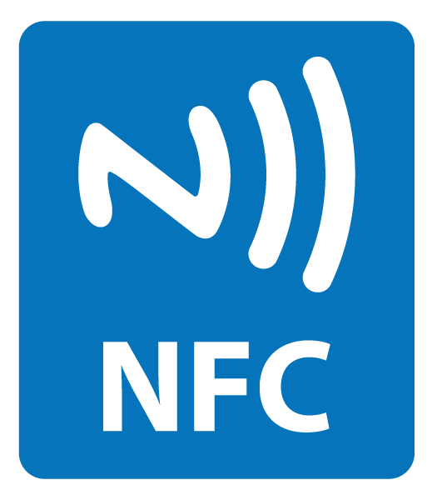
Near Field Communication

Slide 2
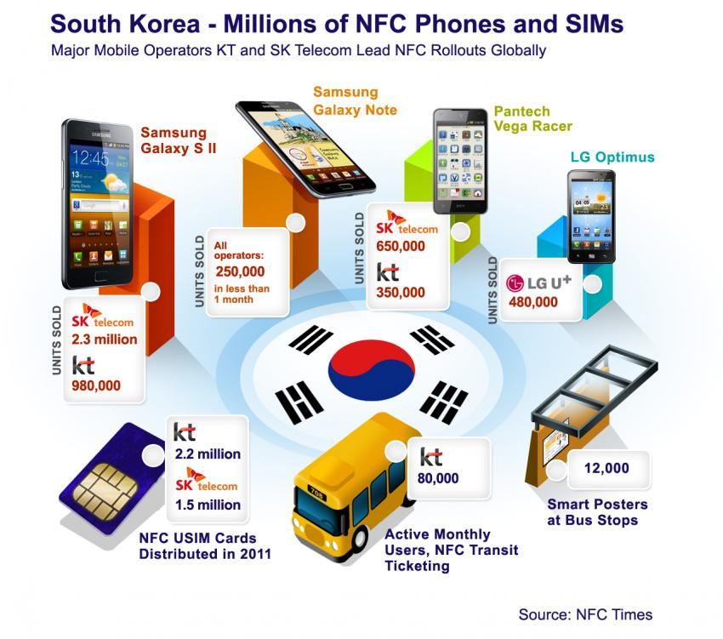
Near Field Communication

Slide 3
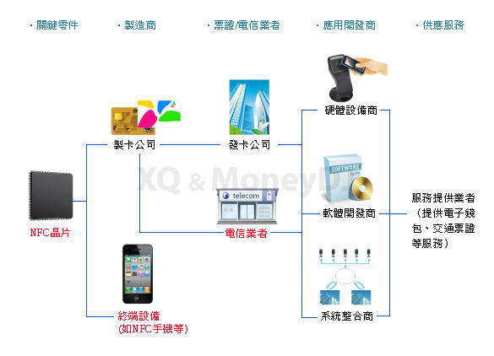
Near Field Communication

Slide 4
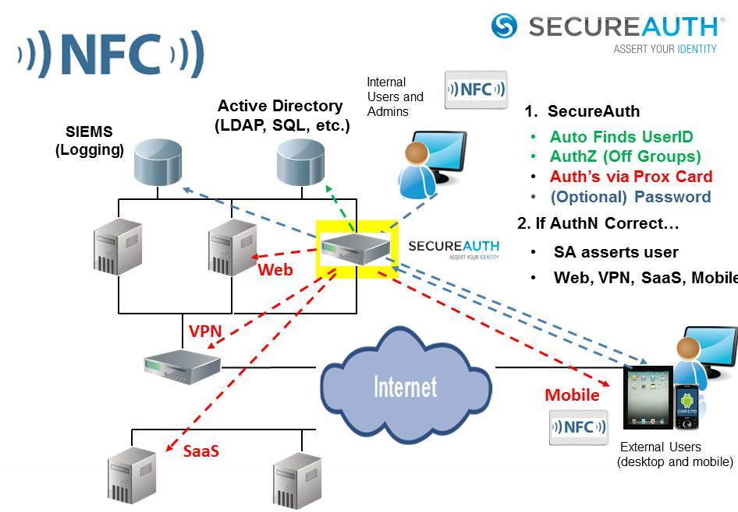
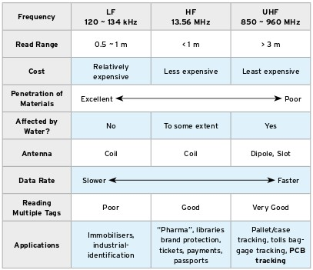
Near Field Communication

Slide 5
Near Field Communication
What is NFC?
  Invented by NXP (was Phillips)
  Short range (up to 10 cm) wireless communication
  A variety of ranges
    125 KHz and 13.56MHz most common in US
  Passive communication
    Initiators generates magnetic field
    Activates “targets” which have no power supply
  Active communication
    Peer to peer
    Each device alternates between initiator and target modes
  NFC tags based on ISO14443A and other standards
    About 1 Kb EEPROM in most cases

Slide 6
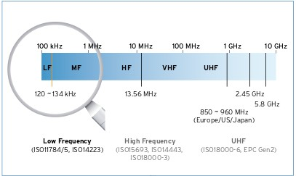
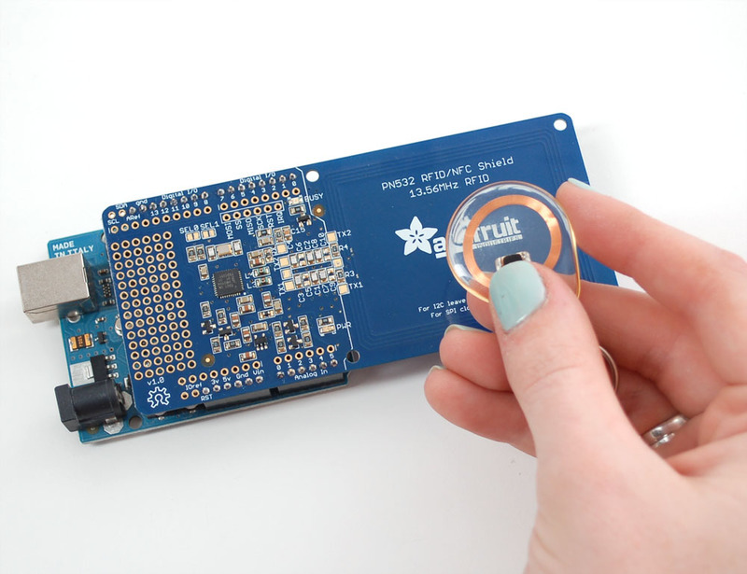
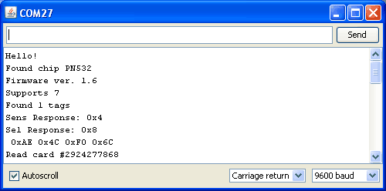
Near Field Communication
More about NFC
  NFC Data Exchange Format
    NDEF Messages
    NDEF Records
    URIs, plain text, etc.
  MiFare format
  Record Type Definitions
    Provide multiple vectors via the URI ID for infiltration
    Also receive memory dumps from devices

Slide 7
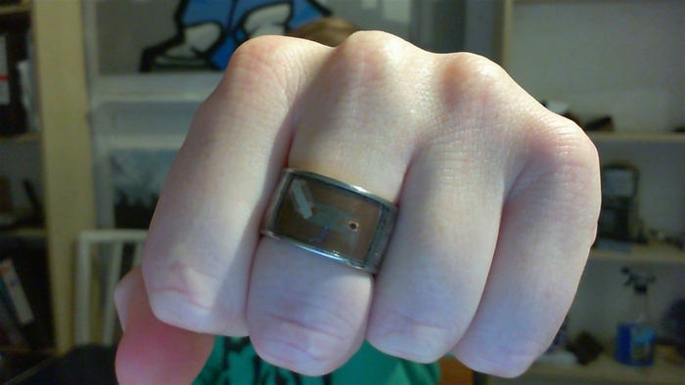
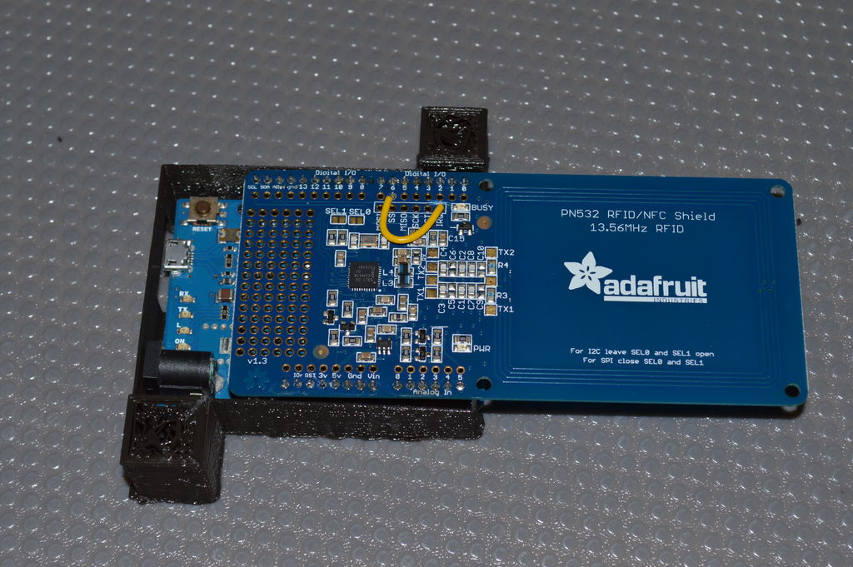
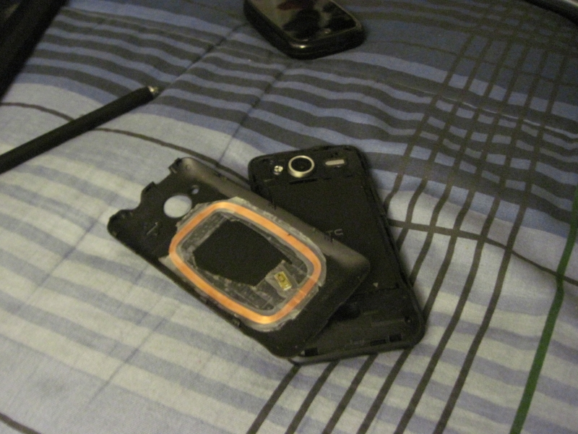
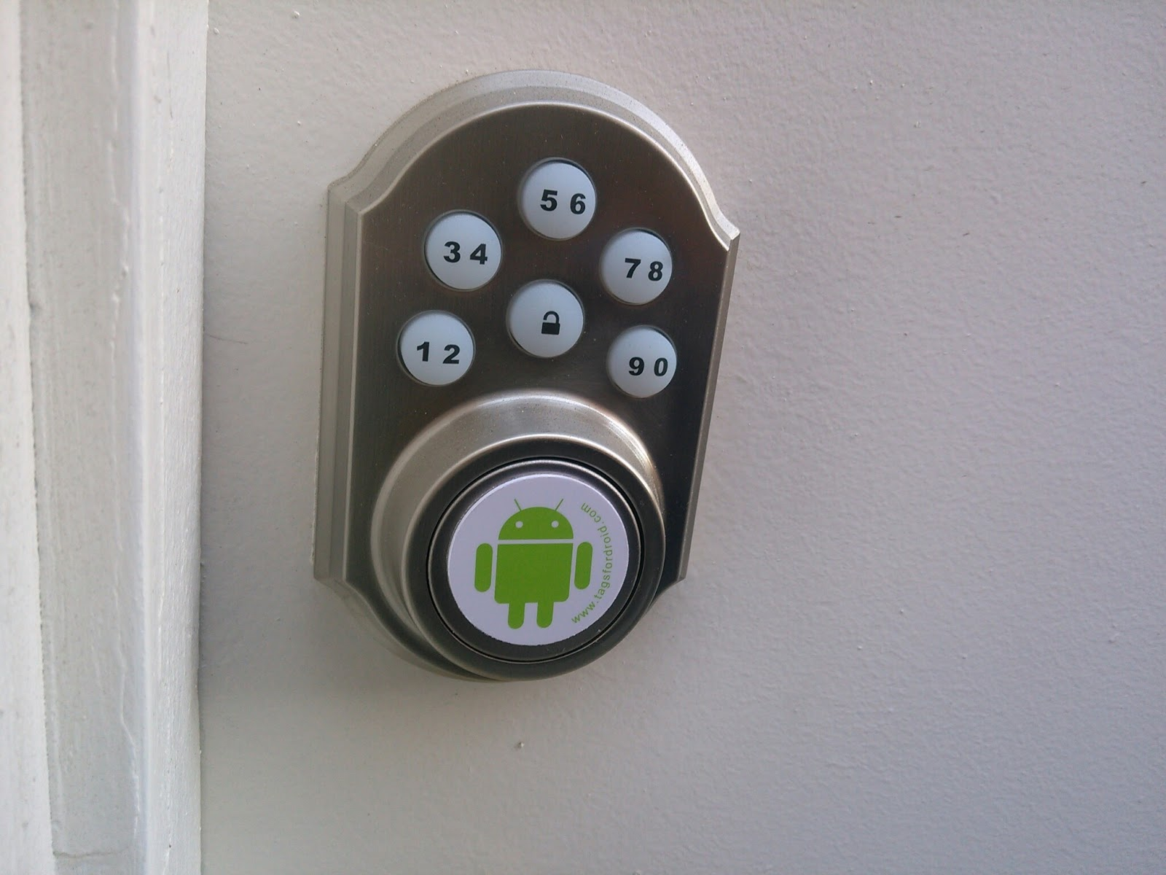
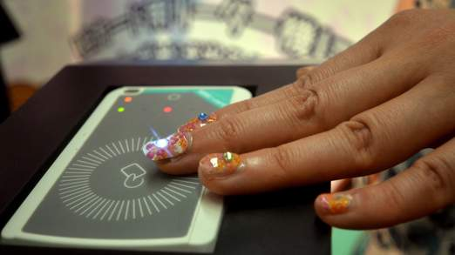
Near Field Communication
What you can do...
  Access control
  Business card
  Automatic data exchange
  Automate device operations
    Trigger, Lan Wan, Tasker
  Payments, ticketing, and more

Slide 8
Near Field Communication
Prepared by Joe Blankenship
Cyber Geography Research Institute International
Questions and Demos

