Slide 1
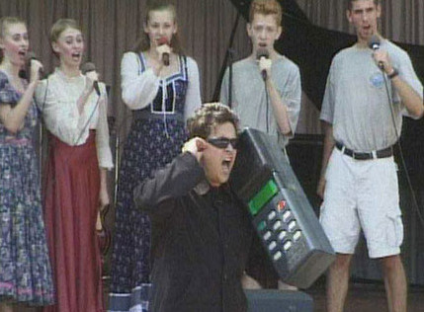
Introduction to Cellular Communications
Prepared by Joe Blankenship www.thejoeblankenship.com www.cgrii.org
Notes:
Sources:
http://cdn.themetapicture.com/media/funny-big-old-cell-phone.jpg

Slide 2
Agenda
https://github.com/joeblankenship1
History
Definitions
Network Components
Network Function
System Overview
Notes:
Please contact me with any suggestions!!!

Slide 3
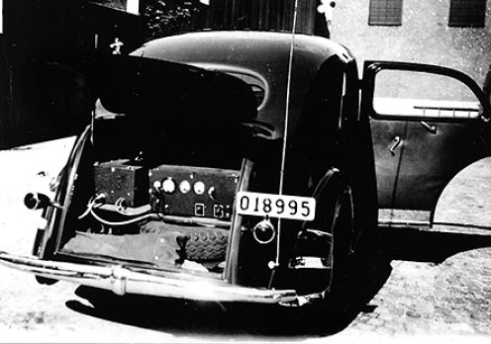
History
1920s
  Detroit Police Department utilizes a 2 MHz system in their vehicles
Notes:
Sources: Wikipedia
http://usercontent2.hubimg.com/915259_f496.jpg

Slide 4
History
1940s
  Frequencies were allocated between 30 & 40 MHz. Police expanded their wireless systems in 1940 while the first private mobile systems became available
  St. Louis deploys the first public mobile phone system (three channels @ 150 MHz) in 1945
    FCC allocated 6 channels, 60 KHz apart. However, massive interference prevented broad adoption
  Boston & New York begin operating a mobile system between 35 and 44 MHz in 1947 (original Push-to-Talk (PTT) operation)
  FCC authorized separate radio channels to ROC's (Radio Common Carriers) in 1949 permitting connection to the public telephone network allowing mobile telephone services
Notes:
Sources: Wikipedia

Slide 5
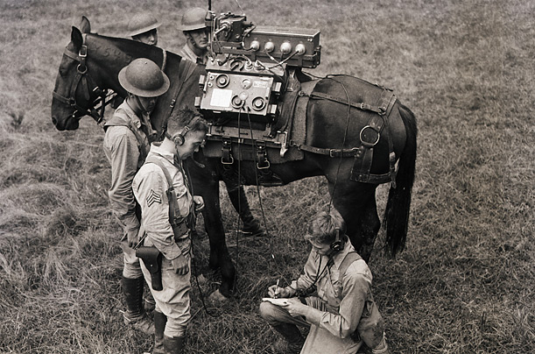
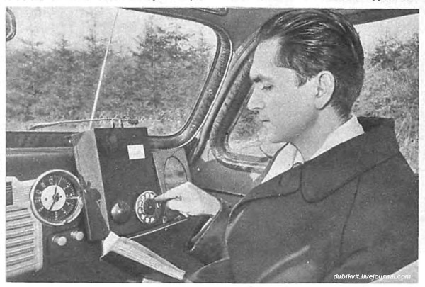
History
1950s
  AT&T proposed a broadband mobile phone system operating in the 800 MHz range to the FCC in 1953
  Wire line channels at 150 MHz expanded from 5 to 11 (channel spacing of 30 KHz) in 1955.
  12 wire line channels added at 450 MHz in 1956
    Each call being handled by a mobile operator
Notes:
Sources: Wikipedia
http://img.timeinc.net/time/photoessays/2007/cell_phone/cell_phone_06.jpg
http://media.englishrussia.com/newpictures/First-Russian-mobile-phones-from-1960s/611486_600_full.jpg

Slide 6
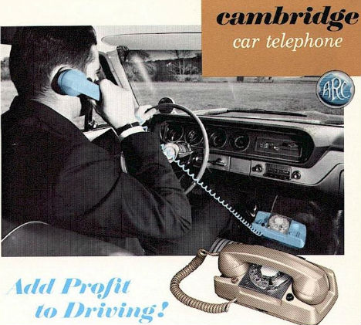
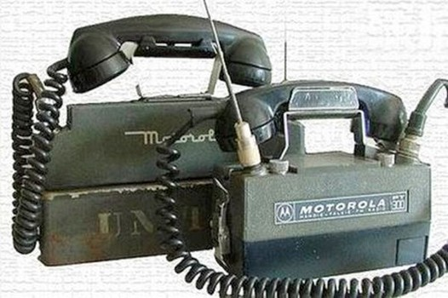
History
1960s
  A new 150 MHz system provided automatic channel selection for each call in 1964
    Eliminated need for Push-to-Talk
  Automatic capability extended to 450 MHz band in 1969
    IMTS (Improved Mobile Telephone System) became the standard for mobile telephone service
Notes:
Sources: Wikipedia
http://img.weburbanist.com/wp-content/uploads/2012/09/car-phones-1.jpg
http://cdn2-b.examiner.com/sites/default/files/styles/image_content_width/hash/0c/6e/0c6ef19a5933674fc645d2c512949ae6.jpg

Slide 7
History
1970s
  FCC allocates 75 MHz in the 800 MHz range and requests feasibility proposals in 1970
  AT&T details original “cellular system” in proposal submitted to FCC in 1971
  FCC allocates 40 MHz for mobile phone service and solicits for a developed “cellular system” based on Bell Systems 1971 proposal
  AT&T applied for authorization to develop and operate a cellular system in Chicago in 1975
  Illinois Bell Telephone is granted a license to construct and operate a developmental cellular system in Chicago in 1977
  2,100 mobile sets were procured for the Chicago testing
    Initial system served over 2000 trial customers in 1978
Notes:
Sources: Wikipedia

Slide 8
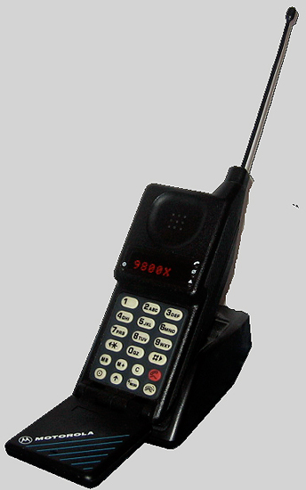
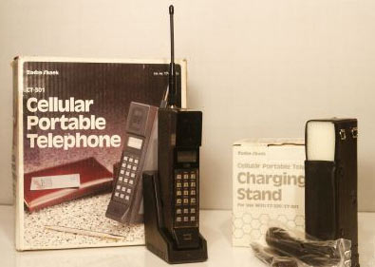
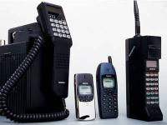
History
1981
  FCC issues standardization rules pertaining to cellular operating systems that still apply today
Notes:
Sources: Wikipedia
http://www.pimall.com/nais/pivintage/images/blockcellphone.jpg
http://www.childofthe1980s.com/wordpress/wp-content/uploads/2008/12/1980s-mobile-phones.jpg
http://netdna.webdesignerdepot.com/uploads/cellphone_design/dkmb86g_392fhn6j9hb_b.jpg

Slide 9
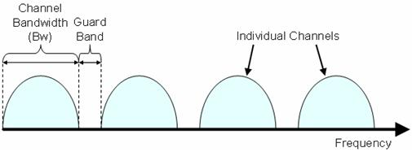
Definitions
Channel
  A portion of the radio frequency spectrum allocated for communications via assigned center frequency
Bandwidth
  The width of the channel
Control Channel
  The portion of cellular communication that initiates, sustains, modifies, and ends the call
Voice Channel
  The portion of cellular communication that handles the voice communication and other data
Notes:
Sources: Wikipedia
http://www.ni.com/cms/images/devzone/tut/dhall_MIMO_fig4.JPG

Slide 10
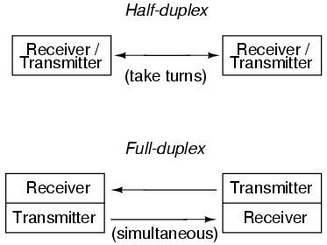
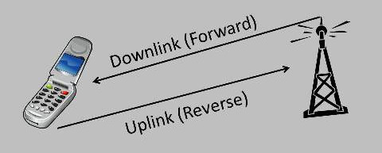
Definitions
Half Duplex
  Forward and reverse channel take turns
Full Duplex
  Simultaneous forward and reverse channel function
Forward Channel
  Base station to mobile
  (down link)
Reverse Channel
  Mobile to base station
  (up link)
Notes:
Sources: Wikipedia
http://www.electronicspoint.com/tutorialimages/Digital/04232.png
http://gnuradio.org/redmine/attachments/download/144/updown.jpg

Slide 11
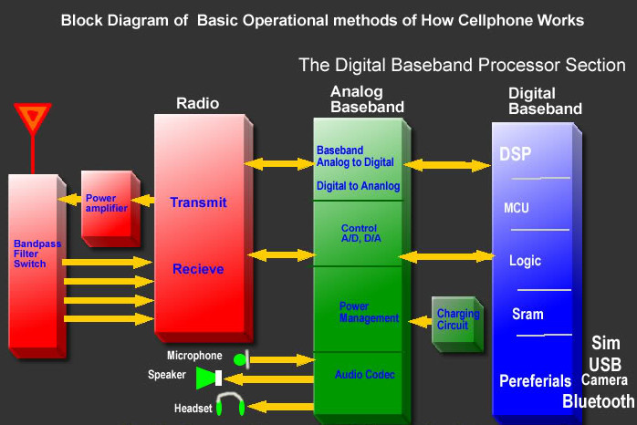
Definitions
Cellular Phone
  Basically a radio operating over radio frequencies allocated for cellular use
  First-generation cellular phones use analog FM signals to transmit voice over the air
  Second-generation phones use digital technology (significantly more advanced)
Notes:
Sources: Wikipedia
http://i946.photobucket.com/albums/ad302/djniel2k/cellphone%20repair%20tutorials/block4.jpg

Slide 12
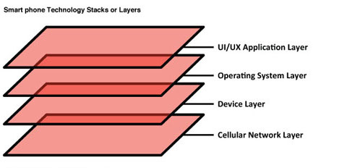
Definitions
Smart Phone
  Are essentially computers that have
    A mobile operating system
      application suite -- the basic applications users access regularly (menu screens, calendars, etc)
      user interface framework -- the graphics and layouts seen on the screen
      application execution environment (AEE) -- application programming interfaces, which allow developers to create their own programs
      middleware -- software libraries that enable smartphone applications (such as security, Web browsing and messaging)
      kernel - management systems for processes and drivers for hardware
  Which sits on top of hardware
    that supports the operation
    of the above software
    Interfaces with the I/O devices
    Acts as the gateway between the
    mobile operating system...
  And
    The radios operating over
    frequencies allocated for cellular use
Notes:
Sources: Wikipedia
http://electronics.howstuffworks.com/smartphone2.htm
http://www.mauronewmedia.com/blog/wp-content/uploads/2012/11/Fig-13.jpg

Slide 13
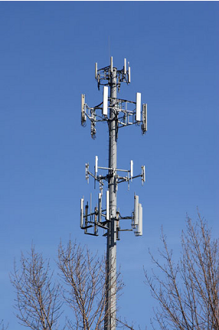
Definitions
Cell Site/Base Station
  Physical location of radio equipment that provides coverage within a cell
  This includes power sources, interface equipment, radio frequency transmitters/receivers, antenna systems
Registration
  Process of cell phone turning on and reporting to cell site
System ID (SID)
  Unique identifier for each cellular network
Notes:
Sources: Wikipedia
http://www.emfandhealth.com/image/obj464geo446pg16p17.png

Slide 14
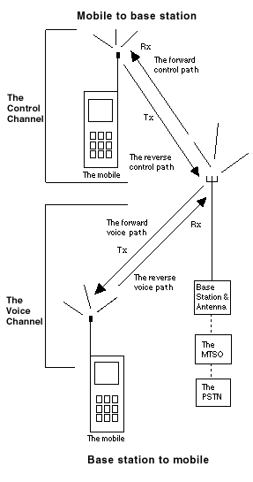
Definitions
Voice Communication
  Takes place on a voice channel
    Forward voice channel (FVC)
    Reverse voice channel (RVC)
  Consists of voice audio traffic and data
    Caller ID
  How do smart phone card readers work?
    e.g. Square?
Notes:
Sources: Wikipedia
http://www.privateline.com/Cellbasics/image36.gif

Slide 15
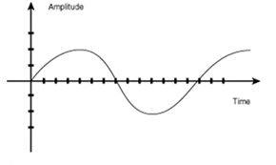
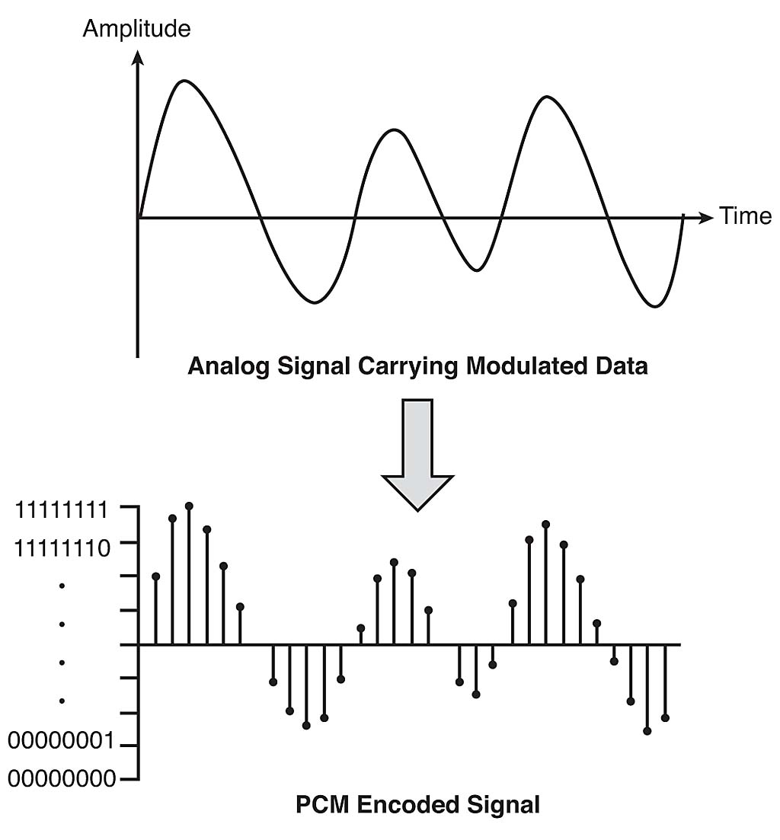
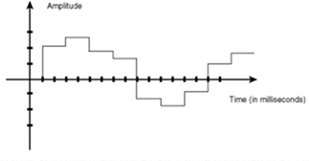
Definitions
Notes:
Sources: Wikipedia
http://www.cisco.com/web/services/news/ts_newsletter/tech/chalktalk/images/chalk_0906img2.jpg
http://www.cisco.com/web/services/news/ts_newsletter/tech/chalktalk/images/chalk_0906img3.jpg
http://core0.staticworld.net/images/idge/imported/article/nww/2008/08/04fig01-100278636-orig.jpg

Slide 16
History or Definition
Questions?

Slide 17
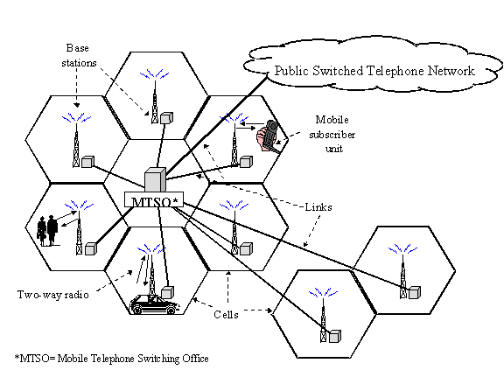
Network Components
Main components of a cellular network
  The mobile telephone switching office (MTSO)
  The cell site
  The format/standard
Notes:
Sources: Wikipedia
http://www.itu.int/osg/spu/ni/images/mtso.gif

Slide 18
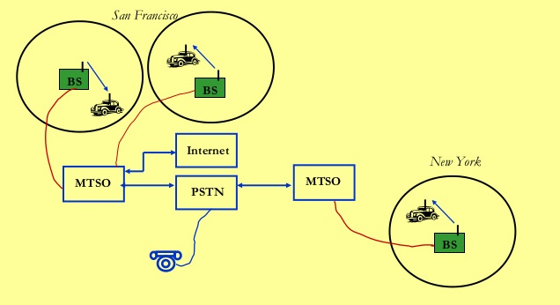
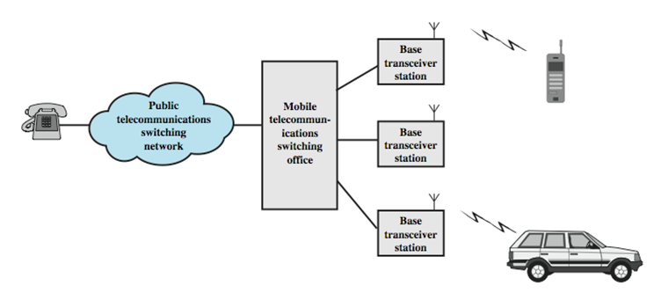
Network Components
MTSO (Mobile Telephone Switching Office)
  Manages scores of cells and base stations
  tracks billing and locates subscribers
  Uses databases to authenticate phones and customers
PSTN (Public Switched Telephone Network)
  Connects phones worldwide
  Made up of local networks, Exchange area networks & long-haul networks
Notes:
Sources: Wikipedia
http://image.slidesharecdn.com/wirelesscommunicationppt-140910231019-phpapp02/95/wireless-communication-15-638.jpg?cb=1410390904
http://ironbark.xtelco.com.au/subjects/DC/lectures/22/wireless_cellular_overview.png

Slide 19
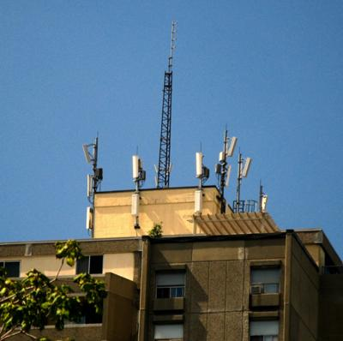
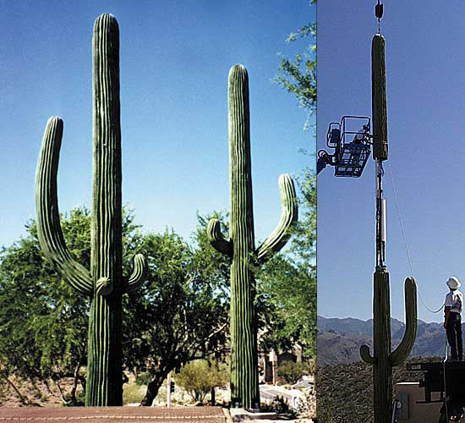
Network Components
The cell site
  Cellular technology (re)uses individual radio frequencies by dividing a service area into separate geographic zones called cells
  Cells can be as small as a building up to 20+ miles across
  Each cell is equipped with its own radio transmitter/receiver antenna array
Notes:
Sources: Wikipedia
http://www.cell-tower-leases.com/images/cherryhill-circle-rooftop-cellular-antenna-installation-21373427.jpg
http://www.thegreenhead.com/imgs/hidden-cell-tower-2.jpg

Slide 20
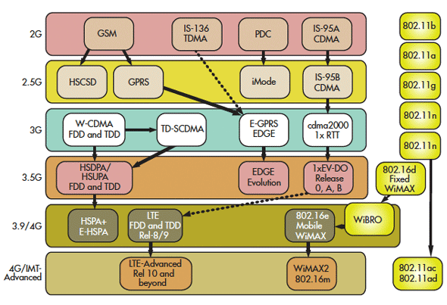
Network Components
Formats and Standards
  Frequency Re-Use Plan
    FDMA, TDMA, CDMA
  Format/Standard
    AMPS, IS-136, 4G
  Operating Frequency
    Various
Notes:
Sources: Wikipedia
http://electronicdesign.com/site-files/electronicdesign.com/files/archive/electronicdesign.com/content/content/74012/74012-f1.gif

Slide 21
Network Components
Frequency Reuse Plans
  Frequency-Division Multiple Access
    Available spectrum is divided into small blocks of frequencies
    Each channel is assigned to one of these blocks
  Time-Division Multiple Access
    Users share an RF spectrum by each taking turns in its use
    Channels are defined by the fractions of a time, or timeslot
    Timeslots are grouped in a repetitive structure called a frame
  Code-Division Multiple Access
    Each channel is assigned a unique code
    Encodes the data to be sent over the channel
    All channels can transmit simultaneously
Notes:
Sources: Wikipedia

Slide 22
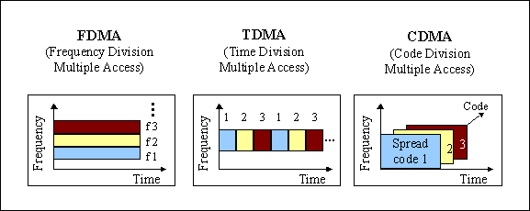
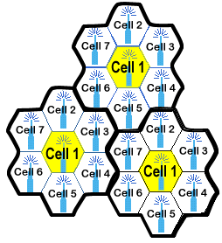
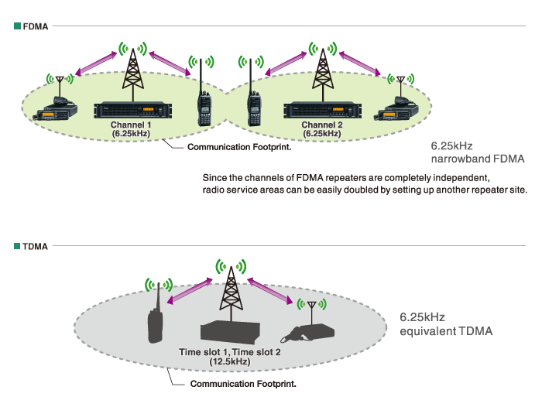
Network Components
Notes:
Sources: Wikipedia
http://www.gsmfavorites.com/documents/introduction/gsm/FreqReuse.gif
http://www.parissinos.gr/idas/dpmr/features/img/fdma_tdma_right.gif
http://www.itu.int/osg/spu/ni/images/codedivision.gif

Slide 23
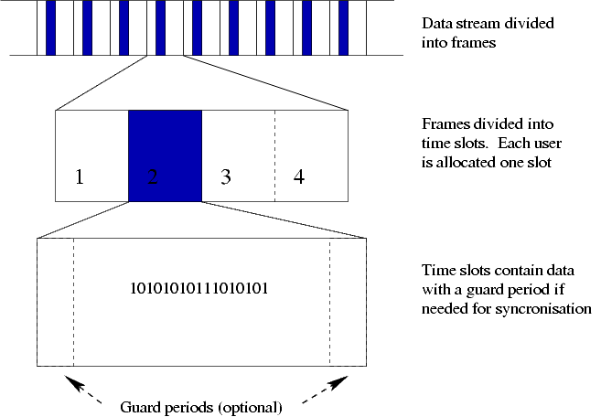
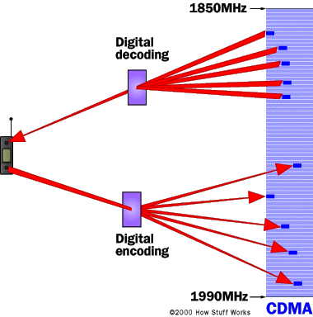
Network Components
TDMA
Notes:
Sources: Wikipedia
http://upload.wikimedia.org/wikipedia/commons/f/f9/Tdma-frame-structure.png
http://www.emfnews.org/images/cdma-cell-phone-frequencies.jpg

Slide 24
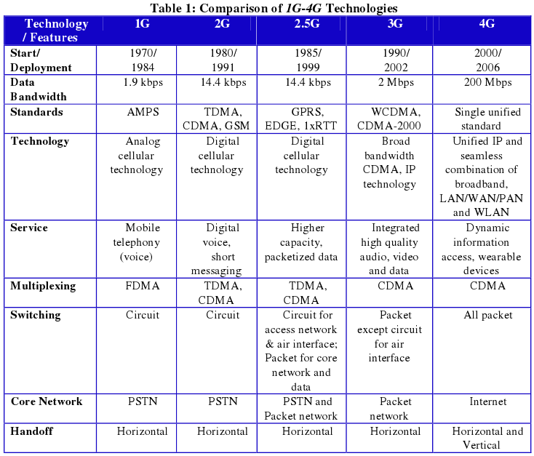
Network Components
Standards
  Standards are agreed upon protocols set by various organizations
  Standards are also called formats
Notes:
Sources: Wikipedia
http://www.taiwan4g.com/2012/img/comparison_1g-4g.png

Slide 25
Network Components
Advanced Mobile Phone System (AMPS)
  Replaced IMTS (Improved Mobile Telephone Service) by using the spectrum space more effectively
  Allows cells to reuse radio frequencies
  800 MHz Spectrum (824 MHz – 894 MHz)
    30 KHz-wide channels (30 KHz bandwidth)
    Each base station transmit/receive channel is separated by 45 MHz
  Approximately 45 Channel pairs per cell
  832 Channels (42 CC & 624 VC)
  AMPS became extremely vulnerable to fraud once 50,000+ new cellular subscribers signed up daily
Notes:
Sources: Wikipedia

Slide 26
Network Components
Narrow Advanced Mobile Phone System (NAMPS)
  An interim solution to capacity problems
  While three times AMPS capacity to extend low call capabilities was claimed, it never did reach that goal
  Bandwidth of 10 KHz versus 30 KHz
  Operational in 35 US and overseas markets
  Combines existing voice processing with digital signaling
  Interference increased with reduced bandwidth
  2496 Channels
  Analog voice channel processes one call at a time
    This limits one control channel to 60 voice channels
Notes:
Sources: Wikipedia

Slide 27
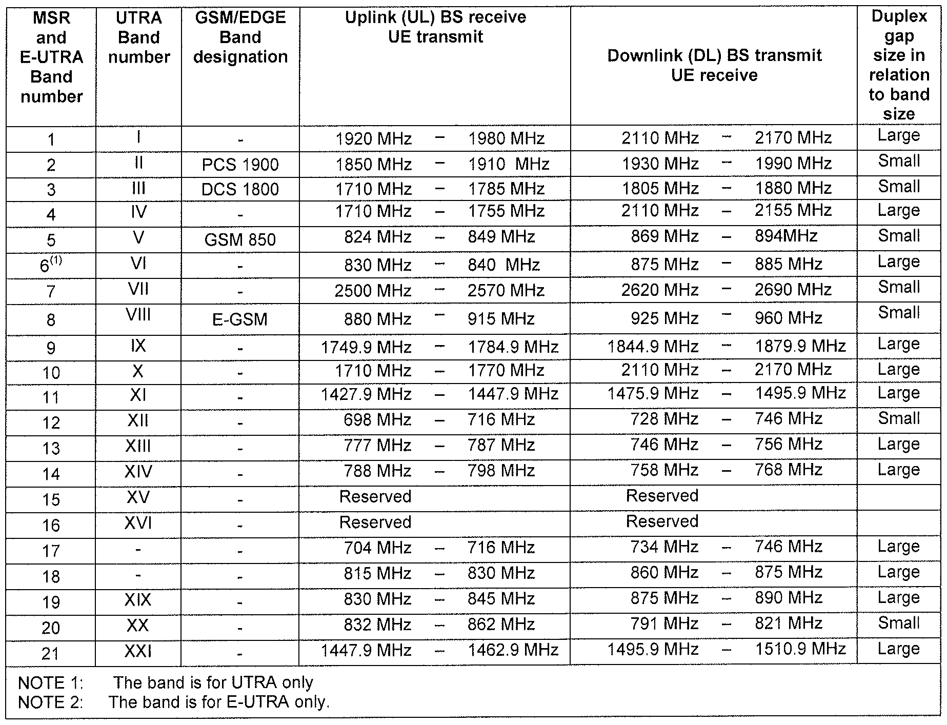
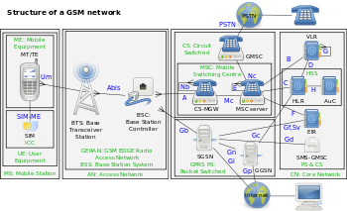
Network Components
TDMA Standards
  IS-40 (1G)
    Control Channel is analog
    Voice Channel is analog
  D-AMPS (2G)
    Digital Advanced Mobile Phone System (D-AMPS)
    IS-54
      Control Channel is analog
      Voice Channel is analog
    IS-136
      Control Channel is digital
      Voice Channel is digital and/or analog
GSM (2G)
  Control Channel is digital
  Voice Channel is digital and/or analog
cdmaOne (2G)
Notes:
Sources: Wikipedia
http://upload.wikimedia.org/wikipedia/commons/thumb/d/d1/Gsm_structures.svg/350px-Gsm_structures.svg.png
http://patentimages.storage.googleapis.com/WO2012112112A1/imgf000012_0002.png

Slide 28
Network Components
IS-54
  Digital Voice Channels & Analog Control Channels
  30 KHz channel bandwidth – exists in AMPS & PCS
  Band A & B each have 21 Control Channels
  Band A & B each have 395 Voice Channels
  3 Conversations per channel possible
  125 – 300 conversations per cell
  Calls are divided by time – NOT frequency
  Initial voice privacy and fraud detection implementations – 832 Channels with VSELP Vocoder
Notes:
Sources: Wikipedia

Slide 29
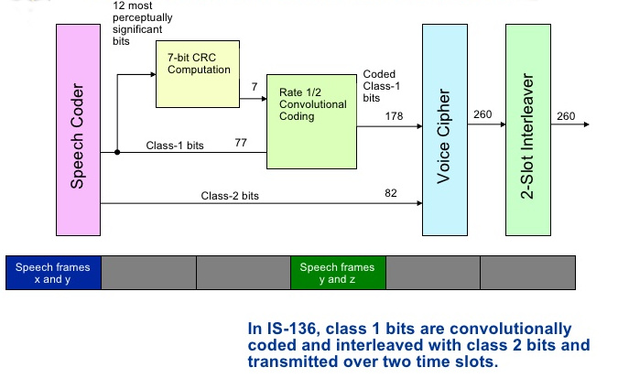
Network Components
IS-136 Definitions
  Vocoder
    A vocoder is a method used by IS-136 to “process” the voice of a cellular call
  Vector Sum Excited Linear Prediction (VSELP)
  Algebraic Code Excited Linear Prediction (ACELP)
  The vocoder depends on the system
Notes:
Sources: Wikipedia
http://image.slidesharecdn.com/dvc-12643988536959-phpapp02/95/dvc-24-728.jpg?cb=1264377336

Slide 30
Network Components
IS-136
  both digital voice and control channels – 20 KHz bandwidth
  Caller ID, E-mail, Text paging, SMS, Voicemail, Advanced fraud protection and IMSI (International Mobile Station ID)
  Band A & B can have up to 23 Control Channels
  Band A & B each have 382 Voice Channels
  Prominent System in North & South America
  Channels are split into 6 timeslots – 2 per traffic channel. VSELP & ACELP Vocoders
  Offers both cellular @800MHz & PCS @1900 MHz
Notes:
Sources: Wikipedia

Slide 31
Network Components
Global System for Mobile Communications (GSM) Standard (2G)
  The most common format world-wide (default global standard as of 2014)
  Most 2G GSM networks operating in the 900 MHz or 1800 MHz bands
    Where these bands were already allocated, the 850 MHz and 1900 MHz bands were used
    In rare cases the 400 and 450 MHz frequency bands are assigned in some countries because of previously used for first-generation systems.
  Most 3G networks in Europe operate in the 2100 MHz frequency band
  The frequency is divided into timeslots per phones
    8 full-rate or 16 half-rate speech channels frequency
      8radio timeslots are grouped into a TDMA frame
      Half-rate channels use alternate frames in the same timeslot
      The channel data rate for all 8 channels is 270.833 kbit/s
      Frame duration is 4.615 ms.
  The transmission power in the handset is limited to a maximum of 2 watts in GSM 850/900 and 1 watt in GSM 1800/1900
  Uses a variety of vocoders (EFR, UMTS, AMR-Narrowband)
  Subscriber Identity Module (SIM) card
    Detachable smart card containing the user's subscription information and phone book
    This allows the user to retain their information after switching handsets
  Security Issues?
Notes:
Sources: Wikipedia

Slide 32
Network Components
CDMA Standard (2G)
  IS-95
    Each channel is assigned a unique code and then encodes the data to be sent
    All channels can transmit simultaneously (all callers share both the same channel)
    Spread spectrum{10 x the width of conventional call}
    Bandwidth is 1.23 MHz with 63 channels per carrier
    20 Channels – calls divided by code rather than frequency or time
    Exists in both cellular and PCS bands
    4 – 5 times the capacity of GSM
    10 x the capacity of AMPS with 380 voice channels per cell
    “Soft” handoffs {two cells share the call during the handoff}
    Simplified system planning through the use of the same frequency in every sector of every cell
    Enhanced privacy
    Improved coverage characteristics, allowing for the possibility of fewer cell sites
    Bandwidth on demand
Notes:
Sources: Wikipedia

Slide 33
Network Components
Personal Communications Systems (PCS)
  1800 & 1900 MHz rather than 800 MHz
    Trial networks operational in US in 1993
    FCC began spectrum auctions in 1995
  Much smaller cells (maximum of 6 miles vs 30 miles for cellular)
  Lower powered, higher frequency with personalized features
  Pico cells covering interior of buildings
  Microcells cover select outdoor areas
  Macrocells provide extensive coverage to wider areas
Notes:
Sources: Wikipedia

Slide 34
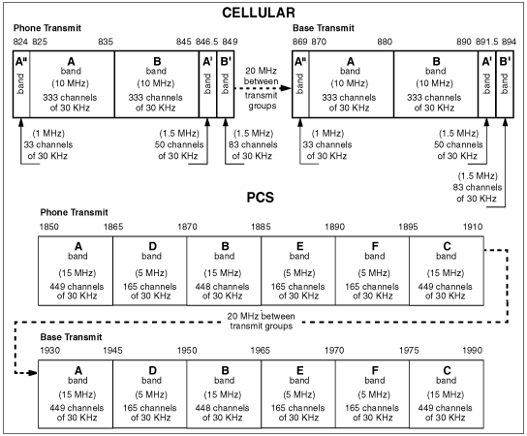
Network Components
Personal Communications Systems (PCS)
  As with AMPS, channel numbers imply one uplink & one downlink frequency {Channel 512 = 1850.2MHz up/ 1930.2MHz down}
  Forward is @ 1930.05 – 1989.990 MHz
  Reverse is @ 1850.01 – 1909.950 MHz
  Available in TDMA, CDMA & GSM formats
Notes:
Sources: Wikipedia
http://www.privateline.com/PCS/images/fig01.gif

Slide 35
Network Components
General packet radio service (GPRS) (2G, 2.5G, 3G)
  Packet oriented mobile data service for GSM
  Maintained by the 3rd Generation Partnership Project (3GPP)
  GPRS is a best-effort service
    variable throughput and latency that depend on the number of other users sharing the service concurrently
  In 2G systems, GPRS provides data rates of 56–114 kbit/second
    2G cellular technology combined with GPRS is sometimes described as 2.5G
    It provides moderate-speed data transfer, by using unused TDMA channels in, for example, the GSM system
    GPRS is integrated into GSM Release 97 and newer releases
  Supports
    SMS messaging, "Always on" internet access, Multimedia messaging service (MMS), Push to talk over cellular (PoC), Instant messaging and presence—wireless village, Internet applications for smart devices through wireless application protocol (WAP), Point-to-point (P2P) service: inter-networking with the Internet (IP), Point-to-Multipoint (P2M) service: point-to-multipoint multicast and point-to-multipoint group calls; interaction with WCDMA
  On Class A, B, C devices
Notes:
Sources: Wikipedia

Slide 36
Network Components
Enhanced Data rates for GSM Evolution (EDGE) (2.5G, 3G)
  aka Enhanced GPRS (EGPRS), IMT Single Carrier (IMT-SC), or Enhanced Data rates for Global Evolution
  Improved data transmission rates as a backward-compatible extension of GSM
  Considered a pre-3G radio technology and is part of ITU's 3G definition
  Standardized also by 3GPP as part of the GSM family
    Compact-EDGE was developed for use in a portion of Digital AMPS network spectrum
    Supported by all major chip vendors for both GSM and WCDMA/HSPA
  Delivers threefold increase in capacity and performance compared with an ordinary GSM/GPRS connection
  Can be used for any packet switched application (e.g. such as an Internet connection)
  Evolved EDGE provides reduced latency and more than doubled performance to complement High-Speed Packet Access (HSPA)
    Peak bit-rates of up to 1Mbit/s and typical bit-rates of 400kbit/s are expected
Notes:
Sources: Wikipedia

Slide 37
Network Components
CDMA-2000 (3G)
  Aka. C2K or IMT Multi‑Carrier (IMT‑MC)
  Standards for sending voice, data, and signaling data between mobile phones and cell sites
    Voice: CDMA2000 1xRTT, 1X Advanced
    Data: CDMA2000 1xEV-DO: Release 0, Revision A, Revision B, Ultra Mobile Broadband (UMB)
    1x and 1xRTT = “1 times Radio Transmission Technology”
    1xEV-DO = “Evolution-Data Optimized”
      For the wireless transmission of data through radio signals
      Uses multiplexing techniques including CDMA & TDMA to maximize throughput
  Developed by 3GPP2 as a backwards-compatible successor to second-generation cdmaOne (IS-95)
    Used especially in North America and South Korea.
    Compares to UMTS, a competing set of 3G standards, used in Europe, Japan, and China.
  All are approved radio interfaces for the ITU's IMT-2000
  In the United States, CDMA2000 is a registered trademark of the Telecommunications Industry Association (TIA-USA)
Notes:
Sources: Wikipedia

Slide 38
Network Components
Wideband Code Division Multiple Access (W-CDMA or WCDMA) (3G, 2G compatible)
  Part of Universal Mobile Telecommunications System (UMTS) family (Japan)
  An air interface standard that supports conventional cellular voice, text and MMS services
    Can also carry data at high speeds, allowing mobile operators to deliver higher bandwidth applications including streaming and broadband Internet access
  Basis of Japan's NTT DoCoMo's FOMA service
    Achieves higher speeds and supports more users compared to most previously used TDMA and time division duplex (TDD) schemes
  Uses the same core network as the 2G GSM networks deployed worldwide, allowing dual mode mobile operation along with GSM/EDGE; a feature it shares with other members of the UMTS family
Notes:
Sources: Wikipedia

Slide 39
Network Components
4G (fourth generation)
  Provides usual voice and services of 3G
  Bandwidth can better permit mobile broadband Internet access (hotspots, tethers) vs. 3G
  Pre 4G standards (commercially 4G)
    Mobile WiMAX standard
    Long Term Evolution (LTE) standard
    HSPA+
    HSPA 14
  4G Systems (commercially 4G+)
    Long Term Evolution Advanced (LTE ) standard
      This is the current dominant format for 4G
      Speed nearing 1Gbps
    WiMAX2
      Comparable to LTE Advanced
  3G and 4G equipment made for other continents are not always compatible, because of different frequency bands
Notes:
Sources: Wikipedia

Slide 40
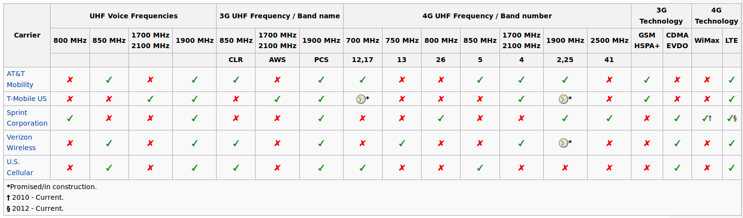
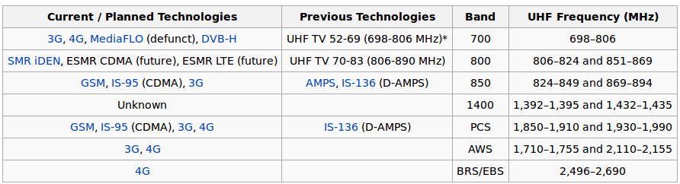
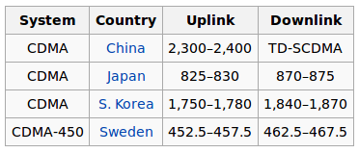
Network Components
Frequencies
  Depend on the network and geographic location
Notes:
Sources: Wikipedia

Slide 41
Components
Questions?

Slide 42
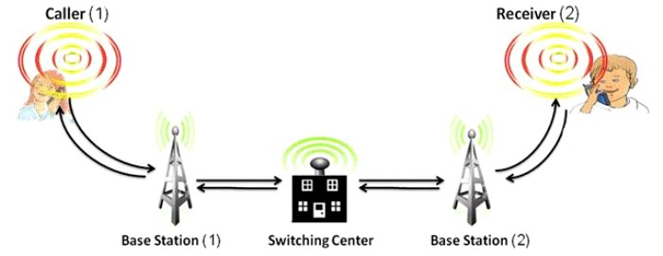
Network Function
Cell Phone Registration
  Self-diagnostics test when powering up
  Searches through FCCs (forward carrier channel)
    Picks one with the strongest signal
  Verifies by re-scanning and settling on that FCC
  “Idle” mode (not making a call)
    Re-scans every seven seconds
    Or when the signal strength drops to a predetermined threshold
  Identifies itself on the RCC (reverse carrier channel)
    Sends its MIN, ESN & home SID to the base station
  The cell site relays this information to the MTSO
    Which communicates with databases, switching centers, etc.
Notes:
Sources: Wikipedia
http://www.inspirationgreen.com/assets/images/Issues/Cell%20phones/cell%20phone%20base%20station.JPG

Slide 43
Network Function
Supervisory Audio Tone (SAT)
  A high-pitched, inaudible tone that helps the system distinguish between callers on the same channel but in different cells
  There are 3 different SATs
    SAT 0 is @5970 Hz
    SAT 1 is @6000 Hz
    SAT 2 is @6030 Hz
    Using different frequencies assures the mobile is using the right channel (think DTMF)
  The SAT is transmitted continuously during a call
    A mobile call drops within 5 seconds without a SAT or the wrong SAT
  The SAT can be muted when a phone is powered up/down or a site sends a “burst” of data
Notes:
Sources: Wikipedia

Slide 44
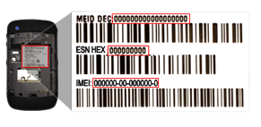
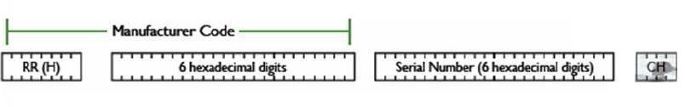
Network Function
Electronic Serial Number (ESN)
  “Replaced by” MEID (mobile equipment identifier) in 2010
  Every cell phone is assigned a unique number which is electronically burned into the phone’s ROM (read only memory) chip
  It is a long binary number
    ESN is 32 bits
    MEID is 56 bits or 14 hex digits
  The ESN or MEID gets transmitted whenever the phone is turned on
    Retransmitted during handoff to another cell or during periodic registrations
Mobile Identification Number (MIN)
  aka mobile subscription identification number (MSIN)
  Fancy talk for your phone number
MEID Format
Notes:
Sources: Wikipedia
http://mobileshoppingtips.com/wp-content/uploads/2014/04/find-esn-imei-meid-back-of-phone.png
http://ruimtools.com/img/euimid/sf_uimid.jpg

Slide 45
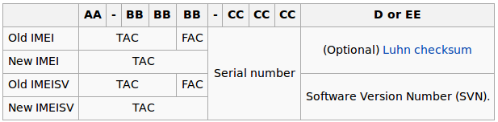
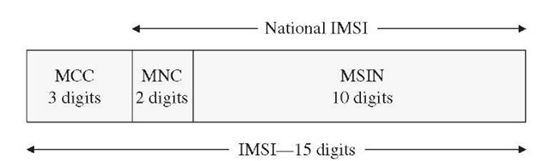
Network Function
International Mobile Station Equipment Identity (IMEI)
  Number to identify 3GPP (i.e., GSM, UMTS and LTE) and iDEN mobile phones, as well as some satellite phones
  it is usually found printed inside the battery compartment of the phone, but can also be displayed on-screen on most phones by entering *#06#
  Also in the settings menu on smartphone operating systems.
  Type Allocation Code (TAC)
  Final Assembly Code (FAC) (ceased after 2004)
International Mobile Subscriber Identity (IMSI)
  identify the user of a cellular network and is a unique identification associated with all cellular networks
  stored as a 64 bit field
  To prevent eavesdroppers identifying and tracking the subscriber on the radio interface, the IMSI is sent as rarely as possible and a randomly generated TMSI is sent instead.
Temporary Mobile Subscriber Identity (TMSI)
  identity that is most commonly sent between the mobile and the network
  randomly assigned to every mobile in the area the moment it is switched on
  number is local to a location area and is updated each time the mobile moves to a new geographical area
Notes:
Sources: Wikipedia
http://what-when-how.com/wp-content/uploads/2012/03/tmp2352_thumb.jpg
http://en.wikipedia.org/wiki/International_Mobile_Equipment_Identity

Slide 46
Network Function
Cellular Classes and Ranges
  Station Class Mark
    Defines the effective radiated power level of the phone
      Class I 4 watts
      Class II 1.6 watts
      Class III 0.6 watts
  All mobile phones use adaptive power control to optimize communication links
  Analog Phones Display 8 levels of power & Digital Phones Display 14 levels of power
    Class I -28 dB of range
    Class II -24 dB of range
    Class III -20 dB of range
Notes:
Sources: Wikipedia

Slide 47
Network Function
Forward Control Channel Messages
  Often Used on Forward Voice Channel (FVC)
Mobile Station Control Message
  also used on FVC
  Page
  Alert
  Release
  Recorder
  Stop Alert
  Audit
  Send Called Address
  Power Level Adjustment
  Directed Retry
  Registration & Local Control
Notes:
Sources: Wikipedia
http://www.privateline.com/Cellbasics/image36.gif

Slide 48
Network Function
Accessing the Network
  Phone is powered on
  Phone scans for strongest available control channels in preferred network
  Phone reads overhead message from cell site(s) to learn how to access/operate in network
  Phone remains locked onto strongest preferred channel
  Phone will rescan every 2-5 minutes to update signal strengths
Notes:
Sources: Wikipedia

Slide 49
Network Function
Cellular Phone Powers Up
  Initialization
    Retrieve System Parameters
    Scan Dedicated Control Channels
    Update Overhead Information
  Paging Channel Selection
    Scan Paging Channels
    Verify Overhead Information
  Idle
    Response to Overhead Information regarding SID
    Update Overhead Information
    Registration
    Response to Authentication
    Page Match
    Order & Power
    Call Initiation/Origination
Notes:
Sources: Wikipedia

Slide 50
Network Function
Phone call phases
  Call setup
    Communication consisting of data only
    Occurs on the control channel
    Required for intercept of call
    Control Channel (data only)
  Voice communication
    Communication consists of voice and data
    Occurs on the voice channel (data and voice)
  Call termination
    Preceded by release order
Notes:
Sources: Wikipedia

Slide 51
Network Function
The Phone call (uplink)
  Cellular phone is locked into a control channel
  User dials number and initiates that call
  Reverse message is sent, using busy/idle bit of FCC as the key
  The MIN, ESN/MEID and dialed number are transmitted
  MTSO verifies account is active and transmits a VCA (voice channel activation) and SAT (supervisory audio tone)
  Cell phone hears VCA and changes frequencies
  Cell phone transponds proper SAT back to cell site indicating the mobile is on frequency
  Cell site allows completion of connection which causes the dialed phone to ring
Notes:
Sources: Wikipedia

Slide 52
Network Function
The Phone call (downlink)
  Land party (via cell phone, land line, etc.) dials mobile number
  PSTN forwards to MTSO for verification & forwarding
  All mobiles receive the “page” call
    Verifies the party's phone(s) are there to communicate
    “Hello”
  Only the desired mobile responds on the RCC (reverse control channel)
    “Hello back”
  Cell site makes note of the RCC that response came from and orders cell site to make a VCA
  Cell site assigns VCA and transmits SAT
  Mobile phone hears VCA, changes frequencies and the SAT is looped back, telling the base station that the mobile has arrived
  Cell site allows completion of call after hearing proper SAT
  Mobile phone rings
Notes:
Sources: Wikipedia

Slide 53
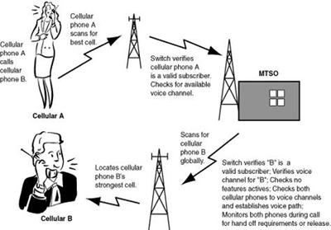
Network Function
Call Termination
  Prefaced by a release order
  Noted by two conditions
    Loss of RSSI (received signal strength indication) on the voice channel
    Absence of SAT
Notes:
Sources: Wikipedia
http://www.electroschematics.com/wp-content/uploads/2010/03/Mobile-Communication.png

Slide 54
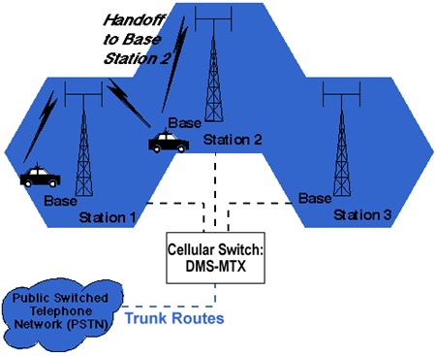
Network Function
Handoff
  When a cell phone approaches the boundary of one cell
    the cellular network senses that the signal is becoming weak
    automatically hands off the call to the antenna in the next cell into which the caller is traveling
  Depending in population concentration; cell count can increase or decrease
  Intra-cell handoff
  Inter-cell handoff
    Soft
    Hard
Notes:
Sources: Wikipedia
http://www.gsmfavorites.com/documents/introduction/gsm/Handoff.gif

Slide 55
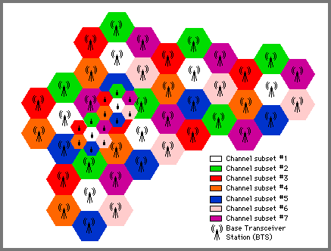
Network Function
Clusters
  Cellular systems allocate all available frequencies among a group of cells
    The group of cells is called a cluster
    No two cells in a cluster use the same frequency.
  Clusters are arranged so that no two adjacent cells use the same frequency
Notes:
Sources: Wikipedia
http://people.seas.harvard.edu/~jones/cscie129/nu_lectures/lecture7/cellular/cell_struc.gif

Slide 56
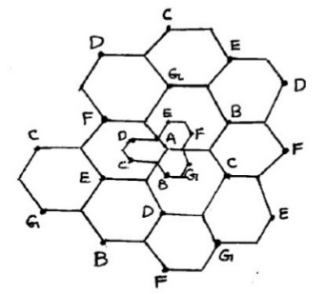
Network Function
Sectoring
  Splitting a cell into sectors by replacing an omnidirectional base station antenna with several directional antennas on the same tower
  This divides a single cell coverage into 3, 6, or more distinct areas
    120 degrees for 3 & 60 degrees for 6 around the site
    Each with their own frequencies
Notes:
Sources: Wikipedia
http://image.slidesharecdn.com/powerpointpresentationshweta-131125205813-phpapp02/95/cell-splitting-and-sectoring-8-638.jpg?cb=1385413124

Slide 57
Network Function
Roaming
  When traveling beyond a networks primary coverage area, they can still make calls
  The cellular carrier in the area where they are traveling provides the service
  “roaming” mode is more expensive to operate
  The per minute charges are more and certain surcharges may apply. The cellular provider can do this because no “contract” exists with the user.
Notes:
Sources: Wikipedia

Slide 58
Network Function
Caller ID
  Caller ID information is sent to the called party by the telephone switch as an analog data stream between the first and second rings
  If the telephone call is answered too quickly after the first ring, caller ID information will not be transmitted to the recipient
  two types of caller ID
    number only
      Single Data Message Format (SDMF)
      caller's telephone number, the date and time of the call
    name+number
      Multiple Data Message Format (MDMF)
      SDMF plus the directory listed name for the particular number
  SDMF caller ID reader will not recognize MDMF
  Several ways to spoof
Notes:
Sources: Wikipedia

Slide 59
Function
Questions?

Slide 60
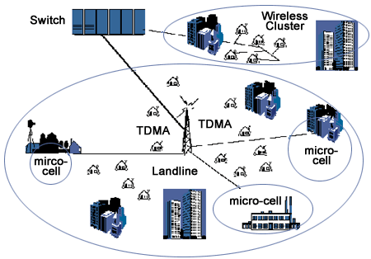
Systems Overview
Notes:
Sources: Wikipedia
http://www.gsmfavorites.com/documents/introduction/gsm/FWA.gif

Slide 61
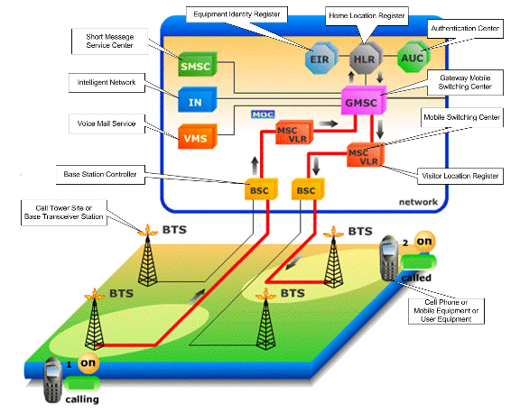
Systems Overview
Notes:
Sources: Wikipedia
http://johnbminor.com/index_files/image3931.gif

Slide 62
Projects
Openmoko
  a project to create a family of open source mobile phones
OpenBTS (Open Base Transceiver Station)
  A software-based GSM access point, allowing standard GSM-compatible mobile phones to be used as SIP endpoints in Voice over IP (VOIP) networks
OsmocomBB (Open Source Mobile Communications – Baseband)
  A free firmware for the devices known as "Baseband Processor" Chipsets found in GSM mobile phones
PiPhone
  Tutorial and material on Adafruit
Software Defined Radio applications
  Numerous projects via GNU Radio and other OS Projects

Slide 63
Resources
Phone Arena
  http://www.phonearena.com/
GSM Arena
  http://www.gsmarena.com/
3GPP
  http://www.3gpp.org/
IEEE
  http://ieeexplore.ieee.org/Xplore/home.jsp
Walter Shaw
  http://whoiswaltershaw.com/about.html
Others
  Go forth and search!

Slide 64
That's all folks!
Cyber Geography Research Institute International www.cgrii.org
Thanks!

