Slide 1

A Primer for Critical Thinking
Prepared by Joe Blankenship www.thejoeblankenship.com
Notes:
If you don't know who Richard Feynman is, get to reading...
http://en.wikipedia.org/wiki/Richard_Feynman

Slide 2
Agenda
https://github.com/joeblankenship1
Basic Concepts
Considerations
Structured Thinking
Analytic Tools
Notes:
Please contact me with any suggestions!!!

Slide 3
Why Critical Thinking
Questioning
Analyzing
Conceptualizing
Defining
Examining
Inferring
Listening
Reasoning
Synthesizing
Evaluating Information
In a
Structured way
Handle uncertainty
Alleviate Ignorance
Intellectual
Independence
Clear Expression
of Ideas
Individual Growth
Social Enrichment
Evaluating our
Thoughts
Refining our
Thought processes
Curiosity
Perspective
Knowledge
Skepticism
Responsibility
Create/Assess Information more Thoroughly
Better able to Identify/Reject Fallacies

Slide 4
Why Critical Thinking?
Critical thinking belongs to the world
  Gives you praxis in everything
  Taking time to “think critically” saves you time
Curiosity and skepticism are good
Make it a game
  You brain wants an adventure
Falsification and Fallacy
  Being proven wrong is an opportunity
  Being able to see how others are wrong
    Helps you better see the
      “who, what, when, where, why, and how”

Slide 5
Basics
Solid reasoning behind your conclusion
Premises (statements) form your argument
Good argument supports the conclusion
Deductive
Ampliative
Bad
Guaranteed
Not Guaranteed,
but Possible
Try again...
Deductive arguments can still be False!
Notes:
Source: Dr. Geoff Pynn, Assistant Professor, Northern llinois University

Slide 6
Basics
Is it Valid?
  Premises can't be true if Conclusion is False
  Invalid if conclusion is false with all premise as True
Is it Sound?
  A Valid argument has Premises that are True
  Anything else is unsound
Falsification?
  If there is something wrong; try again and make it better!
Research?
  Logic is not enough, you need Knowledge!
This is deductive reasoning
Notes:
Source: Dr. Geoff Pynn, Assistant Professor, Northern llinois University; Julianne Chung, Yale University; Aaron Ancell, Duke University

Slide 7
Basics
Premises...
  Don't guarantee a correct Conclusion (ampliative!)
Conclusions..
  Inferences to best explanation
Is the explanation “good”?
  Fit? Is it Simple?
Is there a better explanation?
  Is there more evidence for reevaluation?
This is “every day” abductive reasoning
Notes:
Source: Dr. Geoff Pynn, Assistant Professor, Northern llinois University

Slide 8
Basics
Necessary Conditions
  If “A” is necessary for “B”, “A” has to be be True for “B” to be True
Sufficient Conditions
  If “A” is sufficient for “B”, “A” being True is good enough for “B” to be True
Our assessments of these conditions...
  Generally rely on your assumptions surrounding the condition (or “take things for granted”)
Can use these concepts
  To break down the elements of the condition to create definition
Notes:
Sources:
Kelly Schiffman, Yale University

Slide 9
Basics
Implicit Premises
  Required to make the argument, but not stated
  Usually not controversial and obvious to audience
Ergo...
  Need to examine justification!
  Need to provide explanation!
This is Complicated!
  Embedded in culture, regional, other geographies
Notes:
Sources:
Kelly Schiffman, Yale University

Slide 10
Basics
Descriptive Claims
  Expressing an understanding or describing
  Without a following evaluation
Normative Claims
  Statement of an evaluation
  Without presentation of the rational (usually implicit)
Being aware of this distinction
  Allows one to better scrutinize the problem
  within a contextual space and time
Notes:
Sources:
Kelly Schiffman, Yale University

Slide 11
Basics
Must be aware of Fallacy!
  …the use of poor reasoning in order to build an argument
  Does not necessarily mean the conclusion is false!
Many types
  Formal or informal (poor form or content in systemic logic)
  Presumptive (conclusion is the proof)
  Ambiguity (vague support)
  And on and on...
Notes:
Sources:
https://en.wikipedia.org/wiki/Fallacy

Slide 12
Basics
Questions?

Slide 13
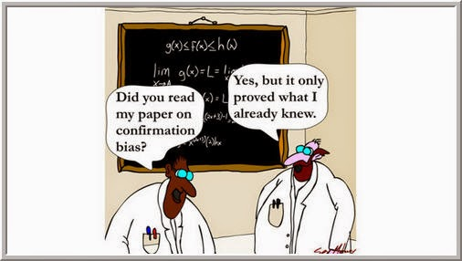
Considerations
Cognitive Bias!
  Illogical inferences and deviations in judgment
  Subjective and created within social spaces
  Can be useful in matters of timeliness (heuristics)
  Symptom of human processing limitation
  Cognitive dissonance
  Emotions
Look to knowledge and evidence
  To see what is there
  To see what is not there (gaps)
  Helps you to see your flaws
  Helps you challenge theirs
Notes:
Sources:
https://en.wikipedia.org/wiki/Cognitive_bias

Slide 14
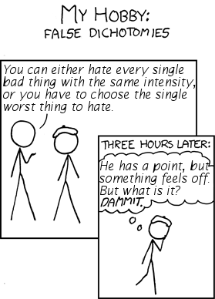
Considerations
Reasoning
  Consciously make sense of things
  Apply logic, Verify facts
  Change or Sustain in light of new information
Assumptions
  Taking something(s) for granted
  Can be dangerous
Avoid False Dichotomy
  An informal fallacy in which
  limited alternatives are used to
  force a choice
Notes:
Sources:
wikipedia

Slide 15
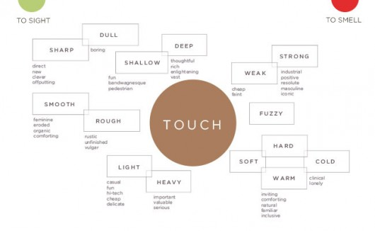
Considerations
Embodied Metaphor
  Your mental processes are unique to you
  You experience (sense) the world differently
  Ergo the manner in which you think is slightly or greatly different than those around you
    Matter of biology
    Matter of scale
    Matter of space
    Matter of time
Notes:
Philosophy in the Flesh by Lakoff and Johnson
http://www.archdaily.com/431201/intuition-your-best-design-tool/

Slide 16
Considerations
Most Importantly...
Ask Questions!
Any Questions?

Slide 17
Structured Thinking
Quality of Life == Quality of Thought
Deciding to think critically is the beginning
  In order to make that process better
  We have to find ways to analyze our thoughts
  While eliminating/observing biases
In order to analyze thought
  We have to look at what composes thought
  Understand the processes behind our reasoning
  Establish ways by which to test and reassess thought
  Find and Include newer data with each iteration
  Question everything
Notes:
Sources:
Analytic Thinking by The Foundation for Critical Thinking

Slide 18
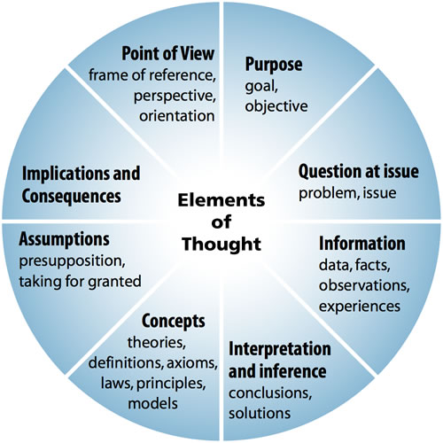
Structured Thinking
Notes:
Sources:
Analytic Thinking by The Foundation for Critical Thinking

Slide 19
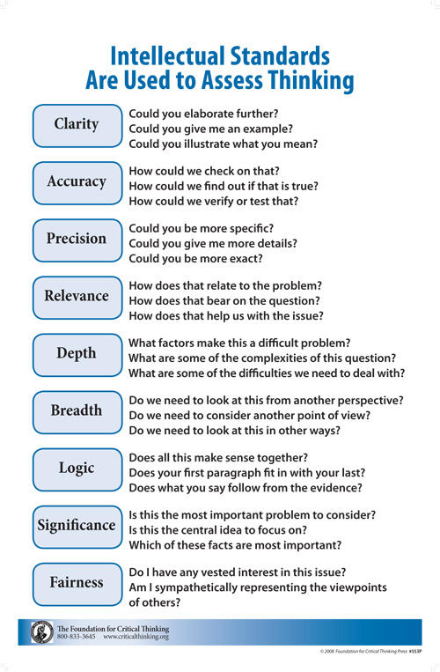
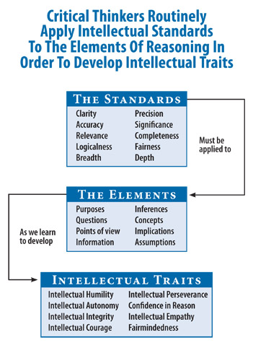
Structured Thinking
What others can you think of?
How do they vary depending on “where”, “when”, “how”, and “who” you are?
Questions!
Notes:
Sources:
Analytic Thinking by The Foundation for Critical Thinking

Slide 20
Structured Thinking
We do this to
  Overcome subconscious processes
    Biases, perception, memory, processing
  Prepare for paradigm shifts
    The most knowledgeable of us have the most to unlearn
  Keep you fresh
    Over time, we become entrenched in daily activity
    Need to keep fighting against that
  Memory changes over time
    Long term
    Short term

Slide 21
Structured Thinking
We do this to
  Ensure delivery of best Information
    To seniors
    To peers
  Fill the gaps
    When lacking adequate information
    Backed by strong logic and empirical data
  Structure the problem
    Break it down into smaller part
    Put it into a form that is easily and holistically understood

Slide 22
Structured Thinking
Questions?

Slide 23
Analytic Tools
Caution!
  Don't start with your conclusion; end with it
  Look at alternate solutions
  Let the analysis favor the solution; not you
  Thinking is not analysis
  Focus on the process of analysis
    Not the substance
  When in doubt, ask and ask again
  Work hard to prove yourself wrong
    Allow others to do the same
    Your argument will become stronger
Notes:
Sources:
The Thinker's Toolkit by Jones

Slide 24
Analytic Tools
Problem Restatement
Pros/Cons/Fixes
Divergent/Convergent
Sorting & Time Lines
Causal Flow Diagram
Matrix
Decision Tree
Weighted Ranking
Hypothesis Testing
Devil's Advocate
Probability Tree
Utility Tree
Utility Matrix
Advanced Utility Analysis
Notes:
Sources:
The Thinker's Toolkit by Jones

Slide 25
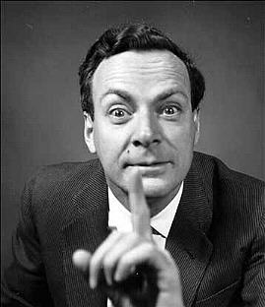
Analytic Tools
Problem Restatement
  Paraphrase
    Use different word; maintain original meaning
  180 degree turn around
    Turn the problem around
  Broaden the focus
    Restate in a large context
  Redirect the focus
    Change to a tangent
  Ask why and why again
    Repeat until the core issue emerges
Notes:
Sources:
The Thinker's Toolkit by Jones
http://www.3quarksdaily.com/.a/6a00d8341c562c53ef0147e2bd982b970b-800wi

Slide 26

Analytic Tools
Pros/Cons/Fixes
  List the Pros
  List the Cons
  Consolidate the Cons
    Merge similar
    Delete redundant
  Neutralize the Cons
    Or convert Cons to Pros (semi fix)
    Divergent lists may occur
  Compare Pros and Cons for all options
  Pick one option
Notes:
Sources:
The Thinker's Toolkit by Jones
http://img.gazeo.pl/gazeo_2012_EN/Technology/Technology_and_maintenance/The_pros_and_cons_of_autogas_systems/A_list_of_pros_and_cons_waiting_to_be_completed.jpg

Slide 27
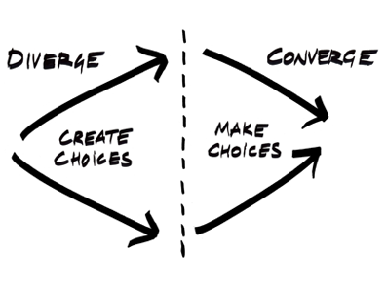
Analytic Tools
Divergent/Convergent Thinking
  Brainstorm
    Divergent
  Winnow (cut) and cluster (group) ideas
    Convergent
  Select Practical/Promising Ideas
    Convergent
Notes:
Sources:
The Thinker's Toolkit by Jones
https://uxthink.files.wordpress.com/2010/01/picture-26.png

Slide 28
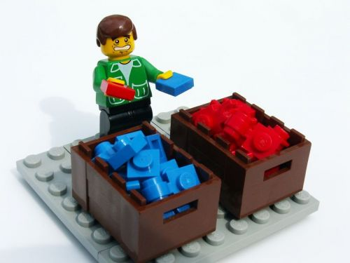
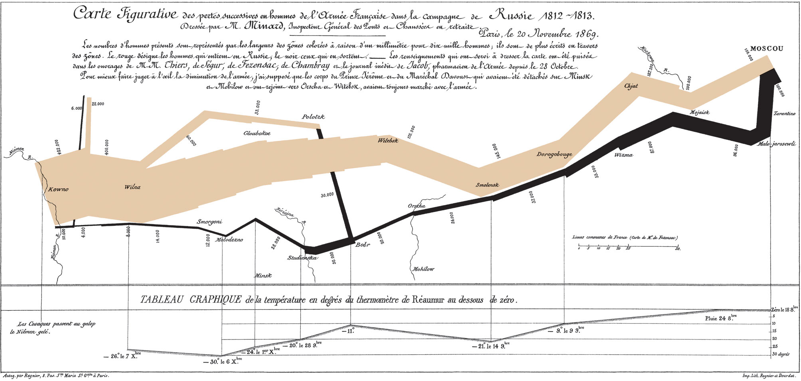
Analytic Tools
Sorting
  Sorting a problem into its parts
  Analysis can benefit from basic sorting
Chronology and Time Lines
  Shows timing and sequence
  Draws attention to key events
  Easier to identify patterns and correlations
Notes:
Sources:
The Thinker's Toolkit by Jones
http://www.craiglotter.co.za/wp-content/uploads/2010/04/data-sorting-lego.jpg
http://upload.wikimedia.org/wikipedia/commons/2/29/Minard.png

Slide 29
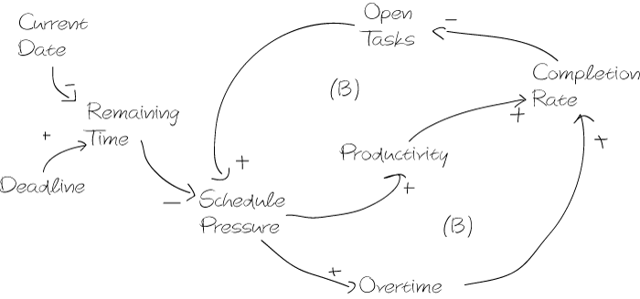
Analytic Tools
Causal Flow Diagram
  Identify major factors (drivers)
  Identify cause & effect relationships
  Characterize relationships as direct or inverse
  Diagram the relationships
  Analyze behavior of relationships as integrated system
Watch for:
  Feedback loops
    Unstable
      All direct
      Even # inverse
    Stable
      Odd # inverse
Notes:
Sources:
The Thinker's Toolkit by Jones
http://www.business-prototyping.com/wp-content/uploads/2012/11/cld_elaborate_schedule_pressure1.gif

Slide 30

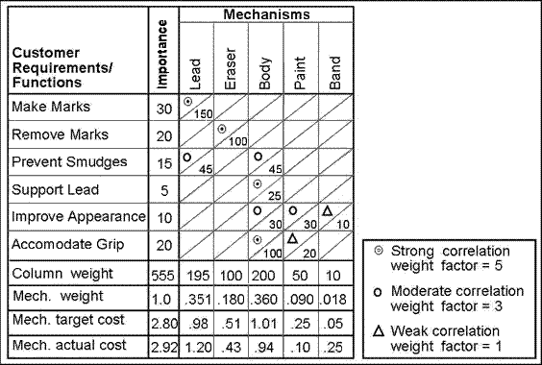
Analytic Tools
The Matrix
  Simply, a grid with as many cells as needed to address the problem
    Separate the problem's elements
    Categorize information
    Compare types of information
    Compare pieces of information within types
    Spot correlations, patterns, and potentially trends
NO
YES
Notes:
Sources:
The Thinker's Toolkit by Jones
http://theawesomedaily.theawesomedaily.netdna-cdn.com/wp-content/uploads/2015/03/1413474840_Matrix-Wallpapers.jpg
http://www.npd-solutions.com/image25.gif

Slide 31
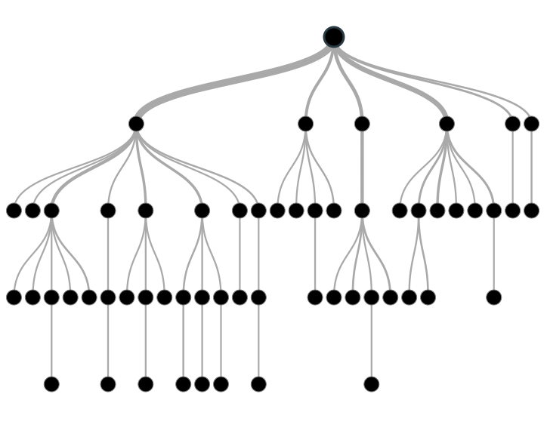
Analytic Tools
Decision or Event Tree
  Show choices and outcomes at different points in alternate chain of events
    Identify the problem
    Identify major decisions and events
    Identify alternatives for each decision and event
    Construct a tree for all scenarios
      Branches are mutually exclusive
      Branches are collectively exhaustive
Should you use a Matrix or a Tree?
Notes:
Sources:
The Thinker's Toolkit by Jones
https://littleml.files.wordpress.com/2012/01/screen-shot-2012-01-23-at-10-00-17-am1.png

Slide 32
Analytic Tools
Weighted Ranking
  List all major criteria for ranking
  Pair-rank them (pair-wise comparison)
    Which is more important? 1 or 2, 1 or 3, etc.
    Results in a list of most important to least
  Take top “several” and weight them in percentiles
    Total must equal 1.0 (or 100%)
  Construct a weighted rank matrix
    Contains
      Items to be ranked
      Selected criteria
      Criteria weights
Criterion | Pair-rank Votes | Final Rank
Color | 3 | 3
Wheels | 2 | 4
Engine | 5 | 1
Make | 1 | 5
Model | 4 | 2
Notes:
Sources:
The Thinker's Toolkit by Jones

Slide 33
Analytic Tools
Weighted Ranking (cont.)
  Pair-rank all items by each criterion
    “Is this (item) more important than this (item) based on this (criteria)? Yes/No
  Multiply number of votes by criterion weight
  Add the weighted values for Total Votes
  Determine Final Ranking
  Sanity Check
 | Criteria
Items | Engine 0.5 | Model 0.3 | Color 0.2 | Total Votes | Final Rank
2014 GTO | 1 | 1 | 3 | 1.4 | 3
1969 GTO | 3 | 2 | 2 | 2.5 | 1
1964 GTO | 2 | 3 | 1 | 2.1 | 2
Notes:
Sources:
The Thinker's Toolkit by Jones

Slide 34
Analytic Tools
Hypothesis Testing
  Generate hypotheses and narrow them down
  Construct a matrix
    Column for Evidence
    Column for each hypothesis
  List significant (and absent) evidence
    Alexander's question (What evidence NOT included would refute any hypothesis?)
  Test evidence for consistency with each hypothesis
    C (consistent), I (inconsistent), ? (ambiguous)
    Optional degree
      - (“in part”), + (“in many respects”), * (“absolutely”)
Notes:
Sources:
The Thinker's Toolkit by Jones

Slide 35
Analytic Tools
Hypothesis Testing
  Refine Matrix
    Reword hypotheses
    Add significant evidence
    Delete (but record) evidence consistent with all hypotheses
  Evaluate each hypothesis
    Evaluate underlying assumptions and validity
    Remove hypotheses with significant inconsistent evidence
  Rank hypotheses by weakness of inconsistent evidence
    Hypothesis with weakest inconsistent evidence is most likely
  Sanity Check
Notes:
Sources:
The Thinker's Toolkit by Jones

Slide 36
Analytic Tools
Question: How did the bread at the bakery become over-baked?
 | Hypotheses
Evidence | Sabotage by Employees | Fluctuation in Gas Pressure | New flour is defective
Only two oven overcooked bread | C | I | C
Three batches over-baked | C | C | C
Maintenance found nothing wrong with ovens | C | C | C
Only batches with new flour were over-baked | I | I | C
 | Hypotheses
Evidence | Sabotage by Employees | Fluctuation in Gas Pressure | New flour is defective
Only two oven overcooked bread | C | I | C
Only batches with new flour were over-baked | I | I | C
Does this conclusion make sense?
Notes:
Sources:
The Thinker's Toolkit by Jones

Slide 37
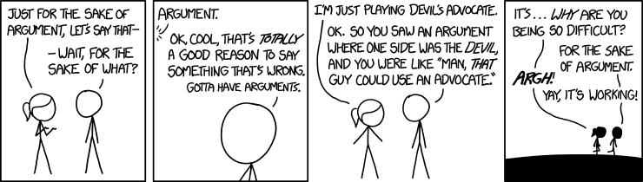
Analytic Tools
Devil's Advocate
  Closely related to Hypothesis Testing
  Challenges validity and encourages focus
    Via defense of opposing viewpoint
    Seeking new evidence to support opposing viewpoint
    In attempt to encourage objectivity
  This helps bolster primary viewpoint
Notes:
Sources:
The Thinker's Toolkit by Jones
http://freethoughtblogs.com/pharyngula/files/2014/10/the_sake_of_argument.png

Slide 38
Analytic Tools
Probability Tree
  Like a decision tree, but with probability!
  3 rules
    Events must be mutually exclusive
    Events must be collectively exhaustive
    Probabilities of branches at each node must equal 1.0
  Follow the steps for a decision tree, then...
    Assign probability to each event/decision
    Calculate conditional probability of each scenario
      Multiply probabilities of all nodes in a scenario
    Calculate the answer to probability questions related to tree
Notes:
Sources:
The Thinker's Toolkit by Jones

Slide 39
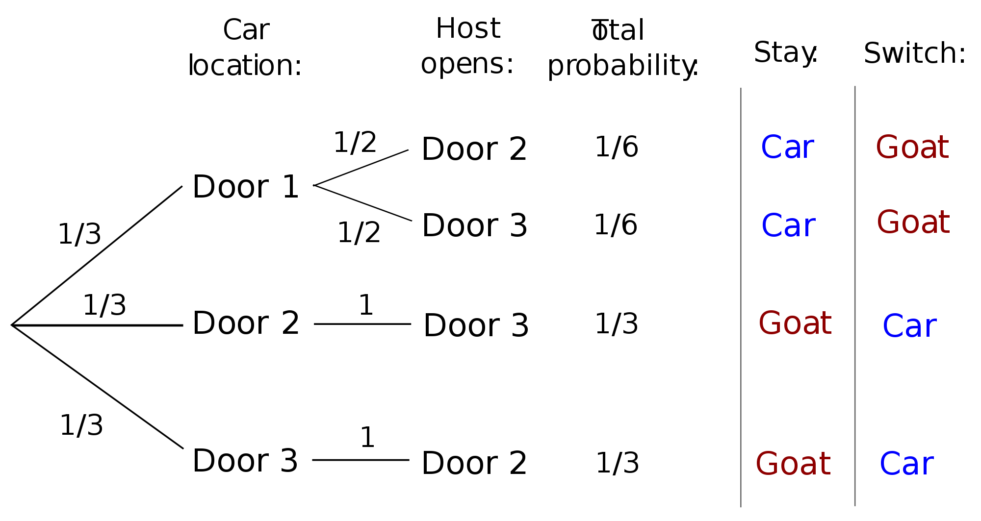
Analytic Tools
Monty Hall Problem: Which door to choose?
Notes:
Sources:
The Thinker's Toolkit by Jones
http://en.wikipedia.org/wiki/Monty_Hall_problem

Slide 40
Analytic Tools
Utility Analysis
  Rank n options according to how they serve the self-interests of the decision maker
  Utility analysis has 3 basic elements
    Options (alternative courses of action)
      Must be mutually exclusive
    Outcomes (result of selecting an option)
      Must be collectively exhaustive
    Perspectives (point of view with respect to an outcome)
      Role-play or “red team” perspectives

Slide 41
Analytic Tools
Utility Tree
  Identify options and all possible outcomes
    Options are mutual exclusive, not collectively exhaustive
    Outcomes must be both
  Identify the perspective of the analysis
  Construct a set of decision trees
    For the options and outcomes
  Assign a utility value to each scenario in each tree
    Utility Question: “If this scenario occurs, what is the utility from the perspective of...?”
    Utility determines what we want
    Probability determines what we get

Slide 42
Analytic Tools
Utility Tree
  Probability Question
    “If this option is selected, what is the probability of the outcome?”
  Expected Value (EV)
    Product of Utility and Probability
    Utility is conditioned by its probability of occurring
  Total Expected Value (Total EV)
    Add all expected values for an option
  Rank the expected values from first to last
  Sanity Check!

Slide 43
Analytic Tools
Utility Matrix
  Two advantages over Utility Tree
    Relative differences in utility outcome values are easier to perceive
    Math is easier to perform
  Focus is on alternative outcomes
    Utility tree portrays whole scenarios in which outcomes are a single part
  Essentially same process as Utility tree
    Utility value is 0 to 100 unless money is value
    Has to be at least 1 “100” unless using money

Slide 44
Analytic Tools
Scenario: You are planning to invest $5000 and want to know which investment is safest.
Perspective: My $ Profit |  | Outcome: National and Political Outcome |  |  |  | Total EV | Rank
 |  |  | War | Prosperity | Depression
Options | Speculative Stock | Utility | 100 | 20 | 0 | 17.2 | 3
 |  | Probability | 0.1 | 0.36 | 0.54
 |  | EV | 10 | 7.2 | 0
 | Blue-chip Stock | Utility | 80 | 70 | 10 | 38.6 | 2
 |  | Probability | 0.1 | 0.36 | 0.54
 |  | EV | 8 | 25.2 | 5.4
 | Govt. Bonds | Utility | 40 | 40 | 40 | 40.0 | 1
 |  | Probability | 0.1 | 0.36 | 0.54
 |  | EV | 4 | 14.4 | 21.6
* This is purely hypothetical and for demonstration of the concept's functionality only.

Slide 45
Analytic Tools
Advanced Utility Analysis
  Multiple options, outcomes, AND perspectives
  Create a utility matrix for multiple perspective
    ~ 13 step process
    Matrices have identical structure
      Same options
      Same outcomes
      Same outcome probabilities
      Utility value will vary based on perspective
  Also accounts for multiple classes of outcomes
    ~14 step process
    More likely to be examined with advanced utility analysis

Slide 46
Analytic Tools
Advanced Utility Analysis (multiple perspectives)
  Identify options and outcomes
  Identify and weight the perspectives
  Create identical utility matrices for each perspective
For each utility matrix
  Assign utility values (values 0 – 100; has to be at least one 100)
  Assign probabilities
  Calculate EV
  Calculate Total EV
Then...

Slide 47
Analytic Tools
Advanced Utility Analysis (multiple perspectives)
  Construct a single “merged” matrix with the same options vs. perspectives
  Take the Total EV from the utility matrices and place them in the corresponding new options vs. perspective matrix
  Multiply Total EV by the perspective weight
  Add the products for the “Total Weighted EV”
  Rank your options
  Sanity Check!

Slide 48
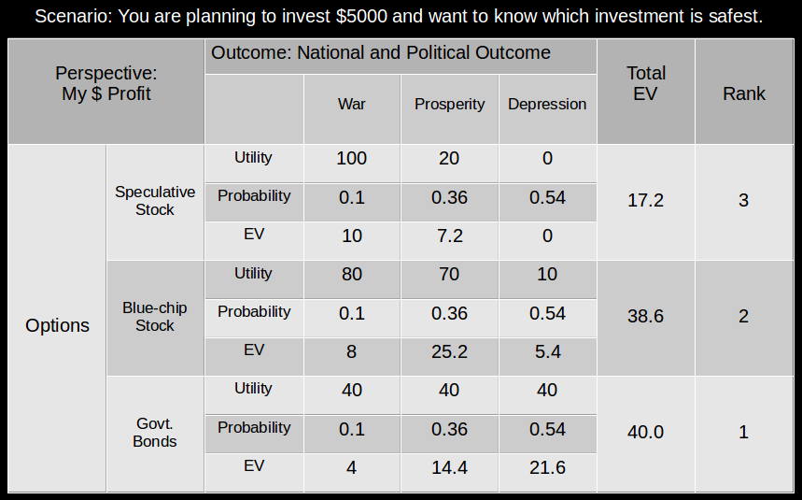
Analytic Tools
Scenario: You are planning to invest $5000 and want to know who thinks which investment is best.
Utility Matrices
Perspective: Merged | Perspectives |  |  |  | Total Weighted EV | Rank
 |  | You 0.3 | Financial Advisor 0.4 | Friend 0.3
Speculative Stock | UM Total EV | 17.2 | 40.0 | 25.0 | 28.66 | 2
 | Weight | 0.3 | 0.4 | 0.3
 | New Total EV | 5.16 | 16 | 7.5
Blue-chip Stock | UM Total EV | 38.6 | 35 | 40.0 | 37.58 | 1
 | Weight | 0.3 | 0.4 | 0.3
 | New Total EV | 11.58 | 14 | 12
Govt. Bonds | UM Total EV | 40 | 15.0 | 35.0 | 28.5 | 3
 | Weight | 0.3 | 0.4 | 0.3
 | New Total EV | 12 | 6 | 10.5
Does this conclusion make sense?
* This is purely hypothetical and for demonstration of the concept's functionality only.

Slide 49
Analytic Tools
Advanced Utility Analysis (multiple classes of outcomes)
  Identify options
  Identify outcome classes
    Identify each classes' range
    Weight each class by importance
  Identify perspective of analysis
  Create utility matrices for each outcome class
    Identical options and perspective
For each utility matrix
  Assign utility values (values 0 – 100; has to be at least one 100)
  Assign probabilities
  Calculate EV
  Calculate Total EV
Then...

Slide 50
Analytic Tools
Advanced Utility Analysis (multiple classes of outcomes)
  Construct a single “merged” matrix with the same options vs. outcome classes
  Take the Total EV from the utility matrices and place them in the corresponding new options vs. outcome classes
  Multiply Total EV by the perspective weight
  Add the products for the “Total Weighted EV”
  Rank your options
  Sanity Check!

Slide 51
Analytic Tools
Scenario: You are planning to invest $5000 and want to know which outcome is most likely.
Utility Matrices
Perspective: You | Classes of Outcomes |  |  |  | TW EV | Rank
 |  | Political Instability 0.3 | Better Opportunity 0.4 | Market Depression 0.3
Invest Now | UM Total EV | 17.2 | 40.0 | 25.0 | 28.66 | 2
 | Weight | 0.3 | 0.4 | 0.3
 | New Total EV | 5.16 | 16 | 7.5
Wait until Next FQ | UM Total EV | 38.6 | 35 | 40.0 | 37.58 | 1
 | Weight | 0.3 | 0.4 | 0.3
 | New Total EV | 11.58 | 14 | 12
Wait until Next FY | UM Total EV | 40 | 15.0 | 35.0 | 28.5 | 3
 | Weight | 0.3 | 0.4 | 0.3
 | New Total EV | 12 | 6 | 10.5
Does this conclusion make sense?
* This is purely hypothetical and for demonstration of the concept's functionality only.

Slide 52
Resources
The Foundation for Critical Thinking
  http://www.criticalthinking.org/
The Thinker's Toolkit by Morgan D. Jones
Structured Analytic Techniques by Heuer & Pherson
Kahn Academy has a good basic course
  https://www.khanacademy.org/partner-content/wi-phi/critical-thinking/v/intro-to-critical-thinking
Your peers (Practice the concepts; find new ones)
Academia (we have numerous schools in the area)
Anyone with an open mind
  After building confidence, even some without

Slide 53
That's all folks!
Also visit (and if you feel like, donate to)
Cyber Geography Research Institute International www.cgrii.org
Thanks!

