Slide 1

Geography for Hackers
Prepared by Joe Blankenship www.thejoeblankenship.com www.cgrii.org
P
2
Notes:
Sources:
http://img09.deviantart.net/a314/i/2011/304/f/8/hacker_game_of_life_patern_by_jrsall92-d4eme1m.png

Slide 2
Agenda
https://github.com/joeblankenship1
What is QGIS?
Concepts
Goals
Other Courses
Resources
Notes:
Please contact me with any suggestions!!!

Slide 3
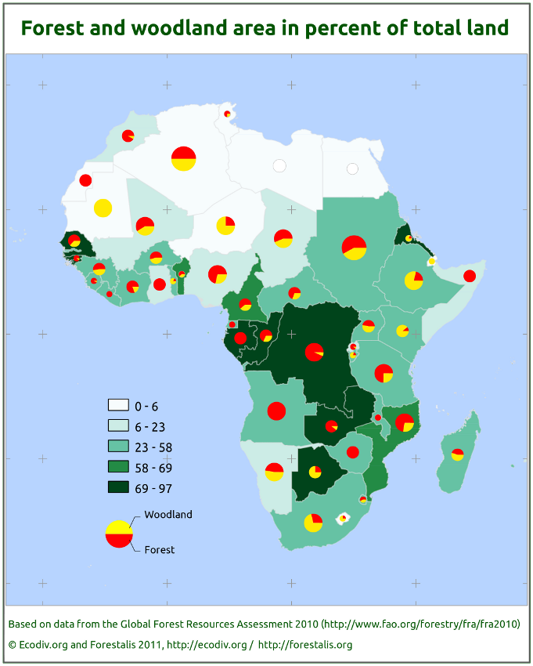

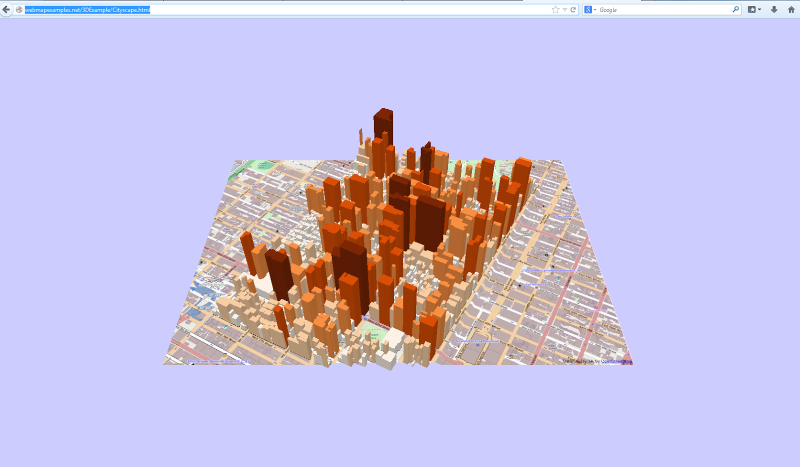
What is QGIS?
GIS Analysis Suite
Free and Open Source
Windows, Mac, Linux, BSD, and Android
Create, Edit, Visualize, Analyze, Publish
Desktop, Browser, Server, Web Client, Android (Beta)
Notes:
Sources:
https://pvanb.files.wordpress.com/2011/01/forest_woodland_cover_100dpi.png
http://3.bp.blogspot.com/-zaPH31UR9M0/UzJDL0OT-jI/AAAAAAAAAc4/XqIBWFWQWz4/s1600/WebScreenshot.png
https://pbs.twimg.com/profile_images/475971445944631296/Nc4o9cJ2.png

Slide 4
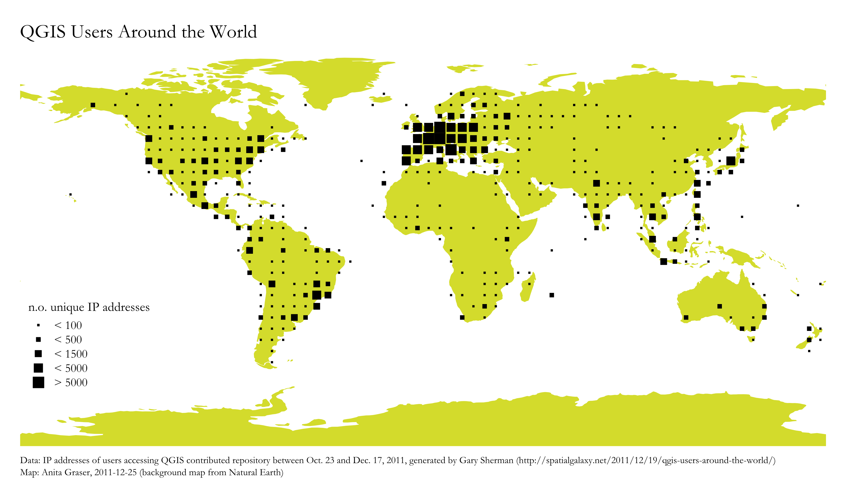
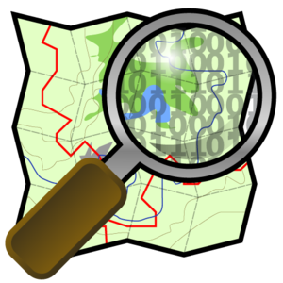






What is QGIS?
Diverse Global User Base
  World Bank
  NGOs
  Local, State, Federal Governments
Works with...
  OSM, OpenGeo Suite, Python, MapBox, Google, Oracle, SQLServer, Bing, and more!
Notes:
Sources:
https://underdark.files.wordpress.com/2011/12/pluginrepo_requests_global_clipped.png
http://wiki.openstreetmap.org/w/images/thumb/9/97/OpenStreetMap-Logo_500px_72dpi_transparency.png/300px-OpenStreetMap-Logo_500px_72dpi_transparency.png
http://boundlessgeo.com/wp-content/uploads/2013/09/OpenGeoSuite_NewIcon.png
https://upload.wikimedia.org/wikipedia/commons/thumb/c/c3/Python-logo-notext.svg/2000px-Python-logo-notext.svg.png
http://www.seomofo.com/downloads/new-google-logo-knockoff.png
https://upload.wikimedia.org/wikipedia/commons/thumb/5/50/Oracle_logo.svg/663px-Oracle_logo.svg.png
https://upload.wikimedia.org/wikipedia/de/thumb/8/8c/Microsoft_SQL_Server_Logo.svg/1000px-Microsoft_SQL_Server_Logo.svg.png
https://upload.wikimedia.org/wikipedia/commons/thumb/e/e9/Bing_logo.svg/1000px-Bing_logo.svg.png

Slide 5

What is QGIS?
Please Support this Project and Donate!
Notes:
Sources:
http://memesvault.com/wp-content/uploads/Happy-Meme-Faces-Transparent-19.png
https://pbs.twimg.com/profile_images/475971445944631296/Nc4o9cJ2.png

Slide 6
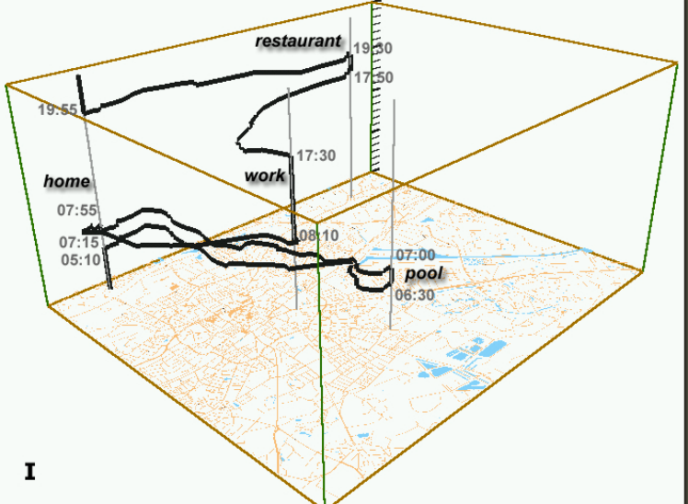
Concepts
Geography
  Space
  Place
  Scale
  Time
Why do you need Geography?
  Spatial relationships
  Spatial practices
  Scalability of space and place
  Mutual production of space/time
Notes:
Sources:
http://www.aviz.fr/~bbach/spacetimecubes/figures/Kraak2003spacetimecube.png

Slide 7
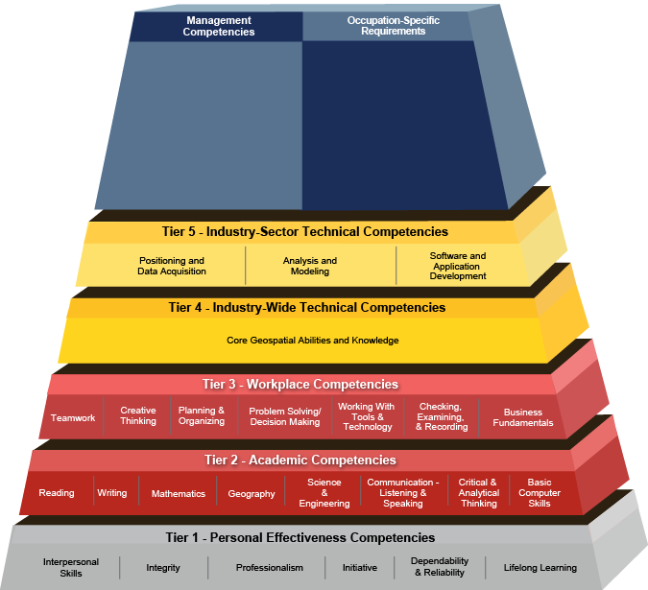
Concepts
GIScience
  Use of geospatial technologies to examine problems in human and physical geographies
Notes:
Sources:
http://www.careeronestop.org/COMPETENCYMODEL/competency-models/geospatial-technology.aspx

Slide 8
Goals
Basics
  Download and Install
    Windows, Mac, Linux
  Start up and GUI
    “Buttonology”
  Plugins
    OpenLayers, OpenGeo, Explorer, Processing, Plugin Builder, GeoSearch
    Search, Update, Install
Tools
  Selection Tools
  Density Map
  Projection Tools
  Resampling
  GeoStats
Vector Data and Analysis
Raster Data and Analysis
Notes:
Sources:

Slide 9






Other Courses
Introduction to Cartography
WebGIS with OpenGeo Suite
Python Programming with PyQGIS
Remote Sensing for Hackers
Notes:
Sources:
http://www.gisblog.com/wp-content/uploads/2014/01/QGISBanner.png
https://media.licdn.com/media/p/2/005/080/21c/1daefaf.png
https://www.python.org/static/community_logos/python-logo-master-v3-TM.png
http://download.osgeo.org/osgeo/logos/OSGeo.jpg
http://domoticx.com/wp-content/uploads/raspberry-pi-logo.png
https://www.arduino.cc/en/uploads/Trademark/ArduinoCommunityLogo.png

Slide 10


Resources
USF School of Geosciences
  http://hennarot.forest.usf.edu/main/depts/geosci/
  If you're a USF student, take a course!
USF GTU-KK
  Eager Geo-minds wanting to do great things (link coming soon!)
QGIS
  http://www.qgis.org/en/docs/index.html
Boundless
  http://boundlessgeo.com/
Python
  https://www.python.org/
Notes:
Sources:
http://www.usf.edu/imagery/usf-logo2.gif
http://www.utdallas.edu/news/imgs/photos/Gamma-Theta.jpg

Slide 11
Resources
R
  https://www.r-project.org/
Books
  Thematic cartography and geovisualization (3rd ed) by Slocum, McMaster, Kessler,& Howard
  Elements of cartography (6th ed) by Arthur H. Robinson
  The PyQGIS Programmer's Guide: Extending QGIS with Python by Gary Sherman
FOSS4G GeoAcademy
  http://spatialquerylab.com/foss4g-academy-curriculum/
ColorBrewer
  http://colorbrewer2.org/flash/index.php
TypeBrewer
  http://typebrewer.org/

Slide 12
That's all folks!
Cyber Geography Research Institute International www.cgrii.org info@cgrii.org
Thanks!

