Slide 1

Geography for Hackers
Prepared by Joe Blankenship www.thejoeblankenship.com www.cgrii.org
P
4
Notes:
Sources:
http://img09.deviantart.net/a314/i/2011/304/f/8/hacker_game_of_life_patern_by_jrsall92-d4eme1m.png

Slide 2
Agenda
https://github.com/joeblankenship1
What is PyQGIS?
Concepts
Goals
Other Courses
Resources
Notes:
Please contact me with any suggestions!!!

Slide 3
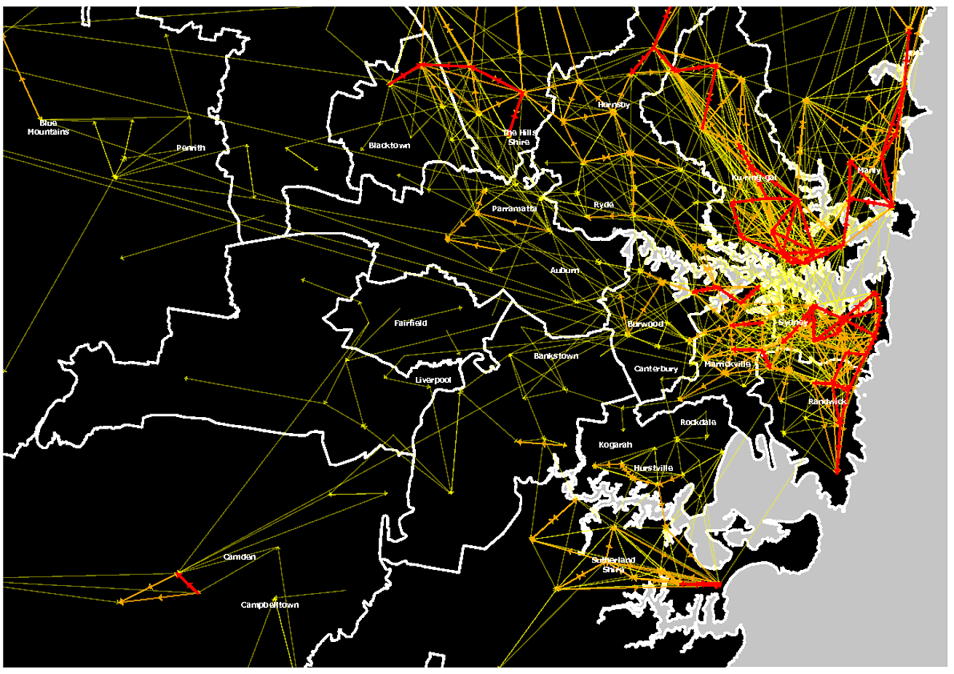
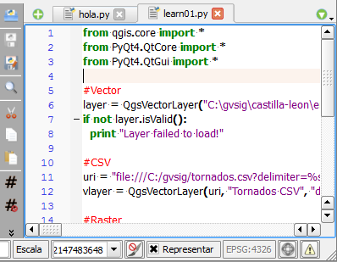
What is PyQGIS?
Python 2.X Library for QGIS
Open Source!
Scripts and Plugins
Automate tasks
Data and UX Manipulation
Integrate powerful Python libraries into your analysis
Notes:
Sources:
http://i.stack.imgur.com/IKQEg.png
https://masquesig.files.wordpress.com/2014/01/pyqgiscargarcapas02.png

Slide 4
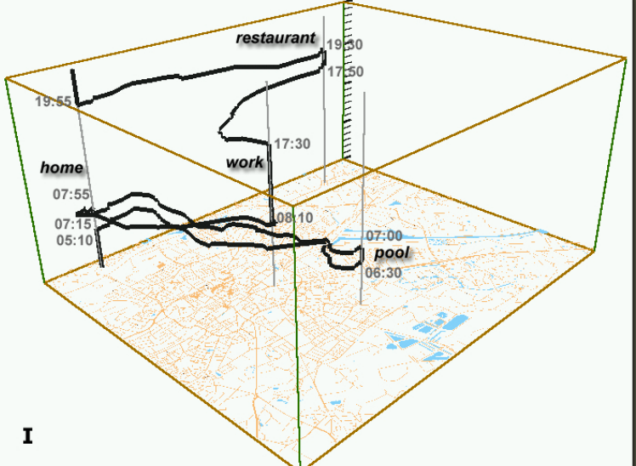
Concepts
Geography
  Space
  Place
  Scale
  Time
Why do you need Geography?
  Spatial relationships
  Spatial practices
  Scalability of space and place
  Mutual production of space/time
Notes:
Sources:
http://www.aviz.fr/~bbach/spacetimecubes/figures/Kraak2003spacetimecube.png

Slide 5
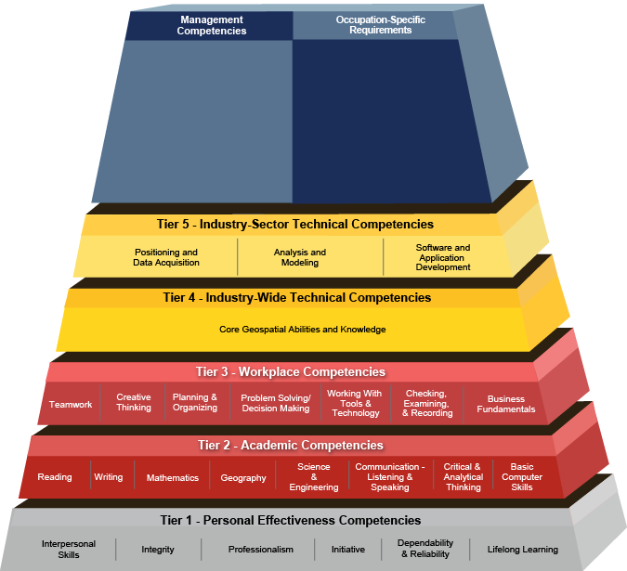
Concepts
GIScience
  Use of geospatial technologies to examine problems in human and physical geographies
  Geographic Information Systems (GIS)
Notes:
Sources:
http://www.careeronestop.org/COMPETENCYMODEL/competency-models/geospatial-technology.aspx

Slide 6



Goals
Basics
  Download and Setup
    QGIS 2.X
    Python 2.X
    QT
    PyQT
    PyQGIS
    Sample Data
  Start up and GUI
    QGIS Console
    IDE
http://locatepress.com/ppg
http://www.qt.io/developers/
http://locatepress.com/ppg/data_code
Notes:
Sources:
http://locatepress.com/static/images/ppg_orange_225px.png
http://reichertbrothers.com/images/qt-logo.png
http://saltyfeet.com/wp-content/uploads/2014/11/data-visualization-icon.png

Slide 7
Goals
Python Basics
  Very Quickly... Just the Basics
QGIS API
  Documentation, QGIS Classes and Methods, QT Signal and Slots
Using Console
  Settings, Functionality, Data Providers
Applications
  Writing, Running, Script Runner, Documentation
  Plugins, Wrappers, Workflow
Notes:
Sources:

Slide 8






Other Courses
Introduction to Cartography
Spatial Analysis with QGIS
WebGIS with OpenGeo Suite
Remote Sensing for Hackers
Notes:
Sources:
http://www.gisblog.com/wp-content/uploads/2014/01/QGISBanner.png
https://media.licdn.com/media/p/2/005/080/21c/1daefaf.png
https://www.python.org/static/community_logos/python-logo-master-v3-TM.png
http://download.osgeo.org/osgeo/logos/OSGeo.jpg
http://domoticx.com/wp-content/uploads/raspberry-pi-logo.png
https://www.arduino.cc/en/uploads/Trademark/ArduinoCommunityLogo.png

Slide 9


Resources
USF School of Geosciences
  http://hennarot.forest.usf.edu/main/depts/geosci/
  If you're a USF student, take a course!
USF GTU-KK
  Eager Geo-minds wanting to do great things (link coming soon!)
QGIS
  http://www.qgis.org/en/docs/index.html
Boundless
  http://boundlessgeo.com/
Python
  https://www.python.org/
Notes:
Sources:
http://www.usf.edu/imagery/usf-logo2.gif
http://www.utdallas.edu/news/imgs/photos/Gamma-Theta.jpg

Slide 10
Resources
R
  https://www.r-project.org/
Books
  Thematic cartography and geovisualization (3rd ed) by Slocum, McMaster, Kessler,& Howard
  Elements of cartography (6th ed) by Arthur H. Robinson
  The PyQGIS Programmer's Guide: Extending QGIS with Python by Gary Sherman
FOSS4G GeoAcademy
  http://spatialquerylab.com/foss4g-academy-curriculum/
ColorBrewer
  http://colorbrewer2.org/flash/index.php
TypeBrewer
  http://typebrewer.org/

Slide 11
That's all folks!
Cyber Geography Research Institute International www.cgrii.org info@cgrii.org
Thanks!

