Slide 1

Geography for Hackers
Prepared by Joe Blankenship www.thejoeblankenship.com www.cgrii.org
P
1
Notes:
Sources:
http://img09.deviantart.net/a314/i/2011/304/f/8/hacker_game_of_life_patern_by_jrsall92-d4eme1m.png

Slide 2
Agenda
https://github.com/joeblankenship1
20th Century Geography
Concepts
Cartography
Types of Maps
Other Courses
Resources
Notes:
Please contact me with any suggestions!!!

Slide 3
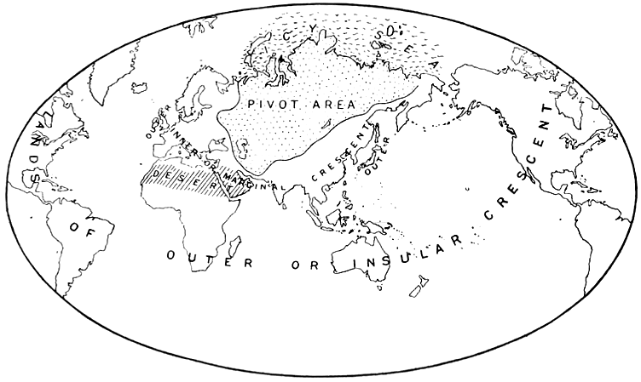
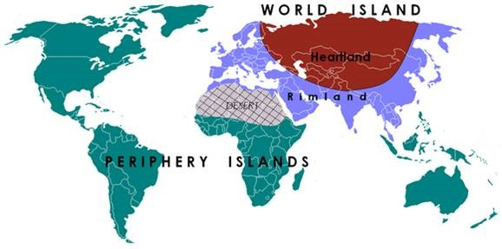
20th Century Geography
Halford Mackinder
  Heartland, World Island
Karl Haushofer
  Geopolitik
Nicholas Spykman
  Rimland
Erwin Raisz
Arthur Robinson
Notes:
Sources:
https://en.wikipedia.org/wiki/Halford_Mackinder
https://en.wikipedia.org/wiki/Karl_Haushofer
https://en.wikipedia.org/wiki/Nicholas_J._Spykman
https://en.wikipedia.org/wiki/File:Heartland.png
http://www.iris.institute/v1/wp-content/uploads/2015/04/p1.jpg

Slide 4
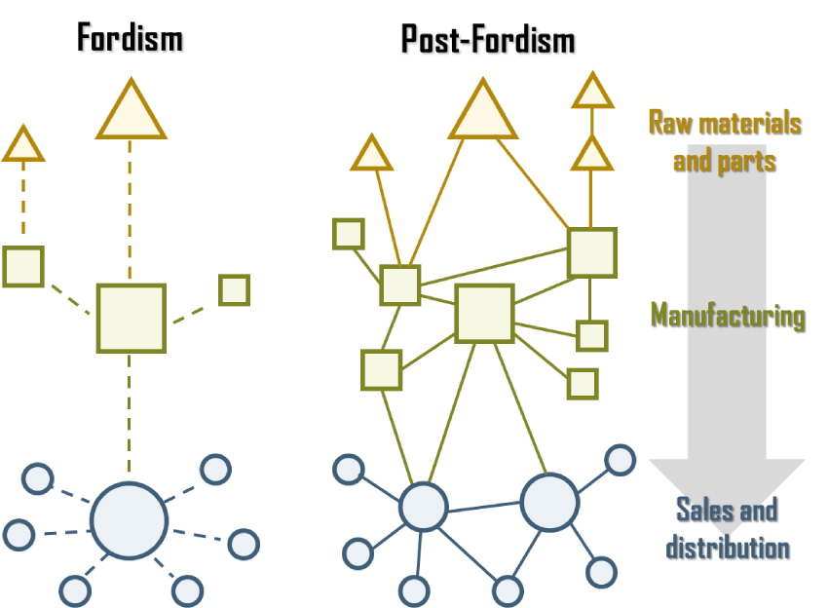
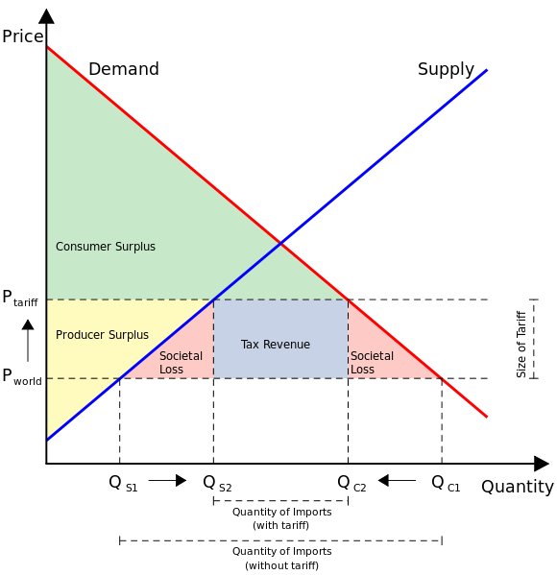
20th Century Geography
Fordist Model
  Keyenes
Austrian School
  Hayek
Breton Woods
Globalization
  Neoliberalism
Notes:
Sources:
https://people.hofstra.edu/GEOTRANS/eng/ch5en/conc5en/img/fordpost.png
https://upload.wikimedia.org/wikipedia/commons/thumb/4/4d/EffectOfTariff.svg/580px-EffectOfTariff.svg.png

Slide 5
Concepts
hack·er /hakər/ n a person who delights in having an intimate understanding of the internal workings of a system... motivated by a multitude of reasons such as profit, protest, or challenge.
ge·og·ra·pher /jēˈäɡrəfər/ n a person who specializes in research, delineation, and study of the physical features of the earth... and human activity as it affects and is affected by one another.
Notes:
Sources:
Dan Catalin Vasile
Merriam Webster Dictionary
Joe Blankenship

Slide 6
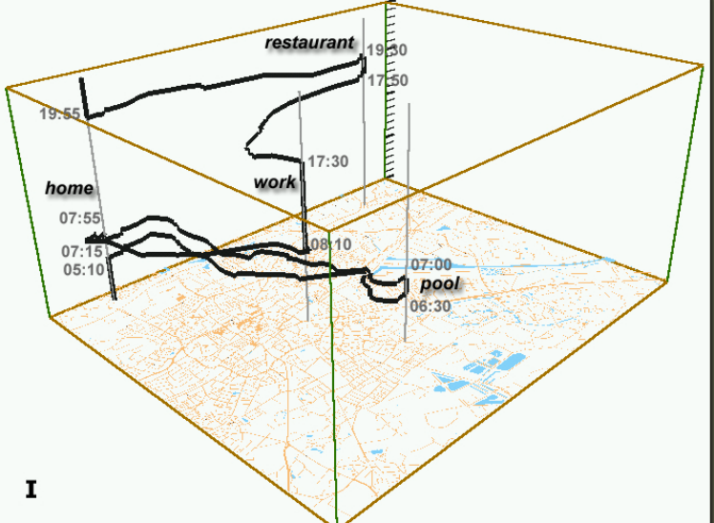
Concepts
Geography
  Space
  Place
  Scale
  Time
Why do you need Geography?
  Spatial relationships
  Spatial practices
  Scalability of space and place
  Mutual production of space/time
Notes:
Sources:
http://www.aviz.fr/~bbach/spacetimecubes/figures/Kraak2003spacetimecube.png

Slide 7
Concepts
Unique to Geography
  There are no absolutes
  If it exists, there is a geographic study of it
  Maps are a product of geography
    Cartography
  Geovisualizations
    Visual representation of spatial data
    Can be a map, but does not have to be
  Geography and hacking go together
    It is understanding how things work where they are
Notes:
Sources:

Slide 8
Concepts
Remote Sensing
Geomorphology
Quantitative Methods
Climate Change
Cartography
GIScience
Physical
Geography
Biogeography
GPS
Geography
GIS
Soils
Human
Geography
Urban
Political
Economic
Cultural
Population
Notes:
Sources:
https://visitskc.wordpress.com/2009/02/18/geography/

Slide 9
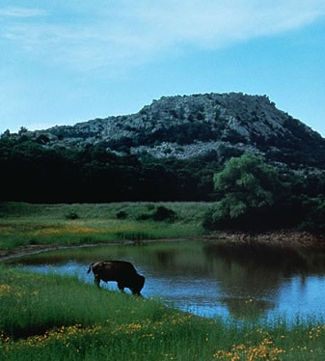
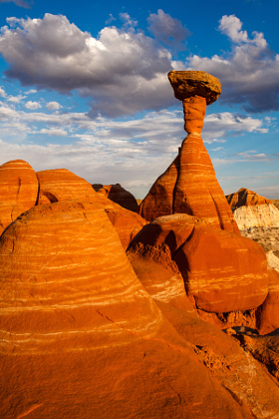
Concepts
Physical Geography
  Study of the planet as it “naturally” persists, varies, and evolves
  Divisions between human and non-human worlds
  Natural Resources
  Inequalities in Access
  Environmental Hazards, Land Use, the Commons
Notes:
Sources:
http://www.earthonlinemedia.com/ipg/images/book_graphics/buffalo_wetland_USFWS.jpg
https://drscdn.500px.org/photo/12122551/w%3D280_s%3D1/cfe0ff88790fe3dc3872709a5839963a
http://www.grad.usf.edu/programs/programinfomation.php?pcode=GPYAS-M.A.

Slide 10
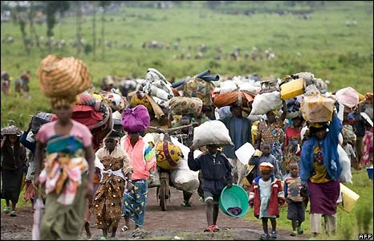
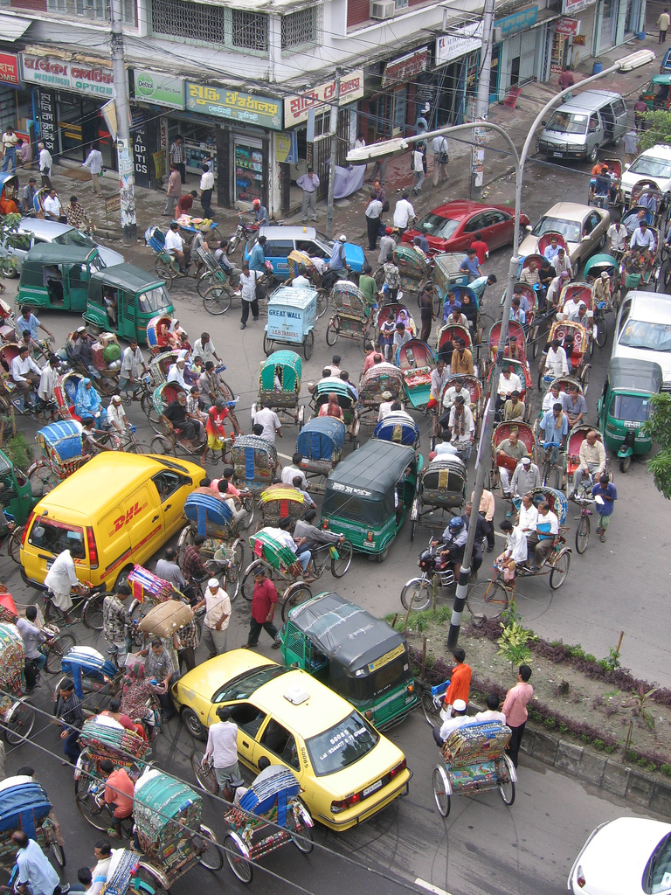
Concepts
Human Geography
  Study of how humans produce space and place
  People, politics, economics, power
  Spatial arrangements and relationships
  Urban-Rural Aspects
  Uneven Development
Notes:
Sources:
http://770congo.weebly.com/uploads/1/5/9/2/15920650/545952751.jpg
https://upload.wikimedia.org/wikipedia/commons/b/bd/Dhaka_traffic.jpg
http://www.grad.usf.edu/programs/programinfomation.php?pcode=GPYAS-M.A.

Slide 11
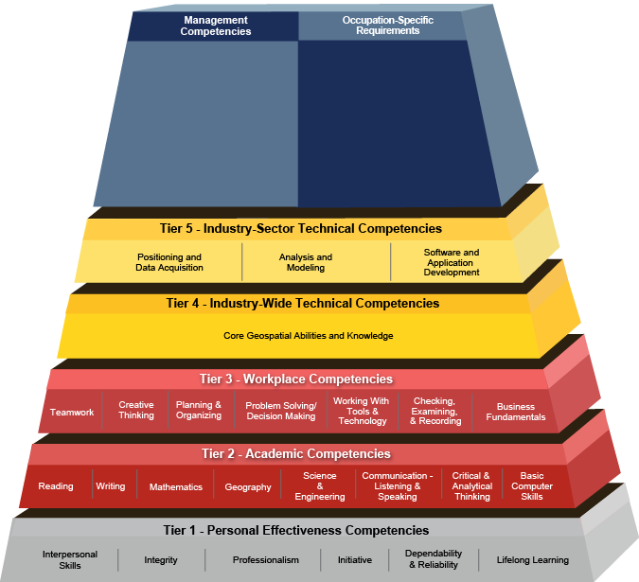
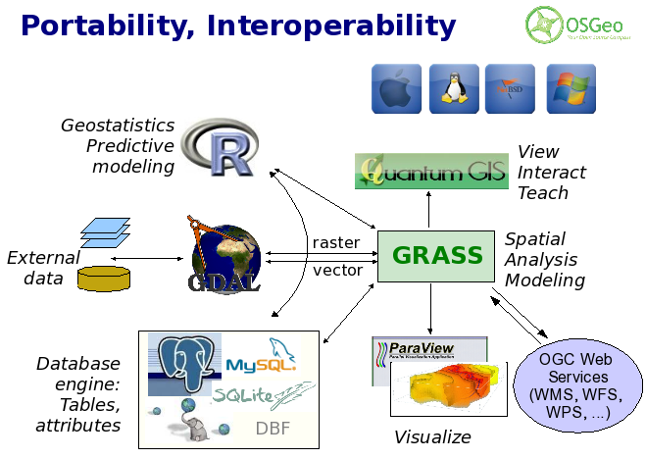
Concepts
GIScience
  Use of geospatial technologies to examine problems in human and physical geographies
  Geographic Information Systems (GIS)
  Numerous platforms
    Mobile, client, server, distributed systems
Notes:
Sources:
http://gis.cri.fmach.it/uploads/images/osgeo_software_stack.png
http://www.careeronestop.org/COMPETENCYMODEL/competency-models/geospatial-technology.aspx
http://www.grad.usf.edu/programs/programinfomation.php?pcode=GPYAS-M.A.

Slide 12
Concepts
?
Questions

Slide 13
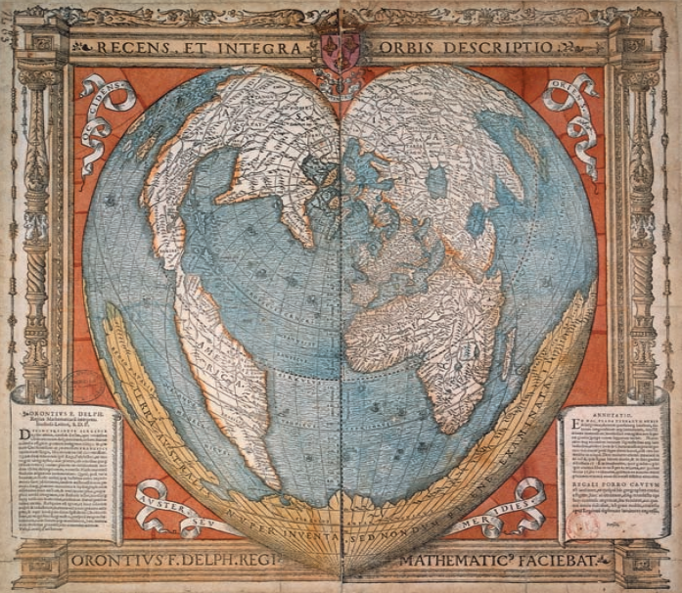
Cartography
Definition
  The art and science of making maps (and other spatial visualizations)
Types of maps
  General Reference Maps
  Thematic Maps
Data will indicate what type of map is possible
  Indicates the possible theme
Notes:
Sources:
http://cdn8.openculture.com/wp-content/uploads/2015/09/02224545/history-of-cartography2.png

Slide 14
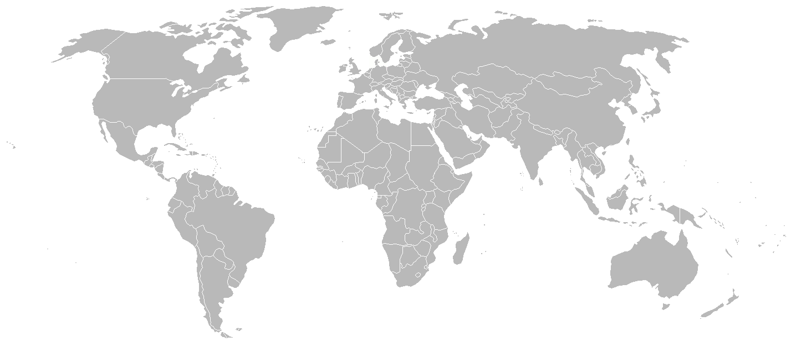
Cartography
Consider real-world scale of problem
Determine purpose and users of the map
Collect data for purpose
Design and build the map
Determine is the users found the map useful
  Add and revisit steps as needed
?
Purpose
Data
Build
Notes:
Sources:
http://vignette4.wikia.nocookie.net/lyricwiki/images/4/44/World_Map_%28Simple%29.png/revision/latest?cb=20060929175749

Slide 15
Cartography
Data
  Document Everything!
    Transformation
    Normalization
    Standardization
  Qualitative and Quantitative
    Both can be mapped
    Nominal, ordinal, interval, ratio
  Scale: Large vs. Small
Data Management
  Provenance
    Metadata
    Time stamp
  Storage
    Folders
    Database
      Relational
      Non-relational
      Graph
  Security
    Encryption?
  Backups!
Notes:
Sources:

Slide 16
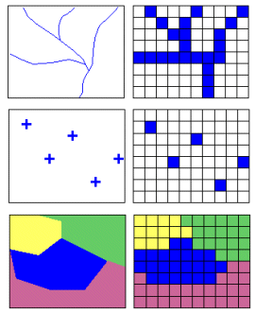
Cartography
Vector
  Discrete data w/ 1+ values
  Points, Lines, Polygons, Volumes
  Referenced at X,Y intersect
Raster
  Continuous data w/ 1 value
  Cells of varying shape and size
  Referenced at center or corner of cell
Notes:
Sources:
http://gis.nic.in/gisprimer/images/vector.gif

Slide 17
Cartography
Data Classification
  Unclassified Data == uncategorized data
  Common Class methods
    Equal interval
    Quantile
    Mean/Standard Deviation
    Max breaks
    Natural break (Jenks)
File Types
  Flat files
    CSV, TXT, JSON
  WKT (well-known text)
  Shapefiles
  SpatiaLite
  XML (KML, KMZ)
  Geodatabases
  HDFS (Hadoop)
  So many others
Notes:
Sources:

Slide 18
Cartography
Datum
  Geodesy
  An applied mathematic reference system to establish where things are
  WGS84
    World Geodetic System
    1984; at sea level
  NAD83
    North American Datum
    1983; Meades Ranch Triangulation Station
Coordinate Systems
  Used to determine where a point or object is in space
  Global vs. Projected Coordinate Systems
  Graticules
    Latitude, Longitude, Elevation
    Degrees, minutes, seconds
    Decimal degrees
    UTM (universal transverse Mercator)
Notes:
Sources:

Slide 19
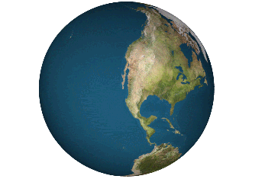
Cartography
Projections!
  How we get from 3D to 2D
  Class
    Conic, Cylindrical, Planar, Mathematical
  Case
    Tangent, Secant
  Aspect
    Polar, Equatorial, Oblique
EPSG
Map purpose determines projection(s) used
Area (Equal Area)
Shape (Conformal)
Distance (Equidistant)
Direction (Azimuthal)
Mathematical
Notes:
Sources:
http://p2cdn4static.sharpschool.com/UserFiles/Servers/Server_998122/Image/Staff%20Directory/Yoder%20M/Dymaxion_2003_animation_small1.gif

Slide 20
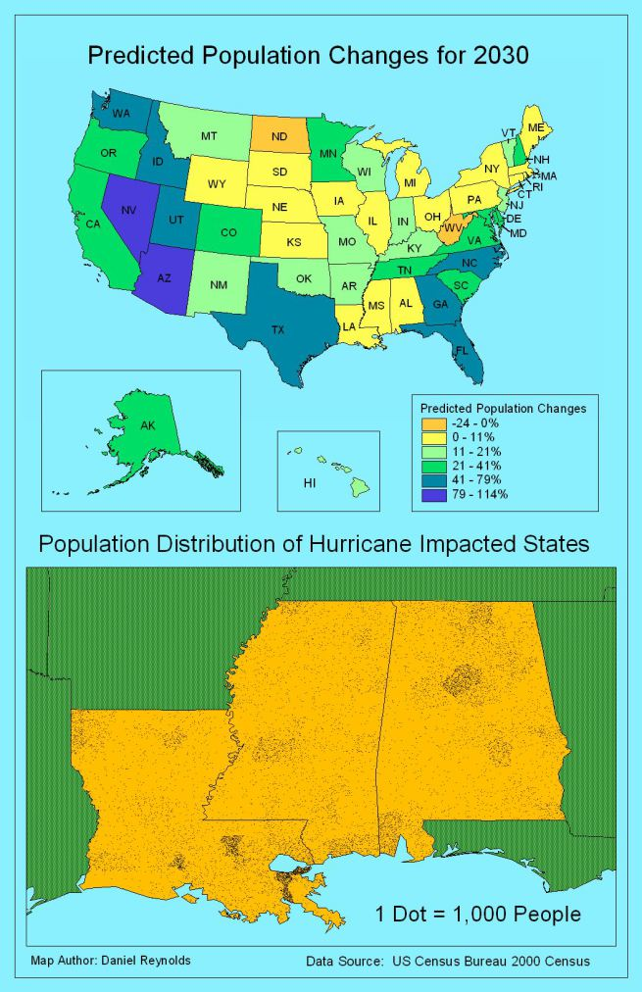
Cartography
Map Components
  Title (subtitles)
  Legend
  Compass
  Scale Indicator
  Sources
  Author
  Other elements applicable for the purpose
Essential for reproducibility and reference
Notes:
Sources:
https://cartastrophe.files.wordpress.com/2009/08/4850_map12.jpg?w=655

Slide 21
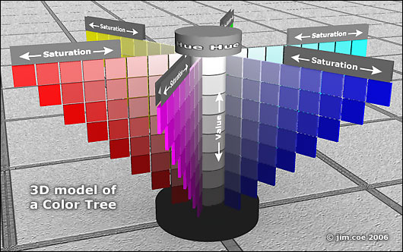
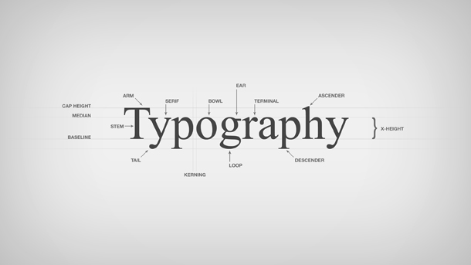
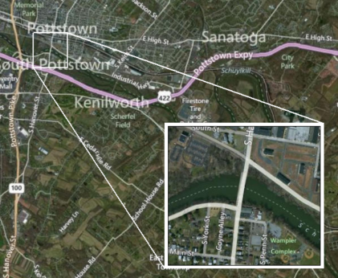
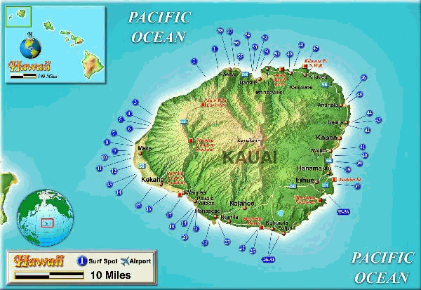
Cartography
Color, Typography, Insets, Design
  Purpose of Map
  Cartographic Standards
    Robinson/Raisz
    Slocum et al.
  Culture/People
  Medium of Publication
  Intellectual/Visual Hierarchy
    Balance, contrast, figure-ground
Emphasize the most important facets!
Notes:
Sources:
http://www.art-head-start.com/images/layout/colortree3-530.jpg
http://www.better2web.com/djfiles/typography-b2w.jpg
http://i.stack.imgur.com/Q0Hti.png
http://www.directionsmag.com/images/newsletter/2004/07_14/kauai_lg.gif

Slide 22
Cartography
?
Questions

Slide 23
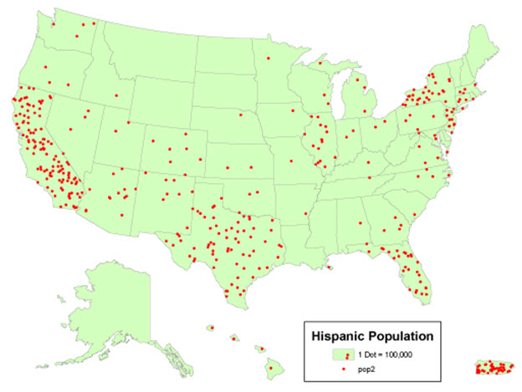
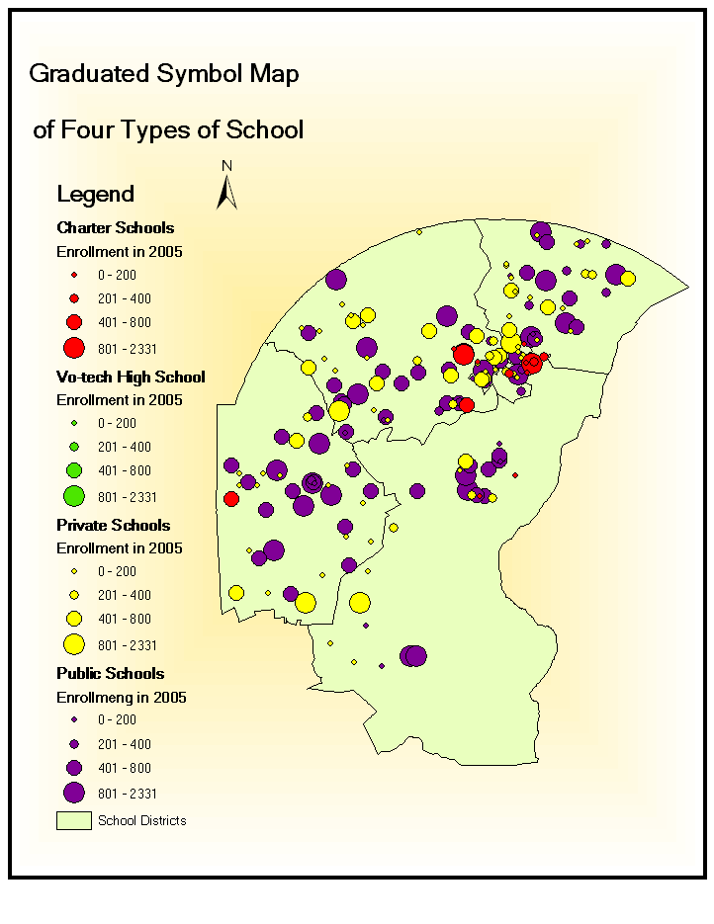
Types of Maps
Proportional Symbols
Dot
Notes:
Sources:
https://www.e-education.psu.edu/geog160/files/geog160/image/Chapter03/Dot_Density.jpg
http://udel.edu/~fernzx/Project2/Q4.Graduated%20Symbols%20of%204%20Types%20of%20School.png

Slide 24
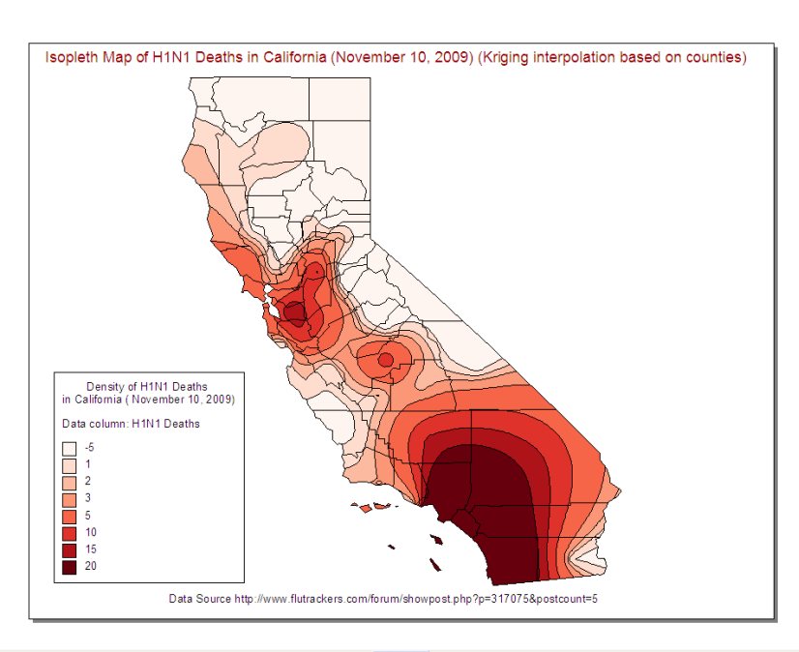
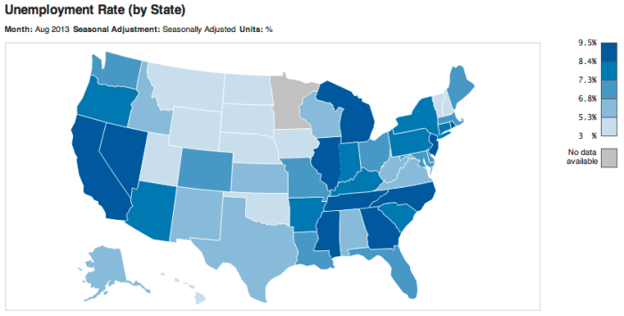
Types of Maps
Isopleth
Choropleth
Notes:
Sources:
https://datamarket.files.wordpress.com/2013/10/choropleth-unemployment-by-state-usa.png?w=700&h=354
https://flutrackers.com/forum/filedata/fetch?id=664809

Slide 25
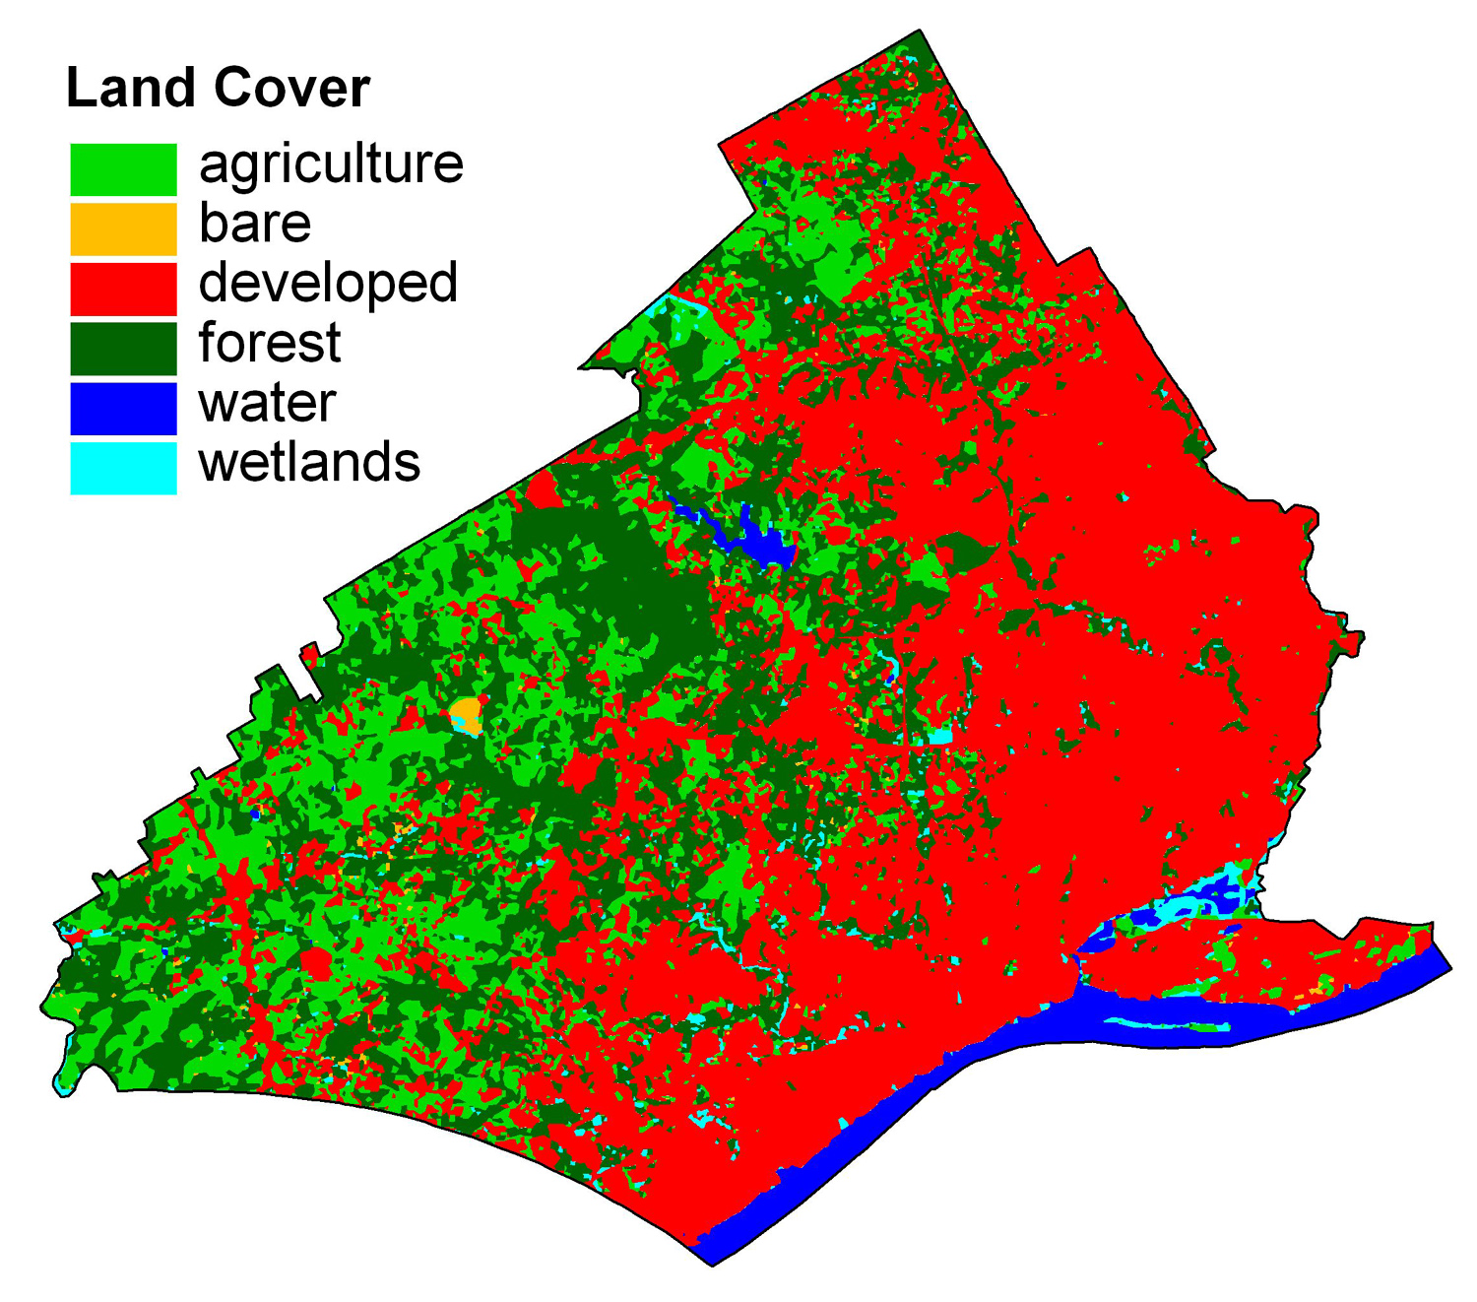
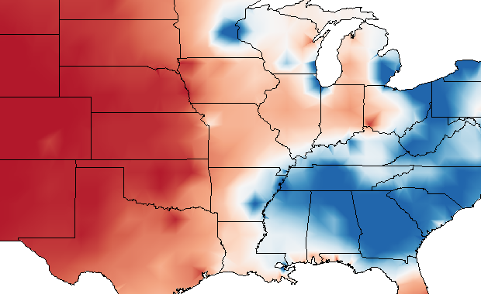
Types of Maps
Isarithmic
Dasymetric
Notes:
Sources:
http://astro.temple.edu/~jmennis/research/dasymetric/dasycasestudy/landcover2.jpg
http://1.bp.blogspot.com/-CYK7W35hPrI/TlwYaBY4TXI/AAAAAAAAAAU/QJCIjtQBOds/s1600/isarithmic+map.png

Slide 26
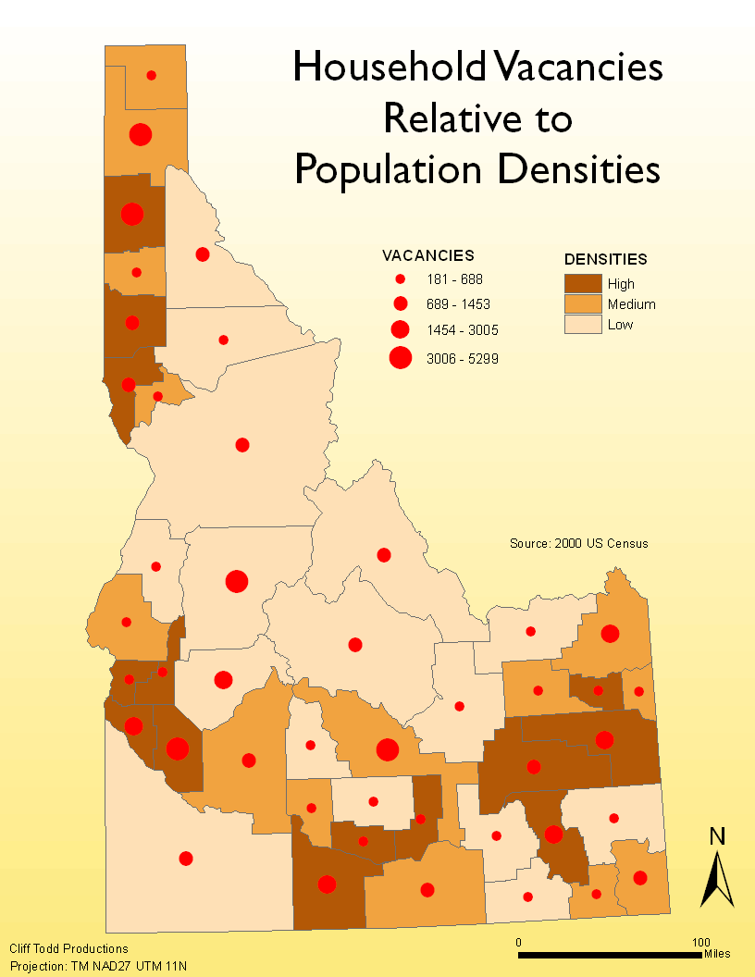
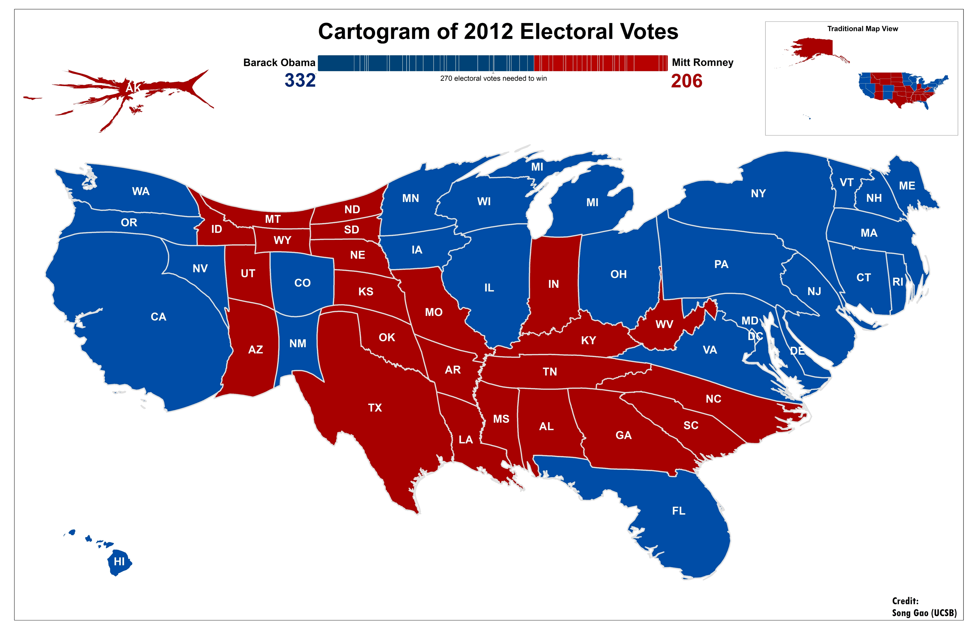
Types of Maps
Cartogram
Multivariate
Notes:
Sources:
http://3.bp.blogspot.com/-dhimqqJCXIo/T3u3vCWpPYI/AAAAAAAAAPc/zZOCLgA3YPE/s1600/Lab7_Part2.png
http://www.geog.ucsb.edu/~sgao/images/cartogramUSelection_SongGao.jpg

Slide 27
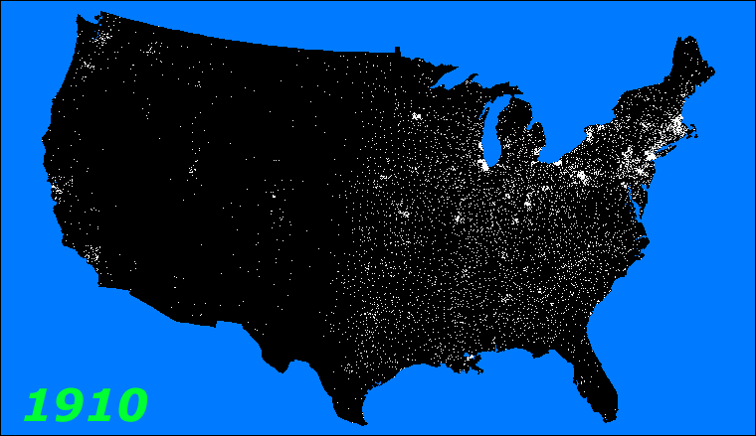
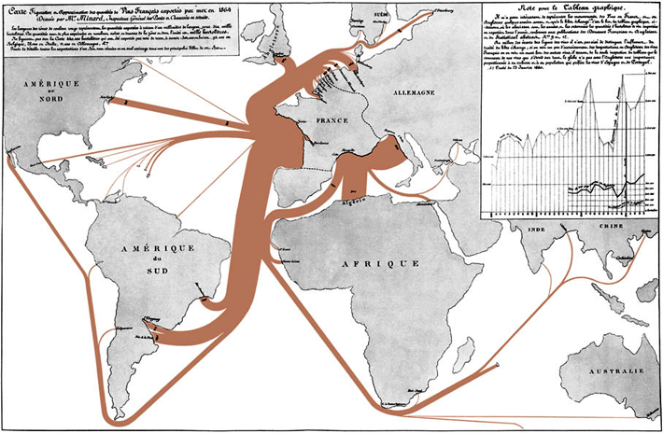
Types of Maps
Animated
Flow
Notes:
Sources:
https://www.datavisualization.ch/wp-content/uploads/2009/07/flow_map_01.png
http://ucdata.berkeley.edu/rsfcensus/graphics/lightshowpercent.gif

Slide 28
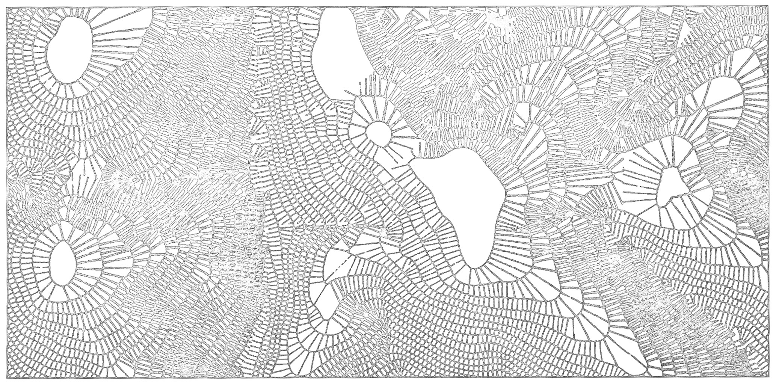
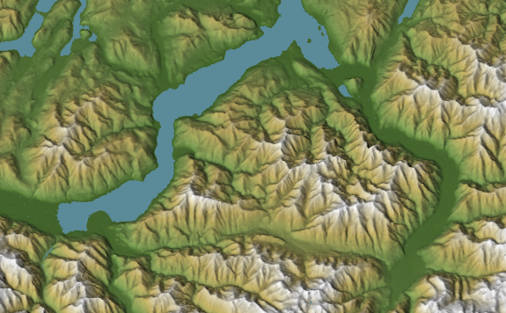
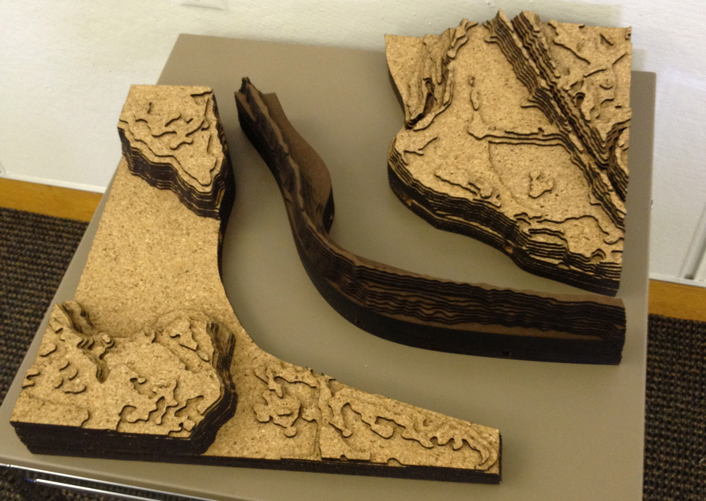
Types of Maps
Terrain Maps
  Vertical View
    Hachure
    Contour
    Shaded Relief
  Oblique View
    Draped Images
    Panorama
    Block Diagram
  Physical Model
Notes:
Sources:
http://www.u.arizona.edu/~kbailey/GEOG416A/hachure.jpg
http://cartography.oregonstate.edu/AlternativeProjectionsFor3DMaps_files/stacks_image_2988.png
http://lab.visual-logic.com/wp-content/uploads/2013/03/IMG_0616.jpg

Slide 29
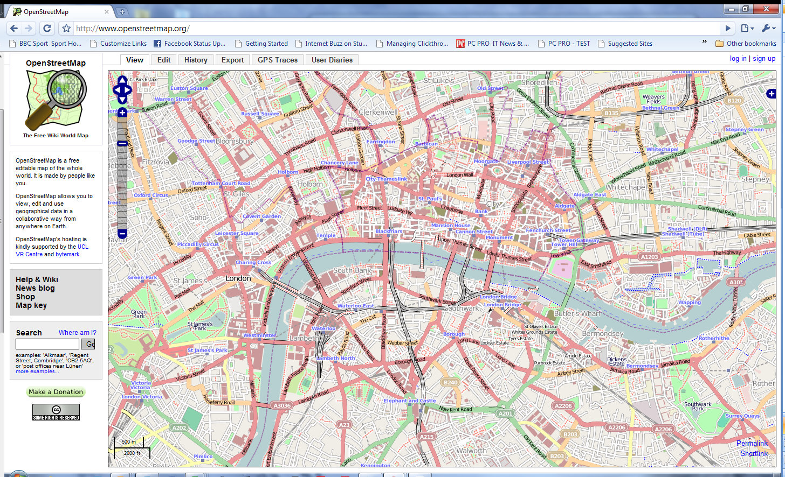
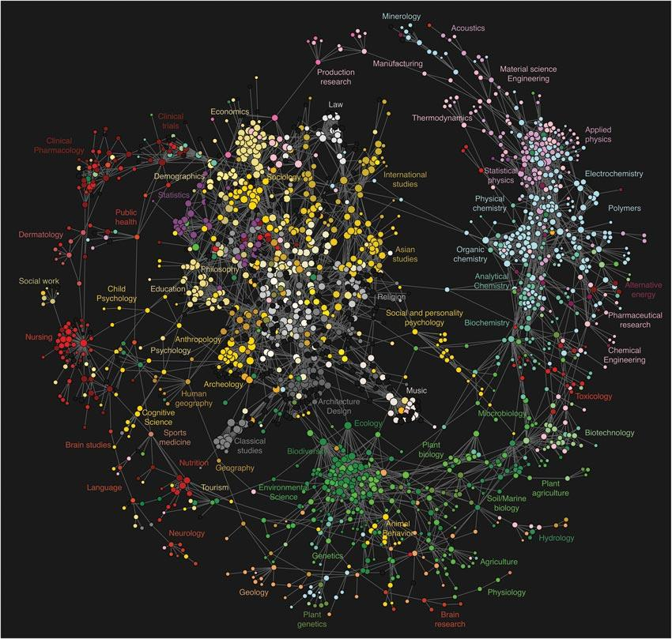
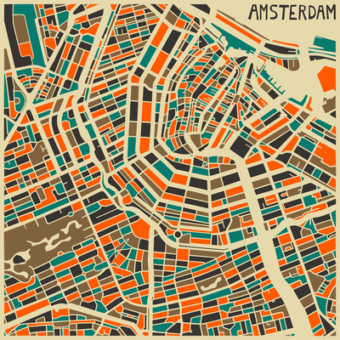
Types of Maps
Web Maps
Geovisualizations
  Data Exploration
  Uncertainty
  Spatial Statistics
  Virtual Environments
  Augmented Reality
Art Maps
Many Others
Notes:
Sources:
http://cdn1.alphr.com/sites/alphr/files/images/blogs/wp-content/uploads/2009/07/openstreetmap-google-chrome-29072009-112029.jpg
http://www.nature.com/news/2009/090309/images/Map-Huge.jpg
http://blog.artweekenders.com/wp-content/uploads/2013/07/Jazzberry-Blue-Amsterdam-Map.jpg

Slide 30
Types of Maps
?
Questions
Notes:
Sources:

Slide 31






Other Courses
Spatial Analysis with QGIS
WebGIS with OpenGeo Suite
Python Programming with PyQGIS
Remote Sensing for Hackers
Notes:
Sources:
http://www.gisblog.com/wp-content/uploads/2014/01/QGISBanner.png
https://media.licdn.com/media/p/2/005/080/21c/1daefaf.png
https://www.python.org/static/community_logos/python-logo-master-v3-TM.png
http://download.osgeo.org/osgeo/logos/OSGeo.jpg
http://domoticx.com/wp-content/uploads/raspberry-pi-logo.png
https://www.arduino.cc/en/uploads/Trademark/ArduinoCommunityLogo.png

Slide 32


Resources
USF School of Geosciences
  http://hennarot.forest.usf.edu/main/depts/geosci/
  If you're a USF student, take a course!
USF GTU-KK
  Eager Geo-minds wanting to do great things (link coming soon!)
QGIS
  http://www.qgis.org/en/docs/index.html
Boundless
  http://boundlessgeo.com/
Python
  https://www.python.org/
Notes:
Sources:
http://www.usf.edu/imagery/usf-logo2.gif
http://www.utdallas.edu/news/imgs/photos/Gamma-Theta.jpg

Slide 33
Resources
R
  https://www.r-project.org/
Books
  Thematic cartography and geovisualization (3rd ed) by Slocum, McMaster, Kessler,& Howard
  Elements of cartography (6th ed) by Arthur H. Robinson
  The PyQGIS Programmer's Guide: Extending QGIS with Python by Gary Sherman
FOSS4G GeoAcademy
  http://spatialquerylab.com/foss4g-academy-curriculum/
ColorBrewer
  http://colorbrewer2.org/flash/index.php
TypeBrewer
  http://typebrewer.org/

Slide 34
That's all folks!
Cyber Geography Research Institute International www.cgrii.org info@cgrii.org
Thanks!

