Slide 1

Geography for Hackers
Prepared by Joe Blankenship www.thejoeblankenship.com www.cgrii.org
P
3
Notes:
Sources:
http://img09.deviantart.net/a314/i/2011/304/f/8/hacker_game_of_life_patern_by_jrsall92-d4eme1m.png

Slide 2
Agenda
https://github.com/joeblankenship1
What is OpenGeo Suite?
Concepts
Goals
Other Courses
Resources
Notes:
Please contact me with any suggestions!!!

Slide 3
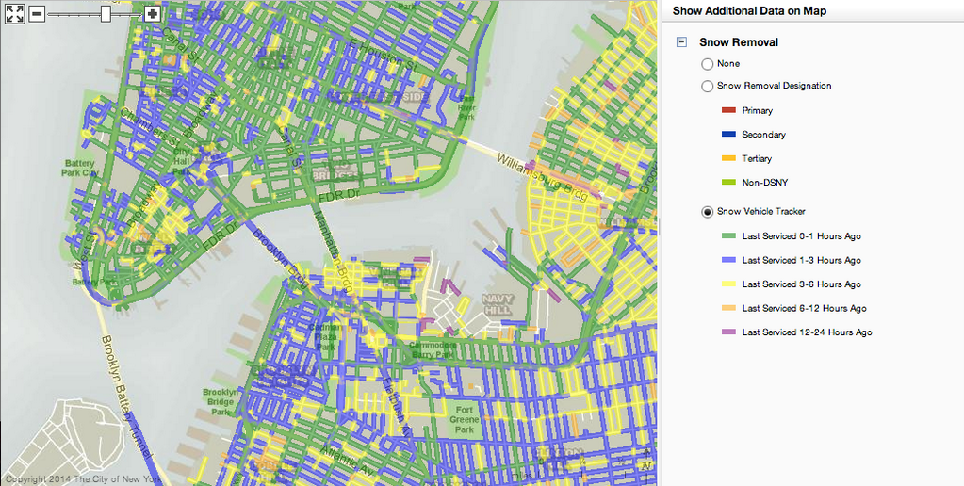
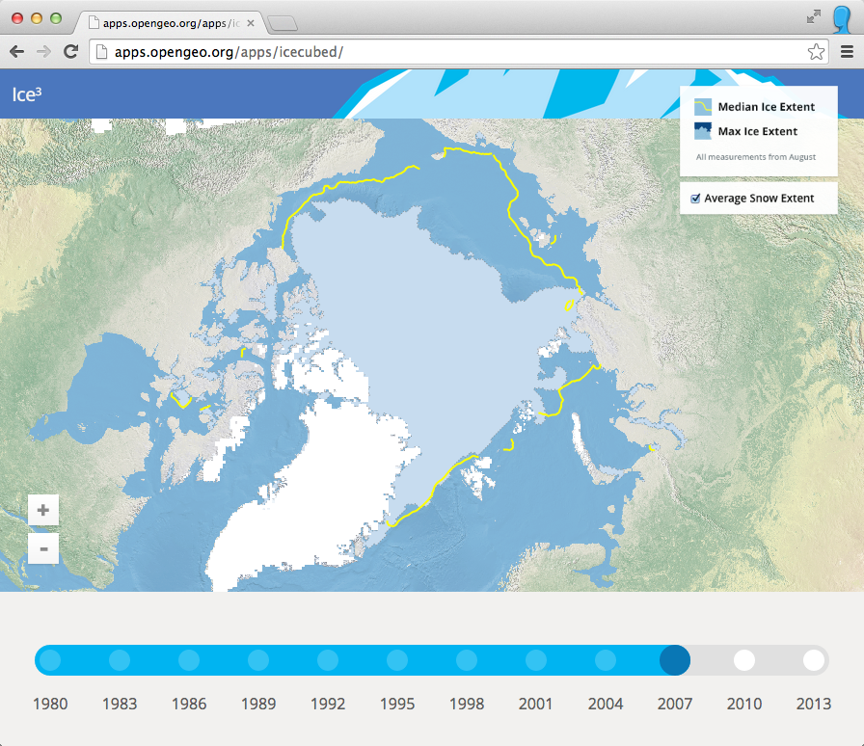
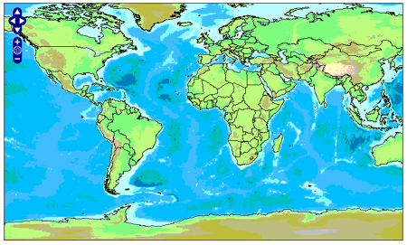
What is OpenGeo Suite?
Suite built with Open Source Software
Manage Data, Publish Maps, Build Apps, Analytic Tools
PostGIS, GeoServer, GeoWebCache, OpenLayers, and More
Web, Desktop, and Mobile
Cloud Instances (AWS, Azure)
Notes:
Sources:
http://developers.boundlessgeo.com/assets/img/tools/plownyc.png
http://boundlessgeo.com/wp-content/uploads/2014/08/apps_opengeo_org_apps_icecubed_.png
http://spatialhorizons.com/wp-content/uploads/2007/12/openlayers_map1.jpg

Slide 4
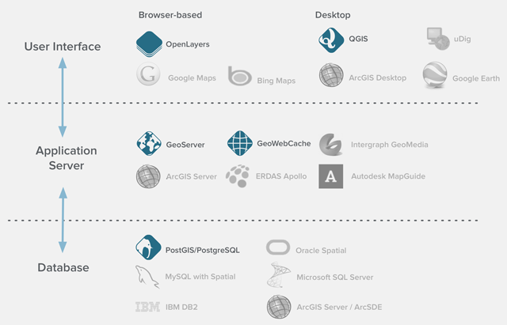
What is OpenGeo Suite?
Notes:
Sources:
http://boundlessgeo.com/wp-content/uploads/2015/10/ecosystem_grey2.png

Slide 5
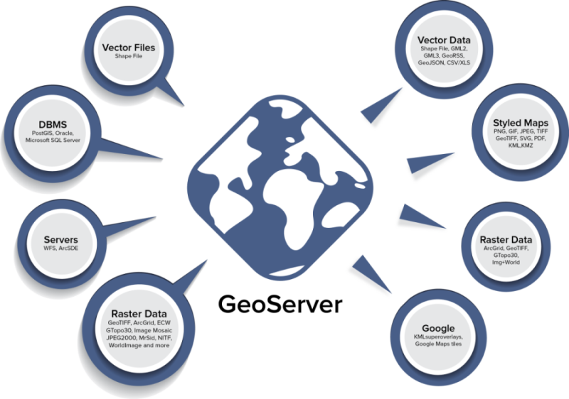
What is OpenGeo Suite?
Notes:
Sources:
http://boundlessgeo.com/wp-content/uploads/2015/10/GeoServer-Graphic1-e1447277233800.png

Slide 6
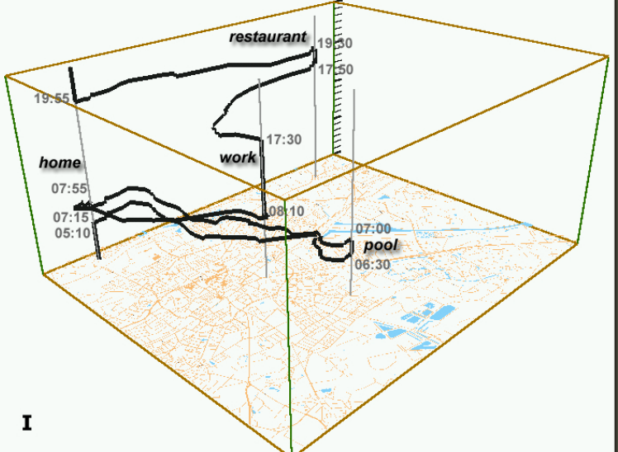
Concepts
Geography
  Space
  Place
  Scale
  Time
Why do you need Geography?
  Spatial relationships
  Spatial practices
  Scalability of space and place
  Mutual production of space/time
Notes:
Sources:
http://www.aviz.fr/~bbach/spacetimecubes/figures/Kraak2003spacetimecube.png

Slide 7
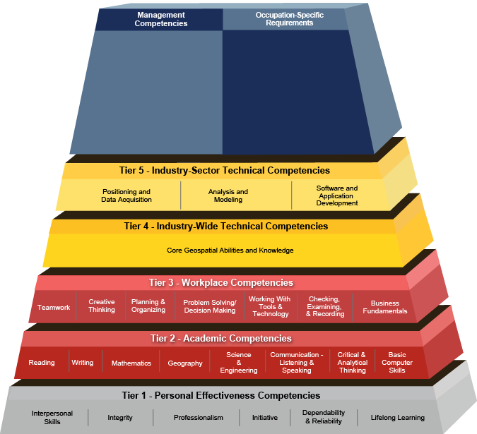
Concepts
GIScience
  Use of geospatial technologies to examine problems in human and physical geographies
  Geographic Information Systems (GIS)
Notes:
Sources:
http://www.careeronestop.org/COMPETENCYMODEL/competency-models/geospatial-technology.aspx

Slide 8
Goals
Basics
  Download and Install
    Windows, Mac, Linux
    VirtualBox
    OpenGeo Suite
    Optional
      GeoNode
      GeoGig
  Start up and GUI
    Bash (SSH, Putty)
    Web Interface
PostGIS
  PostgreSQL
  PGAdminIII
GeoServer
  Security
  Data (QGIS, Raw)
  Connections
  Data Management
  Group Policy
Notes:
Sources:

Slide 9
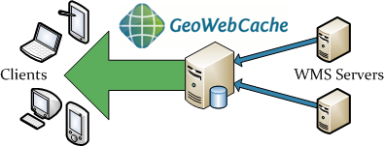
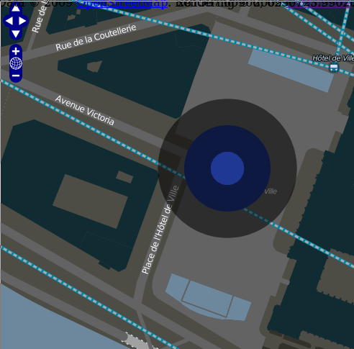
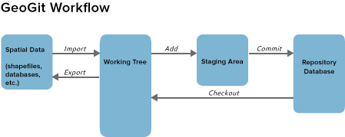
Goals
GeoWebCache
  Tiling Overview
OpenLayers
  Create Web Map
    Data
    Styling
    Publication
  URL Manipulation
  GeoNode
GeoGig
  Versioning
Notes:
Sources:
http://geowebcache.org/docs/current/_images/how_it_works.png
http://i.stack.imgur.com/eey5t.png
http://geogig.org/docs/_images/geogig_workflow_remotes1.png

Slide 10






Other Courses
Introduction to Cartography
Spatial Analysis with QGIS
Python Programming with PyQGIS
Remote Sensing for Hackers
Notes:
Sources:
http://www.gisblog.com/wp-content/uploads/2014/01/QGISBanner.png
https://media.licdn.com/media/p/2/005/080/21c/1daefaf.png
https://www.python.org/static/community_logos/python-logo-master-v3-TM.png
http://download.osgeo.org/osgeo/logos/OSGeo.jpg
http://domoticx.com/wp-content/uploads/raspberry-pi-logo.png
https://www.arduino.cc/en/uploads/Trademark/ArduinoCommunityLogo.png

Slide 11
Resources
QGIS
  http://www.qgis.org/en/docs/index.html
Boundless
  http://boundlessgeo.com/
Python
  https://www.python.org/
R
  https://www.r-project.org/
Books
  Thematic cartography and geovisualization (3rd ed) by Slocum, McMaster, Kessler,& Howard
  Elements of cartography (6th ed) by Arthur H. Robinson
  The PyQGIS Programmer's Guide: Extending QGIS with Python by Gary Sherman
FOSS4G GeoAcademy
  http://spatialquerylab.com/foss4g-academy-curriculum/
ColorBrewer
  http://colorbrewer2.org/flash/index.php
TypeBrewer
  http://typebrewer.org/

Slide 12
That's all folks!
Cyber Geography Research Institute International www.cgrii.org info@cgrii.org
Thanks!

