Slide 1
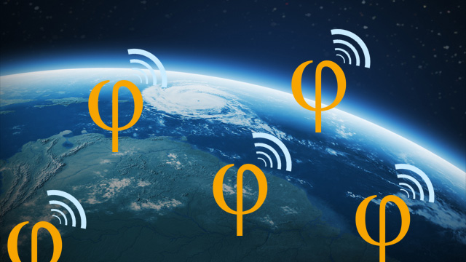
Introduction to
Software Defined Radio

Slide 2
Agenda
Materials
What is SDR?
The Basics
SDR & Security
Demonstrations
Q & A
thejoeblankenship.com
joe@cgrii.org
@CGRIIorg on Twitter

Slide 3
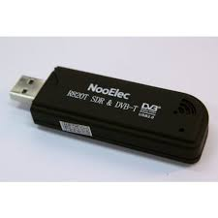

Materials
Laptop (Ubuntu or other Linux OS)
  GNU radio (can download Ubuntu image with GNU radio from GNURadio website)
RTL-SDR dongle (NooElec R820T DVB-T is what I used)
Antenna and cables

Slide 4
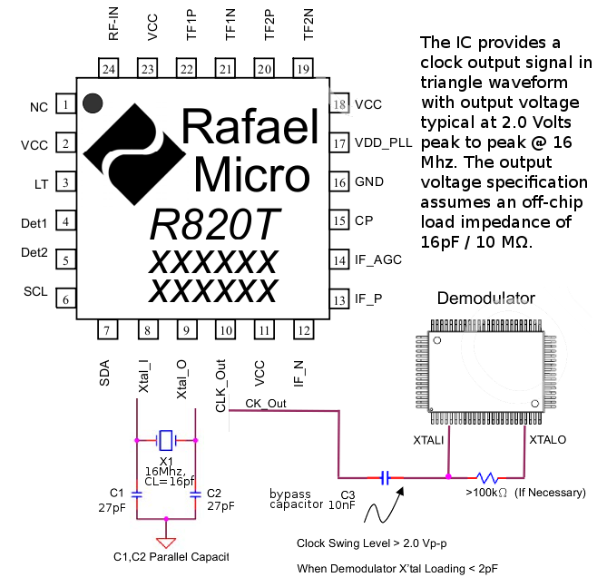
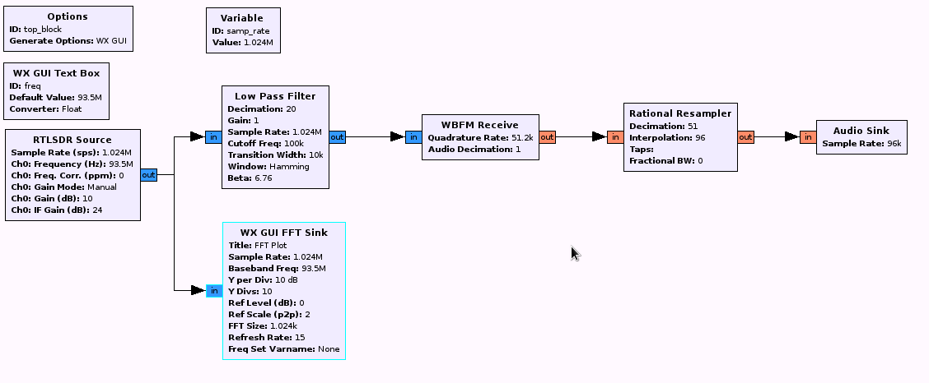
What is Software Defined Radio?
Software Defined Radio (SDR) in general
  Basic reception, modulation/demodulation, and filtering defined in software
  Digital Signal Processing (DSP) algorithms implemented in configurable hardware and/or PC software
SDR is NOT:
  A computer-controlled conventional radio
  A conventional radio with a GUI integrated into its front panel

Slide 5
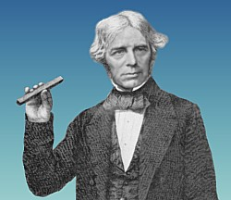
The Basics
Hardware
  Receivers vs. Transceivers
  Frequency/Signal Dependent
    Antennas
    Environment
  Price/Functionality
  Stay Flexible!
Software
  Up to you
Faraday Approved!

Slide 6
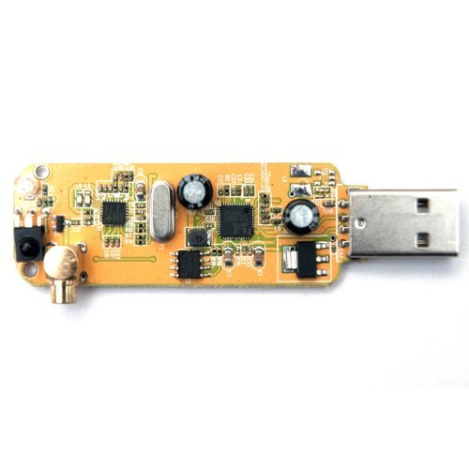
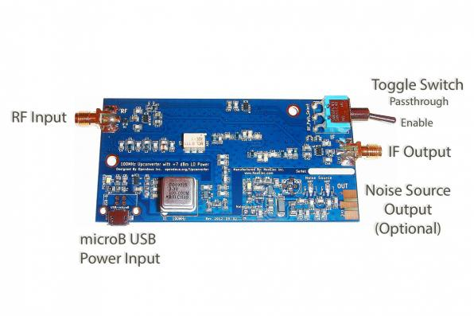
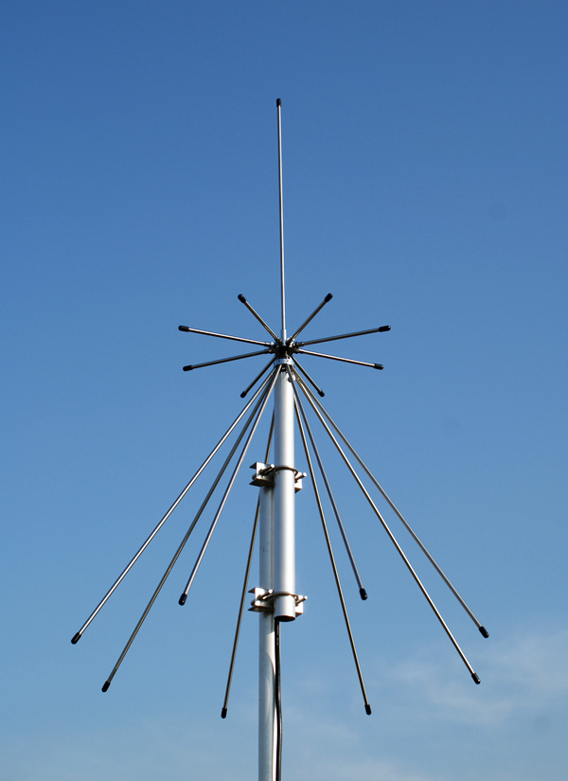
The Basics
The NooElec RTL-SDR receiver uses the Rafael Micro RTL2832-R820T tuner chipset with MCX connector input
Widely supported by large hobbyist community
Has range of ~25MHz to ~1750MHz
There is no “one size fits all” antenna
The discone antenna is a good all-purpose antenna for VHF/UHF transmission, but has limits
For HAM Radio applications, the HamItUp can be used to interface with the NooElec receiver
Requires connector adapters
Provides additional gain while shifting all HF signals into the VHF range

Slide 7
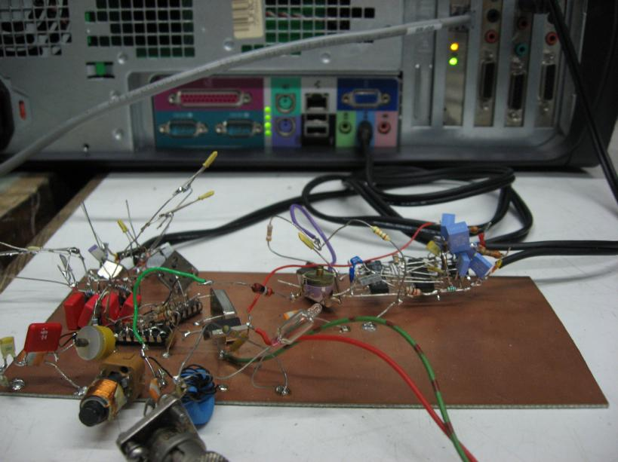
The Basics
Don't do this... unless you really want to

Slide 8
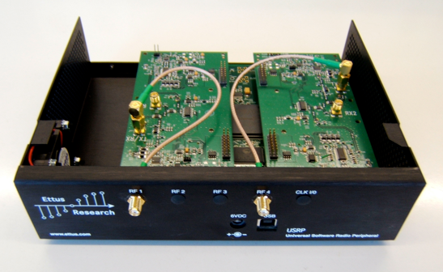
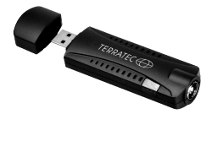
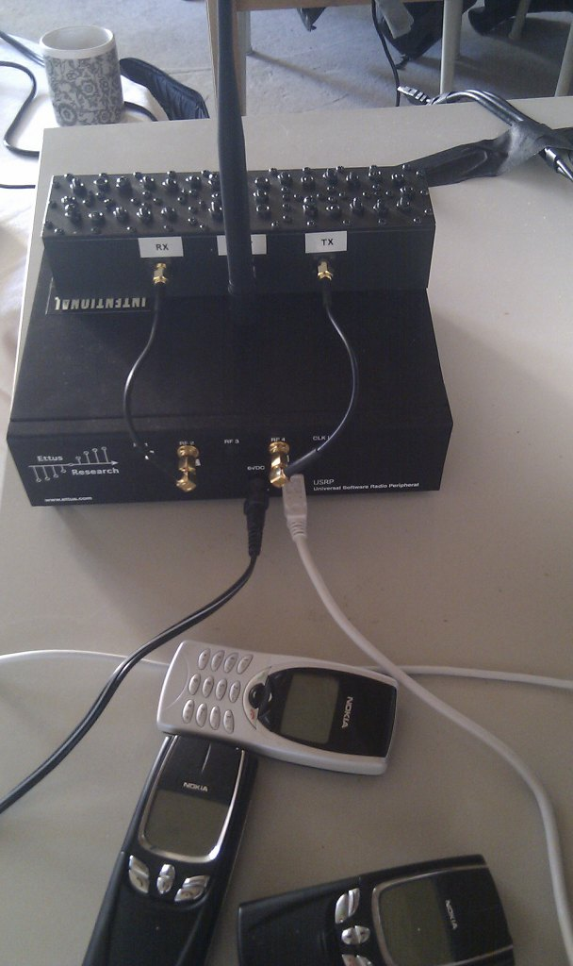
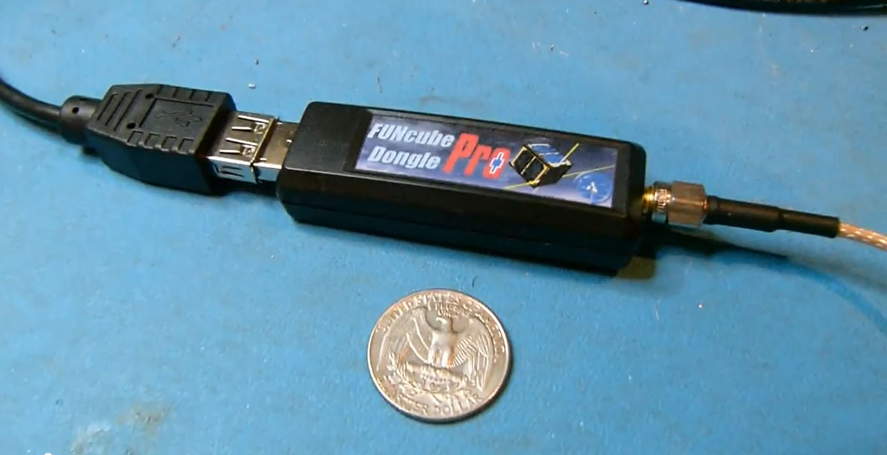
The Basics
Other options
  USRP
    More expensive
    Much more functionality
  Terratec t stick +
    53 – 2200 MHz
  FunCube Dongle
    Similar to NooElec
    64 - 1,700 MHz

Slide 9
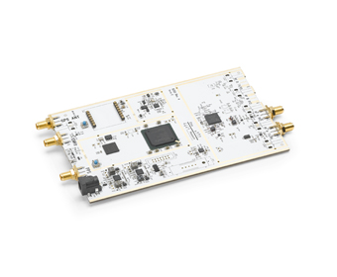
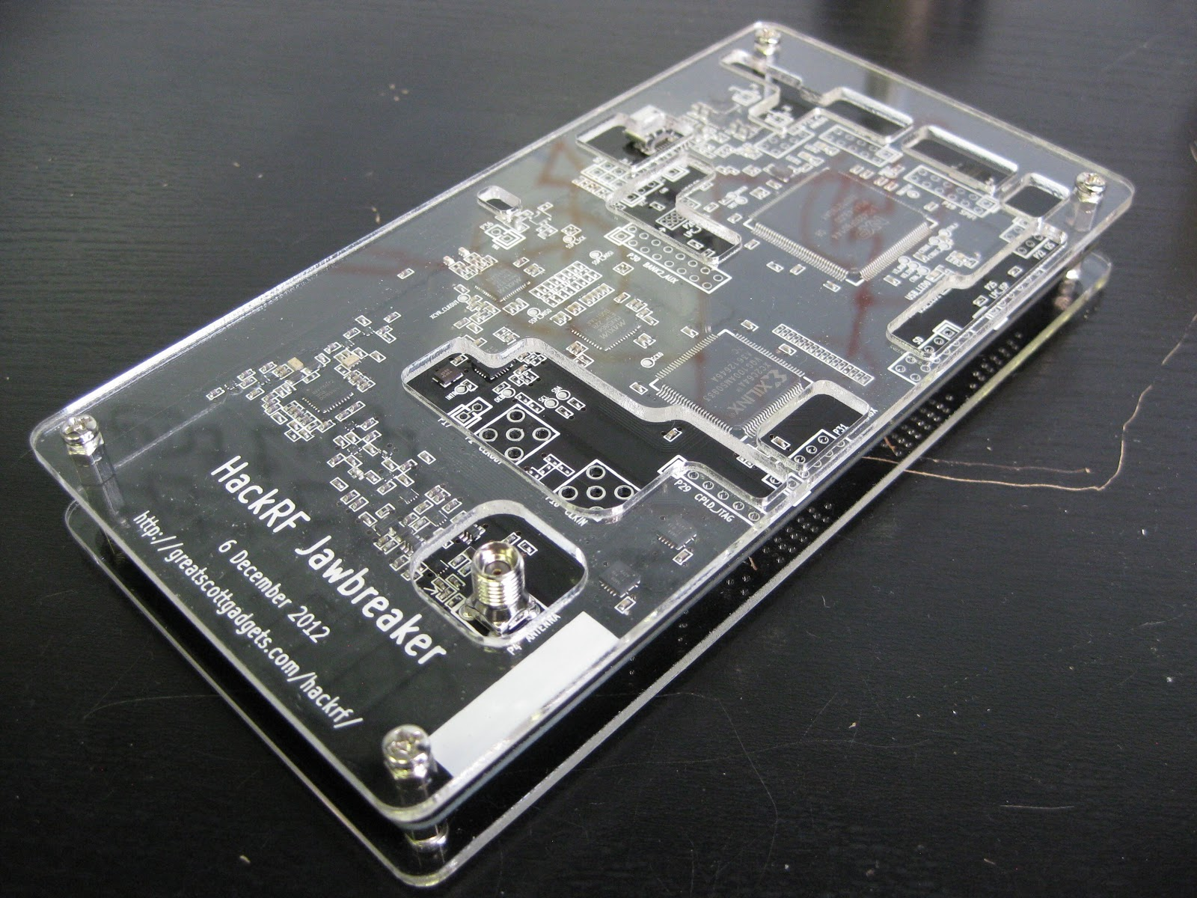
The Basics
Other options
  B200
    Reasonable price
    Good functionality
    70M to 6G
  Hack RF
    Half the price of B200
    Half Duplex :(
    5M to 6G (reportedly 200k to 7.2G)

Slide 10

The Basics
Things you can do with SDR
  Basic Radio broadcasts
    Must comply with FCC
  Amateur Radio
    License to transmit
  Radio Astronomy
  Track AIS (Automatic Identification System)
  Track Mode S (Aircraft)
  Build a GSM network
    FCC strikes again!!!
  Construct your own secure communication network
    Guerrilla radio at your own risk
  Satellite packet collection and more!

Slide 11
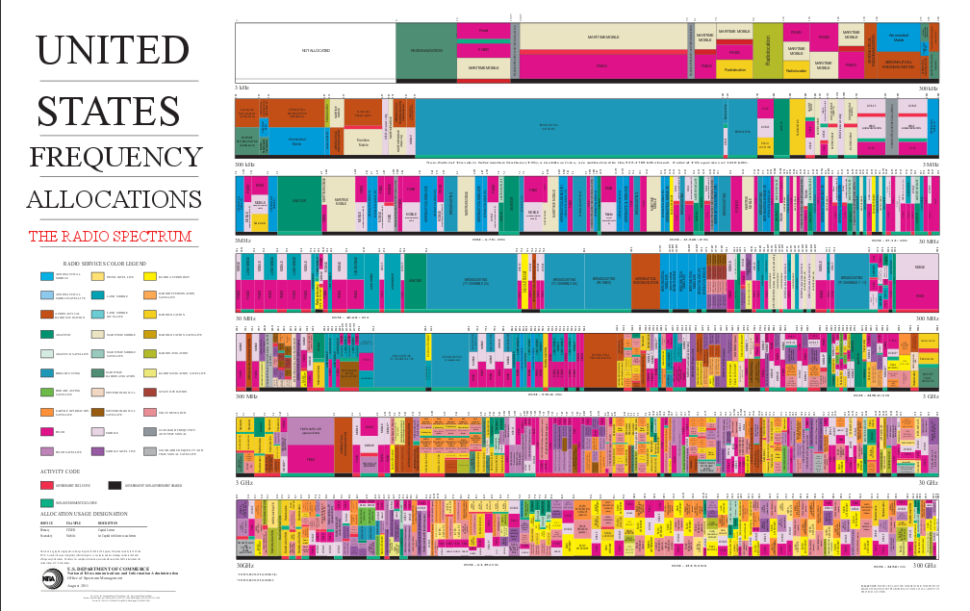
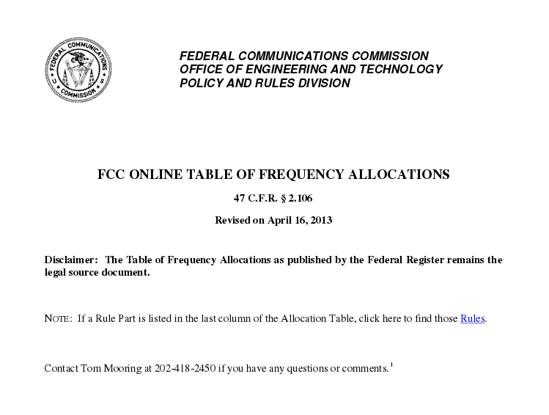
The Basics
Several Online Resources
  FCC
    Publicly available resources
    All laws regarding reception and transmission
  Community Sites
    RTL-SDR.com
    RTLSDR.org
  Other Hobbyist sites
    http://superkuh.com/rtlsdr.html
  Balint Seeber's page
    http://spench.net/drupal/research/sdr
    http://wiki.spench.net/wiki/Presentations
  GNURadio Course Videos
    https://www.youtube.com/playlist?list=PL618122BD66C8B3C4&feature=view_all
  AMSAT
    http://www.amsat.org/
  Other
    https://www.radioreference.com/apps/db/?ctid=1022

Slide 12
SDR for Security?
Data transfer is increasingly wireless
  Multi-modal vulnerabilities
    (cellular, WiFi, Bluetooth, RFID… any EMR)
Vulnerabilities are best found by you; not them
  Many security devices not built securely
  They often leak EM signals
  Attack vectors will only increase, more rapidly, over time
Helps security professionals think differently

Slide 13
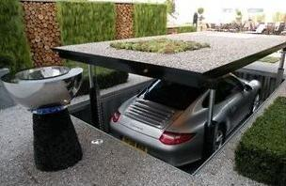

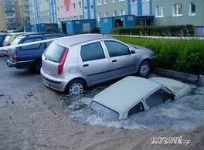

The Basics
Final Notes
  It does require some basic knowledge of radio theory
  Programming/electronics knowledge is also a plus
  Don't get frustrated... “Radio Happens”
  If you can think it, you can probably do it... possibly

Slide 14
Demonstrations
“Hello World” Dial tone (GNURadio)
FM Radio (GNURadio)
VHF/UHF Radio (gqrx)
Mode S Collection (Dump1090)

Slide 15

Any Questions?

