Slide 1
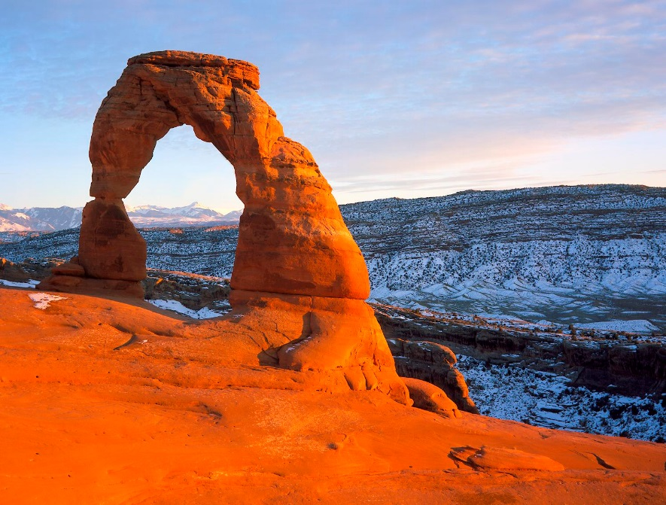
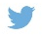

MUNICIPAL LEADER PERCEPTIONS of urban water issues in Utah
MELISSA
HAEFFNER,
PhD
@melissahaeffner
Courtney Flint, PhD
Douglas Jackson-Smith, PhD
ISSRM HOUGHTON MICHIGAN/2016
Notes:
Water in the American West is often framed from a top-down perspective as a crisis of how to meet growing demands associated with rapid population growth given a finite and potentially decreasing supply. Similarly, there is a large literature on state- and regional-scale struggles over water development projects across the region. Less well understood are the perspectives of local municipal leaders who actually develop and manage the water distribution and supply systems that serve most of the population. We argue that understanding the political water conversation at this scale is important for understanding why there might be differences in water supply management across a diverse social and biophysical landscape. We conducted 50 community key informant interviews across 12 municipalities in Utah to systematically understand the water concerns that animate their decision-making, with particular attention to the level of urgency and action surrounding water supply issues. Unlike federal and state scale narratives that emphasize the need for development of new water supplies and/or use reduction through conservation, local managers in Utah appear more concerned about maintenance of existing systems - securing existing water rights, protecting water quality, and fixing aging infrastructure. Further, we use results from recent surveys of residents in each municipality to compare the perceptions and concerns of municipal leaders with those of their constituents. The links between state, municipal, and resident discourses reveal a more well-rounded picture of how water is viewed by key local decision-makers in the West.

Slide 2
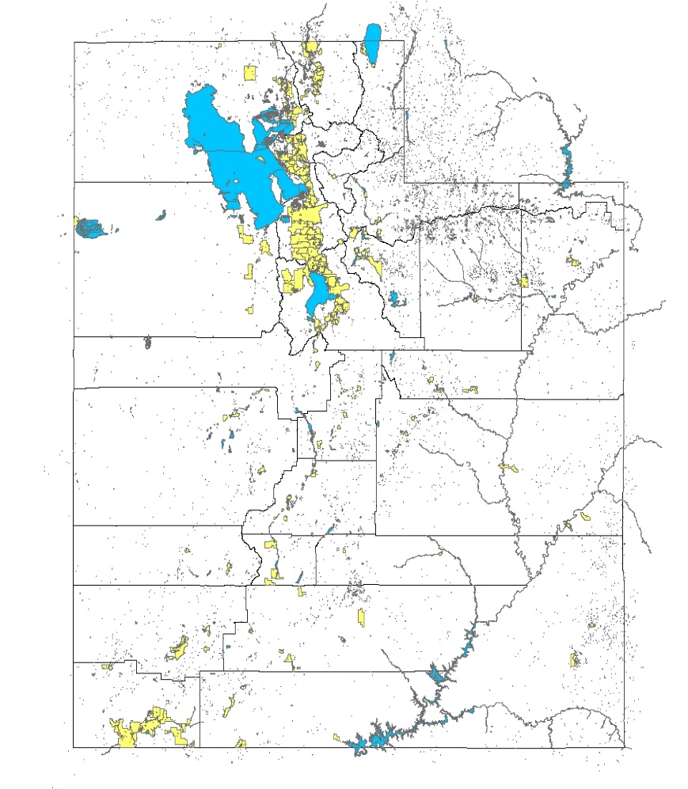
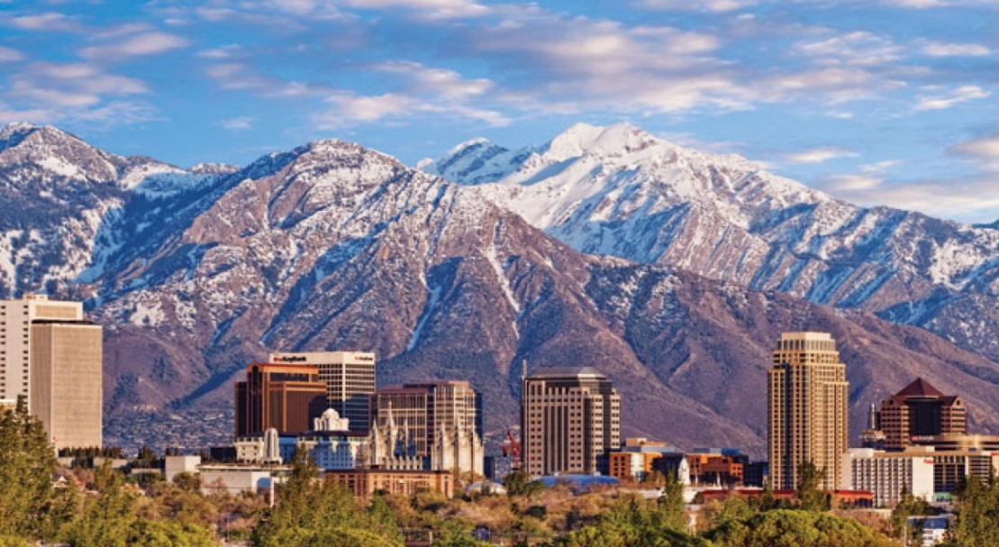

WHAT ARE municipal leader perceptions on water in Utah?

Slide 3
Methods
Purposive sample
12 cities
Selection
Semi-structured interviews
Techinique
NVIVO 11 Pro
Kappa coefficient
Analysis
Notes:
Kappa: .6681-.9357 original parent nodes
93-97% agreement original parent nodes

Slide 4
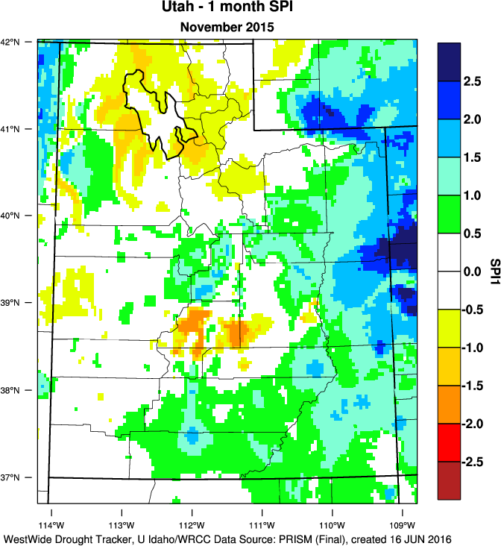
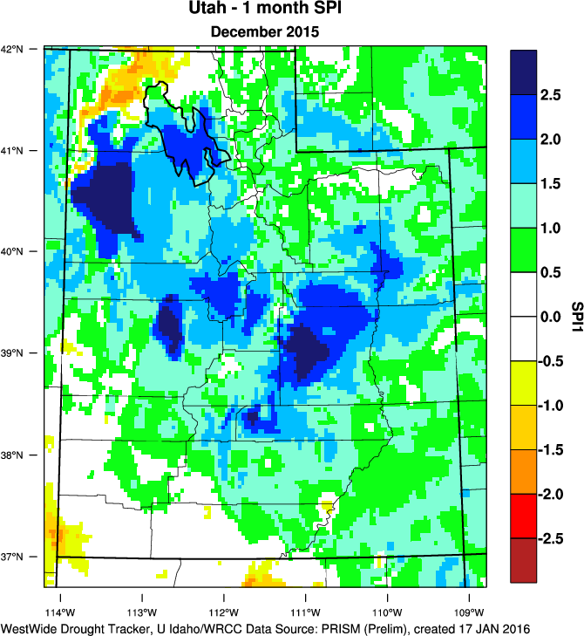
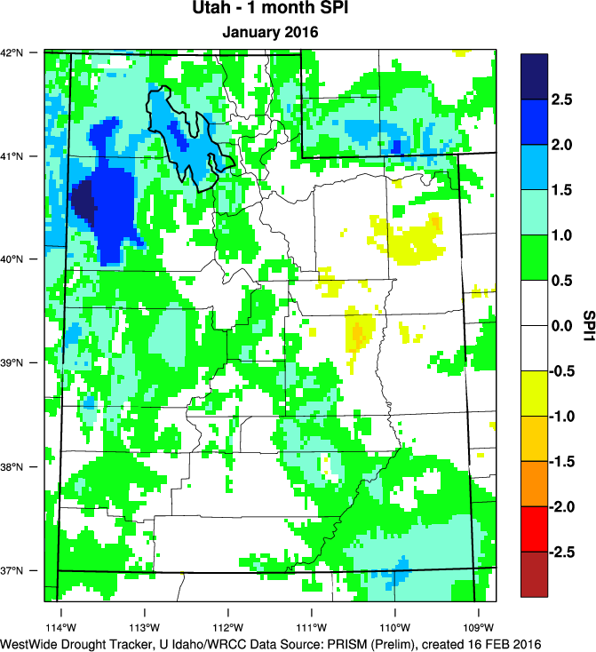
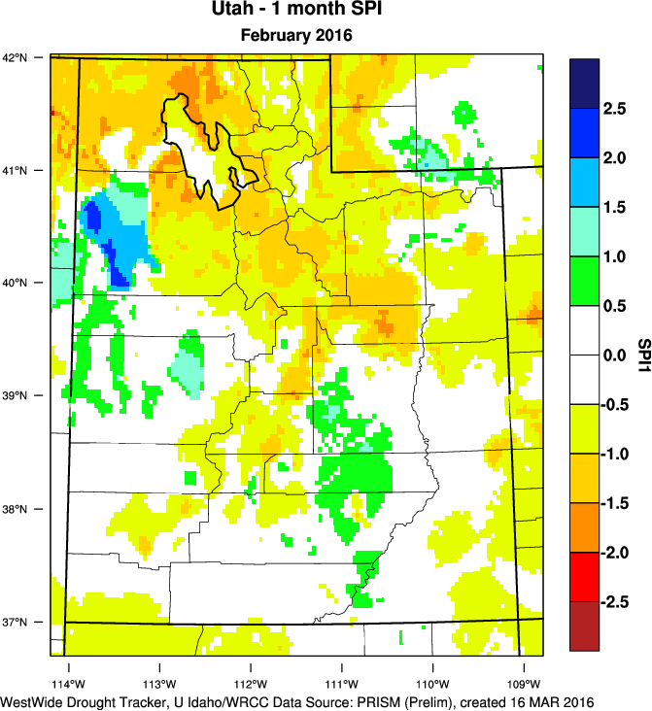
Geographic variability
Salt Lake
State capital
Suburbs
4th fastest growing in US
Heber
Economically significant agriculture
Cache
Sources: PRISM (Parameter-elevation Regressions on Independent Slopes Model http://prism.oregonstate.edu), National Weather Service Cooperative Observer Network

Slide 5
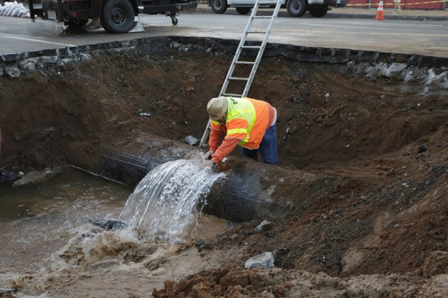
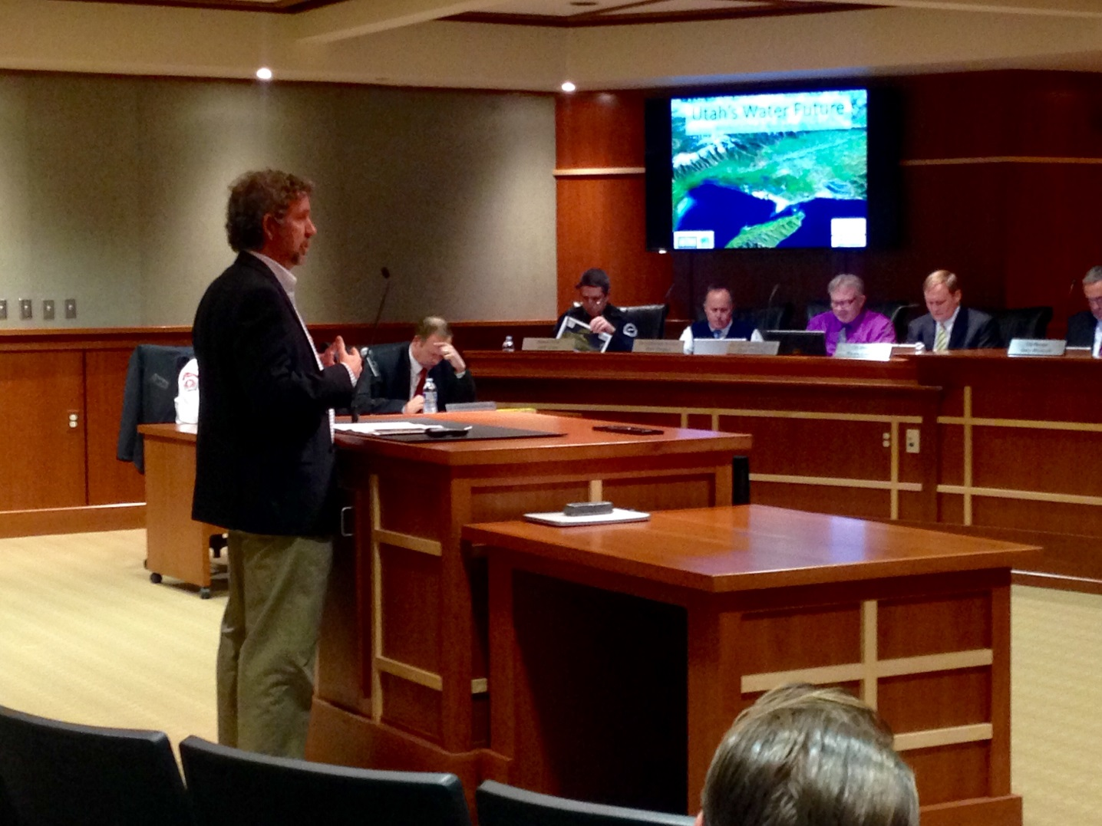
Actor variability
Mayors
City Council
Elected
Public utilities
Public works
Practitioner

Slide 6
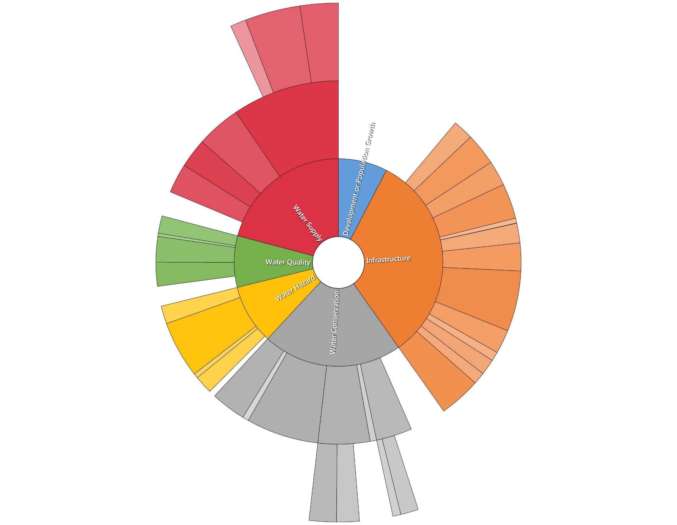
Development (338)
“Maintaining an expectation of maintaining a quality of life that [residents] are used to without growth just completely overwhelming them.”
Supply (1004)
“Right now our biggest issue is source and having enough source, we have two wells and a spring.”
Infrastructure (1571)
“The key water issue right now is infrastructure, the cost
of keeping it, maintaining.”
Rivers
Aquifers
Canyons
Watershed network
Rights
Aging
Storage
Canals
Future
Funding
Current
Development
Irrigation
Supply
Green
Waterways
Infrastructure
Large projects
Water Quality (385)
“I was elected 2 years ago and in knocking on a lot of doors to get elected, this was a top three issue; water quality.”
Pollution
Pipes and sewers
Drinking
Quality
Health
Hazards
Water
conservation
Irrigation
Flooding
Stormwater
Conservation/Cost (1041)
“The secondary water we are concerned about because it is unmetered now, it is a flat rate and people just over-water, just extremely over-water”
Climate/Snow
Willingness
Technology
Drought
Wells
Cost
Education
Wastewater
Hazards (446)
[There was] flooding in 2011, the river was very high, …we had NRCS provide funds, we had FEMA provide funds to repair breaks…”
Outdoor
Water pressure
Indoor
Reuse
Lawns
Farming
Programs
Water bills

Slide 7
Do key water issues of leaders in Utah cities differ by place?
“I will admit, uh, those areas that are blessed with water, they need to send it where people are not blessed with water” -Cache Valley
We’re trying to focus and delay as long as a possible the need to trigger the supply up in Bear Lake which would then result in the increase in cost.
- Salt Lake Valley
Salt Lake Valley (16) Cache Valley (14) Heber Valley (6)

Slide 8
Do key water issues of leaders in Utah cities differ by position?
“The political will requires education. We have found that if you’ll educate them …typically when we do a master plan… it’s a, it’s a long and difficult education process for councils and Mayors.”
- Practitioner
“In quantity is where I think we get worried a little bit because [our city] is 110,000 people and because we still have about 30 to 40% of our city that’s undeveloped.”
– Practitioner
“I think we’re, we’re not dumb enough to build out all the houses and then go, “Oh crap! We don’t have any more water!”
- Elected official, same city
Elected (24) Practitioner (18)

Slide 9
Salt Lake Valley (16) Cache Valley (14) Heber Valley (6)

Slide 10
Elected (24) Practitioner (18)

Slide 11
Summary
Different scales = different focus
Infrastructure is top priority for city leaders
Key issues differ by place and position
Overall, amount of time is spent on issues equally

Slide 12
Are these the same water issues of residents?
Life is good. So when we go in and start tearing up a canal …until we’re actually out there getting started, they could care less. The minute we start, “you idiots, what are you thinking? Why are you doing this?” - Practitioner
Residents Leaders

Slide 13

Column Sampling
federal
column
state
municipal
household
individual
Notes:
iUTAH organized multiple attributes and drivers of water use, water sustainability across scales
Core theme: whether or not cities and residents are responsive to water scarcity
Whether the social and institutional processes
That would allow proactive adaptation to cc are taking place
Column sampling can elicit more nuanced understanding
Polar scientists
Secondarily involved in working with some of these data
Rich resource for how households think about water situation

Slide 14
Thank you!
Elected officials
Public utility directors
Participants
Courtney Flint, PhD
Douglas Jackson-Smith, PhD
Co-authors
Natalie Harker Kenley
Ashley Bell
Transcribers
Matthew Barnett
Ennea Fairchild
Coders
This research was supported by NSF EPSCoR grant IIA 1208732 awarded to Utah State University, as part of the State of Utah EPSCoR Research Infrastructure Improvement Award.

Slide 15
Citations
PRISM (Parameter-elevation Regressions on Independent Slopes Model http://prism.oregonstate.edu), National Weather Service Cooperative Observer Network (COOP)

Slide 16
Are these the same key water issues of state actors?
How water is framed at state level
Selection

