Slide 1
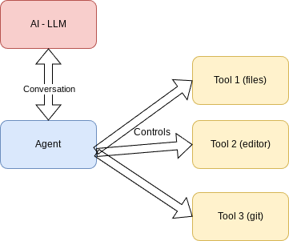
Agentic development
LLM – Local or remote
Agent – talks to LLM and controls tools
Various tools – do the work

Slide 2
Examples of AI agent development environments
Windsurf: https://windsurf.com/
Cursor: https://cursor.com/
Warp: https://www.warp.dev/
All-hands: https://www.all-hands.dev/
Claude Code: https://www.anthropic.com/claude-code
Gemini CLI: https://github.com/google-gemini/gemini-cli

Slide 3
MCP – Model Context Protocol
Unified communication protocol to communicate with tools using JSON-RPC
Proposed by Anthropic
Inspired by LSP (Language Server Protocol)
Quickly becoming the standard
Offers: Tools, Resources, Prompts and Introspection

Slide 4
Free Pascal / Lazarus support for MCP
MCP protocol implemented
Server & client side
Support for Tools, Resources and Prompts (completions)
Transport: StdIO Socket (HTTP: in the works)
IDE integration/IDE Control

