Slide 1



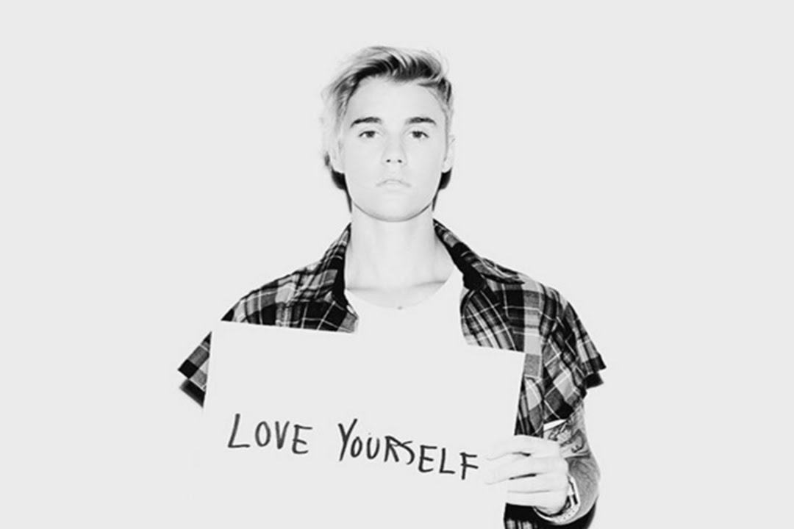
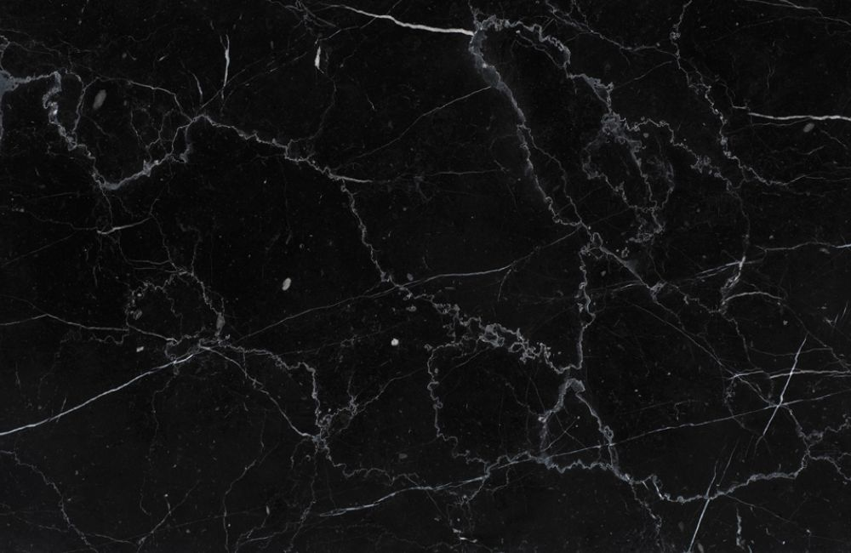
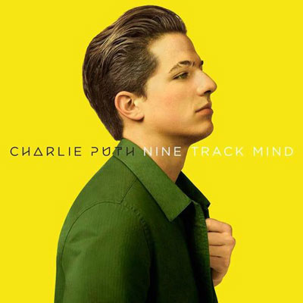
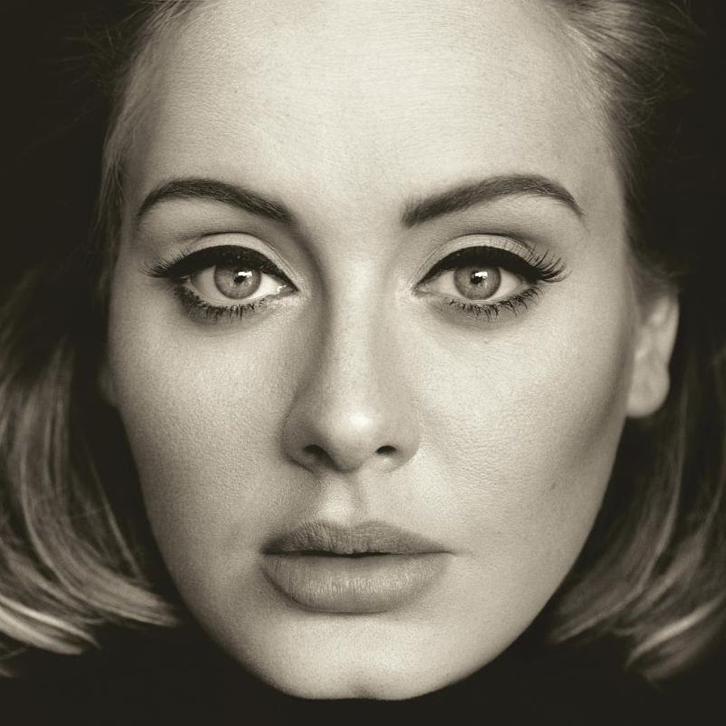
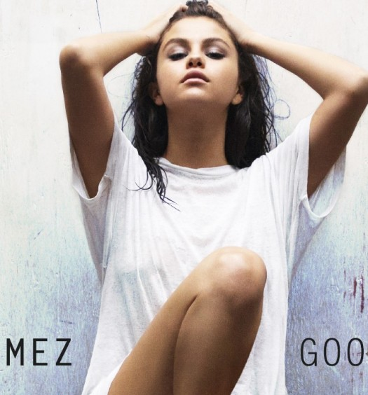






Home
Top 50 Hits
About
JUSTIN BIEBER
LOVE YOURSELF
CHARLIE PUTH
ONE CALL AWAY
ADELE
HELLO
SELENA GOMEZ
HANDS TO MYSELF
Copyright 2016

