Slide 1
陳祖宇 102590047 四資三

Slide 2

Home
Top 50 hits
Contact
No.1 Song and Album Introduce
No.2 Song Name
No.3 Song Name
No.4 Song Name

Slide 3




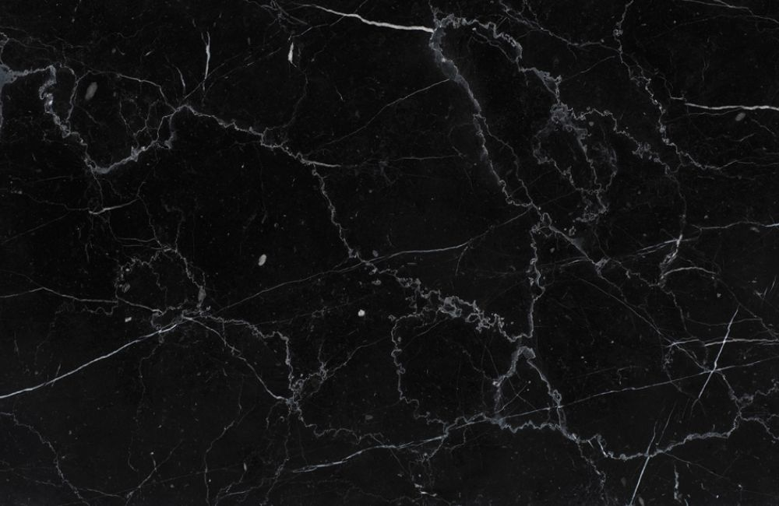

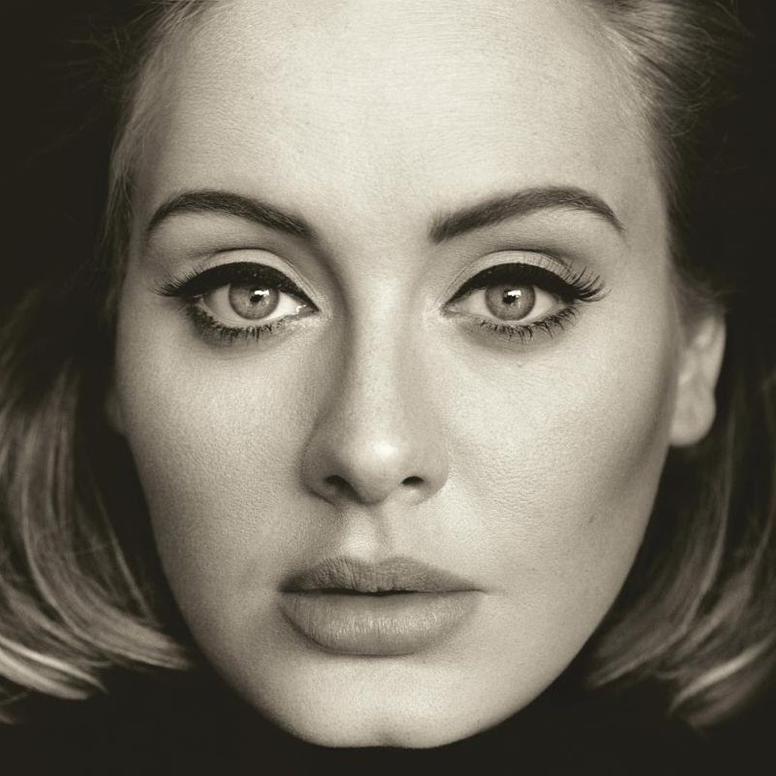







Home
Top 50 Hits
About
JUSTIN BIEBER
LOVE YOURSELF
CHARLIE PUTH
ONE CALL AWAY
ADELE
HELLO
SELENA GOMEZ
HANDS TO MYSELF
Copyright 2016

