Slide 1
HOMEPAGE
Specifications
Cakehub logo, search bar, add to cart icon is floating
Each slide is a divider
I removed Cake types and replaced it with dividers
Logo and icons are just buffers for layout
Cake types are the dividers and redirects when clicked
1st slide is about us (cake hub)
2nd slide is cake type 1
3rd slide is cake type 2
4th slide is cake type 3
Padding between dividers
Notes
-Maybe more noticeable icons
-Better or same font as logo

Slide 2





About Cakehub

Slide 3
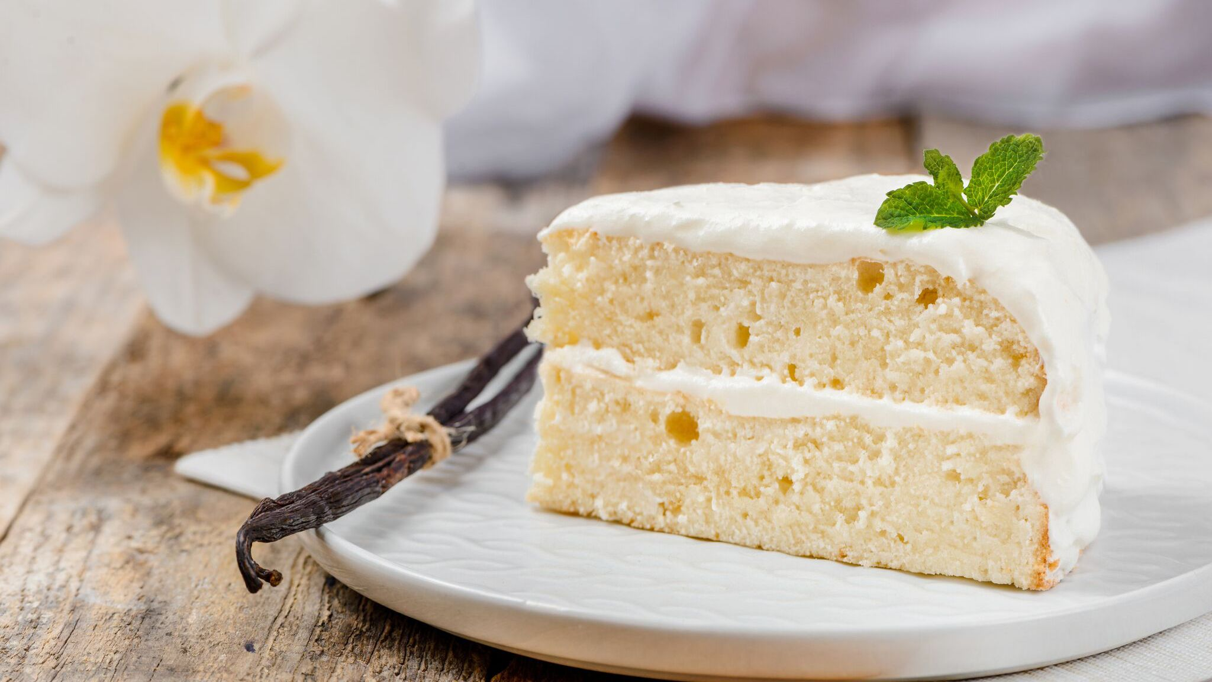
Back to the Classics

Slide 4
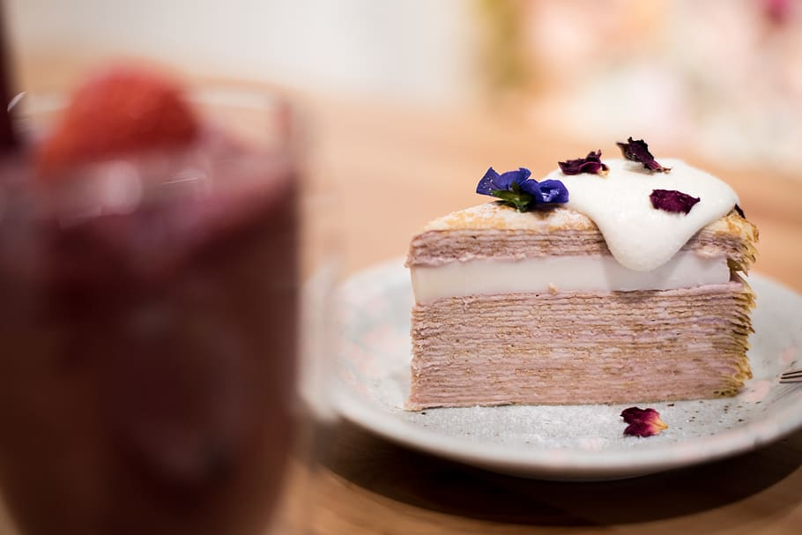
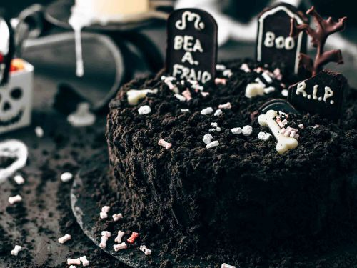




Themed Cakes

Slide 5
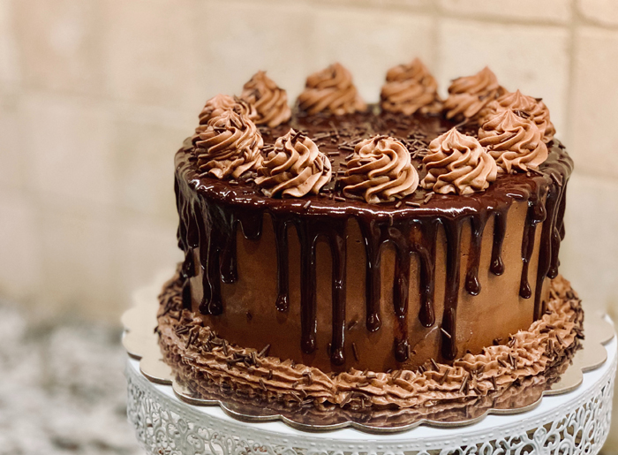
Personalize Your Cake

