Slide 1

Agenda
Introduction of case
Pipeline
EDA and Unsupervised learning
Train, metric selected and explain
Model for differential privacy
Train, tuning, monitor and deploy on AWS platform

Slide 2
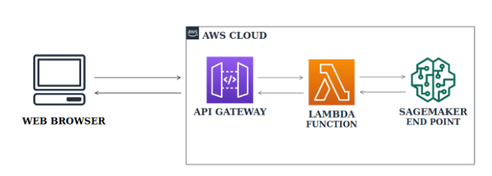




END TO END MACHINE LEARNING PIPELINE
Development platform-
Train, tuning and monitor
models with Sagemaker
Extract and
upload files
Git repo
Add/push
Local PC
Test api

