Slide 1

HR Workforce & Attrition
Analysis (2019-2025)
Geoflex Workforce Solutions
Examining workforce structure, employee attrition, recruitment effectiveness,
and data quality across Nigeria and Kenya.
PREPARED BY
Joecliff Ayibabrakemi Wilson
INSTRUCTOR
Mr. Felix R.R.
DATE
September 2026
Tools Used: Microsoft Excel • Power Query • Power BI • DAX • PowerPoint • AI Tools
AI tools for Research, brainstorming, documentation, and workflow support.

Slide 2
GeoFlex Workforce Solutions had HR information spread across eight separate datasets. The data contained duplicate records, missing values, inconsistent formats, and other quality issues, making it difficult to rely on for accurate workforce decisions. The first step was to clean, organize, and understand the data so it could provide reliable insights for decision-making.
K E Y I N S I G H T S
PROJECT OBJECTIVES
B U S I N E S S P R O B L E M
Customer Service recorded the highest departmental attrition rate at 18.3%, while Supply Chain recorded 13.3%.
Where is Geoflex actually losing and gaining workforce value across Nigeria and Kenya, and what should leadership fix first?
THE ANALYSIS FOCUSES ON THREE BUSINESS QUESTIONS
Campus Recruitment recorded a 17.9% hire rate, compared with 12.5% for Indeed.
01
Clean & validate 8 raw HR datasets (Excel / Power Query)
01
Where is employee attrition highest?
148 exit records contained negative tenure values, indicating recorded exit dates that occurred before the corresponding hire dates.
Build an interactive HR dashboard (Power BI)
02
02
Which recruitment sources produce the highest hire rates?
Only 1.3% of performance reviews fell into the High performance category.
03
Turn findings into recommendations for management
03
Which departments and branches require further HR attention?
The recruitment status field cannot reliably represent the hiring funnel because it combines stages and outcomes in one field.
GEOFLEX WORKFORCE SOLUTIONS | HR ANALYTICS PROJECT

Slide 3
E X E C U T I V E S U M M A R Y
Bottom Line Up Front
Geoflex has a 2,500-person workforce that is growing and diverse. However, the 14.5% overall attrition rate does not tell the full story. Most employee exits are concentrated in a few departments and branches, with the highest risk occurring during employees’ first year.
14.5%
68%
28.0%
1,053
Attrition varies significantly by branch, ranging from 7.4% in Ilorin to 23.1% in Busia.
A significant share of recorded exits occurred within employees’ first year, while some records were flagged for invalid tenure data.
Walk-In/organic channels generated more hires than Indeed, which accounted for just 12.5%.
Duplicate records removed across 8 source tables before any analysis began
WHAT THIS MEANS FOR LEADERSHIP
Leadership should focus retention efforts on the areas experiencing the most employee exits, particularly Customer Service, Administration, Busia and Lokoja branches, and employees in their first year, rather than using the same approach across the entire company.
While also fixing data-quality issues such as duplicate records, inconsistent status fields, and currency differences that may affect the accuracy of these findings.
GEOFLEX WORKFORCE SOLUTIONS | HR ANALYTICS PROJECT

Slide 4
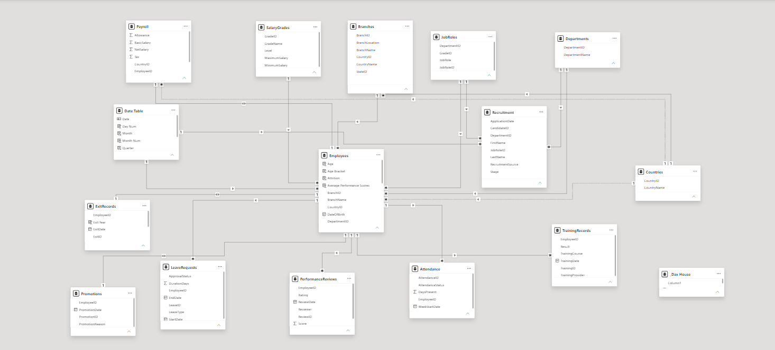
K E Y V I S U A L S - D A T A M O D E L I N G S T R U C T U R E
EmployeeID
GEOFLEX WORKFORCE SOLUTIONS | HR ANALYTICS PROJECT

Slide 5
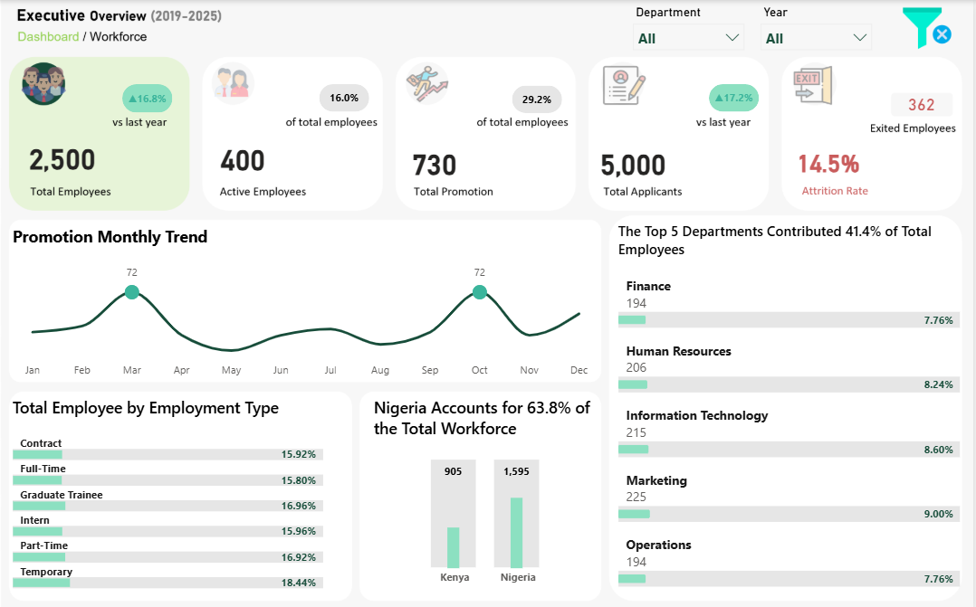
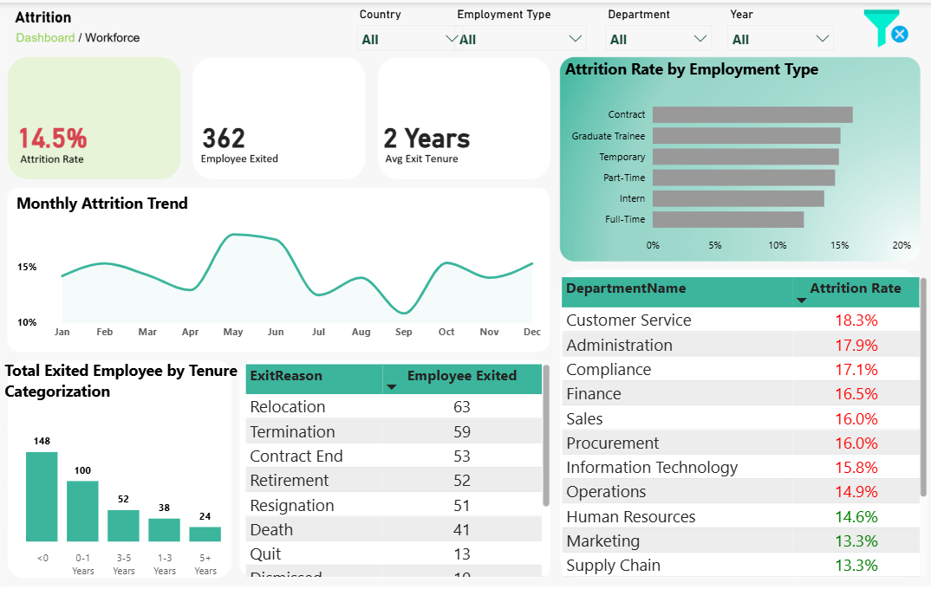
K E Y V I S U A L S — T H E D A S H B O A R D
EXECUTIVE OVERVIEW
ATTRITION ANALYSIS
GEOFLEX WORKFORCE SOLUTIONS | HR ANALYTICS PROJECT

Slide 6
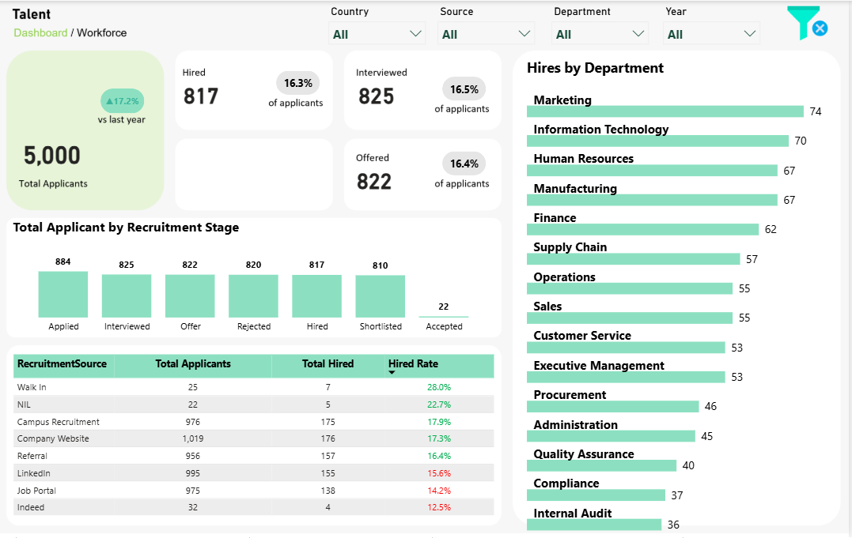
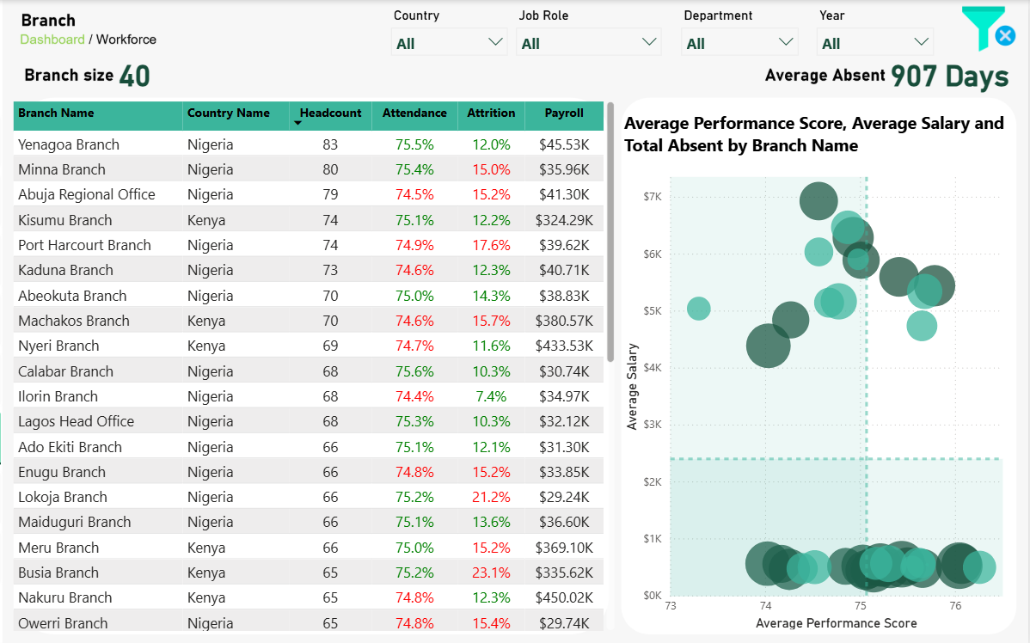
K E Y V I S U A L S — T H E D A S H B O A R D
TALENT ACQUISITION
BRANCH COMPARISON
GEOFLEX WORKFORCE SOLUTIONS | HR ANALYTICS PROJECT

Slide 7
R E C O M M E N D A T I O N S
Five Practical Next Steps
01
Before introducing a company-wide retention programme, leadership should first understand why employees are leaving in Customer Service, Administration, Busia, and Lokoja, where retention appears to be a greater concern.
02
Compare the cost of each recruitment source with the number of hires it generates to identify which sources provide the best results and deserve more attention.
03
Investigate why employees are leaving within their first year and review whether the onboarding process and early employee support are addressing their needs effectively.
04
Correct negative tenure records and verify that each employee’s exit date is consistent with their hire date to ensure tenure is reported accurately.
05
Clean and reorganize the recruitment data so that each applicant’s progress from application to interview, offer, and hiring can be tracked correctly. This will help the business know where applicants are being lost and how effective its recruitment process is.
GEOFLEX WORKFORCE SOLUTIONS | HR ANALYTICS PROJECT

Slide 8
THANK YOU
Questions & discussion welcome.
Joecliff Ayibabrakemi Wilson
HR Workforce & Attrition Analysis (2019 -2025) — Geoflex Workforce Solutions
Special Acknowledgement
A special thank you to my instructor, Mr. Felix R. R., for his guidance and support throughout this project.
github.com/joecliffayibabrakemi-debug/HR-Workforce-Attrition-Analysis-Geoflex-Workforce-Solutions
linkedin.com/in/joecliff-wilson

