Slide 1
Bash Scripting
CIRC Summer School 2016
Baowei Liu

Slide 2
About the Class
Lectures along with example demonstrations. Project session for hands-on experience. Have a project?
Trying examples and doing projects on Bluehive

Slide 3
Bash Script
Unix/Linux commands in a text file – batch mode
An executable program to be run by the shell (Bash)

Slide 4
Model for Modern OS
Users
Shell
Kernel
Hardware

Slide 5
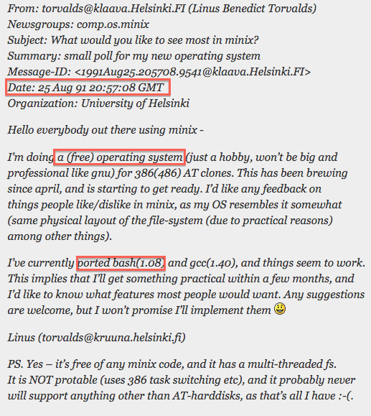
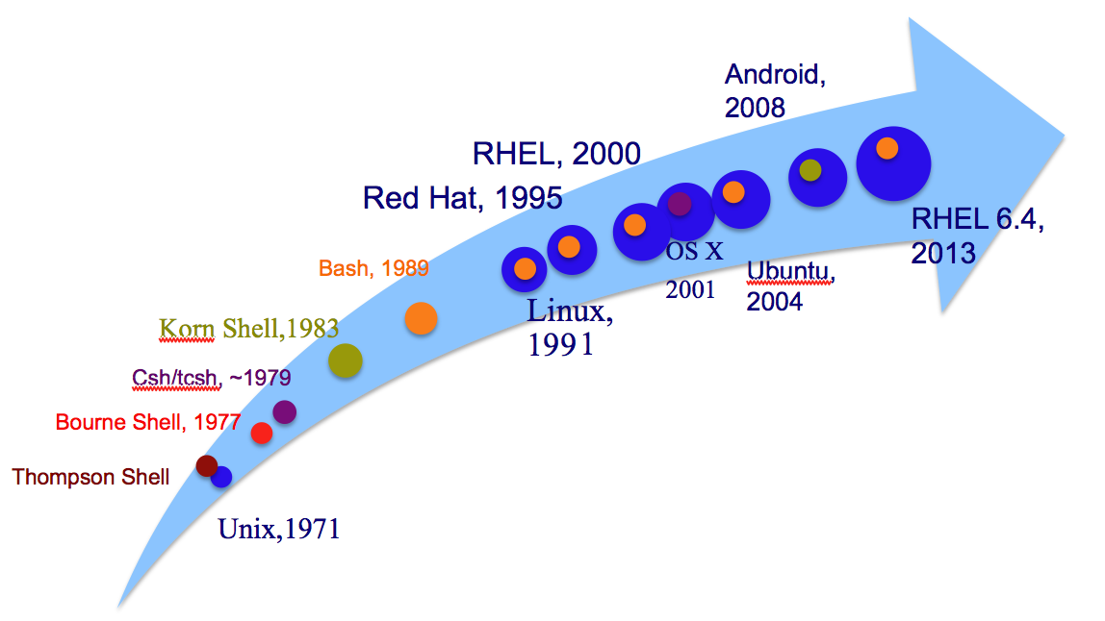

Linux and Shells
https://en.wikipedia.org/wiki/

Slide 6
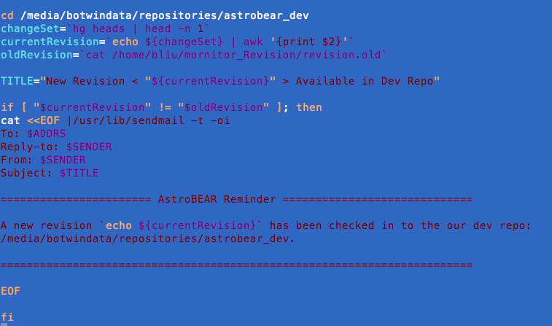

Bash Script VS. Command Lines
Easy to edit: long command lines
Record & reusable: many command lines or options
Flexible and Efficient: Run with different arguments.
Easy to use with job scheduler

Slide 7
Bash Script VS. Other Script Language
Easy to program: the commands and syntax are exactly the same as those directly entered at the command line. Quick start.
Only need a Linux system to run
Slow run speed comparing with other programming languages
Not easy for some tasks like floating point calculations or math functions

Slide 8
Scenarios Using Bash Script
Manipulate files: handle large number of files, change individual parameters in data files, etc.
Wrap up programs: pipeline different tools with different options/flags

Slide 9
To Write a Bash Script
An editor: vi emacs, nano,….
Some Linux commands
Set executable permission
Specify interpreter as bash: #!/bin/bash
Comments: # (single line)

Slide 10
Some Linux Commands
ls: list directory contents
cd: change directory
man: manual
echo

Slide 11
Linux Command echo
Display a line of text
Example: echo hello world
“…” or ‘…’

Slide 12
File permissions
Three scopes and permissions
Bash script has to have execute permission to allow the operating system to run it.
Check permissions: ls –l
Change permissions: chmod +x filename

Slide 13
Day 1 Examples
ssh to bluehive:
Create a directory for this class:
mkdir folderName
cp /public/bliu17/Teaching/Bash/shareFiles.sh .
./shareFiles.sh Day1

Slide 14
Bash Variables
Create a variable: name=value
No data type
No need to declare but can be declared with “declare command”
No white space allowed before and after =
Use $ to refer to the value: $name
Name cannot start with a digit.

Slide 15
Environment Variables
env
$SHELL
$PATH
$LD_LIBRARY_PATH
$RANDOM
$USER
$PWD

Slide 16
Variable Value
Assign value: a=2
Pass value: b=$a
Display value: echo $a
Strong quoting & weak quoting

Slide 17
Assign Variable Value
Parameter expansion ${}
Command Substitution: $(), or `
Arithmetic expansion: $(( … ))

Slide 18
Parameter and Parameter Expansion
Parameter – an entity store value ( e.g. variable)
${parameter}
Indirection ${!parameter}

Slide 19
Arithmetic Expression
Arithmetic operators: + - * /
Integer only
Arithmetic Expansion ((…))
White spaces are not important

Slide 20
Basic calculator: bc
An arbitrary precision calculator language
Simple usage: echo $a+$b | bc
Can use math library: echo “s(0.4)” | bc -l
bc –l <<< “s(0.4)”

Slide 21
Command Substitution
$() is nestable
echo $(echo $(ls))
echo “$(echo “$(ls)”)”
cannot be $(( command ))
`` cannot be directly nesting
echo `echo \`ls\``

Slide 22
Shell Expansions Review
Parameter Expansion: $variable, ${variable}
Arithmetic Expansion: $(( expression ))
Command Substitution: $() or ``

Slide 23
Loop Constructs: for loop
Basic Syntax
for arg in [list]
do
…..
done
[list]:
1. Command Substitution: `ls`
2. Arithmetic Expansion
3. Brace Expansion (string or integer): {1..5}

Slide 24
for loop –Arithmetic Expansion
Basic Syntax
for (( expr1; expr2; expr3 ))
do
…
done
Examples:
White space are not important for Arithmetic Expansion

Slide 25
Project
Copy the Project folder to your own directory: ./shareFiles.sh Project
Write a Bash script to count how many files there are in files/
Key tech: editor, chmod, command substitution, for loop, arithmetic expansion, echo

