Slide 1
Low-Power Architectures and Design Techniques
Mohsen Nasroullasi
Robert Pawlowski
Joe Crop

Slide 2
Overview
Survey: Lower-Power Techniques
Simulation & Implementation: Sub-Threshold / Asynchronous Circuits
Simulation: Sub-Threshold Multi-Core Processing

Slide 3
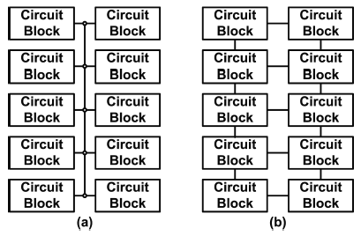
Data Bus Partitioning
Reduces dynamic power consumption by reducing the capacitive load of the bus.
Method used in recent Intel 48-core processor
[4 ] S. Meliza ”Ultra low energy digital logic controller design for wireless sensor net-works,” M.S. dissertation, OSU, Corvallis Oregon, 2009.
[24] J. Howard, S. Dighe, Y. Hoskote, et al., "A 48-Core IA-32 Message-Passing Processor with DVFS
in 45nm CMOS", ISSCC 2010 Digest of Technical Papers, pp. 108-109, Feb., 2010.

Slide 4
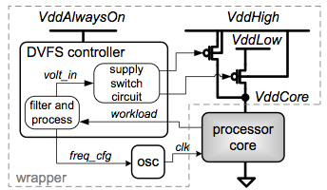
Dynamic Voltage and Frequency Scaling (DVFS)
Reduces dynamic and static power by dynamic scaling of V_{dd} and frequency.
Draw backs: Design complexity and hardware overhead
[22] Cheng, W.H.; Baas, B.M.; , "Dynamic voltage and frequency scaling circuits with two supply voltages," Circuits and Systems, 2008. ISCAS 2008. IEEE International Symposium on , vol., no., pp.1236-1239, 18-21 May 2008.

Slide 5
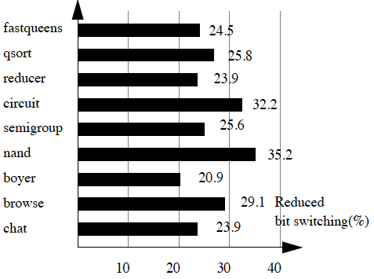
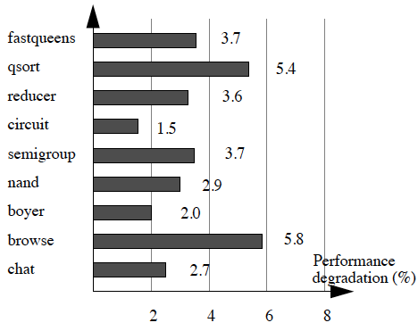
Cold Scheduling
Re-ordering instructions reduces switching activity within CPU
Therefore, reduced energy consumption
Bit switching reduction of cold scheduling
Performance degradation due to cold scheduling
[23] ‪C. L. Su, C. Y. Tsui, and A. M. Despain. "Low power architecture design and compilation techniques for high-performance processors." IEEE COMPCON, Feb. 1994.‬

Slide 6
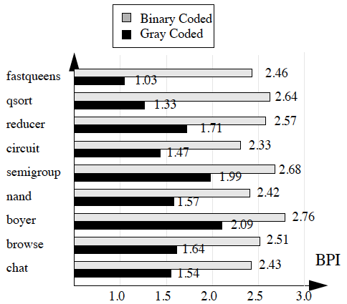
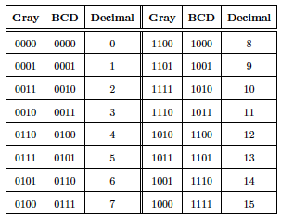
Gray-Coding
Reduces number of bit transitions
Good for PC
Drawback: random access can result more bit transitions than BCD
[4 ] S. Meliza ”Ultra low energy digital logic controller design for wireless sensor net-works,” M.S. dissertation, OSU, Corvallis Oregon, 2009.
[23] ‪C. L. Su, C. Y. Tsui, and A. M. Despain. "Low power architecture design and compilation techniques for high-performance processors." IEEE COMPCON, Feb. 1994.‬

Slide 7
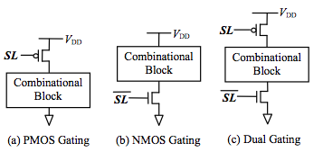
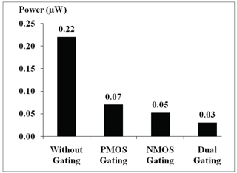
Power Gating
Reduces static power consumption by turning off blocks which are not in use.
Drawbacks:
Increases area overhead.
Slower startup and shutdown.
Logic overhead to generate the control signals.
[21] Tong Lin; Kwen-Siong Chong; Bah-Hwee Gwee; Chang, J.S.; , "Fine-grained power gating for leakage and short-circuit power reduction by using asynchronous-logic," Circuits and Systems, 2009. ISCAS 2009. IEEE International Symposium on , vol., no., pp.3162-3165, 24-27 May 2009

Slide 8
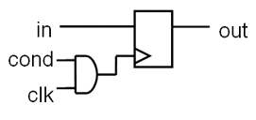
Clock Gating
Reduces dynamic energy by disabling the clock on registers when the block is not in use.

Slide 9
Sub-Threshold / Asynchronous Multiplier
Does the pairing of sub-threshold and asynchronous logic reduce the energy consumption over conventional sub-threshold logic design?
Sub-threshold operation
Asynchronous operation
Sub-threshold Asynchronous Multiplier

Slide 10
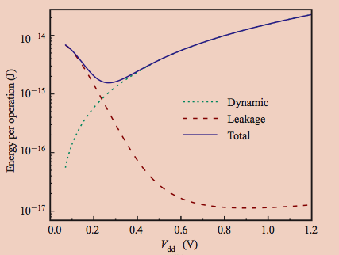
Sub-threshold Operation
Sub-threshold logic is run with a supply voltage below the Vt of the transistor
Leakage energy increases as supply voltage decreases.
[6 ] S. Hanson, et al., ”Ultralow-voltage minimum-energy CMOS,” IBM Journal of Research and Development, Vol. 50, pp. 469-90, 2006.

Slide 11
Asynchronous logic
Event driven – no clock.
Advantages
Burn only leakage power before waking to perform the computation.
Tolerant of input vector/process variations.
Take away need to design a high-fanout, timing-sensitive clock signal.
Removal of clock drivers results in less power consumption
Disadvantages
Increase in circuit complexity.
Increase in area.

Slide 12
Asynchronous Handshaking
Control Signal
Control Block
Ready
Ready
Ready
Ready
Ready
Ready
Ready
Done
Done
Done
Done
Done
Done
Done
Logic Block
Data Signal

Slide 13
Asynchronous Handshaking
Ready
Ready
Done
Done

Slide 14
Asynchronous Handshaking
Busy
Ready
Busy
Done

Slide 15
Asynchronous Handshaking
Busy
Ready
Done
Done

Slide 16
Asynchronous Handshaking
Done
Ready
Done
Done

Slide 17
Asynchronous Handshaking
Done
Busy
Done
Busy

Slide 18
Asynchronous Handshaking
Done
Busy
Done
Done

Slide 19
Asynchronous Handshaking
Done
Done
Done
Done

Slide 20
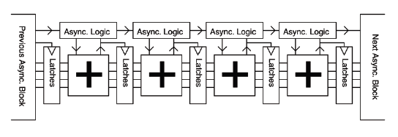
Asynchronous Multiplier

Slide 21
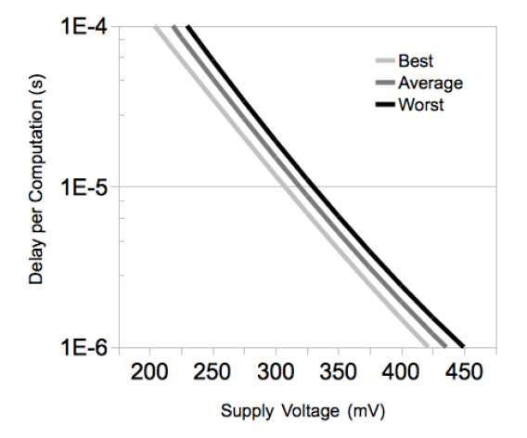
Sub-threshold Asynchronous Multiplier
Implemented at a supply voltage of 350mV
1.17pJ/computation, 11.3 kHz
Compared to synchronous sub-threshold multiplier
2.92 pJ/computation
Asynchronous architecture takes
advantage of delay variation of operands
Reduces Static Power
C. Singh, et al., “A 4-bit Subthreshold MIPS Processor for Ultra Low Power Applications,” [Online document] April. 2008 [2010 Jan 30], Available at HTTP: http://users.ecel.ufl.edu/~csingh/MIPS.pdf, April 2008.

Slide 22
Sub-threshold Multi-Core – (Overview)
Does a multi-core sub-threshold processor with throughput M utilize less energy than a single-core super-threshold processor with throughput M?
Assumptions:
The code being executed is perfectly parallelizable
Throughput is proportional to clock speed
MSP430 Microcontroller used for simulations

Slide 23
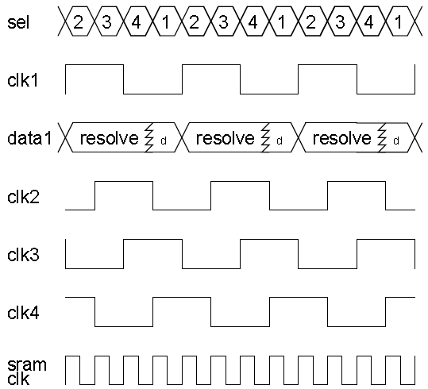
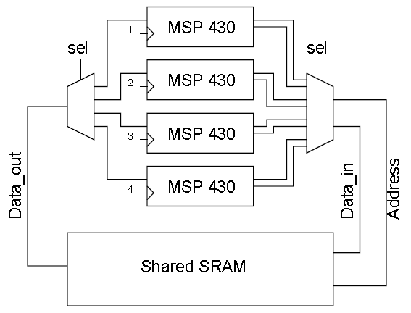
Sub-Threshold Multi-Core - (Theoretical Timing)

Slide 24
Sub-Threshold Multi-Core - (Theoretical Timing)

Slide 25
Sub-Threshold Multi-Core - (Theoretical Timing)

Slide 26
Sub-Threshold Multi-Core - (Theoretical Timing)

Slide 27
Sub-Threshold Multi-Core - (Theoretical Timing)

Slide 28
Sub-Threshold Multi-Core - (Theoretical Timing)

Slide 29
Sub-Threshold Multi-Core - (Theoretical Timing)

Slide 30
Sub-Threshold Multi-Core - (Theoretical Timing)

Slide 31
Sub-Threshold Multi-Core – (Simulation Results)
 | Nominal | Sub-threshold | 4 Core Equivalent
Max Speed | 500MHz | 125MHz | 125MHz x 4
Voltage | 1.2V | 0.84V | 0.84V
Energy (J/comp) | 26.4E⁻¹² | 6.23E⁻¹² | 24.92E⁻¹²
Pros | Small Area | Low-Power | Energy Efficiency
Cons | High-Power | Slow, Less Reliable | Large Area, Complexity, IO!
Power can be reduced by this method.
However, not actually sub-threshold

Slide 32
Sub-Threshold Multi-Core – (Simulation Results)
 | Nominal | Sub-threshold | 152 Core Equivalent
Max Speed | 500MHz | 3.3MHz | 3.3MHz x 152
Voltage | 1.2V | 0.6V | 0.6V
Energy (J/comp) | 26.4E⁻¹² | 3.24E⁻¹² | 492E⁻¹²
Pros | Small Area | Low-Power | Energy Efficiency
Cons | High-Power | Slow, Less Reliable | Large Area, Complexity, IO!
In theory, Sub-threshold Multi-core processors are more power efficient.
However, currently impractical
Don’t know the optimal case

Slide 33
References
[1 ] Paul R. Gray, Paul J. Hurst, Stephen H. Lewis, Robert G. Meyer, ”Analysis And Design Of Analog Integrated Circuits,” 5Th Ed, Wiley, New York, 2009.
[2 ] C. Su, C. Tsui, A. Despain, ”Low power architecture design and compilation techniques for high performance processors,” Proceedings of the IEEE COMPCON, February 1994.
[3 ] G. Blair, ”Designing low-power digital CMOS,” Electronics & Communication Engineering Journal, vol. 6, no. 5, pp. 229-236, Oct. 1994.
[4 ] S. Meliza ”Ultra low energy digital logic controller design for wireless sensor net-works,” M.S. dissertation, Oregon State University, Corvallis Oregon, 2009.
[5 ] A. Wang and A. Chandrakasan, ”A 180-mv subthreshold fft processor using a minimum energy design methodology,” Solid-State Circuits, IEEE Journal of, vol.40, no. 1, pp. 310-319, 2005.
[6 ] S. Hanson, et al., ”Ultralow-voltage minimum-energy CMOS,” IBM Journal of Research and Development, Vol. 50, pp. 469-90, 2006.
[7 ] T. Sakurai, ”Low power digital circuit design,” in Proc. of the 30th European Solid-State Circuits Conf., Sep. 2004, pp. 11-18.
[8 ] H. Soeleman and K. Roy, ”Ultra-low power digital subthreshold logic circuits,” in IEEE International Symposium on Low Power Electronics and Design, 1999, pp.94-96.
[9 ] B. Zhai, et al., ”A 2.60pJ/Inst. Subthreshold Sensor Processor for Optimal Energy Effi- ciency,” IEEE Symposium on VLSI Circuits (VLSI-Symp), June 2006.
[10 ] B. Gwee, et al, ”A Low-Voltage Micropower Asynchronous Multiplier With Shif-tAdd Multiplication Approach,” IEEE Transactions on Circuits and Systems I: Reg-ular Papers, Vol. 57, No. 7, pp. 1349-1359, July 2009.
[11 ] C. Singh, et al., ”A 4-bit Subthreshold MIPS Processor for Ultra Low Power Applications,” [Online document] April. 2008 [2010 Jan 30], Available at HTTP: http://users.ecel.ufl.edu/ csingh/MIPS.pdf, April 2008.
[12 ] W. Chedid, C. Yu, and B. Lee, ”Power Analysis and Optimization Techniques for Energy Efficient Computer Systems,” Advances in Computers, Vol. 63, 2005.
[13 ] William Dally et al. ”Stream Processors: Programmability with Efficiency” ACM Queue, March 2004, pp. 52-62.

Slide 34
References
[14 ] Kapasi, U. J., Rixner, S., Dally, W. J., Khailany, B., Ahn, J. H., Mattson, P., and Owens, J. D. 2003. ”Programmable Stream Processors.” Computer 36, 8 (Aug.2003), 54-62.
[15 ] Khailany, B., Dally, W. J., Rixner, S., Kapasi, U. J., Owens, J. D., and Towles, B. 2003. ”Exploring the VLSI Scalability of Stream Processors.” In Proceedings of the 9th international Symposium on High-Performance Computer Architecture(February 08 - 12, 2003). HPCA. IEEE Computer Society, Washington, DC, 153.
[16 ] Tong Lin; Kwen-Siong Chong; Bah-Hwee Gwee; Chang, J.S.; , ”Fine-grained power gating for leakage and short-circuit power reduction by using asynchronous-logic,” Circuits and Systems, 2009. ISCAS 2009. IEEE International Symposium on , vol., no., pp.3162-3165, 24-27 May 2009.
[17 ] Nair, P.S.; Koppa, S.; John, E.B.; , ”A comparative analysis of coarse-grain and fine-grain power gating for FPGA lookup tables,” Circuits and Systems, 2009. MWSCAS ’09. 52nd IEEE International Midwest Symposium on , vol., no., pp.507-510, 2-5 Aug. 2009.
[18 ] Ming-Dou Ker; Tzu-Ming Wang; Fang-Ling Hu; , ”Design on mixed-voltage I/O buffers with slew-rate control in low-voltage CMOS process,” Electronics, Circuits and Systems, 2008. ICECS 2008. 15th IEEE International Conference on , vol., no., pp.1047-1050, Aug. 31 2008-Sept. 3 2008
[19 ] Sulaiman, D.R.; , ”Using clock gating technique for energy reduction in portable computers,” Computer and Communication Engineering, 2008. ICCCE 2008. In-ternational Conference on , vol., no., pp.839-842, 13-15 May 2008.
[20 ] Calhoun, B.H.; Wang, A.; Verma, N.; Chandrakasan, A.; , ”Sub-Threshold Design: The Challenges of Minimizing Circuit Energy,” Low Power Electronics and Design, 2006. ISLPED’06. Proceedings of the 2006 International Symposium on , vol., no., pp.366-368, 4-6 Oct. 2006.
[21] Tong Lin; Kwen-Siong Chong; Bah-Hwee Gwee; Chang, J.S.; , "Fine-grained power gating for leakage and short-circuit power reduction by using asynchronous-logic," Circuits and Systems, 2009. ISCAS 2009. IEEE International Symposium on , vol., no., pp.3162-3165, 24-27 May 2009.
[22] Cheng, W.H.; Baas, B.M.; , "Dynamic voltage and frequency scaling circuits with two supply voltages," Circuits and Systems, 2008. ISCAS 2008. IEEE International Symposium on , vol., no., pp.1236-1239, 18-21 May 2008.
[23] ‪C. L. Su, C. Y. Tsui, and A. M. Despain. "Low power architecture design and compilation techniques for high-performance processors." IEEE COMPCON, Feb. 1994.‬
[24] J. Howard, S. Dighe, Y. Hoskote, et al., "A 48-Core IA-32 Message-Passing Processor with DVFS
in 45nm CMOS", ISSCC 2010 Digest of Technical Papers, pp. 108-109, Feb., 2010.

