Slide 1
Design verification using Specman
Instruction for interfacing specman with Modelsim

Slide 2
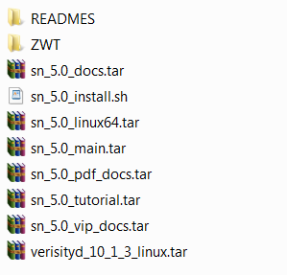
Install Specman
1. Get a Specman installation packet from somewhere or you can get a cracked one from us.
2. Making sure you have all tar files:

Slide 3
Run installation script
Using sh ./sn_5.0_install.sh -64bit command to run the installation script. (Recommand try it on engineering computer lab)
Choosing completely install.

Slide 4
Setup environment parameter
1. Setup VRST_HOME
setenv VRST_HOME /path_where_you_install
source $VRST_HOME/env.csh -64bit
2. Setup SPECMAN_HOME
source $VRST_HOME/env.csh SPECMAN_HOME=sn_5.0
3. Setup LM_LICENSE_FILE
source $VRST_HOME/env.csh LM_LICENSE_FILE= /path

Slide 5
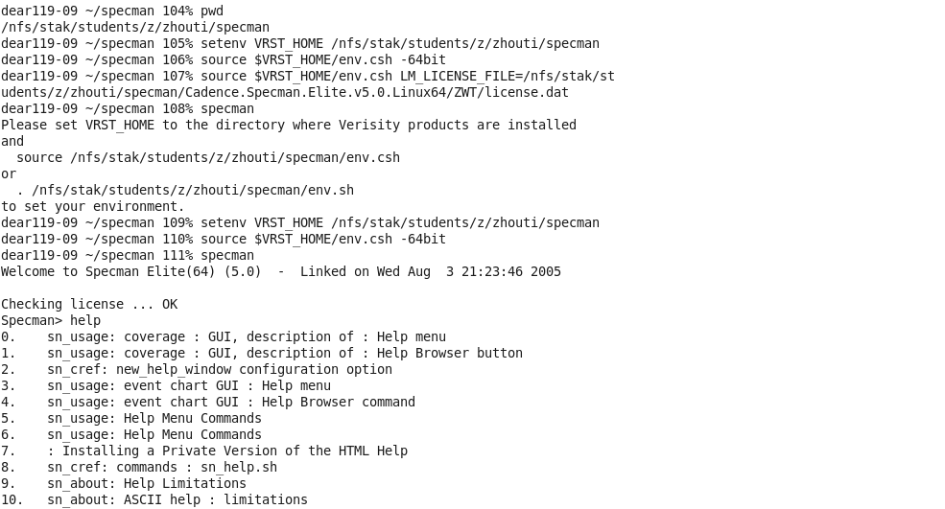
Run specman

Slide 6
verify.sh
specman -command "load design; write stubs -verilog;“
vlib work
vlog specman.v design.v
cmd = "";
cmd="vsim -keepstdout -c topMod specman";
$cmd <<EOF
Sn
load design.e;
Test
run 10000EOF

Slide 7
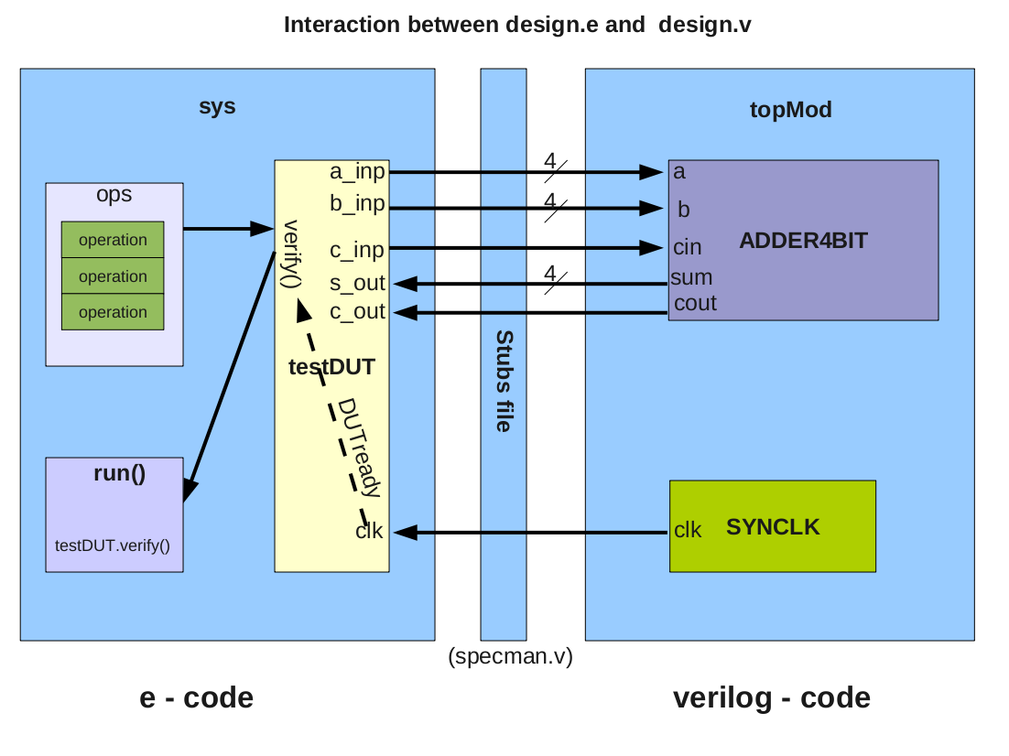
design.v
adder
Fadder
syn_clk
topMod

Slide 8
design.e
unit testDut
function verify()
struct operation

Slide 9
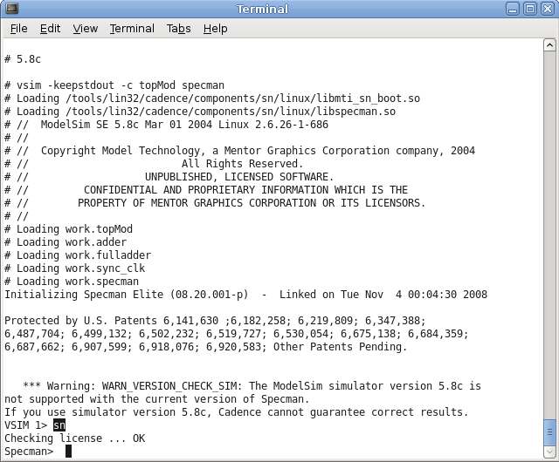

Slide 10
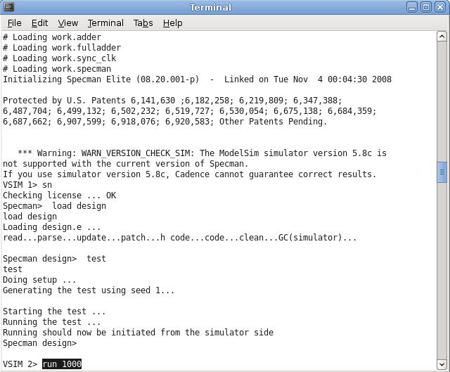

Slide 11
