Slide 1




Jia Guo
VHDL vs. Verilog
Guangxin Wang
Neil Glover
Yunqi Wang
Coding Example
VHDL Quiz
Background
and History of VHDL
Comparison of VHDL and Verilog
ECE574
Spring, 2013
VHDL vs. Verilog

Slide 2
VHDL Background and History
VHDL vs. Verilog

Slide 3
Introduction
VHDL (VHSIC Hardware Description Language) is a powerful hardware description language used for modeling electronic systems.
VHDL can be used to describe both digital and mixed signal systems.
VHDL can be used with field-programmable gate arrays and to design integrated circuits.
VHDL can also be used as a general purpose parallel programming language.
VHDL vs. Verilog

Slide 4
VHDL History
The Very High Speed Integrated Circuit (VHSIC) Hardware Description Language(VHDL) is the product of a US Government request for a new means of describing digital hardware.
The VHSIC Program was an initiative of the U.S Department of Defense designed to push for innovations in VLSI technology, as a result VHDL was proposed as a versatile hardware description language.
VHDL vs. Verilog

Slide 5
VHDL History
Very High Speed Integrated Circuit (VHSIC) Program
  Launched in 1980
  Aggressive effort to advance design methods
  Object was to achieve significant gains in VLSI technology
  Need for common descriptive language
Woods Hole Workshop
  Held in June 1981 in Massachusetts
  Discussion of VHSIC goals
  Comprised of members from industry, government, and academia
VHDL vs. Verilog

Slide 6
Summary: History of VHDL
  1981 Initiated by US DoD to address hardware life-cycle crisis
  1983-85 Development of baseline language by intermetrics, IBM an TI
  1986 All rights transferred to IEEE
  1987 Publication of IEEE Standard
  1987 Mil Std 454 requires comprehensive VHDL descriptions to be delivered with ASICs
  1994 Revised standard( named VHDL 1076- 1993)
VHDL vs. Verilog

Slide 7
Summary: History of VHDL
2000 Revised standard (named VHDL 1076-2000, Edition)
2002 Revised standard (named VHDL 1076-2002)
2007 VHDL Procedural Language Application Interface standard (VHDL 1076c-2007)
2009 Revised Standard (named VHDL 1076-2008)
VHDL vs. Verilog

Slide 8
Why VHDL
Implementation Independent
Well supported
Increase Productivity
VHDL can be simulated
Standardized
VHDL vs. Verilog

Slide 9
VHDL can do…
Abstractions of digital hardware in a single cohesive language
Documentation
Design Interchangeable
Large-Scale Design
Flexible design methodologies
VHDL vs. Verilog

Slide 10
VHDL can do…
Mixing of multiple level models in one simulation
Hierarchical abstractions to control scale-up problems of large systems
VHDL is a combination of: sequential, concurrent, netlist, timing, and waveform.
A human-to-tool, human-to-human, and tool-to-tool communication medium
VHDL vs. Verilog

Slide 11
Comparison of VHDL and Verilog
VHDL vs. Verilog

Slide 12
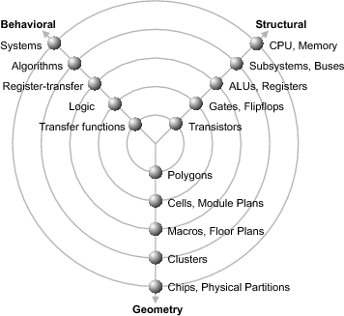
Gajski-Kuhn Y-chart
Each axis represents type of description
  Behavioral
    Defines outputs as function of inputs
    Algorithms but no implementation
  Structural
    Implements behavior by connecting components with known behavior
  Physical
    Gives size/locations of components and wires on chip/board
  Design process is illustrated by travel route
VHDL vs. Verilog
Notes:
A more detailed abstraction model is the Y-chart Gajski and Kuhn invented in 1983. With this well-known chart it is possible to visualize design views as well as design hierarchies. It is widely used within VHDL design and can give us an idea for modeling abstraction levels, too. The name Y-chart arises from the three different design views, which are shown as radial axes forming a ‘Y’.
Five concentric circles characterize the hierarchical levels within the design process, with increasing abstraction from the inner to the outer circle. Each circle characterizes a model, explained after introducing the three domains.

Slide 13
VHDL vs. Verilog
VHDL | Verilog
All abstraction levels | All abstraction levels
Complex grammar | Easy language
Describe a system (everything) | Describe a digital system
Lots of data types | Few data types
User-defined package & library | No user-defined packages
Full design parameterization | Simple parameterization
Easier to handle large designs
Very consistent language. Code written and simulated in one simulator will behave exactly the same in another simulator. E.g. strong typing rules. | Less consistent language. Have to follow some methodology for coding styles.
Based on Pascal language | Based on C language
Most FPGA design in VHDL | Most ASIC design in Verilog
VHDL vs. Verilog

Slide 14
VHDL vs. Verilog
Verilog is easier for designing at the gate-level, but people who do higher level simulations seem to prefer VHDL
VHDL places constraints on evaluation order that limit the optimizations that can be performed
  Verilog allows the simulator greater freedom
  For example, multiple levels of zero-delay gates can be collapsed into a single super-gate evaluation in Verilog
  VHDL requires preserving the original number of delays in propagating through those levels
VHDL vs. Verilog

Slide 15
VHDL vs. Verilog: Manage Large designs
VHDL:
  Configuration, generate, generic and package statements all help manage large design structures
Verilog:
  There are no statements in Verilog that help manage large designs

Slide 16
VHDL vs. Verilog: Structural Replication
VHDL:
  The generate statement replicates a number of instances of the same design-unit or some sub part of a design, and connects it appropriately
Verilog:
  There is no equivalent to the generate statement in Verilog.
VHDL vs. Verilog

Slide 17
VHDL vs. Verilog: Process block
VHDL:
    process (clk, clk_mem)
    begin
    …...
    end;
Verilog:
    always @ (clk, clk_mem)
    begin
    ….
    end
VHDL vs. Verilog

Slide 18
VHDL vs. Verilog: Signal Assignment
VHDL:
    c <= a and b;
Verilog:
    assign c = a & b ;
VHDL vs. Verilog

Slide 19
VHDL vs. Verilog: Signal Delays
VHDL:
      a <= transport b after 1 ns;
Verilog:
      #1 assign a = b;
    ‘a’ output is delayed by 1 time unit
    The ‘# ‘ operator is the delay operator
      #1 assign a = #1 b;
    ‘b’ is delayed by 1 unit, then assigned to ‘a’, which is then delayed by 1 time unit
VHDL vs. Verilog

Slide 20
VHDL vs. Verilog: Clock Generator
VHDL:
    signal clk : std_logic := ‘0’;
    process
    begin
    clk <= not (clk) after clockperiod/2;
    wait on clk;
    end;
Verilog:
    initial clk = 0;
    always #(clockperiod/2) clk = ~ clk;
VHDL vs. Verilog

Slide 21
Code Comparison
VHDL vs. Verilog
Assignment 2 from class: ALU
VHDL vs. Verilog

Slide 22
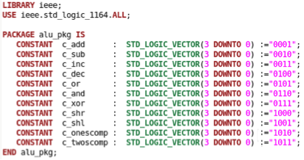
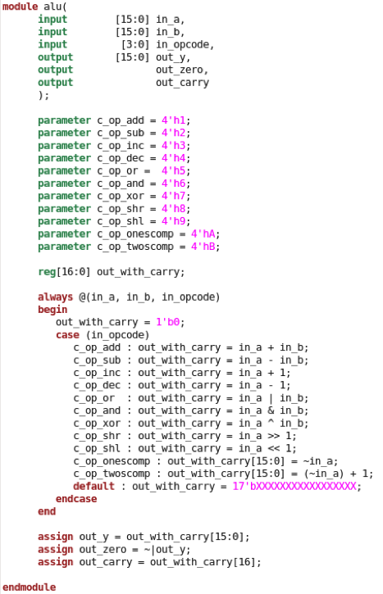
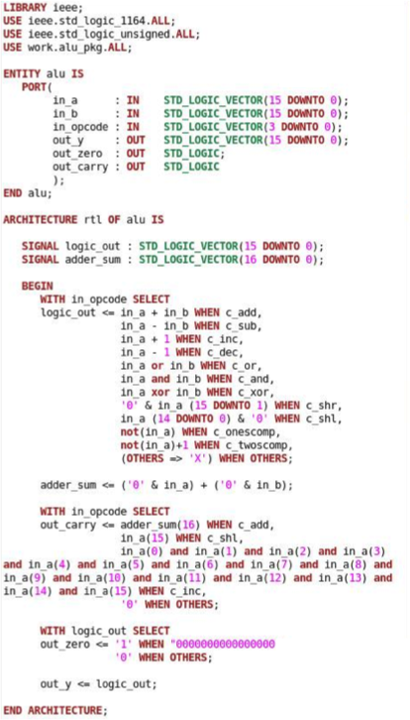
VHDL
Verilog
VHDL vs. Verilog

Slide 23
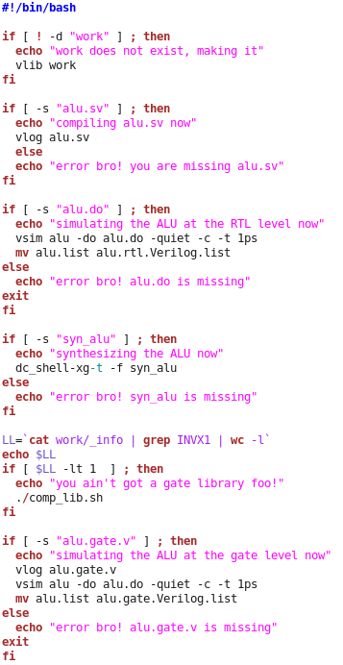
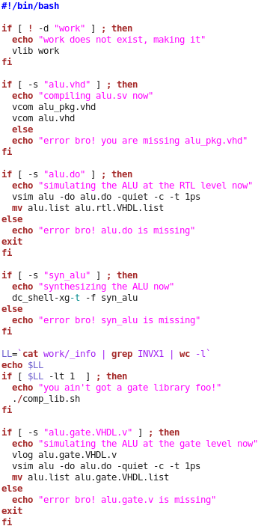
VHDL
Verilog
VHDL vs. Verilog

Slide 24
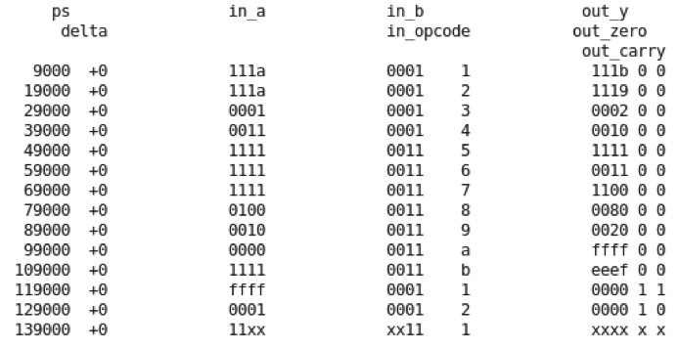
VHDL
Verilog
VHDL vs. Verilog

Slide 25
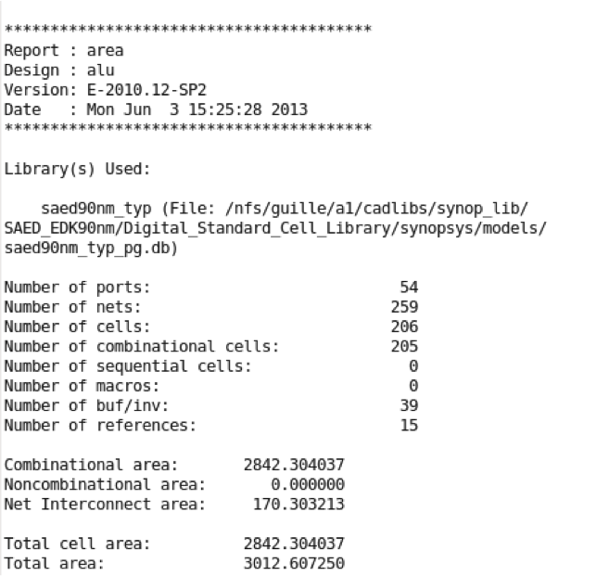
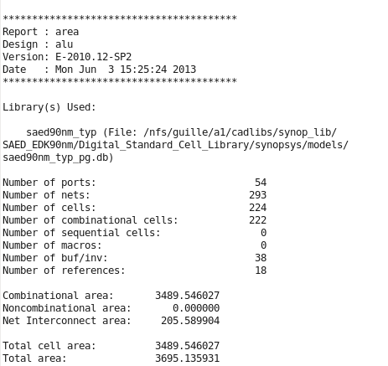
VHDL
Verilog
VHDL vs. Verilog

Slide 26
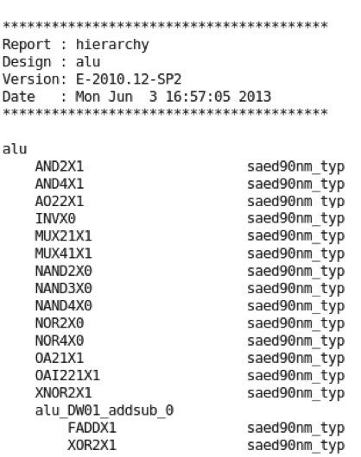
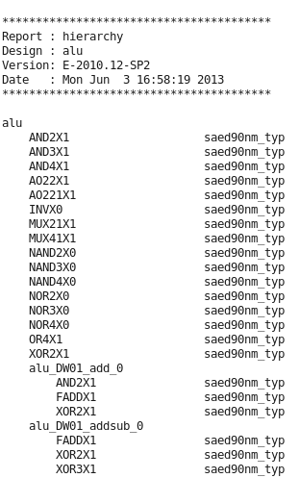
VHDL
Verilog
VHDL vs. Verilog

Slide 27
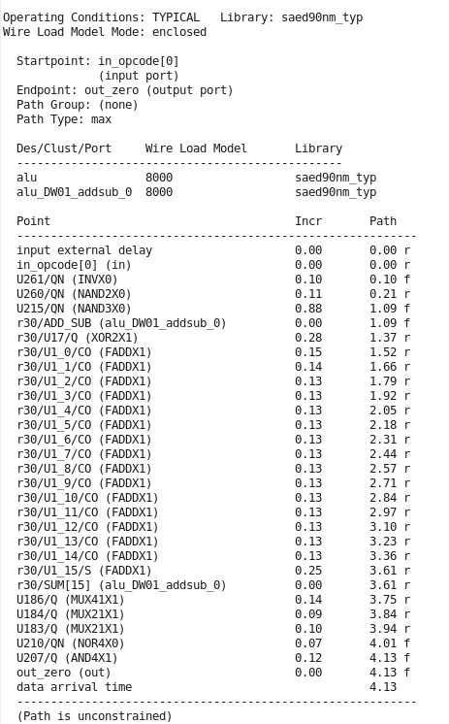
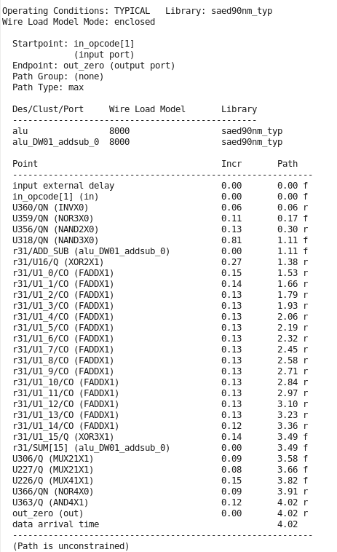
VHDL
Verilog
VHDL vs. Verilog

Slide 28
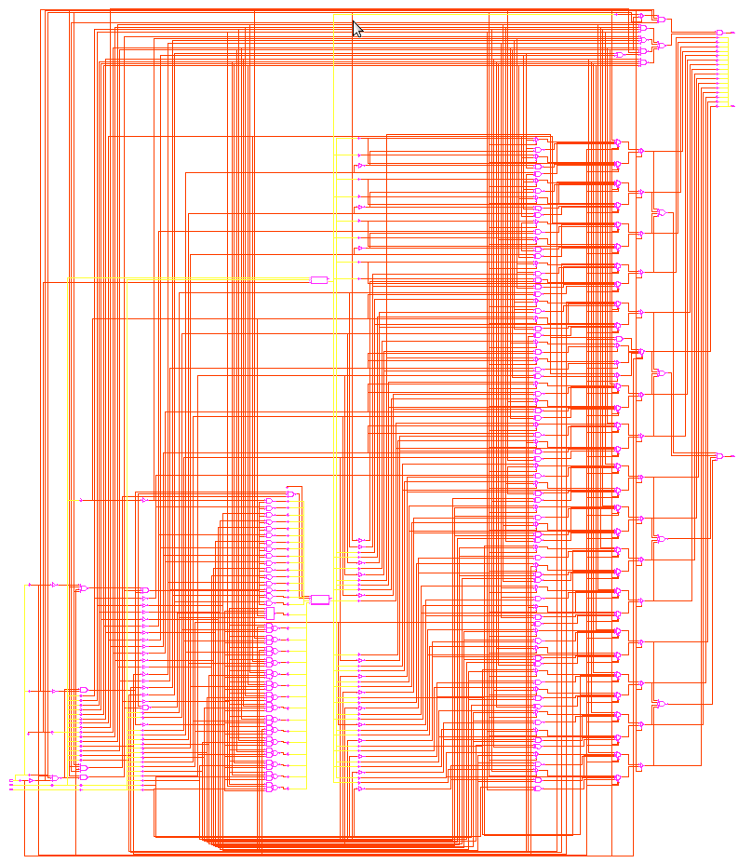
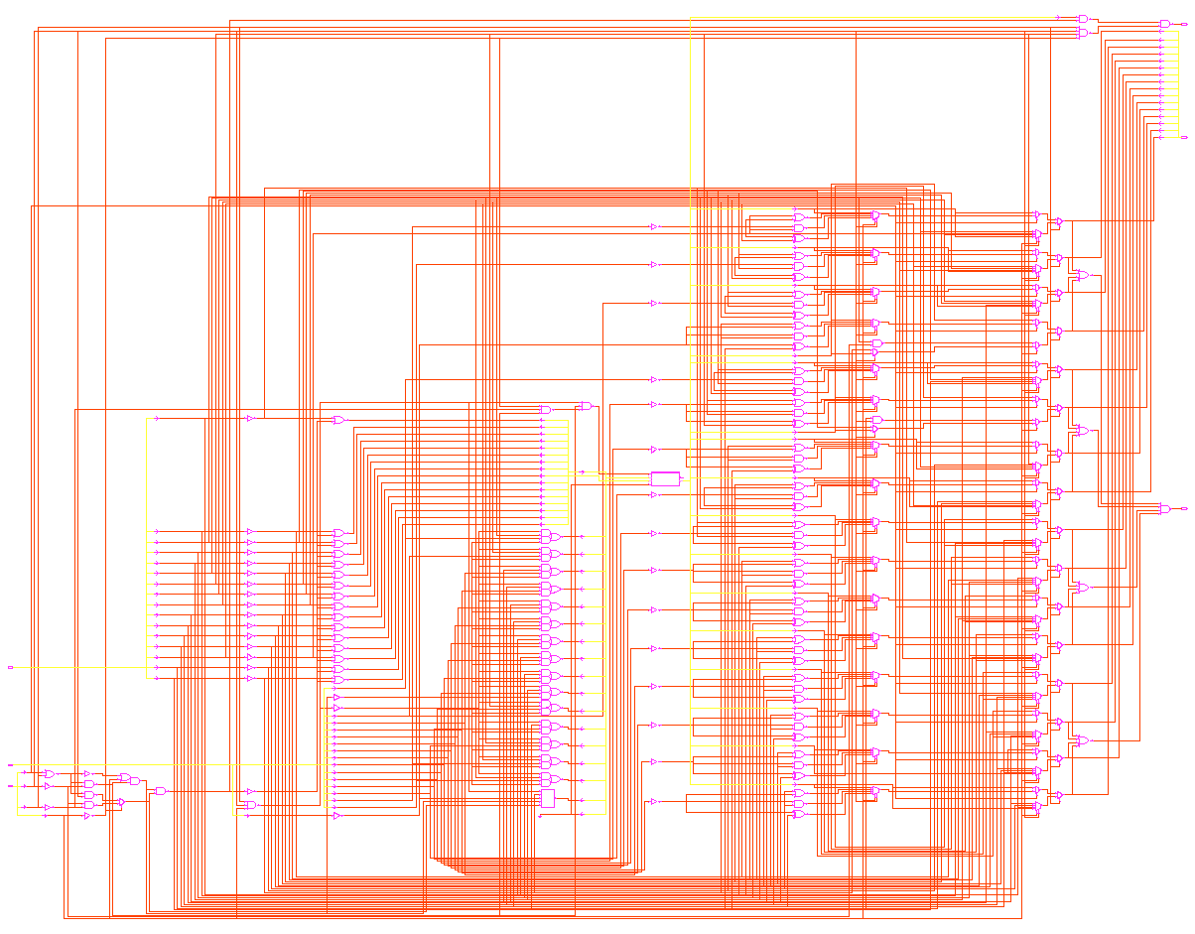
VHDL
Verilog
VHDL vs. Verilog

Slide 29
VHDL Quiz
VHDL vs. Verilog

Slide 30
1. VHDL cannot be used to describe both digital and mixed signal systems.
True
False
VHDL vs. Verilog

Slide 31
2. VHDL can be used for both field-programmable gate arrays(FPGA) and integrated circuits.
True
False
VHDL vs. Verilog

Slide 32
3. VHDL code will produce the same simulation results on different systems.
True
False
VHDL vs. Verilog

Slide 33
4. VHDL is based on C language.
True
False
VHDL vs. Verilog

Slide 34
5. VHDL predates verilog as an IEEE standard.
True
False
VHDL -- 1987 Verilog -- 1995
VHDL vs. Verilog

Slide 35
6. Guess what is the function of the VHDL code on the right.
architecture ***** of **** is
begin
B <= NOT A;
end BEHAVIORAL;
A
Inverter
B
OR Gate
C
AND Gate
D
D Flip-flop
VHDL vs. Verilog

Slide 36
architecture behv of ******* is
begin
process(data_in, clock)
begin
-- clock rising edge
if (clock='1' and clock'event) then
data_out <= data_in;
end if;
end process;
end behv;
7. Guess what is the function of the VHDL code on the right.
A
Inverter
B
OR Gate
C
AND Gate
D
D Flip-flop
VHDL vs. Verilog

Slide 37
8. Guess what is the function of the VHDL code on the right.
architecture behv of ******** is
begin
process(data_in, enable)
begin
if (enable='1') then
data_out <= data_in;
end if;
end process;
end behv;
A
Inverter
B
Latch
C
AND Gate
D
D Flip-flop
VHDL vs. Verilog

Slide 38
architecture behav1 of ****** is
begin
process(x, y)
begin
if ((x='1') and (y='1')) then
F <= '1';
else
F <= '0';
end if;
end process;
end behav1;
9. Guess what is the function of the VHDL code on the right.
A
Inverter
B
OR Gate
C
AND Gate
D
D Flip-flop
VHDL vs. Verilog

Slide 39
architecture rtl of moore_4s is
the state machine
type state_type is (s0, s1, s2, s3);
state
signal state : state_type;
begin
process (clk, reset)
begin
if reset = '1' then
state <= s0;
elsif (rising_edge(clk)) then
case state is
when s0=>
if data_in = '1' then
state <= s1;else
state <= s0;
end if;
.......
end case;
end if;
end process;
process (state)
begin
case state is
when s0 =>
data_out <= "00";
when s1 =>
....
end process
10. Guess what is the structure of the VHDL code on the right.
A
State Machine
B
C is not right
C
D is not right
D
B is not right
VHDL vs. Verilog

Slide 40

Thank You!
Any questions?
VHDL vs. Verilog

Slide 41
Thank You!
VHDL vs. Verilog

