Slide 1
Regaining Throughput Using Completion Detection for Error-Resilient, Near-Threshold Logic
Joseph Crop, Robert Pawlowski, Patrick Chiang
Oregon State University
This research was funded in part by CDADIC: The Center for the Design of Analog and Digital Circuits and the Department of Energy Early Career Program
Notes:
[Thank You Mr. Speaker,] Before I start I would quickly like to thank my co-author Robert Pawlowski and my advisor Patrick Chiang for their contribution to this work.

Slide 2
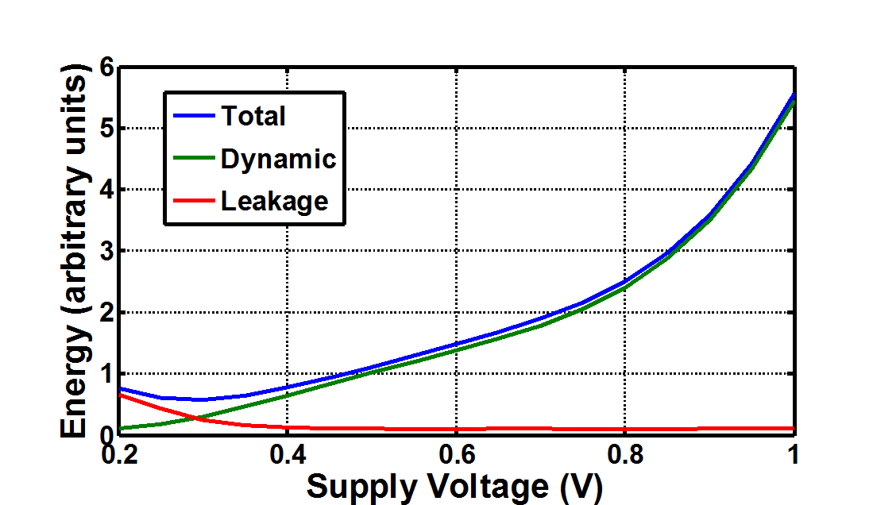
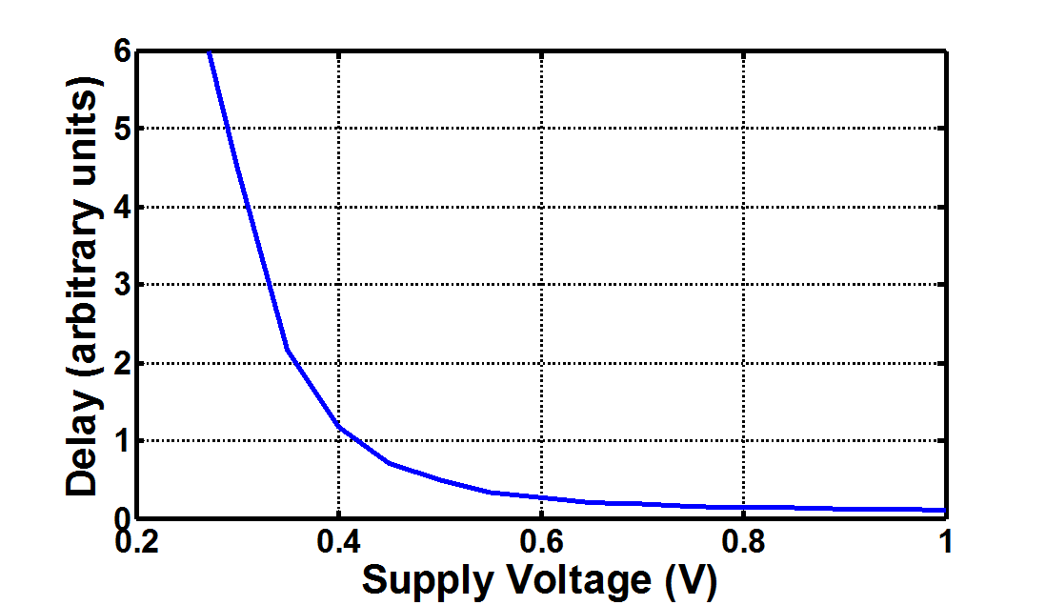
Near Threshold Operation (NTV)
+ Temperature Variations
+ Voltage Variations
+ Aging
Energy/Computation Vs. VDD
Delay Vs. VDD
PROBLEM: Lower VDD → Delay Uncertainty
Notes:
Near-threshold operation is gaining attraction as a great design point for energy constrained applications. As we can see here, as VDD is lowered, energy scales with its square.
[click]
Another nice advantage of NTV is that logic delay is not as adversely effected as it is in the sub-threshold region. Sub-threshold begin around 400mV and below.
[click]
However, one major disadvantage of NTV as voltage is scaled is uncertainty in delays due to unpredictable variations.
[click]
Here we can see the delay variation of 10 random inputs to an adder as voltage is scaled.
Not only does delay get worse as voltage is scaled but delay variations are exacerbated.
[click]
On top of these static data-related variations are temperature changes, voltage droops, and aging over time.
All these exacerbated sources of variation make NTV design very difficult.

Slide 3
Conventional Variation Tolerance
Delay Margining
Increase cycle time in NTV
Worst-case path delay from Monte Carlo [6]
OUR GOAL:
Error detectors that significantly improve throughput at NTV
Timing Error Detection (Razor) [5]
NTV needs aggressive
min-path buffer insertion
Limited Detection Window
FURTHER:
Detector must be robust and resilient to variation at NTV
clock
data
Notes:
Ensuring correct circuit operation in the highly variable environment of NTV is critical.
[click]
The most common practice to do this is to simply over-margin.
[click]
This histogram shows a delay distribution of the impact of an EEG filtering application on a 16-bit CLA adder.
In this case the margin is set high enough such that no delay exceeds it.
[click]
More recent methods have used simplified Monte Carlo models to find the worst possible case across all variations. In work presented in ISSCC two years ago a synthesis method was used to determine a maximum clock frequency of 14MHz for the worst case across all variations. But, their test chip ended up operating at 43MHz. A 14MHz margin in this case is clearly unacceptable.
[click]
Another technique, known as timing error detection, or most commonly, Razor circuits use a double sampling shadow latch in conjunction with a normal flip-flop to detect setup violations.
[click]
For example, in this diagram if the data is double-sampled after the first rising clock edge no error signal is asserted.
[click]
However, if the data is double-sampled after the second rising edge, two different values will be latched, resulting in an error.
[click]
Furthermore, this error detection must happen within a “min-path window,” Ensuring no hold time violations on the shadow latch.
If data from the next cycle races through the pipeline stage faster than the allotted window a false error can occur.
[click]
In order for razor circuits to properly operate in NTV, the min-path buffer insertion must be very aggressive.
[click]
Even with this there is still a large uncertainty of the detection window from chip to chip and even stage to stage of a pipeline.
[click]
If the buffer insertion could prove to be successful the resulting throughput increase is typically limited to around 20% faster than the worst case delay. In NTV this can seriously limit razor’s ability to regain throughput.
In this graph we can see the potential percent throughput of razor versus an ideal error detector that has a detection window of infinity running on the adder delays above. Clearly there is a potential for better performing error detection in NTV.
[click]
The goal for this work was to find an error detection technique to improve the throughput beyond the maximum 20% given by Razor circuits.
[click]
Furthermore, and most importantly, these detectors must by robust, and variation resilient while operated on near-threshold.
***In fig 3, %’s are throughput, not detection windows
***Mention axis, error rate

Slide 4
NTV Error Detection: Transition Aware Completion Detection (TACD)
Don’t look at output values, look at output transitions
Transition Detectors:
UNLIKE RAZOR: Take min-path buffers out of the datapath
Tunable (NTV tolerant)
To learn more about TACD come visit my poster
Notes:
Let’s take a look at our first proposed NTV error detector named Transition Aware Completion Detection, or TACD
To simplify this introduction the following example will be shown on a simple 4-bit ripple adder seen here.
[click 1]
[click 2]
Looking at output values as Razor does requires two state-holding elements. If we compare only transitions, we only need an XOR operation.
[click 3]
Here is an example of how the TACD scheme might look on this adder circuit. The goal of this circuit is to speculate an error before it happens, this is done by speculating future transitions on other outputs using Transition Detectors.
[click 4]
The transition detectors are comprised of an XOR operation with a tunable delay element to generate speculative, “not-complete” timing pulses.
Each transition detector must have a delay long enough to assert until another output transitions, asserting a different transition detector. Otherwise the computation is speculated as completed.
[click 5]
The tune-ability of the transition detector delay makes this method more robust to NTV operation.
[click 6]
This diagram shows the operation of this simple TACD circuit example.
In this case even though the logic has finished switching, an error is asserted.
This margin, set by the delay of a transition detector, is the limiting factor of the throughput improvement capabilities of TACD.
In this example, because the critical path of the adder is the carry propagation, in order to get any throughput increase we need to strategically add transition detectors within the logic like this…
[click 7]
When transition detectors are added strategically the overall overhead of the detector can be reduced due to reducing the requirements of the delay elements.
[click 8]
One of the issues with Razor in NTV is that the min-path buffers are difficult to control.
One of the advantages of TACD is that we can take the buffers out of the datapath and into a separately synthesized module. This makes them much more manageable.
[click 9]
To learn more about TACD and the timing requirements of the transition detectors I encourage you to come visit my poster at the poster session.

Slide 5
NTV Error Detection: Current Sensing Completion Detection (CSCD)
Measure logic’s dynamic current across power gate
Clocked analog comparator
Error-detection window not limited by min-path
Sensor calibrated for variations
clock
data
Vsense
To learn more about CSCD come visit my poster
Notes:
Our second NTV error detection method is based on the principal of current sensing.
[click 1]
By measuring the change in voltage of a virtual supply after a power gating transistor we can see that the dynamic switching activity of combinational logic is directly correlated with a virtual supply droop.
[click 2]
In this illustration we can see that in cycle one, the data is ready before the clock edge which is reflected in the current profile.
[click 3]
In cycle two, the setup time is violated. If we measure the droop at the last clock edge we’ll detect an error.
[click 4]
Here is an example of how the current sensors might be added into a typical pipeline. The sensors are limited to the intra-stage combination logic.
As a sense amplifier our current sensor only needs to be clocked once to determine an error. This ends up saving significant energy over conventional analog current sensors.
[click 5]
This also means that this method does not have the error detection window constraint that Razor does. As a matter of fact it’s window is almost the size of the entire clock period.
[click 6]
The threshold of the sensor can easily be calibrated. This is done with a digital control loop, setting the threshold to the current draw of a single logic gate switching.
[click 7]
To learn more about the circuit details of CSCD and some of the design challenges associated with it I encourage you to visit me durring the poster session.
**this needs to be explained further?

Slide 6
Resiliency of Error Detectors
 | Previous Work | Proposed Work
 | Razor [5] | TACD | CSCD
Detection Window | ~20% after clk | > 70% before clock | ~ 95% before clock
Throughput Potential | < 20% | Dependent on TDs ( >20% ) | Limited by Sensing Margin ( >50% )
NTV Adaptability | None | Tunable Transition Detectors | Sensing Threshold Calibration
Larger Detection Window → Larger Throughput Potential
NTV Adaptability comes with tradeoffs
CSCD – Mixed-Signal Integration, Supply Noise Concerns
TACD – Test-ability, Delay in error-window
Notes:
Now I would like to compare the variation resiliency of two proposed error detectors with the conventional Razor method at NTV.
[click 1]
As I mentioned earlier, Razor’s detection window is limited to the hold-time constraint on the shadow latch.
Because TACD and CSCD do their detection before the clock edge there is no direct hold-time concern allowing their windows to be much larger than Razor’s 20%.
[click 2]
These larger detection windows directly relate to a potential increase in throughput.
In the case of TACD the throughput is limited by the delay of the Transition Detectors.
And in CSCD, the throughput is limited by the sensing threshold margin.
[click 3]
Most importantly, TACD and CSCD are adaptable after fabrication to NTV variations.
In the case of TACD it has tunable transition detectors and CSCD has a calibrate-able sensing threshold.
[click 5]
The adaptability of these methods do come with tradeoffs and design challenges.
Among other things CSCD requires a mixed-signal design flow and can be sensitive to supply noise.
TACD can be difficult to test and adds unwanted delays into the error signal due to the transition detector delays.

Slide 7
Experimental Results
 |  | Previous Work | Proposed Work
 | No Detection (16-bit Adder) | Razor [5] | TACD | CSCD
Avg. Energy (fJ/comp) | 192.5 | 976.5 | 910.3 | 195.9
Throughput (MIPS) | 32 | 38.4 (20%) | 41 (28%) | 49.9 (56%)
Area Overhead (µm²) | 15495 | 24080 (155%) | 15796 (102%) | 16005 (103%)
CSCD has best energy overhead
Throughput limited by speculation window
TACD/Razor area scales best with larger logic
Notes:
In order to quantitatively compare the performance metrics of these error detectors we have run Spice simulations of each detector with a 16-bit carry look-ahead adder and the EEG adder data we say earlier.
The reason this adder logic was chosen was because we unfortunately don’t have the resources to run extensive SPICE simulations on anything more complicated.
[click 1]
As I mentioned earlier, CSCDs single comparison per cycle gives it by far the best energy.
[click 2]
When it comes to throughput, both of the proposed error detectors outperform Razor.
Because CSCDs detection window is so large, it has the highest throughput potential.
[click 3]
Both of the proposed error detectors have smaller area than Razor. Razor’s area is pushed beyond TACD primarily because of the aggressive buffer insertion needed for NTV.
It is important to note however, that the TACD and Razor areas scale better with larger, more complex logic, such as a 16-multiplier for example, as multiple CSCD sensors may be needed for optimal performance.

Slide 8
Conclusion
Timing guard bands for NTV are excessive
No timing error detector for NTV exists
We propose two resilient error detectors to improve throughput for NTV
TACD (Transition Aware Completion Detection)
CSCD (Current Sensing Completion Detection)
Simulations show significant throughput increase compared with Razor
See you at the poster session!
Notes:
In conclusion
[click]
Timing guard bands for NTV are excessively and drive system performance down.
[click]
And no timing error detector exists that can reliably work in NTV
[click]
In this work we have proposed two resilient error detectors to improve throughput specifically for NTV.
[click]
The first, Transition Aware Completion Detection, is a fully synthesizable error detector that uses tunable delay elements to speculate transitions.
[click]
The Second, Current Sensing Completion Detection, uses calibrate-able analog current sensors to detect when an operation has not completed on time.
[click]
Finally, Our SPICE simulations show a significant increase in throughput using these detectors over the Razor double-sampling technique.
[click]
Thanks for your time.

Slide 9
References
[1] K. Bowman, J. Tschanz, N. S. Kim, J. Lee, C. Wilkerson, S.-L. Lu, T. Karnik, and V. De. Energy-ecient and metastability-immune resilient circuits for dynamic variation tolerance. Solid-State Circuits, IEEE Journal of, 44(1):49 {63, jan. 2009.
[2] K. Bowman et. al. A 45 nm resilient microprocessor core for dynamic variation tolerance. Solid-State Circuits, IEEE Journal of, 46(1):194 {208, jan. 2011.
[3] J. Crop, E. Krimer, N. Moezzi-Madani, R. Pawlowski, T. Ruggeri, P. Chiang, and M. Erez. Error Detection and Recovery Techniques for Variation-Aware CMOS Computing: A Comprehensive Review. Journal of Low Power Electronics and Applications, 1(3):334{356, 2011.
[4] R. G. Dreslinski, M. Wieckowski, D. Blaauw, D. Sylvester, and T. Mudge. Near-Threshold Computing: Reclaiming Moore^aA Zs Law Through Energy Ecient Integrated Circuits. Proceedings of the IEEE, 98(2):253{266, 2010.
[5] D. Ernst, S. Das, S. Pant, R. Rao, C. Ziesler, D. Blaauw, T. Austin, K. Flautner, and T. Mudge. Razor: a low-power pipeline based on circuit-level timing speculation. IEEE Comput. Soc.
[6] G. Gammie, N. Ickes, M. Sinangil, R. Rithe, J. Gu, A. Wang, H. Mair, S. Datla, B. Rong, S. Honnavara-Prasad, and Others. A 28nm 0.6 V low-power DSP for mobile applications. In Solid-State Circuits Conference Digest of Technical Papers (ISSCC), 2011 IEEE International, number March 2010, pages 132{134. IEEE, 2011.
[7] K. Hu, T. Jiang, J. Wang, F. O'Mahony, and P. Chiang. A 0.6 mw/gb/s, 6.4{7.2 gb/s serial link receiver using local injection-locked ring oscillators in 90 nm cmos. Solid-State Circuits, IEEE Journal of, 45(4):899 {908, april 2010.
[8] M. Keating, D. Flynn, R. Aitken, and K. Shi. Low power methodology manual: for system-on-chip design. Springer Verlag, 2007.
[9] L. Nagy and V. Stopjakova. Current Sensing Completion Detection in deep sub-micron technologies. In Design and Diagnostics of Electronic Circuits and Systems (DDECS), 2010 IEEE 13th International Symposium on, pages 145{148. IEEE, 2010.
[10] R. Pawlowski, E. Krimer, J. Crop, J. Postman, N. Moezzi-Madani, M. Erez, and P. Chiang. A 530mv 10-lane simd processor with variation resiliency in 45nm soi. In Solid-State Circuits Conference Digest of Technical Papers (ISSCC), 2012 IEEE International, pages 492 {494, feb. 2012.

Slide 10
Backup Slide 1: Razor Circuit Details
clk
data in

Slide 11
Backup Slide 2: TACD Timing Requirements
$$d_{inv}=d_{NAND tree}+∆_{toggle max}+ d_{margin}$$
• d_{inv}: delay of tunable TDs
• d_{NAND tree}: delay of global NAND
• d_{margin}: PVT margins from EDA
• Output Glitch Tolerance: Δ_{toggle max} must be less than the time between two consecutive output transitions or unwanted glitches.
• Δ_{toggle max}: worst case
time between any two
output transitions

Slide 12
Backup Slide 3: CSCD Circuit Details

Slide 13
Backup Slide 4: CSCD Resiliency

