Slide 1
DSP Builder in MATLAB
Weijun Li
Zhenwei Cai

Slide 2
What is DSP builder?
DSP Builder is a technology that allows you to go from system definition and simulation using the industry-standard MathWorks Simulink tools to system implementation in a matter of minutes.

Slide 3
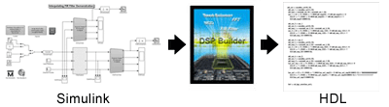
The DSP Builder Signal Compiler block reads Simulink Model Files (.mdl) that are built using DSP Builder and MegaCore® blocks and generates VHDL files and Tcl scripts for synthesis, hardware implementation, and simulation.
MegaCore: The intellectual property core for Altera.
Tcl: Tool Command Language.

Slide 4
This technology allows us for the first time to automatically generate timing-optimized register transfer level (RTL) code based on high-level Simulink design descriptions.
With this new DSP Builder feature, we can achieve high-performance design implementations, running at near-peak FPGA performance.

Slide 5
Relation to Verilog
Allows HDL import of VHDL or Verilog HDL design entities and HDL defined in a project file.
DSP Builder generates VHDL and does not generate Verilog HDL. However, after you have created a project, you can use the quartus_map command in the Quartus II software to run a simulation netlist flow that generates files for Verilog HDL simulation.

Slide 6
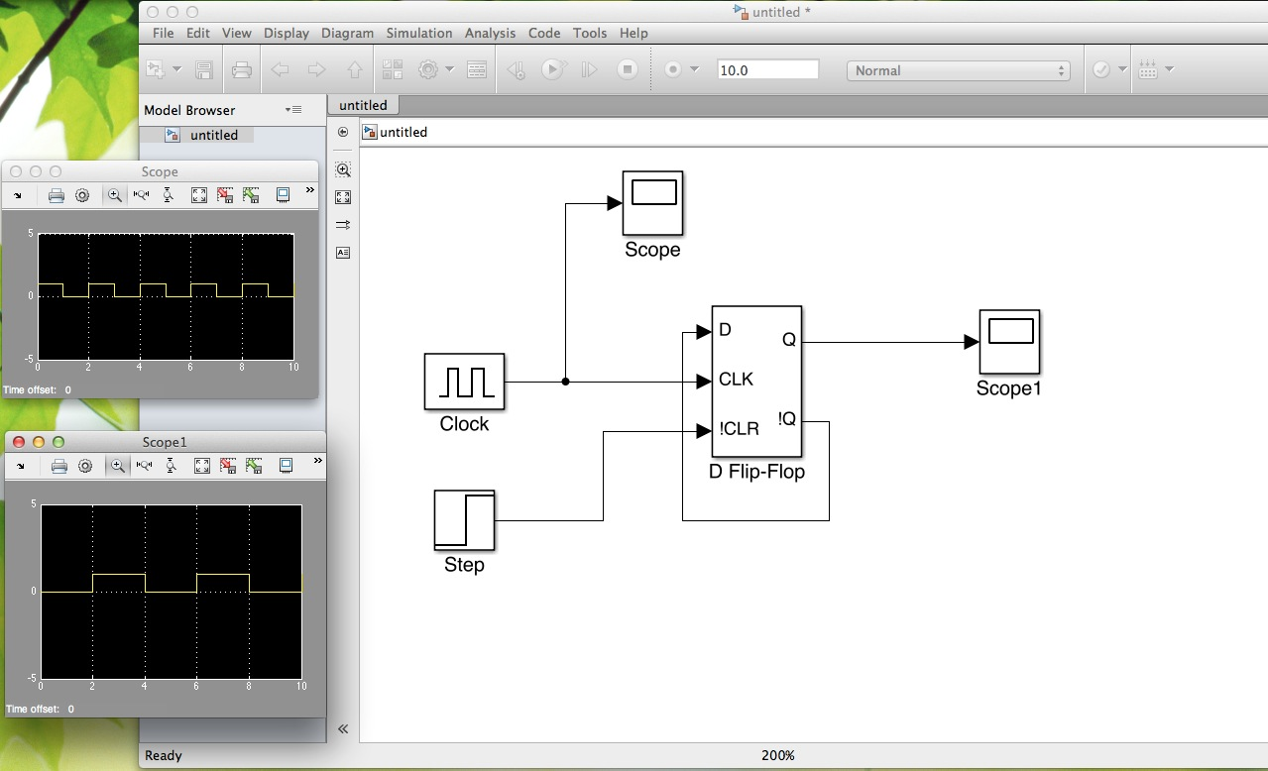
Visualization

Slide 7
DPS builder
Matlab: testing software development
Verilog:
bulid actual hardware

Slide 8
Automatic:
Build Matlab/ simulink blocks
Simulation
Let DSP builder convert and synthesize VHDL.
Then test by SignalTap II.
Manul:
Build Matlab/ simulink blocks
Simulation
Let DSP builder convert and synthesize VHDL.

Slide 9
4. Using modelsim to simulate the testbench.
5. Using Quantus II to do time sequence simulation.
6. Then test by SignalTap II.

Slide 10
Altlab libaray:
Signal compiler module;
Subsystem builder;

Slide 11
Signal compiler:
Signal compiler is the heart of DSP builder. The main functions are:
Convert simulink to synthesizable RTL verilog code.
Generate testbench in VHDL
Output the simulink simulation to VHDL testbenches, and generate ASCII files.

Slide 12
Generate TCL files for leonardoSpertum, Synplify and modelsim.
Generate .vec files for Quantus II.

Slide 13
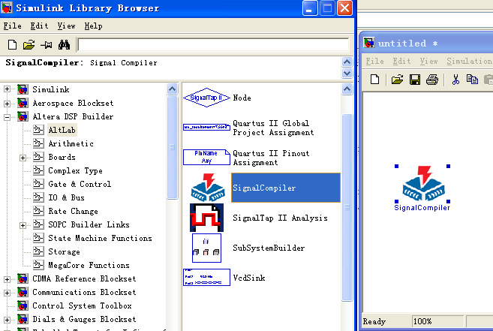
Signal compiler

Slide 14
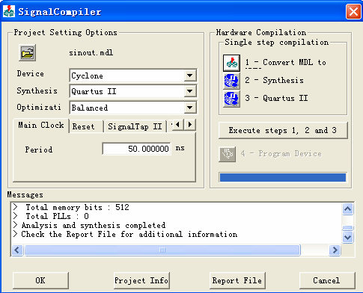
Signal compiler
Setting the compiler

Slide 15
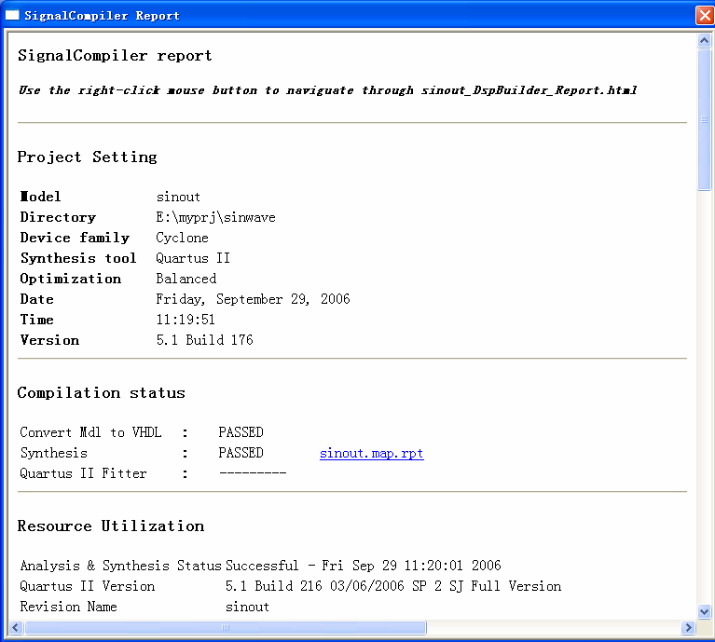

Slide 16
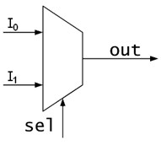
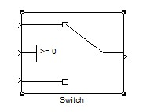
Selector:

Slide 17
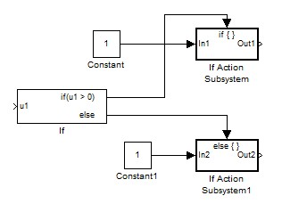
If statement:

Slide 18
Thank you.

