Slide 1
Code Optimization
Chengyi Tan
Jian Shen

Slide 2
Contents
Synthesizable
State-machine optimization
Speed-space trade-off
Win-win

Slide 3
Synthesis advices
Never use initial block
Never use delays
Never use a loop with uncertain cycles
Use synchronization methods to design the circuit
Contain all the signals in the sensitive list if comb-logic is used
All the registers should be resettable

Slide 4
State-Machine
How to make a good state-machine
Safe
Satisfy the time and area limitation
Clear and easy to maintain

Slide 5
Speed-space Trade-off
Speed optimization
Duplication
Reg out
Space optimization
Resource sharing

Slide 6
Speed-optimization

Slide 7
Duplication
module test3_2(
input tri_en,
input clk,
input wire[23:0] data_in,
output wire[23:0] out
);
reg tri_end;
always@(posedge clk)
tri_end<=tri_en;
assign out = tri_end?data_in:'bz;
endmodule
module test3_2_1(
input tri_en,
input clk,
input wire[23:0] data_in,
output wire[23:0] out
);
reg tri_end1,tri_end2;
always@(posedge clk)
tri_end1<=tri_en;
always@(posedge clk)
tri_end2<=tri_en;
assign out[11:0] = tri_end1?data_in[11:0]:'bz;
assign out[23:12]= tri_end2?data_in[23:12]:'bz;
endmodule

Slide 8
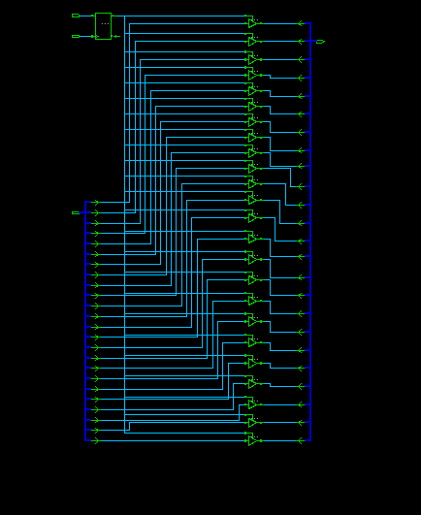
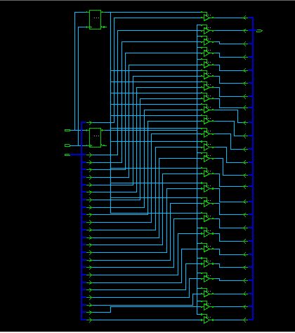
Duplication

Slide 9
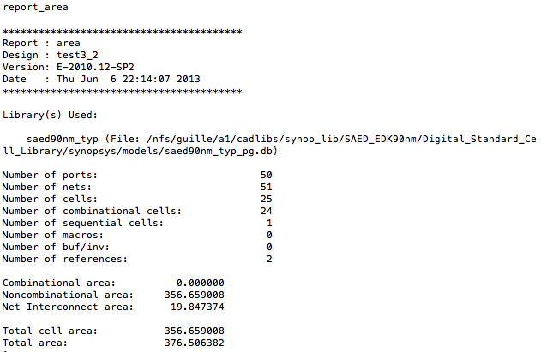
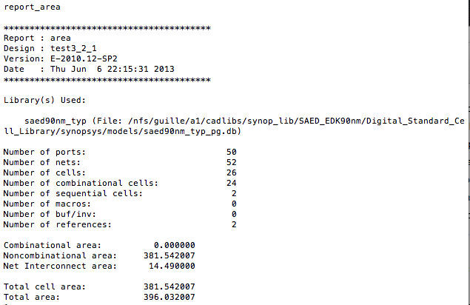
Duplication

Slide 10
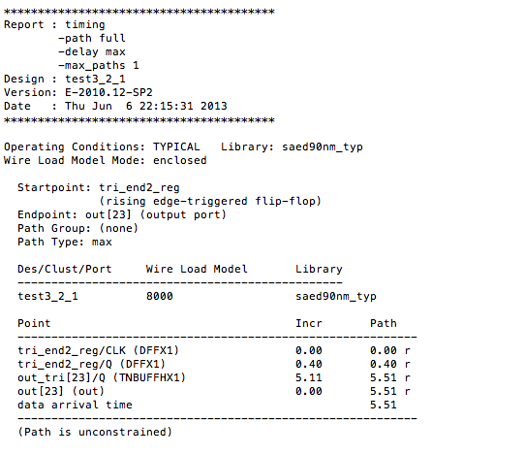
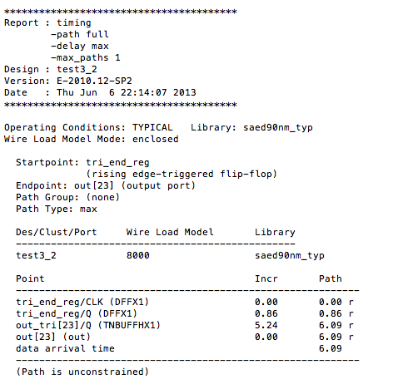
Duplication

Slide 11
Reg out
module test4(
input a,
input b,
input clk,
output wire[1:0] c
);
reg q1,q2;
always @(posedge clk)
q1<=a;
always @(posedge clk)
q2<=b;
assign c = q1 + q2;
endmodule
module test4_1(
input a,
input b,
input clk,
output reg[1:0] c
);
wire[1:0] c_temp;
assign c_temp = a+b;
always @(posedge clk)
c<= c_temp;
endmodule

Slide 12
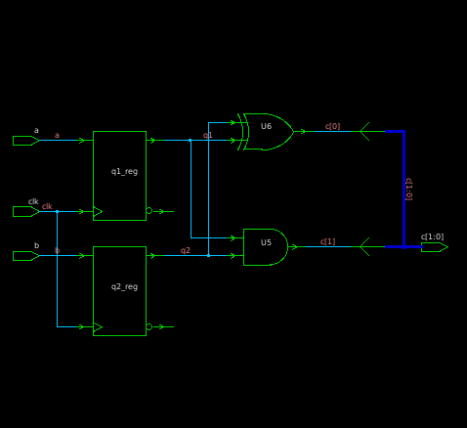
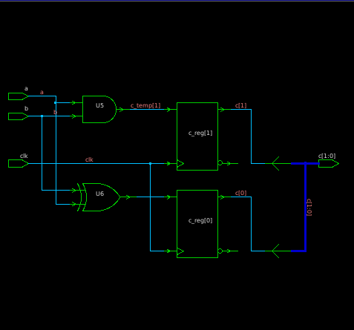
Reg out

Slide 13
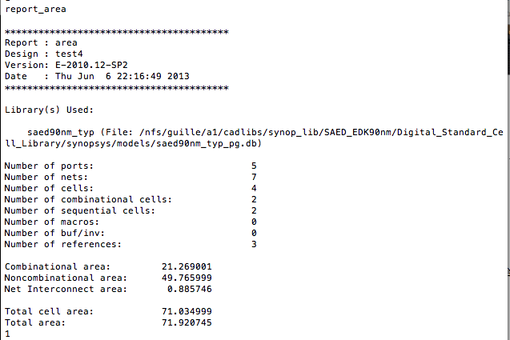
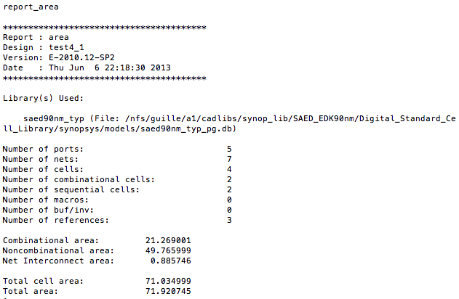
Reg out

Slide 14
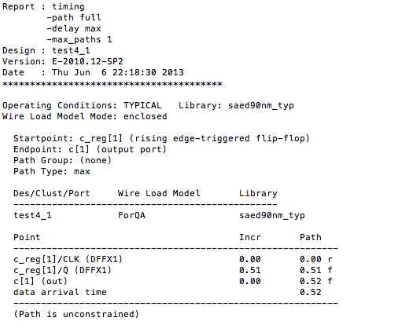
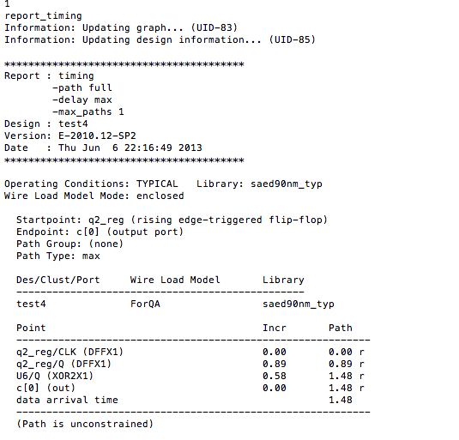
Reg out

Slide 15
Space Optimization

Slide 16
Resource Sharing 1
module resource_sharing_1m2a (
input sel,
input a,
input b,
input c,
input d,
output reg sum
);
always_comb begin
if(sel) begin
sum = a + b;
end
else begin
sum = c + d;
end
end
endmodule
module resource_sharing_2m1a (
input sel,
input a,
input b,
input c,
input d,
output reg sum
);
reg atemp;
reg btemp;
always_comb begin
if(sel) begin
atemp = a;
btemp = b;
end
else begin
atemp = c;
btemp = d;
end
sum = atemp + btemp;
end
endmodule

Slide 17
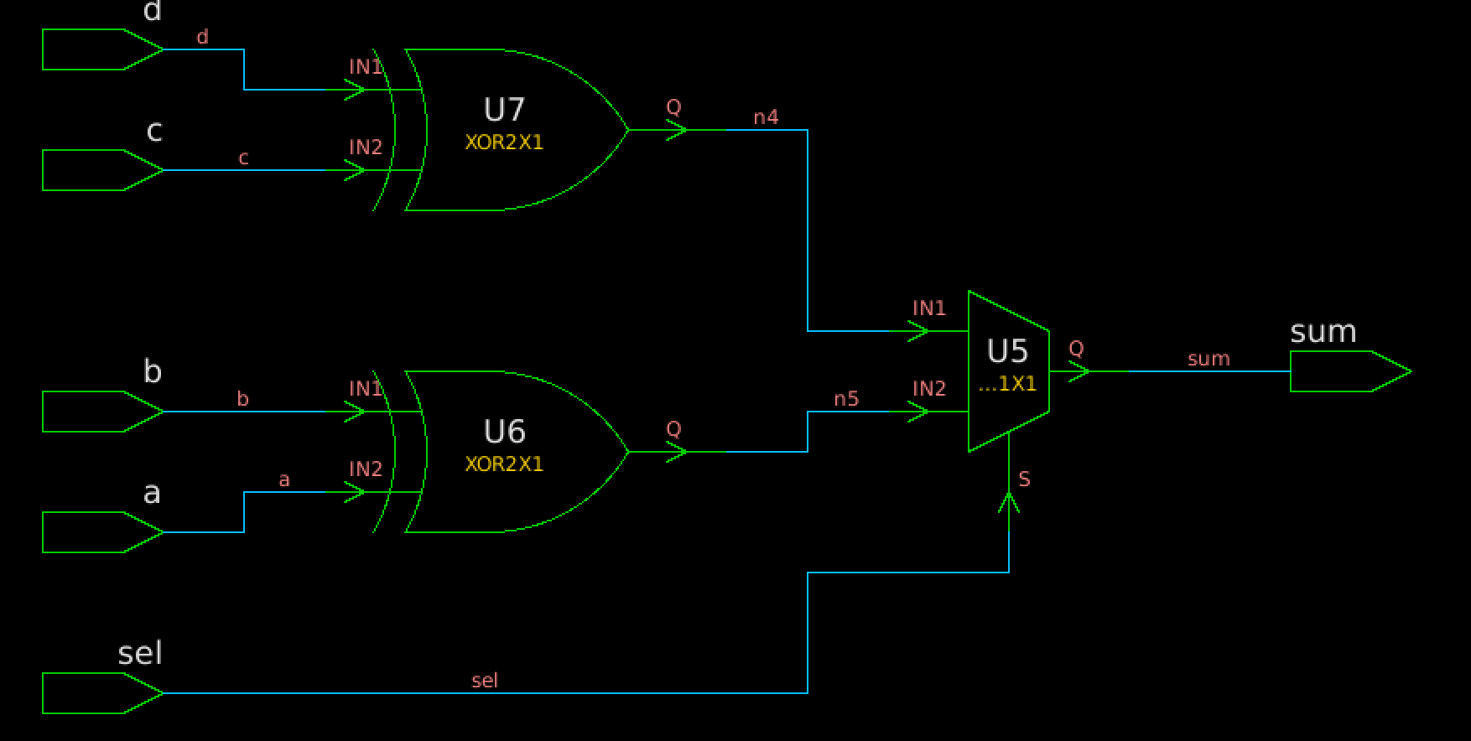
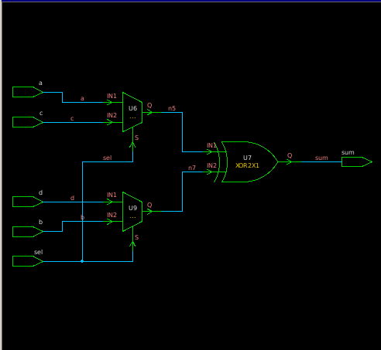
Resource Sharing 1

Slide 18
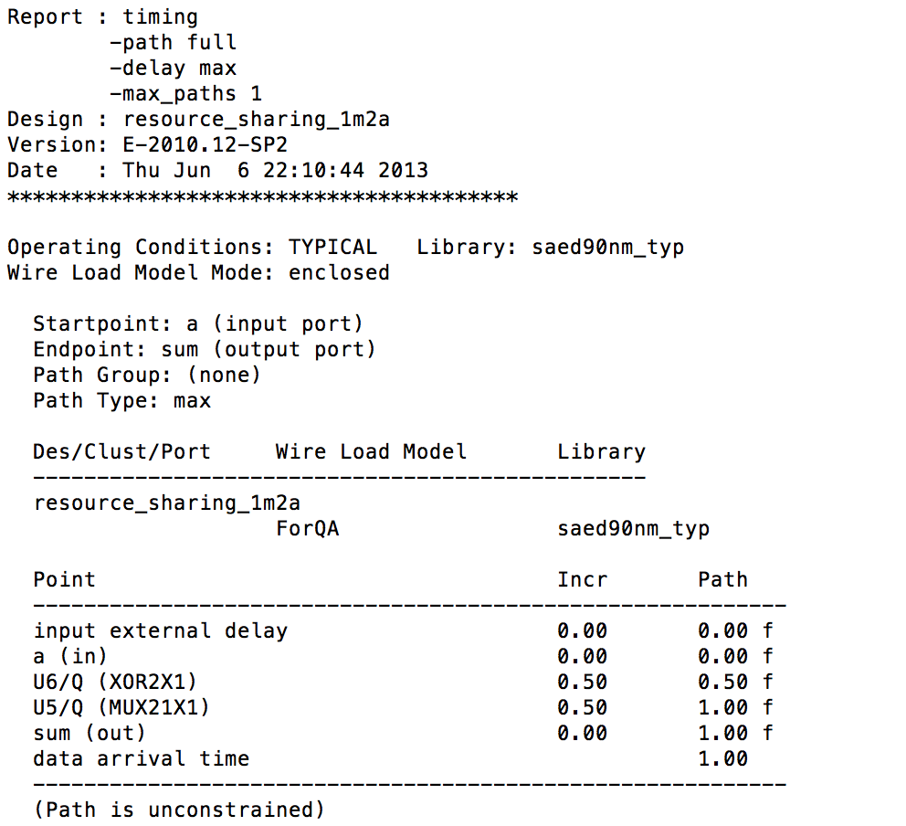
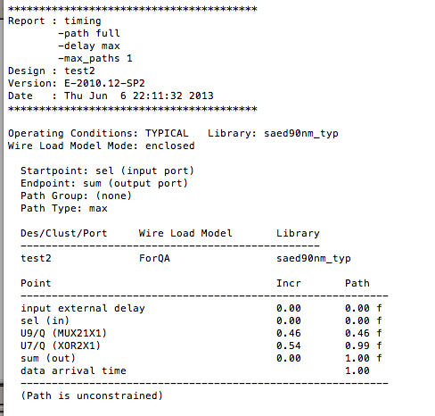
Resource Sharing 1

Slide 19
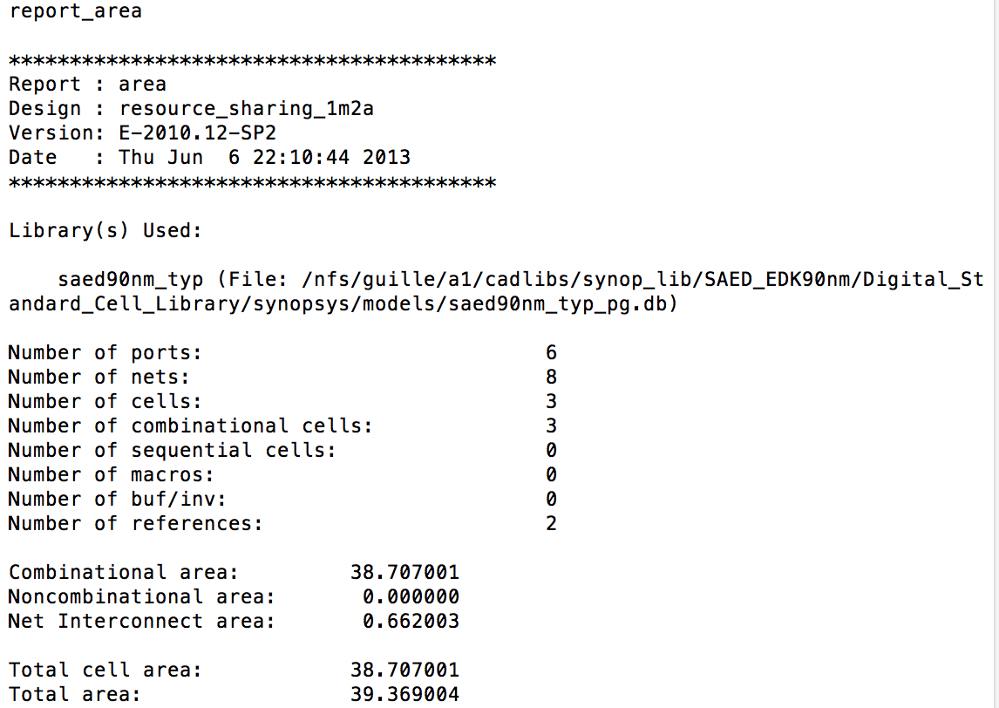
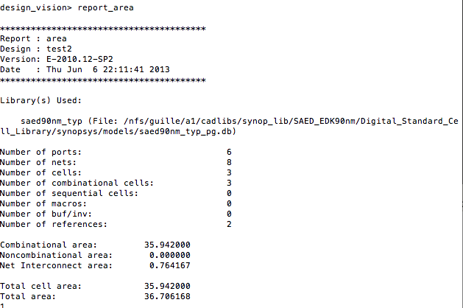
Resource Sharing 1

Slide 20
Resource Sharing 2
module adder(
input a,
input b,
input c,
output reg s1,
output reg s2
);
always_comb begin
s1 = a+b;
s2 = c+a+b;
end
endmodule
module adder(
input a,
input b,
input c,
output reg s1,
output reg s2
);
always_comb begin
s1 = a+b;
s2 = c+(a+b);
end
endmodule

Slide 21
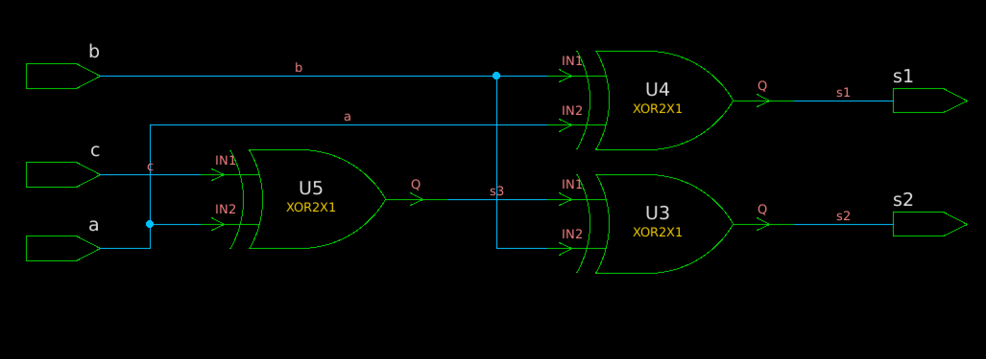
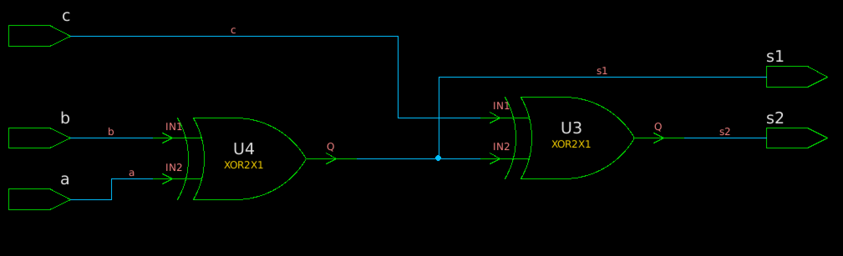
Resource Sharing 2

Slide 22
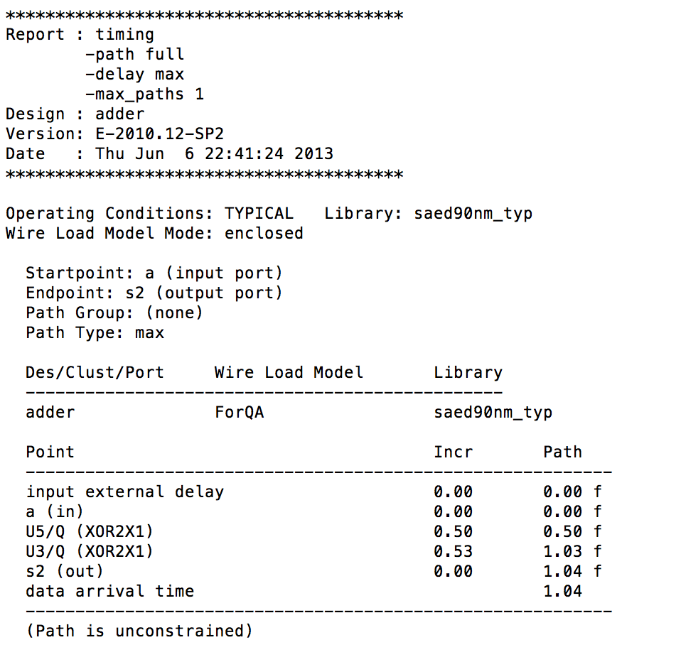
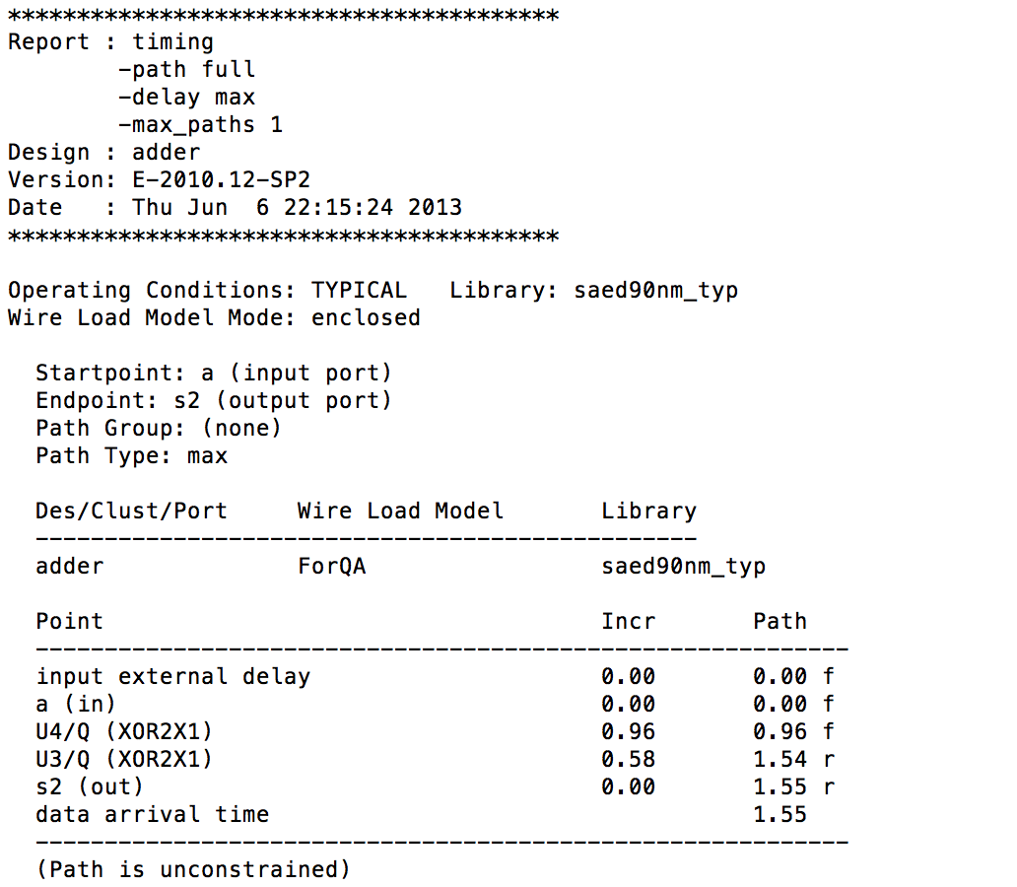
Resource Sharing 2

Slide 23
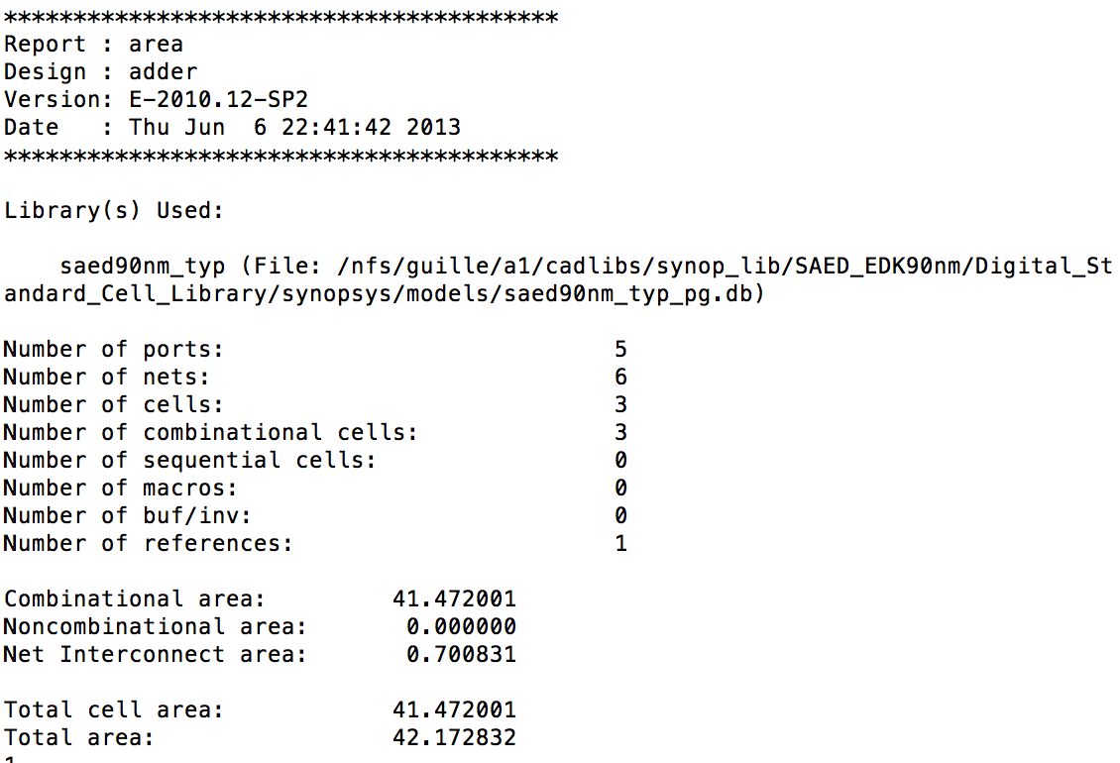

Resource Sharing 2

Slide 24
Win-Win

Slide 25
algorithm optimization
module mul(
input clk,
input [3:0]a,
input [3:0]b,
input reset_n,
output reg[3:0]c
);
reg [4:0]i;
always@(posedge clk)
begin
if(!reset_n)begin
c = 0;
i = 0;
end
else begin
for(i=0;i<b;i=i+1)
begin
c = c + a;
end
end
end
endmodule
module multi(
input clk,
input reset,
input start,
output reg done,
input [3:0] ain,
input [3:0] bin,
output reg[5:0] yout
);
reg [3:0] a;
reg [3:0] b;
always@(posedge clk or negedge reset)
begin
if(~reset)
begin
a<=0;b<=0;yout<=0;done<=1'b1;
end
else
begin
if(start)
begin
a<=ain;b<=bi;yout<=0;done<=0;
end
else
begin
if(~done)
begin
if(b!=0)
begin
if(b[0]) yout<=yout+a;
b<=b>>1;a<=a<<1;
end
else done<=1'b1;
end
end
end
end
endmodule

Slide 26
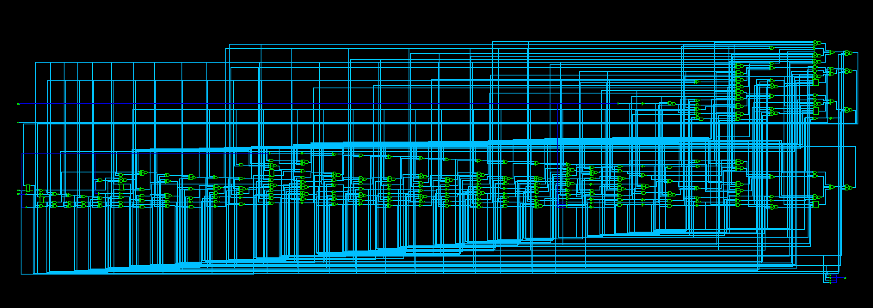
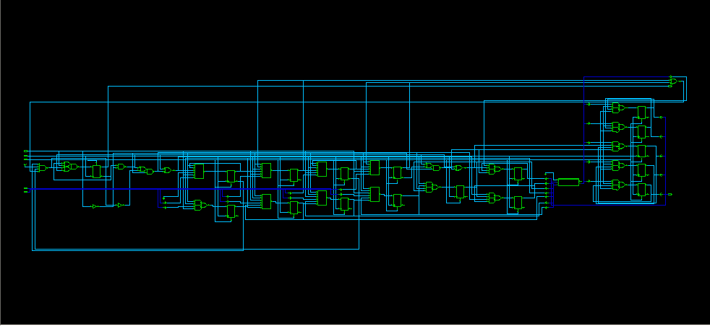
algorithm optimization

Slide 27
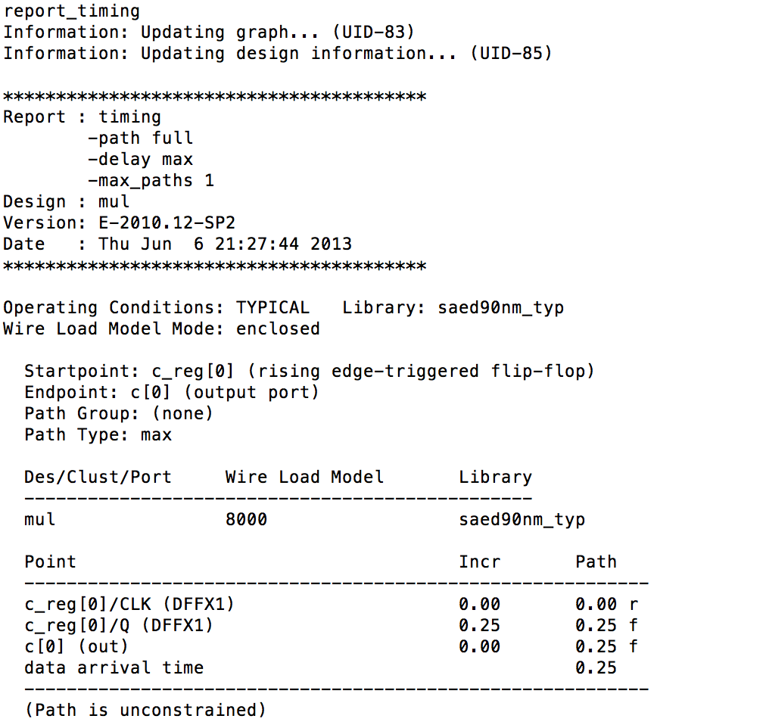
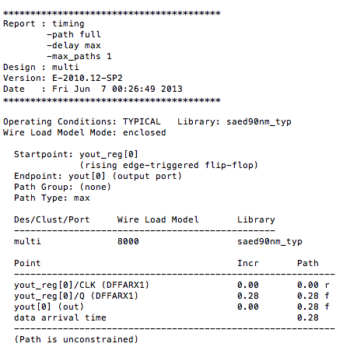
algorithm optimization

Slide 28
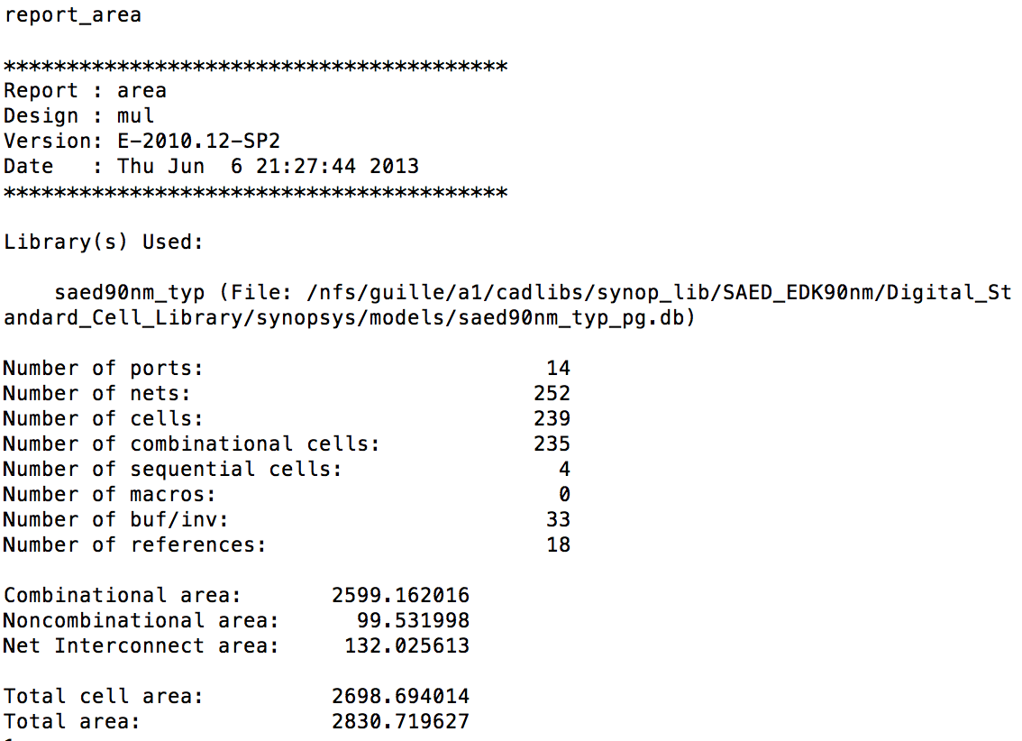
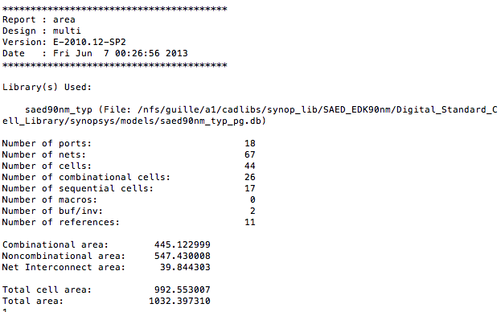
algorithm optimization

Slide 29
Pipeline
module adder8(
input[7:0] ina,inb;
input cin,clk;
output[7:0] sum;
output cout;
);
reg[7:0] tempa,tempb,sum;
reg cout,tempc;
always @(posedge clk)
begin
tempa=ina;tempb=inb;tempc=cin;
end
always @(posedge clk)
begin
{cout,sum}=tempa+tempb+tempc;
end
endmodule
module adder_pipe2(
input[7:0] ina,inb;
input cin,clk;
output reg[7:0] sum;
output reg cout;
);
reg[3:0] tempa,tempb,firsts;
reg firstc;
always @(posedge clk)
begin
{firstc,firsts}=ina[3:0]+inb[3:0]+cin;
tempa=ina[7:4]; tempb=inb[7:4];
end
always @(posedge clk)
begin
{cout,sum[7:4]}=tempa+tempb+firstc;
sum[3:0]=firsts;
end
endmodule

Slide 30
Conclusion
Synthesizable
State-machine optimization
Speed-space trade-off
Win-win

