Slide 1


Ogg Video Coding
Joe Crop
Alex Ewing
Vivek Selvaraj

Slide 2
Outline
  Why Open Source Standards?
  The Politics of Ogg
  Intro of Ogg Theora
  The Theora Codec and Specifications
  Firefogg Example
  SSIM Index
  Comparison (Ogg vs. H.264)

Slide 3
The Importance of Open Source and Patent Free
  Legality over MP3 patents
    Microsoft sued for 1.5 billion
    Sandisk mp3 players seized at a tech show
    MP3 was free at first, ~$2 per application now
  H.264 charges for content
    Web video free until at least 2015, but then what?
    Sub-license?
  HTML5
    Native support ensures widespread adoption

Slide 4
HTML5 Battlelines
Mozilla & Opera
- Web browsers
- Mozilla sublicenses to Linux distros.
Google
- Supports both H.264 & Theora
Apple
- MPEGLA member
- Seeks to replace Flash with something it has some control
Microsoft
- MPEGLA member
Some hardware makers
- already have h.264 acceleration
- few will want to accelerate other codecs for minimal gain

Slide 5
Hardware Acceleration
  Important for embeded and mobile device
    Processing Power
    Battery life
  H.264 accelerated in virtually all smart phones, few netbooks
  Theora is lower complexity, often playable without acceleration
  Acceleration is still valuable for power consumption

Slide 6
Hardware Acceleration
  Mozilla funded port to run on TI C64x DSP
    C64x DSP is in Palm Pre, Droid, Nokia N-series
    Frame Decode step moved entirely to DSP
    Cpu idle time for total playback moved from 20% to 80%
  Continued work on accelerating Theora in Firefox
  Google working on ARM acceleration

Slide 7
Introduction to Ogg Theora
  Ogg is a Codec Family
    Theora is the video codec
  Theora is Lossy
  Based on VP3.1 from On2 Technologies
  Ogg is Open Source

Slide 8
Theora General Specifications
  Constant frame rate (VFR in development)
  Chroma Subsampling: 4:2:0, 4:2:2, and 4:4:4
  Only Y-Cb-Cr color spaces are supported
  8 x 8 Type-II Discrete Cosine Transform
  Block-based motion compensation
  I- and P-frames only, no B-frames
  Decoder in charge of error detection/ correction

Slide 9
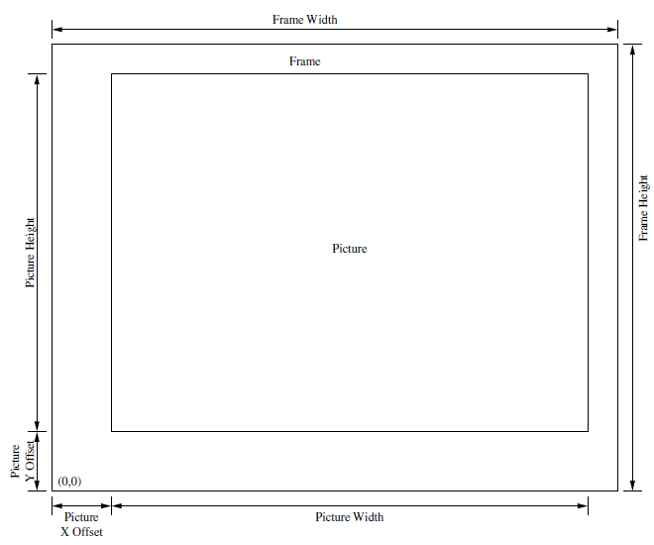
Basic Video Structure
  Maximum video size:
    1048560 x 1048560
  "Picture" can be offset within video
  Right-handed coordinate system

Slide 10
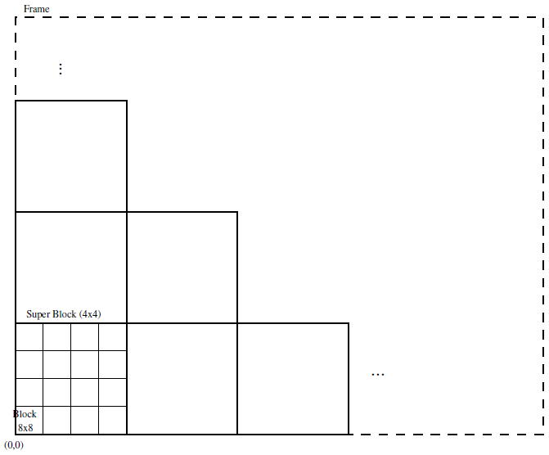
Block Structure
  Frame
    Super Block
      Block
        Pixel
  2x2 blocks are called Macro Blocks

Slide 11
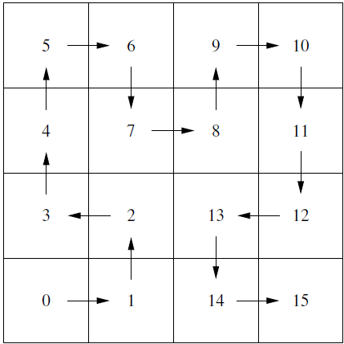
Block Ordering (V1)
  Hilbert Curve
    Reason: Looks cool!
    CS people like cool algorithms

Slide 12

Block Ordering (V2)
  Elimination of Hilbert Curve
    Reason: Bad for Cache Cohearancy
    Much faster block lookups

Slide 13
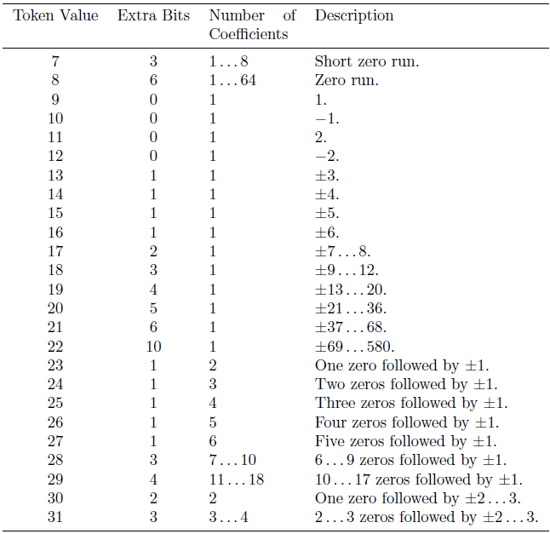
DCT Coeficient Table
  More tokens
  Ability to represent more
    i.e. ones followed by zeros

Slide 14
The Ogg container format…
  An open media container format for multimedia codecs
  Convenient interleaving of audio and video data
  Provides packet framing and error detection
  Periodic time stamps for efficient seeking
  Apt for internet streaming and software processing pipelines
  Facilitates easy media editing

Slide 15
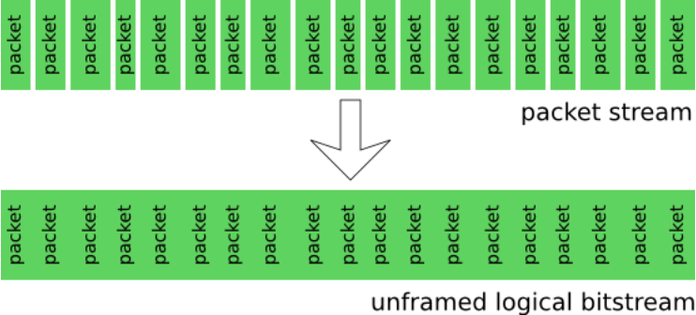
Simple data encapsulation…

Slide 16
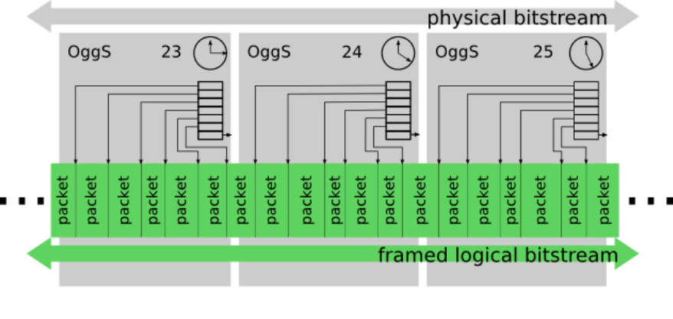
Time stamped packets…

Slide 17
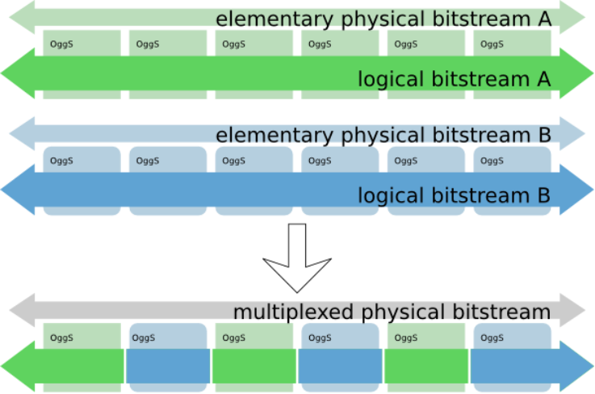
Interleaved raw data streams…
The bitstreams could include audio, video, subtitles, overlay video.

Slide 18
Bitstream Headers
This is how the logical bitstream of the video data is organized.
Header types -
  IDENTIFICATION Header
  COMMENT Header
  SETUP Header
  FRAME Header

Slide 19
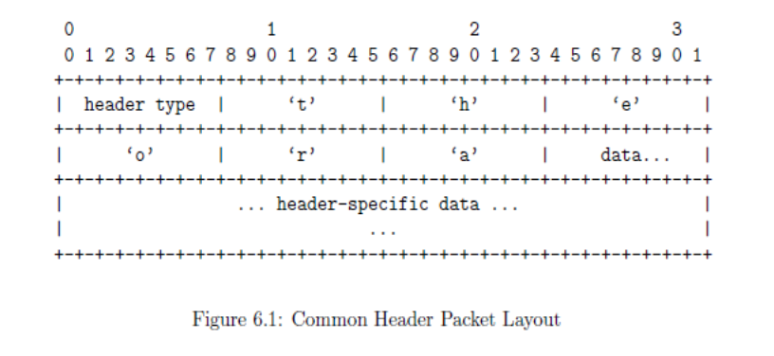
Common Header Format
[1]

Slide 20
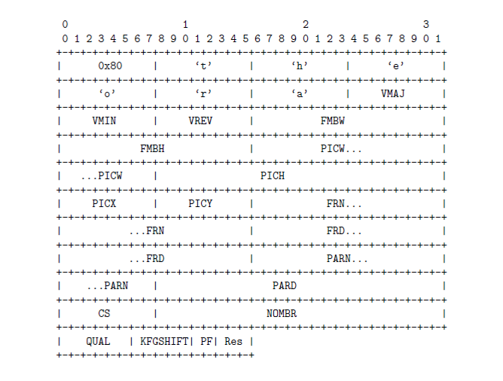
Identification Header
[1]

Slide 21
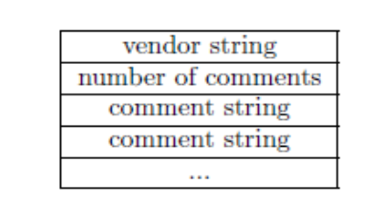
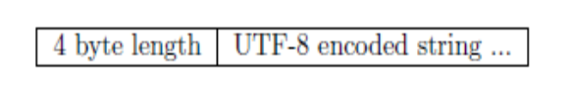
Comment Header
[1]

Slide 22
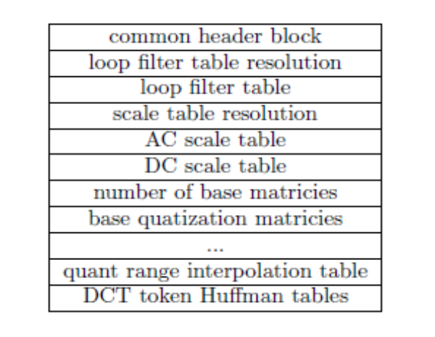
Setup Header
[1]

Slide 23


Firefogg (www.firefogg.org)
  A Firefox browser extension
  Create Theora and Vorbis encoded video files on-the-fly from the website

Slide 24
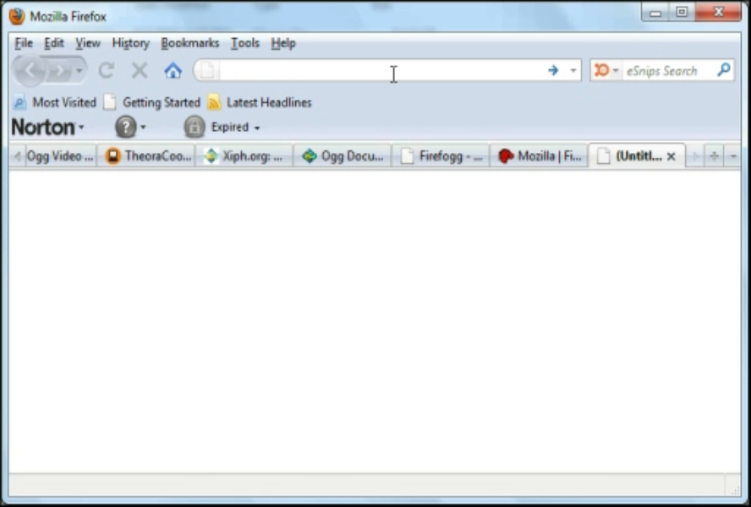
Ogg Demos

Slide 25
Video Codec Comparison
  H.264 considered to be superior to Theora
    Is it truly better?
    Is Theora "good enough" for web video
  How do we compare video codecs?
    Mean Squared Error (MSE)
    Structural SIMilarity index (SSIM)

Slide 26
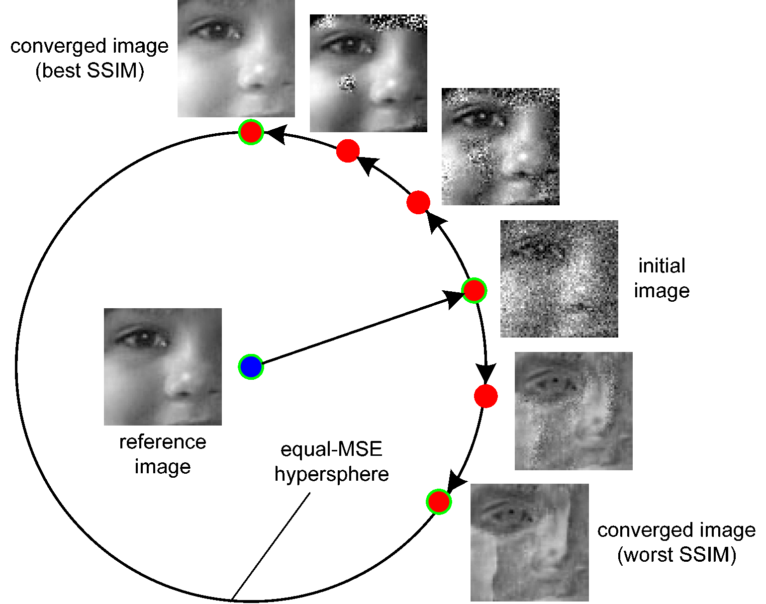
SSIM Index
  Most image quality methods don't actually compare "visual quality"
  SSIM index is a much better comparison than MSE

Slide 27
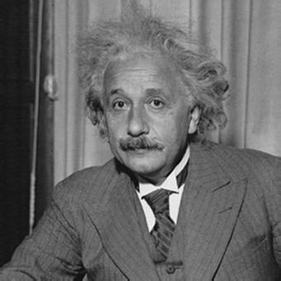


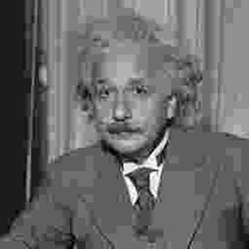
SSIM Index (contd.)
MSE:0
SSIM:1
MSE:144
SSIM:0.913
MSE:144
SSIM:0.84
MSE:142
SSIM:0.662

Slide 28
Qualitative comparison
  Encoding video to a high standard is hard!
  Tools for H.264 are mature and easy to use.
  Theora is developed by a handful of people. Best tools are complex command-line libraries
  H.264 has powerful open-source encoders with GUI interfaces

Slide 29
Methodology
  Trial and error found that given the limited professional experience and tools, we were unable to approach Theora dev's quality.
  Took a professionally coded Theora video and its uncompressed master, then coded the master in H.264 to a similar file size.
  Then changed the video containers to .avi to compare in the MSU video analyzer
Results
  Videos look similar, but high quality H.264 trounces Theora in all metrics
  Results generally similar to tests conducted by MSU and Martin Fielder

Slide 30
Conclusions
  H.264 is better, particularly in tools
  Theora is not competitive for commercial products, but has room for improvement
  Whether it will have a successful niche depends on further encoding improvements and tools
  Google's Dark Horse - VP8?

Slide 31
References
[1] Xiph.org Foundation "Theora Specification" August 5, 2009. [Online]. Available :http://theora.org/doc/Theora.pdf [Accessed: May, 5, 2010]
[2] S. Shankland. "Microsoft takes H.264 stand in Web Video Debate," April 30, 2010. [Online]. Available: http://news.cnet.com/8301-30685_3-20003838-264.html [Accessed: May 6, 2010]
[3] M. Shaver, "HTML5 Video and Codecs," January 23, 2010. [Online]. Available: http://shaver.off.net/diary/2010/01/23/html5-video-and-codecs/ [Accessed: May 6, 2010]
[4] R. Lawler, "Google to Open Source VP8 for HTML5 video," April 10, 2010. [Online]. Available: http://newteevee.com/2010/04/12/google-to-open-source-vp8-for-html5-video/ [Accessed: May 6, 2010]
[5] Z. Wang et al, "Image Quality Assessment: From Error Visibility to Structural Similarity" IEEE TRANSACTIONS ON IMAGE PROCESSING, VOL. 13, NO. 4, APRIL 2004. [Online] Available: http://www.cns.nyu.edu/pub/eero/wang03-reprint.pdf
[6] Z. Wang et al, "Maximum SSIM" [Online]. Available: http://www.ece.uwaterloo.ca/~z70wang/research/ssim/maxmin_SSIM.gif [Accessed: 6 May, 2010]
[7] Vatolin, Dimitry, "MSU Video Quality Measurement Tool" [Online]. Available: http://compression.ru/video/ [Accessed: 14 May, 2010]

