Slide 1
DBMS · PROJECT-BASED LEARNING · REVIEW 1
BOARDING PASS
SEQ 018
AIRLINE
RESERVATION
DATABASE
PROJECT
Airline Reservation &
Flight Operations DBMS
REVIEW
Review 1 · Week 7 · 5 marks
DELIVERABLE
Problem · Scope · Objectives · Users
ER design · Relational schema
NORMAL FORM
Third Normal Form (3NF)
DESIGN AND IMPLEMENTATION OF A DATABASE MANAGEMENT SYSTEM FOR AIRLINE RESERVATION AND FLIGHT OPERATIONS MANAGEMENT SYSTEM
FRONT END
Role-based web application
STATUS
DESIGN FROZEN
19 RELATIONS
24 RELATIONSHIPS
3NF
RBAC
8 REPORTS
REVIEW 1 · WEEK 7 · JOE DANIEL · 25WU0103019

Slide 2
01 · PROBLEM
The problem, in one line
An airline runs on one shared fact: who is on which seat of which flight. Today it lives in four disconnected files.
Duplicate seat allocation
Manifests that disagree
Orphaned baggage
Redundancy & anomalies
Two counters sell 14A. Found at the gate.
Ticketed, boarded and bag lists never reconcile.
A bag tag with no traceable passenger.
Aircraft model and city retyped on every row.
Design a normalised relational database that holds airports, routes, aircraft, seats, flights, fares, passengers, bookings, tickets, check-ins, baggage, cancellations and payments as a single authoritative record; enforces the airline's rules inside the database; stays correct when two agents book the same seat at the same instant; and serves a role-based web application.
SINGLE SOURCE OF TRUTH
RULES IN THE DATABASE
CORRECT UNDER CONCURRENCY
ROLE-BASED ACCESS
One row per fact, joined not copied
Constraints and triggers, not UI checks
Row locks + a unique key backstop
Every section gated by permission
SKYBASE · AIRLINE RESERVATION & FLIGHT OPERATIONS DBMS · PROJECT 18 · REVIEW 1
02

Slide 3
02 · SCOPE & OBJECTIVES
What is in, what is out, and why
IN SCOPE
OUT OF SCOPE
OBJECTIVES
✚
Airports, routes, aircraft types and fleet
✕
GDS / IATA interlining and codeshare
▸
Model all thirteen named entities in a crow's-foot ERD
✚
Seat maps, flights, gates, actual times
✕
Dynamic revenue management
Normalise every relation to 3NF, showing the FD that forced it
✚
Fares per flight per cabin class
✕
Crew rostering and duty-time legality
▸
✚
Passengers, bookings (PNR), tickets, seats
✕
Frequent-flyer accrual and redemption
▸
Push each business rule to the lowest layer that can enforce it
✚
Check-in, boarding pass, baggage
✕
Cargo, maintenance (MRO), load sheets
✚
Cancellation, refund, payment
✕
Live payment-gateway authorisation
▸
Guarantee one seat, one passenger under concurrency
✚
RBAC: roles, permissions, role dashboards
✕
Airport slots and ATC integration
▸
Enforce least privilege through RBAC, not hidden buttons
✚
Eight SQL reports as views
▸
Answer the operational day in SQL, not a manual merge
▸
Index what is actually searched, and justify each index
SKYBASE · AIRLINE RESERVATION & FLIGHT OPERATIONS DBMS · PROJECT 18 · REVIEW 1
03

Slide 4
03 · USERS & RBAC
Seven roles, seven dashboards
The web app has one section per role. Access is data, not code: APP_USER → ROLE → ROLE_PERMISSION → PERMISSION.
ROLE
WEB SECTION THEY LAND ON
FLIGHTS
& FARES
PASSENGERS
BOOKINGS
/ TICKETS
SEATS
CHECK-IN
/ BAGGAGE
CANCEL
/ REFUND
PAYMENTS
REPORTS
Passenger
My trips · book · web check-in
R
R U self
C R own
U own
C web
C own
C R own
—
Reservation Agent
Sell & amend desk
R
C R U
C R U
C R U
R
C R
C R
R
Check-in / Gate
Departure control console
R
R
R
R U
C R U
—
—
R
Flight Ops
Live operations board
R U
R
R
R U
R
R
—
R
Fleet Planner
Schedule & fare builder
C R U D
—
R
C R U D
—
—
—
R
Finance Officer
Revenue & settlement
R
R
R
—
—
R U
C R U
R
Administrator
User & role management
ALL
ALL
ALL
ALL
ALL
ALL
ALL
ALL
DATABASE LAYER
APPLICATION LAYER
ROW LAYER
AUDIT
GRANTs on views per database role
Route guard reads ROLE_PERMISSION on login
passenger_id = current_user_passenger() in a view
created_by / processed_by on every write
SKYBASE · AIRLINE RESERVATION & FLIGHT OPERATIONS DBMS · PROJECT 18 · REVIEW 1
04

Slide 5
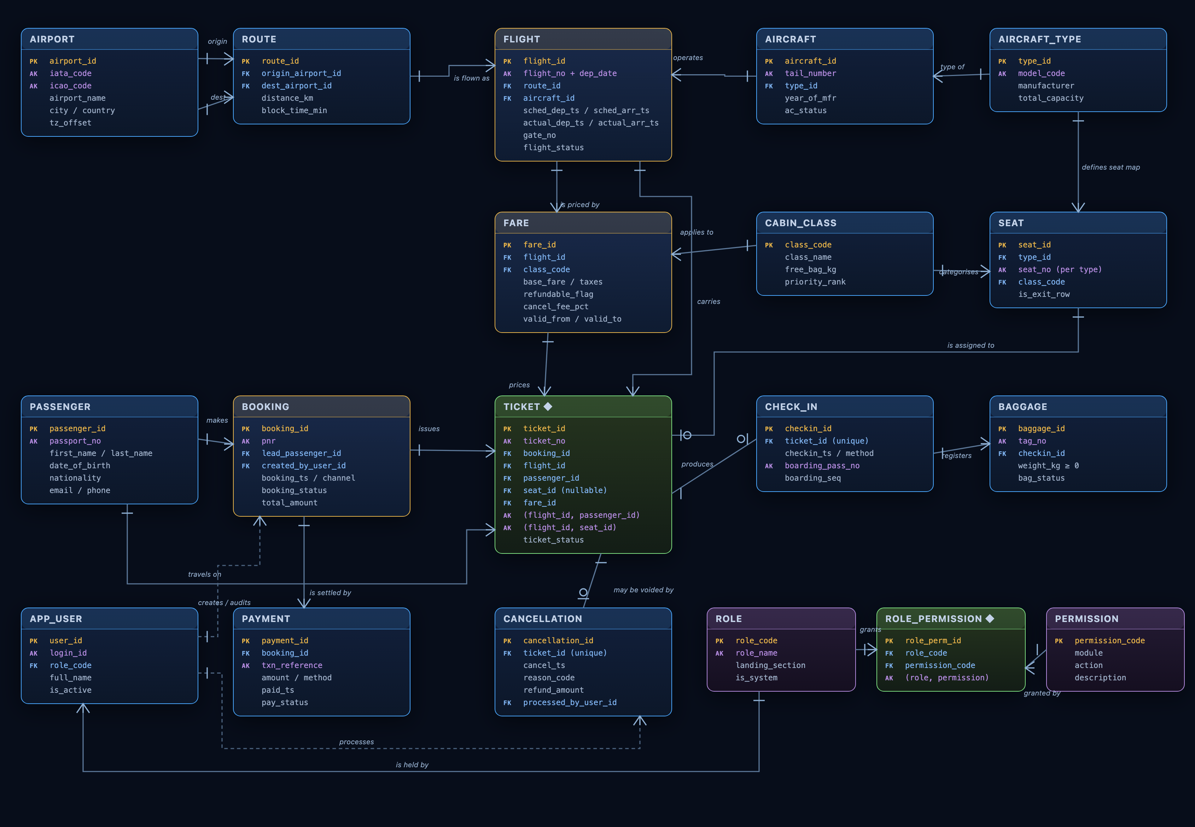
04 · CONCEPTUAL DESIGN
Entity–Relationship Diagram
HOW TO READ IT
|—
exactly one
—<
many (0..N)
—o|
zero or one
- - -
audit / attribution
PK primary key
FK foreign key
AK alternate (unique) key
◆ associative entity
Entities
19
Relationships
24
Associative entities
5
Normal form
3NF / BCNF
TICKET ◆
the hub — booking × passenger × flight, plus the optional seat
ROLE_PERMISSION ◆
the RBAC grid the web app reads on every request
SKYBASE · AIRLINE RESERVATION & FLIGHT OPERATIONS DBMS · PROJECT 18 · REVIEW 1
05

Slide 6
04 · CONCEPTUAL DESIGN
Entity–Relationship Diagram
05

Slide 7
05 · BUSINESS RULES
Every rule, and where it lives
A rule enforced only in the application is a rule a stray UPDATE will break.
#
BUSINESS RULE
ENFORCED BY
LIVES IN
R1
One seat per passenger per flight
UNIQUE(flight_id, passenger_id)
TABLE
R2
One passenger per seat per flight
UNIQUE(flight_id, seat_id) partial index
TABLE
R3
Aircraft-capacity limit
Trigger: live coupons vs. total_capacity
TRIGGER
R4
Seat must exist on the operating type
Trigger across SEAT / FLIGHT / AIRCRAFT
TRIGGER
R5
Non-negative, bounded baggage
CHECK(weight_kg BETWEEN 0 AND 40)
COLUMN
R6
No orphan baggage
checkin_id NOT NULL FK, ON DELETE RESTRICT
REFERENTIAL
R7
Check-in only for confirmed tickets
Trigger on status + check-in window
TRIGGER
R8
One check-in, one cancellation per ticket
UNIQUE(ticket_id) on both relations
TABLE
R9
Refund from the frozen fare, seat released
sp_cancel_ticket() in one transaction
TRANSACTION
R10
Ticketing requires settled payment
sp_issue_tickets(): SUM(payments) >= total
TRANSACTION
R11
Idempotent payments
UNIQUE(txn_reference)
TABLE
R12
Route origin ≠ destination, arrival > departure
CHECK constraints on ROUTE and FLIGHT
TABLE
R13
Identity uniqueness (PNR, ticket, tag, tail)
UNIQUE on every alternate key
TABLE
R14
A user may only reach permitted sections
ROLE_PERMISSION + GRANTs on views
RBAC
The application layer gives the error message. The database layer makes the invalid state impossible — whichever client, script or console reaches the data.
SKYBASE · AIRLINE RESERVATION & FLIGHT OPERATIONS DBMS · PROJECT 18 · REVIEW 1
08

Slide 8
BOARDING PASS
SEQ 018
DBMS · PROJECT-BASED LEARNING · REVIEW 1
THANK YOU
PROJECT
Airline Reservation &
Flight Operations DBMS
REVIEW
Review 1 · Week 7 · 5 marks
DELIVERABLE
Problem · Scope · Objectives · Users
ER design · Relational schema
NORMAL FORM
Third Normal Form (3NF)
DESIGN AND IMPLEMENTATION OF A DATABASE MANAGEMENT SYSTEM FOR AIRLINE RESERVATION AND FLIGHT OPERATIONS MANAGEMENT SYSTEM
FRONT END
Role-based web application
STATUS
DESIGN FROZEN
19 RELATIONS
24 RELATIONSHIPS
3NF
RBAC
8 REPORTS
REVIEW 1 · WEEK 7 · JOE DANIEL · 25WU0103019

Slide 9
09 · REQUIREMENTS, REPORTS & NEXT
What we build from here
FUNCTIONAL REQUIREMENTS · 24
REPORTS PLANNED · 8
THE TARGET APPLICATION
▸
Maintain airports, routes, fleet and seat maps
▸ Flight manifest
multi-table joins
A Python (Flask) web application over the same schema. On login the app reads ROLE_PERMISSION for the signed-in user and renders only the sections that role holds — booking desk, departure control, operations board, schedule builder, revenue, or user administration. Every route is guarded server-side; the database GRANTs are the second line, so a forged request still cannot read another passenger's PNR.
▸
Publish flights and fares per cabin class
▸ Occupancy & load factor
COUNT, GROUP BY
▸
Search flights and create a PNR
▸ Route demand
GROUP BY + HAVING
▸
Allocate a seat with no double allocation
▸ Baggage summary
SUM, NOT EXISTS
▸
Issue tickets once payment covers the total
▸ Cancellation & refund
correlated subquery
▸
Check in, board, accept and tag baggage
▸ On-time performance
CASE, AVG
▸
Cancel, refund and release the seat
▸ Revenue statement
▸
Authorise every section by role
nested aggregate + UNION
▸
Validate input at app and database layer
▸ Passenger travel history
view with row predicate
WEEK 7 · NOW
Problem, scope, objectives, users · ER diagram · initial relational schema · cardinality and associative entities
Review 1 — Conceptual design
WEEKS 8–11
Full FD list and data dictionary · DDL with all constraints and triggers · sp_book_seat / sp_check_in / sp_cancel_ticket · sample data · the eight report views · the seat race demonstrated in two live sessions
Review 2 — Database
WEEKS 12–16
Flask app with role-based sections · CRUD, search, validation, reporting, error handling · test log covering every boundary case · source, script, screens, report, viva
Review 3 — Application & viva
SKYBASE · AIRLINE RESERVATION & FLIGHT OPERATIONS DBMS · PROJECT 18 · REVIEW 1
10

Slide 10
05 · CARDINALITY
Cardinality, participation & associative entities
Total participation becomes a NOT NULL foreign key; partial becomes a nullable one.
RELATIONSHIP
CARDINALITY
PARTICIPATION
WHERE THE FOREIGN KEY LIVES
AIRPORT — ROUTE (origin / dest)
1 : N
Partial : Total
ROUTE.origin_airport_id, dest_airport_id
ROUTE — FLIGHT
1 : N
Partial : Total
FLIGHT.route_id NOT NULL
AIRCRAFT_TYPE — AIRCRAFT — FLIGHT
1 : N : N
Total : Total
AIRCRAFT.type_id, FLIGHT.aircraft_id
AIRCRAFT_TYPE — SEAT
1 : N
Total : Total
SEAT.type_id — the map belongs to the type
FLIGHT — CABIN_CLASS
M : N → FARE
Total : Total
FKs in FARE ◆
BOOKING × PASSENGER × FLIGHT
M : N : N → TICKET
Total : Total : Partial
FKs in TICKET ◆
SEAT — TICKET
1 : 0..1
Partial : Partial
TICKET.seat_id NULL-able + UNIQUE(flight, seat)
TICKET — CHECK_IN — BAGGAGE
1 : 0..1 : N
Partial : Total
CHECK_IN.ticket_id UNIQUE ◆
TICKET — CANCELLATION
1 : 0..1
Partial : Total
CANCELLATION.ticket_id UNIQUE ◆
BOOKING — PAYMENT
1 : N
Partial : Total
PAYMENT.booking_id NOT NULL
ROLE — PERMISSION
M : N → ROLE_PERMISSION
Total : Total
FKs in ROLE_PERMISSION ◆
FIVE ASSOCIATIVE ENTITIES · TICKET (ternary M:N + optional seat) · FARE (flight × class, carries price) · CHECK_IN and CANCELLATION (1:1 events with their own attributes) · ROLE_PERMISSION (role × permission)
SKYBASE · AIRLINE RESERVATION & FLIGHT OPERATIONS DBMS · PROJECT 18 · REVIEW 1
06

Slide 11
06 · RELATIONAL SCHEMA
Nineteen relations, normalised to 3NF
1NF
Repeating passenger / seat / bag groups on one booking row
2NF
(flight_no, dep_date) → flight details; passport_no → passenger details
3NF
flight → aircraft → type → model, capacity · route → airport → city
✔ Split into TICKET and BAGGAGE rows
✔ Extract FLIGHT, PASSENGER, SEAT
✔ Extract AIRCRAFT_TYPE, AIRPORT, CABIN_CLASS, FARE
AIRPORT
ROUTE
AIRCRAFT_TYPE
AIRCRAFT
CABIN_CLASS
PK airport_id
PK route_id
PK type_id
PK aircraft_id
PK class_code
AK iata_code
FK origin_airport_id
AK model_code
AK tail_number
class_name
airport_name
FK dest_airport_id
manufacturer
FK type_id
free_bag_kg
city / country
distance_km
total_capacity
ac_status
priority_rank
tz_offset
AK (origin, dest)
SEAT
FLIGHT
FARE ◆
PASSENGER
BOOKING
PK seat_id
PK flight_id
PK fare_id
PK passenger_id
PK booking_id
FK type_id
FK route_id
FK flight_id
AK passport_no
AK pnr
seat_no
FK aircraft_id
FK class_code
name / dob
FK lead_passenger_id
FK class_code
sched & actual times
base_fare / taxes
nationality
FK created_by_user_id
AK (type_id, seat_no)
gate / status
refundable / cancel_fee_pct
email / phone
status / total_amount
AK (flight_no, dep_date)
TICKET ◆
CHECK_IN ◆
BAGGAGE
CANCELLATION ◆
PAYMENT
PK ticket_id
PK checkin_id
PK baggage_id
PK cancellation_id
PK payment_id
AK ticket_no
AK ticket_id
AK tag_no
AK ticket_id
FK booking_id
FK booking / flight / passenger
checkin_ts / method
FK checkin_id
cancel_ts / reason_code
AK txn_reference
FK seat_id (NULL) · fare_id
AK boarding_pass_no
weight_kg ≥ 0
refund_amount
amount / method
AK (flight, passenger)
bag_status
FK processed_by_user_id
paid_ts / pay_status
AK (flight, seat)
APP_USER
ROLE
ROLE_PERMISSION ◆
PERMISSION
PK user_id
PK role_code
PK role_perm_id
PK permission_code
AK login_id
AK role_name
FK role_code
module
FK role_code
landing_section
FK permission_code
action
full_name
is_system
AK (role, permission)
description
is_active
EVERY RELATION IS IN 3NF — AND IN BCNF: IN EACH, EVERY DETERMINANT IS A CANDIDATE KEY. BOOKING.total_amount AND CANCELLATION.refund_amount ARE DERIVED VALUES STORED DELIBERATELY, RECONCILED IN-TRANSACTION.
SKYBASE · AIRLINE RESERVATION & FLIGHT OPERATIONS DBMS · PROJECT 18 · REVIEW 1
07

Slide 12
08 · CONCURRENCY
Two agents, one seat 14A
The boundary case the whole design exists to survive.
T1 · COUNTER A
t
T2 · COUNTER B
BEGIN; SELECT … seat 14A FOR UPDATE; → 0 rows
t1
t2
BEGIN; SELECT … FOR UPDATE; ⏳ BLOCKED
SELECT COUNT(*) … → 179 / 180 seats sold
t3
⏳ still waiting
INSERT INTO ticket(… seat 14A …); COMMIT; ✔
t4
t5
→ resumes: 1 row (seat now taken)
t6
INSERT … 14A; ✕ duplicate key uq_ticket_flight_seat
t7
ROLLBACK; → offer 14C; COMMIT; ✔
Nobody is double-seated and nobody is turned away — the loser retries onto the next free seat.
PESSIMISTIC
DECLARATIVE
ISOLATION
SCOPE
SELECT … FOR UPDATE takes the row lock; T2 blocks instead of reading stale data
UNIQUE(flight_id, seat_id) is the backstop — it holds even if the lock is forgotten
READ COMMITTED + FOR UPDATE; SERIALIZABLE only for the capacity phantom, with retry
Seat holds are rows with an expiry, never an open transaction waiting on a human
SKYBASE · AIRLINE RESERVATION & FLIGHT OPERATIONS DBMS · PROJECT 18 · REVIEW 1
09

