Slide 1
Reactive messaging
JoeDayz | 2025

Slide 2
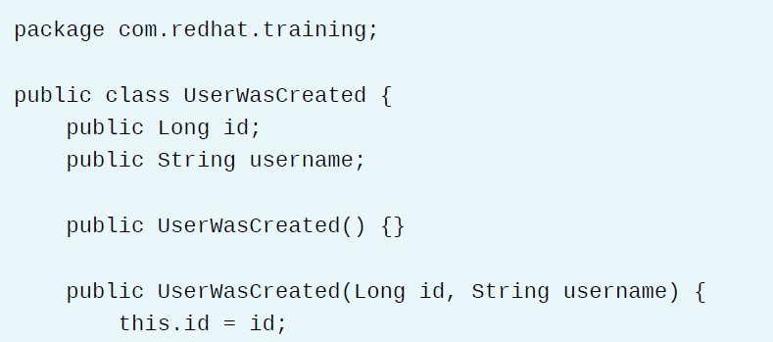
Evento

Slide 3
Eclipse Microprofile Reactive Messaging Spec 2.0
Quarkus usa SmallRye Reactive Messaging que soporta Kafka, AMQP o MQTT.
Conceptos:
Messages (org.eclipse.microprofile.reactive.messaging.Message)
Channels (Incoming channels [consumo], outgoing channels [producción])
Connectors (Connector Kafka, RabbitMQ, Pulsar, etc)

Slide 4
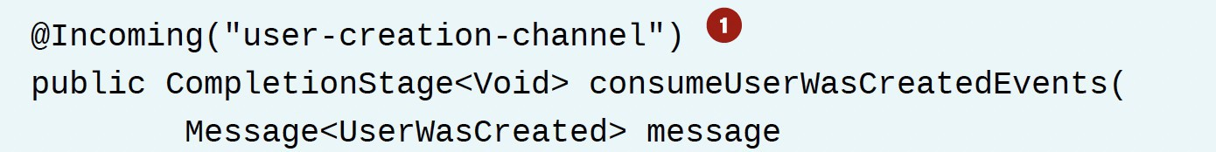
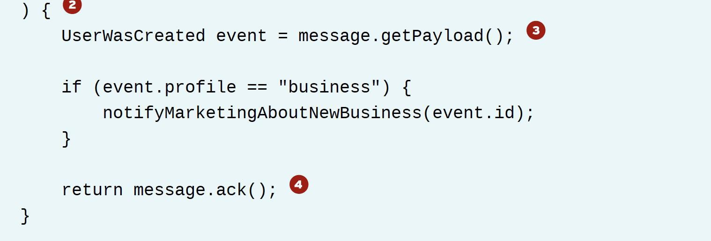
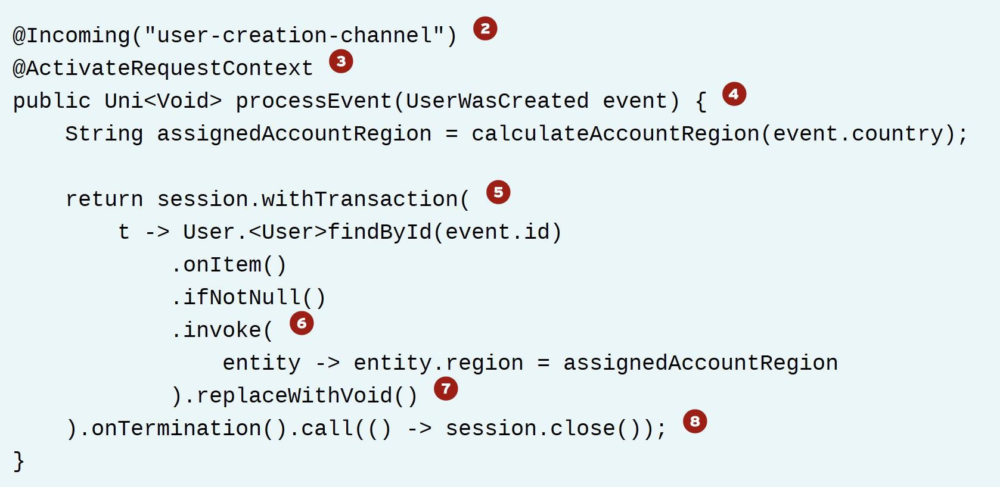
Consumo
De Mensajes
- Payload

Slide 5
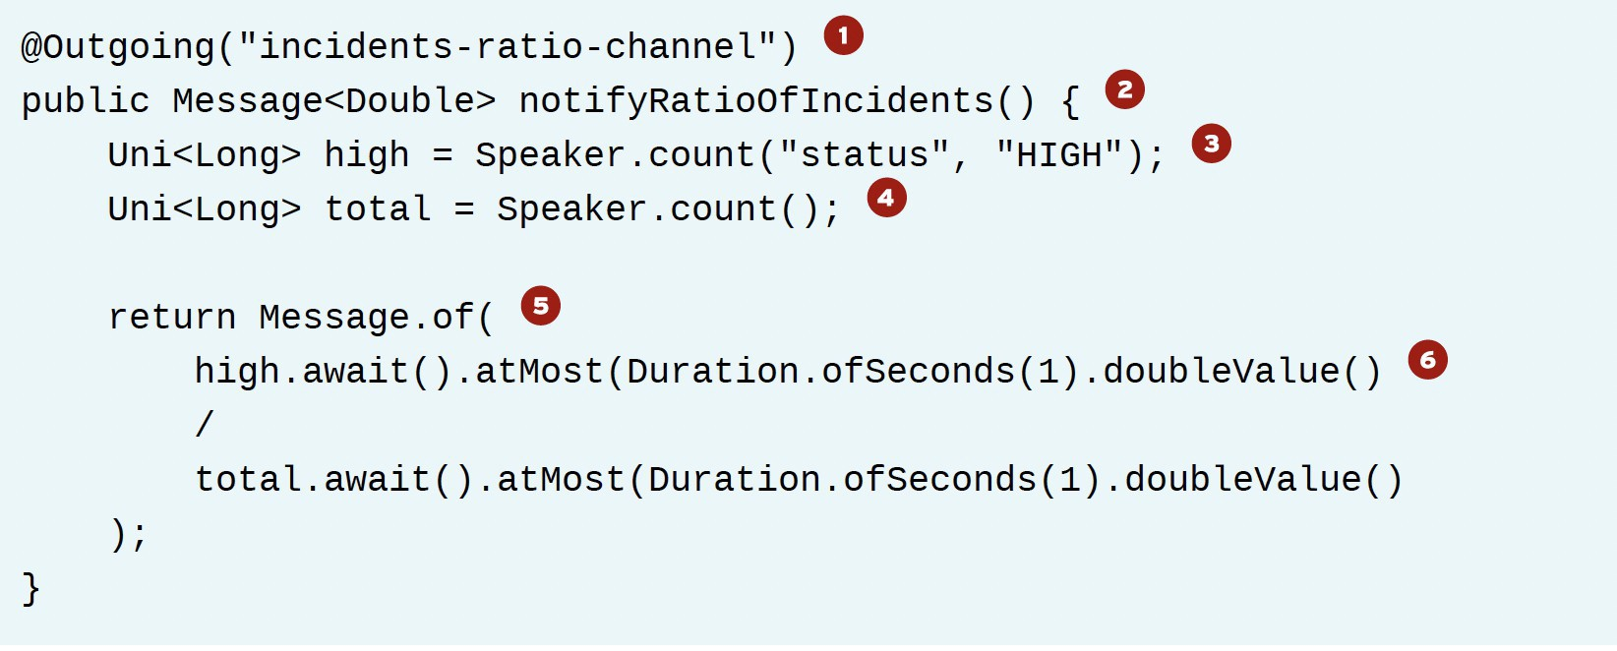
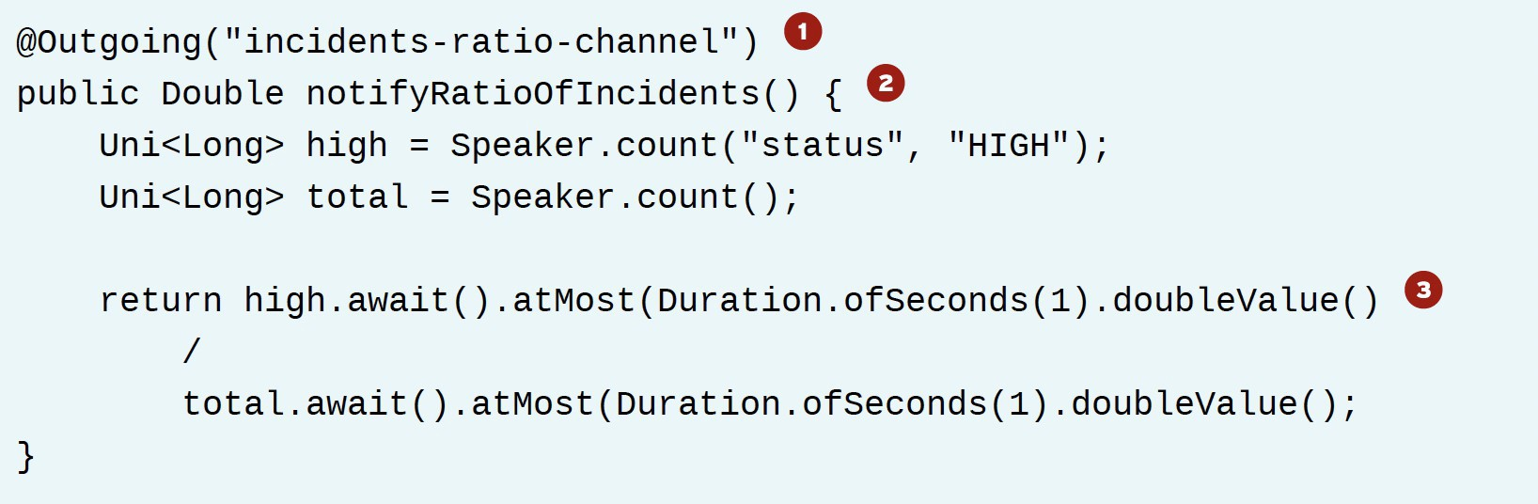
Producir
Mensajes

Slide 6
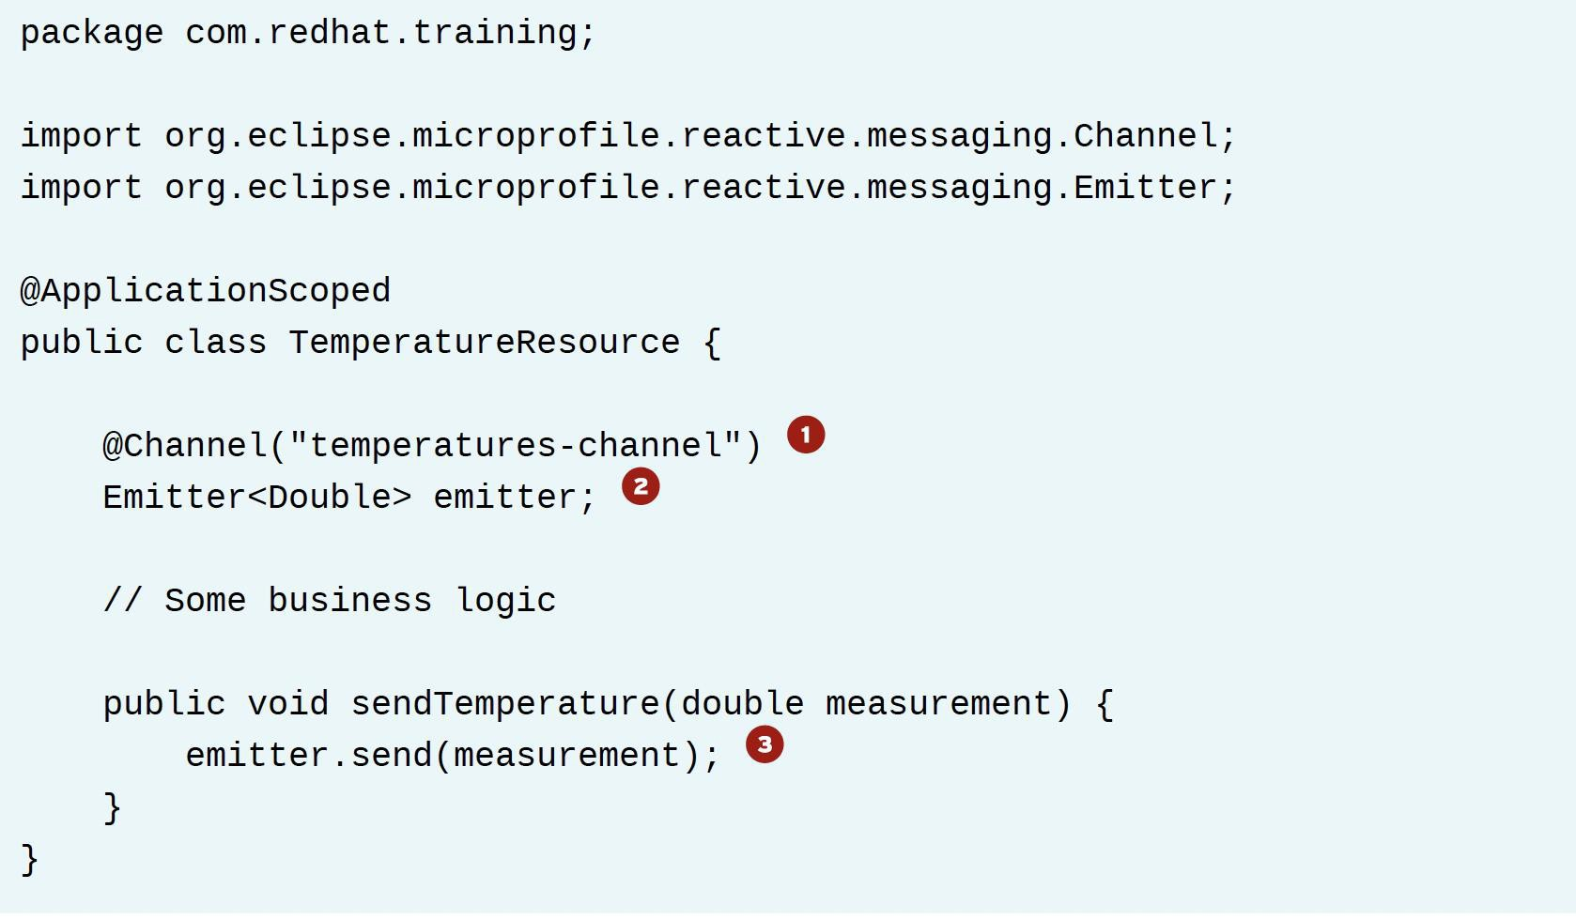
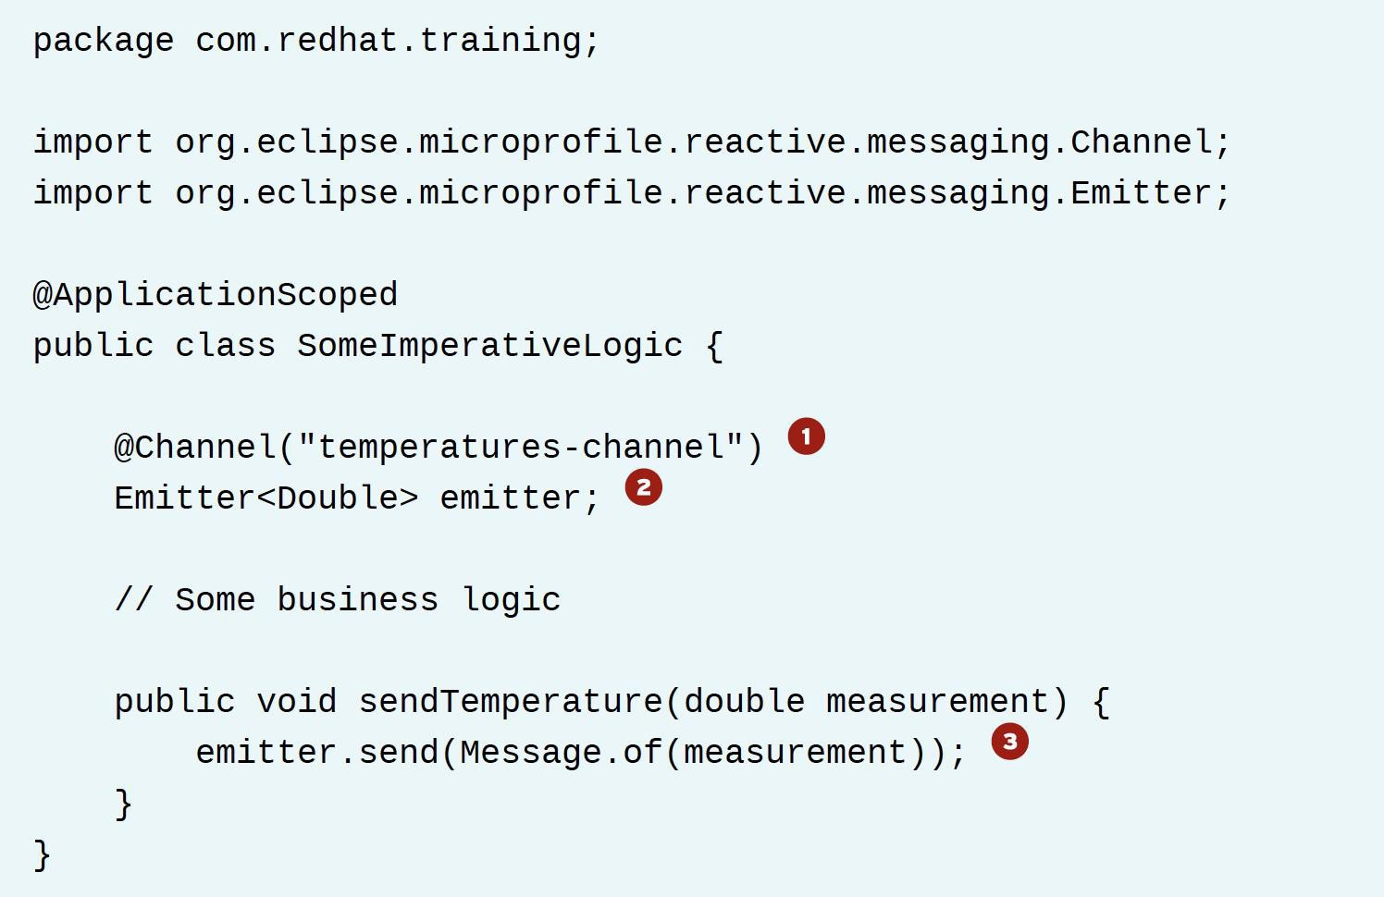
Código imperativo
Emitter

Slide 7
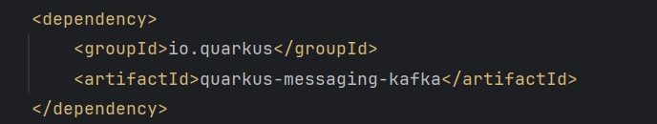
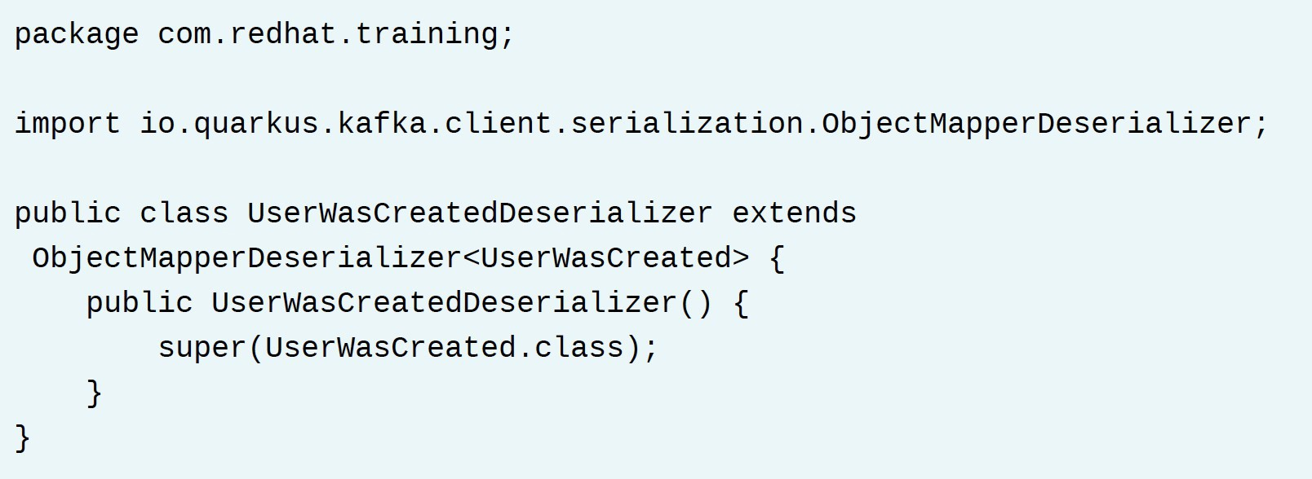
Kafka
quarkus-messaging-kafka
Serializers: io.quarkus.kafka.client.serialization.ObjectMapperSerializer Deserializers: io.quarkus.kafka.client.serialization.ObjectMapperDeserializer

Slide 8
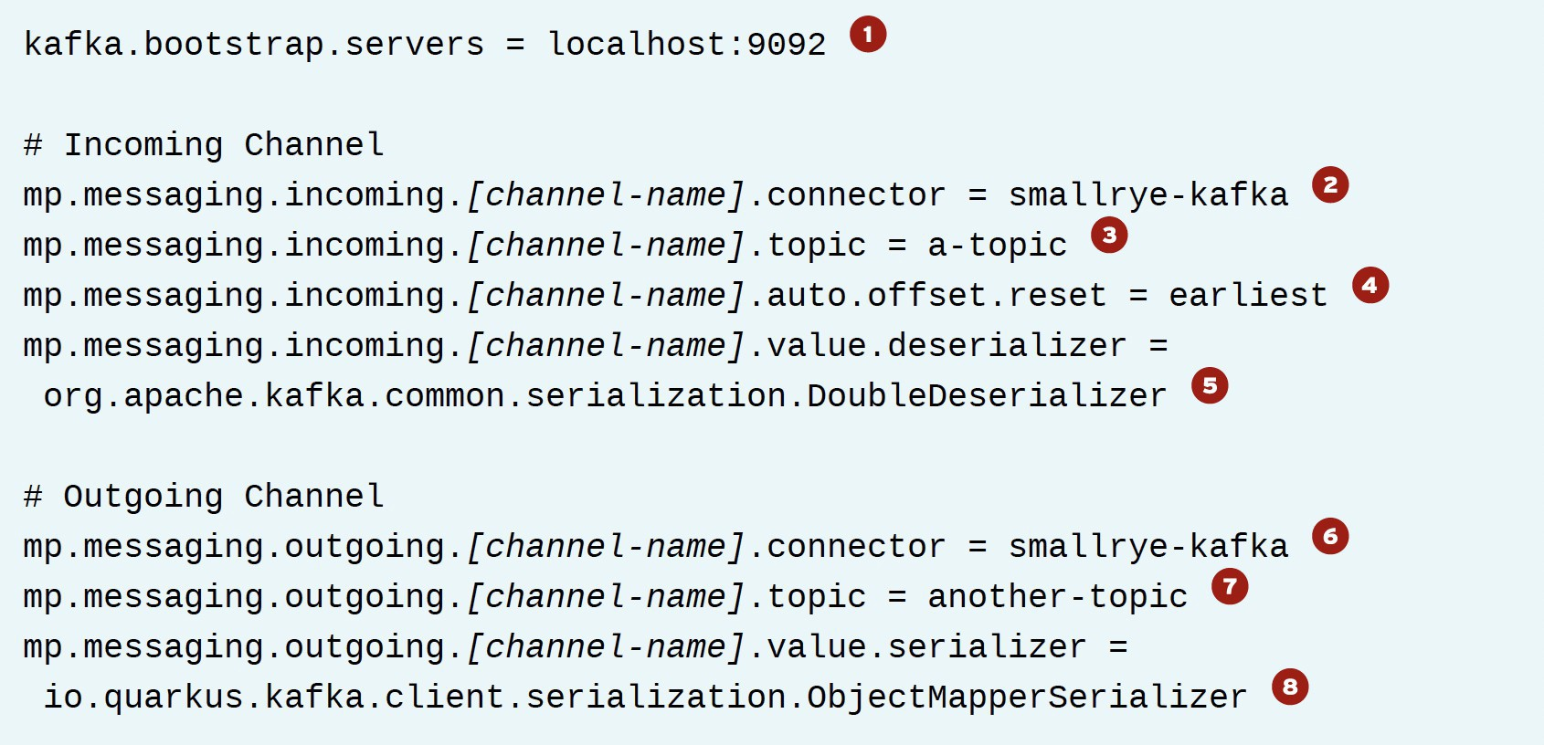
Kafka
Configuration

Slide 9
Recursos
https://smallrye.io/smallrye-reactive-messaging/3.21.0/
https://quarkus.io/version/2.13/guides/kafka-reactive-getting-started
https://quarkus.io/version/2.13/guides/amqp https://kafka.apache.org

