Slide 1
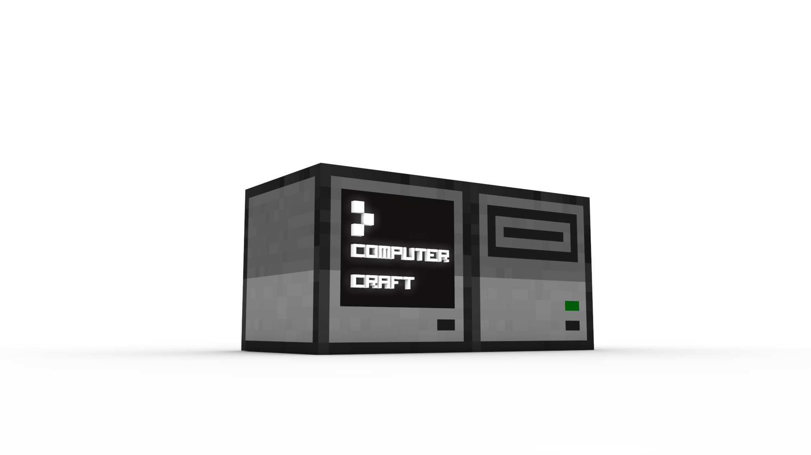
Crafting a Computer in Minecraft

Slide 2
Possible Challenges
Beginner: Best display on monitor
Intermediate: Best printer program
Advanced: Best turtle program
All Around: Best thing using ComputerCraft

Slide 3
Parts of a Computer
CPU – Central Processing Unit
RAM – Random Access Memory
Hard Drive – Stores Data
Floppy Disk – Stores Data off computer (like a USB stick)
Monitor – Visual output interface
Motherboard – Connects computer components to make up the computer

Slide 4
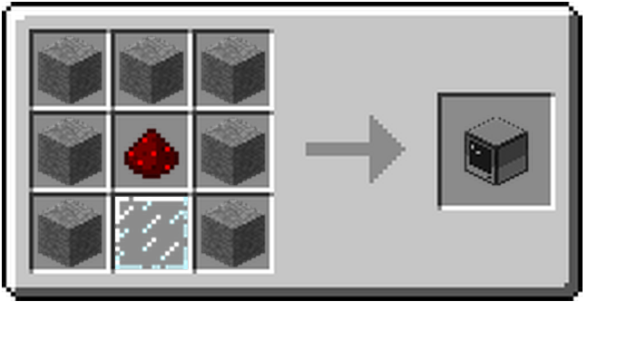



Computer Crafting Recipe
Stone
Glass Pane
Redstone

Slide 5
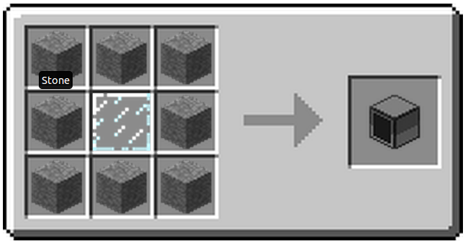
Monitor Crafting Recipe
Stone
Glass Pane

Slide 6
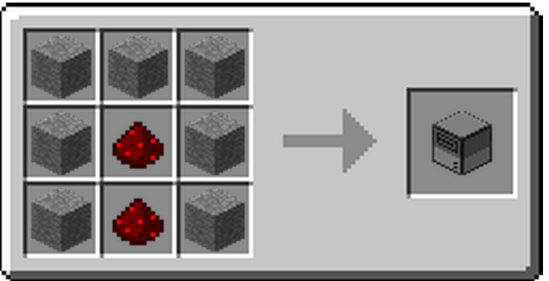
Disk Drive Crafting Recipe
Stone
Redstone

Slide 7
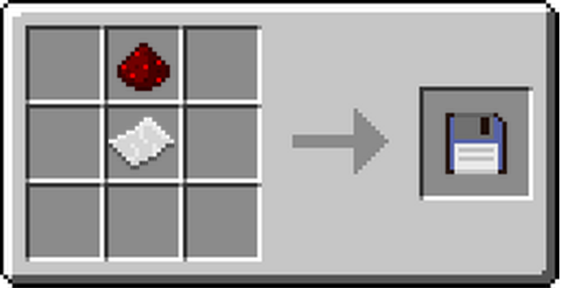

Floppy Disk Crafting Recipe
Paper
Redstone

Slide 8
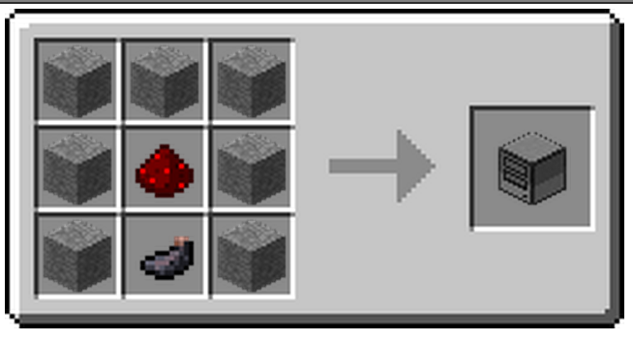

Printer Crafting Recipe
Stone
Ink Sac
Redstone

Slide 9
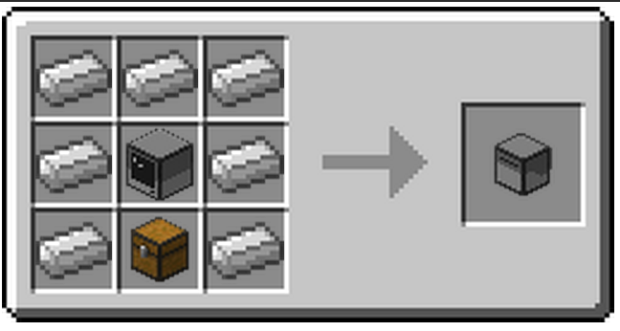



Turtle Crafting Recipe
Iron Ingot
Chest
Computer

Slide 10
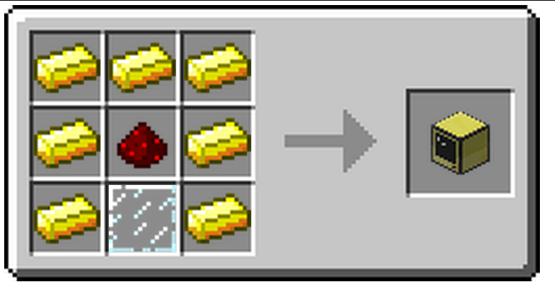

Advanced Computer Recipe
Gold Ingot
Glass Pane
Redstone

Slide 11
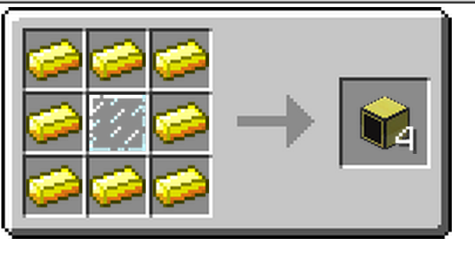
Advanced Monitor Recipe
Gold Ingot
Glass Pane

Slide 12
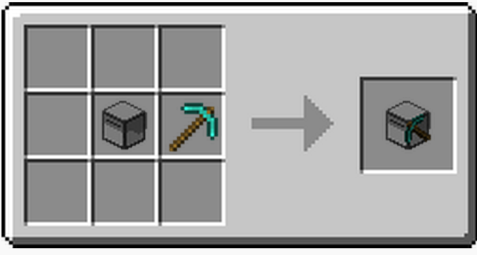
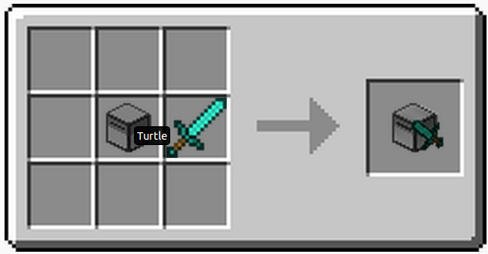



Some Turtle Recipes
= Mining Turtle
= Melee Turtle
Turtle
Diamond Pickaxe
Diamond Sword
Go to http://computercraft.info/wiki/Turtle#Recipes for more info on turtle recipes

Slide 13
Command Line
When crafting a computer or any computer peripheral. Right click the device to enter command prompt, etc.
Command line works similar to your computer command line

Slide 14
Introduction to Command Line
cd – change directory
  cd .. - go up one directory
ls – list files in directory
mkdir – make a new directory
cp – copy a file
mv – move a file or directory
rm – remove a file
up arrow – last command

Slide 15
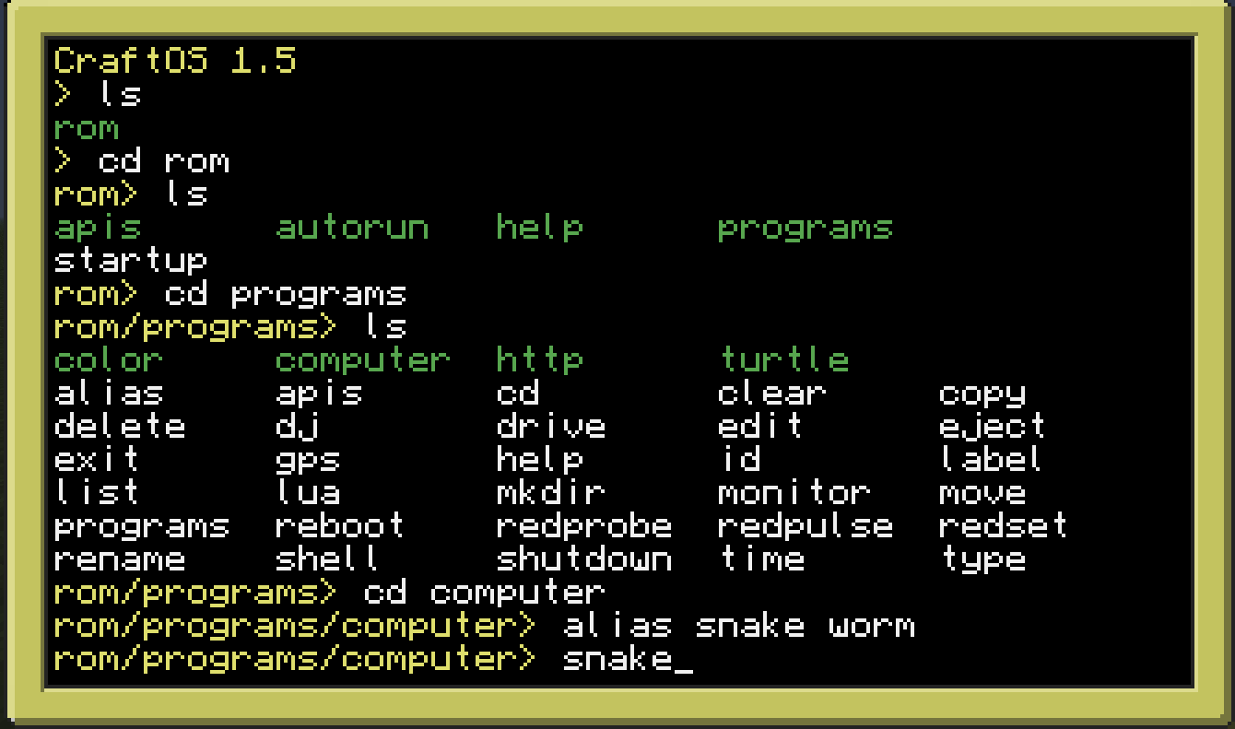
Alias worm and play “Snake”

Slide 16
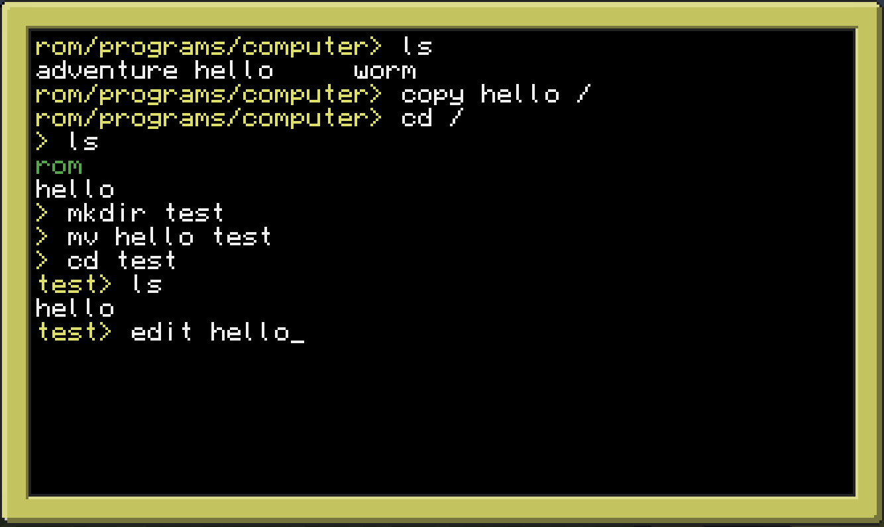
Copy hello Program and Edit

Slide 17
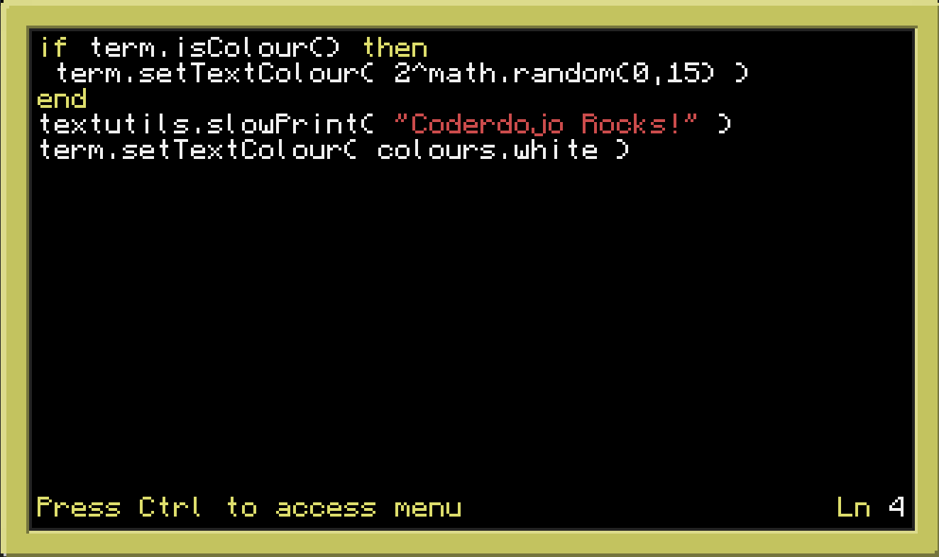
Edit slowPrint in hello Program

Slide 18
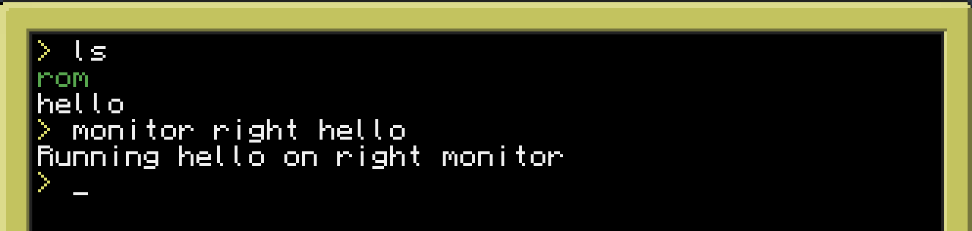
Display on Right Monitor

Slide 19
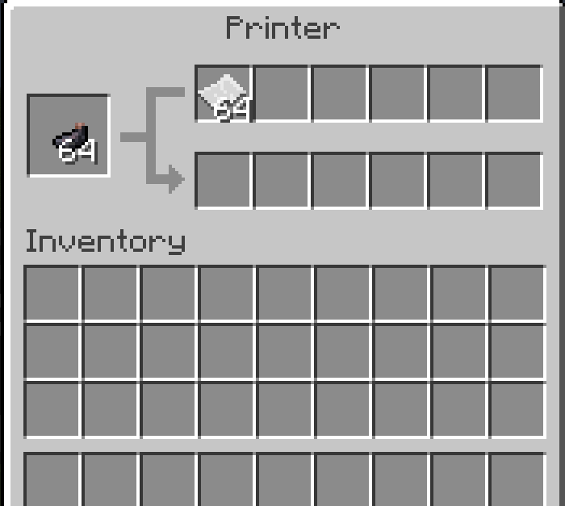
Put Ink and Paper into Printer
Ink Sac
Paper

Slide 20
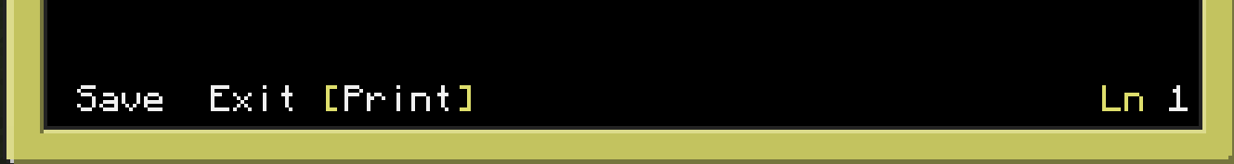
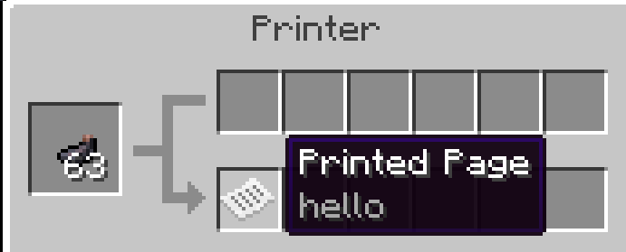

Print hello Code
Step 1: > edit hello
Step 2: Cntrl – arrow over to “Print” - press enter
Step 3: Prints page
Step 4: Get printed page from printer (right click printer)
Step 5: View printed page

Slide 21
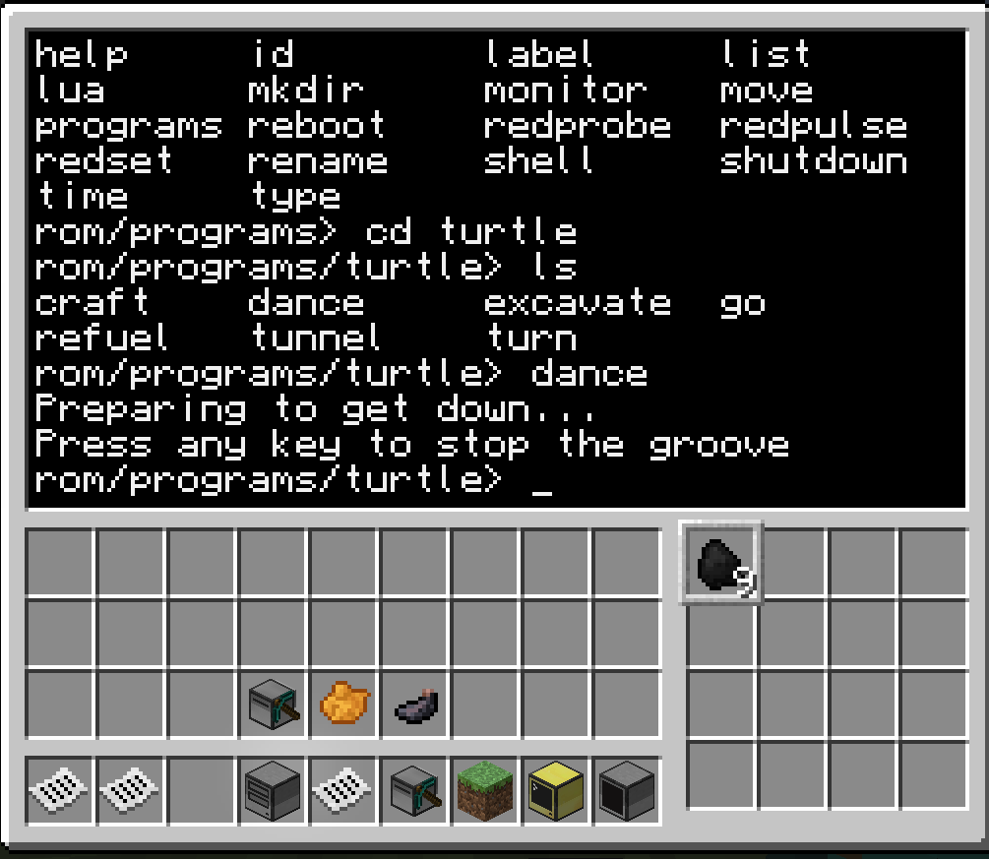
Make a Turtle Dance
Note: Right click turtle to enter above view

Slide 22
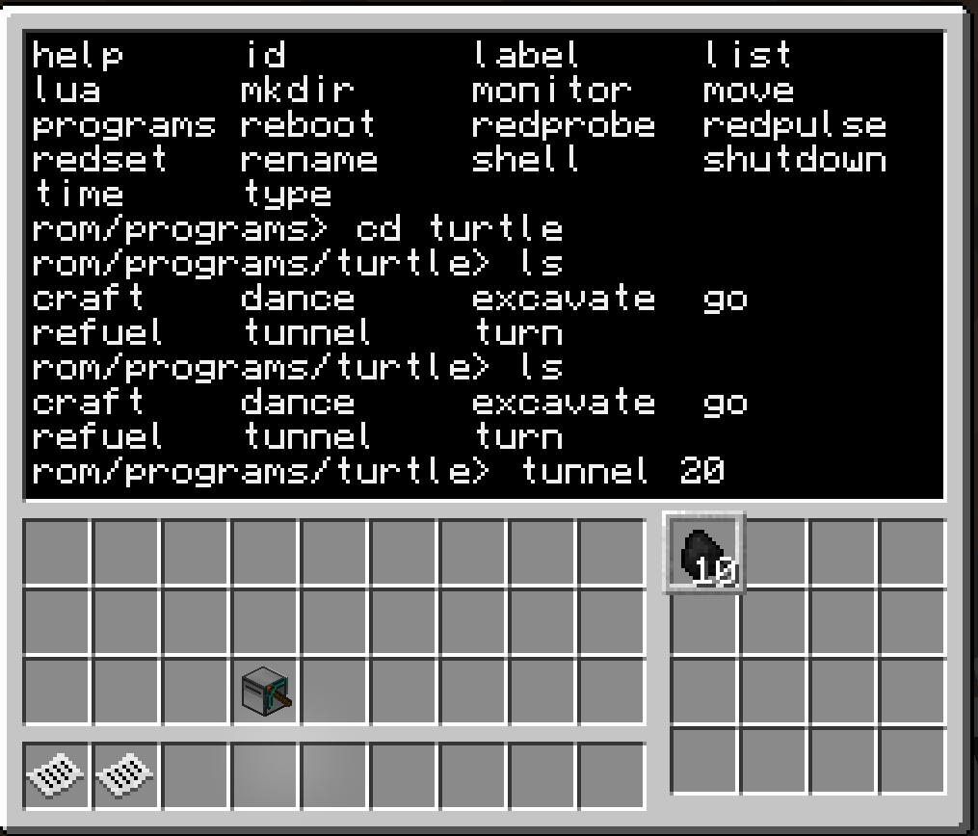
Create Tunnel with Mining Turtle
Note: Make sure you fuel the turtle with coal

Slide 23
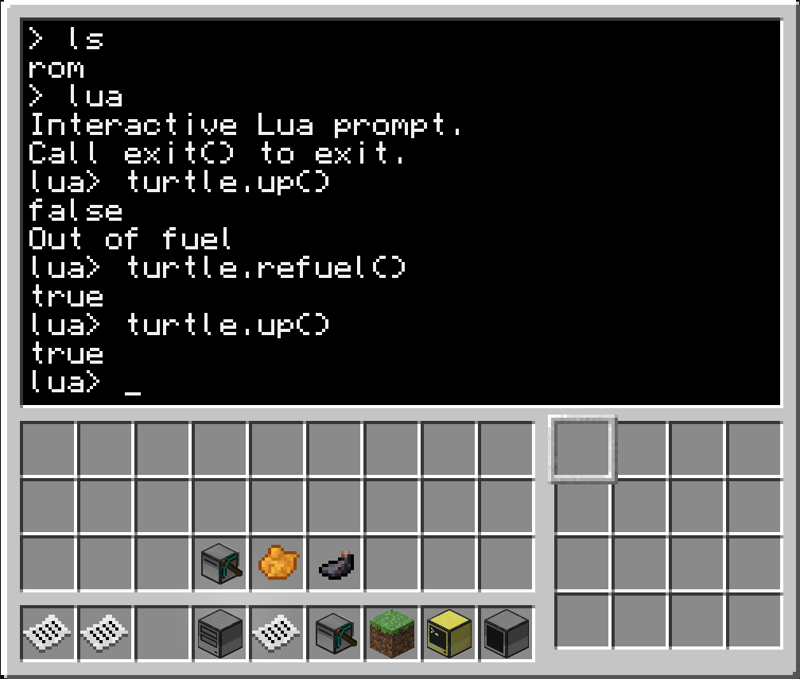
Program a Turtle Using Lua
Turtle Commands: http://computercraft.info/wiki/Turtle_(API)
Execute the commands via lua interpreter as shown below.

Slide 24
Have Fun Creating a Turtle Program
Go to http://www.computercraft.info/forums2/index.php?/forum/21-turtle-programs for some example programs
Save program on disk by attaching a disk drive to the turtle like demonstrated with the computer. (Attach a disk drive by putting it next to the turtle)
Go to http://computercraft.info/wiki/Turtle for more information about turtles

Slide 25
Thank You
Twitter: @joeddean
Email: joe.dean@gmail.com

