Slide 1
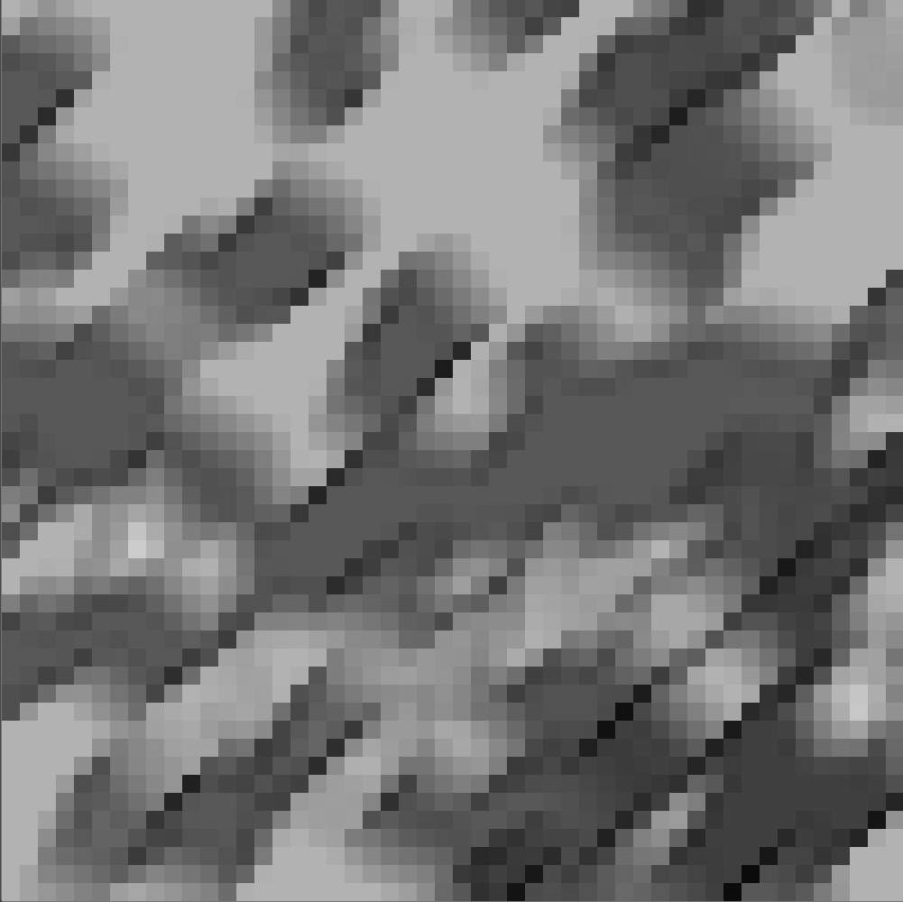
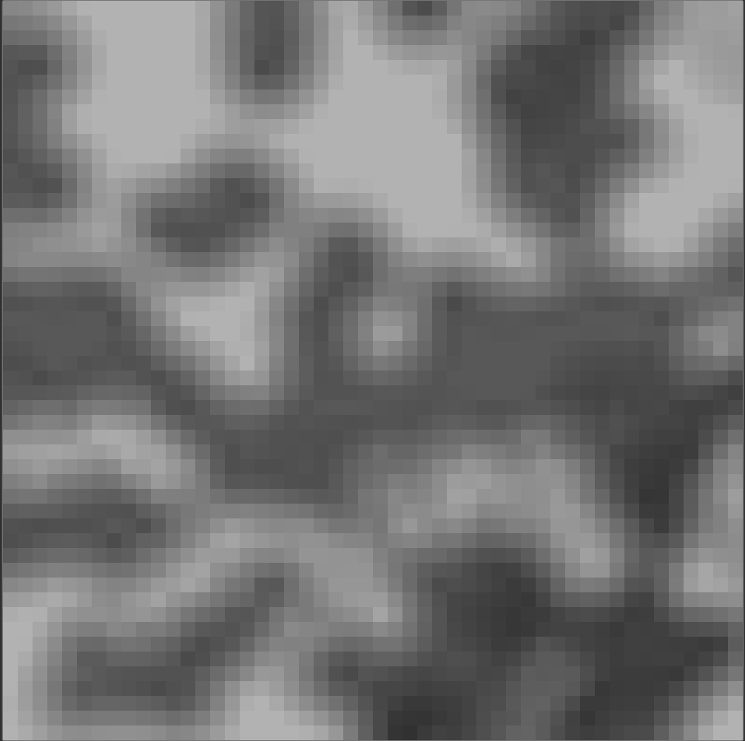
A
C10-60-500-R45
10px
Simulates astigmatism, image blur at 45°
10px
B
C10-500-500
10px
Greatly over-sampled, image is completely blurred
10px

