Slide 1

G2M CASE STUDY
Virtual Internship
5th September 2021

Slide 2
Agenda
Problem Statement
Approach
EDA
EDA Summary
Recommendations

Slide 3
Problem Statement
XYZ is a private firm in US. Due to remarkable growth in the Cab Industry in last few years and multiple key players in the market, it is planning for an investment in Cab industry and as per their Go-to-Market(G2M) strategy they want to understand the market before taking final decision.
Objective : Provide actionable insights to help XYZ firm in identifying the right company for making investment.
Answers to following questions (hypotheses) will provide an insight to which company will be right for investment.
Which month is the busiest for the cab companies?
Which days are popular among riders?
Which cabs are more popular across the cities and among the age groups?
What are the profits of each company over the years?
What are the number of users for each cap company across the time periods?
Does the income of the riders have an influence on cab rides?

Slide 4
Approach
The approach to arrive at a desired conclusion involves the following:
Exploratory Data Analysis
Finding answers to the stated hypothesis
Comparing the profits made by the companies
Recommendations

Slide 5
Exploratory Data Analysis
Data created from merging 4 different data files into one
Resulting in a dataset with 14 features
An additional 5 features were derived from the previous 14 to help with analysis
A total of 359392 rows present in the data
Assumptions
Price charged contained a lot of data points that differed greatly from the others.
The cost of trip is the cost of running the trip and the price charged is the price paid for each trip, then the profit made on each trip can be calculated as Price Charged - Cost of Trip.

Slide 6
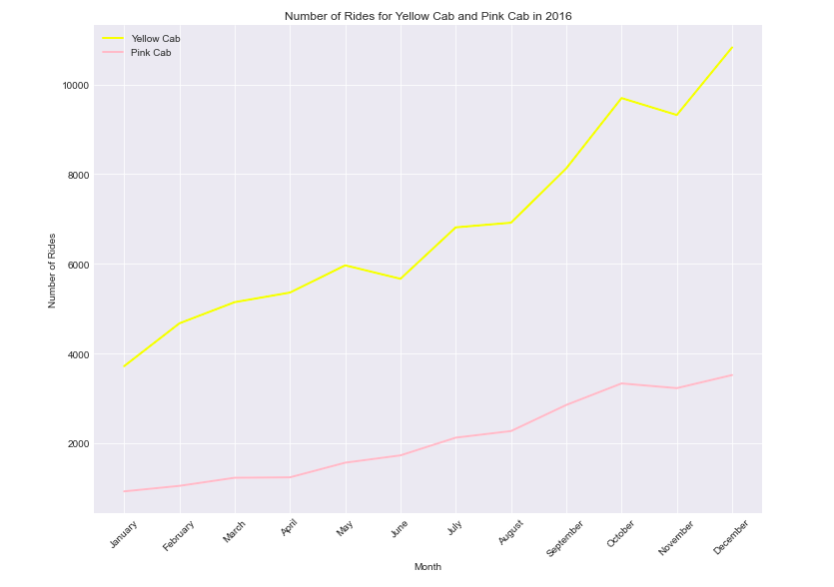
Monthly Number of Rides for each company

Slide 7
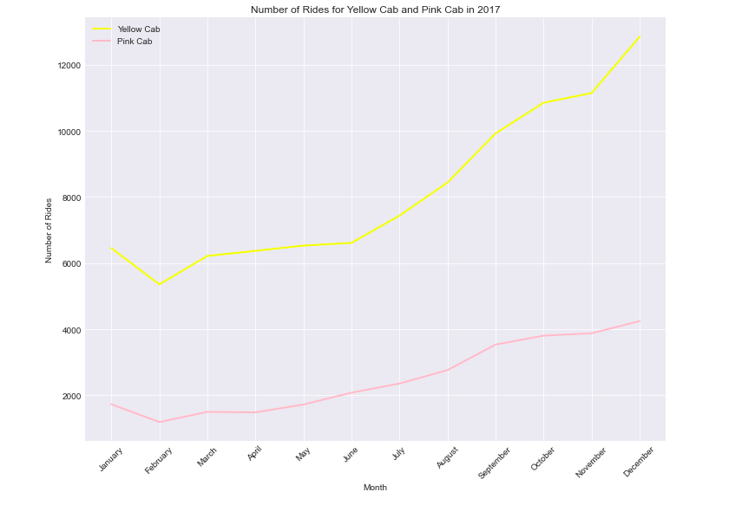
Monthly Number of Rides for each company

Slide 8
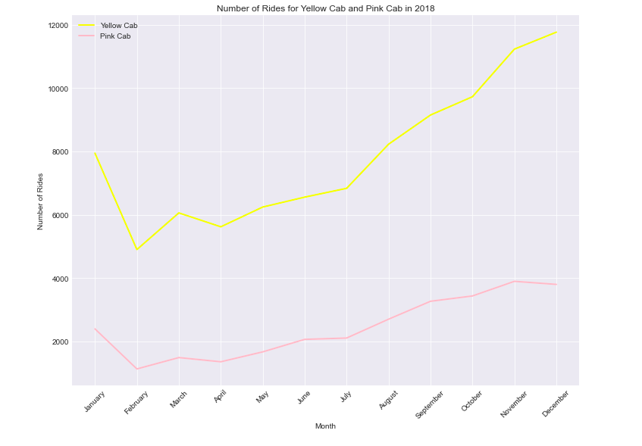
Monthly Number of Rides for each company

Slide 9
Monthly Number of Rides for each company
In 2016, there was an upward trend in the number cab rides for each of the companies with yellow cab having more rides in each month as compared to pink cab.
2017 was similar for both companies. An upward trend, with yellow cab having more rides. But there appeared to be a dip in number rides for the month of February in 2017 for both companies. After which there was a steady rise again to December.
In 2018, a dip was recorded in the month of February again, after which the number to rides started to rise again in the subsequent months. Except for pink cab where they saw a slight dip December 2018.
Yellow cab tends to have had more rides across then 3 years period. December appears to be the busiest month for both companies across the years. But why, does the number of rides dip in February?

Slide 10
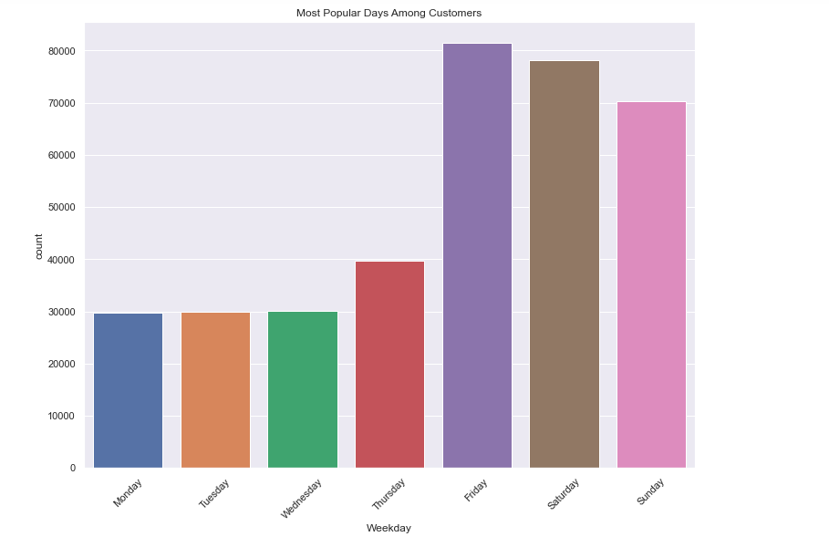
Most popular day among users

Slide 11
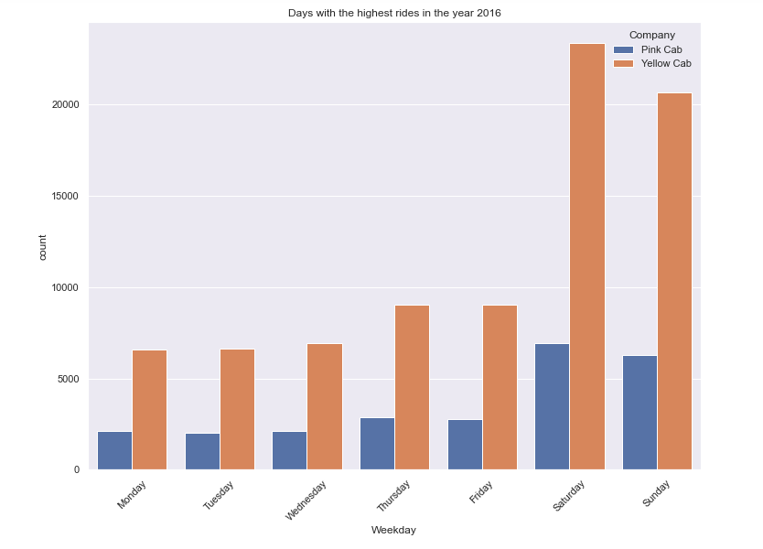
Most popular day among users

Slide 12
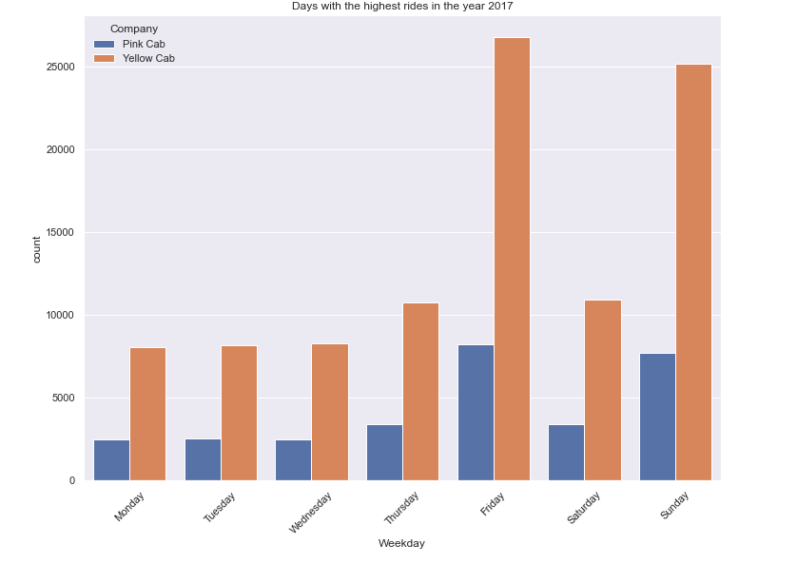
Most popular day among users

Slide 13
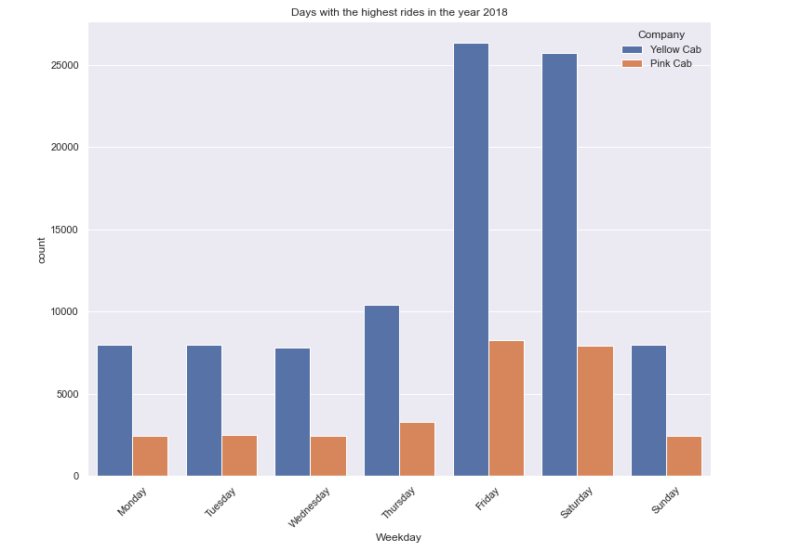
Most popular day among users

Slide 14
Most popular day among users
From the visualizations above, the weekends (Friday - Sunday) have seen the greatest number of rides, Friday being the highest across the 3 years.
In 2016, both companies start seeing the number rides increasing from Thursday, through Saturday before dropping on Sunday. Yellow Cab had more rides on each day with Saturday being the most popular day among riders for both companies.
The popular day among among riders changed to Friday in 2017 and 2018 for both companies.

Slide 15
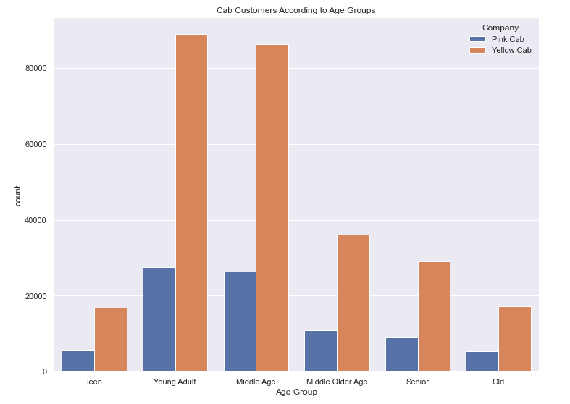
Most popular day among users

Slide 16
Most popular day among users
The Young Adults (between 20 to 29 years) and the middle age (between 40 to 49 years) are people who patronize cab rides, among all customers. Again, yellow cab has more customers in these groups.
2017 recorded the highest number of trips across all age groups. 2016 recording the least.

Slide 17
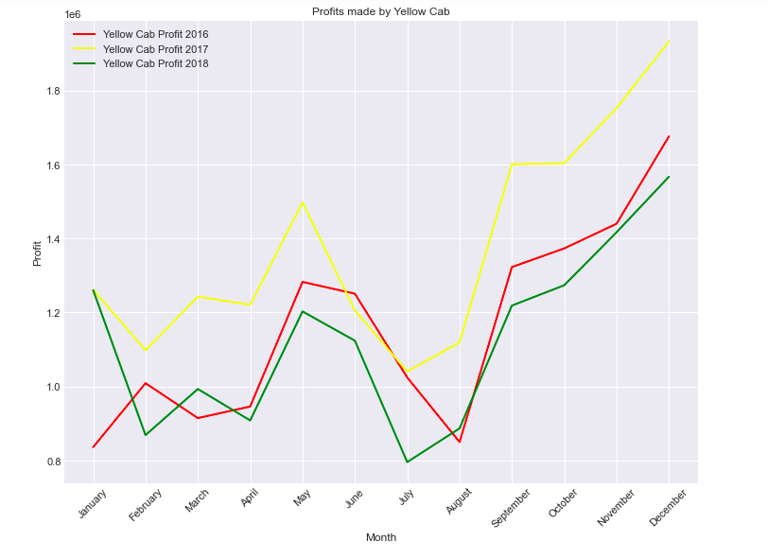
Profits Made By the Companies

Slide 18
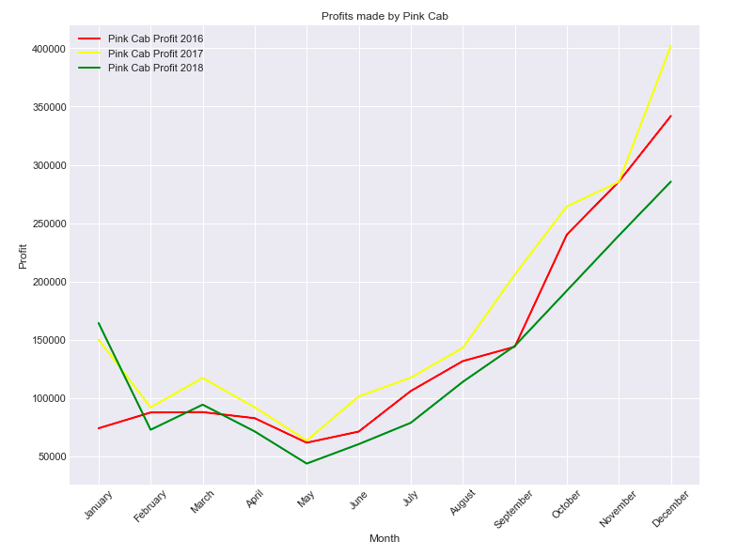
Profits Made By the Companies

Slide 19
Profits Made By the Companies
Yellow Cab made the biggest profits in 2017. May, September, December being the months in 2017 where yellow cab made bigger profits compared to the rest of the months
There appears to be a drop in profits for yellow cab in the months February, July and August for 2017 and 2018 for yellow cab
Pink Cab experienced a steady rise in profits from May to December in all of the 3 years after experiencing a dip in February, a rise in March and then a dip from April to May
Pink Cab in Feb 2017 saw a slight rise in profits as opposed to what happened in 2016 and 2018

Slide 20
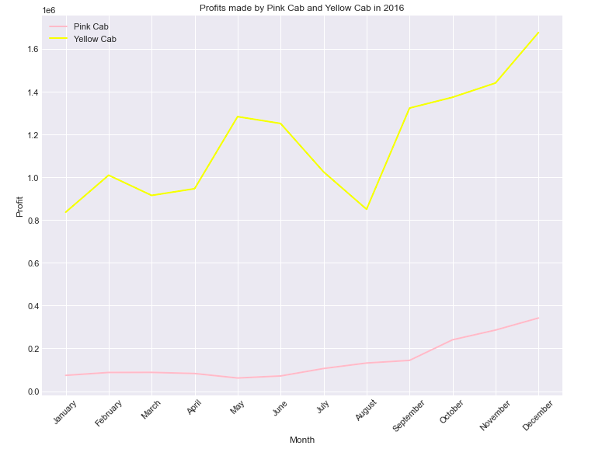
Profits Made By the Companies

Slide 21
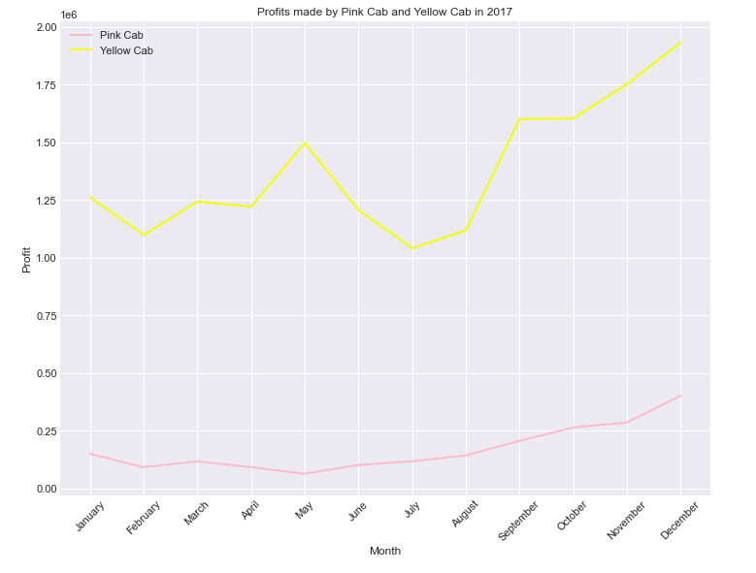
Profits Made By the Companies

Slide 22
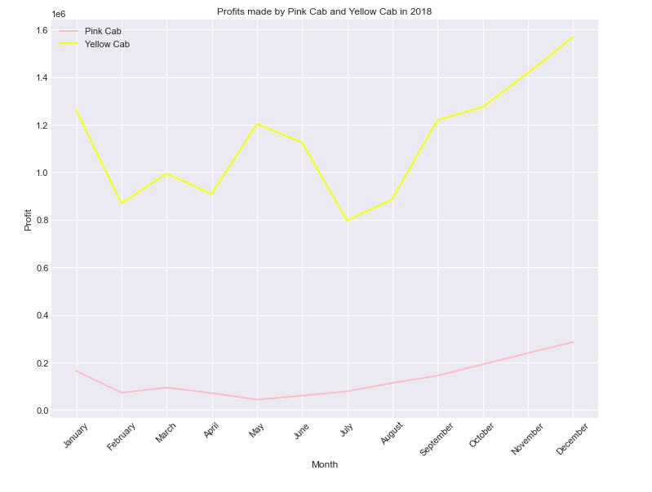
Profits Made By the Companies

Slide 23
Profits Made By the Companies
Yellow Cab charges an average of 458 per ride
Pink Cab charged an average of 310 per ride
Pink Cab makes an average profit of 62.65 on each ride
Yellow Cab makes an average profit of 160 on each ride

Slide 24
Number of Users of the cab companies
A total of 46148 customers were recorded
26078 are customers of both cab companies
13818 are customers of Yellow Cab
6252 are customers of Pink Cab

Slide 25
Recommendations
After the analysis it is clear that Yellow Cab is better than Pink Cab because:
Yellow Cab has more customers than Pink Cab, eventhough it charges more. Yellow Cab must be doing something fundamentally right that Pink Cab is missing
Yellow Cab make more profits across the timeline than Pink Cab
Yellow Cab makes a profit an average profit of 160 on each ride as compared to the 62 made by Pink Cab
Yellow Cab is more popular among the younger generation who were majority of the customers.
It will make economic sense for company XYZ to invest in Yellow Cab.

Slide 26
Thank You

