Slide 1
Li
NGEA PDAC 2027 | FRANK ARNOTT AWARD
Why this project works
REE
A plain-language justification of our lithium + rare-earth workflow for Ireland
Prepared for our mentors
Team Rahaldi Taher | Extivonus Fransiskus | Jesslyn Jane | Joe Fawwaz | Kiki Siagian
Mentors Cendi Dana | Reza Alfurqan | Fahmi Hakim

Slide 2

1
The fair question
"Ireland has no rare-earth deposit. Is a rare-earth study even valid?"
Short answer: yes, and the lithium half makes the whole entry stronger. The next few slides explain why, in plain terms, so we are all comfortable defending it.
NGEA PDAC 2027 | Why this project works | for our mentors
2 / 10

Slide 3




2
What this award actually rewards
The Frank Arnott Award does not ask you to find a deposit. It scores how well you turn open data into insight. The four prize categories are:
Innovation
Data integration and visualisation
New methods brought to earth science
Many datasets combined and shown clearly
Impact and exploration significance
Collaboration
Useful, actionable geological conclusions
A real multidisciplinary team effort
None of these require a known deposit. They reward a clever, honest, well-integrated study, which is exactly what we built.
NGEA PDAC 2027 | Why this project works | for our mentors
3 / 10

Slide 4



3
Why rare earths in Ireland is valid
We are not claiming a deposit
No-deposit is the normal case
We deliver the first systematic, island-wide rare-earth screen of Ireland from open data, plus a real answer about what the rare-earth signal is.
Most ground has no known deposit. A method that works WITHOUT labels is more useful and more transferable than one that needs known deposits. That is the innovation.
We found a real result
It is measured, not guessed
Ireland's soil rare earths are a secondary, clay-rich regolith signal (ion-adsorption style), not a Mourne bedrock halo. Ion-adsorption clay is a globally important rare-earth source.
The conclusion is backed by several independent checks (next slide), so it is a defensible scientific finding, not a hopeful map of hot spots.
NGEA PDAC 2027 | Why this project works | for our mentors
4 / 10

Slide 5

4
Why our rare-earth result is trustworthy
We did not just draw hot spots. We tested the signal four independent ways, and they all agree.
It repeats. The same anomaly appears in two separately sampled soil layers (agreement +0.88).
It matches independent geophysics. It tracks an independent airborne signal, thorium (+0.73).
Other media behave as expected. Stream sediments and stream water are decoupled from it, exactly what a clay/regolith signal should do.
It is not luck. A statistical permutation test rules out chance.
Plain version: the rare-earth signal is real and we know what it is, a clay-rich regolith (ion-adsorption-style) signal. That is a finding worth presenting, deposit or not.
NGEA PDAC 2027 | Why this project works | for our mentors
5 / 10

Slide 6

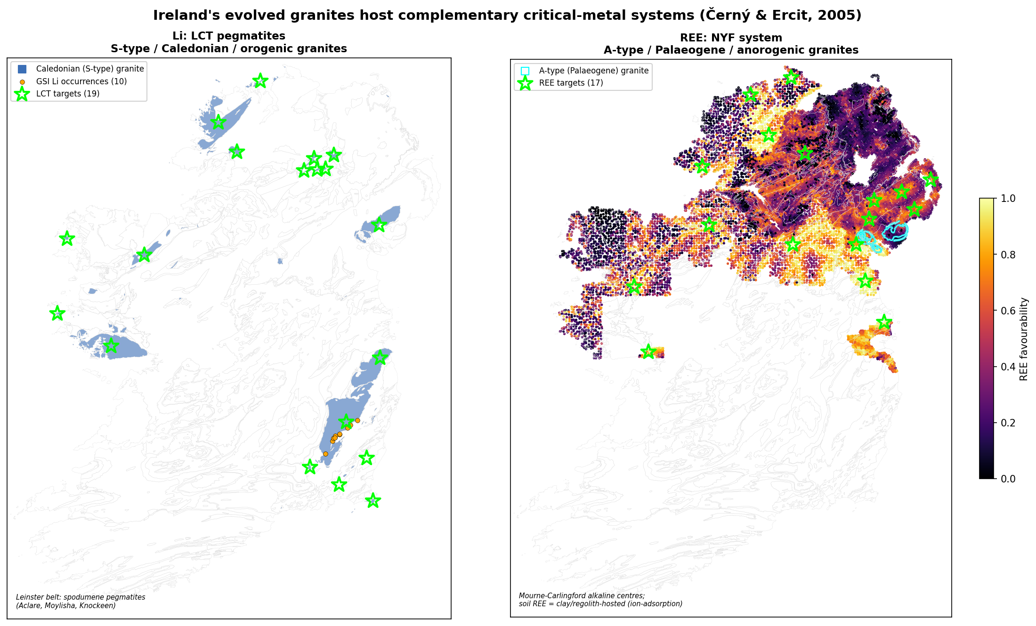
5
Why both lithium and rare earths, not just REE
One geological story
Ireland's evolved granites have two ends: Caledonian S-type granites make lithium; Palaeogene A-type granites carry rare earths. Same data, same workflow, two metals.
Lithium de-risks the entry
Lithium has real, known occurrences, so it proves our workflow works on known ground. Lithium gives credibility; rare earths give the innovation.
Two methods, one pipeline
Supervised learning for lithium, label-free for rare earths. Showing both in one pipeline is the methodological core and scores on integration and innovation.
NGEA PDAC 2027 | Why this project works | for our mentors
6 / 10

Slide 7
6
Our honesty is a strength
Judges trust teams that report what works and what does not. We do both, openly.
Lithium: we do not over-claim
Rare earths: we report the real nature
The lithium map is a good reconnaissance fertility map, but only 4 of 10 known occurrences sit within 20 km of a target. We say so, and present the Leinster belt as the credible set, not drill-ready.
We do not pretend Ireland has a Mourne rare-earth deposit. We show the signal is secondary clay/regolith, and we point primary search to the right tools (residual, stream, heavy minerals).
We fixed our own mistakes
Real data only
We caught and corrected an invalid early score and colour-image geophysics, and removed every approximation so the study now uses only real measured data.
No manual shapes, no invented coordinates. Real Tellus geochemistry, real airborne geophysics, real GSI and GSNI geology. Honesty that judges can verify.
NGEA PDAC 2027 | Why this project works | for our mentors
7 / 10

Slide 8
7
Why we have a real chance to win
Innovation
Data integration and visualisation
A label-free rare-earth workflow, two paradigms in one pipeline, and per-target mineral-system explanations.
All Tellus layers plus three geochemical media (soil, stream sediment, water), geology and geophysics, clearly visualised.
Impact and exploration significance
Collaboration
Actionable Leinster lithium leads and the first island-wide rare-earth screen, with a clear search strategy.
A multidisciplinary student team, with the workflow reproducible by anyone.
We score on all four axes, and our honesty plus the dual-metal story sets us apart.
NGEA PDAC 2027 | Why this project works | for our mentors
8 / 10

Slide 9

8
What we ask of you
Back the dual lithium + rare-earth framing
It is our strength and our edge, not a distraction. The two halves support each other.
Help us get a little more data
Northern Ireland mineral-occurrence records, and field or petrographic checks on the Leinster targets.
Review before we submit
A critical read of our labels, thresholds, and wording so the final entry is airtight.
NGEA PDAC 2027 | Why this project works | for our mentors
9 / 10

Slide 10
Li
Rare earths in Ireland is not a weakness. It is our edge.
REE
Lithium proves the workflow on known ground. Rare earths show innovation on a real frontier. Together, built on real data, they are a strong, honest entry.
NGEA PDAC 2027 | Why this project works | for our mentors
10 / 10

