Slide 1
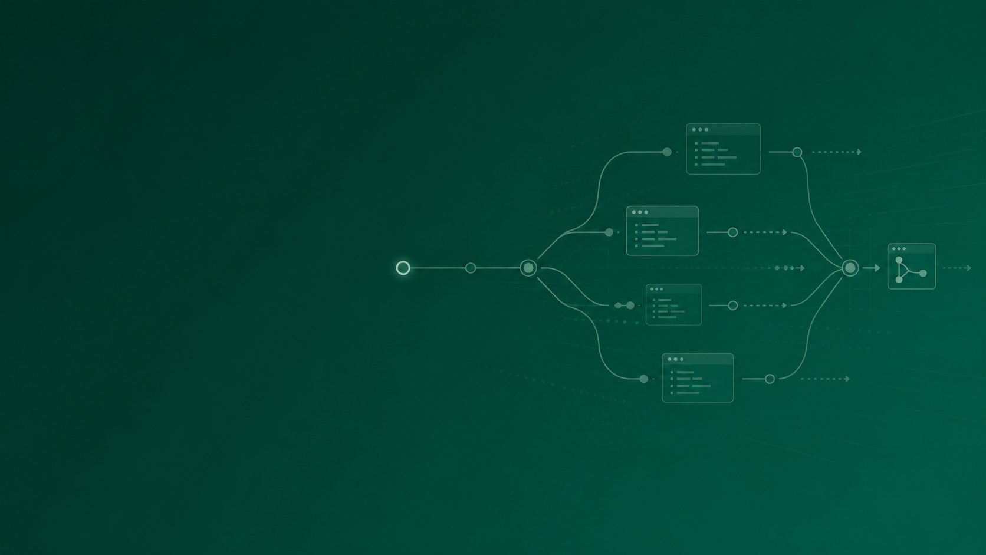
AGENTIC SOFTWARE DEVELOPMENT
AT LEAST FIVE TIMES FASTER
5×
-- The right work moves from days to hours...
Writing software faster and better with AI agents
Notes:
Open on the number, no throat-clearing. We're now building software at least five times faster than we were. Work that used to take weeks, we turn around in days. Let it sit. Then: I'm going to show you what that actually means, how we make it reliable, and why it matters to a room like this one - and it isn't a someday thing, it's how we already work.

Slide 2
WHAT “AGENTIC” MEANS
Not autocomplete. You hand over a goal.
THE ASSUMPTION
WHAT IT ACTUALLY IS
Fancy autocomplete.
You give it the objective.
It finishes the line you are already typing.
It plans the steps, does the work, and checks its own output.
You remain in control and accountable
Notes:
Quick translation for everyone who isn't an engineer. Most people assume AI coding is fancy autocomplete - it finishes the line you're typing. That's not what we're talking about. Agentic means you hand over an objective - build this, investigate that - and it works out the steps itself: it plans, it does the work, and it checks its own output. You're delegating an outcome, not steering keystroke by keystroke.

Slide 3
THE PROOF
From days to hours.
The task A reporting UI, GCP data retrieval, caching and automation for surveillance research and investigation.
→
BEFORE
AFTER
3 weeks
3 days
One developer, heads down.
Agent builds; engineer reviews, tests and accepts.
Notes:
Let me pin that to something real. Take a concrete piece of work - building a reporting UI for surveillance research and investigation. The before: about three weeks, one developer, heads down. The after: three days, with us reviewing the work. Same output, same standard, a fraction of the time. Swap in whatever example lands best with your team. How do I know this? Because I’m that developer, working on a codebase that I built pre-AI and seeing the gains when implementing new features with agentic development.

Slide 4
ACROSS THE WHOLE LIFECYCLE
Not just writing code.
Ideation
Analysis
Design
Shape options before committing to one.
Explore a codebase and surface trade-offs.
Produce a design we review before code.
Build
Code review
Testing
One feature at a time,
test-first.
A second set of eyes on every change.
Write and run the tests, not just the feature.
The value is not just faster coding - it is faster feedback across the lifecycle.
GitHub Copilot + Superpowers for engineering. Copilot for M365 for analysis support.
Notes:
And this isn't only about writing code, which is the part people fixate on. The agent helps across the whole lifecycle - shaping ideas, analysing an existing codebase, designing, building, reviewing code, and writing the tests. In practice that's GitHub Copilot with the Superpowers plugin doing the heavy lifting across all of it. We also use Copilot for M365 for some analysis work, though not really for coding. The breadth is the point: the gains compound across the work, not just in one slice of it.

Slide 5
HOW WE GET THERE
We don’t prompt and hope...
01
02
A detailed spec, approved first
Feature by feature, test-driven
The agent writes a full specification; we read and approve before a line of code is written.
It builds one feature at a time, tests first - each step verified before the next.
Spec
→
Approve
→
Test
→
Build
→
Verify
→
Next feature
Notes:
The speed isn't luck, and it isn't typing wishes into a box and hoping. Two things make it reliable. First, before any implementation, we have the agent write a detailed spec that we read and approve. Second, it then builds feature by feature, test-driven - the test comes first, so every step is verified before it moves to the next. That discipline, backed by the Superpowers techniques running inside Copilot, is why the speed repeats instead of being a lucky one-off.

Slide 6
MORE THAN ONE AT A TIME
You’re not waiting while it builds.
Hand a task to the agent and you’re free - review the last piece, scope the next, or pick up something else entirely.
STREAM 01
STREAM 02
STREAM 03
Build a reporting UI
Refactor the ingest job
Write the test suite
Agent building…
Agent building…
Agent building…
YOU
Reviewing · steering · validating · unblocking. The engineer becomes the control point, not the typing bottleneck.
Notes:
And there's a second multiplier people miss. When you hand a task to the agent, you're not sitting watching it type - you're free. You review the last piece of work, scope the next one, or pick up something else entirely. So one person keeps several streams moving at once. It isn't only that each task is faster - it's that more of them are in flight. That's a big part of where the five-times comes from.

Slide 7
WHAT IT MEANS
SAME TEAM
A small team with the right method moves many times faster.
5×
MORE FLOW
And this is here now - not some time in the future.
Notes:
Now pull up from the detail to what it means for this room. The headline isn't that the tool is clever - it's what a small team can now do. The right method makes a handful of people several times more productive - call it five times, faster on each task and several running at once. And the part I want you to hold onto: this is here now. Not a roadmap, not a pilot for next year. The capability is on the table today, and that's what should change how we plan.

