Slide 1
Writing Tests for ASP.Net Core
Joe Gardner - Software Developer – Clearent, LLC
https://github.com/joegardnr/CodePaLOUsa
Notes:
Today we are going to talk about approaches to writing tests for ASP.Net Core.
If you tried to write tests for ASP.Net in the past, you’ll be pleasantly surprised at how much has changed.
It’s much easier to write tests for your web apps.
I’ll try to convince you that 100% test coverage is actually possible.

Slide 2

What is ASP.Net Core?
Microsoft’s All New, Next Generation Web Framework
Cross Platform / Targets .NetStandard (for now)
Unified MVC/Web API Controllers
No WebForms / WebPages
No upgrade path from ASP.Net 4.x
https://github.com/joegardnr/CodePaLOUsa
Notes:
ASP.Net Core is a completely new framework that takes advantage all the lessons learned over the last decade plus of web development.
It’s cross platform, allowing you to build Web Applications that run on Windows, Mac, and Linux.
It unifies the MVC and Web API controllers from ASP.Net 4 into a single implementation. Finally!
It also greatly simplifies the framework by dropping WebForms, Web Pages, and those Web Handlers (ASHX) that you remember exist but forget how they work.
Because it’s a totally new framework, there is no upgrade path from current ASP.Net applications.

Slide 3
Testing for ASP.Net Core is Easy
Built in Dependency Injection makes everything Highly Testable
Fewer static classes and methods
Built in “Mocks” as part of the framework
Red
Green
Refactor
https://github.com/joegardnr/CodePaLOUsa
Notes:
Since there is no upgrade path, that means every ASP.Net Core is effectively a new app, so let’s start with good tests from the begninning.
You have no excuse not too, especially when you see how easy it is to write those tests.
Dependency Injection is not just built in, but actually a fundamental part of how ASP.Net Core works. That makes it much easier to abstract away the “framework” stuff from the code we are actually writing and want to test.
And as a result of that DI first approach, there’s fewer static classes and methods, which made testing harder on the old ASP.Net.
In many cases, the framework has built in “mocks” or “default” classes we can use, eliminating the need to create our own mocks (or “doubles” as some folks call them).

Slide 4

About the Tooling…
Visual Studio 2015 tooling is abandoned
The dotnet-test-foo approach is abandoned
VS Test Adapters (foo.runner.visualstudio) is the supported tooling
Notes:
Before we jump into our first Demo, let’s talk about the Tooling.
Visual Studio 2015 introduced the “Preview” tooling for .Net Core and ASP.Net Core. It used a new project format known as “Project.JSON” that ditched the XML nightmare that is the old CSPROJ format. Instead was a new JSON based file that was actually human readable. They went as far as calling it a “Release Candidate”.
And then they abandoned it and went back to XML based CSPROJ. The internet got mad.
Somewhat lost in all the wailing and gnashing of teeth was the fact that the API for the test runners changed too. And it changed dramatically.
Everyone had to rewrite their test adapters, and some frameworks, most significantly Nunit, are still struggling to catch up.

Slide 5
Tooling
DEMO
https://github.com/joegardnr/CodePaLOUsa
Notes:
In this Demo I will create a new xUnit Test Project for an existing ASP.Net Core project, using Visual Studio.
We’ll look at the CSPROJ file that gets created and talk about the three main references:
Microsoft.NET.Test.Sdk
xunit
xunit.runner.visualstudio
I will then write an incredibly short test to call the controller and assert a non-null result.
We will debug that test, mostly to show how the Test Explorer is still terrible.
We will also do the commandline “dotnet test” command to see that tooling experience.

Slide 6
Dependency Injection (DI)
Dependency Injection is a fundamental part of ASP.Net Core
Transient – New Instance each time it’s requested from the DI Container
Scoped – New Instance per HTTPRequest
Singleton – Only One Instance per app lifetime
https://github.com/joegardnr/CodePaLOUsa
Notes:
Dependency Injection is a fundamental part of how ASP.Net Core works.
The built in DI Container (aka, Dependency Resolver) supports three lifetimes:
Types registered as “Transient” are created new each time they are requested. If the processing of a single request called into three or four other classes, and they all had the same IWhatever as a dependency, each class would get a new and independent instance.
The Scoped lifetime ensures you get the same a new instance the first time the DI Container is asked for it, but each subsequent call returns that first instance for the particular HTTP Request only.
If you register a type as a Singleton, you only ever get one instance for the lifetime of the application. When you register it you can either create that instance right then, or let the DI Container do it for you.

Slide 7
Dependency Injection
DEMO
https://github.com/joegardnr/CodePaLOUsa
Notes:
In this Demo I will have an existing Controller, an IDataRepo interface, and an DateRepoCodeMock class that implements IDataRepo.
Create an instance of that DataRepoCodeMock, inject it into the Controller, and Asserts the resulting GET actually used it.
Add a new Constructor for the Controller that includes the IDataRepo as a new dependency.
Write the line in the Controller that actually uses it.
Debug the test to prove it works.
Run the API to prove it fails (because I didn’t register up the dependency yet)
Register the dependency and prove the API works now.

Slide 8
Testing HTTP Context
Tests for Controllers can abstract away all the other “Request” stuff and focus on the actual logic we want to verify
No need for third party “abstractions” libraries, or convoluted “Wrapper” classes
https://github.com/joegardnr/CodePaLOUsa
Notes:
With real DI, we can focus on just writing tests for the logic we actually want to test. And all the other stuff is easily managed, either through mocks we create, or built in classes that effectively serve as code mocks for us.
That has a huge impact on how we write tests for our Controllers, the part of our App that is mostly directly in contact with the user.
In ASP.Net 4.x, this was really hard. The lack of interfaces made us write lots of wrapper classes, or sent us hunting down shady “abstractions” packages on nuget. And that WebForms page lifecycle… forget it.

Slide 9
More Dependecy Injection
DEMO
https://github.com/joegardnr/CodePaLOUsa
Notes:
Let’s look at how easy it is to mock/stub HTTPContext type stuff now.
This will follow the prior demo by introducing a second dependency, IApiKeyValidator
Add to the test an example of how to set some Header values on the Request that is part of the Controller
Add the code to the controller to use it.
Debug the test to show it working
Show how I registered the new IApiKey validator with the DI Container
Demo the API to prove it works and does stuff with the header (probably by debugging)

Slide 10

Validating Input
Default Controller Data Binding still understands System.ComponentModel.DataAnnotations
Model Binding happens BEFORE the Controller Method is called
We can fake ModelState Errors it in our Unit Tests
https://github.com/joegardnr/CodePaLOUsa
https://xkcd.com/327/
Notes:
So far we’ve just looked at GET methods that don’t accept any complex input. But eventually we’ll want to Create or Update some data supplied by the user.
That means we’ll want to validate the input.
The default model binding in ASP.Net Core Controllers still rely on the DataAnnotations attributes to validate the input and set the ModelState accordingly.
But that all happens BEFORE our Controller Method is called. So to simulate the behavior of a ModelState Error, we have to fake it.

Slide 11
ModelState
DEMo
https://github.com/joegardnr/CodePaLOUsa
Notes:
In this Demo I’ll add in a POST method that accepts an instance of our ContactInfo model.
Add the DataAnnotations to the Model to make the Name a required field.
Show that sending an instance of ContactInfo to the Controller without the required Name field as part of a unit test doesn’t trigger the ModelState error.
Prove that it does work on the normal API.
In the Test, Add “Errors” to the ModelState on the Controller to see it pass.
To see this work the “real” way will require an Integration Test…

Slide 12
TestServer and Integration Tests
Part of the Microsoft.AspNetCore.TestHost nuget package
In Process Test Web Host for doing Integration Tests
Real HTTP Request testing, with full Model Binding, Routing, etc
Fast execution
Debug across the HTTP Request Boundary
https://github.com/joegardnr/CodePaLOUsa
Notes:
Traditionally, to run full Integration Tests has been a lot work. We would first need to configure a web server somewhere, either locally or externally. Then deploy our app to it. Assign it a name and a port. Then configure out Integration Tests to know that name and port.
These kinds of tests usually got skipped at development time. They were just too expensive to run often.
The TestServer is part of the Microsoft.AspNetCore.TestHost library and provides a way to do Integration Tests of the full Web App, but hosted by in-process test web server.
That means we can test the full stack without ever having to leave Visual Studio. These tests behave a lot like the Unit Tests we’ve been writing so far. They do run a little bit slower, but we can do some cool stuff.

Slide 13
Integration & “Hybrid” Tests
DEMO
https://github.com/joegardnr/CodePaLOUsa
Notes:
In this Demo we’ll look at a test the demonstration how to create an instance of the TestServer.
Talk about the config file we have to create to get it all to work.
Debug a test that calls from the Test Class to the Controller class and see how we still hit our breakpoints.
Introduce the concept of a “Hybrid” integration test, referring back to our earlier discussion on DI.
Changing our Startup class to do TryAdd(Singleton/Scoped/Transient) gives us the ability to inject Mocked dependencies into our controller.
That gives us all the flexibility of a Unit Test, with only some of the performance hit of the Integration Test.
Crucially, it’s fast enough to run at Development time.

Slide 14
What about MVC?
ASP.Net Core unified MVC and WebAPI Controllers into a Single Implementation
That means the way you test them is unified now too
[HttpGet]
public IActionResult Get() {
var allContacts = _repo.GetAllContacts();
return Ok(allContacts);
}
[HttpGet("view")]
public IActionResult GetView() {
var allContacts = _repo.GetAllContacts();
return View("ContactList", allContacts);
}
https://github.com/joegardnr/CodePaLOUsa
Notes:
You might be asking, “Where are the MVC Demos. This has all been WebAPI stuff, and I don’t do that.”
Remember there is just one controller implementation now. WebAPI is MVC too.
All the testing is the same.

Slide 15
MVC
DEMO
https://github.com/joegardnr/CodePaLOUsa
Notes:
In this Demo we will look at an example where we quickly add a new method to our existing Controller that just Copies the existing GET method.
Call it “GetView()” and add the “view” name to the route.
Instead of returning an OkObjectResult, we’ll return a ViewResult and reference a view.
Show the view CSHTML file exists in the normal place (Views/<controllername>/<viewname>.cshtml).
Copy the Test for the Get Method and change it to expect a ViewResult
Assert that the ViewResult.Model property is our expected contact list collection just like in the original API test.
Add an assert that the ViewName matches what we expect.
Run the service for real and hit our new /view end point to prove it works.

Slide 16
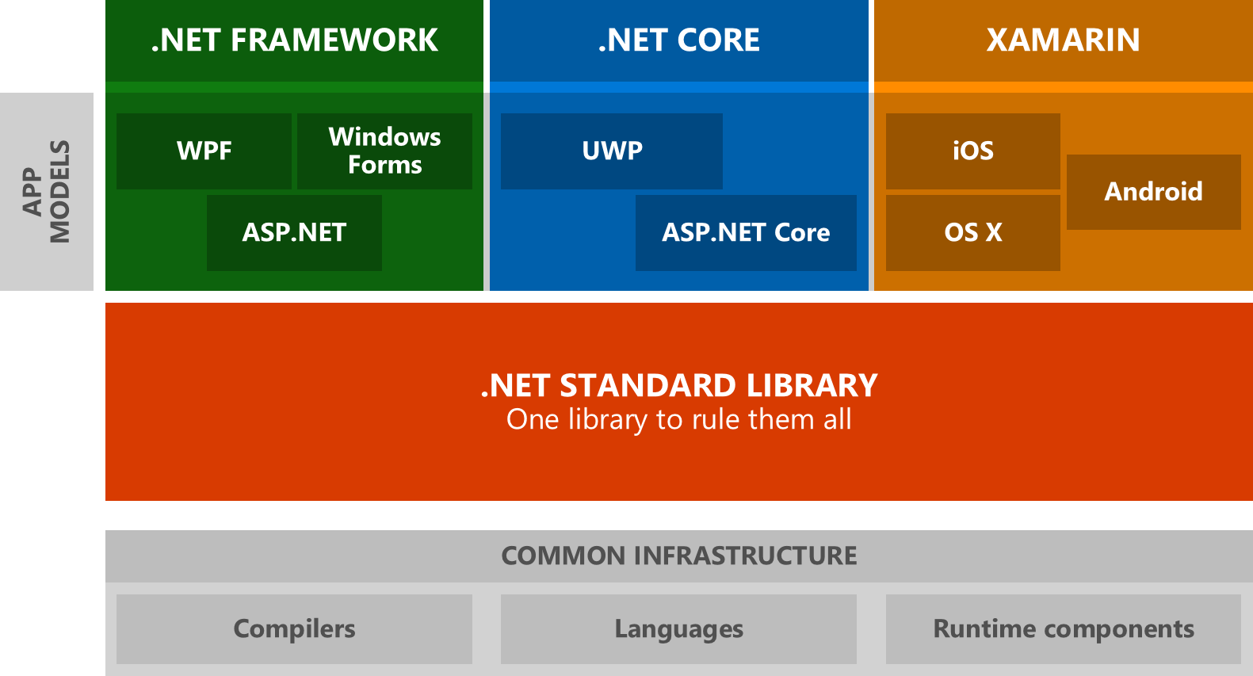
ASP.Net Core .Net Core .Net Standard
.Net Core is a completely separate runtime from “Full Framework” on Windows
.Net Standard is the bridge between the windows only “Full Framework” and the cross-platform “Core” framework
ASP.Net Core targets .Net Standard, which means it runs on both runtimes
That may not be true forever. MS wants ASP.Net core to be .Net Core only
Notes:
One last thing to talk briefly about, even though it’s not strictly related to Test writing.
ASP.Net Core, .Net Core, and .Net Standard are all very confusing, so I thought it worth an explanation for anyone that is wondering what to do.
.Net Core is a completely separate runtime from “Full Framework” on Windows. Your existing Applications cannot run on it.
.Net Standard is the API bridge Microsoft has built to allow your Libraries to be referenced by applications on either runtime.
At the moment, ASP.Net core is a Library that targets .Net Standard, which means you can create applications that run either on Full Framework or .Net Core but NOT BOTH.
However, Microsoft has made it clear they want ASP.Net Core to drop .Net Standard and target .Net Core only.

Slide 17
As a Web Developer, what do I do?
Try to target .Net Core for your ASP.Net Core apps when possible
Identify any dependencies that cannot target .Net Standard and start planning to eliminate them
Use the ability to target 4.6.1 to port your existing ASP.Net applications in stages
https://github.com/joegardnr/CodePaLOUsa
Notes:
So as a Web Developer, what do I do?
We talked at the beginning about how there was no upgrade path from ASP.Net 4.x to ASP.Net Core. That means to take advantage of ASP.Net Core it has to be a new application.
The smartest long term strategy would be to try and target .Net Core first. For one thing, ASP.Net Core has better performance on .Net Core than it does Full Framework. It’s also clearly the future of where Web on the .Net Framework is going.
The upcoming .Net Standard 2.0 will implement almost everything that is in Full Framework 4.6.1. Most of your existing libraries should run on .Net Core with nothing more than a recompile. And maybe not even that, because they are including the ability for .Net Core Runtime to use most 4.6.1 libraries as-is. Just drop in and go.
However, if you still have some libraries that cannot run on .Net Core, you can simply target full framework and still get many of the benefits. It can also buy you time to get that whatever dependency prevented you from targeting .Net Core factored out. And once you do, it’s a simple change to get your app running cross-platform (and faster!)

Slide 18
QUESTIONS?
https://github.com/joegardnr/CodePaLOUsa
Notes:
There are bunch more demos and examples in the source repo I’m (probably) pushing to Github, so go look there. Any questions I can try to answer in the 30 seconds that will likely be left?

Slide 19
Links
Slides and Demo Code
https://github.com/joegardnr/CodePaLOUsa
Official Microsoft Docs
https://docs.microsoft.com/en-us/dotnet/core/testing/unit-testing-with-dotnet-test
https://docs.microsoft.com/en-us/aspnet/core/testing/integration-testing
https://github.com/joegardnr/CodePaLOUsa

