Slide 1
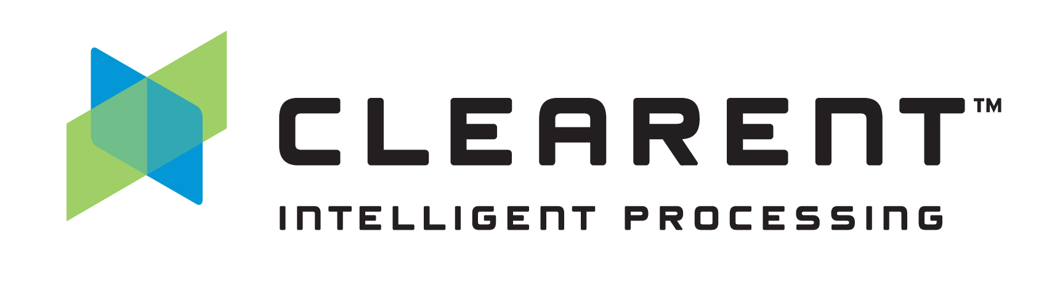
Automated Testing of ASP.Net Core
Joe Gardner | Lead Developer | Clearent
jgardner@clearent.com | https://developer.clearent.com

Slide 2
What is ASP.Net Core?
Microsoft’s Open Source Web Framework
Cross Platform with the .Net Core Runtime (Windows, Linux, and macOS)
High Performance
Combines WebAPI, MVC, and Razor Pages into a single application model
Built In Dependency Injection

Slide 3
What Are Automated Tests?
Executions of your code that verify results without human user intervention.
Notes:
Yes, Billy the intern counts as a human. Automated tests are run by the computer, not a person.

Slide 4
Reasons to Automate Testing
Faster than Manual Testing
Less Error Prone
Repeatable / Reusable
Future changes are safer
Shortens the Feedback Cycle
Notes:
Everybody is testing their code, but Automated Testing is inherently better than doing it manually.

Slide 5
Why not Automate Testing?
Take too long to write
Too hard to write / Brittle tests
The “Architect” says NO
Extra work but no extra Benefit
10x Engineers Don’t Write Tests!
Notes:
10x Engineers are the new Chuck Norris

Slide 6
DEMO
Our Testing Journey Begins

Slide 7
PowerShell, Seriously?!?!
Works with Legacy Code!
Zero barrier to entry (you’ve already got PowerShell installed)
Useful as Post-Deployment Verification Scripts
Easy to include in your Deployment pipeline (but potentially brittle)
Nobody has to know you wrote them (but hoarding knowledge is bad, please share)
Best used in very limited scenarios (this is not a hammer)
# Arrange
$baseUri =
"http://localhost:5000/api/address"
$id = 1
# Act
$result = Invoke-RestMethod
-Method Get -Uri "$baseUri/$id"
# Assert
if($result.id -eq 1)
{Write-Output "Success!"}
else
{Write-Error "`nFailure!"}

Slide 8
Testing Pyramid
Acceptance Tests
Requires Full/Real System
Crosses Multiple System Boundaries
Expensive to Write / Expensive to Run
Integration Tests
Requires Partial System
Crosses a Single System Boundary
Cheap to Write / Expensive to Run
Unit Tests
Mocked/Faked System Components
Fully Internal / Doesn’t Cross System Boundaries
Cheap to Write / Cheap to Run
AT
IT
UT
Notes:
It’s harder to write Unit tests AFTER you’ve written the code. But IT/ATs are still better than no tests.

Slide 9
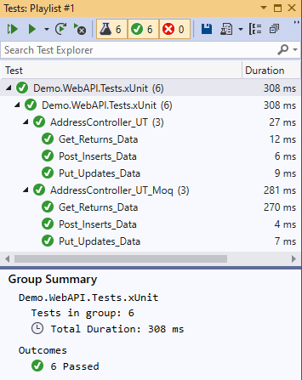
Unit Tests for ASP.Net Core
Testing Frameworks
xUnit - https://github.com/xunit/xunit
Nunit - https://github.com/nunit/nunit
MSTest - https://github.com/Microsoft/testfx
Test Runners
dotnet test
Visual Studio Test Explorer
.Net Core Test Explorer (VS Code)
Mocking
Code Mocks (hand coded)
Moq - https://github.com/Moq/moq4/
Nsubstitute - https://nsubstitute.github.io/
Notes:
If you want to run “unit” tests, you’ll need some extra tooling.

Slide 10
DEMO
Unit Tests

Slide 11
Microsoft.AspNetCore.TestHost
Actual HTTP Requests In-Memory!
Actually test your Routes!
Debug your Middleware!
Test your Authorization restrictions!
Reliable “Integration” Tests during Build!
Exclamation Points!!!
// Arrange
var webHost = new WebHostBuilder().UseStartup<Startup>();
var server = new TestServer(webHost);
var client = server.CreateClient();
// Act
var response = await client.GetAsync($"api/address/1");
var address = await response.Content.ReadAsAsync<Address>();
// Assert
Assert.Equal(HttpStatusCode.OK, response.StatusCode);
Assert.Equal(expectedAddress.Id, actualAddress.Id);

Slide 12
DEMO
Unit Integration Hybrid Tests?

Slide 13
What else is there?
Alba - http://jasperfx.github.io/alba/
Wrapper / Extension Methods for TestServer.
Postman - https://www.getpostman.com/downloads/
Desktop GUI for Rest APIs
Selenium - https://www.seleniumhq.org/
Programmatically drive a web browser and capture results
Cypress - https://www.cypress.io/
In-browser tests

Slide 14
Opinions / Advice
Arrange / Act / Assert
Assert One thing per test (makes future changes easier)
Controllers Only Concern is Responding to Requests
Push all business logic down a layer.
Limit the amount of “ASP” you need to test.
Plain old Library testing is much simpler.
When in doubt, use TestHost (and/or Alba)
TestHost is slower, but not that slow.
Better to test too much than not enough.
WebApplicationFactory
Intended to make TestServer easier to use, but hides too much

Slide 15
Questions?
xUnit - https://github.com/xunit/xunit
Nunit - https://github.com/nunit/nunit
MSTest - https://github.com/Microsoft/testfx
Alba - http://jasperfx.github.io/alba/
Joe Gardner | jgardner@clearent.com | https://developer.clearent.com

Slide 16
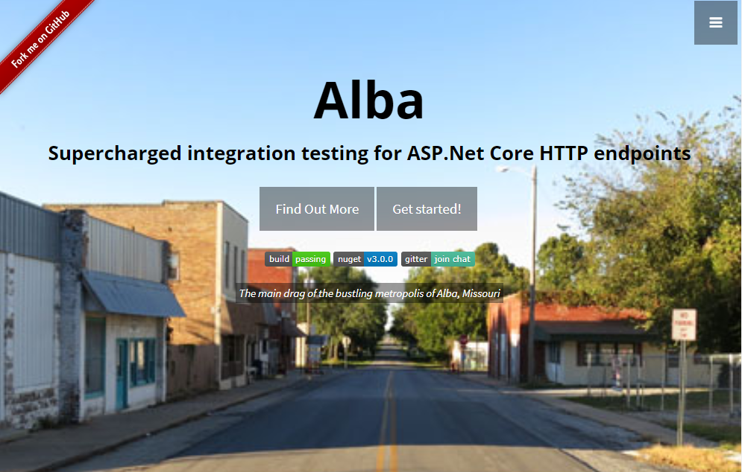
Alba Makes it Easier?
Based on/extends TestHost.
Declarative “Scenario” style tests and assertions
Open Source Project by Jeremy Miller (of StructureMap fame)
http://jasperfx.github.io/alba/

