Slide 1

Automated Testing of ASP.Net Core
Joe Gardner | Technical Manager| Carvana
Joe.Gardner@carvana.com
https://www.linkedin.com/in/joegardner/

Slide 2
What is ASP.Net Core?
Microsoft’s Open Source Web Framework
Cross Platform with the .Net 6 Runtime (Windows, Linux, and macOS)
High Performance
Combines WebAPI, MVC, and Razor Pages into a single application model
Built In Dependency Injection
Build Single Page Applications with Blazor

Slide 3
What Are Automated Tests?
Executions of your code that verify results without human intervention.
Notes:
Yes, Billy the intern counts as a human. Automated tests are run by the computer, not a person.

Slide 4
Reasons to Automate Testing
Faster than Manual Testing
Less Error Prone
Future changes are safer
Shortens the Feedback Cycle
Tests are a form of (Developer) Documentation
Helps you Design your Application
Notes:
Everybody is testing their code, but Automated Testing is inherently better than doing it manually.

Slide 5
Why not Automate Testing?
Take too long to write
Too hard to write / Brittle tests
The “Architect” says NO
Extra work but no extra Benefit
I don’t write Bugs!
Notes:
10x Engineers are the new Chuck Norris

Slide 6
DEMO
Our Testing Journey Begins

Slide 7
PowerShell, Seriously?!?!
Works with Legacy Code!
Zero barrier to entry (you’ve already got PowerShell installed)
Useful as Post-Deployment Verification Scripts
Easy to include in your Deployment pipeline (but potentially brittle)
Nobody has to know you wrote them (but hoarding knowledge is bad, please share)
Best used in very limited scenarios (this is not a hammer)
# Arrange
$baseUri =
"http://localhost:5000/api/address"
$id = 1
# Act
$result = Invoke-RestMethod
-Method Get -Uri "$baseUri/$id"
# Assert
if($result.id -eq 1)
{Write-Output "Success!"}
else
{Write-Error "`nFailure!"}

Slide 8
Testing Pyramid
User Acceptance Tests (aka End to End Tests)
Requires Full/Real System
Crosses Multiple System Boundaries
Expensive to Write / Expensive to Run
Integration Tests
Requires Partial System
Crosses a Single System Boundary
Cheap to Write / Expensive to Run
Unit Tests
Mocked/Faked System Components
Fully Internal / Doesn’t Cross System Boundaries
Cheap to Write / Cheap to Run
AT
IT
UT
Notes:
It’s harder to write Unit tests AFTER you’ve written the code. But IT/ATs are still better than no tests.

Slide 9
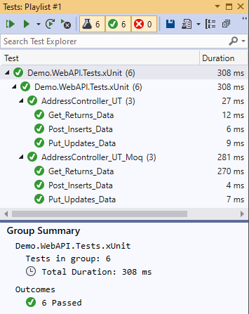
Unit Tests for ASP.Net Core
Testing Frameworks
xUnit - https://github.com/xunit/xunit
Nunit - https://github.com/nunit/nunit
MSTest - https://github.com/Microsoft/testfx
Test Runners
dotnet test
Visual Studio Test Explorer
.Net Core Test Explorer (VS Code)
Utility Libraries
Moq, Nsubstitute, FakeItEasy
Fluent Assertion
AutoFixture
Notes:
If you want to run “unit” tests, you’ll need some extra tooling.

Slide 10
DEMO
“Unit” Tests

Slide 11
WebApplicationFactory in Microsoft.AspNetCore.Mvc.Testing
Actual HTTP Requests In-Memory!
Test your Routes!
Debug your Middleware!
Test your Authorization restrictions!
Reliable “Integration” Tests during Build!
// Arrange
var webHost = new WebApplicationFactory<Startup>();
var client = webHost.CreateClient();
// Act
var response = await client.GetAsync($"api/address/1");
var address = await response.Content.ReadAsAsync<Address>();
// Assert
Assert.Equal(HttpStatusCode.OK, response.StatusCode);
Assert.Equal(expectedAddress.Id, actualAddress.Id);

Slide 12
DEMO
Integration Unit Tests?

Slide 13
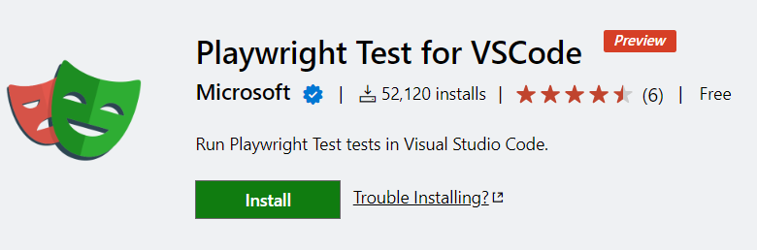
Client Side Testing (in a Real Browser)
Selenium - https://www.seleniumhq.org/
Programmatically drive a web browser and capture results
Write tests in many languages (C#, Java, etc)
Cypress - https://www.cypress.io/
In-browser tests
Write tests in Typescript
Playwright - https://playwright.dev/dotnet/
Programmatically drive a web browser (different implementation than Selenium)
Write tests in many languages (C#, Java, etc)
Automatic Wait!

Slide 14
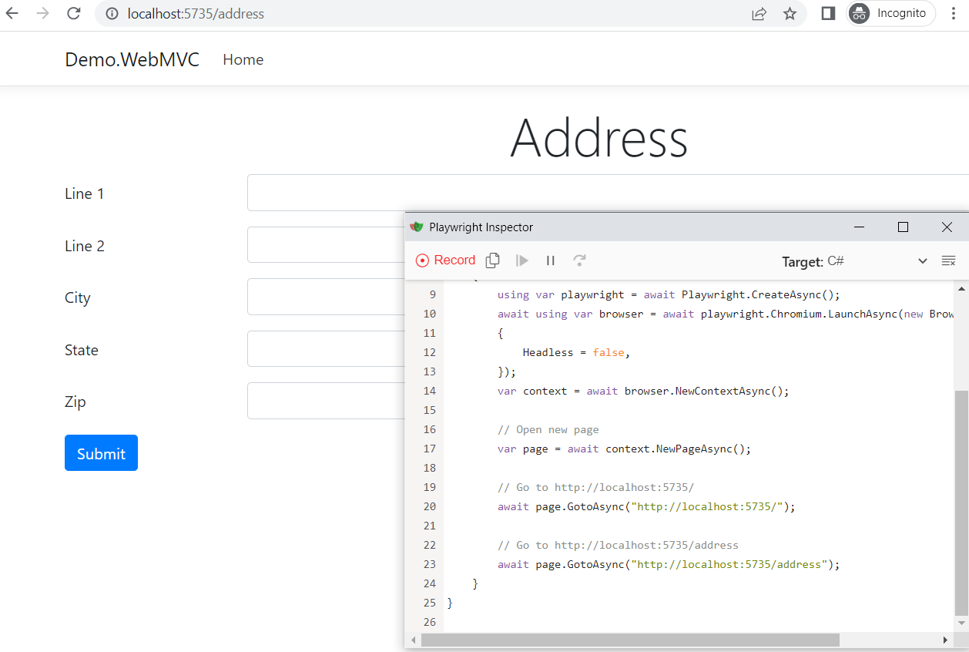
Playwright!
Cross Browser
Cross Platform
Write your Tests in C# / NUnit!
(or Java, Python, Typescript)
Auto-Wait
Built in TestGenerator / Codegen
Debugging / Inspector

Slide 15
DEMO
Browser Tests!

Slide 16
Questions?
MS Docs - Integration Testing ASP.Net Core
xUnit - https://github.com/xunit/xunit
Nunit - https://github.com/nunit/nunit
Playwright - https://playwright.dev/
Kent Beck - Test Driven Development: By Example
Joe Gardner | joe.gardner@carvana.com
https://www.linkedin.com/in/joegardner

