Slide 1

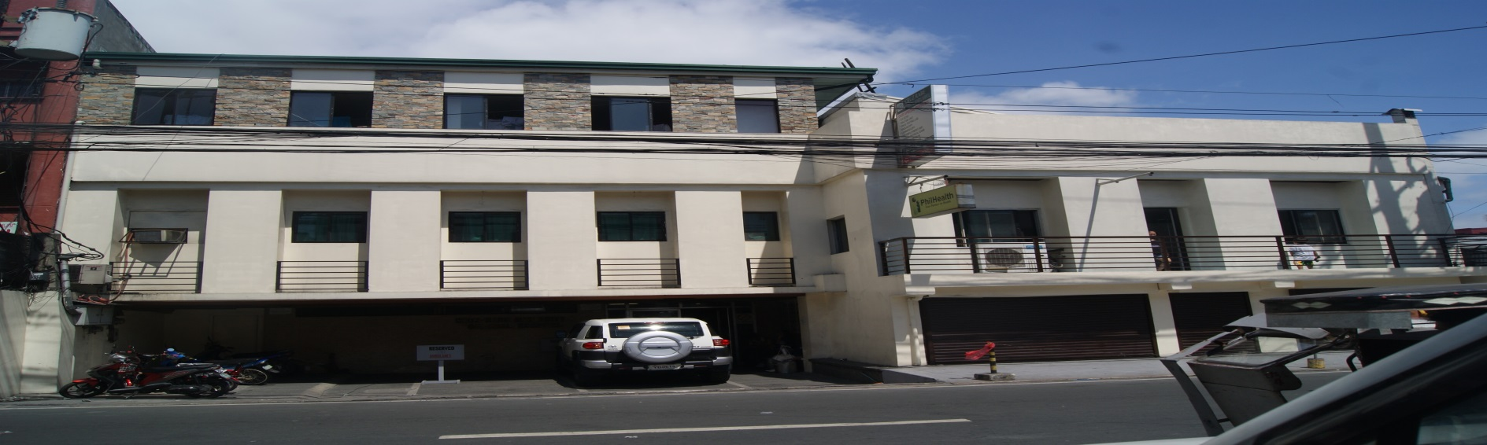
Cruz-Rabe Maternity And General Hostpital
Presented By:
Mark Kevin Navarro
Cristine Ronario
Flordeliza Calanno

Slide 2
Background of the Client
Cruz-Rabe Maternity and General Hospital is one of the group of hospital that Dr. Jerry Cruz and Rabe founded.
Mrs. Carmelita Buenaflor is the head pharmacist.
Target users:
Pharmacist
Accounting
Management of the Hospital

Slide 3
Background of the client(contd)
Main problem of the client(Pharmacist):
Paper works
Return Item Forms that Accounting Needed
List of Inventory

Slide 4
Cruz-Rabe Maternity And General Hospital Pharmaceutical Management System
The main users are the ff:
Pharmacist
Accounting
The main Functionality:
Records Stock Inventory of the Pharmacist Department
Record of Return Item and Stock Issue Item

Slide 5
Cruz-Rabe Maternity And General Hospital Pharmaceutical Management System
Two Part of the System:
Backend: For Pharmacist to Record Information.
Frontend: For Accounting to view the Return Item Records.

Slide 6
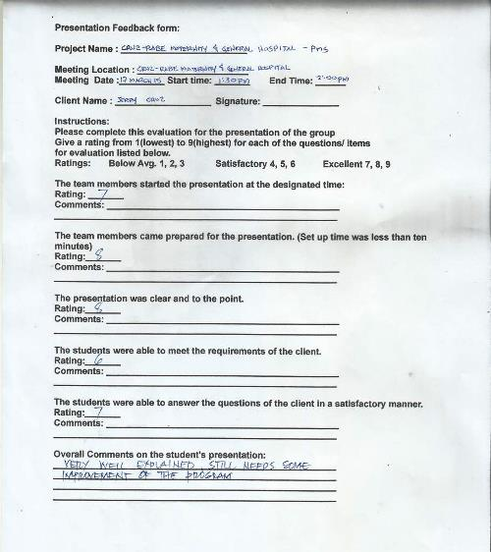
Iterations 1

Slide 7
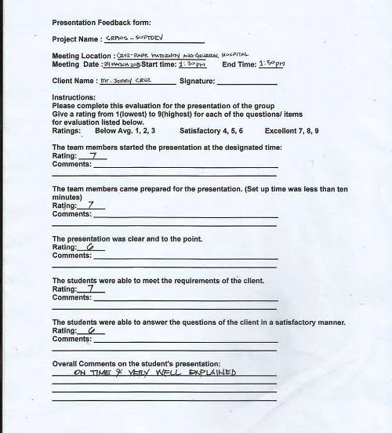
Iteration 2

Slide 8
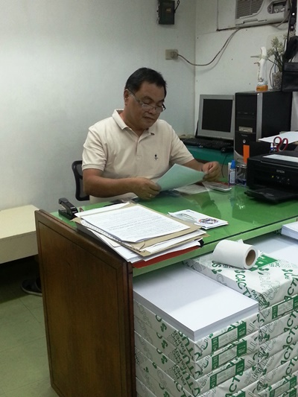
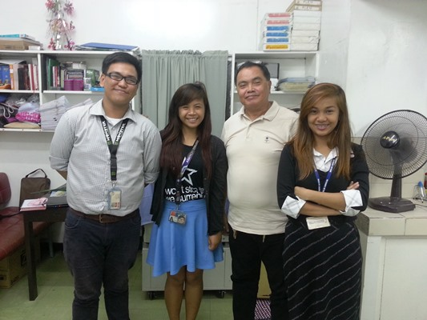
With the Client
Mr. Jerry Cruz
Owner of the CRMGH
TEAM KFC
Group 4

Slide 9
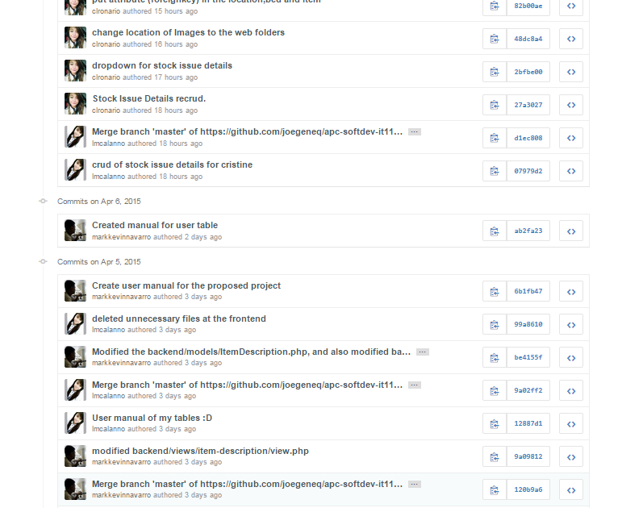
Member’s Contribution
GitHub Home page

Slide 10
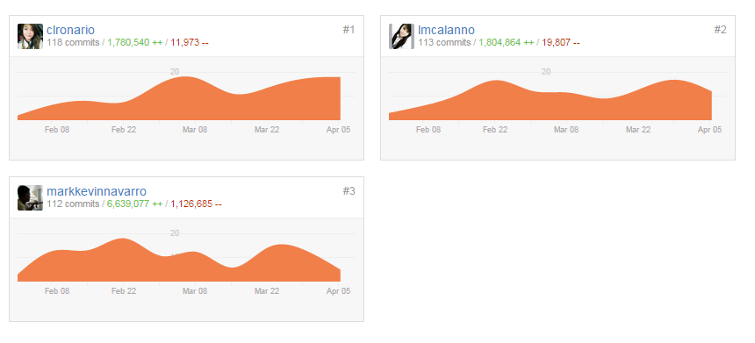
Member’s Contribution
Group’s Contribution Graph

Slide 11
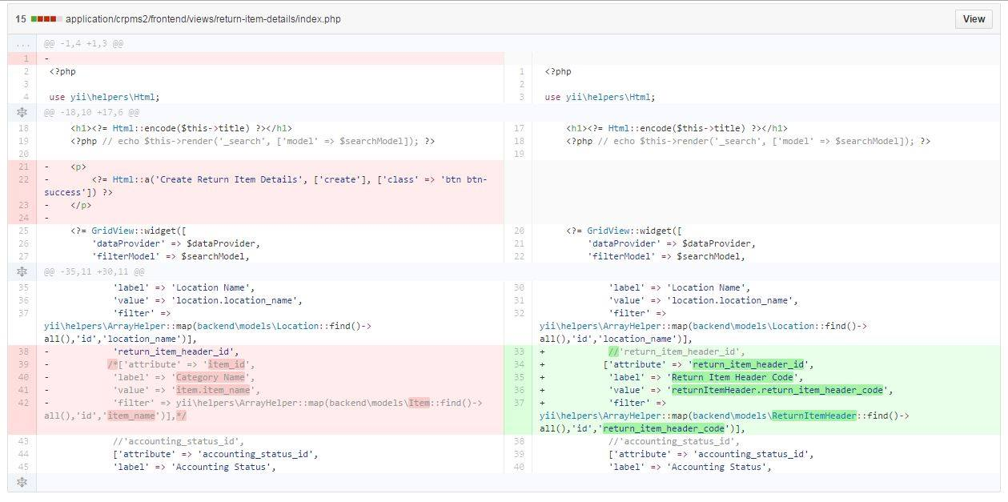
Member’s Contribution(cont’d)
Mark Kevin Commit with Diff

Slide 12
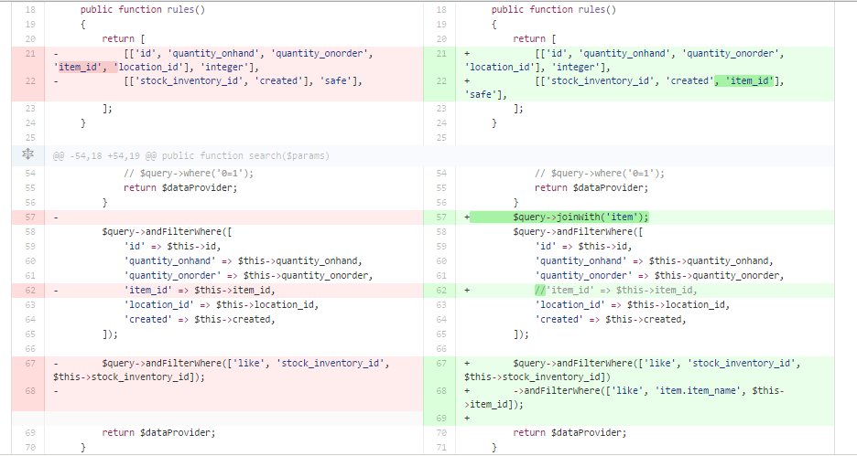
Member’s Contribution(cont’d)
Flor’s Commit with Diff
Source:https://github.com/joegeneq/apc-softdev-it112-04/commit/
a31038722f68b99e86c9d836c76d04882a85a7a6?diff=split

Slide 13
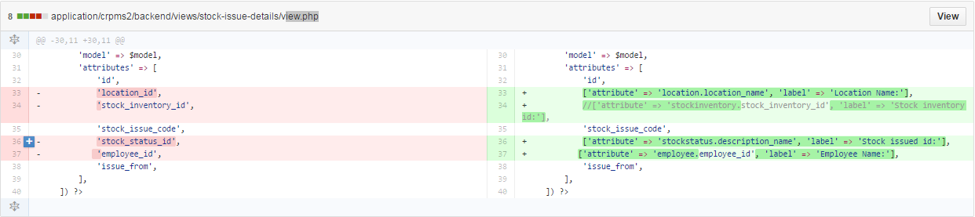
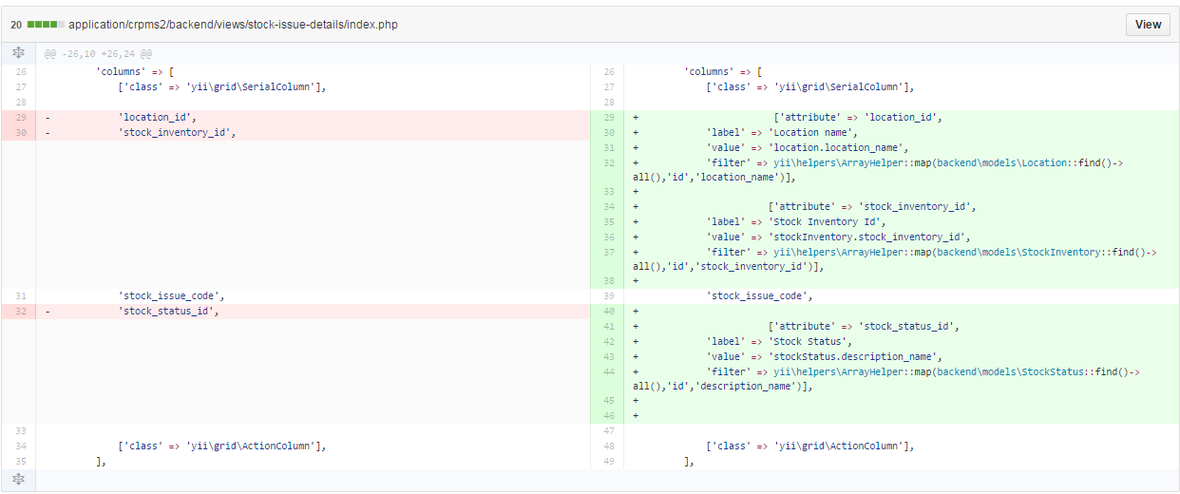
Member’s Contribution(cont’d)
Cristine’s Commit with Diff

Slide 14
Demo Of the Project

Slide 15
Current Status of the Project

