Slide 1
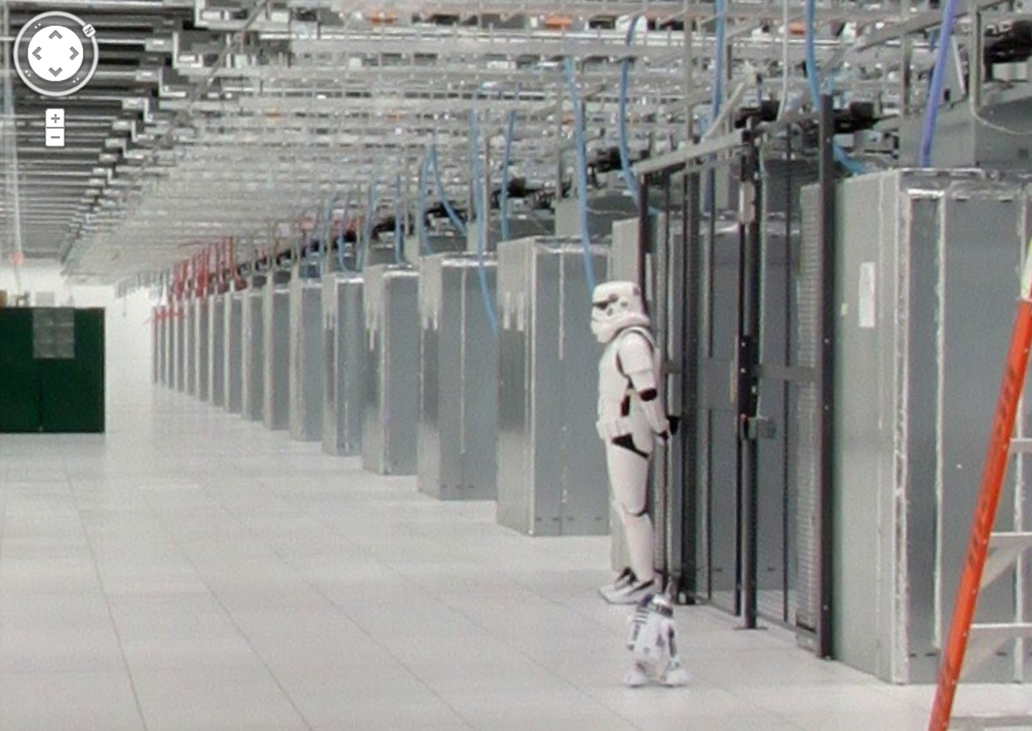
3rd Platform Data Center and the Rising Role of Cloud SPs
IDC Report

Slide 2
Data Centers
Cloud, Mobile, Social and Big Data Solutions while primarily running in the cloud are still, of course, dependent on the real physical datacenters underneath the cloud.
And there are massive changes underway in this datacenter "foundation" for all of the services and solutions that make up the 3rd Platform, including a battle of visions about how best to build and operate a modern datacenter

Slide 3
Rapid growth in Integrated Systems in Enterprise Datacenters
Integrated systems that pre-integrate system components and software to simplify buying, implementing, and running IT will continue to grab bigger chunks of enterprise datacenter real estate in 2015.
Nearly 10% of general-purpose enterprise server, storage, networking, and management software spending will funnel through these systems in 2015, up from 6–7% in 2014.
By 2020, integrated systems will account for almost 20% of this spending.

Slide 4
Cloud Service Providers Skewing Industry growth toward componentized/commoditized systems
A counter-vision of datacenter infrastructure comes from the world of cloud service providers, which favor highly componentized and commoditized systems and have largely eschewed the integrated systems of major system OEMs.
In 2015, an astounding 25–30% of server shipments (including shipments from ODMs) will go to cloud service providers' datacenters.
This will grow to 43% by 2017. These cloud services providers are already playing an even greater role in HDD storage capacity shipments through direct purchases or via ODMs.
Consequently, in spite of the rapid growth of integrated systems that scale at the level of one to three racks in enterprise datacenters, IDC predicts the commoditized/componentized vision will gain the greater share over the next three years as an increasing amount of compute and storage capacity in the market funnels through cloud SPs' datacenters in 10 or more rack modules.

Slide 5
Redeveloping/adapting software for OpenStack and other open infrastructure platforms
A top priority for datacenter software players.
The growth of both integrated systems for enterprises and cloud SPs' hyperscale component infrastructures means that infrastructure/management software vendors including those aimed at the strategic hybrid cloud opportunity need to have an "architecture neutral" software-defined datacenter strategy: offerings that can run, for example, in a tightly integrated/converged model as well as on componentized environments.
Using integrated systems packaging as a way to lock in customers to bundled software offerings is an utterly losing strategy.
In 2015, IDC predict virtually all infrastructure/management software vendors will continue to race toward the new model; a key step will be redeveloping/adapting offerings to run in an OpenStack, CloudStack, or other vendor and architecture neutral environment.

Slide 6
The IT hardware industry just like the software industry flipping to a "cloud first" strategy
In IDC Predictions 2008: The Post-Disruption Marketplace Takes Place (IDC #209776, December 2007), we talked about an upcoming "big flip" in the software industry: that the cloud (SaaS) would become the primary design point and first release path for new software.
IDC predicts that in 2015, IT hardware/systems vendors will also "flip" their strategies, designing new innovations for initial release and (widespread) adoption through cloud SPs‘ datacenters, not enterprise datacenters.

Slide 7
The IT hardware industry just like the software industry flipping to a "cloud first" strategy …continuation
The ongoing shift of "where computing happens" from enterprise datacenters to SPs' datacenters — means that cloud SPs, with their huge and growing scale and broad market reach, will soon become the fastest and largest channel for new hardware/system architecture adoption.
This obviously makes it even more urgent that IT hardware and software providers find a way to sell more offerings into and through — the SP community.
Most of the server OEM vendors have thus far had very mixed success here their traditional focus has been on enterprise datacenters.
In 2015, we predict HP, IBM, Dell, EMC, Oracle, Fujitsu, Cisco, Juniper, and others will sharply increase their focus on offerings that align with SPs' unique architecture, scale, deployment, and pricing demands.

Slide 8
On the path to the solid state optimized datacenter
The need for greater speed, rapid scale, and density in the increasingly data-intensive 3rd Platform datacenter will drive very rapid growth in the deployment of solid state (flash-based) storage over the next several years.
IDC predicts that most of the major integrated system players will be selling all-flash configurations as standardized offerings (i.e., not custom builds) and that by 2018, a majority of integrated systems sold will be "all flash.“

Slide 9
On the path to the solid state optimized datacenter …continuation
Any cold data will be flying out of the rack into bulk storage appliances and the cloud.
The impact of solid state won't be limited to servers and integrated systems, however.
The growing use of solid state for memory, cache, and storage will drive major redesigns of datacenter modules in terms of size, power/cooling profiles, and asset lifecycle management.
It will also spur significant re-architecting of many critical business applications.

Slide 10
The Future, not like the Past
It's no longer the speed of business that creates challenges.
It's the speed of disruption that is permeating our business models in seemingly every possible way that is causing businesses to rethink how they operate.
The speed of disruption is also the trigger that is causing entire industries to think about how to re-purpose what they have, and redefine a new sense of the brand.
They are realizing their current model may not be sustainable.
Welcome to the new business paradigm called the innovation management.

