Slide 1
Virtual Window TV Dario Carosella Januar 2020

Slide 2
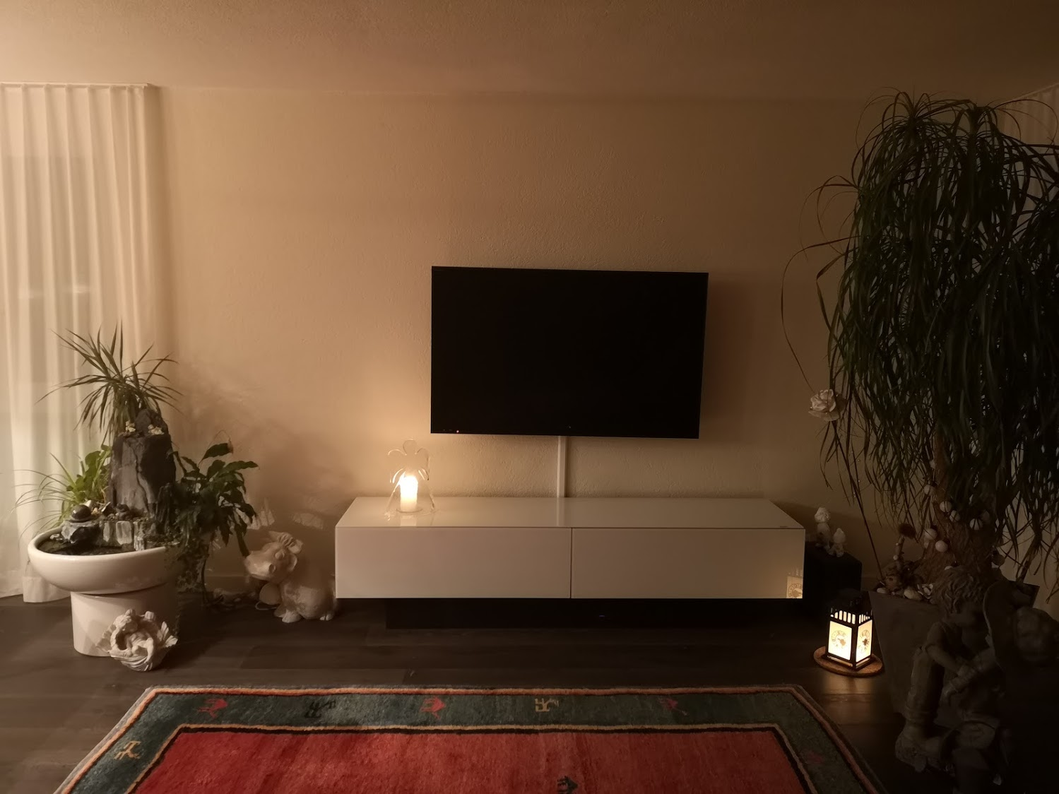

Slide 3
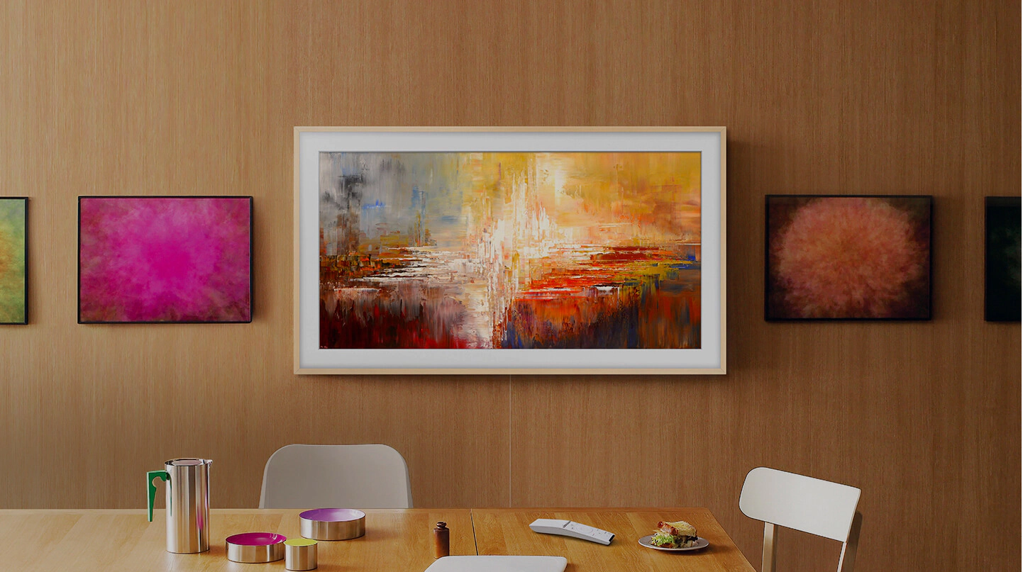

Slide 4
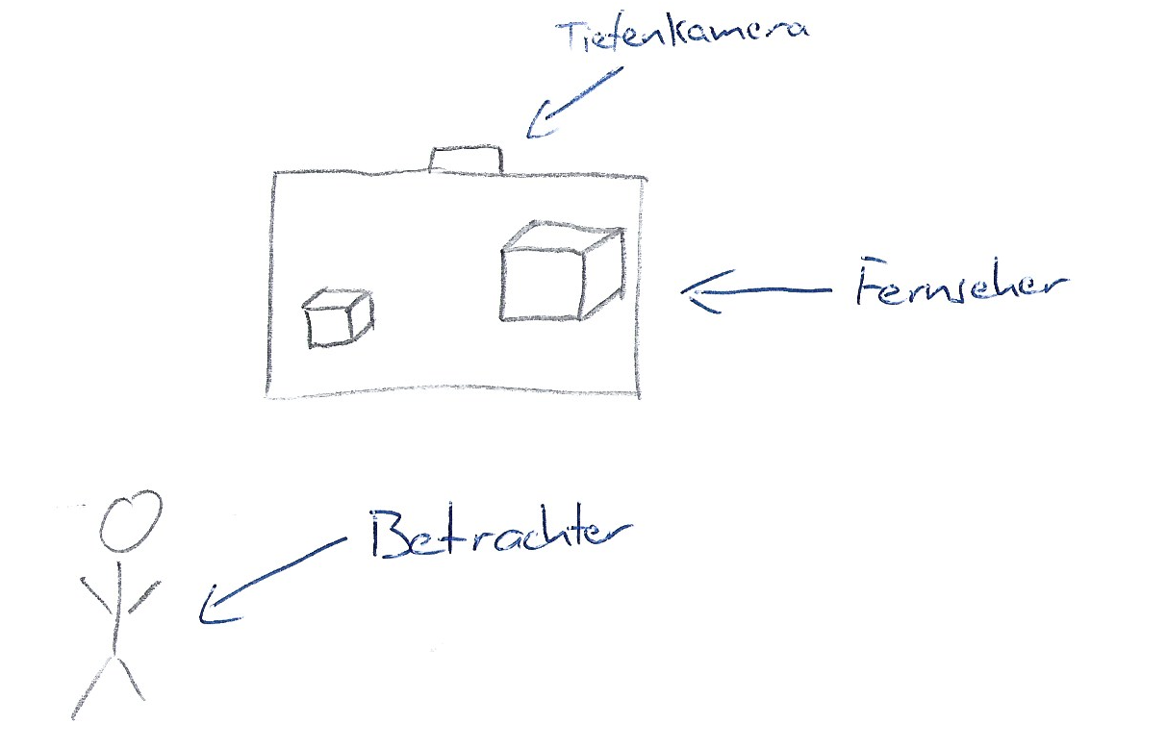

Slide 5
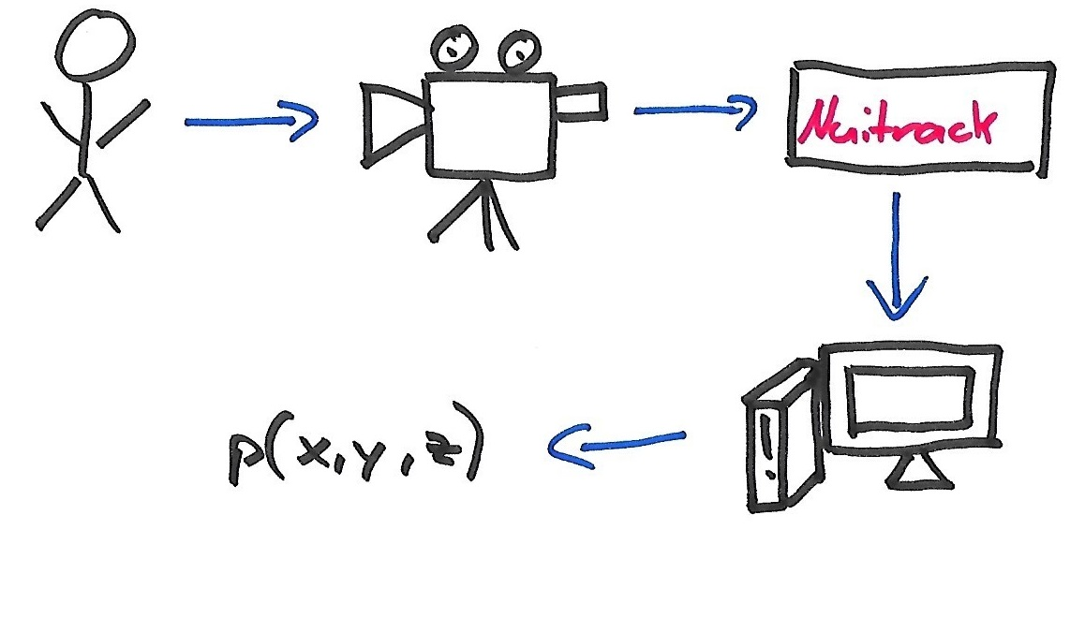

Slide 6
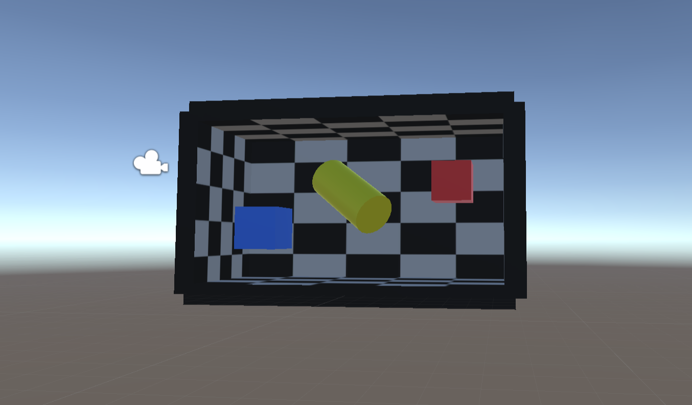

Slide 7


Slide 8

Dario Carosella

