Slide 1

Towards an energy efficient computation in Erlang
Áron Attila Mészáros
Gergely Nagy
ELTE IK, Computer Science BSc
STCS 2019

Slide 2




Motivation
Environmental awareness
Energy conservation, minimizing energy consumption
Even in computers
Green computing
Why Erlang?
Popular languages – lots of research (e.g. C++, Java, Haskell)
Erlang
Widely used in the industry
No such research yet

Slide 3
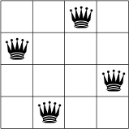
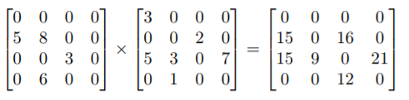
Previous Work
Tool for measuring energy consumption
Measuring complex algorithms
N-queens
Sparse matrix multiplication
Special attention to:
Lists vs arrays
Higher order functions
Parallelization (parallel map)

Slide 4
New goals
Improve methodology
Directly measure language elements
Measure data structures independently
Further inspection of parallelization
Spawning processes
Sending messages
Refactoring in order to minimize energy consumption

Slide 5
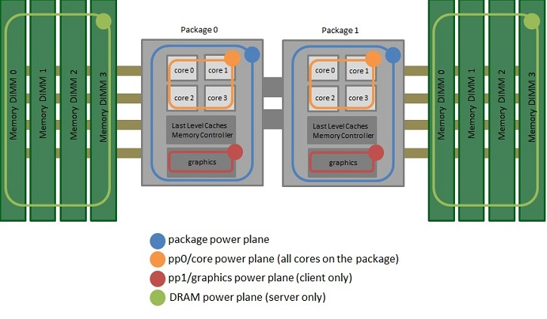
How to measure energy consumption
Running Avarage Power Limit (RAPL)
Intel
Methods:
MSR
perf_event,
sysfs
Domains:
PKG – package
PP0 – core
PP1 – uncore
DRAM

Slide 6
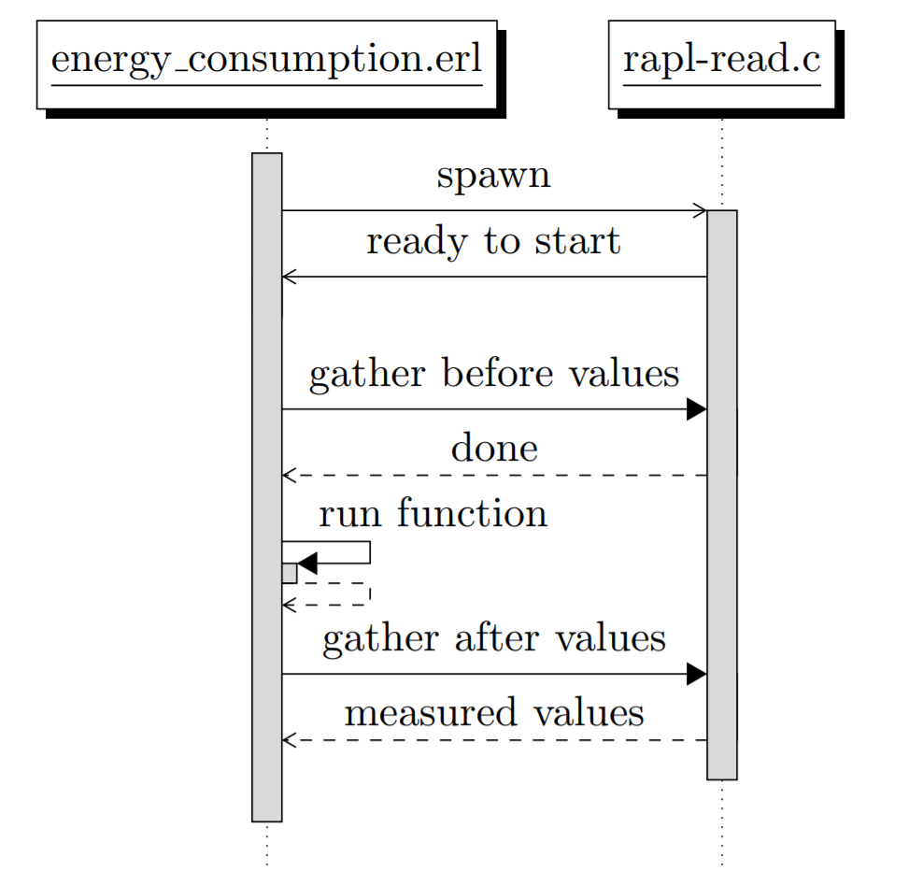
Erlang framework
C program to read RAPL values
Erlang module to run measured functions
Communication via ports
Runs the functions
Tells the C program when to measure
Python GUI
Using TkInter
Setup measurement
Helps with organizing the measurements
Visualizing results

Slide 7
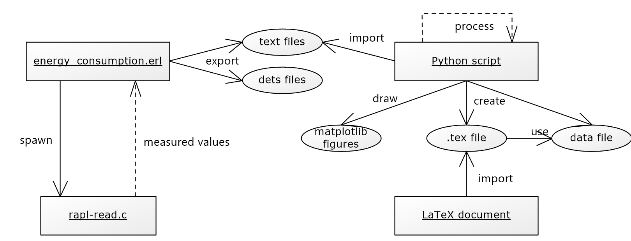
Processing Data
Methodology
Everything is measured 10 times
Discarding minimal and maximal values
Calculate average energy consumed
Also measuring runtime
Visualization
Python – matplotlib

Slide 8
Higher order functions
Parameters or the result is a function
Integral part of functional programming languages
Examples
map
filter
fold
We wanted to find the cost of passing functions as a parameter

Slide 9


HOFs - Measurements
Passing named or unnamed function
Using HOF or list comprehension or recursion
Implementing our own higher order functions
Measured:
map
filter
map ∘ filter

Slide 10
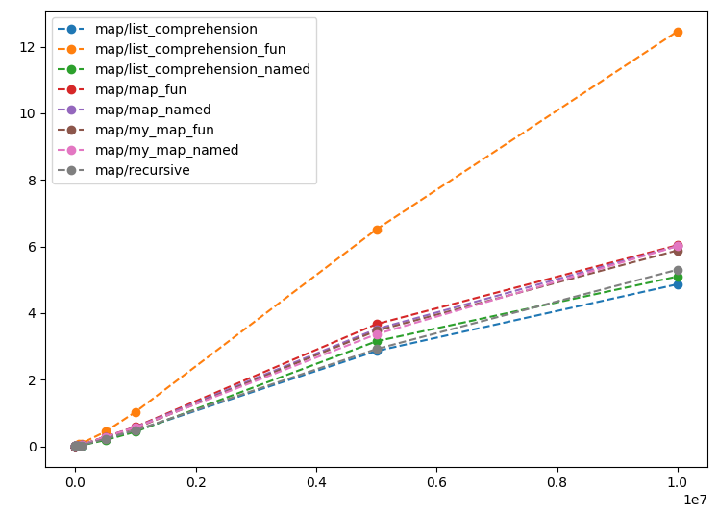
map - results
Best:
List comprehension
Recursion
Worst:
List comprehension with unnamed function
All map implementations
Ranking is same based on energy and time
Energy (J)
Input size

Slide 11
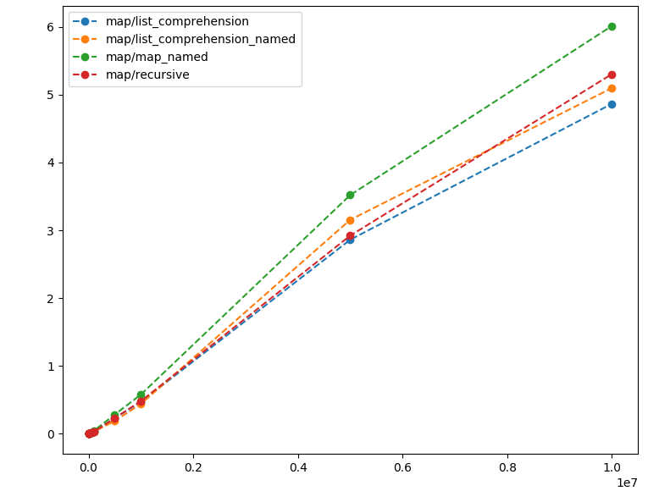
map - results
Energy (J)
Input size

Slide 12
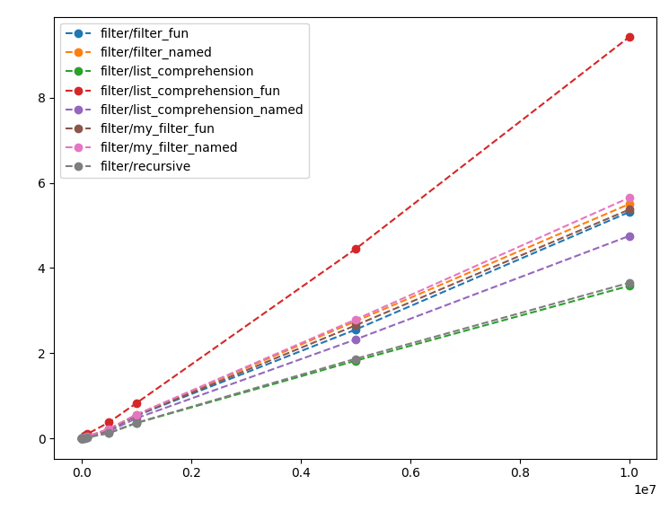
filter - results
Best:
List comprehension
Recursion
Worst:
List comprehension with unnamed function
All map implementations
Ranking is same based on energy and time
Same trends as with map
Energy (J)
Input size

Slide 13
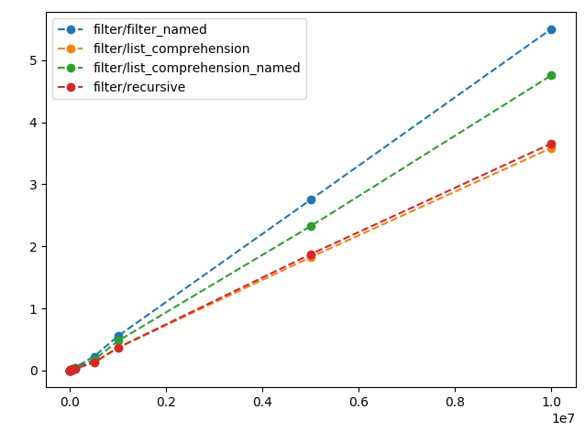
filter - results
Energy (J)
Input size

Slide 14
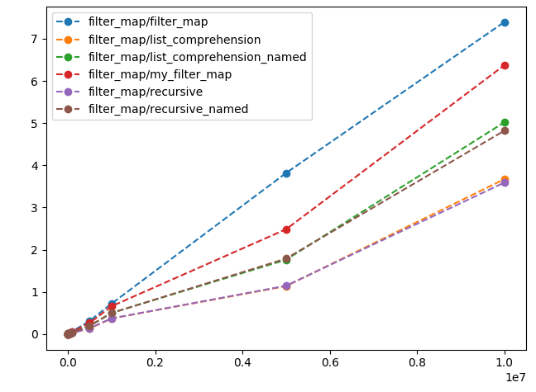
map ∘ filter - results
Best:
List comprehension
Recursion
Worst:
Filter then map
Own HOF implementation
Ranking is same based on energy and time
Energy (J)
Input size

Slide 15
HOFs - Findings
Refactoring higher order function calls to a simple recursive function or list comprehension reduces energy consumption and runtime
Eliminating the HOF is not enough, we need to eliminate the called function as well to minimize energy consumption.
This is consistent with previous findings (N-queens)

Slide 16
Data structures
Investigating different ways to store key-value pairs
list of tuples
map
dict
Measuring different operations on those data structures
find
delete
update
building the data structure

Slide 17
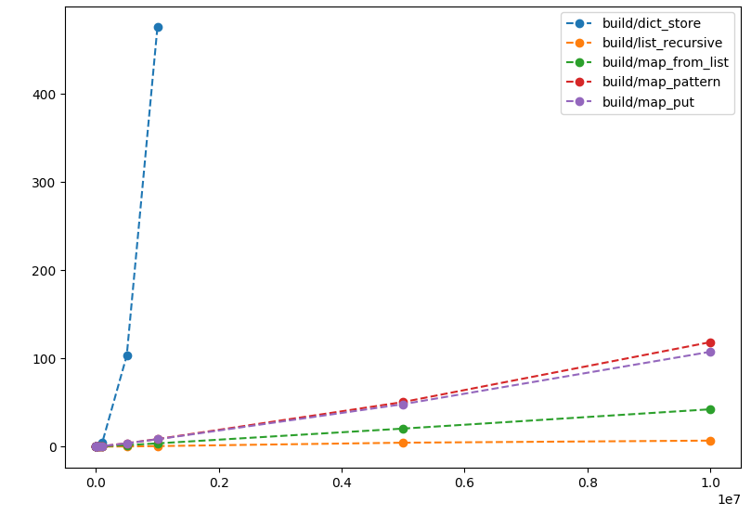
building - results
Dicts are really expensive to build
Lists are the cheapest
Building a map from a list of tuples is cheaper than building the map directly
Energy (J)
Input size

Slide 18
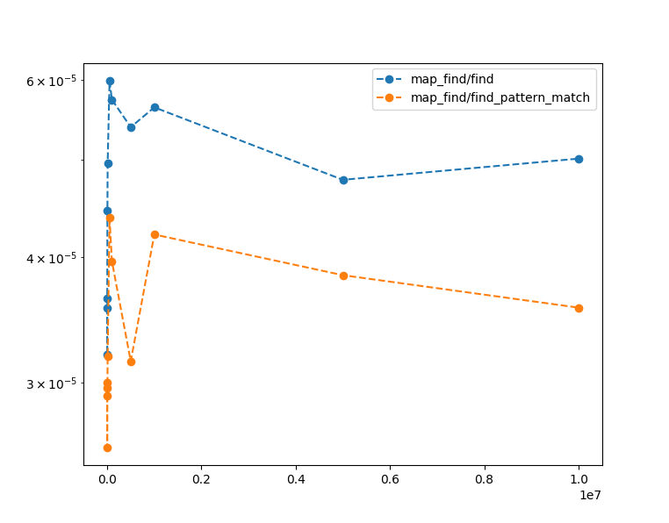
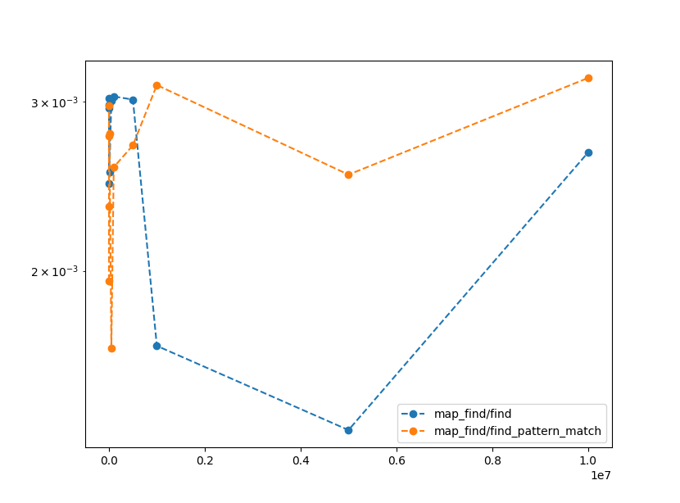
find - results
Time (s)
Energy (J)
Input size
Input size
Finding with pattern matching is faster, but consumes more energy
Using the find function consumes the least energy but is slower

Slide 19
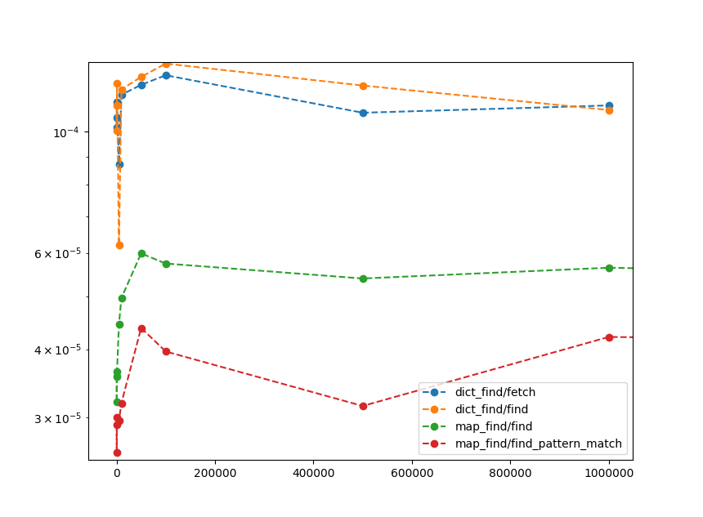
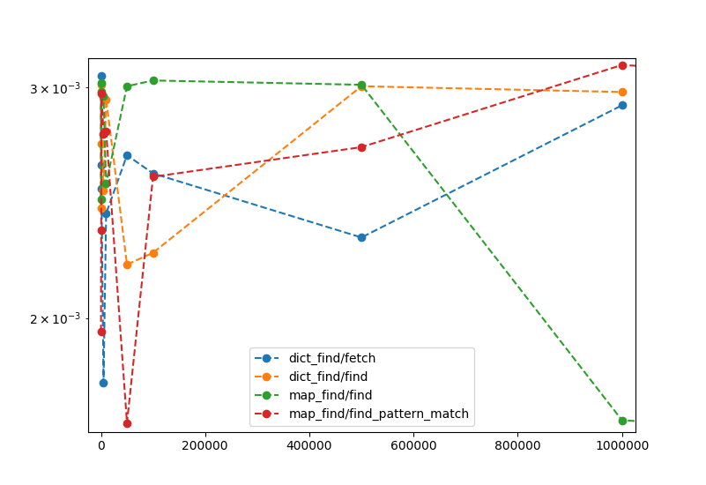
find - results
Time (s)
Energy (J)
Input size
Input size
Finding in a dict is similar to finding in a map,
Maps are quicker
Energy consumption may be better for maps (cannot construct large enough dicts)

Slide 20
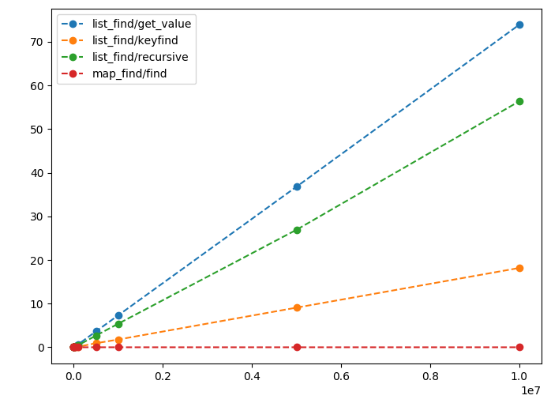
find - results
proplists:get_value is inefficient, even a simple recursive find is better
lists:keyfind is better
Compared to maps all are worse (expected, because of complexity differences)
Energy (J)
Input size

Slide 21
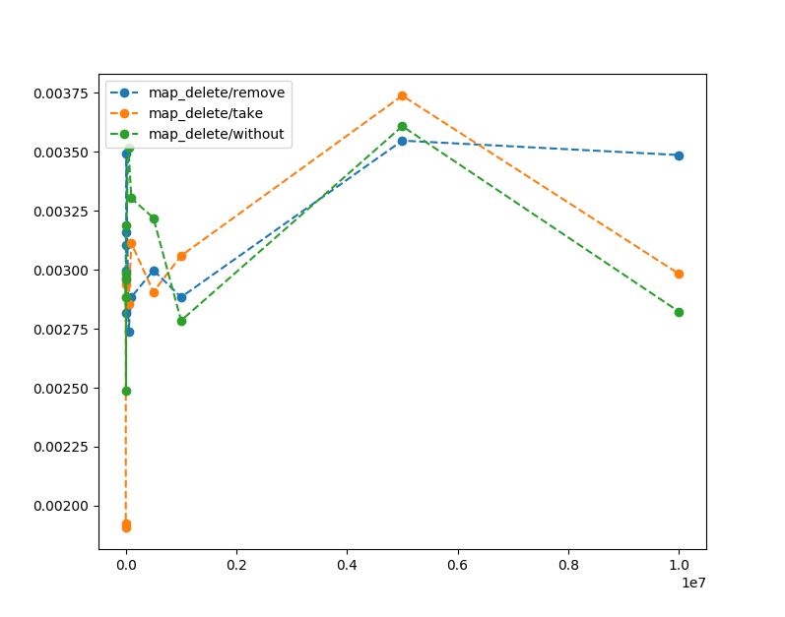
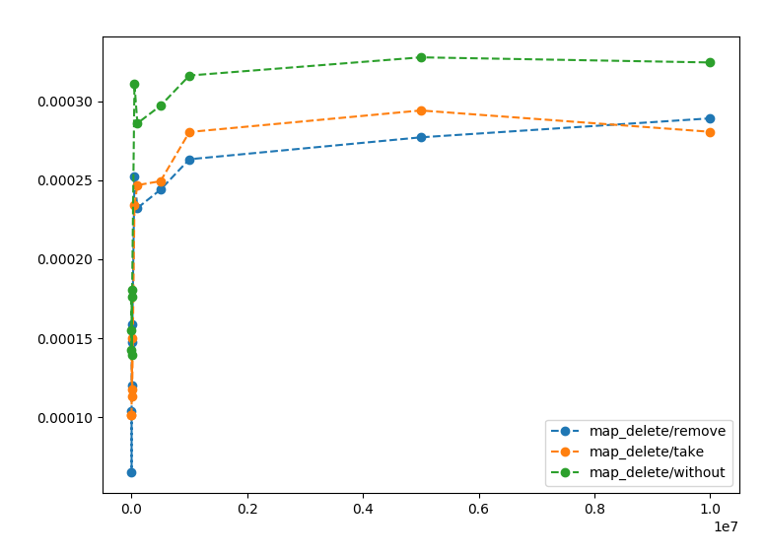
delete - results
Time (s)
Energy (J)
Input size
Input size
Deleting with maps:without is the slowest, but consumes the least energy

Slide 22
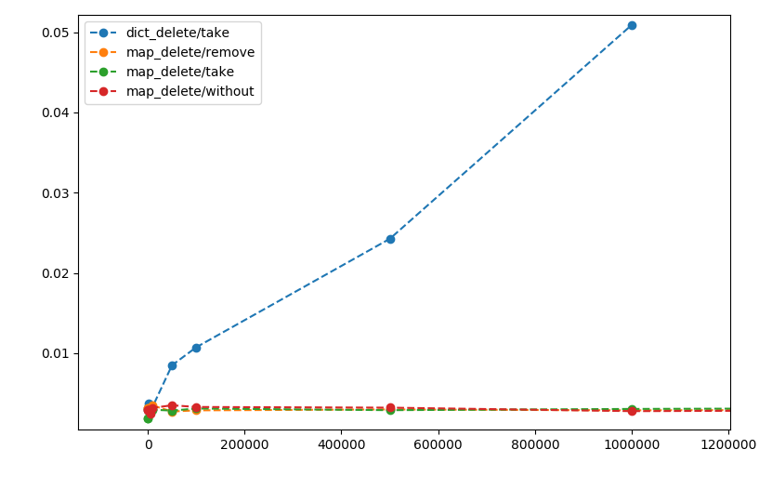
delete - results
Deleting from a dict is worse than deleting from a map
Complexity difference
Energy (J)
Input size

Slide 23
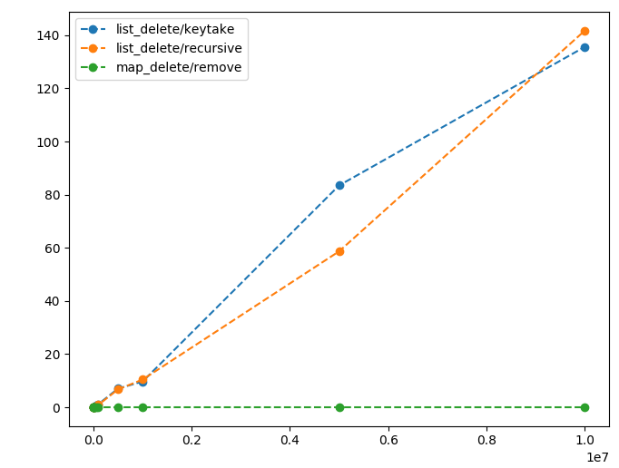
delete - results
Deleting from list is much worse than all previous examples
Complexity difference
No conclusive difference between the two ways to delete
Energy (J)
Input size

Slide 24
update - results
Results for updating an element in out dictionaries show the same patterns as deleting an element.
Maps are the most efficient
Dicts are in the middle
Lists perform the worst

Slide 25
Data structures - findings
Most of the differences between the data structures can be attributed to different representations
Interesting findings are:
We should use lists:keyfind instead of proplists:get_value
With maps the quickest solution is not always the more efficient
More investigation is needed, because measured values are so small
Refactoring may be possible between different implementations of functions on the same data structure
Based on the cost to build every data structure we may be able to decide how many of each operation is needed until it is worth building a different data structure

Slide 26
Conclusions
Tool for measuring energy consumption
Higher order functions have an overhead
It may be eliminated by rewriting the calls to higher order functions with recursion or list comprehensions
Function calls should also be eliminated
Erlang built-in functions on the same data structures can have significant differences in performance

Slide 27
Future work
Investigating the cost of spawning processes and sending messages
Measuring different algorithmic skeletons for parallelization
Creating refactorings based on our findings using RefactorErl

Slide 28
Thank you for your attention

