Slide 1



Towards an energy efficient computation in Erlang
EFOP-3.6.2-16-2017-00013
Áron Attila Mészáros
Gergely Nagy
Melinda Tóth
István Bozó

Slide 2




Motivation
Environmental awareness
Energy conservation, minimizing energy consumption
Even in computers
Green computing
Why Erlang?
Popular languages – lots of research (e.g. C++, Java, Haskell)
Erlang
Widely used in the industry
No such research yet

Slide 3
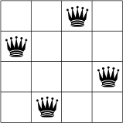
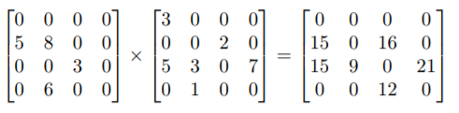
Previous work
Tool for measuring energy consumption
Measuring complex algorithms
N-queens
Sparse matrix multiplication
Special attention to:
Lists vs arrays
Higher order functions
Parallelization (parallel map, token ring)

Slide 4
New goals
Improve methodology
Directly measure language elements
Measure data structures independently
Further inspection of parallelization
Spawning processes
Sending messages
Refactoring in order to minimize energy consumption

Slide 5
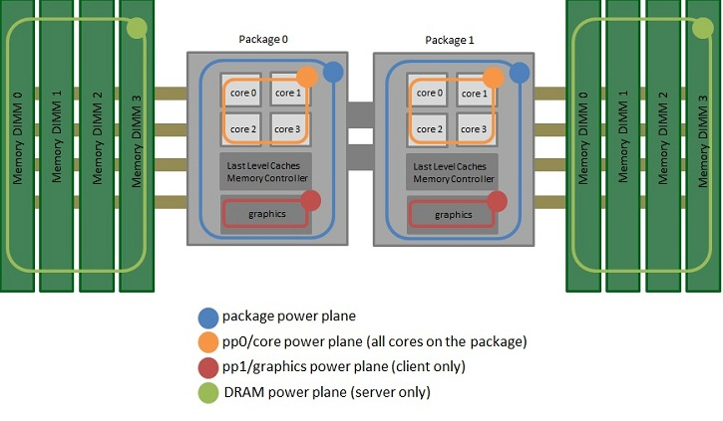
How to measure energy consumption
Running Avarage Power Limit (RAPL)
Intel
Methods:
MSR
perf_event,
sysfs
Domains:
PKG – package
PP0 – core
PP1 – uncore
DRAM

Slide 6
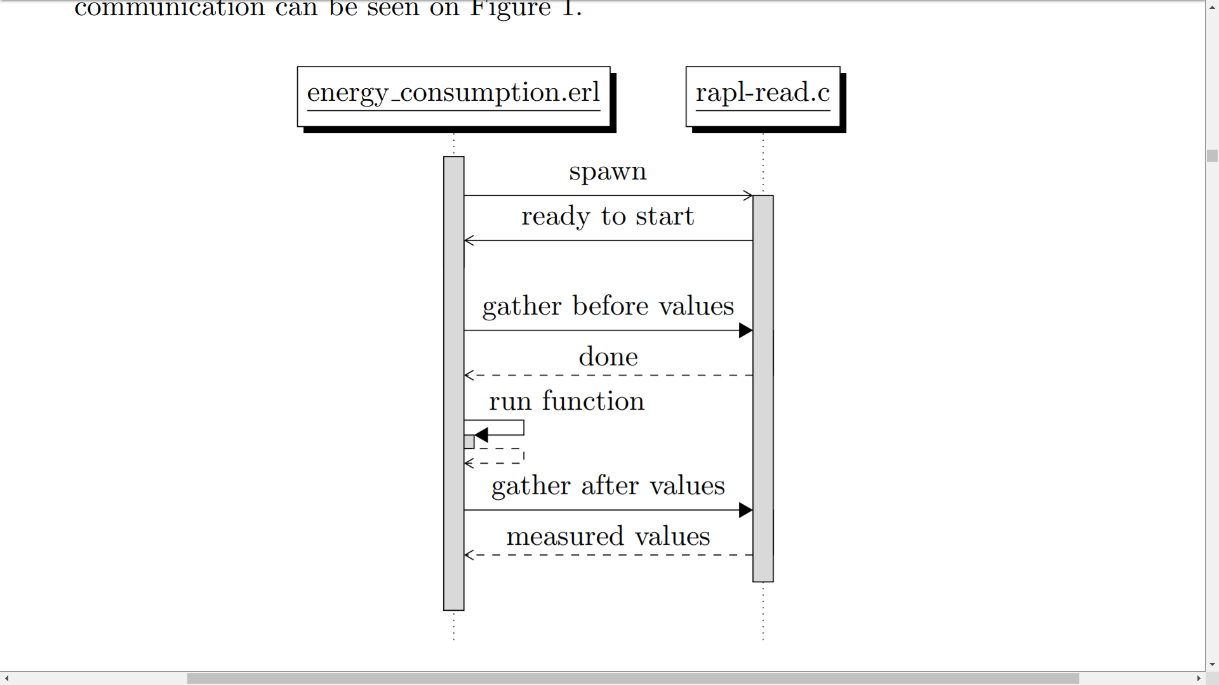
Framework for Erlang
C program to read RAPL values
Erlang module to run measured functions
Communication via ports
Runs the functions
Tells the C program when to measure
Python GUI
Using TkInter
Setup measurement
Helps with organizing the measurements
Visualizing results

Slide 7
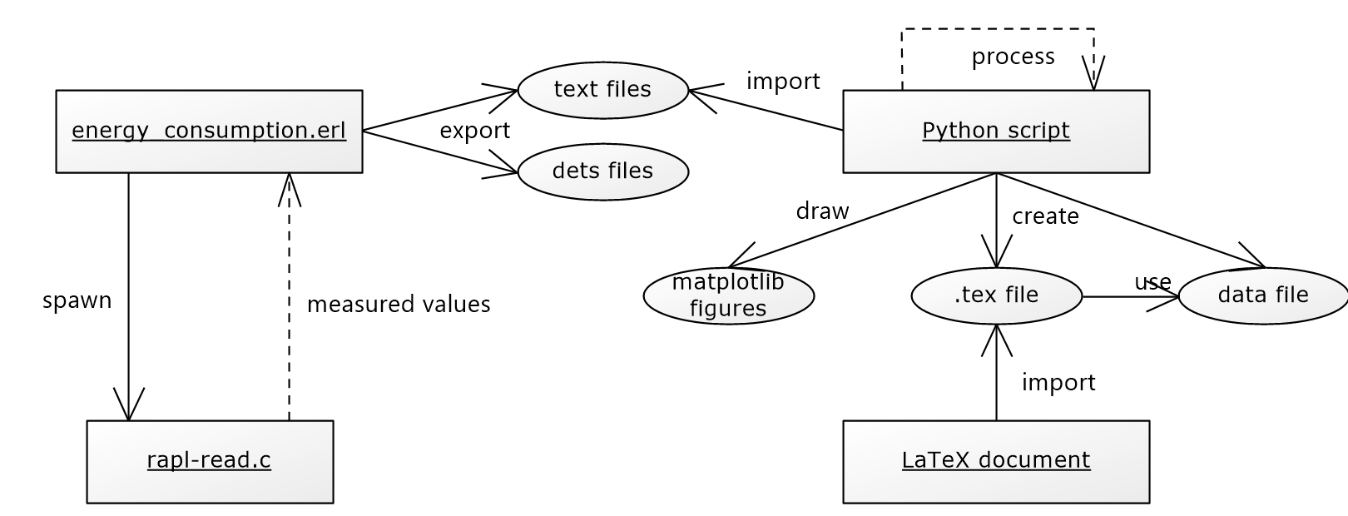
Methodology
Methodology
Everything is measured 10 times
Discarding minimal and maximal values
Calculate average energy consumed
Also measuring runtime

Slide 8
Measurements
Higher order functions
Important part of functional languages
We wanted to find the cost of passing functions as parameters
Data structures
List, map, dictionary
What is the cost of creating these data structures?
What is the cost of operations?

Slide 9


Higher order functions
Passing named or unnamed functions
Using HOF, list comprehension or recursion
Implementing our own higher order functions
Measured:
map
filter
map ∘ filter

Slide 10
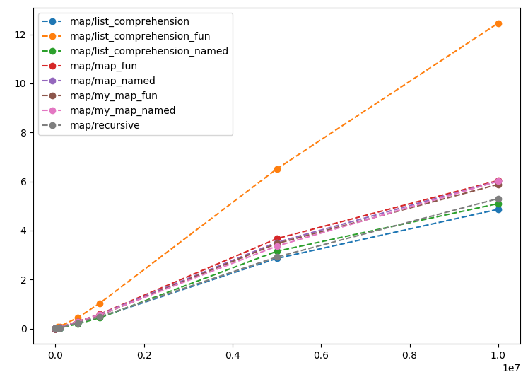
Map - results
Best
Recursion
List comp.
Worst
List comp. with fun.
All maps
Graph is the same based on energy and runtime
Energy (J)
Input size

Slide 11
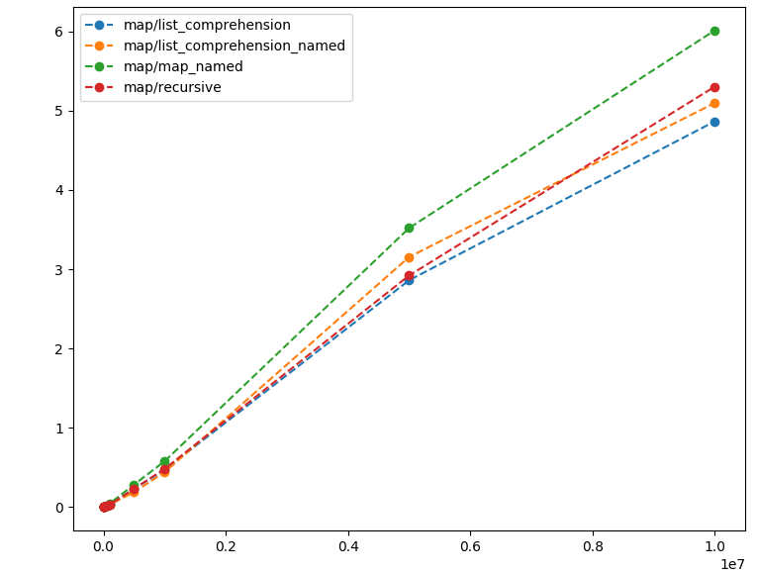
Map - results
Energy (J)
Input size

Slide 12
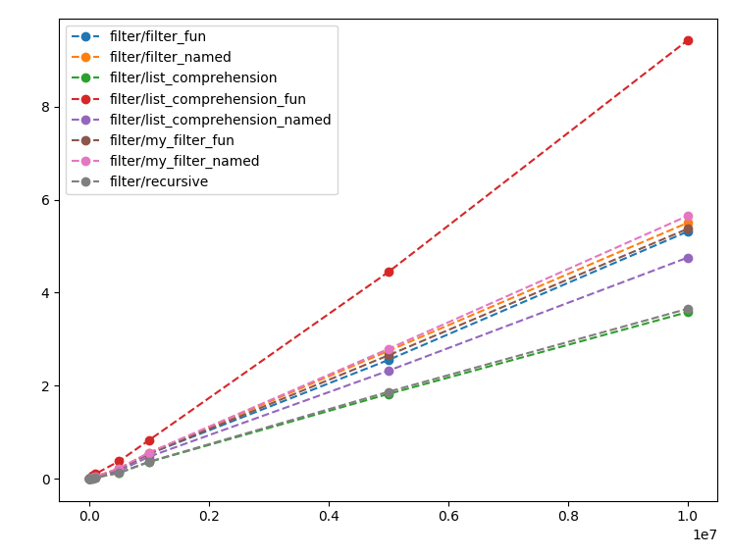
Filter - results
Same results as with map
Energy (J)
Input size

Slide 13
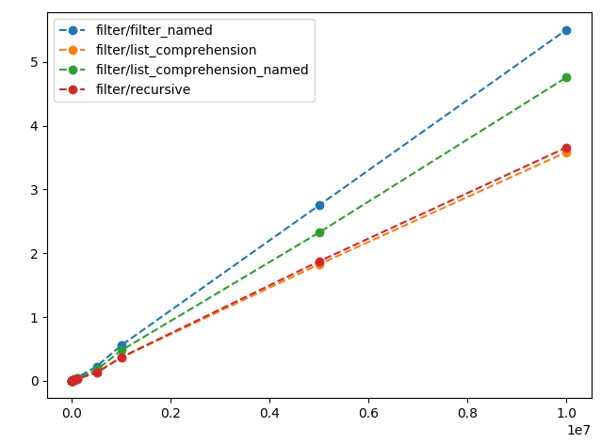
Filter - results
Energy (J)
Input size

Slide 14
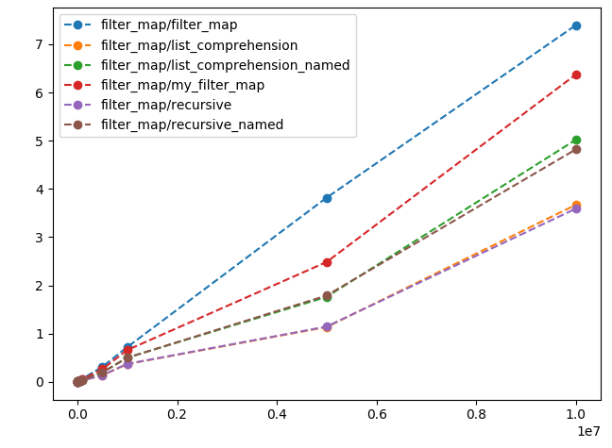
Map ∘ filter - results
Larger differences
HOF iterates over the list twice
Energy (J)
Input size

Slide 15
HOFs - findings
Refactoring higher order function calls to a simple recursive function or list comprehension reduces energy consumption and runtime
Eliminating the HOF is not enough, we need to eliminate the called function as well to minimize energy consumption.
This is consistent with previous findings (N-queens)

Slide 16
Data structures
Investigating different ways to store key-value pairs
list of tuples
map
dict
Measuring different operations on those data structures
find
delete
update
building the data structure

Slide 17
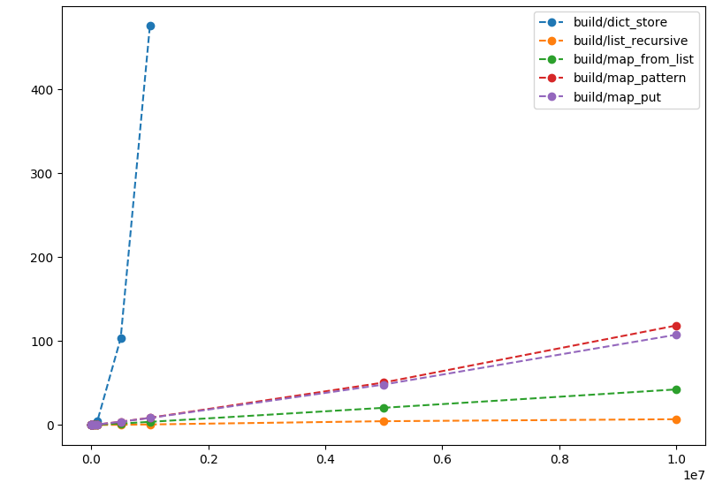
Building - results
Dicts are expensive
Lists are cheap
Building a list then map is cheaper than building map directly
Energy (J)
Input size

Slide 18
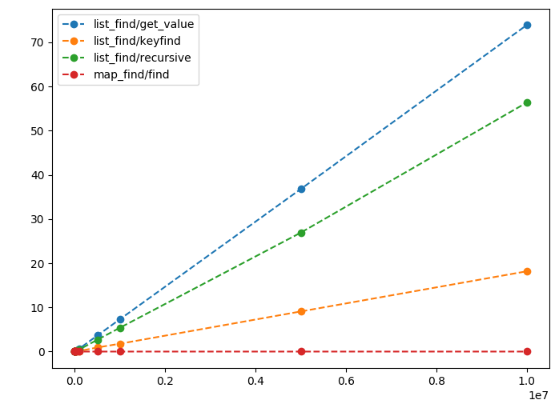
Find - results
proplists: get_value vs lists:keyfind
Energy (J)
Input size

Slide 19
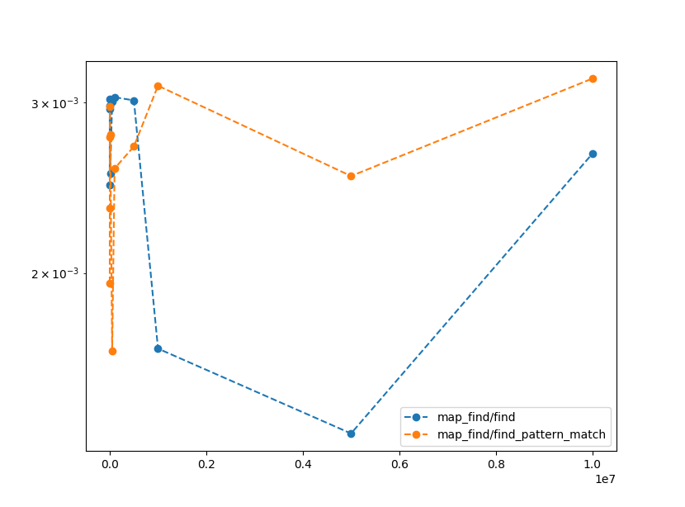
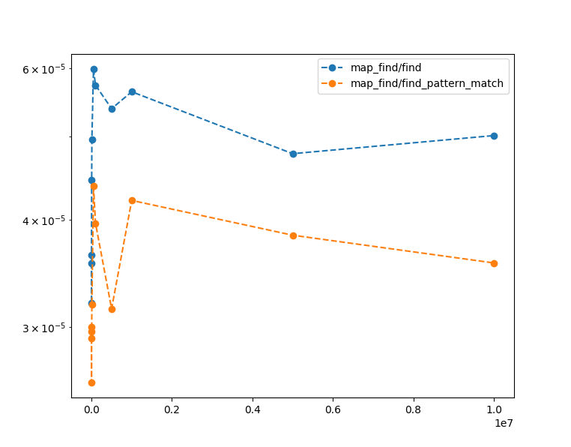
Find - results
Energy (J)
Time (s)
Input size
Input size
Finding with pattern matching is faster, but consumes more energy
Using the find function consumes the least energy but is slower
Needs more testing

Slide 20
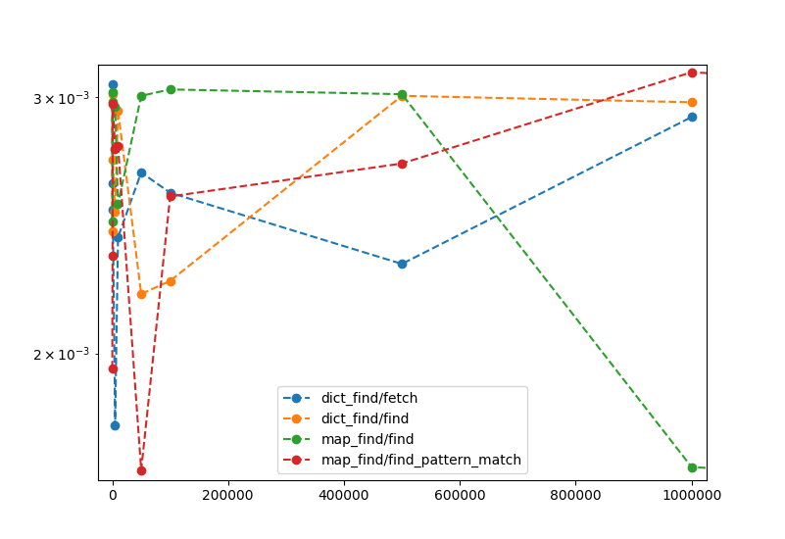
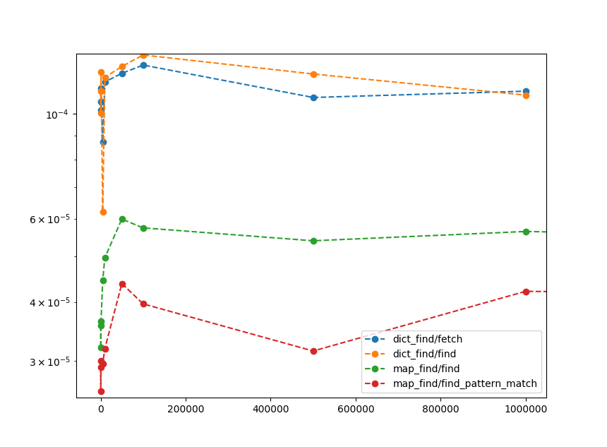
Find - results
Energy (J)
Time (s)
Input size
Input size
Finding in a dict is similar to finding in a map,
Maps are quicker
Energy consumption may be better for maps (cannot construct large enough dicts)

Slide 21
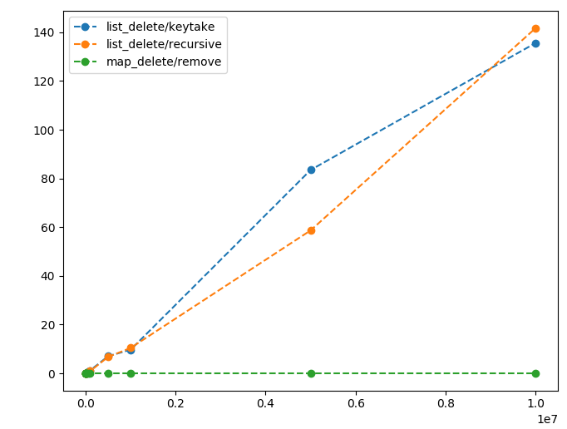
Delete - results
No conclusive difference between the two ways to delete
Much worse than deleting from a map (as expected)
Energy (J)
Input size

Slide 22
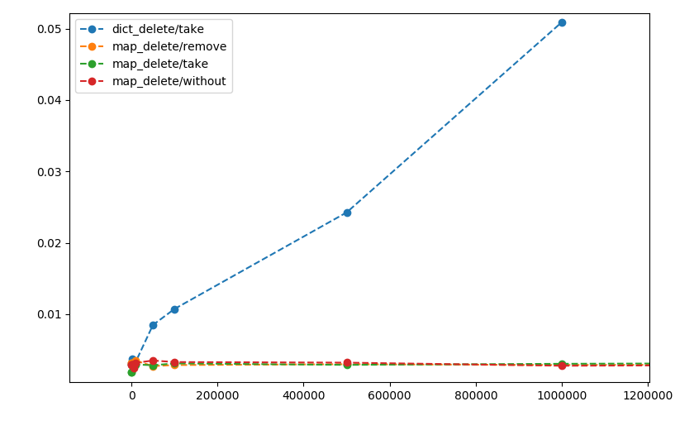
Delete - results
Deleting from a dict is worse than deleting from a map
Energy (J)
Input size

Slide 23
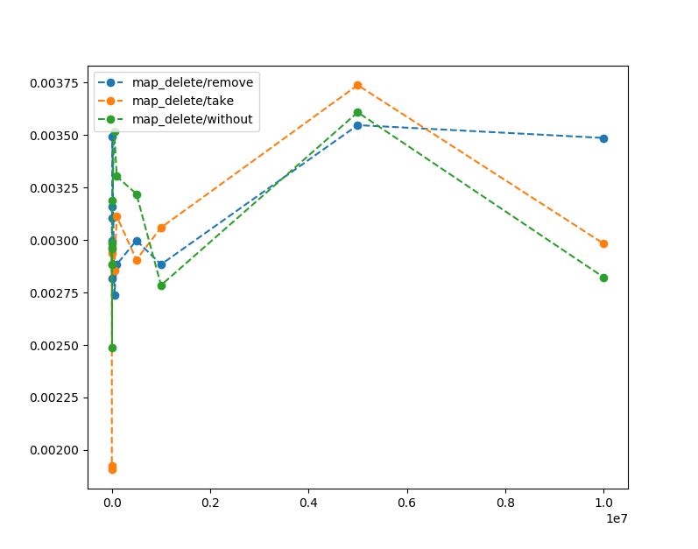
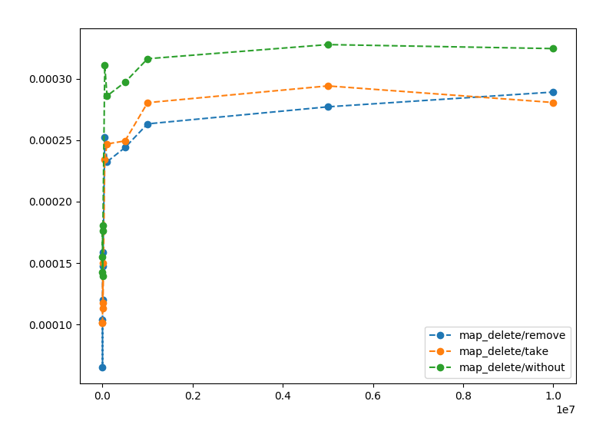
Delete - results
Energy (J)
Time (s)
Input size
Input size
Deleting with maps:without is the slowest, but consumes the least energy
Needs more testing

Slide 24
Update - results
Results for updating an element in out dictionaries show the same patterns as deleting an element.
Maps are the most efficient
Dicts are in the middle
Lists perform the worst

Slide 25
Data structures - findings
Most of the differences between the data structures can be attributed to different representations
Interesting findings are:
We should use lists:keyfind instead of proplists:get_value
With maps the quickest solution is not always the more efficient
More investigation is needed, because measured values are so small

Slide 26
Data structures - findings
Refactoring may be possible between different implementations of functions on the same data structure
Based on the cost to build every data structure we may be able to decide how many of each operation is needed until it is worth building a different data structure

Slide 27
Conclusions
Tool for measuring energy consumption
Higher order functions have an overhead
It may be eliminated by rewriting the calls to higher order functions with recursion or list comprehensions
Function calls should also be eliminated
Erlang built-in functions on the same data structures can have significant differences in performance

Slide 28

Future work
Investigating the cost of spawning processes and sending messages
Measuring different algorithmic skeletons for parallelization
Creating refactorings based on our findings using RefactorErl

Slide 29
THANK YOU FOR YOUR ATTENTION!
EFOP-3.6.2-16-2017-00013

