Slide 1
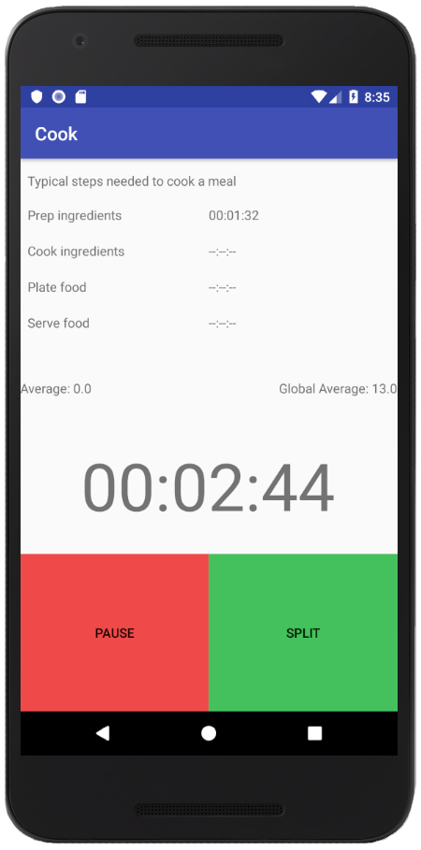
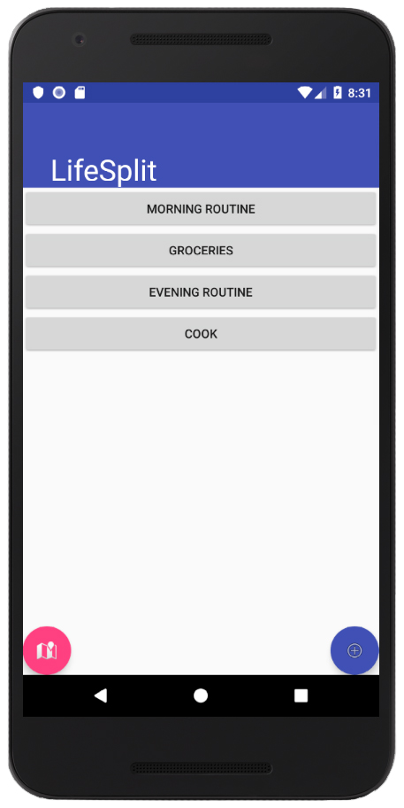
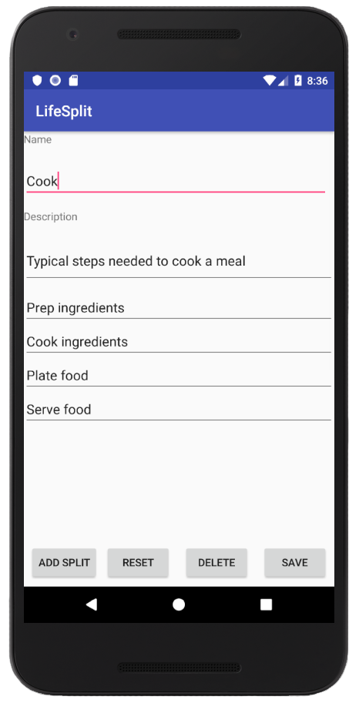
LifeSplit
Bradley Hoefel, Joe Gildner, Daniel Wilson
Motivation
Vision
It’s easy to forget how much time we each spend every day performing simple tasks and routines. LifeSplit helps make users aware of the time they spend in these habits and pushes them to optimize their lives, making more time for the things that count.
Additionally, LifeSplit encourages users to actively engage with their daily routines, making a competition out of the most mundane aspects of our lives. This helps bring a source of joy to what might be otherwise joyless activities.
LifeSplit is a time management application for daily activities inspired by the PC speedrunning software LiveSplit.
LifeSplit’s primary goal is to give its users a better idea of how long certain daily activities take them, so they can better plan out their day.
LifeSplit achieves this goal by having its users time how long a common task takes. The app calculates the average time a task takes, so the user can better understand how long their daily routine takes.
LifeSplit includes preset tasks and allows for unlimited custom tasks defined by the user. Users can compare how long a task takes them to the average time of the app’s user base through global average task times.
Interactive timing system for everyday tasks.
Includes general preset tasks for common routines.
Task customization allows for unlimited user-defined tasks.
Edit and delete existing tasks.
GPS tracking for commute times or exercise routines.
Specify locations to automatically trigger splits.
Track progress with split times and average task times stored locally.
Compare times with the global average of all users for each preset task.
Features
Timing
Menu
Customize
Easy-to-use timer tracks each step in the task.
Select from 5 preset tasks and an unlimited number of custom tasks.
Create custom tasks with any number of steps.
Data Management
GPS Integration
Future Features
MySQL is used to store all user data including custom tasks, split times, and average times.
Firebase Realtime Database stores global average times across all users for preset tasks allowing users to compare their results.
LifeSplit uses GPS location to enhance user experience:
Map visible on timing screen allows for navigation while driving while still timing tasks.
Specify locations on a map to trigger an automatic split – useful for commute times or exercise routines.
Personal info stored remotely allowing for shared profile access across multiple devices.
Better support for directly comparing times with other users.
Average and best times for tasks displayed in task selection menu.
Notes:
[7] ASD Data and Statistics, https://www.cdc.gov/ncbddd/autism/data.htm
Lynn Newman, Mary Wagner, Anne-Marie Knockey, Camille Marder, Katherine
Nagle, Debra Shaver, Xin Wei, Renee Cameto, Elidia Contreras, Kate Ferguson,
Sarah Greene, and Meredith Schwarting. 2011. The post-high school outcomes
of young adults with disabilities up to 8 years after high school. A report from
the National Longitudinal Transition Study- 2 (MLTS2).
(From white paper) The Autism and Developmental Disabilities Monitoring (ADDM)
network of the Centers for Disease Control and Prevention (CDC)
estimated that about 1 in 59 children in the USA has been diagnosed
with Autism Spectrum Disorder (ASD)

