Slide 1
Doctor-Client Health Program Management System
By Emmanuel loter joel

Slide 2
Doctor-Client Health Program Management System
Doctor-Client Health Program Management System
Introduction
Project Overview
Key Features and Functionality
Architecture and Workflow
Technologies Used
Database Structure
Code Overview
User Interface Screenshots
Challenges and Solutions
Future Enhancements
Conclusion

Slide 3

Project Title: Doctor-Client Health Program Management System: a secure, user-centric web application for healthcare management.
Project Subtitle: Developed to streamline and secure doctor workflows managing health programs and client medical data effectively.
Author and Date: Authored by Emannuel Loter Joel; presentation date 27th April 2025.

Slide 4
Introduction
Technology Stack: Utilizes Flask for backend, SQLite database, and HTML/CSS with JavaScript for responsive frontend interfaces.
User Authentication: Implements secure doctor login and registration processes ensuring confidential access control and data privacy.
Core Functionalities: Supports health program creation, client registration and enrollment, plus comprehensive client profile management features.

Slide 5
Project Overview
Problem Statement: Doctors face challenges managing numerous health programs and tracking client data efficiently within existing systems.
Proposed Solution: A streamlined, user-friendly web application simplifies health program management, client registration, and enrollment workflows.
Target Users: Designed primarily for doctors and medical staff requiring secure, intuitive tools for managing health services.

Slide 6
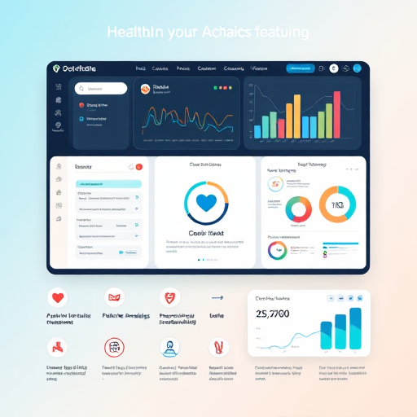
Key Features and Functionality
Doctor Authentication: Enables doctors to register and log in using securely hashed passwords preventing unauthorized access.
Health Program Management: Facilitates creation, editing, viewing, and deletion of health programs with comprehensive administrative controls.
Client Management: Supports client registration, enrollment into programs, profile viewing, and efficient client search by name.

Slide 7
Architecture and Workflow
User Interaction Flow: Doctors log in securely, manage programs, register clients, enroll them, and access client profiles seamlessly.
Database Schema: SQLite schema defines doctors, clients, programs, and enrollments tables maintaining relational integrity and query efficiency.
Session Management and UI: Flask sessions authenticate users; HTML forms with flash messages provide real-time feedback enhancing user experience.

Slide 8
Technologies Used
Flask Server Logic: Manages HTTP routing, request handling, and integrates backend services ensuring scalable, modular application architecture.
Database Management with SQLite: Relational database schema efficiently stores, retrieves, and maintains data consistency for users, programs, and enrollments.
Security via Werkzeug: Implements robust password hashing and authentication mechanisms preventing unauthorized access and securing sensitive data.

Slide 9
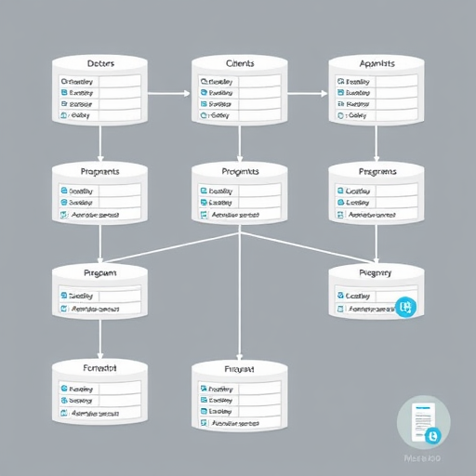
Database Structure
Doctors Table Structure: Contains unique ID, username, and securely hashed password fields for authenticated access management.
Programs Table Design: Stores program ID and descriptive program name to organize distinct health initiatives systematically.
Clients and Enrollments: Clients table records demographic details; Enrollments table establishes many-to-many client-program relationship.

Slide 10
Code Overview
Home Route Logic: Redirects unauthenticated users to login page, ensuring secure access before displaying home dashboard content.
Secure Login Implementation: Uses Werkzeug's password hashing to verify credentials, preventing plaintext password storage and enabling secure authentication.
Doctor Login Route Example: Flask route checks submitted username and hashed password, initiating user session upon successful credential verification.

Slide 11
User Interface Screenshots
Login Interface Design: Clean form captures username and password, implementing input validation and error feedback for authentication failure.
Doctor Dashboard Layout: Dashboard aggregates patient metrics, active programs, and navigation panels enabling efficient clinical workflow oversight.
Client Profile and Enrollment: Detailed client profiles show demographics and enrolled health programs with options for real-time updates and management.

Slide 12

Challenges and Solutions
Password Security: Werkzeug.security's hashing algorithm guarantees robust password protection against common attack vectors.
Data Integrity Enforcement: Foreign keys in enrollments table maintain referential integrity linking clients and programs reliably.
UI Usability Enhancements: Simple, clear form designs reduce user error and improve navigation efficiency within health program modules.

Slide 13
Future Enhancements
User Role Differentiation: Defines distinct admin and doctor roles with specific permissions, strengthening system security by role-based access control.
Data Analytics Integration: Incorporates analytical tools to visualize and track client progress, enabling data-driven program adjustments and outcomes assessment.
Automated Email Notifications: Implements email alerts for enrollments and reminders to enhance communication efficiency and patient engagement.

Slide 14
Conclusion
Secure Interaction Platform: Provides encrypted channels ensuring confidentiality and integrity of communications between doctors and patients.
User-Centered Design: Employs intuitive interface components facilitating seamless navigation and efficient health program management by medical staff.
Conclusion and Q&A: Thank you for your attention; the floor is open for questions to discuss system features and implementation details.

