Slide 1
Data Science: what it’s good for, with examples
Joe Hahn
Oracle Data Scientist
27 Nov 2018

Slide 2
agenda:
what does a data scientist do?
what skills should a data scientist have?
analytics & machine learning
aside: artificial intelligence
using machine learning to perform predictive maintenance

Slide 3
what does a Data Scientist (DS) do?
a DS uses analytic methods (summarized later in slide #3) to:
increase firm’s (or client’s) awareness of its biz environment, ie
who are your customers, what they want, whose stealing your customers etc
forecasting (expenses, future biz opportunities)
make additional $ for employer or clients, by
expanding firm’s customer base
increase customer loyalty, reduce customer attrition
reduce production costs
minimizing accidents or equipment failures that cause production downtime
optimize business processes: reduce cost & time-to-deliver
in summary, a DS is there to:
know the biz and its environment
know how to use data + algorithms to optimize the business

Slide 4
what skills should a Data Scientist (DS) have?
two types of DS:
GUI-based (?) DS that uses drag-n-drop tools like Tableau etc to explore/viz data, Azure etc to build data-prep workflows & train ML models
little or no coding is required
in skilled hands, data prep & model building can be very rapid
tools are well-suited for majority of biz problems that often have simple data-preps requirements
much data reside in databases, so all DS should know SQL
programmatic DS that uses code (often R or python) to munge/visualize data and build ML models
development is slower
results in custom code tailored to particular biz prob
some data preps are too complex to GUI tools
Big Data tools (Hadoop, Spark) are mostly driven by bash scripts + python/R
AI is mostly code driven (eg Tensorflow)

Slide 5
programmatic DS should have these skills:
most data science happens on linux servers, on prem or in cloud, so know:
linux!
know how to access servers securely using ssh
git: to push source code into cloud instance & pull results
bash shell scripting is nice-to-have
much data is in databases
SQL to query db tables
SQL scripting to export results back into db tables
Q: python or R?
A: python
plus these libraries: numpy, pandas, matplotlib, scikit-learn
Jupyter notebook
browser-based
great for developing/prototyping/debugging code in cloud (no desktop)
plots are inline

Slide 6
standout DS will also have Big Data skills:
what is Hadoop?
is collection of big data wrangling apps, the must-knows are:
HDFS = file system, for data storage
Hive = SQL query engine
Spark = generic data prep & model building engine
Yarn = cluster’s job manager
want to experiment with Hadoop?
launch small EMR cluster in AWS cloud
notes: https://github.com/joehahn/exes-n-ohs/blob/master/aws.txt
load csv data into HDFS (easy)
query data using Hive (good job!)
query data using Spark (stand proud!)
costs $1/hr

Slide 7
analytics, ML, and AI...what’s the diff?
many firms have an analytics team or dept, usually headed by Analytics Manager
some Analytics Managers do NOT know the diff between analytics ML and AI
analytics is the use of data + algorithms to understand a firm’s business environment, its business problems, and the solutions to those problems
∼80% of a DS’s analytic efforts is devoted to:
gathering data relevant to a business problem aka use case,
then data exploration ie
cleaning, joining, & aggregating datasets
trend analysis:
timeseries plots
y vs x scatterplots
histograms etc
purpose of analytics:
to grok the data
ie figure out what data is trying to say

Slide 8
note that many business questions do NOT require ML or AI
usually simple SQL + common sense provides answer:
example: how many automobiles will be burgled at Fisherman’s Wharf in SF next month?
fast easy approx soln: about same as last month
yes this is a real ask!
alt question better suited for ML:
there is a 50% chance of quarter inch of rain tomorrow night, how many vehicles will get burgled in the Wharf overnight assuming it does rain? and no rain?

Slide 9
∼ 20% of DS’s time is often devoted to developing machine learning (ML) models
a ML model is an algorithm that predicts aka estimates an unknown quantity y as a function of input features x_{j}
model is first trained ie fitted to historical data consisting of numerous features x_{j} and their target variables y_{j}
x_{j} = [x₀, x₁, x₂, ...] = list of numerical details describing event x_{j}
medical insurance claim ex:
x₀ = diagnosis ID, x₁ = treatment ID, x₂ = treatment expense etc
training ML model associates features x_{j} to target variable y_{j}
to generate a prediction, feed new set of features x_{K} into model to compute predicted (estimated) y_{K}
example: medical insurance claims processing:
train ML on historical claim facts x_{j} and y_{j} = whether panel of medical experts accepted/rejected claim
you now have a ML model that automates work done by panel
automation saves firm $ and time

Slide 10
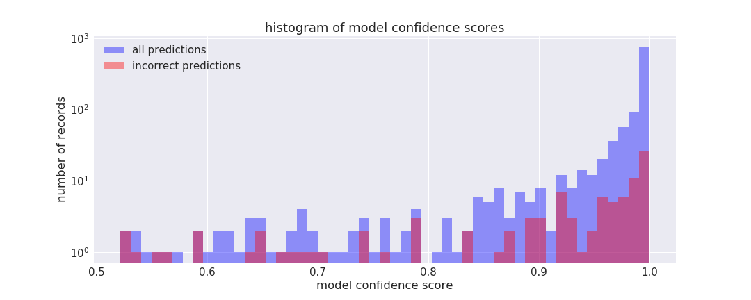
once ML model is trained, it is then tested by comparing model predictions to another sample of historical x, y data
if model achieves desired accuracy (say 95%), then business would productionize model ie make model available to rest of biz
productionizing insurance model:
this ML model is a classifier
classifier generate two outputs:
predicted target variable y_{j}
confidence score cs = measure of how certain (or not) model is about predicted y_{j}
productionized model automates processing of those claims whose predictions have cs > 80%

Slide 11
productionized model auto-processes those claims whose predictions have cs > 80%
model auto-processes 93% of all claims, with 95% accuracy
model diverts 7% remaining claims back to medical panel, for manual adjudication
main takeaway:
use of ML reduced caseload on expert panel to 7% of the pre-ML caseload
will panel’s workload (eg person-hours needed to manually process claims) also drop to 7%?

Slide 12
aside: Artificial Intelligence (AI)
maybe 1% of business use cases are good candidates for an AI based solution
what is AI?
answer varies, depends on who you ask
me: algorithms whose output is indistinguishable from human-generated
examples:
chatbot that uses Q&A to triage calls to company helpdesk
algorithm that chooses words for smart speaker
model that writes news summaries, snippets of original background music
shipping logistics, rideshare route optimization
characteristics of an AI solution:
usually built on large neural networks that are cpu and memory intensive
success usually requires LOTS of training data
AI model development requires highly skilled DS plus lots of development time
recommendation: only use AI for those 1% of use cases that truly merit AI
otherwise use simple plain-vanilla analytics to solve the easy 80% of biz questions
with ML model built & productionized, for automating or optimizing the other 20%

Slide 13
how to get started in AI via baby steps:
install Tensorflow on desktop
TF = sophisticated (and complicated!) library for building/training neural net
actually install Keras (which runs on top of TF, makes TF somewhat less complicated)
search for online tutorial on how to build/train a multilayer perceptron (MLP), to make predictions on data
is Hello World of neural nets
next step
get good book on Keras/TF to build CNN, RNN, autoencoders, Q-learning etc
i like Deep Learning with Keras
figure out how to use tensorboard to avoid under/over fitting
next step:
train your neural net using desktop’s GPU...see a speed boost?
TF wont talk to your GPU?
do above on GPU instance in Amazon cloud
go to AWS marketplace, search for Bitfusion Tensorflow
LSTM ex: https://github.com/joehahn/tf-text-classification-demo
cost = $1/hour

Slide 14
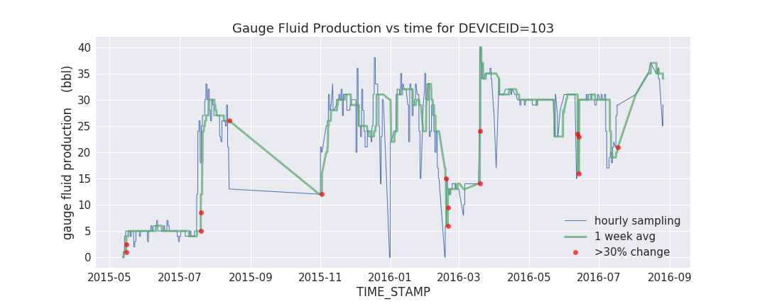
personal hobby horse: predictive maintenance for upstream oil & gas
predictive maintenance (PDM) is the use of data + ML algorithms to optimize the utilization and servicing of high-value machinery (eg factory robots, fleet of vehicles, network of oilwells etc)
no good blogs on this topic, no good books, very few journal articles, why?
probably because there is no useful public data on topic
and is difficult problem...
upstream oil & gas is characterized by production losses due to unanticipated equipment failures
oil/gas wells emit flood of telemetry ie sensor readings
analytics teams in O&G are overwhelmed by data
currently reactive, want to be predictive

Slide 15
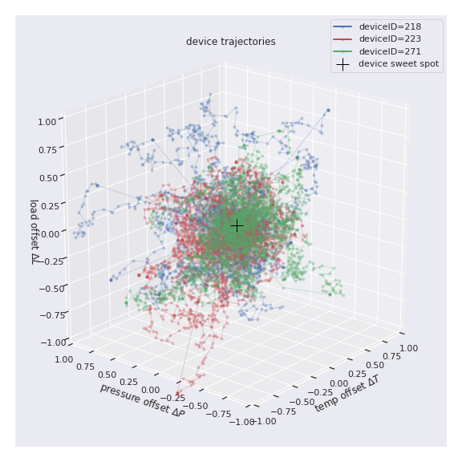
data requirements for PDM
PDM requires two kinds of input data:
telemetry
state of each well over time
repair logs
how issues mitigated by SME
there is telemetry data online, but no telemetry AND repair data
to build PDM demo, must generate mock data
simple toy model for upstream O&G:
1000 virtual wells emit mock pressure P, temp T, load L sensor readings
wells’ P,T,L settings random-walk away from sweet spot, become
more prone to various mock failures

Slide 16
simple toy model for upstream O&G:
1000 virtual wells emit mock pressure P, temp T, load L sensor readings
wells’ P,T,L settings random-walk away from sweet spot, become more prone to 3 kinds of mock failures:
jammed_rotor
cracked_valve
broken_gear
failed well’s production is zero until repaired
pool of 100 virtual repair technicians
repair requires 100 timesteps to complete

Slide 17
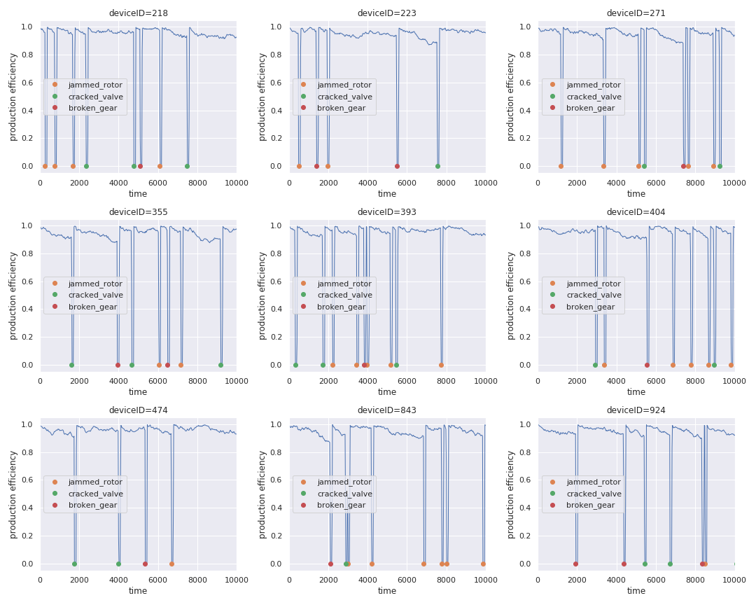
initially 1000 simulated wells are operated in Run-To-Fail (RTF) mode
generates mock telemetry AND repair data
then train 3 binary classifiers on telemetry + repairs data, to predict:
if well suffers jammed_roter failure during next 400 timesteps
if well suffers cracked_valve...
if broken_gear...
then rerun sim in PDM mode:
use 3 ML models to send problematic wells into preventative maintenance before failing catastrophically

Slide 18
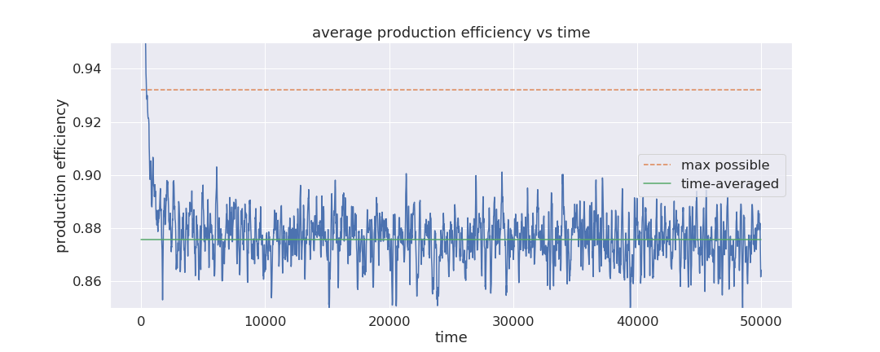
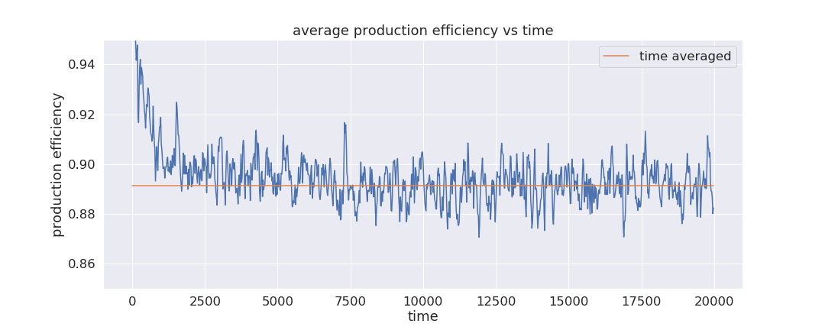
key PDM parameter: preventative maint’ downtime is assumed 25% of catastrophic fail
to mimic benefit of graceful shutdown for repairs
RTF
PDM
results (after much effort):
PDM boosted virtual wells efficiency measly 1.5%
PDM is hard!

Slide 19
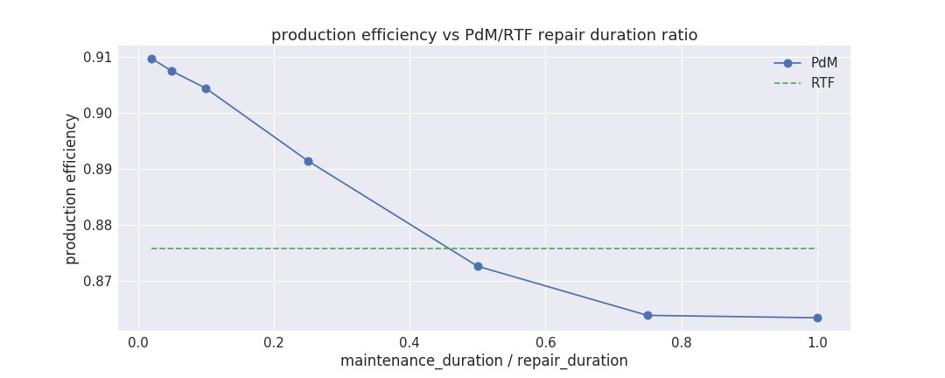
RTF
production boost due to PDM is also sensitive to ratio of preventative-maintenance-downtime/catastophic-fail-downtime
boost (if any) is small, few percent at most
note: 2% prod’ boost for firm producing Mbb/day ➡ $1M/day new revenue

Slide 20
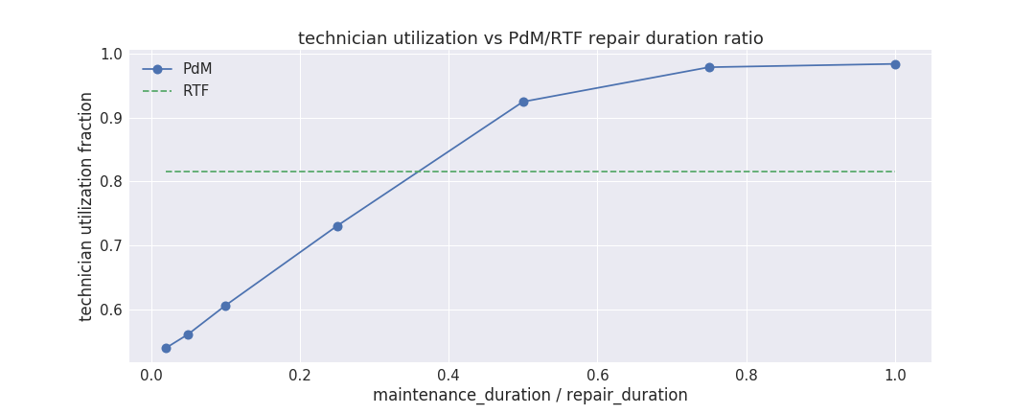
RTF
unanticipated benefit of PDM:
repair technicians workload dropped 10-20%
detailed blog post on above, Jan 2019
open source code (Oracle permitting) May 2019 🤞

