Slide 1


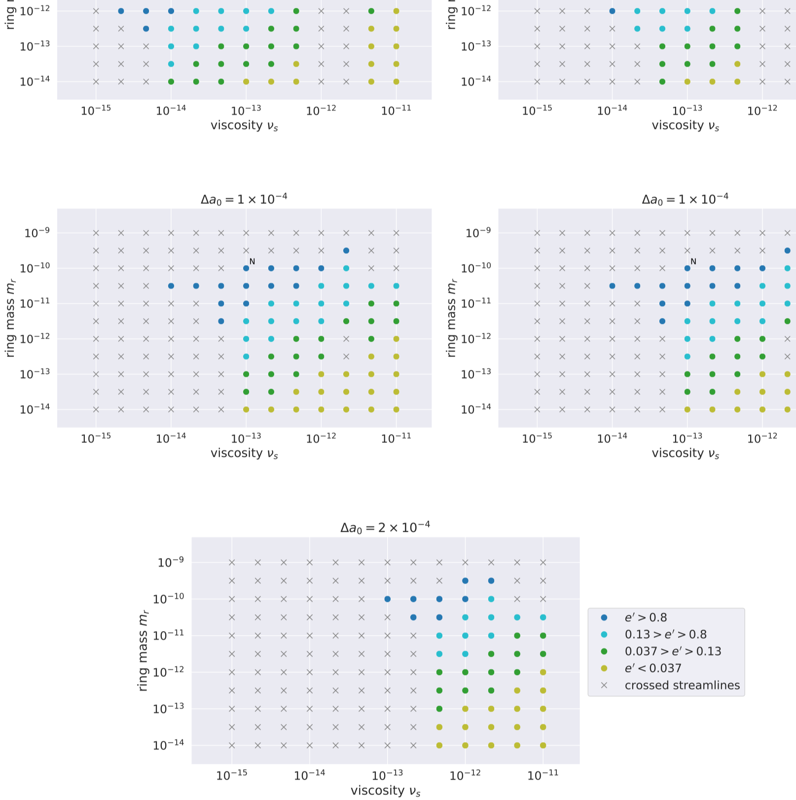
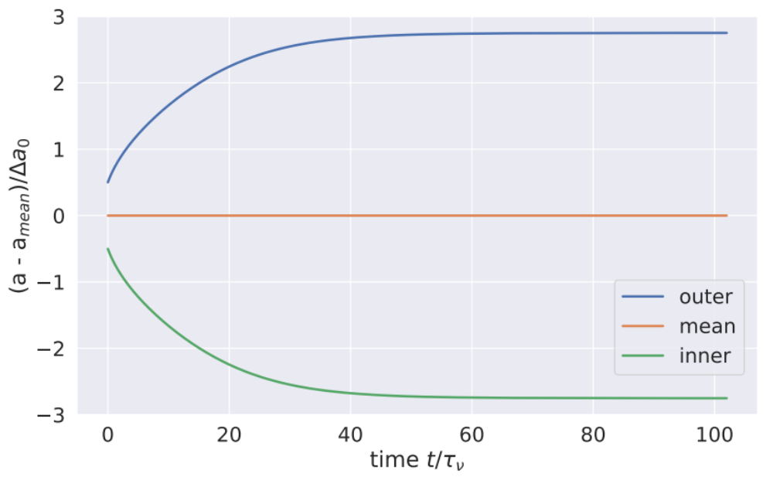
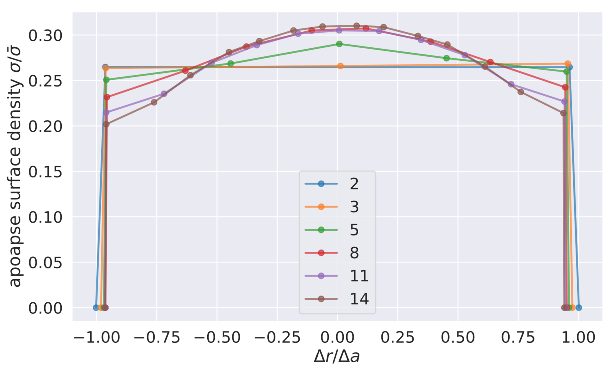
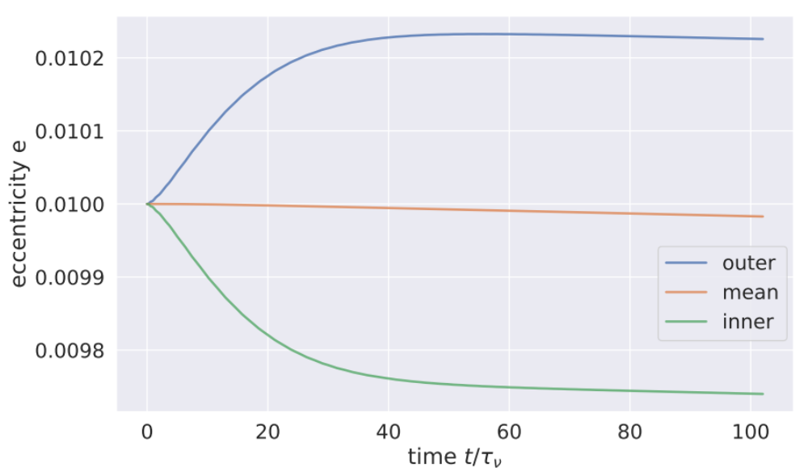
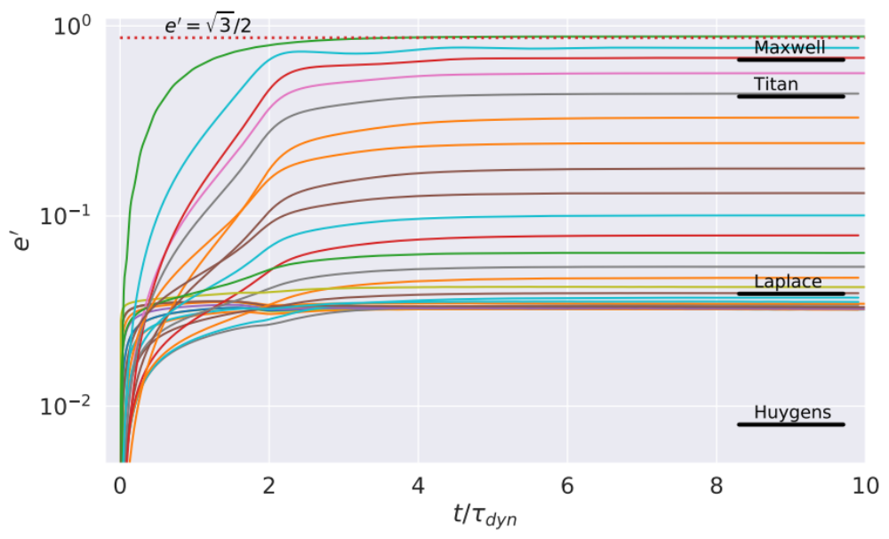
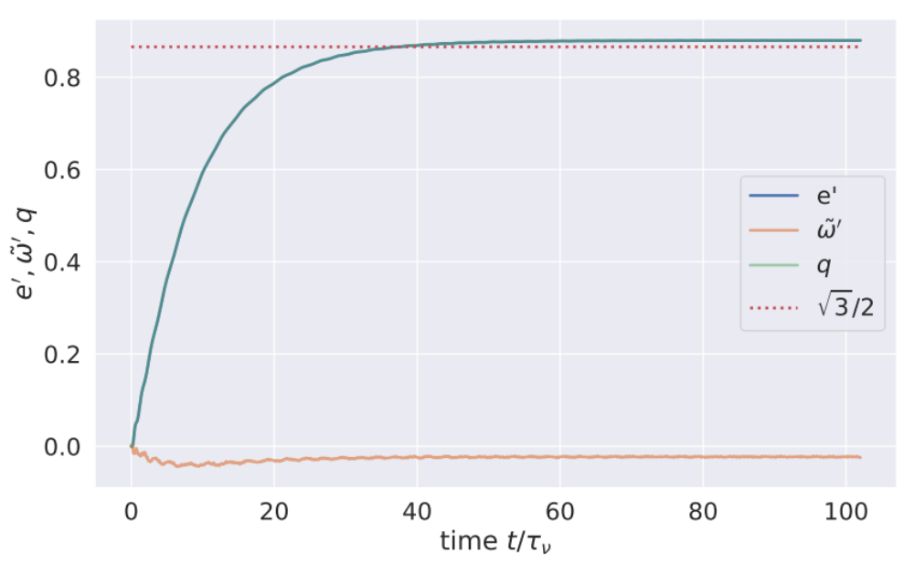
Self-Confinement of
Narrow Eccentric Planetary Ringlets
Joseph Hahn (Space Science Institute), Douglas Hamilton (University of Maryland)
Thomas Rimlinger (Goddard Space Flight Center), Yuxi Lu (Columbia University)
Background
Nbody simulation of the nominal ringlet
Simulation survey
  simulation survey shows that self-confinement is possible
  for a wide variety of initial m_{r}, Δa, ν_{s} conditions
Narrow eccentric planetary ringlets are interesting & puzzling:
  they have very sharp edges
  large eccentricity gradients
  unknown confinement mechanism that opposes radial spreading due to ringlet viscosity
One popular confinement mechanism:
  narrow ringlets are straddled by unseen shepherd satellite(s) whose grav’ perturbations confine it radially (Goldreich & Tremaine 1979, Goldreich et al 1995, Chiang & Goldreich 2000, Mosqueira & Estrada 2002)
but Cassini spacecraft failed to detect any shepherds near Saturn's narrow ringlets, which casts doubt on the above (eg Longaretti 2018)
recall Borderies et al (1982): a narrow ringlet having a
sufficient nonlinearity parameter
q=[(eccentricity-gradient)² + (periapse-twist)²]^{1/2} ≥ √3/2 ≈ 0.87
can be self-confining
  they show that when:
    q<0.87, ringlet viscosity causes angular momentum to flow radially outwards across the ringlet,
    which causes ringlet to spread radially
    But when q>0.87, angular shear reverses sign near periapse, the orbit-averaged angular momentum flows inwards,
    and the ringlet contracts radially due to
    angular momentum flux reversal
  which motivates these Nbody simulations
  we find that, for a wide variety of initial conditions (eg m_{r}, Δa, ν_{s}):
  ringlet self gravity causes its eccentricy-gradient to grow
  while viscosity promotes ringlet’s periapse-twist
  until q➔0.87 (ish)
  at which point viscous spreading ceases
  and the ringlet is self-confining!
following plots shows the evolution of our so-called nominal ringlet
  mass m_{r}=6x10¹⁹ gm (mass equivalent to 25 km-wide ice sphere)
  initial radial width Δa₀=10 km
  shear viscosity ν_{s}=2000 cm²/sec
Evolution of nominal ringlet’s semimajor axes verus time t (in units of the ringet’s viscous spreadting timescale τ_{ν}=Δa²/12ν_{s}≈10³ orbits), with ringlet self-confining when t~40τ_{ν}
Results for survey of simulation having a variety of initial m_{r}, Δa, ν_{s}. Dots indicate sims that do settle into the q≈0.87 self confining state. Dark blue dots indicate ringlets having large eccentricity-gradient and small periapse-twist, and yellow dots have the reverse.
The code
used epi_int_lite (successor to epi_int of Hahn & Spitales 1993)
to simulate evolution of narrow eccentric viscous gravitating ringlets:
  epi_int_lite is a symplectic streamline integrator
  uses trace particles track ringlet streamlines,
  with particles responding to streamline
    self-gravity A_{r}≈2Gλ/Δr
    viscosity, A_{θ}≈-(dF_{ν}/dr)/σr, due to particle-particle collisions
Self-confing ringlets also have sharp edges!
Main Findings
narrow eccentric ringlets can be self-confining and
have sharp edges...shepherd satellites are not required!
in order for a viscous, self-graviting ringlet to evolve into the
q=0.87 self-confining state:
  the initial ringlet must have a non-zero eccentricity in order
  for self-gravity to pump up ringlet’s eccentricity-gradient
    ie circular ringlets stay circular, and spread forever
ringlet viscosity also damps its eccentricy (see plot to left)
  which implies that:
    narrow eccentric
    ringlets are young,
    or their eccentricities
    are sustained by an
    unknown resonance
if interested in these results
or epi_int_lite,
please reach out to
jhahn@spacescience.org
Ringlet initial conditions
all simulated ringlets have:
  specified total mass m_{r}
  shear viscosity ν_{s}
  initial radial width Δa
  initial eccentricity e₀=0.01
  orbit oblate Saturn-like planet whose J₂=0.01
  initial nonlinearity parameter q=0
    ie zero gradients in e or longitudes of periapse
  all simulated ringlets shown here are composed of
  N_{s}=2 streamlines having N_{p}=250 particles per streamline
  simulated ringlets are evolved for 10^{5 to 6} orbits
    ie long enough to determine whether they evolve into
      the self-confining q=0.87 state
      or instead spread radially forever due to ringlet viscosity
Self-gravity causes nominal ringlet’s outer streamline’s eccentricity to grow at the expense of the inner streamline. Which causes the ringlet’s nonlinearity parameter to grow until q≈0.87 (see below), at which point the ringlet is self-confining
What else can epi_int_lite simulate?
nonlinear spiral density waves in gravitating or pressure-supported disks
nonlinear spiral bending waves...probably, this would require extra effort
disturbances (eg particle jams) in incompressible disks...with extra effort
If interested in any of the above, reach out to jhahn@spacescience.org
to discuss possible collaborations
Acknowledgements
This research was supported by National Science Foundation grant AST-1313013

