Slide 1
N-body Simulations of the Self-Confinement of
Viscous Self-Gravitating Narrow Eccentric Planetary Ringlets
Joseph Hahn, SSI
Douglas Hamilton, U Maryland
Thomas Rimlinger, GSFC
Yuxi Lu, Columbia

Slide 2
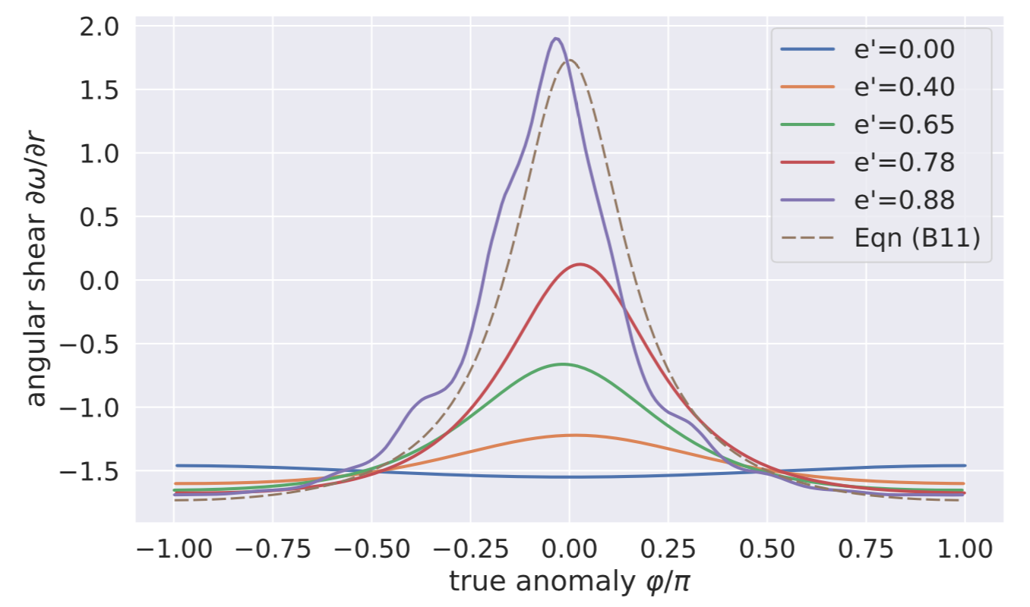
Narrow eccentric planetary ringlets are interesting & puzzling:
sharp edges
large eccentricity gradients
unknown confinement mechanism that opposes radial spreading due to ringlet viscosity
collisional friction > angular momentum flows outward > ringlet spreads radially
popular confinement mechanism:
narrow rings are straddled by a pair of unseen shepherd satellites whose gravities confine it radially (Goldreich & Tremaine 1979, Chiang & Goldreich 2000)
but Cassini failed to detect any shepherds near Saturn's narrow ringlets
Borderies et al (1982):
if eccentricity-gradient ade/da and/or periapse-twist ≳ 0.9
inner ring matter at peri travels slower than outer
frictional collisions causes angular momentum to flow inwards (not out)
angular momentum flux reversal
which motivates these N-body simulations

Slide 3
The Nbody code:
epi_int_lite (successor to epi_int, Hahn & Spitales 1993) to simulate evolution of narrow eccentric viscous gravitating ringlets:
is a symplectic streamline integrator
uses trace particles (ie arcs) track the ringlet’s streamlines, with particles responding to forces exerted by streamlines
streamlines interact as gravitating wires A_{g}=2Gλ/Δ
hydrodynamic viscosity
A_{θ}≈-(dF_{ν}/dr)/σr due to particle-particle collisions
viscous angular momentum flux F_{ν}=−νsσr²(∂ω/∂r)

Slide 4
Results from epi_int_lite simulation
ringlet = 2 streamlines
mass = 25km ice ball
initial width=10km
viscosity=2000 cm²/sec
initial eccentricity e₀=0.01 ⬅ important!
viscosity causes ringlet to spread radially ⬆
⬅ self gravity causes eccentricity gradient to grow
ringlet spreading ceases when angular momentum flux reversal is 100% complete
until nonlinerity parameter of Borderies et al (1982) ➔
q=(e-gradient² + peri-twist²)^{1/2} ≥ √3/2 ≈ 0.9

Slide 5
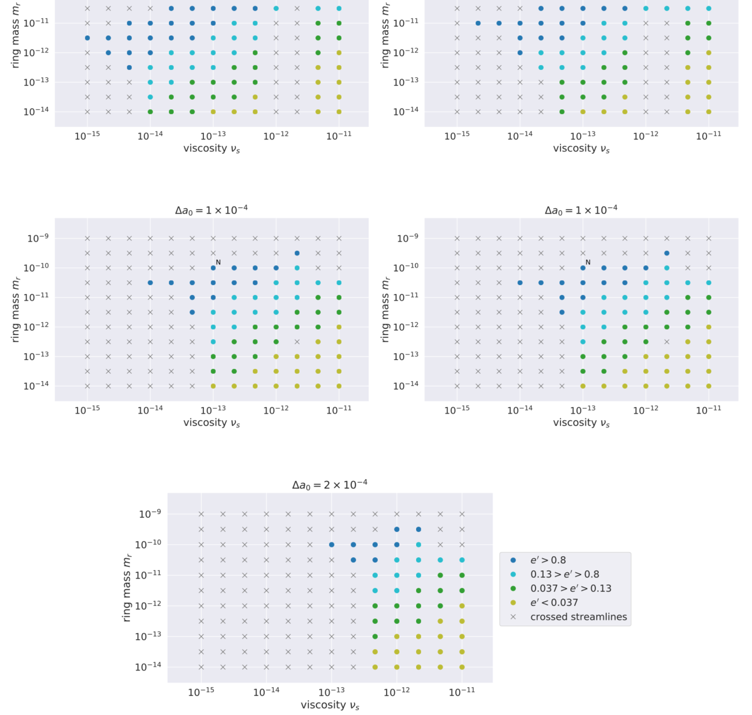
simulations show that self confinement occurs for a wide variety of initial conditions
width
mass
viscosity
eccentricity

Slide 6
self confining ringlets also have very sharp edges
due to angular momentum flux reversal
if ang.mom flows radially inwards (rather than outwards)
then ring matter gets radially concentrated (rather than spreading radially)

Slide 7
viscous friction causes ringlet’s semimajor axis a to shrink, slightly
angular momentum is conserved
so ringlet eccentricity e also shrinks
eventually ringlet’s inner edge circularizes
Nonlinearity parameter q falls below 0.9
ang.mom flux reversal ceases
self confinement is temporary
self confining ringlets are young, or
some other mechanism pump up ringlet’s m=1 eccentricity

Slide 8
Formation of self-confining narrow eccentric planetary ringlets:
We speculate that:
a sharp-edged self-confining narrow eccentric planetary ringlet first originated as an exceptionally large ring particle orbiting in a nearby dense planetary ring
aka small embedded moonlet/propeller object
(keeps everything in planet’s equatorial plane)
if embedded object is orbiting near the dense ring's edge, then
shepherding torque due to resonant interactions w/dense ring (G&T 1982) would cause moonlet to migrate towards & beyond dense ring's edge
if so, then dense ring can also birth multiple moonlets
ala Poulet & Sicardy (2001)
largest moonlet always overtakes smaller exterior moonlets
moonlet-moonlet scattering
eventual collision
if disruptive
narrow eccentric ringlet formation?
maybe…

Slide 9
other problems that epi_int_lite could be thrown at:
nonlinear spiral density waves, out of box
incompressible density waves, light modification
nonlinear spiral bending waves, modest modification
galactic spiral structure, small tweak, maybe
QR code for repo
QR code for paper

