Slide 1
Nbody Simulations of Self-Confining Narrow
Eccentric Planetary Ringlets
Joseph Hahn, SSI
Douglas Hamilton, U Maryland
Thomas Rimlinger, GSFC
Yuxi Lu, Columbia

Slide 2
Narrow eccentric planetary ringlets are interesting & puzzling:
sharp edges
large eccentricity gradients
unknown confinement mechanism that opposes radial spreading due to ringlet viscosity
collisional friction > angular momentum flows outward > ringlet spreads radially
popular confinement mechanism:
narrow rings are straddled by a pair of unseen shepherd satellites whose gravities confine it radially (Goldreich & Tremaine 1979, Chiang & Goldreich 2000)
but Cassini failed to detect any shepherds near Saturn's narrow ringlets
Borderies et al (1982):
if eccentricity-gradient ade/da and/or periapse-twist ≥ 0.87
angular momentum flows inwards
ringlet contracts radially
due to angular momentum flux reversal
which motivates these N-body simulations

Slide 3
The code:
used epi_int_lite (successor to epi_int of Hahn & Spitales 1993) to simulate evolution of narrow eccentric viscous gravitating ringlets:
epi_int_lite is a symplectic streamline integrator
uses trace particles track ringlet streamlines, with particles responding to streamline
self-gravity A_{r}≈2Gλ/Δr
viscosity, A_{θ}≈-(dFν/dr)/σr, due to particle-particle collisions
all simulated ringlets have:
specified total mass m_{r}
shear viscosity ν_{s}
initial radial width Δa
initial eccentricity e₀=0.01
orbit oblate Saturn-like planet with J₂=0.01

Slide 4
we find that, for a wide variety of initial conditions (eg m_{r}, Δa, ν_{s}):
ringlet self gravity causes its eccentricity-gradient to grow
while viscosity promotes ringlet’s periapse-twist
until q➔0.87 (ish)
at which point viscous spreading ceases and the ringlet is self-confining!
following plots shows evolution of
mass m_{r}=25 km-wide ice sphere
initial radial width Δa₀=10 km
shear viscosity ν_{s}=2000 cm²/sec

Slide 5
self-gravity causes ringlet’s outer streamline’s eccentricity to grow at the expense of inner streamline
causes the ringlet’s nonlinearity parameter to grow until q≈0.87
ringlet is then self-confining

Slide 6
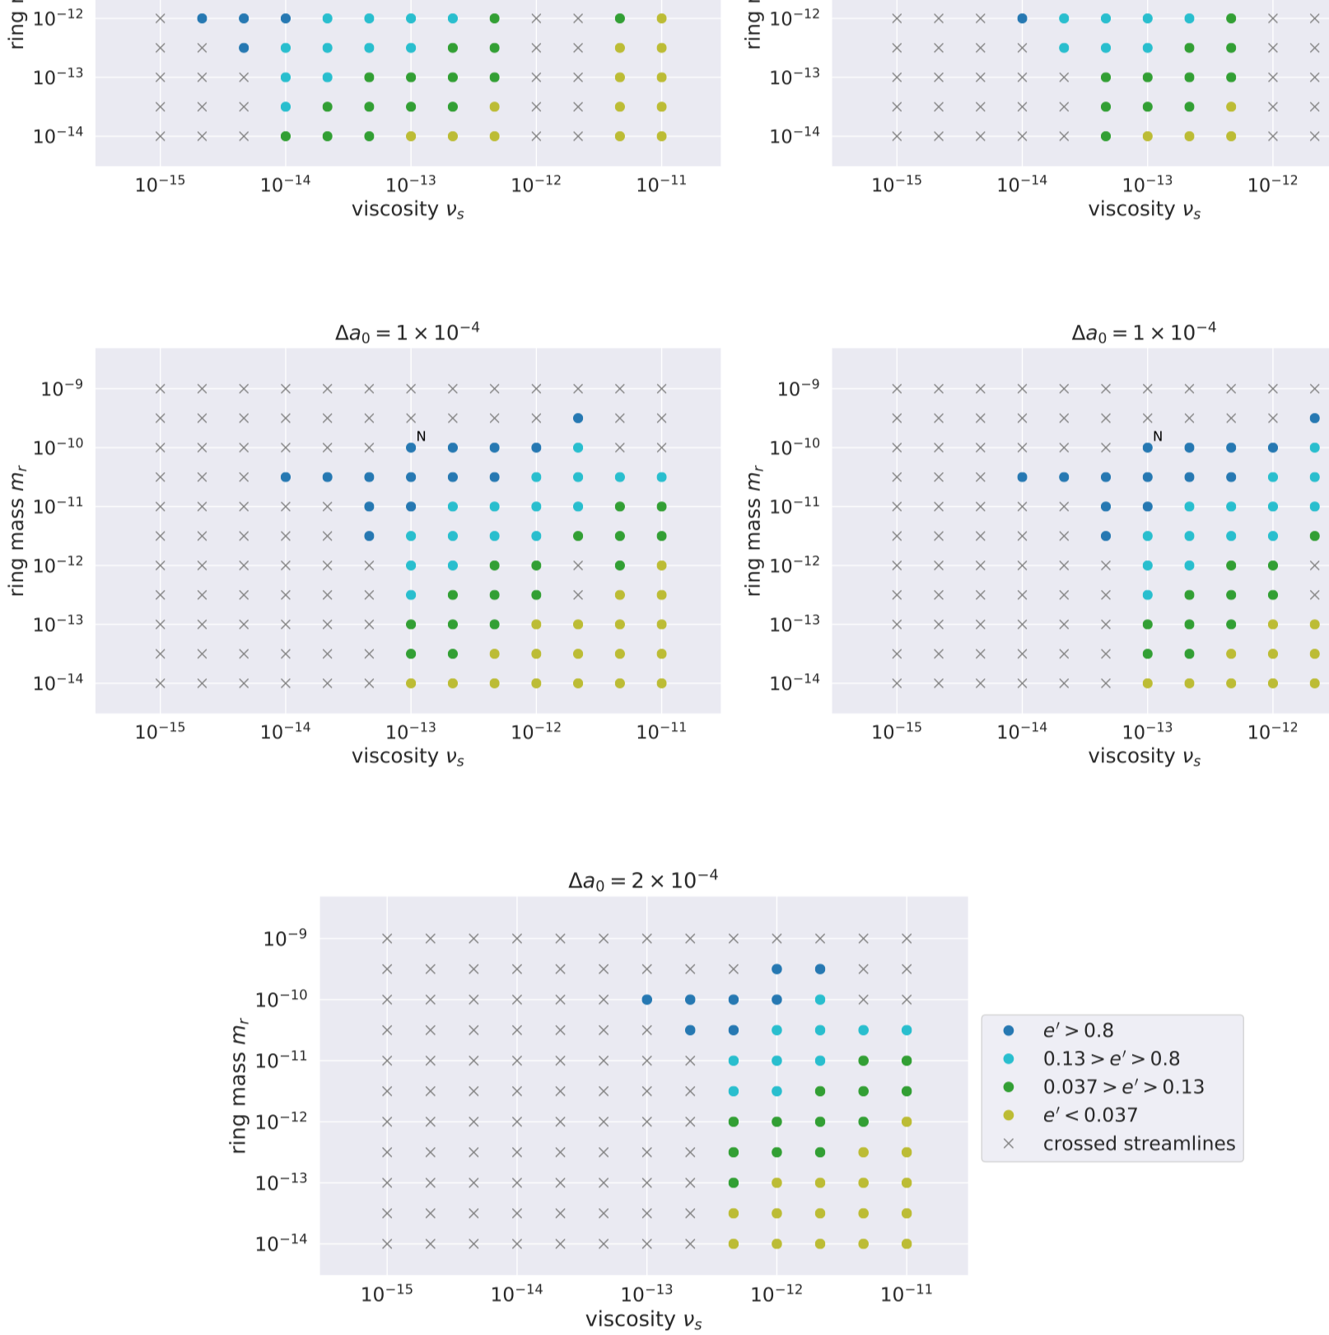
Simulations shows that self-confinement is possible for a wide variety of initial m_{r}, Δa, ν_{s} conditions

Slide 7
Main Findings:
narrow eccentric ringlets can be self-confining, shepherd satellites are not required!
in order for a viscous gravitating ringlet to evolve into q=0.87 self-confining state:
the initial ringlet must have a non-zero eccentricity in order for self-gravity to pump up ringlet’s eccentricity-gradient
ie circular ringlets stay circular, and spread forever
ringlet viscosity also damps its eccentricity (see slide 5)
which implies:
narrow eccentric ringlets are young OR
or their eccentricities are sustained by an unknown resonance
tbc

