Slide 1
Using ML to find the customers worth calling
Results from an ML pilot on 2 years of sales campaign data
Joe Hahn · ML Solutions Architect
phData ML team
jmh.datasciences@gmail.com
11 August 2026

Slide 2
what this pilot is about
— inputs: two years of sales-campaign data (41K records) tracking which customers bought the product
— training an ML model on that data to predict which customers are likely to buy, prior to any sales outreach
— goal: show how to use ML to target customers most likely to buy, & boost sales
two years of
sales history
model learns
who buys
ranked list of
who to call
sales team
closes more sales, faster
Use ML to direct the sales budget & effort at those customers more likely to say yes

Slide 3
the input data:
— csv file having several columns with obfuscated names (b1, c8, i4, etc), and no data dictionary
— AI coding assistant recognised the dataset, and we inferred the column names from the data behaviors, so we also report results vs inferred names that are marked with *
— one column c10 was a copy of the target, which we dropped since a model trained on c10 won’t predict anything
— two columns appear to contain random values, kept
— missing values arrived written four different ways: we standardised them to a common flag, so that the model can treat "not recorded" as a possible signal
— dataset is otherwise sound

Slide 4
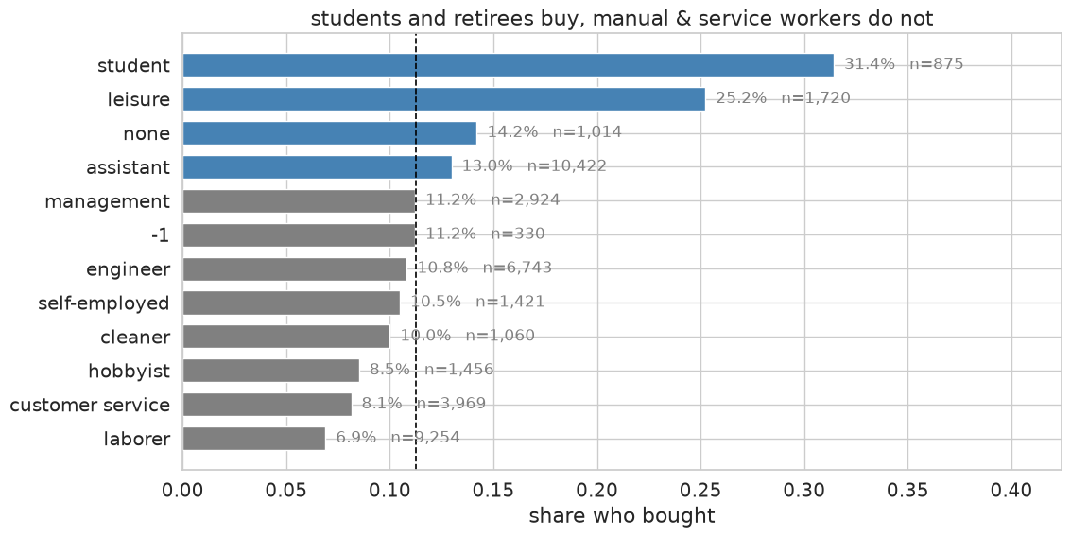
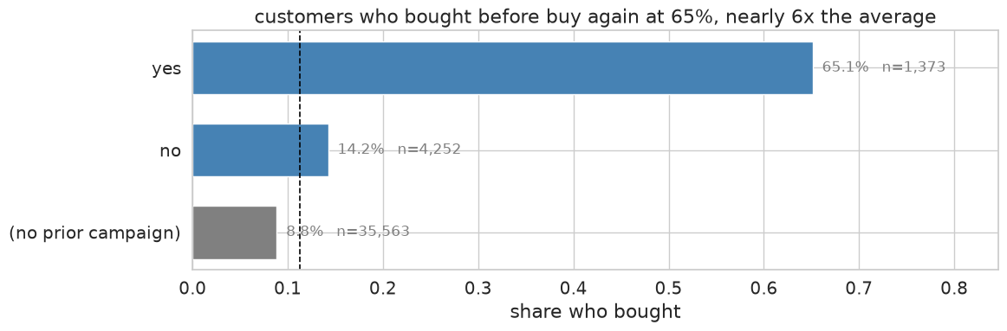
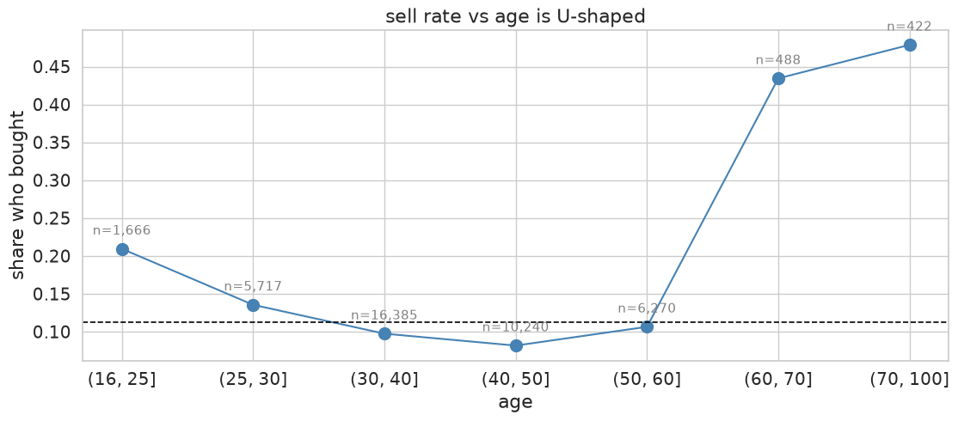
Demographics: who buys
— a customer who bought before is by far the best, 65% vs 11% overall
— students and retirees do buy, manual and service workers less so

Slide 5
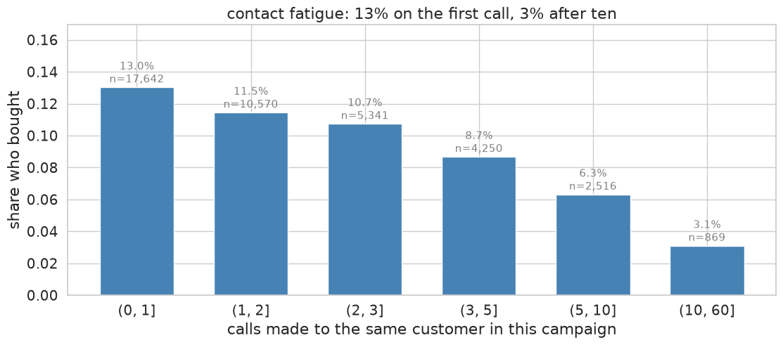
Contact fatigue, and when to stop calling
— 13% buy on the first call, 3% after ten, with no exceptions in the trend
— there is a point where another attempt costs more than it returns

Slide 6
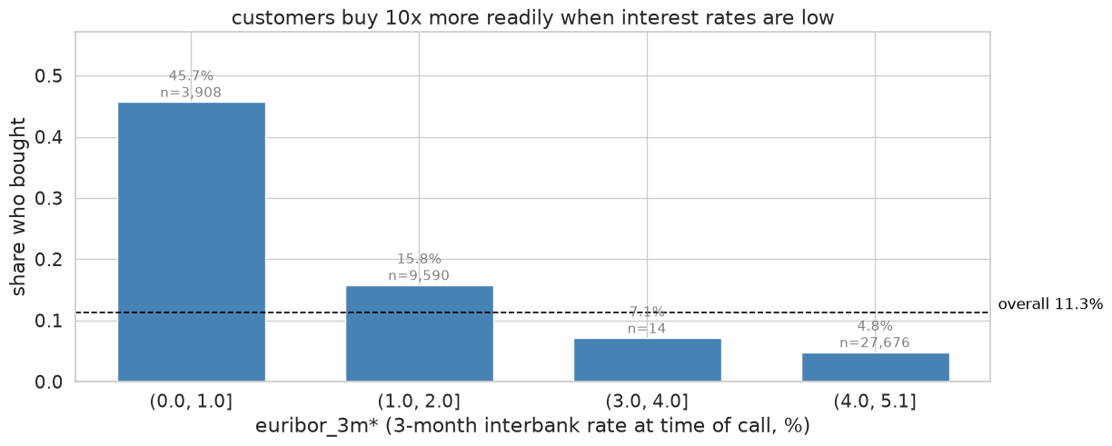
but the biggest drivers are economic (and not the customer segment)
— customers buy 10x more readily when interest rates are low (column i4 aka euribor_3m*)
— bigger than anything about the individual, so this pilot sizes the opportunity separately for good and hard markets

Slide 7
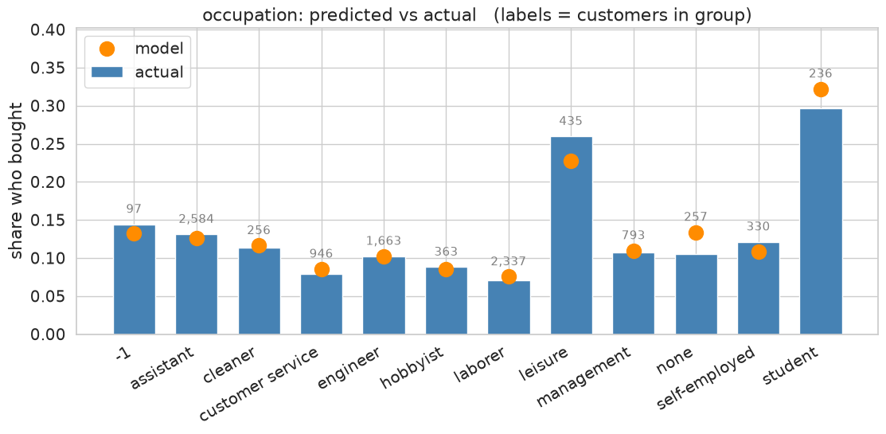
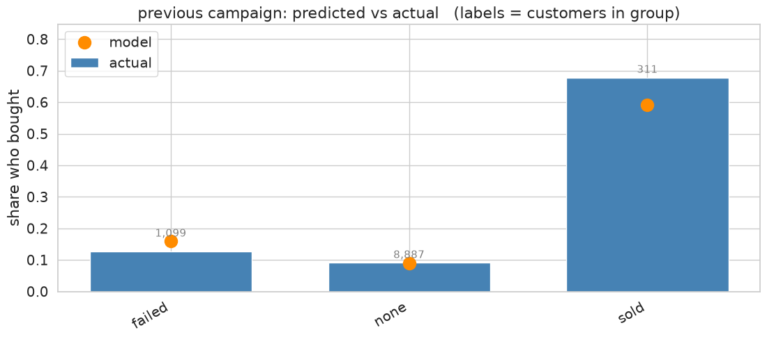
does the ML model agree with reality?
— we trained two different kinds of ML models and got equivalent results;
— predictions for gradient-boosted trees are shown here
— model metric roc_auc=0.81 on customers it had never seen, (0.5 means model is guessing while 1.0 is perfect)
— blue bars indicate what happened, dots are what the model predicted — the ML model tracks every kind of customer well

Slide 8
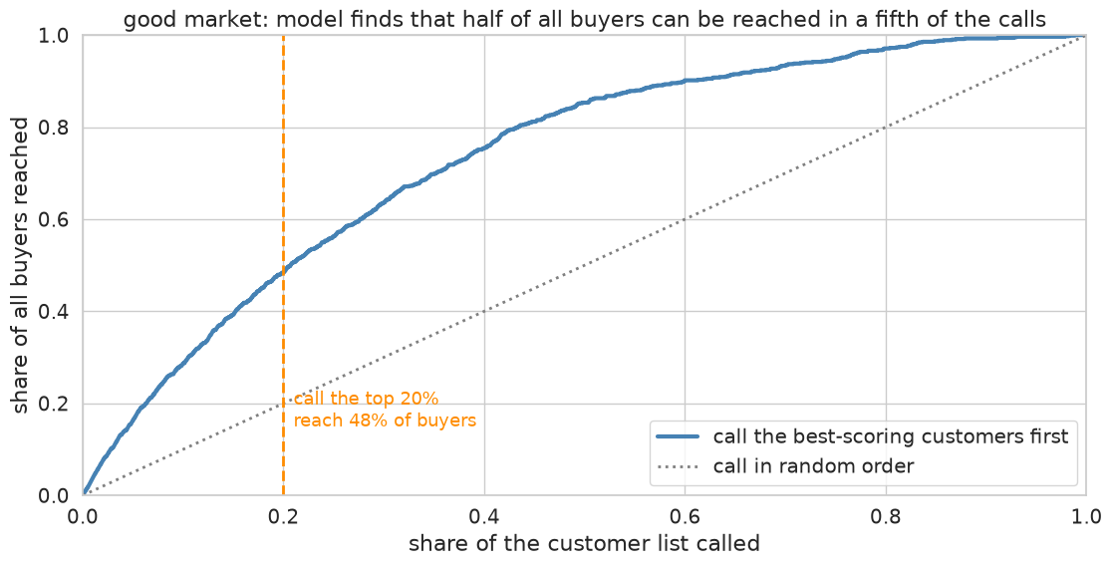
how to turn an ML score into a decision that grows revenue
— as an enterprise firm, suppose your prospect list has 2M potential customers
— the ML model scores every customer from 0 to 1, and you work down that list, beginning with the best prospects
— assumptions: $3 a contact, $80 margin on a sale, suppose your budget=$1.2M => 400,000 contacts
— these figures assume a good market, ie euribor below 2%
— use ML to reach out to the best 20% (400K) of all contacts
— which are 50% of ALL buyers
— vs 20% with no ML ie working the prospect list at random,

Slide 9
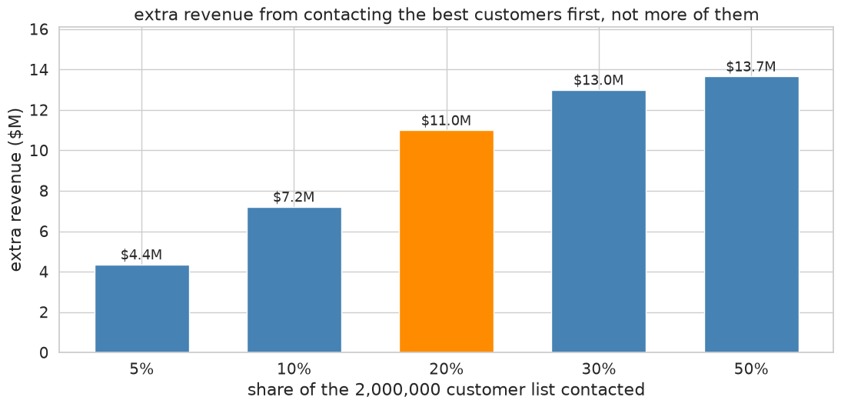
what ML is worth
— +137,000 sales, about $11M, on a 2M customer campaign in a good market: x2.4 revenue lift for the same spend
— same budget, same number of calls, ML aims your sales team at the better prospects
— $47 revenue per call with the model vs $19 without
— in a hard market ML adds only $1M (versus $11M in good times), x1.6 revenue lift, and the campaign still nets $1.4M against $0.4M without it
— that x1.6 is what keeps the campaign above water in a downturn: without ML the contact cost eats nearly all the margin

Slide 10
recommended next steps
— stand the model up next to your database and feed scored prospects to the sales team
— timestamp the records and log which rep made which call, so we can distinguish seasonal business cycles from economic drivers and investigate which sales person should handle which prospect
your customer
database
scoring VM
model + retraining
dashboard
ranked prospects
sales
team
call outcomes flow back to the database, and the model is retrained each quarter so it keeps up with the market

Slide 11
Thanks
Joe Hahn
jmh.datasciences@gmail.com

