Slide 1
"Corporate Leniency Programs and the Role of the Antitrust Authority in Detecting Collusion"
CPRC/COE Symposium:
Towards an Effective Implementation of New Competition Policy
Joseph Harrington
Johns Hopkins University

Slide 2
The process of fighting cartels
Stages
  Detection
  Prosecution
  Penalization
Role of the antitrust authority
  Penalization
    Moderate (U.S.) to Strong (Japan, E.U.)
  Prosecution
    Moderately strong (U.S.) to Strong (Japan, E.U.)
  Detection
    Weak

Slide 3
  "As a general rule, the [Antitrust] Division follows leads generated by disgruntled employees, unhappy customers, or witnesses from ongoing investigations. As such, it is very much a reactive agency with respect to the search for criminal antitrust violations." [Antitrust Bulletin, 1991]

Slide 4
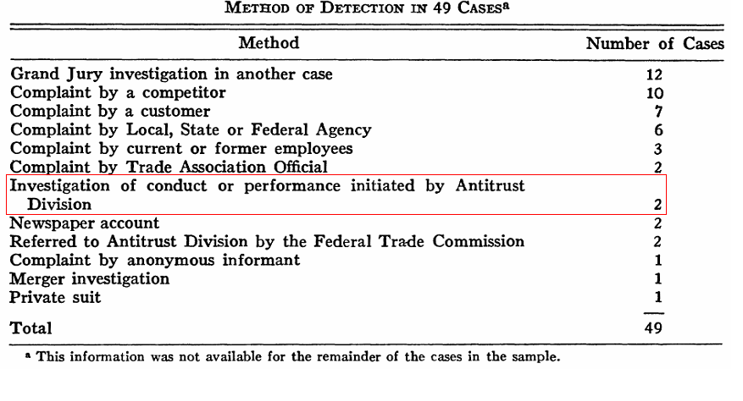
Hay and Kelley, 1974 (Data: 1963-72)

Slide 5
  Can the antitrust authorities be more active in detecting collusion?

Slide 6
Overview of talk
Comparative analysis of leniency programs.
  Design and implementation - How can they affect the incentives of firms to report?
  Measurement - How can we measure the impact of policy on the rate of collusion?
Broadening the domain of programs designed to induce the reporting of cartels.
Developing antitrust programs to "search" for cartels.

Slide 7
Design and Implementation of a Leniency Program
Objectives of a leniency program
  Prosecution – make conviction more likely
  Detection – promote discovery of cartels
  Desistance - make cartels less stable
  Deterrence - make cartels less profitable

Slide 8
Dimensions to a leniency program
  Criteria for being awarded amnesty.
    At what stage of the investigative process can leniency be received?
    How many firms can receive leniency?
    Who is eligible for leniency?
  Extent of penalties that are waived when receiving amnesty.

Slide 9
Review of Leniency Programs
U.S.
  "Full" leniency can be received
    only by the first firm
    either before or after an investigation.
  "Full" leniency involves
    all government penalties being waived
    reduction in liability for private customer damages from treble to single damages
    cartel members that did not receive leniency are liable for those unpaid double damages
  No leniency for other firms.
    Caveat: Plea bargaining

Slide 10
E.U.
  Full leniency can be received
    only by the first firm
    either before or after an investigation.
  Partial leniency can be received by as many as four firms (20-50%)
Japan
  Full leniency can be received
    only by the first firm
    only before an investigation.
  Partial leniency can be received
    by as many as two (or three) firms
    either before (30-50%) or after an investigation (30%)

Slide 11
Relative gain to reporting before an investigation
High
Japan
E.U.
U.S.
Low
Relative gain to reporting first
Low
High

Slide 12
Comparative Analysis - Introduction
Stages
  No knowledge - antitrust authority has no knowledge of collusion.
  Pre-investigation - antitrust authority has some knowledge of collusion but has not yet started an investigation
  Investigation - antitrust authority has begun an investigation

Slide 13
Coordination game faced by cartel members
  Each firm is contemplating whether or not to apply for leniency.
  There can be two solutions (or equilibria)
    "No Report" Solution: Firms do not apply for leniency.
    "Report" Solution: Firms race to report to the antitrust authority.
  Dynamics of the waiting/racing game
    Each firm does not report in the hope that other firms will do the same.
    If a firm believes it is imminent that another firm will report, it races to report.
    Policy challenge: Induce firms to stop waiting and start racing.

Slide 14
Comparative Analysis – No Knowledge Phase
Antitrust authority has no knowledge that there is a cartel.
Pertinent phase for discovering cartels.
All programs:
  Leniency is automatic.
  Leniency is full to the first firm.

Slide 15
Full corporate leniency may be inadequate to induce spontaneous reporting of collusion.
  Waiving fines may be inadequate when it means forgoing collusive profit.
  The "penalties" imposed on an employee are not waived.
    Do they suffer monetary and non-monetary penalties within the firm? Are their bonuses reduced? Are their chances for promotion harmed? Are they fired? Is their career in this industry terminated?
Consider stronger incentives - rewards.

Slide 16
Comparative Analysis – Pre-Investigation Phase
Objectives
  Stop the current collusion.
  Deter future collusion by maximizing penalties
  Trade-off associated with a leniency program:
    lowers the penalty paid by the firm that receives leniency
    raises the expected fines paid by the other cartel members

Slide 17
Race among cartel members
  Differential in leniency between being first to apply and being second is critical.
  Variation in policies
    U.S. policy seeks to maximize this differential by providing maximum leniency and no (guaranteed) leniency for later firms.
    E.U. and Japan moderate this differential by providing partial leniency to later firms.

Slide 18
  Benefit of providing leniency to more firms:
    Additional evidence aids prosecution of the remaining members of the cartel.
    How valuable is it?
      First witness surely has great value.
      Second witness can also be valuable when there is no concrete evidence.
      How typical is it for a third witness to add significantly to the prosecution's case?
  Cost of providing leniency to more firms:
    weakens the incentive to be first and thus may make firms more inclined to wait.
    reduces expected penalties by offering leniency to more firms.

Slide 19
Race between cartel members and the antitrust authority
  Differential in leniency between applying before and after an investigation is critical.
  Variation in policies
    Japan has a large differential as leniency is greatly reduced after an investigation has begun.
    U.S. moderates this differential as full leniency can be received either before or after an investigation

Slide 20
  Benefit:
    Antitrust authority can be a strategic player during the pre-investigation phase.
  Cost:
    Leniency policy creates weak incentives to apply after an investigation.
    Incentives to wait after an investigation.
      Only 30% of fines are waived.
      No differential between being first, second, and third.

Slide 21
Managing the Pre-Investigation Phase
Critical phase for the JFTC.
Once an investigation is launched, the incentive to use the leniency program is weak.

Slide 22
An antitrust authority may want to approach individual cartel members and encourage them to apply for leniency.
  Such a policy may induce reporting.
    If a cartel member is not approached by the JFTC, it might worry that another firm is being approached.
    This could induce them to preempt and apply for leniency.
  Approach smaller firms because
    it allows for the collection of more fines
    it results in higher (proportional) penalties for bigger firms and bigger firms are more likely to have initiated collusion; this serves to discourage cartel formation.

Slide 23
Timing of the start of an investigation
  Don't rush to start an investigation. Use that time to induce firms to apply for leniency.
  Consider pre-announcing the starting date of an investigation.
    Benefit: It may serve to compress the race among cartel members and induce firms to come forward.
    Cost: One loses the value of a surprise raid of company offices.

Slide 24
The Omnibus Question
At the conclusion of a witness interview under the leniency program, the U.S. Department of Justice asks:
  “Do you have any information relating to price-fixing, bid rigging, and similar activities with respect to other products in this industry or in any other industry?”
  Failure to answer the question truthfully means a loss of amnesty and perjury.
The Omnibus Question can be an effective method of detection.

Slide 25
The power of the Omnibus Question lies with the incentives it creates for the individual employee.
  Revealing collusion in other markets may cause additional financial harm to the company.
  But are the employee's interests aligned with the firm?
    An employee may have been demoted or is no longer in line for promotion.
    An employee may have been fired.
    An employee is concerned with protecting his amnesty from prison sentences and fines.
  The incentive is strong for an employee to answer truthfully.

Slide 26
Can the Omnibus Question work in Japan?
  The lack of individual penalties in Japan means this logic is not obviously applicable.
  It is unclear what the employee's status is within the company.
    Employees of Ajinomoto did not appear harmed by their role in the lysine cartel.
    An employee's future may depend on protecting the company's collusion in other markets.
  Are individual penalties present if the employee risks committing perjury?

Slide 27
Measurement of the Impact of a Leniency Program
Having instituted a leniency program, it is critical to assess its impact.
  Has it achieved the desired objectives?
  What has worked and what has not?
  How can it be improved?

Slide 28
Increased usage with revision
  U.S. experience
    Prior to 1993 revision: about one application per year.
    After 1993 revision: about two applications per month.
  E.U. experience
    From original program's inception in 1996 to 2002 revision: 16 applications.
    From 2002 revision to June 2005: 140 applications.

Slide 29
What is success?
  Is success measured by usage?
  Success is measured by the rate of collusion in the economy.
  Have leniency programs:
    increased the probability of successful prosecution?
    increased the probability of detection?
    reduced the average life span of a cartel?
    reduced the number of cartels?

Slide 30
Fundamental data problem
  To measure the effect on the number of cartels requires observing the population of cartels.
  Since collusion is illegal, cartels hide themselves.
  We observe only the population of discovered cartels.

Slide 31
  Inference problems
    Suppose the leniency program does result in a higher rate of detection.
    Holding fixed the number of cartels, we ought to see more discovered cartels.
    But suppose this higher rate of detection causes there to be fewer cartels.
    The net effect on the number of discovered cartels is then ambiguous.
    A program can be having the desired effect but there is no measurable impact on the number of discovered cartels.
    Or the lack of a measurable impact may reveal the leniency program is not working.

Slide 32
Developing indirect measures
  Efficacy of a policy may be reflected in the duration of discovered cartels.
  Prediction: If the leniency policy is working then cartel duration should go up in the short-run but down in the long-run.

Slide 33
  Explanation
    In response to a more aggressive policy, cartels with traits that make them marginally stable will collapse on their own and thereby avoid discovery.
    The remaining population of cartels is then comprised of relatively more stable cartels which means they have higher duration.
    The duration of discovered cartels goes up if the new policy is effective.
    In the long-run, cartel duration is shorter because newly formed cartels are less stable.
  We need to develop methods for indirectly assessing the impact of government programs on the underlying rate of cartel formation.

Slide 34
Broadening the Domain of Leniency Programs
Introduction
  A leniency program is designed to induce those people with the best information about collusion - the cartel members themselves - to report.
  Next step: Develop programs to induce other people who have information to report it to the antitrust authority.
  Candidates
    Buyers
    Employees of the colluding firms who are not involved in the conspiracy
    Competing firms who are not members of the cartel

Slide 35
Buyers
  In many cartels, buyers are not final consumers but rather industrial buyers.
  Industrial buyers have very good information.
  Suspicions might arise because:
    prices are steadily rising and cost and demand factors cannot explain the price increases.
    some suppliers are no longer willing to bid for their business (as part of a customer allocation scheme).
    firms' price changes are much more coordinated; now, firms change their prices within a few days of each other.

Slide 36
  If a buyer does suspect, wouldn't they necessarily report it to the antitrust authorities? What is the need for policies designed to encourage it?
    Benefit from reporting suspected collusion: lower input prices
    Cost from reporting suspected collusion:
      less cooperative business relationship with suppliers.
      presenting a convincing case to the antitrust authority
    Free-riding leads to underreporting.
      A buyer who reports benefits all buyers with lower prices.
      Only that buyer incurs the cost.
    Consider financial rewards to buyers
      Individual - an employee of the company buying inputs from a cartel.
      Corporate - the company for which that employee works.
    A reward scheme might replicate the financial benefit in the U.S. from private customer damages.

Slide 37
Uninvolved company employees
  Sales representatives
    They witness the change in prices.
    They might be instructed not to compete aggressively.
      Not to bid for some company's business (as part of a customer allocation scheme).
      Not to deviate from the price list even when business will be lost.
  Administrative staff
      Observes suspicious expenses.
      Notices that a manager personally handles certain appointments.

Slide 38
  Examples (European Commission decisions)
    Fine arts auctions cartel
      “Sotheby's submits that some of its personnel commented that they had a “feeling” that the introduction of the fixed vendor's commission structure may have arisen out of some sort of understanding with Christie's. Such suspicions were supported by the fact that London had given strict instructions not to depart from the published commission structure and to monitor and report to senior management any discounts offered by Christie's in contravention of its published rates.”
    Carbonless paper cartel
      “A Sappi employee admits that he had very strong suspicions that two fellow employees had been to meetings with competitors. He recollects that they would come back from trade association meetings with a very definite view on the price increases that were to be implemented and that they were relatively unconcerned by competitor reactions.”

Slide 39
  Challenge: Motivating employees to report to the antitrust authority.
    If accusations are not substantiated by the antitrust authority, an employee's superior has considerable range to punish.
    Reporting to the government could be construed as being disloyal to the company.
  Proposal: Design a policy whereby not only the individual benefits financially but also the company.
    Provide financial rewards to the employee.
    Provide the company with the opportunity to receive full leniency (under the usual conditions).
    The employee might be perceived as acting in the firm's best interests and avoid sanctions within the firm.

Slide 40
Non-cartel Competitors
  A firm who competes in this market but is not a member of the cartel has access to information that might lead to suspicions about collusion.
  Is there a role for policy here?
  A non-cartel member may be significantly benefited by collusion.
    If its competitors restrain supply and raise prices, a firm can earn high profits by undercutting its rivals' prices and expanding supply.
    The prospect of foregoing these high profits will make it difficult to induce them to report.

Slide 41
  A non-cartel member may be significantly harmed by collusion.
    Hay and Kelley (1974) found that 20% of cartels were discovered by a complaint by a competitor.
    The cartel may act in an anti-competitive manner against these firms so as to limit their supply.
      Buying up input
      Selective price wars to induce them to exit
    The prospect of ending this aggressive behavior will induce them to report.
    What is the need for further inducements?

Slide 42
Programs inducing buyers and uninvolved employees to report their suspicions are complementary to leniency programs.
  These programs can shift the antitrust authority from the No Knowledge phase to the Pre-Investigation phase.
  The creation of suspicions at the antitrust authority causes firms to enter the waiting/racing game.

Slide 43
Screening for Cartels
Developing a more active role for an antitrust authority in detecting cartels.
Screening - objective is to identify markets where collusion is suspected.

Slide 44
Structural approach to screening
  A structural approach identifies markets with traits conducive to the formation of a cartel.
  Factors conducive to cartel formation include:
    fewer firms
    more homogeneous products
    less volatile demand
    more excess capacity
  Problem of too many false positives
    Imagine the "ideal" market for collusion: two firms, homogeneous products, stable demand, no large buyers, excess capacity, …
    In practice, only a small fraction of such markets probably have cartels.
    The reason is that there are many omitted (unmeasured) factors that influence whether a cartel forms.

Slide 45
Behavioral approach to screening
  A structural approach is based on data about the industry which makes it more likely that a cartel will form.
  A behavioral approach uses data that may itself be evidence that a cartel has formed.
  Approaches
    Identify the means of coordination - evidence of direct communication.
    Identify the end result of that coordination - firms' prices or quantities or some other aspect of market behavior.

Slide 46
Consider an antitrust authority pursuing a behavioral screening approach using market data.
  Criteria for systematic and ubiquitous screening.
    Screen only uses prices, market shares, and other easily available data.
    Screen is routinizable so that it can be conducted with minimal human input.
    Screen is difficult for the cartel to avoid.
  Methods
    Identify collusive markers
    Identify a structural break in the market data-generating process

Slide 47
Identify collusive markers
  Examples of collusive markers:
    a firm's market share is strongly negatively correlated over time.
    market shares are highly stable.
    prices are strongly positively correlated across firms.
    variance of price is low.
  Example: Variance of price
    Variance of price is relatively low when firms collude (Harrington and Chen - U. of Tokyo, 2005)
    Frozen perch - price variance was lower during the cartel phase compared to the post-cartel phase (excluding the transition period)

Slide 48
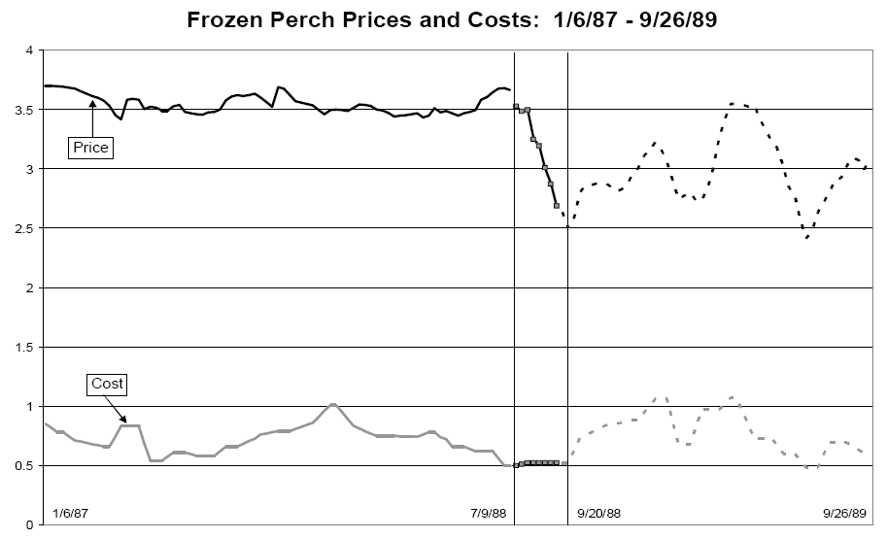
Collusion and the Variance of Price
(Abrantes-Metz, Froeb, Geweke, and Taylor, 2005)

Slide 49
Identify a structural break in the market data-generating process
  Collusion necessarily entails a change in the data-generating process with respect to price and market share.
    This change can be abrupt and, in principle, detectable.
    It can be associated with the formation of a cartel but also its demise.

Slide 50
  Examples
    Has average price changed?
    Has the relationship between a firm's price and cost changed?
    Has the relationship among firms' prices changed?
    Has the variance of price and market share changed?
  Example: Price-cost margin of Nasdaq market-makers

Slide 51
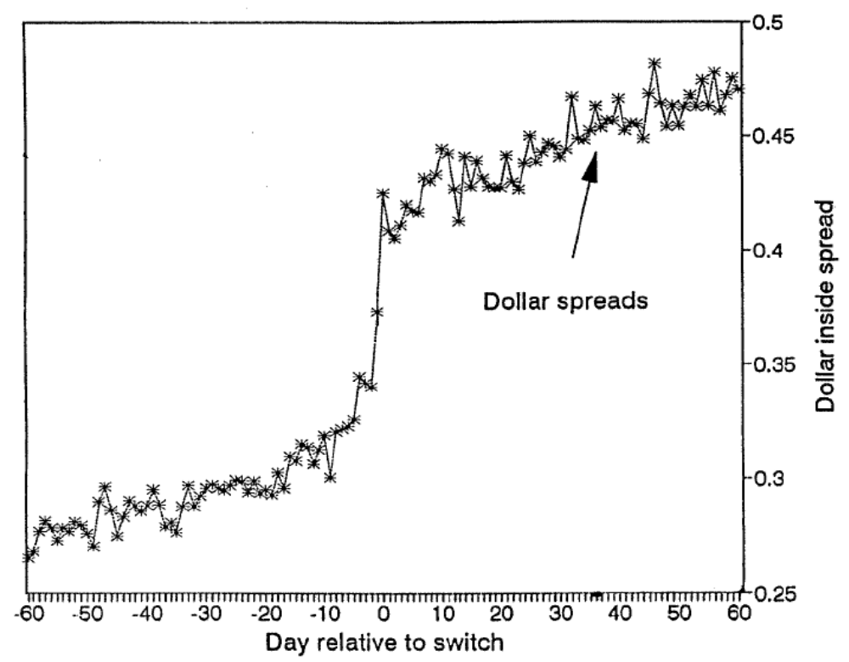
Collusion and Bid-Ask Spreads
(Christie and Schultz, 1999)

Slide 52
Why engage in screening when there is a leniency program?
  Leniency programs may not be effective when there are no suspicions about collusion.
  Screening can create those suspicions.
  Identifying an industry for possible investigation could well induce a race among cartel members to apply for leniency.
  A screening program and a leniency program are complements not substitutes.

Slide 53
Some initial steps toward screening
  Screen government procurement contracts
  Screen past offenders
    Recidivism is serious.
      Collusion may re-emerge in a market or a company may be colluding in other markets.
      Over 1993-2002, 10.2% of Japanese cases involved firms previously sanctioned (Suwazono, 2005)
    Impose behavioral remedies to aid in screening.
      Require the provision of price data by convicted firms which can then be screened.
      Periodically cross-check information with buyers to confirm its authenticity.

Slide 54
A Selection of Suggestions
Manage the pre-investigation phase so as to induce cartel members to apply for leniency.
Measure the impact of the leniency program on the rate of collusion in the economy.
Develop programs to encourage buyers and uninvolved company employees to report.
Screen government purchases for collusion.
Require price data from past offenders and screen it for collusion.
Collect and disseminate information about cartels.

