Slide 1
Orchestrated AI Teams: The Future of Research Excellence
Joe Hays, NRL Code 8234

Slide 2
Executive Summary
Critical Decision: Embrace orchestrated AI or risk irrelevance
The Progression: - 🚗 Traditional PhD = Corvette (baseline) - 🏎️ PhD + LLM Chat = Formula 1 (21-26% faster) - ✈️ PhD + Coding Agents = Cessna (40-55% faster) - 🚀 PhD + Manual Orchestration = Fighter Jet (100-150% faster) - 🛸 PhD + LangGraph = Starship Enterprise (200-400% faster)
The Ask:
  Primary: Commit to organizational investment in orchestrated AI
  Secondary: Consider MARS as the platform
Evidence: Peer-reviewed 2024 studies show transformational gains

Slide 3
Table of Contents
Part 1: The Existential Challenge
Part 2: The AI Acceleration Ladder
Part 3: Technology Primer
Part 4: The Opportunity
Part 5: MARS Prototype Solution
Appendices

Slide 4
Part 1: The Existential Challenge

Slide 5
The Research Acceleration Crisis
The Numbers: - Daily output: ~9,700 STEM papers/day - Human capacity: 2-3 papers/day - Coverage: <1%
Core Advantage:
Researchers + orchestrated AI = 2-5× faster from idea to publication
Why Speed Matters: - First-mover advantage - Compounding returns - Talent retention - Resource efficiency (2× speed = 50% cost per result)

Slide 6
The Information Overload Gap
Daily Papers: 9,700 published Human Capacity: 2-3 readable Coverage: <1%
Result: Missing 99% of relevant breakthroughs

Slide 7
What Happens Without Adaptation
Historical Parallels (2024):
Software Development: - ✅ AI-augmented: 40-55% ↑ - ❌ Traditional: Talent loss
Professional Services: - ✅ AI-augmented: 30-40% ↑ - ❌ Traditional: Losing bids
Research Sector (emerging): - ✅ AI-augmented: 2-3× publications - ❌ Traditional: Falling citations - ❌ Grants: “missed work” penalties
Timeline: 12-18 months before gap becomes irreversible

Slide 8
The Widening Gap
WITH Orchestrated AI: - 90%+ literature coverage - 3-5× faster breakthroughs - Top talent attraction
WITHOUT: - Perpetually “catching up” - Declining grant success - Talent drain
Critical Window: We are at Month 6-8 of 18-month window

Slide 9
The Competitor Landscape
Who’s Already Moving (2024):

Slide 10
Sector | Organizations | Status
Government | DARPA, DOE Labs, NIST | Deployed 2024
Academic | MIT, Stanford, Berkeley | Scaling pilots
Private | DeepMind, Microsoft Research | Production
Defense | Lockheed, Boeing, Northrop | Deployed 2023-24

Slide 11
What They’re Building: Literature monitoring, knowledge graphs, experiment design, orchestration layer ← Key differentiator

Slide 12
Part 2: The AI Acceleration Ladder

Slide 13
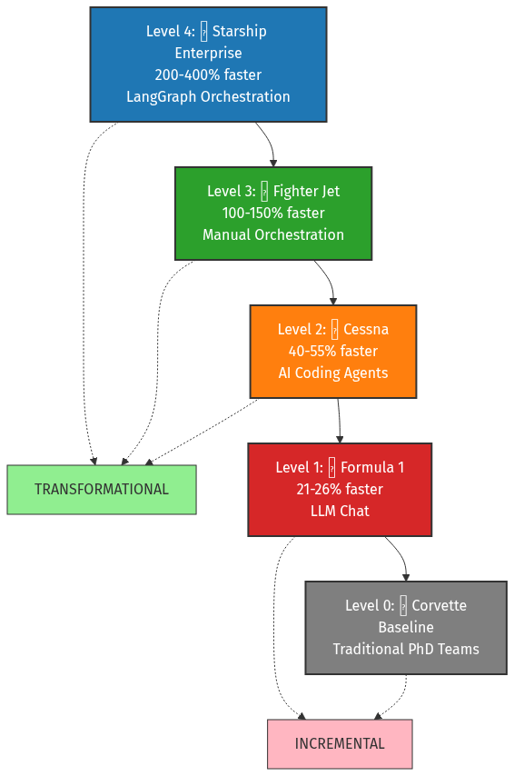
The Five Levels: Visual Overview
AI Acceleration Ladder

Slide 14
Level 0: Traditional PhD Teams (Corvette)
Time Allocation: - High-Value Analysis: 30% (12 hrs) - Literature Review: 20% (8 hrs) - Writing/Docs: 30% (12 hrs) - Experiment Setup: 20% (8 hrs)
Problem: Only 30% on breakthrough work
Baseline Metrics: - Literature coverage: <5% - Publication velocity: 1× - Team effective size: 1× headcount
Constraints: - Fixed human reading speed - 24-hour days - Biological limits

Slide 15
Level 1: PhD + LLM Chat (Formula 1)
Tools: ChatGPT, Claude, Gemini
Evidence (2024): - Google: 21% faster - GitHub Copilot: 26% productivity ↑
Improved: - Routine tasks: +21-26% - High-value time: ~35-38% - Publication: 1.15-1.20×
Limitations: - ❌ No memory between sessions - ❌ No tool integration - ❌ Manual coordination - ❌ Copy-paste overhead
Use Case: Simple Q&A, one-off tasks

Slide 16
Level 2: PhD + AI Coding Agents (Cessna)
Tools: Claude Code CLI, GitHub Copilot, Cursor, Devin
Key: Agents execute, not just advise
Evidence (2024): - Science: 40% faster, 18% higher quality - GitHub: 55.8% speed ↑ - Capgemini: 30-40% time ↓
Improved: - Coding speed: 1.75-2.00× - High-value time: 45-50% - Publication: 1.40-1.60× - Code quality: +18%
Capabilities: - Autonomous execution - Tool integration - Error recovery

Slide 17
Level 3: PhD + Manual Orchestration (Fighter Jet)
Architecture: Multiple specialized agents in parallel
Example:
Sequential (13 hrs): - Lit Review → Code → Test → Docs - 4 hrs → 6 hrs → 2 hrs → 1 hr
Parallel (8 hrs): - Agent A: Lit (4 hrs) - Agent B: Code (6 hrs) } → Merge (2 hrs) - Agent C: Test (2 hrs) - Agent D: Docs (1 hr)
38% faster
Improved: - Parallel: 3-5 tasks simultaneous - High-value time: 60-65% - Publication: 2.00-2.50×
Limitations: - ❌ 3-4 hrs/day coordination - ❌ Human bottleneck (max 3-5) - ❌ Manual integration - ❌ Exhausting after 2-3 hours

Slide 18
Level 4: PhD + LangGraph (Starship Enterprise)
Key: Automated coordination
Evidence (2024): - McKinsey: 30-40% gains beyond single-agent - BCG: 45% margin ↑ - Total: 200-400% vs. baseline
Improved: - Overhead: 3-4 hrs/day → 30 min - Parallel: 10-20+ tasks - High-value time: 75-80% - Publication: 3.00-5.00× - Coverage: 90%+
Difference: Orchestrator handles coordination, human provides strategy only

Slide 19
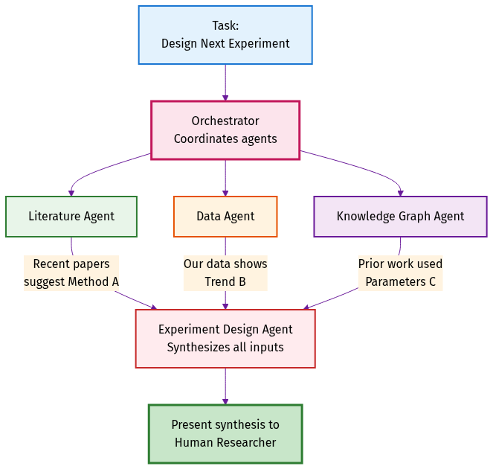
Orchestration Architecture
Orchestration Flow

Slide 20
Orchestrator’s Job: 1. Decompose complex task → subtasks 2. Assign to specialized agents 3. Route information between agents 4. Synthesize outputs 5. Escalate strategic decisions

Slide 21
Evidence Summary: 2024 Studies
Level | Gain | Source Quality | Sample Size
Level 1 (Chat) | +21-26% | High (peer-reviewed) | 4,000+
Level 2 (Agents) | +40-55% | High (peer-reviewed) | 1,000+
Level 3 (Manual) | +100-150% | Medium (case studies) | <100
Level 4 (LangGraph) | +200-400% | Medium (industry) | <50

Slide 22
Key Studies: GitHub Copilot RCT, Science Magazine, McKinsey, BCG
Takeaway: Even conservative estimates show transformational gains

Slide 23
Part 2.7: Concrete Use Cases

Slide 24
What Orchestrated AI Can Do For You
Purpose: Ground the discussion in practical, real-world capabilities
Today (6 operational): - Literature management (85-90% savings) - Documentation automation (75-85% savings) - Knowledge graph tracking - Experiment logging (90% savings) - Semantic code search - Diagram generation (83-90% savings)
Q1-Q2 2025 (7 planned): - Literature surveillance (90%+ coverage) - Gap analysis - Research orchestration - Plan authoring - Code development (95% accuracy) - Codebase analysis - Documentation maturity
Note: This is just the beginning—new capabilities added in 3-7 weeks

Slide 25
Operational: Literature Management
Think of this as your personal librarian
What it does: - Find papers (topic, author, date) - Organize in collections - Cite properly (APA, IEEE, etc.) - Summarize (AI reads 20-30 papers)
Example: Battery electrode proposal
  Traditional: 20-25 hrs
  With MARS: 2-3 hrs
  Savings: 85-90%
You: Describe what you need MARS: Finds, reads, summarizes with citations

Slide 26
Operational: Documentation Automation
Think of this as a technical writer that never sleeps
What it does: - Generate docs from code - Add citations to papers - Create diagrams (architecture) - Check links, gaps - Format to standards
Example: New algorithm docs
  Traditional: 8-12 hrs
  With MARS: 1-2 hrs (review)
  Savings: 75-85%
You: Write the code MARS: Documents, cites, diagrams

Slide 27
Operational: Knowledge Graph
Think of this as a research detective
What it does: - Trace paper → decision - Connect requirement → result - Discover cross-domain links - Preserve institutional knowledge - Answer “why this choice?”
Example: “Which paper inspired this?”
MARS shows: - Paper A → Requirement B - Requirement B → Design C - Design C → Experiment D - Experiment D → Result E
Survives personnel turnover

Slide 28
Operational: Experiment Tracking
Think of this as a lab notebook that writes itself
What it does: - Log parameters, settings - Record results, metrics - Timestamp with provenance - Store searchable format - Enable perfect reproducibility
Example: 50 experiments, 6 months later
You: “Reproduce experiment #23” MARS: All parameters recorded - Same settings - Same data - Same environment - Success: First try
Savings: 90% time on tracking

Slide 29
Operational: Semantic Search
Think of this as search that understands meaning
What it does: - Understand intent, not keywords - Find different terminology - Reduce AI context 40% - Remember across sessions - Ground in codebase (fewer hallucinations)
Example: “Where do we handle authentication errors?”
Keyword search: Misses handle_auth_failure MARS semantic: Finds it (same meaning)
Benefits: - Faster results - Lower costs - Better accuracy

Slide 30
Operational: Diagram Generation
Think of this as an artist who draws what you describe
What it does: - Generate SysML/UML diagrams - Render publication-quality - Update when system changes - Maintain consistent notation - Version with code (git)
Example: “Sensor data flow diagram”
  Traditional: 3-5 hrs (PowerPoint)
  With MARS: 15 min
  Savings: 83-90%
You: Describe in English MARS: Professional diagram

Slide 31
Planned: Literature Surveillance
Think of this as a 24/7 news alert service
What it does (nightly): - Monitor arXiv, PubMed, journals - Scan 9,700+ papers/day - Filter to 10-15 relevant - Summarize with AI - Alert each morning
Example: “Lithium batteries” interest
Morning digest: - 47 battery papers published - 8 most relevant highlighted - AI summaries for each
Coverage: 90%+ vs. <5% manual You sleep: MARS watches

Slide 32
Planned: Gap Analysis
Think of this as a research consultant
What it does: - Analyze hundreds of papers - Identify untried approaches - Recommend background reading - Suggest citations - Connect cross-domain ideas
Example: “What haven’t we tried for battery capacity?”
MARS analyzes 500 papers: - 3 unexplored approaches - 12 papers to read - Citation recommendations
Traditional: Weeks of manual review

Slide 33
Planned: Research Orchestration
Think of this as a project manager
What it does: - Decompose goal → phases - Assign tasks to agents - Coordinate collaboration - Alert at decision points - Track and adapt
Example: “Develop new electrode material”
MARS breaks down: 1. Literature review 2. Simulation 3. Synthesis 4. Testing
You: Review milestones, decide strategy Agents: Execute tasks

Slide 34
Planned: Plan Authoring
Think of this as a grant writer
What it does: - Query literature - Generate plan (milestones, methods) - Include expected outcomes - Format to template - Draft complete sections
Example: Research funding proposal
You: High-level goals MARS: 10-page plan - Background - Methods - Timeline - Outcomes
You refine: Days vs. weeks

Slide 35
Planned: Code Development
Think of this as a programmer following blueprints
What it does: - Generate formal spec - Review spec with you - Implement from spec (95% accuracy) - Write tests - Validate correctness
Example: “Process sensor data, filter noise, detect anomalies”
You write: 2-page spec MARS: - Generates code - Writes tests - Validates
You: Review spec + final code

Slide 36
Planned: Codebase Analysis
Think of this as a tour guide for code
What it does: - Analyze structure - Generate diagrams - Explain in plain English - Answer implementation questions - Reduce learning time (days → hrs)
Example: 50,000-line inherited codebase
You: “How does authentication work?” MARS: - Sequence diagram - Component explanations - Flow walkthrough
Learning: 30 min vs. 2 days

Slide 37
Planned: Documentation Maturity
Think of this as a copy editor
What it does: - Scan all documents - Detect gaps, broken links - Generate drafts - Update citations (Zotero) - Produce publication-ready
Example: 50 project documents, incomplete
MARS: - 15 missing sections identified - 12 drafts generated - 47 broken links fixed - All citations updated
You: Review vs. weeks tracking

Slide 38
Future: Robotics Integration
Think of this as a robotics engineer you talk to
What it will do: - Collect ROS2 sensor data - Preprocess datasets - Submit GPU training jobs - Validate in simulation - Deploy to robot hardware
Example: “Train navigation policy from yesterday’s data”
One sentence → - Find ROS2 bags - Preprocess - Train (4 GPUs, 8 hrs) - Test (Isaac-Lab) - Deploy
Reduction: 80% manual Python coding

Slide 39
Future: HPC Workflows
Think of this as a supercomputer scheduler
What it will do: - Design pipelines - Schedule jobs (SLURM) - Monitor progress - Optimize resources - Alert when ready
Example: 1,000 simulations (parameter sweep)
You describe what you want MARS: - Nextflow/Snakemake setup - Job scheduling - Progress monitoring - Results notification
No scripts, no babysitting

Slide 40
What This Means For You: Summary
Today (6 operational): - 85-90% time savings (literature) - 75-85% reduction (docs) - Perfect reproducibility - Institutional memory
Q1-Q2 2025 (7 v1.0): - 90%+ literature coverage - Multi-month orchestration - 95% code accuracy - Publication-grade docs
Future (2+ expansion): - Robotics workflows (80% reduction) - HPC pipelines (conversational) - Your domain needs (3-7 weeks)
Key Insight: > Every research group will discover 5-10 new use cases we haven’t imagined yet
Platform grows with your needs

Slide 41
Part 3: Technology Primer

Slide 42
What is an LLM?
Simple: Pattern-matching engine trained on billions of pages
Think: Research assistant who read every paper ever written
How: 1. Trained on billions of pages 2. Learns patterns 3. Predicts next words 4. Result: Human-like text
Good At ✅: - Summarization, translation - Q&A, code generation - Pattern recognition
Not Good At ❌: - Original discovery - Precise calculation - Long-term memory - Tool use (basic LLMs)

Slide 43
The Memory Ladder
The Progression: - 📝 Level 0: Post-It Notes (ChatGPT - no memory) - 📓 Level 1: Personal Notebook (session only) - 📖 Level 2: Reference Manual (CLAUDE.md - static context) - 🗂️ Level 3: Card Catalog (RAG/semantic search) - 📚 Level 4: Cross-References (knowledge graphs) - 🏫 Level 5: University Library (OpenMemory - learns) - 🏛️ Level 6: Library of Congress (institutional memory)

Slide 44
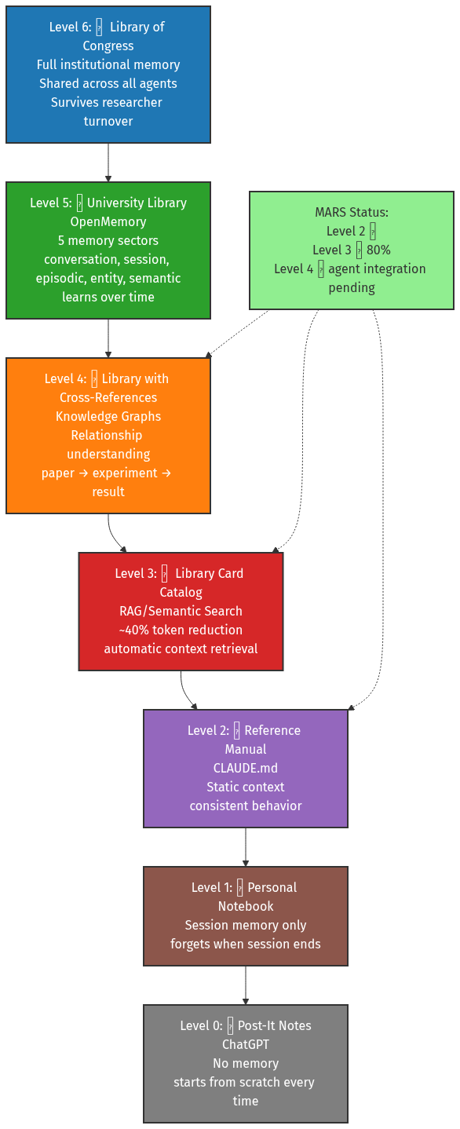
Memory Ladder

Slide 45
Level 0: Post-It Notes (ChatGPT)
📝 The Analogy: Post-It notes you throw away after each conversation
Characteristics: - No memory between conversations - Starts from scratch every time - No context preservation - Must re-explain everything
Example: ChatGPT basic chat - You: “I’m working on battery research” - Close browser - You: “What were we discussing?” - ChatGPT: “I don’t recall previous conversations”
Why This Level: Stateless interaction, no persistence

Slide 46
Level 1: Personal Notebook (Session Memory)
📓 The Analogy: Notebook that disappears when you close it
Characteristics: - Session memory only - Remembers within single conversation - Forgets when session ends - No cross-session learning
Example: ChatGPT with conversation history - You: “I’m researching lithium batteries” - Later in same session - You: “What are the challenges we discussed?” - ChatGPT: “The lithium battery challenges you mentioned were…” - Close browser → memory lost
Improved vs Level 0: Within-session context, but still ephemeral

Slide 47
Level 2: Reference Manual (CLAUDE.md)
📖 The Analogy: Operations manual everyone reads before starting
Characteristics: - Static context loaded at session start - Consistent behavior across sessions - Project-specific knowledge - No learning or adaptation
Example: MARS CLAUDE.md - Every Claude Code session reads CLAUDE.md - Knows MARS structure, commands, policies - Behavior consistent across all sessions - But: doesn’t remember YOUR previous work
MARS Status: ✅ Level 2 Complete (CLAUDE.md + policy bundles)

Slide 48
Level 3: Library Card Catalog (RAG/Semantic Search)
🗂️ The Analogy: Library where you can find any book by topic
Characteristics: - RAG/Semantic Search (~40% token reduction) - Automatic context retrieval - Searches by meaning, not keywords - Finds relevant information on-demand
Example: MARS claude-context MCP - You: “Where do we handle authentication?” - MARS searches codebase semantically - Retrieves relevant code sections automatically - No need to remember exact file paths
MARS Status: ⏳ 80% Complete (infrastructure ready, blocked by upstream bug)

Slide 49
Level 4: Library with Cross-References (Knowledge Graphs)
📚 The Analogy: Library where books reference each other with annotations
Characteristics: - Knowledge Graphs (Neo4j) - Relationship understanding - Traces paper → requirement → experiment → result - Cross-domain connection discovery
Example: MARS Knowledge Graph - You: “Which paper inspired this design decision?” - MARS: “Paper A (2023) → Requirement B → Design C → Experiment D” - Preserves institutional knowledge - Survives researcher turnover
MARS Status: ✅ Infrastructure Complete (agent integration pending)

Slide 50
Level 5: University Library (OpenMemory)
🏫 The Analogy: University library that learns your research interests
Characteristics: - OpenMemory architecture (5 memory sectors) - Conversation: What you just said - Session: This work session’s context - Episodic: Past project milestones - Entity: People, papers, concepts - Semantic: General knowledge learned
Example: Multi-month research project - Remembers your research goals - Tracks ongoing experiments - Recalls past decisions and why - Learns your preferences over time
MARS Status: ⏸️ Planned v1.5+ (4-6 weeks implementation)

Slide 51
Level 6: Library of Congress (Full Institutional Memory)
🏛️ The Analogy: National library preserving all institutional knowledge
Characteristics: - Full institutional memory - Shared across all agents - Survives researcher turnover - Organization-wide knowledge base - Multi-year persistence
Example: Research organization memory - New researcher joins team - MARS: “Your predecessor worked on X, here’s why approach Y failed” - Knowledge doesn’t walk out the door - 10-year institutional memory preserved
MARS Status: ⏸️ Proposed v2.0+ (Major architectural effort)

Slide 52
Memory Ladder: Why It Matters
The Progression: - Level 0-1: Forget everything (start over each time) - Level 2: Read the manual (consistent but static) - Level 3: Search efficiently (find what you need) - Level 4: Understand relationships (connect the dots) - Level 5: Learn over time (adapt to your work) - Level 6: Institutional memory (survive turnover)
MARS Today: Levels 2-4 operational (2-3-4 triangle) MARS v1.0: Level 3 fully operational (40% token reduction) MARS v1.5+: Level 5 (adaptive learning) MARS v2.0+: Level 6 (institutional memory)

Slide 53
What is an AI Agent?
Definition: LLM + Tool Use + Multi-Step Planning
Lab Analogy: - LLM (Chat) = Consultant (advises, leaves) - AI Agent = Postdoc (executes, works autonomously)
What Agents Do: - Read/write files - Execute code, run tests - Query databases - Multi-step planning - Autonomous work (hours)
Why Level 2: Autonomous execution, tool integration, error recovery, but one task at a time

Slide 54
What is MCP?
Model Context Protocol = USB for AI agents
Before MCP: Custom integration = 40-80 hours After MCP: MCP server = <1 hour
Value: - Ecosystem, not custom - No vendor lock-in - Open standard
MARS MCP Servers: - ✅ Zotero (lit mgmt) - Operational - ✅ GitLab (79+ tools) - Operational - ⏸️ 50+ planned: ROS2, SLURM, Overleaf, LabView, MATLAB, SolidWorks, eLabFTW, PubMed, IEEE, arXiv, Benchling, etc.

Slide 55
What is AI Orchestration?
Definition: Automated coordination of specialized AI agents
Lab Analogy: - Manual: You coordinate (3-4 hrs/day) - Automated: AI coordinator (30 min/day)
LangGraph Process: 1. Decompose → subtasks 2. Assign to agents 3. Route information 4. Synthesize outputs 5. Escalate decisions
Result: Human = strategy, orchestrator = tactics

Slide 56
Why Teams Beat Single Agents
Specialization: - Single = Generalist (context switching, errors) - Team = Specialists (focused, quality)
Agent Profiles: - test-czar: Skeptical (finds edge cases) - planner: Pragmatic (feasibility) - research-orchestrator: Optimistic (breakthroughs) - doc-enforcer: Pedantic (publication quality)
Evidence: McKinsey 30-40% gains beyond single-agent
Mechanism: 1. Specialization: +20-30% 2. Parallelization: +25-35% 3. Coordination: +25-40% 4. Compounding: Multiplicative

Slide 57
Part 4: The Opportunity

Slide 58
Become a “Starship Enterprise” Organization
Current State (Corvette → F1): - ❌ Occasional ChatGPT use - ❌ Some early adopter agents - ❌ No strategy - ❌ No infrastructure
Where We Could Be (12 mo): - ✅ Every group has orchestrated AI - ✅ Literature automated (90%+) - ✅ Experiment design AI-augmented - ✅ Publication 3-5× baseline - ✅ Competitive moat

Slide 59
Daily Workflow Vision
Time | Activity | Human Role | AI Role
Morning (15 min) | Literature | Review + approve | 1,500+ papers → 10-15 relevant
Mid-day (4-6 hrs) | High-value | Design, interpret, write | Code, lit, data, docs
Afternoon (2-3 hrs) | Collaboration | Meetings, synthesis | Agent output review
Evening (auto) | Maintenance | None (sleeping) | Lit scrubbing, sims, backups

Slide 60
Time Shift: 30% → 75% on breakthrough work

Slide 61
Competitive Advantage
WITH Orchestrated AI: - More literature (90% vs. 5%) - Faster publication (3-5×) - Higher quality proposals
WITHOUT: - Declining grant success - Talent drain - Slower breakthroughs
Context: Compete against 5-10× our headcount Solution: Force multiplication via orchestrated AI

Slide 62
Accelerating Breakthroughs
1. Cross-Domain Synthesis - Monitor multiple domains - Identify unexpected connections - Example: ML method → materials sim
2. Non-Obvious Patterns - Analyze 1,500+ papers/day - Detect statistical trends - Example: “Method B citations +300%”
3. Rapid Prototyping - Test 10× more hypotheses/year - Proof-of-concept in days - Fail fast, pivot quickly
4. Avoiding Dead-Ends - Comprehensive prior work - Identify showstoppers BEFORE 6-month investment - Example: “Parameter X causes instability”

Slide 63
Part 5: MARS Prototype Solution

Slide 64
How I’ve Been Preparing
Who I Am: Intelligent autonomous systems researcher
“Sharpening the Saw”: - Literature Review: 40% - Documentation: 30% - Actual Research: 20% - Writing: 10%
This was backwards.
Decision: Build research-first platform
Timeline: - August 2025: Started (self-funded) - Sep-Nov 2025: Intensive dev - Current: Foundation complete
Investment: ~800-1,000 hours over 3-4 months

Slide 65
What is MARS?
Modular Agentic Research System = OS for AI-accelerated R&D
Components: 1. Foundation: Docker, Neo4j, Milvus, MLflow 2. AI Integration: LiteLLM, Ollama 3. Research Tools: Zotero, GitLab, PlantUML/SysML
  Agents: DocCzar, TestCzar, KG, orchestrator
  Orchestration: LangGraph foundation
Why Self-Hosted: - Data privacy (never leaves network) - Air-gap capable - No vendor lock-in - Cost control, customization

Slide 66
The 8-Pillar Foundation
Pillar | Description | Why Critical
P1: Modularity | “Hotel rooms” | Add in 3-7 weeks (not 6-12 mo)
P2: Security | Sysbox, DoD | Classified-capable, air-gap
P3: Memory ⭐ | KG, RAG | MOST IMPORTANT - 40% tokens
P4: Observability | Provenance | Full traceability
P5: Reproducibility | Containerized | Experiment replay
P6: Human-AI | Approval gates | Safety, trust
P7: Air-Gap | 100% offline | Classified networks
P8: Open Standards | MCP, Docker | No lock-in, ecosystem

Slide 67
P3 is Key: Without memory = tools. With memory = research accelerators.

Slide 68
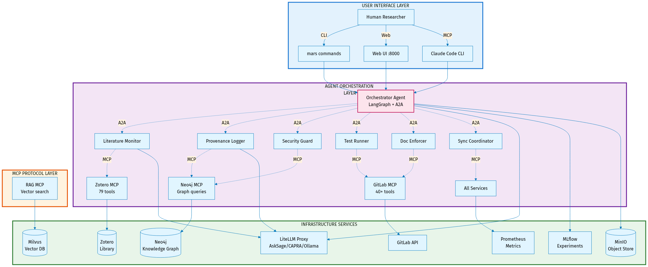
MARS Architecture
MARS Runtime Architecture

Slide 69
Two Faces of MARS
MARS has two distinct instantiations with different purposes:

Slide 70
mars-dev (The Workshop) - 🔧 Purpose: Tools for building MARS itself - 🏗️ Users: MARS developers (me) - 📦 Contains: Development infrastructure - Parallel orchestration (E8) - Session management - Pre-commit hooks - Testing infrastructure - Development CLIs - 📍 Location: mars-dev/ directory - 🎯 Goal: Make MARS better
research-project (The Product) - 🔬 Purpose: Using MARS for research - 👨‍🔬 Users: Research teams (you) - 📦 Contains: MARS as submodule + your work - MARS framework (read-only) - Research algorithms - Experiment scripts - Data and results - 📍 Location: Your repository - 🎯 Goal: Accelerate your research

Slide 71
Key Distinction: mars-dev builds MARS, research-project uses MARS

Slide 72
Research Project Structure
How you’ll use MARS:
your-research-project/ # Your repository
├── .mars/ # MARS configuration overrides
│ ├── config/ # Project-specific settings
│ └── docker-compose.override.yml # Customize services
├── src/
│ ├── framework/ # MARS submodule (read-only)
│ └── algorithms/ # Your research code
├── data/ # Your research data
├── results/ # Your experiment results
├── notebooks/ # Your Jupyter notebooks
├── scripts/ # Your analysis scripts
└── README.md # Your documentation
Critical Principle: MARS framework is read-only. All customization goes in .mars/ directory.

Slide 73
Configuration: MARS vs. Your Project
Two separate configuration mechanisms:

Slide 74
mars-dev Configuration - 🔧 For: Building MARS - 📂 Location: mars-dev/ internal files - ⚙️ Controls: Development tools - E8 orchestration - Pre-commit hooks - Sprint templates - Test infrastructure - 👤 User: MARS developers - 🚫 Not in research-project: Development infrastructure stays separate
research-project Configuration - 🔬 For: Using MARS - 📂 Location: .mars/ directory - ⚙️ Controls: MARS services - LLM models (which AI to use) - Service ports - Resource limits - Domain-specific agents - 👤 User: Research teams - ✅ Overrides MARS defaults: Your project, your rules

Slide 75
Example: Change Neo4j port for your project → edit .mars/docker-compose.override.yml

Slide 76
MARS External Dependencies
MARS is built on 5 external repositories (git submodules):

Slide 77
Dependency | Type | Purpose | Status
LiteLLM | Python/Docker | AI gateway (AskSage/CAPRA access) | ✅ Production
Zotero MCP | Python MCP | Literature management tools | ✅ Production (95% complete)
GitLab MCP | Node.js MCP | 40+ GitLab integration tools | ✅ Production (50% complete)
Zotero Server | Docker Compose | Self-hosted reference server | ✅ Evaluation
Session Exporter | Python CLI | CCC session archival | ✅ Integrated

Slide 78
What “git submodule” means: Version-controlled dependencies - reproducible builds, no surprises
For researchers: You don’t manage these - they’re pre-integrated

Slide 79
MARS vs. mars-dev: The CLIs
Two command-line interfaces with different audiences:

Slide 80
mars-dev CLI - 🔧 For: Building MARS - 👤 User: MARS developers (me) - 📦 Commands: Infrastructure operations - mars-dev up - Start development container - mars-dev down - Stop development - mars-dev build - Build MARS images - mars-dev doctor - Health checks - mars-dev validate - Compliance checks - mars-dev audit - Module validation - 🏗️ Use Case: Develop new MARS features - 📍 Location: mars-dev/scripts/mars-dev
mars CLI - 🔬 For: Running MARS - 👤 User: Research teams (you) - 📦 Commands: Research operations - mars up - Start MARS services - mars down - Stop MARS services - mars logs - View service logs - mars agents list - List available agents - mars services info - Service details - mars rag reindex - Update knowledge graph - 🔬 Use Case: Conduct research - 📍 Location: core/scripts/mars

Slide 81
You’ll use: mars CLI (research-project). You’ll never need mars-dev CLI.

Slide 82
How Research Projects Get MARS
Simple 3-step process:
Step 1: Add MARS as submodule
cd your-research-project
git submodule add https://github.com/nasa/mars-v2 src/framework
git submodule update --init --recursive
Step 2: Create .mars/ configuration
mkdir -p .mars/config
# Customize MARS for your project (optional)
Step 3: Start MARS
cd src/framework
source mars-env.config # Load MARS environment
mars up -d # Start MARS services
That’s it! MARS is running. Now write your research code.

Slide 83
Documentation: Two Audiences
Current State: Documentation is messy (docs/wiki/ will be reorganized)
Future State: Modular documentation architecture aligned with users

Slide 84
For Developers (Building MARS) - 🔧 Audience: MARS developers (me) - 📂 Location: Within module directories - 📦 Structure: - core/docs/ - Core framework - mars-dev/docs/ - Dev tools - modules/*/docs/ - Module-specific - 📝 Content: - ADRs (architecture decisions) - Implementation details - Development workflows - Testing strategies
For Researchers (Using MARS) - 🔬 Audience: Research teams (you) - 📂 Location: Generated GitLab wiki - 📦 Structure: - Getting Started guides - Use case examples - Configuration reference - Troubleshooting - 📝 Content: - How to use MARS services - Research workflows - Agent capabilities - Integration examples

Slide 85
Key Principle: Documentation lives where it’s maintained, aggregated where it’s consumed

Slide 86
Modular Documentation Architecture
Current mess (everything in docs/wiki/):
docs/wiki/
├── adr/ # ALL 36 ADRs mixed together
├── integrations/ # Mixed module concerns
├── tools/ # Mixed concerns
└── ... # 150+ files, unclear ownership
Future organization (modular, clear ownership):
core/docs/ # Core framework docs
mars-dev/docs/ # Development infrastructure
modules/
├── agents/
│ ├── shared/docs/ # All agents
│ └── orchestrator/docs/ # Specific agent
└── services/
├── shared/docs/ # All services
└── ollama/docs/ # Specific service
Benefits: Clear ownership, module independence, easy discovery

Slide 87
Documentation Types & Organization
Every module (core/, mars-dev/, modules/*/) has same structure:

Slide 88
Directory | Purpose | Example
adr/ | Architecture decisions | Design choices, trade-offs
educational/ | Learn the technology | Concepts, tutorials
setup/ | Configuration & usage | Install, configure, run
architecture/ | Implementation details | Internal design, patterns
mcp/ | MCP tool reference | API documentation (services)
testing/ | Test documentation | Test strategy, coverage
troubleshooting/ | Fix issues | Common problems, solutions

Slide 89
ADR Numbering: Per-directory (core/ADR-0001, mars-dev/ADR-0001, ollama/ADR-0001)
Cross-references: Use path for clarity (“mars-dev/ADR-0004” = Modular Documentation)

Slide 90
Generated Wiki (Aggregation)
Source of truth: Documentation lives in module directories (git-tracked)
GitLab wiki: Aggregated view (generated automatically)
docs/wiki/ # Generated, NOT hand-edited
├── adr/
│ ├── core/ # From core/docs/adr/
│ ├── mars-dev/ # From mars-dev/docs/adr/
│ ├── agents/
│ │ ├── shared/ # From modules/agents/shared/docs/adr/
│ │ └── orchestrator/ # From modules/agents/orchestrator/docs/adr/
│ └── services/
│ └── ollama/ # From modules/services/ollama/docs/adr/
├── educational/ # Same structure
├── setup/ # Same structure
└── cross-cutting/ # Strategic docs (VISION, ROADMAP)
├── VISION.md
└── ROADMAP.md
Workflow: Edit module docs → Script aggregates → GitLab wiki updates
Benefit: Single source of truth, multiple views (module-local, centralized wiki)

Slide 91
Self-Hosted GitLab (Security)
Why self-hosted GitLab inside MARS?
Security requirement: Classified research code cannot leave the network
Architecture:
┌─────────────────────────────────────────┐
│ MARS Runtime Container │
│ │
│ ┌────────────────────────────────┐ │
│ │ GitLab CE (Self-Hosted) │ │
│ │ - All repos stored locally │ │
│ │ - No external network access │ │
│ │ - Complete version control │ │
│ │ - Issues, MRs, wikis │ │
│ └────────────────────────────────┘ │
│ │
│ Access: localhost:9080 (inside MARS) │
└─────────────────────────────────────────┘
Benefits: Air-gap capable, no data leakage, full git functionality

Slide 92
GitLab Sync (Collaboration)
Problem: Self-hosted GitLab is isolated - how to collaborate with team?
Solution: Automated bidirectional sync with organizational GitLab
Architecture:
MARS GitLab (Isolated) <---Sync---> Org GitLab (External)
localhost:9080 gitlab.org.example.com
- Classified research - Unclassified/reviewed code
- Daily development - Team collaboration
- Full history - External review
Sync Mechanism: - 260 automated tests, 90%+ coverage - Bidirectional: Pull team updates, push your work - Safe: Agents stopped during sync, network temporarily enabled - Audited: Complete operation logging
User workflow: mars sync:pull (morning), mars sync:push (evening)

Slide 93
GitLab Sync Details
Three key operations:
1. Pull updates (get team changes):
mars sync:pull mars-v2
# 1. Stop agents (30s)
# 2. Enable network temporarily
# 3. Pull from org GitLab
# 4. Disable network (restore isolation)
# 5. Restart agents
# Duration: 30-90 seconds
2. Push work (share your commits):
mars sync:push mars-v2
# Same 5-step process, but pushes instead
3. Check status (see pending changes):
mars sync:status
# Shows: commits to pull, commits to push
Safety: Full audit logging, backup/rollback, metadata sync (issues/MRs/wikis)

Slide 94
The Modularity Ladder
The Progression: - 🏠 Level 0: Custom Home (6-12 months per capability - monolithic) - 🏗️ Level 1: Prefab Sections (3-6 months - brittle integration) - 🏢 Level 2: Apartment Building (1-3 months - microservices) - 🏨 Level 3: Modular Hotel (3-7 weeks per new domain - plug-and-play)

Slide 95
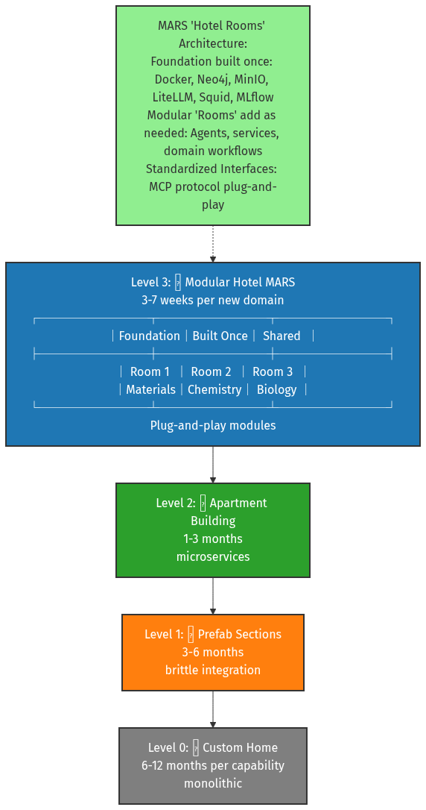
Modularity Ladder

Slide 96
Level 0: Custom Home (Monolithic)
🏠 The Analogy: Building a custom house from scratch every time
Characteristics: - 6-12 months per capability - Everything built from ground up - No reusable components - Tightly coupled code - Hard to modify or extend
Example: Traditional AI research system - Build authentication system - Build storage system - Build compute infrastructure - Build AI integration - Build user interface - Every component custom-built and interconnected
MARS Comparison: Traditional approach takes 6-12 months with 3-5 FTE. MARS Level 3 delivers same capability in 3-7 weeks with 1-2 FTE.
Problem: Every new research domain requires rebuilding everything.

Slide 97
Level 1: Prefab Sections (Brittle Integration)
🏗️ The Analogy: Using prefabricated walls but custom-fitting each connection
Characteristics: - 3-6 months per capability - Some reusable components - Manual integration required - Brittle connections between parts - Version conflicts common
Example: Docker containers with custom glue code - Container for database - Container for AI service - Container for web server - Custom scripts to connect them - Configuration files manually synced
Integration Issues: - Service A expects JSON, Service B sends XML - Container 1 uses Python 3.8, Container 2 needs 3.11 - Network configs conflict between services - Updates to one service break others
MARS Comparison: Level 3 uses standardized MCP protocol - no brittle glue code needed.

Slide 98
Level 2: Apartment Building (Microservices)
🏢 The Analogy: Shared foundation with independent units
Characteristics: - 1-3 months per capability - Microservices architecture - Shared infrastructure - APIs for communication - Better isolation than Level 1
Example: Docker Compose with multiple services - Shared Docker network - Shared storage volumes - API-based communication - Independent deployment of services
MARS Partial Example: - Neo4j knowledge graph service - MLflow experiment tracking service - MinIO object storage service - Services communicate via REST APIs
Remaining Challenges: - Still need custom integration code - API versioning complexities - Service discovery overhead - No standardized agent protocol
MARS Comparison: Level 3 adds MCP standardization - agents plug in instantly.

Slide 99
Level 3: Modular Hotel (Plug-and-Play)
🏨 The Analogy: Hotel with foundation built once, rooms added as needed
Characteristics: - 3-7 weeks per new domain - Foundation built once and shared - Plug-and-play modules - Standardized interfaces (MCP protocol) - 90% foundation reuse
MARS “Hotel Rooms” Architecture:
Foundation (Built Once): - Docker orchestration - Neo4j knowledge graph - MinIO object storage - LiteLLM AI gateway - Squid security proxy - MLflow experiment tracking
Modular “Rooms” (Add As Needed): - Agents (lit-monitor, orchestrator, testczar) - Services (Zotero, GitLab) - Domain workflows (materials, chemistry, biology)
Standardized Interfaces: - MCP protocol: Model Context Protocol for agent communication - Agents register available tools/capabilities - Other agents discover and invoke them - No custom integration code needed
Example - Adding Materials Domain: - Week 1: Use existing foundation (0 hrs) - Weeks 2-4: Build materials agents (80-120 hrs) - Weeks 5-7: Add domain tools (40-80 hrs) - Total: 3-7 weeks, 1-2 FTE
vs. Traditional: 6-12 months, 3-5 FTE
MARS Status: ✅ Production-ready modular architecture

Slide 100
Modularity Ladder: Why It Matters
Speed to New Capabilities: - Level 0: 6-12 months → Level 3: 3-7 weeks (75% time savings) - Level 0: 3-5 FTE → Level 3: 1-2 FTE (50% cost savings)
Reduced Risk: - Shared foundation = well-tested, proven infrastructure - New modules inherit security, observability, reliability - Failures isolated to individual modules
Scaling Research: - Add new research domains rapidly - Researchers focus on science, not infrastructure - Cross-domain insights via shared knowledge graph
Technology Evolution: - Swap AI models without rebuilding (LiteLLM abstraction) - Upgrade infrastructure without touching research code - MCP protocol enables future agent ecosystems
Real-World Impact: - Materials group operational in 5-7 weeks (not 6-12 months) - Chemistry group reuses 90% of infrastructure - Biology group reuses same foundation - Each new domain accelerates the next

Slide 101
Modularity Example: Materials Group
Timeline: 5-7 weeks (vs. 6-12 months from scratch)

Slide 102
Week | Activity | Effort | Notes
Week 1 | Use existing | 0 hrs | Zotero, GitLab, KG (immediate)
Weeks 2-4 | Materials agents | 80-120 hrs | lit-monitor, KG schema, exp-design
Weeks 5-6 | Custom tools | 40-80 hrs | LAMMPS, VASP integration
Total | 5-7 weeks | 120-200 hrs | 90% foundation reuse

Slide 103
Cost Comparison: Monolithic = 6-12 mo, 3-5 FTE | MARS = 5-7 wk, 1-2 FTE Savings: 75% time, 50% FTE

Slide 104
The Security Ladder
The Progression: - 🚪 Level 0: Open Door (public research only) - 🔑 Level 1: Lock & Key (limited classified use) - 🏘️ Level 2: Gated Community (some classified with waivers) - 🏛️ Level 3: Military Base (DoD classified, air-gap capable)

Slide 105
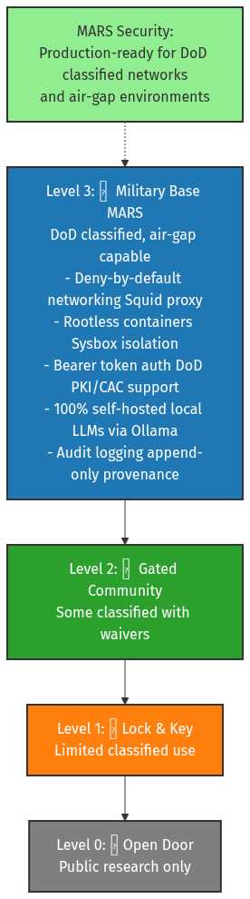
Security Ladder

Slide 106
Level 0: Open Door (Public Research)
🚪 The Analogy: Building with no security - anyone can enter
Characteristics: - No security controls - Cloud-hosted AI (OpenAI, Anthropic) - Data leaves your network - Public internet access required - No classification support
Example: ChatGPT Plus, Claude.ai - Convenient but data goes to cloud - Cannot handle CUI/classified - Vendor controls your data - Internet outage = no access
Appropriate For: Public research, open-source projects, unclassified work only

Slide 107
Level 1: Lock & Key (Limited Classified)
🔑 The Analogy: Building with basic locks, but windows still open
Characteristics: - Basic security (authentication, HTTPS) - Some data stays local - Limited classified use (waivers required) - Still dependent on external services - Partial air-gap support
Example: GitHub Copilot Enterprise - Data stays in your tenant - Authentication required - But: Still calls external APIs - But: Limited control over model
Appropriate For: CUI (Controlled Unclassified Information), some sensitive research

Slide 108
Level 2: Gated Community (Some Classified)
🏘️ The Analogy: Gated neighborhood with security checkpoints
Characteristics: - Enhanced security (network isolation) - Self-hosted infrastructure - Some classified with waivers - Reduced external dependencies - Monitored access
Example: Private cloud deployments - Self-hosted LLM infrastructure - Network segmentation - Access logging - But: May still need external model APIs - But: Not fully air-gap capable
Appropriate For: Sensitive research, some classified work with security waivers

Slide 109
Level 3: Military Base (DoD Classified)
🏛️ The Analogy: Military installation with multiple security layers
Characteristics: - Production-ready for DoD classified - 100% self-hosted (no external calls) - Air-gap capable - Deny-by-default networking - Full audit logging
MARS Security Features:
Network Security: - Squid proxy: Deny-by-default (explicit allowlist) - Air-gap capable (no internet required) - All external calls blocked unless approved
Container Security: - Sysbox: Rootless containers (UID/GID isolation) - No privileged containers - Kernel namespace isolation
Authentication: - Bearer token auth: DoD PKI/CAC support - Certificate-based authentication - Role-based access control (RBAC)
Data Security: - 100% self-hosted: Local LLMs via Ollama - No data leaves network - Encrypted at rest and in transit
Audit & Compliance: - Append-only logging: Full provenance tracking - Tamper-proof audit trail - Classification label propagation
MARS Status: ✅ Production-ready for classified networks

Slide 110
Security Ladder: Why It Matters
The Progression: - Level 0: Convenient but insecure (cloud AI services) - Level 1: Basic protection (some local control) - Level 2: Enhanced security (mostly self-hosted) - Level 3: DoD classified capable (full air-gap, zero trust)
MARS Today: Level 3 operational - Air-gap deployments ready - DoD classified network capable - 100% self-hosted (no external dependencies) - Deny-by-default security posture
Why This Matters: - Classified research: Can use AI on sensitive projects - Data sovereignty: Your data never leaves your network - Mission assurance: Works without internet access - Compliance: Meets DoD security requirements
Competitive Advantage: Most AI tools are Level 0-1 (cloud-dependent). MARS is Level 3 (classified-capable).

Slide 111
What’s Built Today (Nov 2025)
Foundation ✅: - Docker infrastructure - Neo4j (knowledge graph) - Milvus (vector DB) - 80% - MLflow (experiments) - LiteLLM (AskSage) - Ollama (local LLMs)
Research Tools ✅: - Zotero MCP (100%) - GitLab MCP (50%, Phase 6A) - PlantUML/SysML (100%)
Agents ✅: - DocCzar (doc validation) - TestCzar (test coordination) - KG Agent (REQUIREMENT ingestion)
Dev Infrastructure ✅: - E6: Containerized dev (Docker-in-Docker) - E8: Parallel orchestration (5-25 sessions) - E13: Sprint protection (56 tests) - 434+ tests across codebase

Slide 112
Roadmap (v1.0: Feb-Mar 2026)
Component | Status | % | Notes
C2 (Zotero) | ✅ COMPLETE | 100% | Production-ready
C6 (SysML) | ✅ COMPLETE | 100% | Diagram generation
C16 (RAG) | ✅ MERGED | 100% | Semantic search
C3 (GitLab) | 🚧 ACTIVE | 50% | Phase 6A (79 tools)
C4 (Infra) | 🚧 ACTIVE | 87% | 16/20 enhancements
C11 (LangGraph) | 🚧 ACTIVE | HITL P4 | Orchestration
C1 (LiteLLM) | ⏸️ BLOCKED | 75% | AskSage streaming
C5 (Lit Research) | ⏸️ PLANNED | Q1 2025 | Orchestrator + monitor
C12-C15 | ⏸️ PLANNED | Pending | Coder, pub-writer agents

Slide 113
4 complete, 4 active, 9 planned

Slide 114
Use Cases MARS Accelerates Today
1. Literature Management ✅: - Zotero integration - 10 MCP tools - Bidirectional sync
2. Documentation ✅: - DocCzar validates 109 docs - Broken links, citations - Standards enforcement
3. Knowledge Graph ✅: - Neo4j tracks paper → requirement → design → experiment - REQUIREMENT ingestion - Cross-domain synthesis
4. Semantic Search ⏳ 80%: - ~40% token reduction - Automatic context retrieval - (Blocked: upstream MCP bug #226)

Slide 115
What Makes MARS Different?
Feature | LangGraph/AutoGen | Cloud AI | Custom GPT | MARS
Type | Framework (DIY) | Platform | Single-agent | Complete system
Infrastructure | ❌ You provide | ☁️ Vendor | ☁️ Cloud | ✅ Self-hosted
Orchestration | ✅ Yes (DIY) | ⚠️ Limited | ❌ No | ✅ LangGraph built-in
Governance | ❌ You build | ⚠️ Vendor | ❌ None | ✅ Provenance
Air-Gap | ⚠️ Possible | ❌ No | ❌ No | ✅ 100% capable
Research-Specific | ❌ Generic | ❌ Enterprise | ❌ Generic | ✅ Research workflows
Lock-In | ✅ No | ❌ Yes | ❌ Yes | ✅ Open standards

Slide 116
Unique: Research-first + Orchestration + Governance + Independence + Classified

Slide 117
Extensibility: 50+ MCP Integrations
Modularity: Each integration ~1 hour (vs. ~80 hours custom)

Slide 118
Category | Tools | Status
Research | ROS2, SLURM, Overleaf, LabView, MATLAB, SolidWorks | Planned
Data | PubMed, IEEE, Web of Science, arXiv | Planned
Lab Mgmt | eLabFTW, Benchling, LabArchives | Planned
Collab | Slack, Teams, Jira, Confluence | Planned
Hardware | Oscilloscopes, spectrometers, microscopes | Planned
Simulation | ANSYS, COMSOL, OpenFOAM, GROMACS | Planned
Current | Zotero (lit), GitLab (project) | ✅ Operational

Slide 119
Timeline: 3-4 weeks per integration (testing, not coding)

Slide 120
MARS Standards & Protocols
Communication: - Agent-to-Agent (A2A): GraphQL federation (in dev) - Agent-to-Tool (MCP): Model Context Protocol (operational) - Human-to-Agent: Conversational + approval gates
Observability: - Prometheus metrics - Health endpoints - X-Trace-Id propagation - Append-only provenance
Development (mars-dev): - 37 ADRs: Documented decisions - Pre-commit hooks: Validation, tests - E8 orchestration: 5-25 parallel CCC sessions - Session mgmt: Export/import, git integration
Security: - Deny-by-default (Squid) - Rootless containers (Sysbox) - Bearer token auth (DoD PKI) - Secret redaction

Slide 121
Organizational Expansion
Phase 1: Pilot (3-4 months): - 1-2 research groups adopt foundation - Prove value in real programs - Build expertise - Cost: 2-3 FTE during setup
Phase 2: Expansion (6-9 months): - 5-7 additional groups (parallel) - Domain-specific agents (materials, chemistry, biology) - Shared foundation benefits all - Cost: <0.2 FTE per group (shared infra team)
Phase 3: Production (12+ months): - Organization-wide capability - Institutional memory compounds - 3-5× force multiplication achieved - Cost: Shared maintenance (~1-2 FTE)
Timeline: 5-7 weeks per new group (modularity enables parallelization)

Slide 122
Part 6: Technical Implementation Details

Slide 123
Technical Deep Dive: Overview
Purpose: Explain key MARS implementation choices
Topics: 1. Git Worktrees - Parallel development 2. AskSage Integration - DoD AI access via LiteLLM 3. Sysbox Runtime - Secure containerization 4. Git Submodules - Dependency management
Audience: Technical stakeholders, infrastructure teams

Slide 124
Worktrees: Parallel Development

Slide 125
The Problem: Linear Development Bottleneck
Traditional Git Workflow:
main branch (work blocked while testing)
↓
Create feature branch
↓
Make changes (can't work on other features)
↓
Test, iterate
↓
Merge back to main
↓
Switch to next feature
Limitations: - ❌ One task at a time per repository - ❌ Frequent context switching - ❌ Long-running tasks block other work - ❌ Testing requires checkout/stash dance

Slide 126
Git Worktrees: The Solution
What is a worktree? > Multiple working directories for the same repository, each with its own branch
Visual Concept:
Main Repository (/workspace/mars-v2)
↓ branch: main
Worktree 1 (/workspace/mars-v2/mars-dev/worktrees/feature-a)
↓ branch: feature/a
Worktree 2 (/workspace/mars-v2/mars-dev/worktrees/feature-b)
↓ branch: feature/b
Worktree 3 (/workspace/mars-v2/mars-dev/worktrees/testing)
↓ branch: test/integration
All share: Same .git history, tags, remotes Each has: Own working directory, own branch, own state

Slide 127
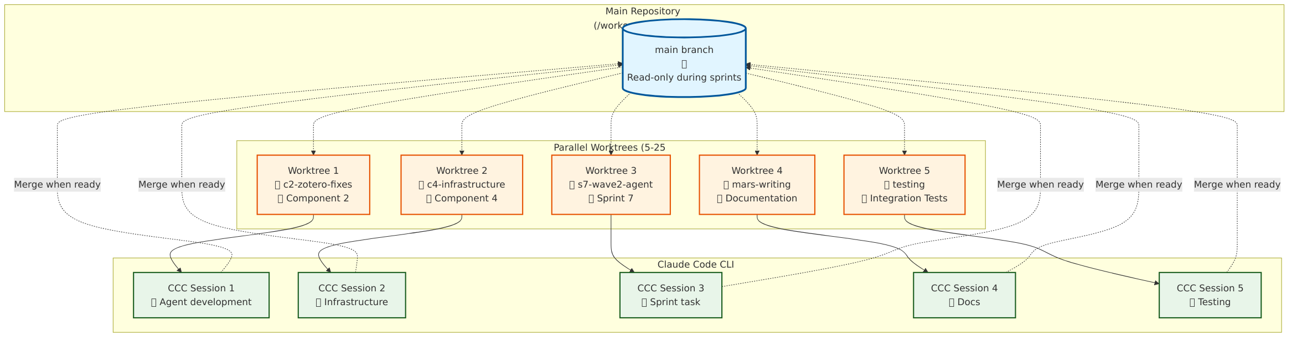
Worktrees in MARS Development
Git Worktrees Workflow

Slide 128
How MARS Uses Worktrees:
Parallel Sprint Development (E8 Orchestration): - 5-25 concurrent CCC sessions, each in own worktree - Example: Sprint 7 (Wave 2) = 8 worktrees simultaneously - Each worktree = isolated environment for one task
Typical MARS Worktree Structure:
mars-v2/ # Main repo (read-only during sprints)
├── mars-dev/worktrees/
│ ├── c2-zotero-fixes/ # Component 2 work
│ ├── c4-infrastructure/ # Component 4 enhancements
│ ├── s7-wave2-agent-scaffold/ # Sprint 7 task
│ ├── s7-wave2-testing/ # Parallel testing
│ └── mars-writing/ # Documentation sessions

Slide 129
Worktrees: Benefits for MARS
1. True Parallel Development: - Work on C2 (Zotero) while C4 (Infrastructure) builds - Run tests in one worktree, write code in another - Documentation in one worktree, implementation in another
2. No Context Loss: - Each worktree preserves full IDE state - Terminal history stays relevant - No constant branch switching
3. Isolated Testing: - Test changes without affecting main development - Multiple test configurations simultaneously - Integration testing in dedicated worktree
4. Sprint Orchestration (E8): - 5-25 parallel CCC sessions (one per worktree) - Zellij dashboard shows all sessions - Merge queue for controlled integration
Productivity Gain: 40-60% faster multi-task development

Slide 130
Worktrees: Command Primer
Create a worktree:
# From main repository
git worktree add ../worktrees/feature-x -b feature/x
# Result:
# - New directory: ../worktrees/feature-x
# - New branch: feature/x (checked out in worktree)
# - Ready to work immediately
List all worktrees:
git worktree list
# Output:
# /workspace/mars-v2 abc1234 [main]
# /workspace/mars-v2/../feature-x def5678 [feature/x]
Work in worktree (completely isolated):
cd ../worktrees/feature-x
vim code.py # Make changes
git add code.py
git commit -m "feat: Add feature X"
# Main repo unaffected, other worktrees unaffected
Merge back to main:
cd /workspace/mars-v2 # Back to main repo
git merge feature/x # Integrate changes

Slide 131
Worktrees: MARS E8 Integration
E8 Parallel Orchestration uses worktrees for sprint management:
Sprint Planning (mars-dev/sprints/s7-wave2/sprint.yaml):
tasks:
- id: T1-agent-scaffold
worktree: s7-wave2-agent-scaffold
branch: feat/s7-wave2-agent-scaffold
- id: T2-testing
worktree: s7-wave2-testing
branch: feat/s7-wave2-testing
Automated Worktree Creation:
# Script: mars-dev/scripts/create-worktrees.sh
./mars-dev/scripts/create-worktrees.sh sprints/s7-wave2/sprint.yaml
# Creates 8 worktrees, 8 branches, 8 Zellij panes
# Each ready for parallel CCC session
Result: 8 tasks progressing simultaneously instead of sequentially

Slide 132
Worktrees: Real-World MARS Example
Scenario: Sprint 7 Wave 2 (8 parallel tasks)
Setup (1 command):
./mars-dev/scripts/launch-sprint.py sprints/s7-wave2/sprint.yaml
What Happens: 1. Creates 8 worktrees (one per task) 2. Creates 8 branches (one per task) 3. Launches Zellij dashboard (8 panes) 4. Starts 8 CCC sessions (one per pane) 5. Loads task context into each session
Parallel Execution: - Pane 1: Agent scaffolding - Pane 2: Integration testing - Pane 3: Documentation updates - Pane 4: ADR authoring - Pane 5-8: Other tasks
Merge Strategy: Controlled queue (one worktree at a time)
Productivity: 8 tasks in parallel vs. sequential = 5-7× faster sprints

Slide 133
AskSage Integration

Slide 134
The Challenge: DoD AI Access
Problem: Commercial AI services not allowed on classified networks
Requirements: - ✅ Air-gap capable (no internet) - ✅ DoD accredited (ATO/security review) - ✅ Data never leaves network - ✅ Vendor lock-in avoidance
Traditional Solution: Build everything from scratch MARS Solution: AskSage + LiteLLM abstraction

Slide 135
What is AskSage?
AskSage: Navy-hosted AI service (GPT-4, Claude, Llama)
Architecture:
Navy CAPRA Endpoint (https://capra.flankspeed.dso.mil)
↓ (DoD PKI authentication)
AskSage API Gateway
↓ (routes to available models)
Commercial AI Providers (Azure OpenAI, AWS Bedrock)
↓ (via FedRAMP connections)
LLM Models (GPT-4, Claude 3.5, Llama 3)
Key Features: - 🔐 DoD PKI authentication (CAC/ECA required) - 🛡️ FedRAMP authorized connections - 📊 Usage tracking and audit logs - 🚫 No training on your data (contractual) - 💰 Government rates (volume discounts)

Slide 136
AskSage vs. Commercial Anthropic
Feature | AskSage | Commercial Anthropic
Access | DoD PKI (CAC/ECA) | API key (anyone)
Network | FedRAMP connection | Public internet
Data Policy | No training (contract) | No training (policy)
Cost | Gov’t rates (~50% less) | Standard API rates
Models | GPT-4, Claude, Llama | Claude only
Classified | ✅ Allowed (with ATO) | ❌ Prohibited
Air-Gap | ⚠️ Partial (local fallback) | ❌ Not possible
Audit | ✅ Full DoD logging | ⚠️ Limited

Slide 137
MARS Approach: Use AskSage for classified, Anthropic for unclassified (LiteLLM handles both)

Slide 138
The LiteLLM Shim: Why It Matters
Problem: Each AI provider has different API
OpenAI API:
import openai
response = openai.ChatCompletion.create(
model="gpt-4",
messages=[{"role": "user", "content": "Hello"}]
)
Anthropic API:
import anthropic
response = anthropic.Anthropic().messages.create(
model="claude-3-5-sonnet",
messages=[{"role": "user", "content": "Hello"}]
)
AskSage API:
import requests
response = requests.post(
"https://capra.flankspeed.dso.mil/v1/chat/completions",
headers={"Authorization": f"Bearer {pki_token}"},
json={"model": "gpt-4", "messages": [...]}
)
All different! Hard-coded vendor = lock-in

Slide 139
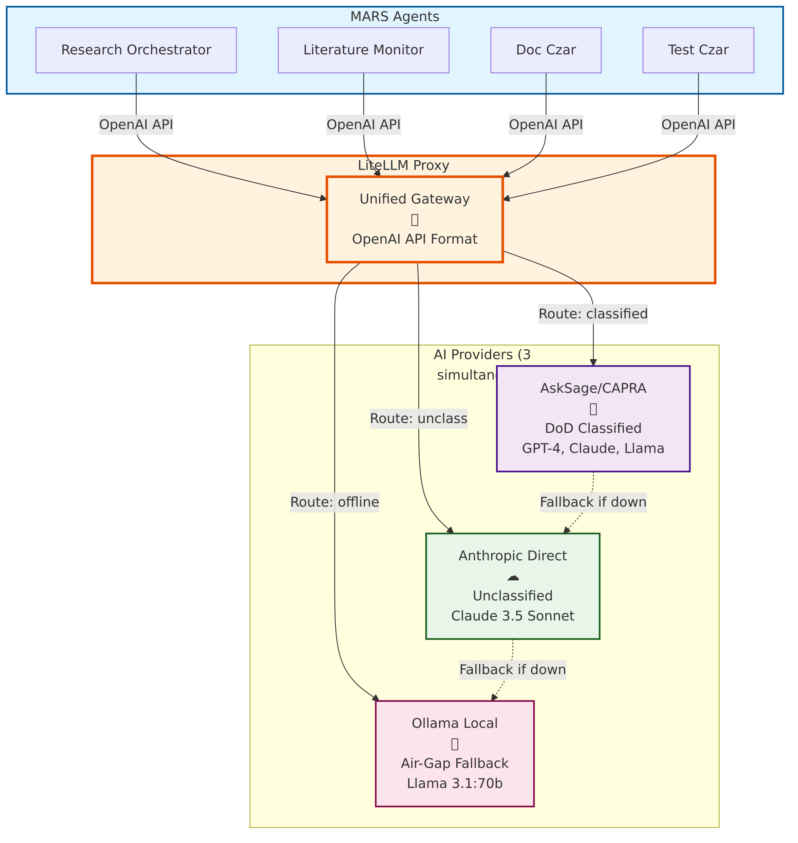
LiteLLM: Unified AI Gateway
LiteLLM Architecture

Slide 140
LiteLLM: Translates all providers → OpenAI-compatible API
MARS Architecture:
MARS Agents
↓ (OpenAI API format - always)
LiteLLM Proxy (localhost:4000)
↓ (routes based on config)
┌──────────────┬─────────────────┬──────────────┐
AskSage Anthropic Ollama
(via CAPRA) (commercial) (local GPU)
Configuration (litellm-config.yaml):
model_list:
- model_name: claude-sonnet
litellm_params:
model: claude-3-5-sonnet-20241022
api_base: https://capra.flankspeed.dso.mil/v1
api_key: ${ASKSAGE_API_KEY}
- model_name: claude-sonnet
litellm_params:
model: claude-3-5-sonnet-20241022
api_key: ${ANTHROPIC_API_KEY}
MARS Agents: Just call localhost:4000/v1/chat/completions → LiteLLM handles routing

Slide 141
LiteLLM Benefits for MARS
1. Vendor Independence: - Switch providers without code changes - Use AskSage on classified, Anthropic on unclass - Fallback to local Ollama if network down
2. Unified Interface: - All agents use same API (OpenAI format) - No vendor-specific code - Simplified agent development
3. Cost Optimization: - Route expensive calls to cheaper models - Load balancing across providers - Usage tracking and quotas
4. Security & Compliance: - Single point of authentication - Centralized audit logging - API key rotation without code changes
5. Air-Gap Readiness: - Swap AskSage → Ollama (config change only) - No agent code modifications - Seamless transition to offline operation

Slide 142
LiteLLM Configuration Example
MARS uses 3 providers simultaneously:
# litellm-config.yaml
model_list:
# AskSage (DoD classified work)
- model_name: gpt-4-asksage
litellm_params:
model: azure/gpt-4
api_base: https://capra.flankspeed.dso.mil/v1
api_key: os.environ/ASKSAGE_API_KEY
# Anthropic (unclassified work)
- model_name: claude-sonnet
litellm_params:
model: claude-3-5-sonnet-20241022
api_key: os.environ/ANTHROPIC_API_KEY
# Ollama (air-gap fallback)
- model_name: local-llama
litellm_params:
model: ollama/llama3.1:70b
api_base: http://localhost:11434
Agent Code (same for all):
import openai
client = openai.OpenAI(base_url="http://localhost:4000/v1")
response = client.chat.completions.create(
model="claude-sonnet", # LiteLLM routes appropriately
messages=[{"role": "user", "content": "Analyze this data"}]
)
No vendor-specific code!

Slide 143
AskSage Authentication Flow
Challenge: AskSage requires DoD PKI (CAC/ECA)
MARS Solution:
1. Manual Token Acquisition (one-time setup):
# User authenticates with CAC/ECA via browser
# Receives JWT token (valid 30 days)
export ASKSAGE_API_KEY="eyJ0eXAiOiJKV1QiLCJhbGc..."
# Saved in mars-env.config (sourced at session start)
2. LiteLLM Token Refresh (automatic):
# litellm-config.yaml
general_settings:
asksage_token_refresh:
enabled: true
refresh_endpoint: https://capra.flankspeed.dso.mil/auth/refresh
refresh_interval: 86400 # 24 hours
3. Fallback to Anthropic (if token expires):
# LiteLLM automatically tries alternate providers
# Config: fallbacks = ["claude-sonnet", "local-llama"]
Result: Minimal user intervention, seamless failover

Slide 144
Sysbox: Secure Containers

Slide 145
The Container Security Challenge
Standard Docker (privileged containers):
Container (runs as root inside)
↓ (has full system access)
Host Kernel
↓ (vulnerable to container escape)
Host Filesystem, Network, Devices
Problem: Root inside container = root on host (with escape exploits)
Traditional Solutions: - Rootless Docker: Docker daemon runs as user (complex setup) - User Namespaces: Map root → user (limited compatibility) - SELinux/AppArmor: Mandatory access control (complex policies)
MARS Solution: Sysbox runtime

Slide 146
What is Sysbox?
Sysbox: Container runtime that provides system-level isolation
Key Feature: Containers that feel like VMs but are still containers
Magic Trick: - Container thinks it has full system access (systemd, Docker-in-Docker) - Host knows container is isolated (UID/GID mapping, namespaces) - Security improved (no privileged mode needed)
Created by: Nestybox (acquired by Docker, 2022) Used by: GitLab CI (Docker-in-Docker), Tailscale (system containers)

Slide 147
Docker Runtimes: Standard vs. Sysbox
Standard Docker (runc runtime):
docker run -v /var/run/docker.sock:/var/run/docker.sock myimage
  ⚠️ Container has full Docker control (can break out)
  ⚠️ Mounted /var/run/docker.sock = root on host
Rootless Docker (rootless daemon):
dockerd-rootless.sh
docker run myimage
  ✅ Docker daemon runs as user (no root)
  ❌ Complex setup (slirp4netns, uidmap, XDG_RUNTIME_DIR)
  ❌ Limited features (no privileged ports, no systemd)
Sysbox Runtime (MARS approach):
docker run --runtime=sysbox-runc myimage
  ✅ Simple: Standard Docker workflow
  ✅ Secure: UID/GID remapping automatic
  ✅ Compatible: Full Docker-in-Docker support
  ✅ Systemd: Works inside containers

Slide 148
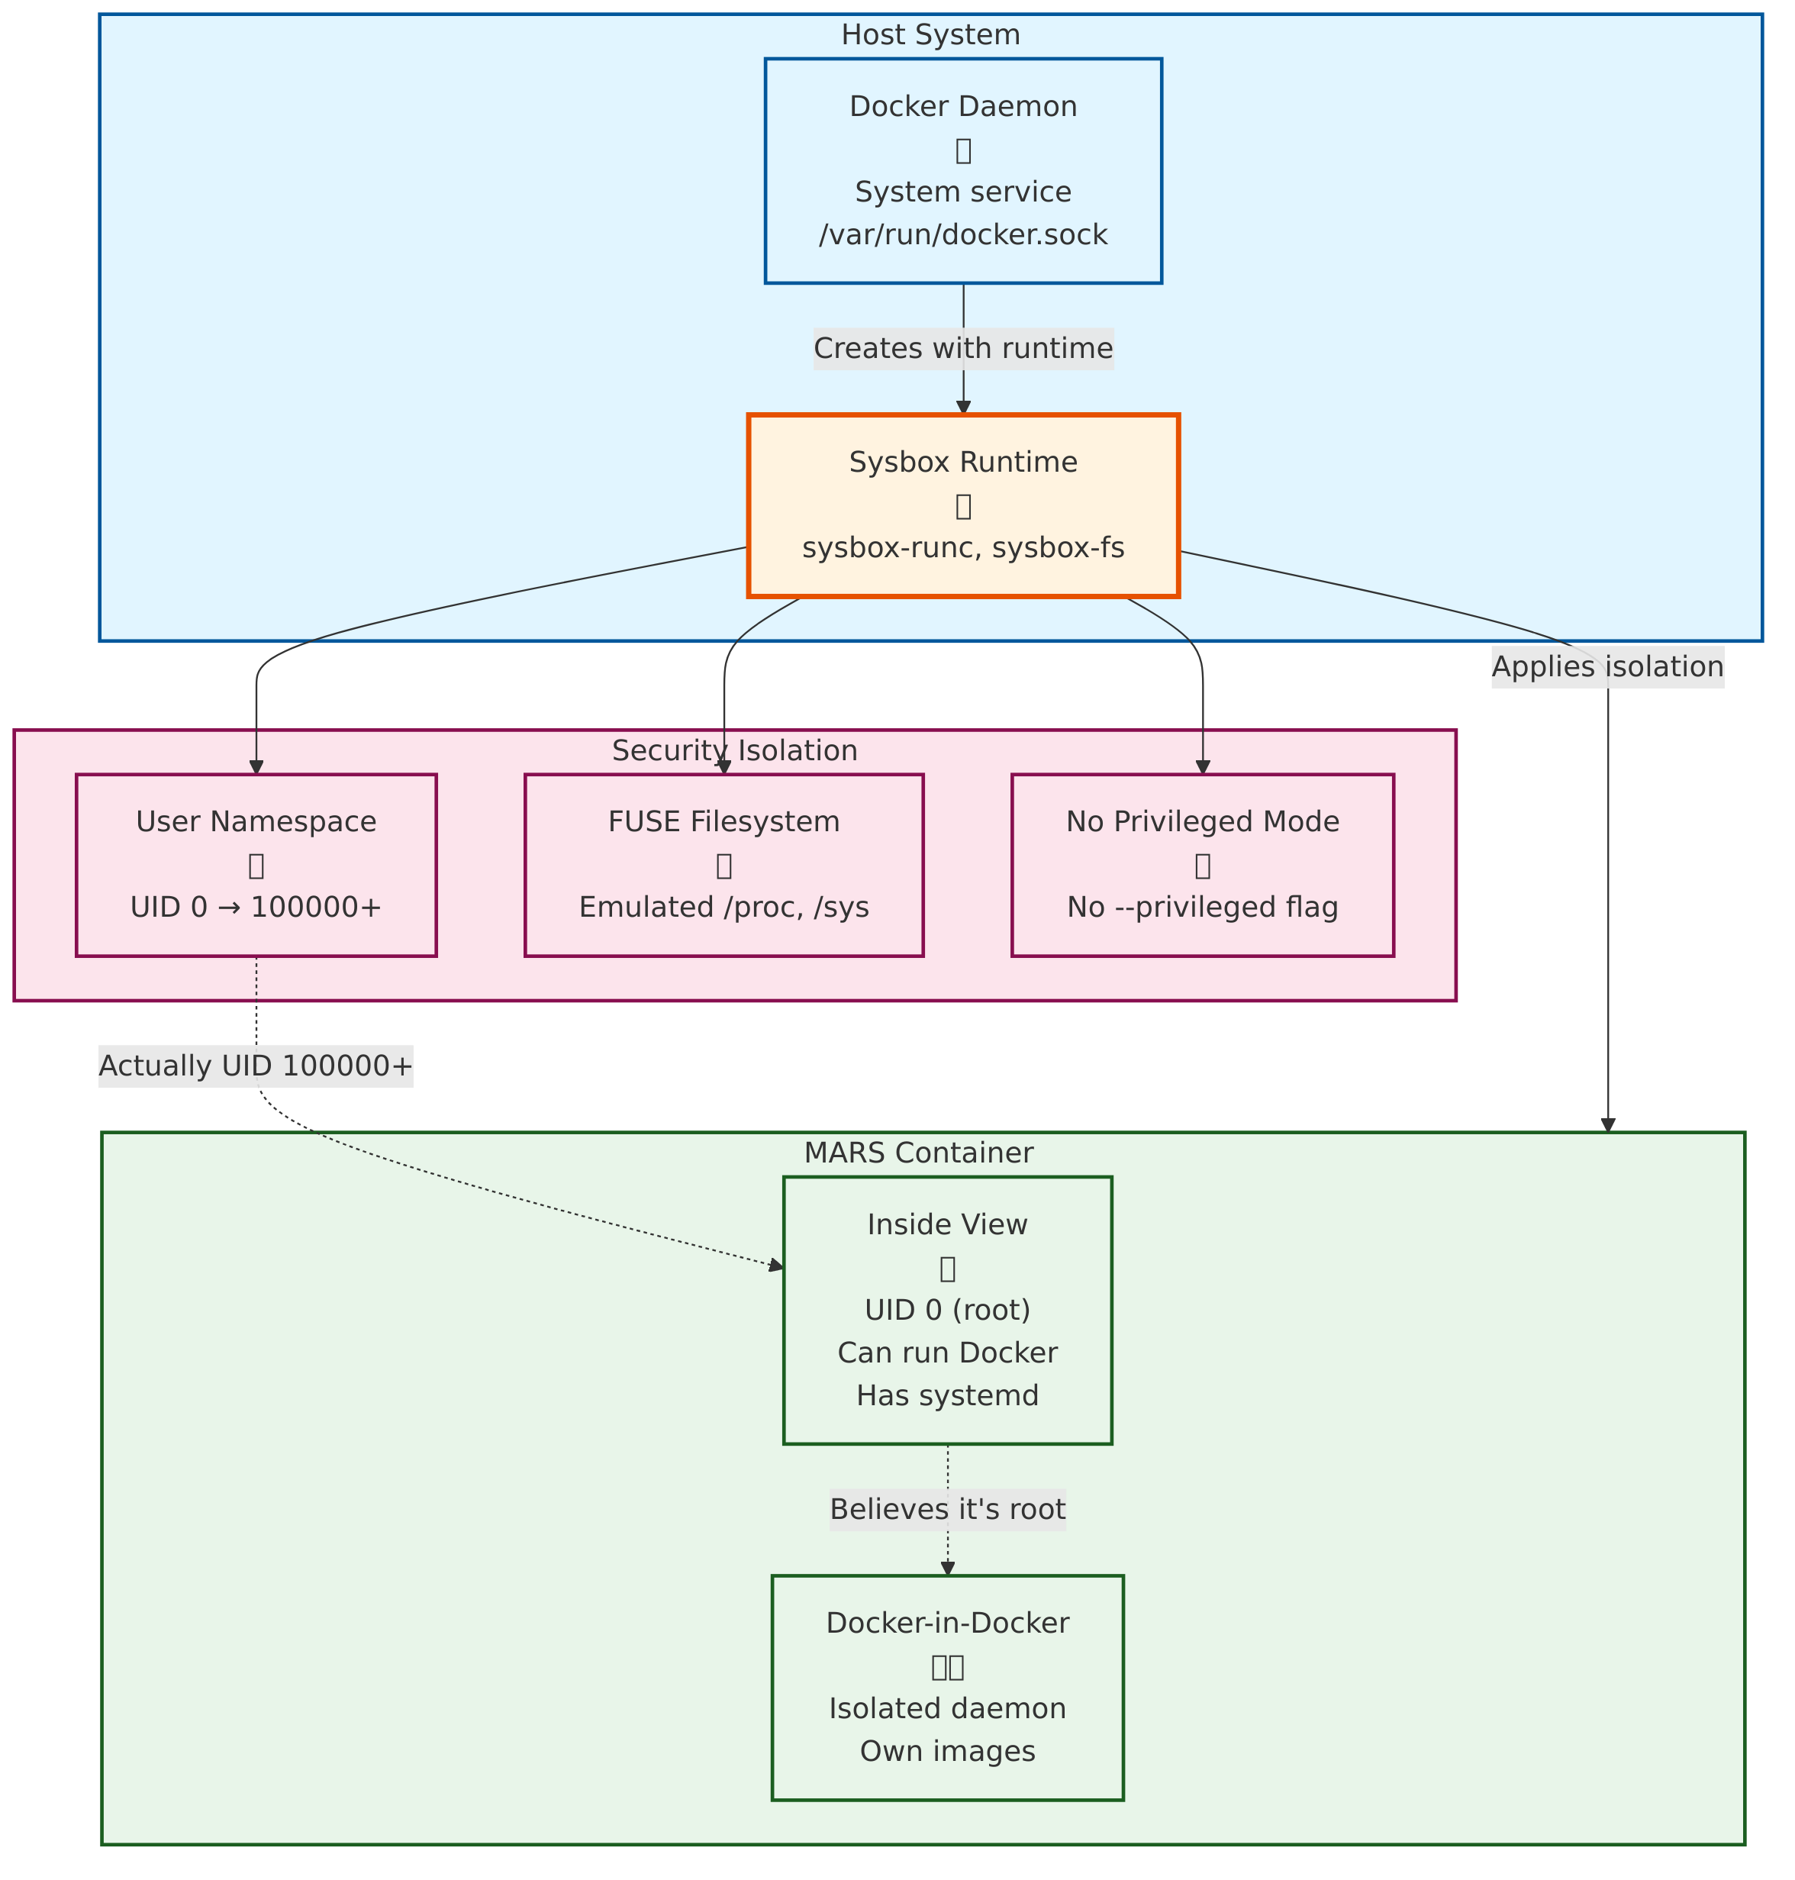
Sysbox Architecture
Sysbox Architecture

Slide 149
How Sysbox Works:
Layer 1: Host Docker Daemon (runs as root, manages containers)
dockerd (system daemon, TCP socket at localhost:9088)
Layer 2: Sysbox Runtime (intercepts container creation)
sysbox-runc (OCI runtime)
↓ (creates user namespace)
sysbox-fs (FUSE filesystem)
↓ (emulates /proc, /sys)
sysbox-mgr (resource management)
Layer 3: Container (isolated environment)
Container sees: UID 0 (root), full /proc, /sys, can run Docker
Host sees: UID 100000+ (unprivileged user), namespaced
Key Insight: Container believes it’s privileged, but host enforces unprivileged operation

Slide 150
DOCKER_HOST: Understanding Docker Sockets
The Docker Socket Landscape:
1. System Docker Socket (privileged):
/var/run/docker.sock (owned by root:docker)
  Default Docker daemon socket
  Requires docker group membership or root
  MARS uses this (via Sysbox isolation)
2. Rootless Docker Socket (user):
/run/user/1000/docker.sock (owned by user)
  Rootless daemon socket
  User-specific (XDG_RUNTIME_DIR)
  MARS doesn’t use (too complex for multi-user)
3. Remote Docker Socket (TCP):
tcp://localhost:2375 (insecure)
tcp://localhost:2376 (TLS)
  Network-accessible Docker API
  Used for remote management
  MARS uses TCP in dev (localhost:9088 for mars-dev)

Slide 151
MARS Docker Architecture
MARS uses 2 Docker configurations:

Slide 152
Production (Sysbox):
DOCKER_HOST=unix:///var/run/docker.sock
DOCKER_RUNTIME=sysbox-runc
Benefits: - System Docker daemon - Sysbox security isolation - Standard workflow
Use Case: - Research deployments - Multi-user environments - Classified networks
Development (mars-dev):
DOCKER_HOST=tcp://localhost:9088
DOCKER_RUNTIME=sysbox-runc
Benefits: - Isolated from system Docker - Won’t interfere with host - Safe for experimentation
Use Case: - Building MARS itself - Testing infrastructure - Parallel dev environments

Slide 153
Key Point: Same Sysbox runtime, different daemon endpoints

Slide 154
Docker Image Caching: Sysbox Behavior
Challenge: Sysbox uses per-container image stores
Standard Docker (shared cache):
/var/lib/docker/
├── image/ # All containers share images
├── overlay2/ # Shared layers
└── containers/ # Container-specific data
Sysbox (isolated cache):
/var/lib/sysbox/
├── container-1/
│ └── var/lib/docker/ # Container 1's images
├── container-2/
│ └── var/lib/docker/ # Container 2's images (duplicate!)
└── container-3/
└── var/lib/docker/ # Container 3's images (duplicate!)
Implication: Each Sysbox container has own Docker image cache

Slide 155
Image Caching: MARS Optimization
Problem: 3 containers × 2 GB images = 6 GB storage waste
MARS Solution: Strategic image caching
Approach 1: Pre-pull in Host:
# On host (before creating Sysbox containers)
docker pull python:3.11-slim
docker pull node:20-alpine
docker pull postgres:15
# Sysbox containers inherit from /var/lib/docker/
# (via sysbox-fs mount magic)
Approach 2: Shared Volume (experimental):
# docker-compose.yml
services:
mars-dev:
runtime: sysbox-runc
volumes:
- docker-cache:/var/lib/docker:ro # Read-only shared cache
Approach 3: Build Once, Run Many:
# Build MARS images on host
docker build -t mars/litellm:latest -f litellm/Dockerfile .
# Sysbox containers can docker pull from host registry
# (if registry is accessible)
Current MARS Status: Uses Approach 1 (pre-pull) + periodic cleanup

Slide 156
Sysbox vs. Rootless Docker: Comparison
Feature | Sysbox (MARS) | Rootless Docker
Setup Complexity | ✅ Simple (install runtime) | ❌ Complex (daemon setup)
Docker-in-Docker | ✅ Full support | ⚠️ Limited
Systemd Support | ✅ Yes | ❌ No
Privileged Ports | ✅ Yes (remapped) | ❌ No (>1024 only)
UID Mapping | ✅ Automatic | ⚠️ Manual config
Image Caching | ⚠️ Per-container | ✅ Shared
Security | ✅ Strong isolation | ✅ Strong isolation
Multi-User | ✅ Works well | ⚠️ Per-user daemon

Slide 157
Why MARS chose Sysbox: Simpler setup, full Docker features, better multi-user

Slide 158
Sysbox in MARS: Practical Example
Scenario: Running MARS development environment (E6)
Without Sysbox (privileged container):
docker run --privileged \
-v /var/run/docker.sock:/var/run/docker.sock \
mars/dev:latest
# ⚠️ Container can:
# - Access host Docker daemon (full control)
# - Escape to host via vulnerabilities
# - Read/write host filesystem
With Sysbox (MARS approach):
docker run --runtime=sysbox-runc \
mars/dev:latest
# ✅ Container can:
# - Run Docker inside (isolated daemon)
# - Use systemd (process manager)
# - Feel like full system
#
# ❌ Container cannot:
# - Access host Docker daemon
# - Break out to host
# - See other containers' data
Security Gain: Defense in depth without functionality loss

Slide 159
Git Submodules

Slide 160
The Dependency Management Challenge
MARS has 2 types of dependencies:
1. Research Project Dependencies (outward): - How do research projects use MARS? - Where does MARS code live in research repos? - How to update MARS version?
2. MARS Internal Dependencies (inward): - How does MARS use external tools (LiteLLM, GitLab MCP, Zotero)? - How to version-control external dependencies? - How to ensure reproducible builds?
Solution: Git submodules (both directions)

Slide 161
What are Git Submodules?
Git Submodule: A git repository embedded inside another git repository
Visual Concept:
Main Repository (research-project/)
├── .git/ # Main repo's git metadata
├── src/
│ ├── algorithms/ # Your research code
│ └── framework/ # MARS (git submodule)
│ ├── .git/ # MARS's git metadata (pointer)
│ └── core/ # MARS source code
└── .gitmodules # Submodule configuration
Key Properties: - Specific commit: Submodule tracks exact MARS version (e.g., commit abc123) - Independent history: MARS and research-project have separate git histories - Reproducible: git clone --recursive gets exact versions

Slide 162
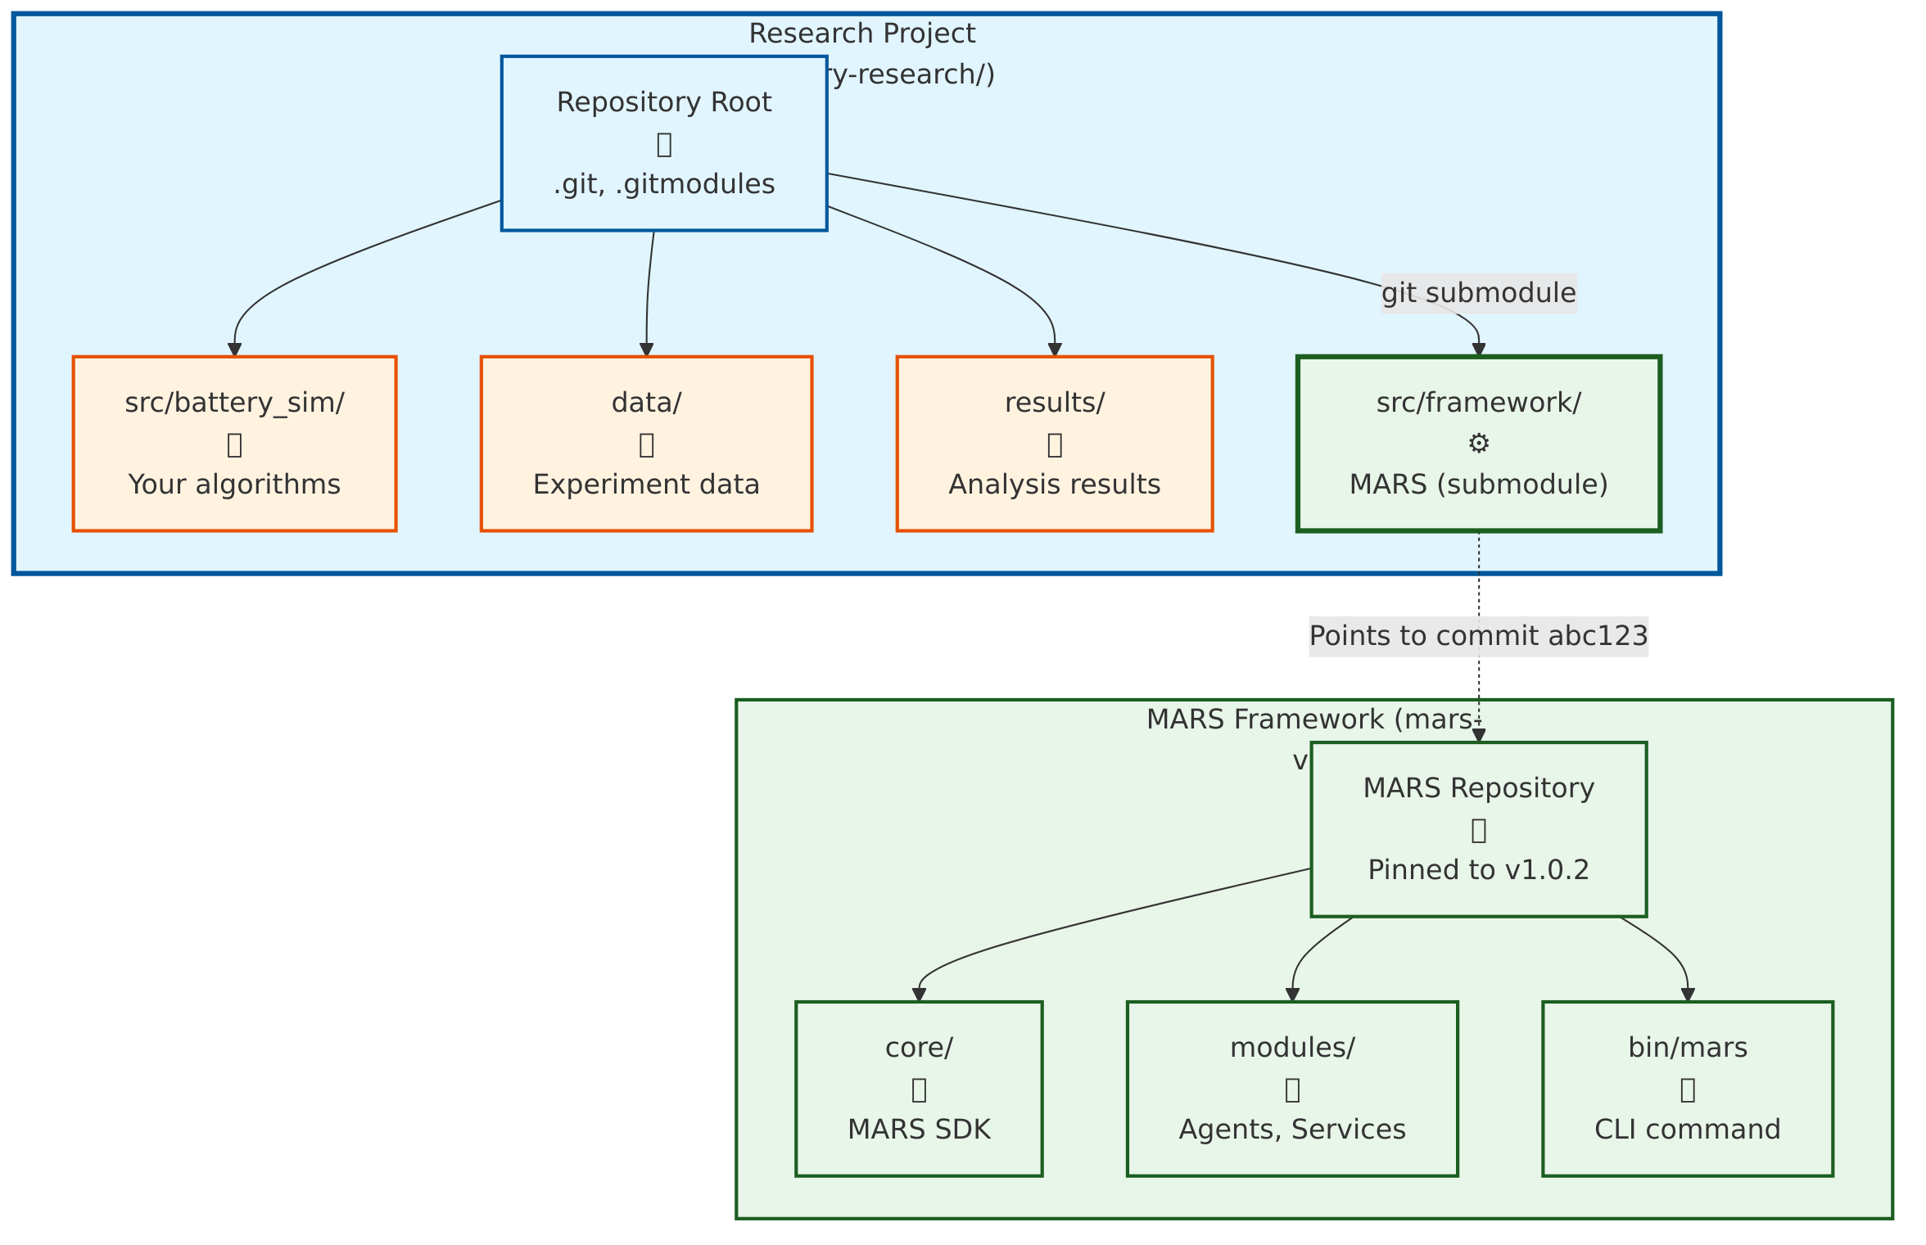
Git Submodules: How Research Projects Use MARS
Git Submodules - Research Project

Slide 163
Research Project Structure:
battery-research/ # Your research repository
├── .git/
├── .gitmodules # Defines MARS submodule
├── src/
│ ├── framework/ # MARS (git submodule)
│ │ ├── core/
│ │ ├── modules/
│ │ └── bin/mars # MARS CLI
│ └── battery_sim/ # Your research code
├── data/ # Your research data
├── results/ # Your experiment results
└── README.md
.gitmodules file:
[submodule "src/framework"]
path = src/framework
url = https://github.com/nasa/mars-v2.git
branch = v1.0
Setup (one-time):
git submodule add https://github.com/nasa/mars-v2.git src/framework
git commit -m "Add MARS framework as submodule"

Slide 164
Submodules: Research Project Workflow
Initial Clone (new team member):
# Clone research project
git clone https://gitlab.example.com/research/battery-sim.git
cd battery-sim
# Initialize submodules (gets MARS)
git submodule update --init --recursive
# Result: src/framework/ now contains MARS
Update MARS Version:
# Navigate to MARS submodule
cd src/framework
# Pull latest MARS changes
git pull origin main
# Return to research project
cd ../..
# Commit updated MARS version
git add src/framework
git commit -m "Update MARS to v1.1"
Benefit: Research project tracks exact MARS version (reproducible results)

Slide 165
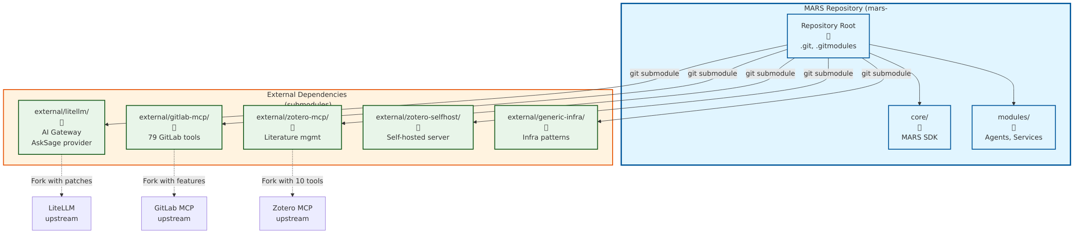
Git Submodules: How MARS Uses External Dependencies
Git Submodules - MARS Dependencies

Slide 166
MARS Repository Structure:
mars-v2/ # MARS repository
├── .git/
├── .gitmodules # Defines 5 external dependencies
├── core/
├── modules/
├── external/ # External dependencies (submodules)
│ ├── litellm/ # Git submodule → LiteLLM fork
│ ├── gitlab-mcp/ # Git submodule → GitLab MCP fork
│ ├── zotero-selfhost/ # Git submodule → Zotero Docker
│ ├── claude-extractor/ # Git submodule → Session exporter
│ └── generic-infra/ # Git submodule → Infrastructure patterns
└── bin/
Why Submodules for External Dependencies? - ✅ Version locking: MARS tracks exact commit of each dependency - ✅ Reproducible builds: git clone --recursive gets everything - ✅ Offline development: All dependencies in one clone - ✅ Fork management: MARS uses forks with custom patches

Slide 167
MARS External Dependencies
5 External Repositories (all managed as submodules):

Slide 168
Dependency | Type | Purpose | Fork?
LiteLLM | Python/Docker | AI gateway (AskSage/CAPRA) | ✅ Yes (AskSage provider)
GitLab MCP | Node.js MCP | 79 GitLab tools | ✅ Yes (fixes/features)
Zotero Server | Docker Compose | Self-hosted Zotero | ❌ No (upstream)
Zotero MCP | Python MCP | Literature mgmt tools | ✅ Yes (10 tools)
Claude Extractor | Python CLI | CCC session export | ❌ No (upstream)
Generic Infra | Patterns | Reusable infra templates | ✅ Yes (extracted from MARS)

Slide 169
Setup:
# One command gets all dependencies
git clone --recursive https://github.com/nasa/mars-v2.git

Slide 170
Submodules: MARS Update Workflow
Update External Dependency:
Scenario: LiteLLM releases new version with bug fixes
Workflow:
# Navigate to submodule
cd external/litellm
# Check current commit
git log --oneline -1
# Output: abc123 Add AskSage provider support
# Pull upstream changes
git fetch origin
git merge origin/main
# Test changes
cd ../..
pytest tests/test_litellm_integration.py
# Commit updated submodule
git add external/litellm
git commit -m "Update LiteLLM to v1.2.3 (bug fixes)"
Benefit: Controlled dependency updates, full testing before integration

Slide 171
Submodules vs. Package Managers
Why not use pip/npm/docker pull?

Slide 172
Approach | Git Submodules | Package Managers
Offline | ✅ Works (bundled) | ❌ Needs internet
Reproducibility | ✅ Exact commit | ⚠️ Version ranges
Custom Patches | ✅ Easy (fork) | ❌ Hard (patch files)
Air-Gap | ✅ Full support | ❌ Requires registry
Version Lock | ✅ Explicit commit | ⚠️ Lock files (can drift)
Security Review | ✅ Full source visible | ⚠️ Binary/compiled

Slide 173
MARS Choice: Submodules for critical dependencies, package managers for libraries
Example: - external/litellm/ → Submodule (custom AskSage provider) - pip install requests → Package manager (standard library)

Slide 174
Submodules: Common Workflows
1. Initial Setup (new MARS deployment):
git clone --recursive https://github.com/nasa/mars-v2.git
cd mars-v2
./mars-dev/scripts/setup-external-deps.sh
2. Update All Submodules:
git submodule update --remote --merge
3. Check Submodule Status:
git submodule status
# Output shows commit hash and branch for each submodule
4. Work on Submodule (develop patch):
cd external/litellm
git checkout -b fix/asksage-streaming
# Make changes, test, commit
git push origin fix/asksage-streaming
# Return to MARS, update submodule reference
cd ../..
git add external/litellm
git commit -m "Update LiteLLM with AskSage streaming fix"

Slide 175
Submodules: Best Practices (MARS Approach)
1. Pin to Specific Commits (not branches):
# Good: Reproducible
cd external/litellm
git checkout abc123 # Specific commit
cd ../..
git add external/litellm
# Avoid: Can change unexpectedly
git submodule update --remote # Pulls latest, may break
2. Test Before Updating:
# Update submodule
cd external/litellm && git pull
# Run tests
cd ../.. && pytest tests/test_litellm_*.py
# Only commit if tests pass
git add external/litellm && git commit -m "..."
3. Document Dependencies:
# external-dependencies.yaml
dependencies:
litellm:
type: git-submodule
path: external/litellm
commit: abc123
purpose: AskSage/CAPRA AI gateway
status: Production

Slide 176
Submodules: MARS Dependency Graph
Research Project (battery-sim)
↓ (git submodule)
MARS v2 (mars-v2)
↓ (5 git submodules)
├── LiteLLM (AI gateway)
├── GitLab MCP (project mgmt)
├── Zotero MCP (literature)
├── Zotero Server (self-hosted)
└── Generic Infra (patterns)
Reproducibility Chain: 1. Research project pins MARS commit (e.g., v1.0.2) 2. MARS pins dependency commits (LiteLLM abc123, GitLab xyz789) 3. git clone --recursive = exact versions, always
Air-Gap Capability: - Single clone = all dependencies (no network needed) - Tarball distribution = fully offline installation - Security review = all source code visible

Slide 177
Submodules: Troubleshooting
Problem 1: Submodule not initialized
# Symptom: external/litellm/ is empty
# Fix:
git submodule update --init --recursive
Problem 2: Submodule detached HEAD
# Symptom: (HEAD detached at abc123)
# Fix (if you want to track a branch):
cd external/litellm
git checkout main
git pull
cd ../..
git add external/litellm
Problem 3: Merge conflicts in submodule
# Symptom: Conflict in submodule pointer
# Fix:
cd external/litellm
git status # See what's conflicting
# Resolve, then:
cd ../..
git add external/litellm

Slide 178
Summary: Technical Implementation

Slide 179
Technical Choices: Recap
1. Git Worktrees: 40-60% faster parallel development - 5-25 concurrent CCC sessions - No context switching - E8 sprint orchestration
2. AskSage + LiteLLM: Vendor independence - DoD classified AI access - Fallback to Anthropic/Ollama - Zero code changes to swap providers
3. Sysbox Runtime: Secure containerization - Docker-in-Docker without privileged mode - UID/GID isolation automatic - Full systemd support
4. Git Submodules: Reproducible builds - Exact dependency versions - Air-gap capable - Offline development
Result: Research-grade platform with DoD-level security

Slide 180
MARS Architecture: Three-Layer System
Separation of Concerns

Slide 181
mars-rt
Runtime CLI
Purpose: Run research projects
Users: Research teams
Commands: - mars up - Deploy services - mars agents list - mars services info
Location: Production/research environments
mars-dev
Development CLI
Purpose: Build MARS itself
Users: MARS developers
Commands: - mars-dev up - Start E6 container - mars-dev build - mars-dev doctor
Location: E6 dev container

Slide 182
mars-user-plugin: Developer Experience Layer
Problem: Every developer has different preferences
Solution: Plugin system for personal customization
Key Features:
  Auto-Mount System: Drop files → auto-mounted in E6 container
  external/mars-user-plugin/
  └── mounted-files/
  └── root/
  ├── .vimrc (660 → rw mount)
  └── .bashrc (640 → ro mount)
  Lifecycle Hooks: Hook into mars-dev events
    pre-up.sh - Before container starts
    container-startup.sh - During startup
    post-build.sh - After build completes
  Git-Tracked: Personal configs tracked in separate repo
    Share across MARS deployments
    Version control your dev environment
    Zero impact on mars-v2 repository

Slide 183
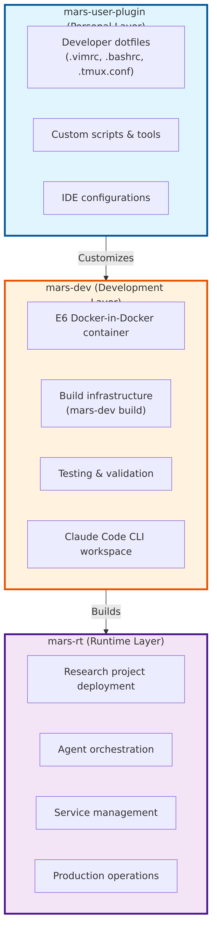
Three-Layer Relationship
Three-Layer Architecture

Slide 184
Key Principle: Clean separation - mars-rt: What research teams use - mars-dev: How we build MARS - mars-user-plugin: How each developer personalizes their workflow

Slide 185
mars-user-plugin: Quick Start
5-Minute Setup
# 1. Clone plugin template
cp -r external/mars-user-plugin-template ~/dev/mars-user
cd ~/dev/mars-user
# 2. Add your dotfiles
cp ~/.vimrc mounted-files/root/.vimrc
chmod 660 mounted-files/root/.vimrc # rw mount
# 3. Register with mars-dev
cd ~/dev/mars-v2
mars-dev register-plugin ~/dev/mars-user
# 4. Rebuild E6 container
mars-dev down
mars-dev build --no-cache
mars-dev up -d
# 5. Your dotfiles are now in E6!
mars-dev exec bash
vim # Uses your .vimrc configuration
Benefits: - ✅ Personal preferences without polluting mars-v2 - ✅ Share configs across MARS deployments - ✅ Version control your dev environment - ✅ Zero learning curve (just drop files)

Slide 186
MARS by the Numbers
Repository Statistics (as of 2025-11-05)

Slide 187
Code Metrics:
Infrastructure:

Slide 188
Category Breakdown:

Slide 189
Category | Modules | Python Files | LOC | Tests (LOC) | Docs (lines) | ADRs
Core | 1 | 78 | 12,689 | 13,817 | 10,043 | 19
mars-dev | 1 | 2,115 | 338,481 | 345,620 | 8,116,090 | 10
Agents | 8 | 41 | 5,101 | 5,617 | 3,312 | 4
Services | 22 | 73 | 7,259 | 10,613 | 15,425 | 4
TOTAL | 32 | 2,307 | 363,530 | 375,667 | 8,144,870 | 37

Slide 190
Appendices

Slide 191
Appendix A: Glossary (Plain Language)
Term | Definition
LLM | Large Language Model - pattern engine trained on text
AI Agent | LLM + tool use + multi-step planning (executes)
MCP | Model Context Protocol - USB for AI agents
Orchestration | Automated coordination of specialized AI agents
LangGraph | Framework for agent orchestration
RAG | Retrieval-Augmented Generation - semantic search (~40% tokens)
Knowledge Graph | Relationship database (Neo4j) - paper → requirement → experiment
Self-Hosted | Runs on our infrastructure, not cloud
Air-Gap | Fully offline operation (no internet)
Rootless | Containers run as non-root user (security)
MCP Server | Tool that provides capabilities to AI agents via MCP

Slide 192
Appendix B: Key References (2024)
Level 1 (Chat AI):
  GitHub Copilot RCT Microsoft/MIT/Princeton/Wharton 26% avg productivity, 4,000+ devs Communications of ACM
  Google Enterprise AI Google, 2024 21% faster task completion Large-scale RCT
Level 2 (AI Agents):
  AI and Coding Productivity Science Magazine, 2024 40% faster, 18% higher quality Peer-reviewed, top-tier
  GitHub HTTP Server GitHub/OpenAI, 2023 55.8% speed improvement 95 professional developers

Slide 193
Appendix B: References (continued)
Level 3/4 (Orchestration):
  McKinsey GenAI Report McKinsey Global Institute, 2024 30-40% efficiency gains Enterprise case studies
  BCG Multi-Agent Study Boston Consulting Group, 2024 45% margin improvement Campaign delivery optimization
Supporting Evidence:
  Stanford HAI Study Stanford Human-Centered AI, 2024 AI-augmented: 2.3× publication rate Literature analysis 2020-2024
  Anthropic Claude Code Anthropic, 2024 49% resolution on SWE-bench Complex problem solving
Insight: Peer-reviewed, large-scale, reproducible evidence of transformational gains

Slide 194
Appendix C: MARS Architecture Deep Dive
Core Services (Self-Hosted): - graph-db (Neo4j) - Knowledge graph - vector-db (Milvus) - Semantic search - object-store (MinIO) - S3-compatible - experiment-tracker (MLflow) - Logging - metrics-store (Prometheus) - Time-series - network-proxy (Squid) - Security
AI Integration: - litellm - Unified API (AskSage, Claude, GPT, local) - selfhosted-models (Ollama) - GPU local LLMs
Research Tools: - biblio-store (Zotero) - Literature - gitlab-sync - Project mgmt, 79 tools - uml-service - PlantUML/SysML diagrams

Slide 195
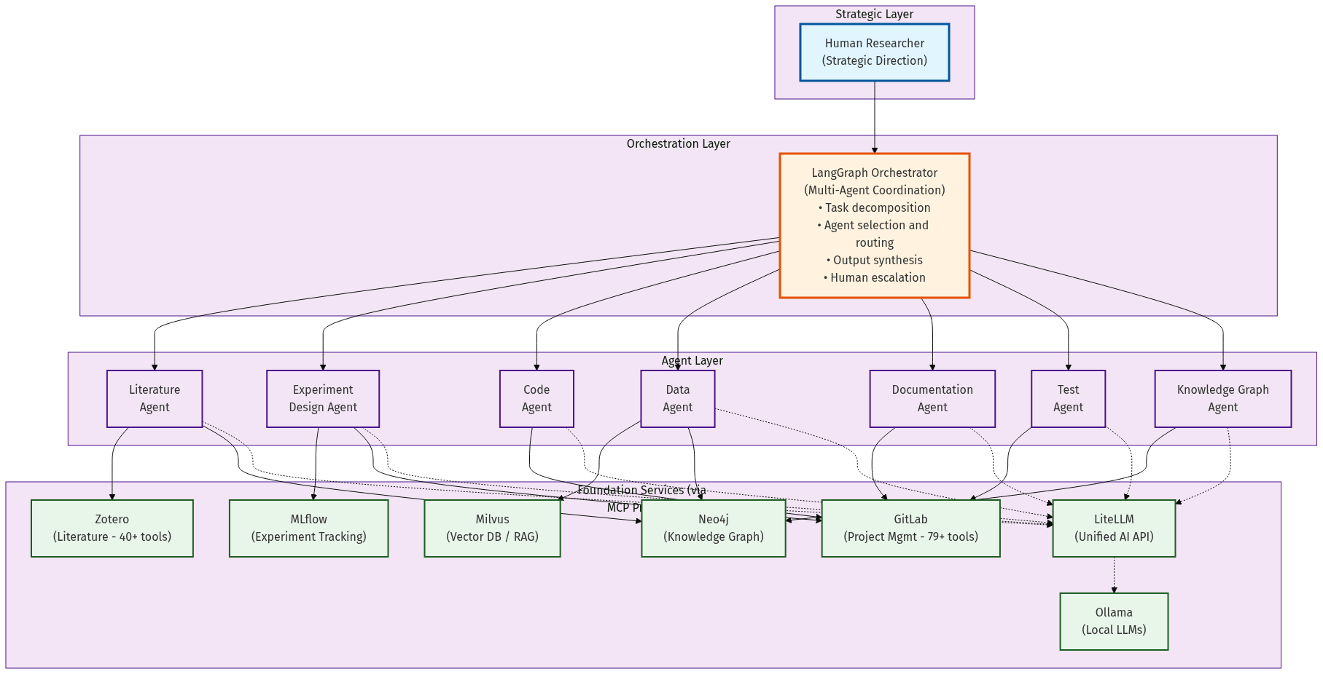
MARS Architecture

Slide 196
Summary: The Path Forward
Where We Are: - Corvette → Formula 1 - Ad-hoc AI chat - No strategy
Where We Need to Be: - Starship Enterprise - Orchestrated AI teams - 3-5× force multiplication
The Window: - 12-18 months before irreversible - We’re at Month 6-8
Evidence: - Peer-reviewed studies - 2-5× productivity gains - Transformational, not incremental
The Ask: 1. Primary: Commit to organizational investment 2. Secondary: Consider MARS as platform
MARS Status: - Foundation operational - Ready for pilot
Next Steps: Leadership decision → Pilot → Expansion

Slide 197
Questions & Discussion
Open Topics: - Pilot program scope and timeline - Resource allocation (people, infrastructure, funding) - Security and compliance review - Integration with existing workflows - Domain-specific requirements
Contact: Joe Hays, NRL Code 8234
Thank you for your time and consideration.

